Slide 1

Project management tools for the Project brief for Design, development and implementation
Notes:
Version 1, January 2024
Resources are updated regularly - the latest version is available at: the-cc.io/curriculum.
This resource is licensed by the Raspberry Pi Foundation under a Creative Commons Attribution-NonCommercial-ShareAlike 4.0 International licence. To view a copy of this license, visit, see creativecommons.org/licenses/by-nc-sa/4.0/

Slide 2
What is project management?
Project management is the use of specific skills, knowledge, and tools to deliver a project. In digital industries, this could be to develop some new software or to install a new network, for example.
Project management means:
Knowing what your goals are
Knowing what the skills are in your team
Knowing what timescale is involved for the completion of the project
Allocating tasks and deadlines to appropriate members of the team
Monitoring the completion of different tasks
Managing resources

Slide 3
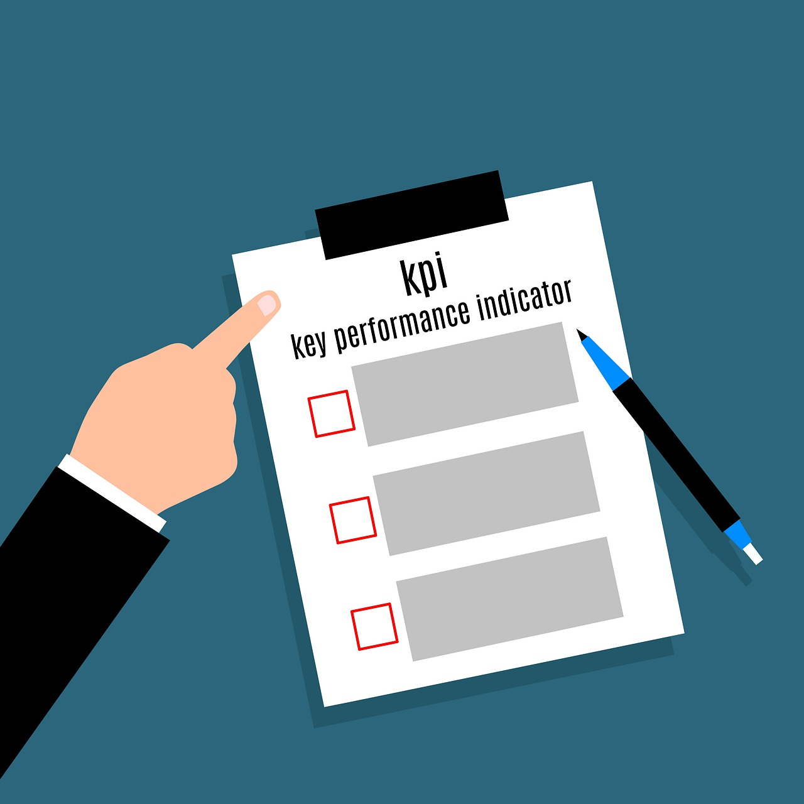
KPIs
A key performance indicator (KPI) is a type of performance objective.
KPIs should be quantifiable measures of performance over time for a specific objective.
Organisations use KPIs to focus the attention of everyone within the organisation.
A KPI for a new software project may relate to the amount of system downtime during the switchover.
Notes:
Image by Mohamed_hassan from Pixabay: https://pixabay.com/illustrations/kpi-indicators-performance-4266500/

Slide 4


Notes:
Project management - Introduction to KPIs film: https://vimeo.com/883952486

Slide 5
SMART targets
S
Specific
The quality of the goals or objectives set will determine the success or failure of a project.
SMART targets (or SMART goals) are a form of objec­tive set­ting which can be used to cre­ate effective targets.
M
Measurable
A
Achievable
R
Realistic
T
Timely

Slide 6
The MoSCoW method
M
Must have — all the requirements that are necessary
The MoSCoW method is a prioritisation tool that is used to determine the most important tasks or features of a project.
It is especially useful when there are competing priorities or when large teams work together and need to know the most important tasks to focus on.
S
Should have — requirements that are important but not necessary
C
Could have — requirements that would be nice to have
W
Will not have — requirements that have been identified as not a priority

Slide 7

Systems Development Life Cycle (SDLC)
The Systems Development Life Cycle (SDLC) defines the main stages of software development.
There are many different approaches to software development, and most development teams use an iterative approach, where stages are revisited throughout the project.
In large organisations, employees will have specific roles and responsibilities within the systems development life cycle.
Notes:
Photo by Lukas from Pexels: https://www.pexels.com/photo/person-encoding-in-laptop-574071/

Slide 8
Systems Development Life Cycle (SDLC)
Evaluation
This stage can be carried out throughout the development process to inform later stages. However, there is usually a formal evaluation when the project is complete.
Analysis
This stage focuses on understanding and defining the user requirements. This stage is normally carried out by a systems analyst. The systems analyst works closely with the client to make sure the requirements are fully understood.
SDLC
Testing
Testing is usually carried out during the development process. A strategy or approach to testing should be agreed. There are many different approaches to testing that can be taken.
Design
This stage focuses on the design process and typically includes designs for user interfaces, system outputs, algorithms, and security features. In large projects, this stage is overseen by systems architects.
Build
A team of programmers with a wide range of experience and skills work together to develop the solution.

Slide 9
Gibbs’ reflective cycle
Gibbs’ reflective cycle is a framework for examining experiences.
Description: What happened?
Feelings: How did you react and feel?
Evaluation: What was good or bad?
Analysis: Why did it happen?
Conclusion: What have you learnt?
Action plan: What are you going to do differently next time?
Description
Feelings
Action plan
Evaluation
Conclusion
Analysis

Slide 10
Empathy maps
Empathy mapping is a visualisation tool that helps to gain insight into a target audience or user.
User experience (UX) designers use empathy maps to develop an understanding of their users. They can then share this information with the team developing the solution.
Says
Thinks
User
Does
Feels

Slide 11

Gantt charts
A Gantt chart is a planning tool that presents each task as a block of time.
It shows how much time it will take to complete a task.
A Gantt chart shows which tasks are dependent on another one being completed before they can begin.
It also shows which tasks can be completed at the same time as others (concurrently).
Notes:
Photo by Anna Nekrashevich from Pexels: https://www.pexels.com/photo/marketing-businessman-person-hands-6801872/

Slide 12
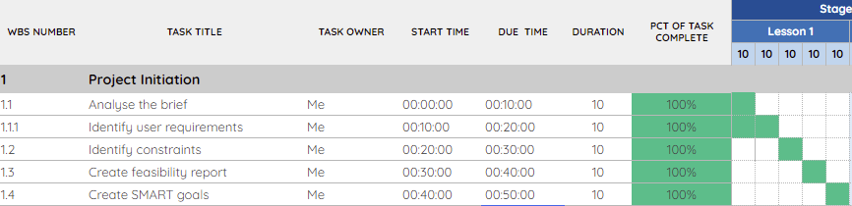
Gantt chart example
Work breakdown structure (WBS)
Task breakdown linked to SMART goals
Duration of task, with planned start and end times
Calculated using functions
Lesson time broken into 10-minute slots
This Gantt chart is an adapted Google Sheets Gantt chart template.
Notes:
Screenshot of an adapted Google Sheets template

Slide 13

Feedback
Feedback is an essential part of any project.
Feedback enables a product or service to become better.
Feedback should be collected from a wide range of users with both technical and non-technical expertise.
It is OK to change your plans based on feedback; it shows you have listened and taken points on board.
Observation can also be used for feedback. For example, you could observe someone using a new piece of software to see if they come across any difficulties.
Notes:
Photo by RDNE Stock project from Pexels: https://www.pexels.com/photo/man-in-black-blazer-sitting-on-black-leather-armchair-5922673/

Slide 14


Notes:
Project management – Feedback film: https://vimeo.com/883952178

