Slide 1
Health
Route: Health & Science
Topic: Working within the health and science sectors
Lesson 3: Opportunities for progression in the health and science sectors
Notes:
Image © iStockphoto/sturti

Slide 2
In this lesson, we will:
Introduction
describe some of the diversity of roles that exist within the health sector
classify occupations as technical, higher technical or professional
describe a range of health career opportunities and the next steps you can take to get there.
Skills:
CS2.2 Communicate effectively with a variety of stakeholders
CS3.1 Identify the functions of different teams/team members as well as their own role within the wider team.
CS5.1 Apply research skills
General competencies:
English:
GEC1 Convey technical information to different audiences
GEC2 Present information and idea
GEC3 Create texts for different purposes and audiences
GEC4 Summarise information/ideas
GEC5 Synthesise information
GEC6 Take part in/lead discussions
Digital:
GDC1 Use digital technology and media effectively
GDC2 Design, create and edit documents and digital media
GDC3 Communicate and collaborate
Lesson 3: Opportunities for progression in the health and science sectors

Slide 3

How many occupations within the healthcare sector can you name?
Introduction
Lesson 3: Opportunities for progression in the health and science sectors

Slide 4


Occupations within healthcare
Activity 1
Watch the following videos that describe roles in different organisations.
1
2
3
4
Healthcare assistant practitioner
(level 5)
Community nurse
Lesson 3: Opportunities for progression in the health and science sectors
Notes:
Videos which describe roles in different organisations:
Healthcare assistant practitioner – https://www.youtube.com/watch?v=fTnB-WMd2ik (with permission)
Community nurse – https://www.youtube.com/embed/TmDuX2-Jcow

Slide 5
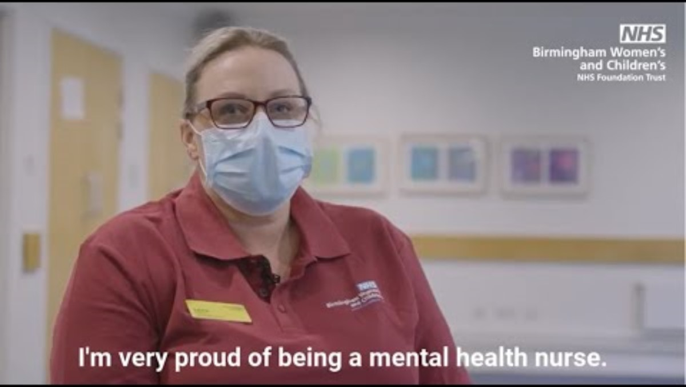
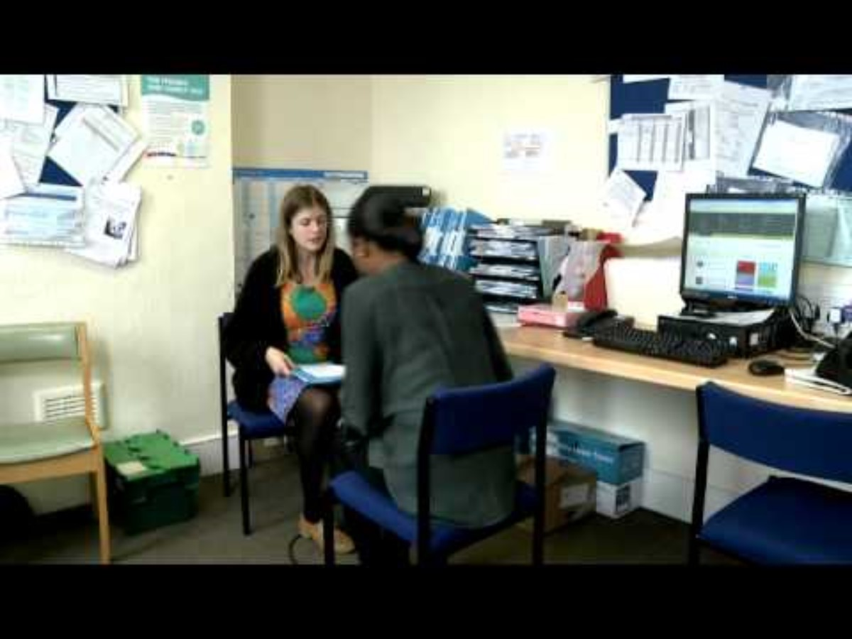
Occupations within healthcare
Activity 1
Watch the following videos that describe roles in different organisations.
1
2
3
4
Mental health nurse
Midwife
Lesson 3: Opportunities for progression in the health and science sectors
Notes:
Videos which describe roles in different organisations:
Mental health nurse – https://www.youtube.com/watch?v=34DPAzumKFM
Midwife – https://www.youtube.com/watch?v=tvzUbYRwcTk

Slide 6
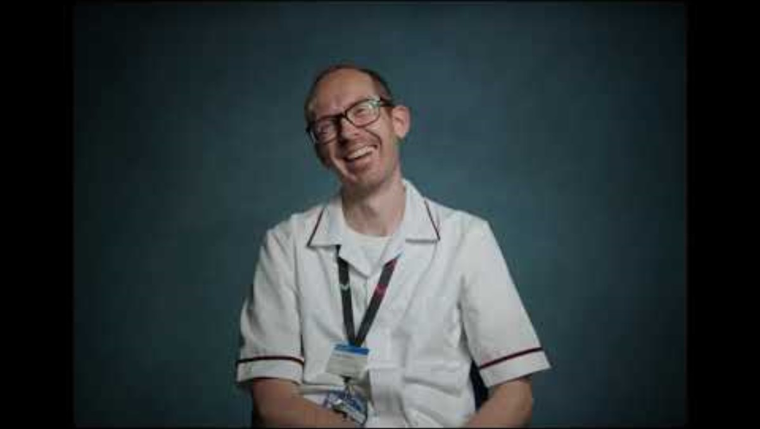

Occupations within healthcare
Activity 1
Allied Health Professionals (AHP)
Watch the following videos that describe roles in different organisations.
5
6
7
8
e.g. Radiographer
e.g. Dietician
Lesson 3: Opportunities for progression in the health and science sectors
Notes:
Videos which describe roles in different organisations:
Radiographer – https://www.youtube.com/watch?v=4J7XyJWtrkk
Dietician (watch to 1.59) – https://www.youtube.com/watch?v=l2Id0cCsOVc

Slide 7
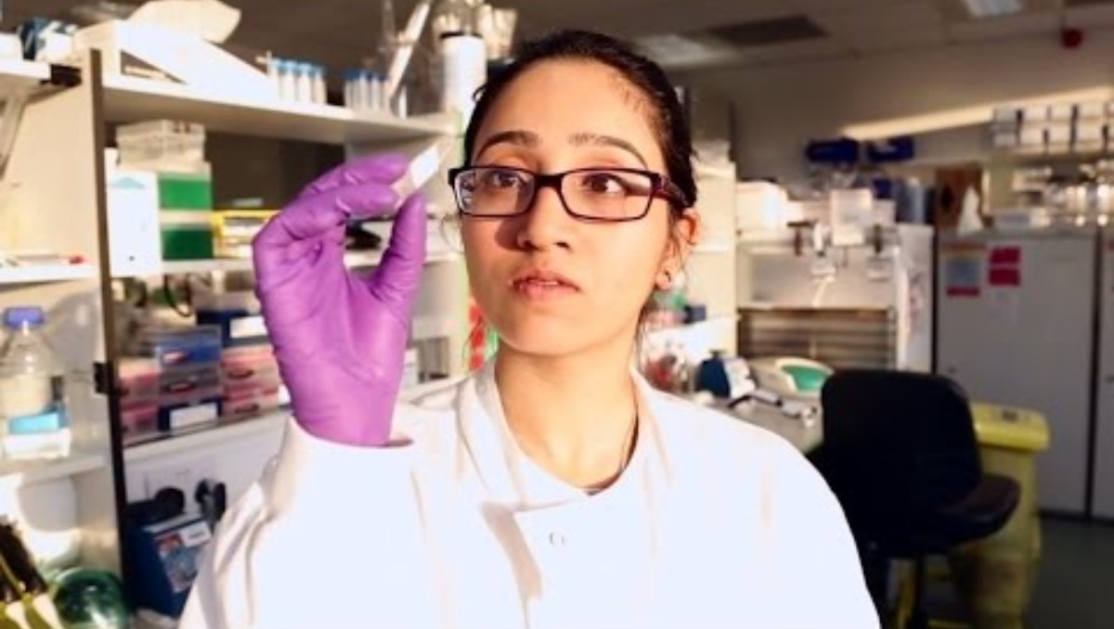

Occupations within healthcare
Activity 1
Watch the following videos that describe roles in different organisations.
5
6
7
8
Research assistant
Genetic counsellor
Lesson 3: Opportunities for progression in the health and science sectors
Notes:
Videos which describe roles in different organisations:
Research assistant – https://www.youtube.com/watch?v=qlLMZ2sJ5Lk
Genetic counsellor – https://www.youtube.com/watch?v=hH7pHJVMHeA

Slide 8
Types of occupation
Activity 2
Type of occupation | Skill level | Qualifications required
Technical | Skilled occupations that a college leaver/apprentice would be entering | Typically Level 2 or 3 qualification of apprenticeship
Higher technical | Requires more knowledge and skills acquired through experience in the workplace or further technical education study | Typically Level 4 or 5 qualification or apprenticeship
Professional occupations | Occupations where there is a clear career progression from higher technical occupations | Typically undergraduate degree (Level 6) or higher, or degree apprenticeship
Lesson 3: Opportunities for progression in the health and science sectors

Slide 9
Types of occupation
Activity 2
Look at the occupational route maps (see useful links).
Identify roles within the health sector that you may wish to pursue (you can use the NHS careers link).
Create your own personalised path into these roles.
Identify any barriers you may meet.
Useful links
Occupational route map
NHS Careers
Lesson 3: Opportunities for progression in the health and science sectors
Notes:
Websites linked in this slide:
www.instituteforapprenticeships.org/occupational-maps/
www.healthcareers.nhs.uk/explore-roles/explore-roles

Slide 10

Types of occupation
Activity 2
There are four pillars of practice for advanced-level nursing practice:
clinical/direct care;
education;
research;
leadership and management.
Lesson 3: Opportunities for progression in the health and science sectors
Notes:
Image credit:
© Shutterstock/VH-studio

Slide 11
Classifying occupations
Activity 3
Complete the card sort activity to sort a range of healthcare occupations into technical/higher technical/professional occupations.
In your notes, write a brief description of the differences between the three classifications of occupation and use the cards to list a few examples of each.
Resources needed
L3 Activity 3 Worksheet
Lesson 3: Opportunities for progression in the health and science sectors

Slide 12
Classifying occupations
Activity 3
Answers
Technical | Higher technical | Professional
optical assistant | lead practitioner in adult care | social worker
adult care worker | healthcare assistant practitioner | healthcare science practitioner
healthcare support worker | nursing associate | registered nurse
dental nurse | dental technician | paramedic
mortuary technician | laboratory manager | midwife
Lesson 3: Opportunities for progression in the health and science sectors

Slide 13
Career action plan
Activity 4
View the links in the following slides to explore some activities you could do to boost your preparation for employment in your future career.
Complete a short action plan of what you wish to work on to progress into your potential career.
Resources needed
L3 Activity 4 Worksheet
Lesson 3: Opportunities for progression in the health and science sectors

Slide 14
Career action plan
Activity 4
There are a number of things you can do to boost your CV, increasing your chances of employment; these include:
Engaging with professional organisations such as St John’s Ambulance
Volunteering in the NHS and non-profit organisations
Completing virtual work experience:
Speakers for Schools
Springpod
Lesson 3: Opportunities for progression in the health and science sectors
Notes:
St John’s Ambulance: http://www.sja.org.uk/get-involved/young-people/
NHS: http://www.england.nhs.uk/get-involved/get-involved/volunteering/
Non-profit organisations: www.kissingitbetter.co.uk/get-involved/volunteer/
Speakers for Schools: http://www.speakersforschools.org/vwex/
Springpod: www.springpod.com/virtual-work-experience

Slide 15
Career action plan
Activity 4
Preparing for your industry placement to get the most from this
Developing a wider interest in health, for example by completing an online course or attending training
Mental Health First Aid Courses
BSL courses
FutureLearn short courses
OpenLearn Health
Royal Society for Public Health courses
Continue to develop your essential skills
Lesson 3: Opportunities for progression in the health and science sectors
Notes:
Preparing for your industry placement: http://www.gov.uk/government/publications/student-guide-preparing-for-industry-placements
Mental health first aid courses: www.sja.org.uk/courses/workplace-mental-health-first-aid/
BSL courses: http://www.british-sign.co.uk/learn-online-british-sign-language-course/
FutureLearn short courses: http://www.futurelearn.com/subjects/healthcare-medicine-courses
OpenLearn Health: http://www.open.edu/openlearn/free-courses/full-catalogue
Royal Society for Public Health courses: http://www.rsph.org.uk/our-services/e-learning.html
Continue to develop your essential skills: http://www.skillsbuilder.org/

Slide 16
AO2 Study question
Plenary
A nursing student completed one of their placements working in a school, assisting a team of professionals in healthcare activities such as immunisations, screenings and running clinics. The student was also involved in dealing with external agencies to support the mental health and wellbeing of students.
After completing their university degree, they decided that they no longer wished to pursue a career which required them to spend most of their time working in a hospital setting.
Explain two other jobs outside of the health sector where the student could apply their knowledge and the skills they have gained on placement and from their degree. [4 marks]
Lesson 3: Opportunities for progression in the health and science sectors

Slide 17
AO2 Study question – mark scheme
Plenary
Award one mark for each explanation point, up to a maximum of two marks. Examples could include:
Social worker supporting families and individuals (1) using their healthcare knowledge gained from their university degree and placement experience with agencies supporting mental health and wellbeing (1).
Primary school teacher working in a large team (1) using their placement and degree experience of working with children (and multidisciplinary agencies)/science knowledge from their degree to teach science (1).
Police officer working in the community (1). The student will have learned communication skills from both their degree and placements/the skills of supporting vulnerable children, which can be applied to the wider community/their healthcare knowledge to deal with ill or vulnerable citizens (1).
Accept any other suitable response.
Lesson 2: Opportunities for progression in the health and science sectors

Slide 18
Consolidation
Consolidation
To further help dispel some of the misconceptions around the lack of diversity of roles within healthcare, look at the following webpages:
So, what does a healthcare scientist do, exactly? (The Guardian)
What is healthcare science? (NHS)
You could also revisit NHS Health Careers
Write a paragraph to correct a common misconception, such as that all scientists work in a laboratory, or everyone that works in healthcare is a doctor or a nurse.
Lesson 3: Opportunities for progression in the health and science sectors
Notes:
So, what does a healthcare scientist do?: http://www.theguardian.com/careers/healthcare-scientist-job-description
What is healthcare science?: http://www.england.nhs.uk/healthcare-science/what/
NHS Health Careers: http://www.healthcareers.nhs.uk/explore-roles/explore-roles

Slide 19
In this lesson, we have:
Consolidation
described some of the diversity of roles that exist within the science and health fields
classified occupations as technical, higher technical or professional
described a range of health career opportunities and the next steps you can take to get there.
Skills:
CS2.2 Communicate effectively with a variety of stakeholders
CS3.1 Identify the functions of different teams/team members as well as their own role within the wider team.
CS5.1 Apply research skills
General competencies:
English:
GEC1 Convey technical information to different audiences
GEC2 Present information and idea
GEC3 Create texts for different purposes and audiences
GEC4 Summarise information/ideas
GEC5 Synthesise information
GEC6 Take part in/lead discussions
Digital:
GDC1 Use digital technology and media effectively
GDC2 Design, create and edit documents and digital media
GDC3 Communicate and collaborate
Lesson 3: Opportunities for progression in the health and science sectors

