Slide 1
Health
Route: Health & Science
Topic: Working within the health and science sectors
Lesson 1: Organisational policies and procedures
Notes:
Image © iStockphoto/sturti

Slide 2
In this lesson, we will:
Introduction
name key organisational policies (Equality, Diversity and inclusion policy, Safeguarding policy, Employment contracts, Performance reviews, Disciplinary policy, Grievance policy) and describe their purpose
summarise the features of each policy
justify the use of different policies in
real-life scenarios.
Skills:
CS2.2 Communicate effectively with a variety of stakeholders
CS3.1 Identify the functions of different teams/team members as well as their own role within the wider team
CS3.2 Undertake collaborative work.
CS5.1 Apply research skills
General competencies:
English: GEC2 Present information and ideas
GEC3 Create texts for different purposes and audiences
GEC4 Summarise information/ideas
GEC5 Synthesise information
GEC6 Take part in/lead discussions.
Digital: GDC2 Design, create and edit documents and digital media
GDC3 Communicate and collaborate.
Lesson 1: Organisational policies and procedures

Slide 3

What are the policies in your place of study?
Introduction
Policies underpin the operations of all organisations.
1. What is the attendance and punctuality policy
for your educational insitution?
2. What is the student ID policy?
3. What is the dress code or uniform policy for
your subject area?
Lesson 1: Organisational policies and procedures

Slide 4
Policies and procedures research
Activity 1
Research six key organisational policies/procedures.
Feed your findings back to the group to produce an overall class table, which summarises the features of each policy.
Resources needed
L1 Activity 1 Worksheet
Lesson 1: Organisational policies and procedures

Slide 5

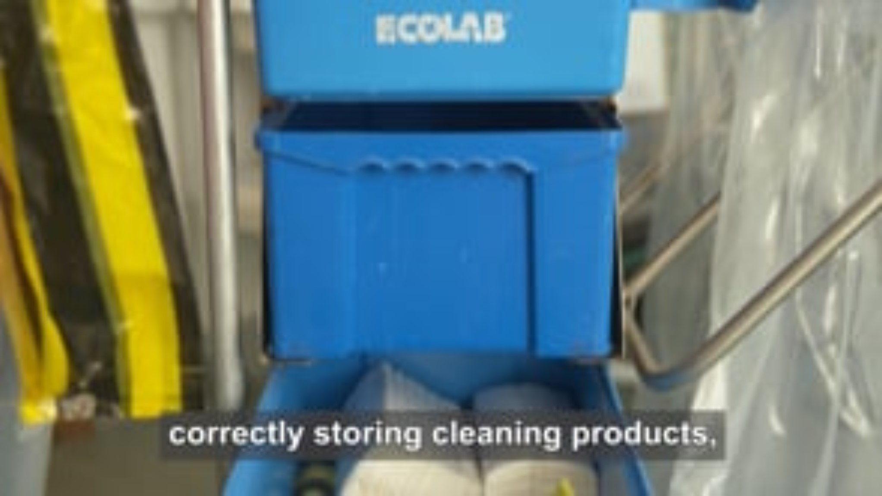
Policy scenario films
Activity 2
Lesson 1: Organisational policies and procedures
Notes:
Films to introduce organisational policies:
Scenario 1 – https://vimeo.com/889410676?share=copy
Scenario 2 – https://vimeo.com/889410735?share=copy

Slide 6

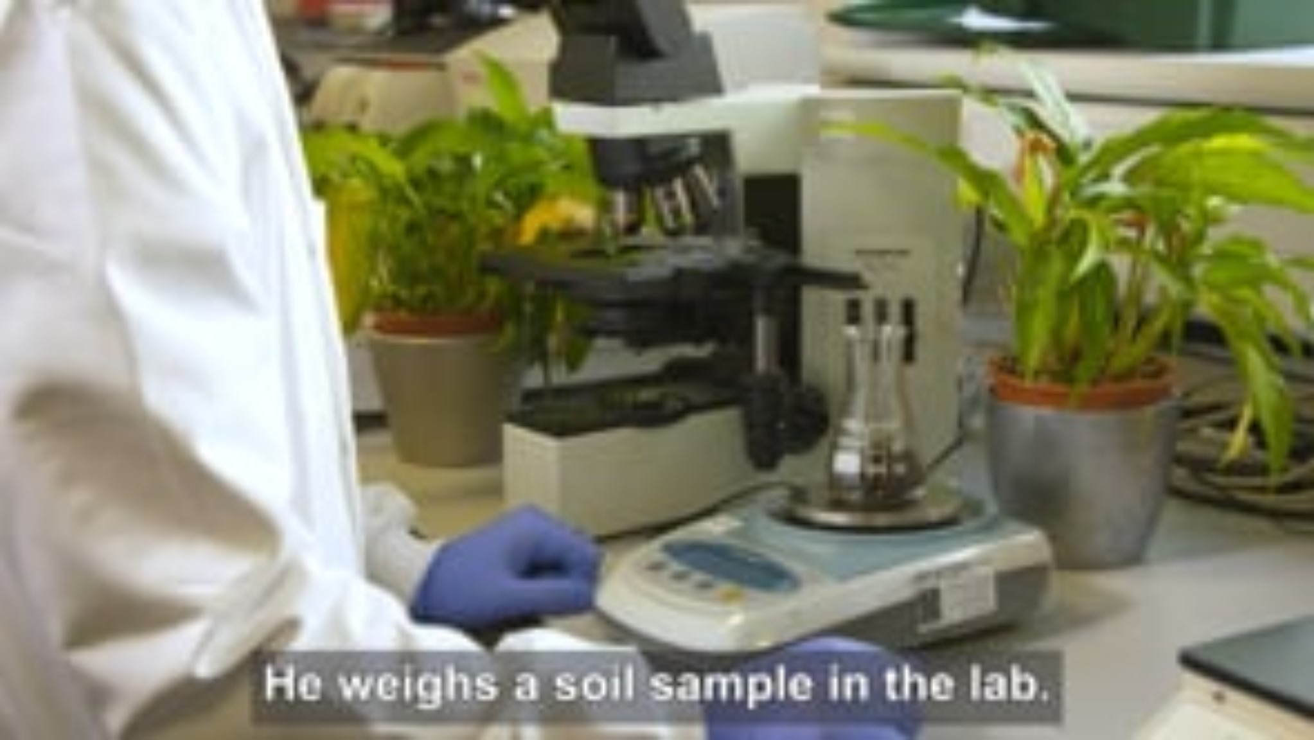
Policy scenario films
Activity 2
Lesson 1: Organisational policies and procedures
Notes:
Films to introduce organisational policies:
Scenario 3 – https://vimeo.com/889410812?share=copy
Scenario 4 – https://vimeo.com/889410863?share=copy

Slide 7

Policy scenario films
Activity 2
Lesson 1: Organisational policies and procedures
Notes:
Films to introduce organisational policies:
Scenario 5 – https://vimeo.com/889410922?share=copy

Slide 8
Multiple choice questions
Plenary
Which of the following policies must a student read and understand before beginning a placement on a children's ward?
A – Equality, diversity and inclusion policy
B – Safeguarding policy
C – Disciplinary policy
D – Grievance policy
(1 mark)
Lesson 1: Organisational policies and procedures

Slide 9
Multiple choice questions
Plenary
Which of the following policies must a student read and understand before beginning a placement on a children's ward?
A – Equality, diversity and inclusion policy
B – Safeguarding policy
C – Disciplinary policy
D – Grievance policy
(1 mark)
Answers
A01
B – Safeguarding policy
(A1.1 – The purpose of organisational policies and procedures in the health and science sector)
Lesson 1: Organisational policies and procedures

Slide 10
Multiple choice questions
Plenary
A laboratory technician believes they have not been considered for a promotion as their manager knows that they are hoping to start a family.
Which of the following documents should they refer to when raising their concerns with the Human Resources (HR) department in their organisation?
A – Equality, diversity and inclusion policy
B – Performance review
C – Employment contract
D – Safeguarding policy
(1 mark)
Lesson 1: Organisational policies and procedures

Slide 11
Multiple choice questions
Plenary
A laboratory technician believes they have not been considered for a promotion as their manager knows that they are hoping to start a family.
Which of the following documents should they refer to when raising their concerns with the Human Resources (HR) department in their organisation?
A – Equality, diversity and inclusion policy
B – Performance review
C – Employment contract
D – Safeguarding policy
(1 mark)
Answers
A01
A – Equality, diversity and inclusion policy
(A1.1 – The purpose of organisational policies and procedures in the health and science sector)
Lesson 1: Organisational policies and procedures

Slide 12
Case study
Consolidation
In scenario 2, the employee has not suffered any consequences to their health from the injury. However, they have submitted a written grievance about health and safety processes and are concerned that this accident could happen again but have more serious consequences.
Read this information from the Health and Safety Executive which summarises steps to keep sharps safe: Write a paragraph summarising the mistakes that have been made.
Lesson 1: Organisational policies and procedures
Notes:
Weblinks on this slide:
www.hse.gov.uk/biosafety/blood-borne-viruses/avoiding-sharps-injuries.htm

Slide 13
In this lesson, we have:
Consolidation
named six key organisational policies and describe their purpose
summarised the features of each policy
justified the use of different policies in real-life scenarios.
Skills:
CS2.2 Communicate effectively with a variety of stakeholders
CS3.1 Identify the functions of different teams/team members as well as their own role within the wider team
CS3.2 Undertake collaborative work.
CS5.1 Apply research skills
General competencies:
English: GEC2 Present information and ideas
GEC3 Create texts for different purposes and audiences
GEC4 Summarise information/ideas
GEC5 Synthesise information
GEC6 Take part in/lead discussions.
Digital: GDC2 Design, create and edit documents and digital media
GDC3 Communicate and collaborate.
Lesson 1: Organisational policies and procedures

