Slide 1
Health
Route: Health & Science
Topic: Working within the health and science sectors
Lesson 5: Potential impacts of future developments in the healthcare sector
Notes:
Image © iStockphoto/sturti

Slide 2
In this lesson, we will:
Introduction
consider the issues facing NHS provision in the UK
consider the potential impact of future developments in the healthcare sector for improving care provision
investigate how the NHS Long Term Plan will address future developments in the healthcare sector.
Skills:
CS2.1 Communicate clearly and effectively with a variety of stakeholders
CS3.2 Undertake collaborative work
CS5.2 Apply principles for evidence-based practice to contribute to research and innovation within a specific area
CS6.1 Present their project findings in a range of formats.
General competencies:
English:
GEC1 Convey technical information to different audiences
GEC2 Present information and ideas
GEC3 Create texts for different purposes and audiences
GEC4 Summarise information/ideas
GEC5 Synthesise information.
Lesson 5: Potential impacts of future developments in the healthcare sector

Slide 3
Current issues in the NHS
Introduction
Click on the link to watch the following video from Sky News about how the government plans to address the NHS staffing crisis:
How the government plans to address the NHS staffing crisis
Lesson 5: Potential impacts of future developments in the healthcare sector
Notes:
Sky News, How the government plans to address the NHS staffing crisis – https://www.youtube.com/watch?v=jXIpHpme3E0

Slide 4
What is the impact of these factors on healthcare provision?
Introduction
Funding of services
Private healthcare provision
Changes in patient/service user demographics (e.g. increasing life expectancy, obesity, inequality, population growth)
AI
Lesson 5: Potential impacts of future developments in the healthcare sector

Slide 5
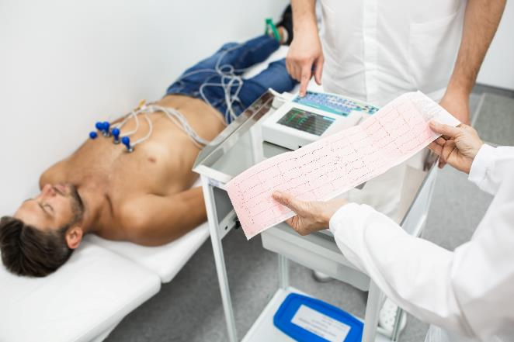

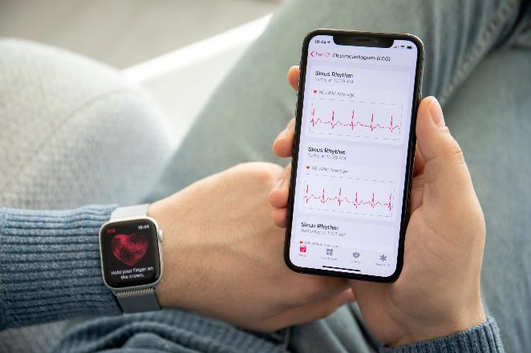
What is this equipment for? How have things improved through the use of technology?
Introduction
Lesson 5: Potential impacts of future developments in the healthcare sector
Notes:
Image credits:
Left image: © Shutterstock/Peakstock
Centre image: Shutterstock/Stephan Kapl
Right image: Shutterstock/DenPhotos

Slide 6
Potential impacts of future developments in Care provision
Activity 1
The following slides discuss a range of ways in which future developments may impact healthcare – for both patients and staff.
As you view the slides and take part in the discussions, complete the worksheet to summarise the potential benefits of new technologies.
AI in particular has a great potential to help healthcare professionals perform better at their jobs.
Resources needed
L5 Activity 1 Worksheet
Lesson 5: Potential impacts of future developments in the healthcare sector
Notes:
Optional background reading:
‘AI-powered personalised medicine could revolutionise healthcare’, The Guardian – https://www.theguardian.com/commentisfree/2023/jun/26/ai-personalise-medicine-patient-lab-health-diagnosis-cambridge#:~:text=Rather%20than%20one%2Dsize%2Dfits,diseases%20such%20as%20cystic%20fibrosis

Slide 7
Potential impacts of future developments Funding of public health
Activity 1
Optional: Watch this video about how money flows in the NHS: NHS finance explained: How money flows in the NHS - 2023 Update
How is public health funded?
Increased funding may lead to reduced waiting times for treatments and appointments, ensuring that patients receive timely care.
Extra funding may enable the NHS to invest in new technologies, equipment, and facilities, which can lead to improved diagnosis and treatment outcomes.
What are the benefits to the healthcare workers?
What are the foreseeable disadvantages?
Lesson 5: Potential impacts of future developments in the healthcare sector
Notes:
Websites linked in this slide:
NHS finance explained: How money flows in the NHS – 2023 update. One NHS Finance, YouTube – https://www.youtube.com/watch?v=qInDQhOd1l8 (with permission)

Slide 8
Potential impacts of future developments Private Medicine
Activity 1
Optional: Watch this video about how private healthcare works: How private healthcare works - YouTube
What is private medicine?
Private medicine may offer greater patient choice including treatment providers and speed of service.
There may be access to more advanced treatments.
What are the benefits to healthcare staff?
Are there any possible disadvantages of private medicine?
Lesson 5: Potential impacts of future developments in the healthcare sector
Notes:
Websites linked in this slide:
How private healthcare works, The independent Healthcare Providers Network, YouTube – https://www.youtube.com/watch?v=OGzSBiYIUeo (with permission)

Slide 9
Potential impacts of future developments Demographics
Activity 1
Optional: Watch this video about the personal demographics service: Overview - Personal Demographics Service on Vimeo
What are demographics?
As life expectancy increases, so can complex care needs.
Increases in obesity can put pressure on healthcare systems.
Increased emphasis on preventive care can result from changing demographics, helping to reduce the burden of chronic diseases and improve overall population health.
What are the disadvantages of changes in patient/service user demographics?
Lesson 5: Potential impacts of future developments in the healthcare sector
Notes:
Websites linked in this slide:
Overview – personal demographics service, NHS England Digital, Vimeo – https://vimeo.com/783923366

Slide 10
Potential impacts of future developments Technological infrastructure
Activity 1
Optional: Watch this video about improving lives with data and technology in the NHS.
Computer systems connect NHS staff with patient histories and test results, coordinating treatment plans and promotes continuity of care.
Patients can access their records and manage their appointments via the NHS app.
Improved technological service will help the NHS meet the demands that it faces by increasing workforce productivity, optimising resource allocation, reducing errors and improving safety.
Research and innovation is supported by large-scale data analysis as well as collaboration between different institutions.
What are the problems of introducing new technologies?
Lesson 5: Potential impacts of future developments in the healthcare sector
Notes:
Website linked in this slide:
NHS is improving lives with data and technology, NHS England Digital, YouTube – https://www.youtube.com/watch?v=pxWGVN-VZoI

Slide 11
Potential impacts of future developments Regenerative medicine
Activity 1
Optional: Watch this video about regenerative medicine Stem cell break through means the world to thirteen-year-old - BBC News
Regenerative medicine regenerates damaged organs or tissues that are not easily repaired.
This may minimise hospital stays and the need for repeat surgeries.
How will this therapy potentially overcome issues for healthcare staff?
How are patients vulnerable to new therapies on offer?
Lesson 5: Potential impacts of future developments in the healthcare sector
Notes:
Website linked in this slide:
BBC News, Stem cell breakthrough means the world to thirteen-year-old – https://www.bbc.co.uk/news/av/uk-wales-64080114
Other useful websites:
Regenerative medicine: the quest to repair damaged hearts – https://www.bhf.org.uk/informationsupport/heart-matters-magazine/research/regenerative-medicine

Slide 12
Potential impacts of future developments Biomarkers
Activity 1
Optional: Watch this video about how biomarkers diagnose dementia.
Biomarkers are biological molecules found in blood or tissues that are signs of a condition or disease.
Biomarkers can be used to track the progress of treatment for a condition and provide more personalised treatment for patients’ needs.
For example, cardiac biomarkers such as enzymes, hormones and proteins appear in your blood following a heart attack. Biomarkers can give information about the severity of a heart attack.
How does the use of biomarkers help healthcare staff?
What are the disadvantages in collecting this type of data?
Lesson 5: Potential impacts of future developments in the healthcare sector
Notes:
Website linked in this slide:
Biomarkers and how they help diagnose dementia – https://www.youtube.com/watch?v=n5m_qOy14VQ
Useful websites:
https://www.bhf.org.uk/informationsupport/tests/blood-tests
https://www.christie.nhs.uk/about-us/news-at-the-christie/latest-news-stories/first-experts-move-into-new-world-class-cancer-research-facility-at-the-christie

Slide 13
Potential impacts of future developments Remote care
Activity 1
Optional: Watch this video about remote care How a virtual ward team is supporting people at home in North Tees and Hartlepool - YouTube
Video consultations may be more appropriate for people with mobility issues or those that live in remote areas.
It reduces travel and waiting times and is useful for out-of-hours emergency consultations.
Makes collaboration between different specialists easier, leading to better patient outcomes.
Continuity of care is facilitated by virtual ongoing monitoring and follow-up consultations.
What are the disadvantages of remote care?
Lesson 5: Potential impacts of future developments in the healthcare sector
Notes:
Website linked in this slide:
https://www.youtube.com/watch?v=W3lKlSMUHFc

Slide 14
Potential impacts of future developments Patient self-management
Activity 1
Optional: Watch this video about why self-care is important
Patient self-management involves identifying strategies to help patients self-manage their condition and improve their health outcomes.
Effective self-management of diseases helps stretch NHS funding further by reducing appointment scheduling, emergency visits and hospitalisations.
What are the benefits to patients when they self-manage their conditions?
What are the disadvantages of patient self- management?
Lesson 5: Potential impacts of future developments in the healthcare sector
Notes:
Website linked in this slide:
YouTube, Why self-care is important, NHS North East London – https://www.youtube.com/watch?v=BkTEEA4WLGk

Slide 15
Potential impacts of future developments Artificial intelligence (AI)
Activity 1
Optional: Watch this video about what is next for AI.
What is AI?
What benefits will AI provide for the patient?
Digital images and AI can be used to triage cases; improving the quality and consistency of the diagnoses and therefore treatment. Workflow is made more efficient.
What are the potential disadvantages of AI in healthcare?
Lesson 5: Potential impacts of future developments in the healthcare sector
Notes:
Website linked in this slide:
What’s next for AI in Healthcare in 2023? The Medical Futurist, YouTube (6.40 minutes long with an industry example at 4.38) – https://www.youtube.com/watch?v=Hzh7zjOXzCU
Optional extra reading:
https://www.hospitaltimes.co.uk/talkingpoint-automation-supports-digital-pathology-ai-triage/ (with permission)

Slide 16
NHS Long-Term Plan
Activity 2
Ahead of the NHS’s 80th anniversary, the NHS Long Term Plan is looking to address significant issues around:
managing funding;
staffing shortages;
increasing inequalities;
a growing and ageing population.
Research the NHS Long Term Plan: www.longtermplan.nhs.uk/
In small groups, research one section of the Long Term Plan.
Answer the questions on the worksheet and complete the table.
Resources needed
L4 Activity 2 Worksheet
Lesson 5: Potential impacts of future developments in the healthcare sector
Notes:
Useful websites:
www.longtermplan.nhs.uk/
www.longtermplan.nhs.uk/wp-content/uploads/2019/01/the-nhs-long-term-plan-summary.pdf
www.youtube.com/watch?v=NCtedekBCyI
www.bmj.com/content/364/bmj.l84
www.kingsfund.org.uk/publications/nhs-long-term-plan-explained

Slide 17
Multiple choice questions
Plenary
Which of the following technological advances improves the diagnostic process in healthcare?
Increasing the availability of private healthcare
Assisting patients with self management of a condition
Enabling remote access for healthcare professionals
Restoring and regenerating damaged tissues
(1 mark)
Lesson 5: Potential impacts of future developments in the healthcare sector

Slide 18
Multiple choice questions
Plenary
Which of the following technological advances improves the diagnostic process in healthcare?
Increasing the availability of private healthcare
Assisting patients with self management of a condition
Enabling remote access for healthcare professionals
Restoring and regenerating damaged tissues
(1 mark)
Answer
AO1
C. Enabling remote access for healthcare professionals
Lesson 5: Potential impacts of future developments in the healthcare sector

Slide 19
Multiple choice questions
Plenary
Which of the following ways can artificial intelligence (AI) assist in initial diagnosis?
Assisting patients with self-management of a condition
Enhancing the triage system
Providing funding for healthcare provision
Enabling continuing care by remote consultation
(1 mark)
Lesson 5: Potential impacts of future developments in the healthcare sector

Slide 20
Multiple choice questions
Plenary
Which of the following ways can artificial intelligence (AI) assist in initial diagnosis?
Assisting patients with self-management of a condition
Enhancing the triage system
Providing funding for healthcare provision
Enabling continuing care by remote consultation
(1 mark)
Answer
AO1
B. Enhancing the triage system
Lesson 5: Potential impacts of future developments in the healthcare sector

Slide 21
Multiple choice questions
Plenary
Which of the following applications can biomarkers be used for?
Tracking the treatment of a disease
Increasing life expectancy
Increasing the availability of new therapeutics
Reducing the costs of treatment plans
(1 mark)
Lesson 5: Potential impacts of future developments in the healthcare sector

Slide 22
Multiple choice questions
Plenary
Which of the following applications can biomarkers be used for?
Tracking the treatment of a disease
Increasing life expectancy
Increasing the availability of new therapeutics
Reducing the costs of treatment plans
(1 mark)
Answer
AO1
A. Tracking the treatment of a disease
Lesson 5: Potential impacts of future developments in the healthcare sector

Slide 23
Summary
Plenary
Summarise (in no more than five sentences) your key learning from today’s lesson.
Share your summary with a partner. Did either of you miss anything essential?
Lesson 5: Potential impacts of future developments in the healthcare sector

Slide 24
Follow-up
Follow-up
Carry out research into genomics. Find out what it is and what impact it might have on future developments in the healthcare sector, such as AI, improved diagnostics and funding.
Write a leaflet that could be used as an infographic to share your findings with service users.
Useful websites:
Accelerating genomic medicine in the NHS
100,000 Genomes Project
Newborns to get rapid genetic disease diagnosis
GENOME UK: The future of healthcare
The NHS’s new strategy for genomics: Five key takeaways
Lesson 5: Potential impacts of future developments in the healthcare sector
Notes:
Accelerating genomic medicine in the NHS: https://www.england.nhs.uk/long-read/accelerating-genomic-medicine-in-the-nhs/
100,000 Genomes Project: https://www.genomicsengland.co.uk/initiatives/100000-genomes-project (with permission)
Newborns to get rapid genetic disease diagnosis: https://www.bbc.co.uk/news/health-63906892
GENOME UK: The future of healthcare: https://assets.publishing.service.gov.uk/government/uploads/system/uploads/attachment_data/file/920378/Genome_UK_-_the_future_of_healthcare.pdf
The NHS’s new strategy for genomics: Five key takeaways: https://www.genomicseducation.hee.nhs.uk/blog/the-nhs-new-strategy-for-genomics-five-key-takeaways/

Slide 25
In this lesson, we have:
Consolidation
considered the issues facing NHS provision in the UK
considered the potential impact of future developments in the healthcare sector for improving care provision
investigated how the NHS Long-Term Plan will address future developments in the healthcare sector.
Skills:
CS2.1 Communicate clearly and effectively with a variety of stakeholders
CS3.2 Undertake collaborative work
CS5.2 Apply principles for evidence-based practice to contribute to research and innovation within a specific area
CS6.1 Present their project findings in a range of formats.
General competencies:
English:
GEC1 Convey technical information to different audiences
GEC2 Present information and ideas
GEC3 Create texts for different purposes and audiences
GEC4 Summarise information/ideas
GEC5 Synthesise information.
Lesson 5: Potential impacts of future developments in the healthcare sector

