Slide 1
Health
Route: Health & Science
Topic: Working within the health and science sectors
Lesson 4: Use of technology to support the healthcare sector
Notes:
Image © iStockphoto/sturti

Slide 2
In this lesson, we will:
Introduction
list some examples of health applications
discuss the use of healthcare applications in supporting the healthcare sector
explain how developments in technology can be used to support the healthcare sector.
Skills:
CS3.2 Undertake collaborative work
CS6.1 Present project findings in a range of formats
General competencies:
English:
GEC1 Convey technical information to different audience
GEC2 Present information and ideas
GEC3 Create texts for different purposes and audiences
GEC4 Summarise information/ideas
GEC5 Synthesise information
Lesson 4: Use of technology to support the healthcare sector

Slide 3

What technology can be used to monitor, track or improve a person’s health and fitness?
Introduction
Lesson 4: Use of technology to support the healthcare sector

Slide 4
Health apps
Activity 1
There are a range of health apps available to download and use – but which are worth using?
Task 1: The apps are shown in the next slide. Start with the three in bold. Search for them on the store on your mobile device/computer and fill in the cost and support columns. Then, choose a further two or three from the slide and repeat.
Task 2: After a class discussion, fill in the evaluation column to give some pros and cons of each app.
Resources needed
L4 Activity 1 Worksheet
Use of mobile device/computer
Lesson 4: Use of technology to support the healthcare sector

Slide 5
Health apps
Activity 1
NHS | Evergreen Life | My Diabetes My Way | NHS food scanner
Chemist4U | NHS Weight Loss Plan | Drink free days | Sleepcycle
NHS Quit smoking | NHS Couch to 5K | Headspace | Apple fitness
Thrive Mental Wellbeing | My Possible Self | Brightsky | Google Fit
Lesson 4: Use of technology to support the healthcare sector

Slide 6
Use of technology in healthcare
Activity 2
Task 1: Watch the film about the use of technology in the NHS.
Make notes on the technology mentioned in the video and how this is supporting healthcare.
Task 2: Research uses of technology. Add these to your mind map.
Resources needed
Click on the link to watch the Sky News film: How technology could ease burden on the NHS
L4 Activity 2 Worksheet
Lesson 4: Use of technology to support the healthcare sector
Notes:
Video in this slide:
Sky News, How technology could ease burden on the NHS – www.youtube.com/watch?v=C9sPbxSmIZI

Slide 7
Use of technology in healthcare
Activity 2
Healthcare technology is rapidly evolving. Some notable areas are:
​
precision medicine​ (based on DNA);
telemedicine and remote monitoring​;
wearable technology​;
robotics and automation​;
3D printing​;
new drug delivery systems​;
virtual reality (VR) and augmented reality (AR);​
electronic patient records (ePR)​;
AI solutions​;
disease surveillance.
Lesson 4: Use of technology to support the healthcare sector

Slide 8

Use of technology in healthcare
Precision medicine
Activity 2
AI will play a vital role in healthcare, aiding in medical imaging analysis, drug discovery and patient data analysis.​
​Watch this video about the NHS Genomics Medicine Service. This service is working to provide a personalised and predictive healthcare system based on our DNA​.
Diagnosis and treatment using targeted therapies based on an individual’s unique genetic profile will become more common.​
Lesson 4: Use of technology to support the healthcare sector
Notes:
Websites linked in this slide:
www.genomicsengland.co.uk/genomic-medicine/nhs-gms
Image credit:
© Shutterstock/Yurchanka Siarhei

Slide 9
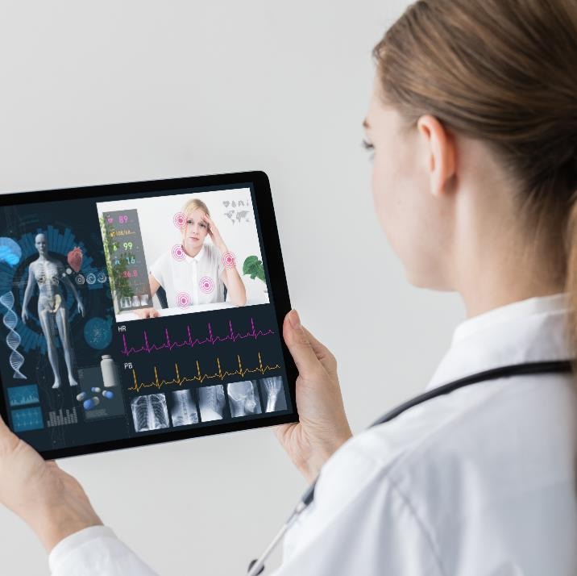
Use of technology in healthcare
Telemedicine and remote monitoring
Activity 2
During Covid-19, Imperial College Healthcare NHS Trust reduced staff exposure to the virus by using the mixed virtual reality platform Microsoft Hololens to conduct virtual ward rounds and treat very ill patients. ​The platform is also used for work experience and teaching.
Doctors use their headset to access patients’ electronic healthcare data to look at their medical notes and test results.
Lesson 4: Use of technology to support the healthcare sector
Notes:
Image credit:
© Shutterstock/metamorworks

Slide 10
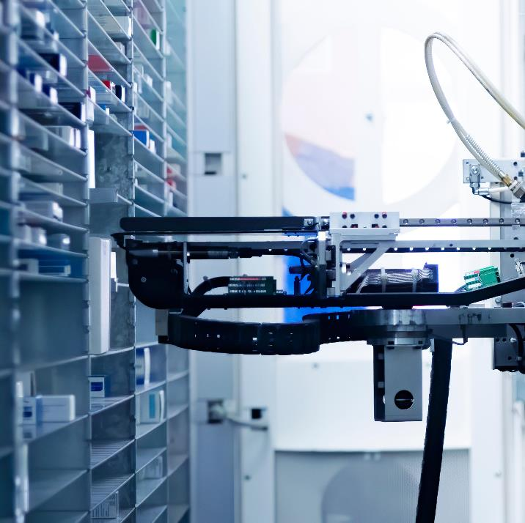
Use of technology in healthcare
Robots and automation
Activity 2
Robots and automation will be increasingly integrated into various healthcare tasks, such as surgery, rehabilitation and caregiving.
Watch this video about pharmacy robots, which can automate the warehousing of medicines: storing and automatically dispensing medicine packages. Pharmacy robots
Pharmacy managers and technicians have more time to advise patients.
Lesson 4: Use of technology to support the healthcare sector
Notes:
Websites linked in this slide:
YouTube, North Tees and Hartlepool NHS Foundation Trust, Robot pharmacy assistant – www.youtube.com/watch?v=kGqruGIXAjY (with permission)
Image credit:
© Shutterstock/Halawi

Slide 11
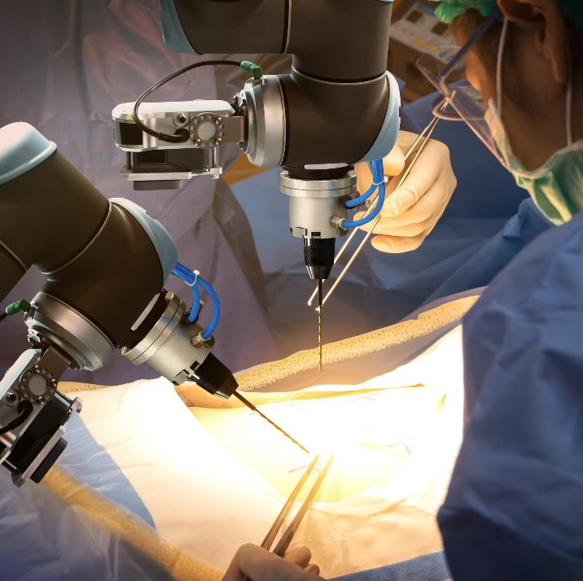
Use of technology in healthcare
Robotic surgery
Activity 2
Robotic-assisted surgeries will become more precise, reducing risks and improving outcomes.​
Robotic-assisted surgery is a type of key-hole surgery. It is minimally invasive, leading to quicker recovery times, fewer complications and less scarring.​
Watch this video about the Da Vinci Surgical System, which is the most widely used system: Da Vinci Surgical System
Lesson 4: Use of technology to support the healthcare sector
Notes:
Websites linked in this slide:
YouTube, h+ magazine, Da Vinci Intuitive Surgical HD – www.youtube.com/watch?v=7sTfD_mStwE (with permission)
Image credit:
© Shutterstock/Zapp2Photo

Slide 12
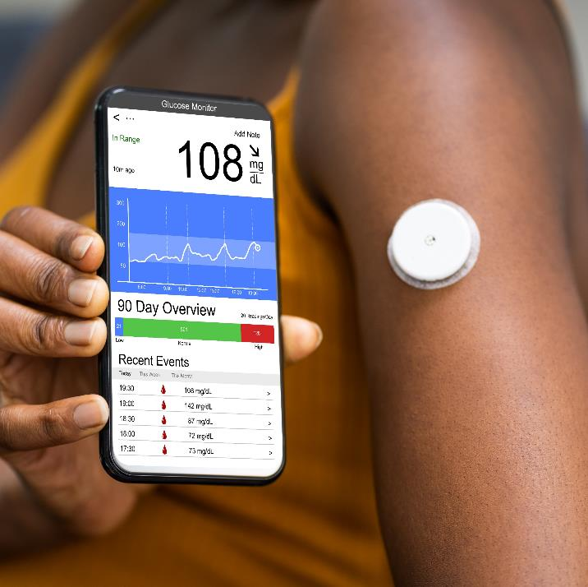
Use of technology in healthcare
Wearable technology
Activity 2
Wearable devices and sensors will continue to advance, enabling real-time monitoring of vital signs, physical activity and sleep patterns.​
These technologies will provide valuable insights for preventive healthcare and disease management​.
Read this article about how the progress of cancer patients is being monitored using health sensors: health sensors
Read this article which looks at continuous glucose monitoring for patients with type 1 diabetes: continuous glucose monitoring
Lesson 4: Use of technology to support the healthcare sector
Notes:
Websites linked in this slide:
https://mft.nhs.uk/2022/01/26/trial-of-wearable-health-technology-for-cancer-patients-opens/
www.england.nhs.uk/diabetes/digital-innovations-to-support-diabetes-outcomes/flash-glucose-monitoring/
Image credit:
© Shutterstock/Andrey_Popov

Slide 13
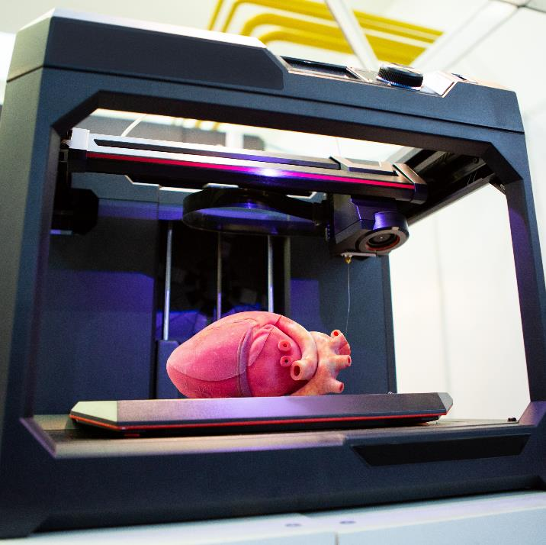
Use of technology in healthcare
3D printing
Activity 2
3D printing will revolutionise healthcare by enabling the production of customised implants, prosthetics and even organs. ​Watch this video about 3D printing and organ transplants: 3D printing
This technology has the potential to significantly improve patient care and outcomes.​
Lesson 4: Use of technology to support the healthcare sector
Notes:
Websites linked in this slide:
YouTube, BBC News, Could 3D printing be the future of organ transplants? – https://www.youtube.com/watch?v=IUx_vkB3PFc
Image credit:
© Shutterstock/Scharfsinn

Slide 14
Use of technology in healthcare
New drug delivery systems
Activity 2
Technological advances in drug delivery will enhance drug efficacy, target specific tissues and enable non-invasive treatments.
Recent examples include controlled release therapies such as Gliadel wafers for chemotherapy. Read this article about Gliadel wafers
Future developments:
Nucleotide based therapy to make proteins inside cells
Tissue targeted delivery using nanoparticles to give a localised therapeutic dose and avoid affecting other tissues​
Ingestible injectables where the site of injection is the gastrointestinal tract, which lacks pain receptors
Lesson 4: Use of technology to support the healthcare sector
Notes:
Websites linked in this slide:
Macmillan Cancer information and support, Treatments and drugs, Gliadel wafers – https://www.macmillan.org.uk/cancer-information-and-support/treatments-and-drugs/gliadel-wafers

Slide 15
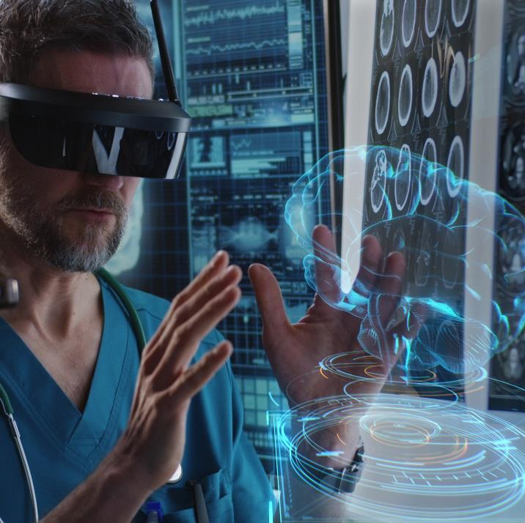
Use of technology in healthcare
Virtual reality and augmented reality
Activity 2
Virtual reality (VR) and augmented reality (AR) technologies are finding applications in medical education, surgical training, pain management and mental health therapies. Watch this video about how a VR game helps a burns victim: Virtual reality (VR)
They offer immersive and interactive experiences for improved learning and patient care.
Lesson 4: Use of technology to support the healthcare sector
Notes:
Websites linked in this slide:
BBC News, Virtual reality game helps ease pain for burns victim – https://www.bbc.co.uk/news/uk-england-south-yorkshire-43744009 (Note that this link features images of burns)
Image credit:
© Shutterstock/Frame Stock Footage

Slide 16
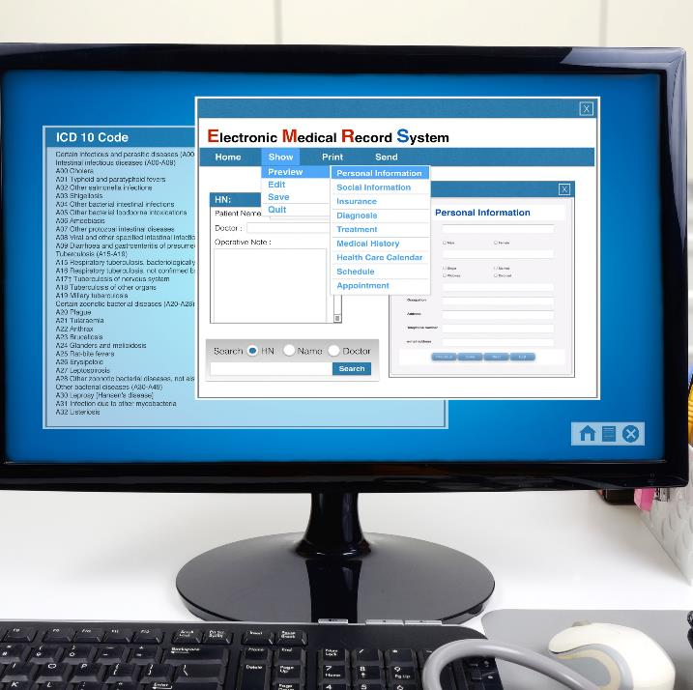
Use of technology in healthcare
Electronic patient records
Activity 2
Electronic patient records (ePR) enable efficient management of patient data and therefore better patient outcomes. Watch this video about ePR: Electronic patient records
Future advances in blockchain technology will make systems even more secure to combat potential security breaches. ​
Lesson 4: Use of technology to support the healthcare sector
Notes:
Websites linked in this slide:
YouTube, East Lancashire Hospitals NHS Trust, ePR interview with Daniel Hallen – https://www.youtube.com/watch?v=EVzaa34rIPs (with permission)
Further information on blockchains: https://www.digitalhealth.net/2022/03/blockchain-makes-medical-data-more-secure/
Image credit:
© Shutterstock/pandstock011

Slide 17

Use of technology in healthcare
AI solutions
Activity 2
The first Health Innovation Lab has been set up by the University of Gloucestershire and Gloucestershire Hospitals NHS Foundation Trust to look at innovative approaches using AI​. Watch this video about the lab: Health Innovation Lab
Issues like bed blocking, waiting lists and appointments will be addressed.​ ​
Lesson 4: Use of technology to support the healthcare sector
Notes:
Websites linked in this slide:
BBC News, Gloucestershire health lab examines how innovation can help NHS – https://www.bbc.co.uk/news/uk-england-gloucestershire-65788775
Image credit:
© Shutterstock/Lifestyle Travel

Slide 18

Use of technology in healthcare
Disease surveillance
Activity 2
The Genomic Surveillance Unit (GSU) at the Sanger Institute sequences the genetic material of both the pathogens and vectors. Read this article about the GSU: Genomic Surveillance Unit
Mutations are tracked that affect the spread and treatment of disease.
The population can be monitored for future pathogens​.
The new Sanger Institute Respiratory Virus and Microbiome Initiative will pioneer genomic surveillance of respiratory viruses. Watch this video: Respiratory Virus & Microbiome Initiative
Sanger Institute Respiratory Virus and Microbiome Initiative
Lesson 4: Use of technology to support the healthcare sector
Notes:
Websites linked in this slide:
Wellcome Sanger Institute, Genomic surveillance unit – https://www.sanger.ac.uk/collaboration/genomic-surveillance-unit/
YouTube, Wellcome Sanger Institute, Respiratory virus and microbiome initiative – https://www.youtube.com/watch?v=JN0qcOxPjL8

Slide 19
Summary question
Plenary
Answer the summary question on the role health applications can play in supporting the healthcare sector.
Swap your answers and mark your partner’s answer using the mark scheme.
Resources needed
L4 Plenary Worksheet 1
L4 Plenary Worksheet 2
Lesson 4: Use of technology to support the healthcare sector

Slide 20
Consolidation
Consolidation
Choose an area of technology from today’s lesson to research in more detail.
Produce a fact sheet to explain what it does and how it benefits the healthcare sector.
Lesson 4: Use of technology to support the healthcare sector

Slide 21
In this lesson, we have:
Consolidation
listed some examples of health applications
discussed the use of healthcare applications in supporting the healthcare sector
explained how developments in technology can be used to support the healthcare sector.
Skills:
CS3.2 Undertake collaborative work
CS6.1 Present project findings in a range of formats
General competencies:
English:
GEC1 Convey technical information to different audience
GEC2 Present information and ideas
GEC3 Create texts for different purposes and audiences
GEC4 Summarise information/ideas
GEC5 Synthesise information
Lesson 4: Use of technology to support the healthcare sector

