Slide 1
Science
Route: Health & Science
Topic: Working within the health and science sectors
Lesson 4: Diversity of roles within organisations and the science sector in general
Notes:
Image ©: iStock 1441663123

Slide 2
In this lesson, we will:
Introduction
describe the factors that contribute to the diversity of employers and organisations within the science sector
describe the diversity of work undertaken in different jobs within the science sector
name some jobs which require the application of science in non-science sectors.
Skills:
CS3.1 Identify their own role in relation to the wider team.
CS3.2 Meet their responsibilities when working in a wider team by ensuring that the project is compliant
General competencies:
English:
GEC1 Convey technical information to different audiences
GEC2 Present information and ideas
GEC3 Create texts for different purposes and audiences
GEC4 Summarise information/ideas
GEC5 Synthesise information
GEC6 Take part in/lead discussions
Digital:
GDC1 Use digital technology and media effectively
GDC2 Design, create and edit documents and digital media
GDC3 Communicate and collaborate
Lesson 4: Diversity of roles within organisations and the science sector in general

Slide 3
Which employer would have a more diverse range of occupations across their company?
Introduction
GlaxoSmithKline
Pharmaceutical and biotechnology company
Multinational
70 000 employees
Monitra
Antibody production company
Based in your town/city
50 employees
List the reasons for your decision.
Lesson 4: Diversity of roles within organisations and the science sector in general

Slide 4

Factors that contribute to the diversity of employers/organisations within the science sector:
Introduction
Size of employer/organisation
Funding streams
Commercial status
Working environments
Geographic location
Lesson 4: Diversity of roles within organisations and the science sector in general

Slide 5

Size of employer/organisation
Introduction
This can range from a small team to thousands of people working in different bases across the world.
Generally, a larger company has a more diverse range of occupations.
However, in some cases a large organisation may also employ many people in the same or similar roles, for example, a manufacturing plant.
Lesson 4: Diversity of roles within organisations and the science sector in general
Notes:
Image credit:
© Shutterstock/Andrii Yalanskyi

Slide 6
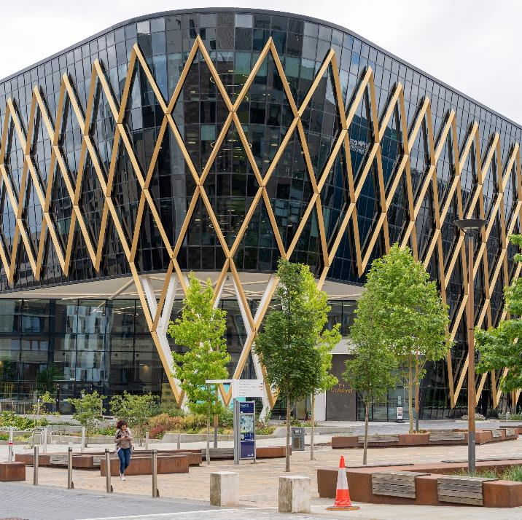
Commercial status
Introduction
Employment in the science sector is spread across a range of organisation types, including organisations you would not perhaps consider to be ‘science’ businesses:
national public bodies, such as the NHS and Environmental Agency;
local government departments, such as departments responsible for public health;
universities;
research institutes;
charities (and other non-profit organisations);
commercial companies (profit-making organisations).
Lesson 4: Diversity of roles within organisations and the science sector in general
Notes:
Image credit:
© Shutterstock/Richard z

Slide 7

Funding streams
Introduction
Some publicly funded organisations, such as those carrying out scientific research and development, may receive grants from:
  bodies such as research councils;
  charitable organisations such as Wellcome.
Commercial companies also carry out research and development, funded through, for example, investment, and profits from the sale of products. Alongside research and development, commercial companies carry out monitoring, measurement and analysis.
Lesson 4: Diversity of roles within organisations and the science sector in general
Notes:
Image credit:
© Shutterstock/Hazel Blaster

Slide 8

Working environments
Introduction
Working environments can include:
laboratories, for example, for research and development, or testing samples for health or environmental monitoring, or for teaching;
manufacturing plants, which could also be in a laboratory on the manufacturing site, to test samples for quality assurance;
field work, for example, collecting samples for environmental monitoring;
office-based such as data analysis;
hospitals, for example, testing clinical samples.
Lesson 4: Diversity of roles within organisations and the science sector in general
Notes:
Image credit:
© Shutterstock/Gorodenkoff

Slide 9
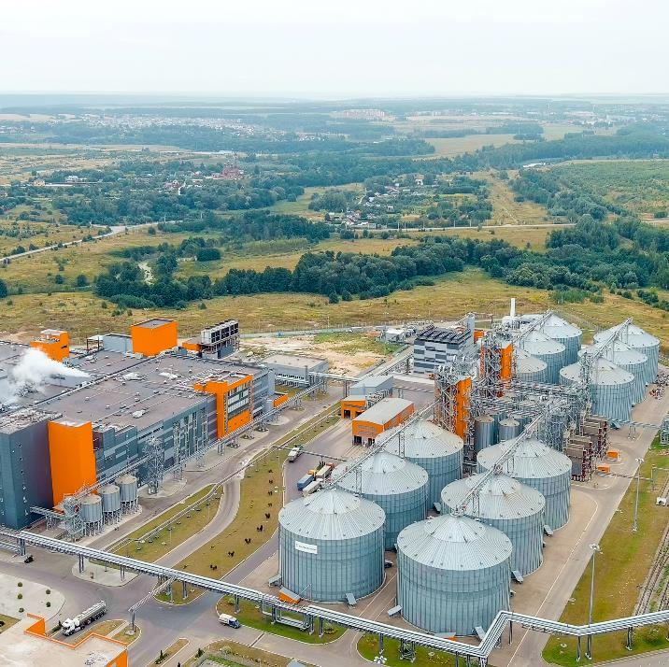
Geographic location
Introduction
Located in this country, abroad or sites in both places
Located where there is space, for example, cheaper land for large-scale manufacturing
Research institutes are often found near universities.
Environmental monitoring will occur close to the environment being studied, for example, rivers, soil samples.
Science roles are also found in businesses that are not classified as part of the science sector.
Lesson 4: Diversity of roles within organisations and the science sector in general
Notes:
Image credit:
© Shutterstock/Maykova Galina

Slide 10

Development of a medicine
Activity 1
The development of a new medicine from inception to market takes at least 12 years on average due to the complexity of the process.
Lesson 4: Diversity of roles within organisations and the science sector in general
Notes:
Image credit:
© Shutterstock/jotamadrid

Slide 11

Development of a medicine
Activity 1
There are high failure rates; only 25 of every
25 000 potential pharmaceutical compounds will go into clinical trials.
Of these, five may be approved for marketing and only one compound from the five licensed will be likely to make a profit.
A new medicine may cost £1.5 billion to bring to market and must comply with licensing requirements in every country in which it is distributed.
Lesson 4: Diversity of roles within organisations and the science sector in general
Notes:
Image credit:
© Shutterstock/jotamadrid

Slide 12
Development of a medicine
Activity 1
Task 1: Complete a matching activity on Worksheet 1 to sequence the main steps involved in the production of a new medicine (answers are on Worksheet 2).
Task 2: Scan the QR codes to find out more about the types of careers that work together in each of these fields. Record your findings in the table on Worksheet 1.
Resources needed
L4 Activity 1 Worksheet 1
L4 Activity 1 Worksheet 2
L4 Activity 1 –
QR codes
Lesson 4: Diversity of roles within organisations and the science sector in general

Slide 13
Careers in the pharmaceutical industry
Activity 1
Development of a medicine
Sector | Disciplines include:
Research and development | archiving, biology, chemistry, clinical studies, drug safety, genetics, health economics, imaging, medical affairs, medical writing, patenting, pharmacy, regulatory affairs, research information, statistics
Manufacturing and supply | engineering, manufacturing, quality
Commercial | healthcare communications, medical information, sales and marketing
Support functions | finance, human resources, information technology, training and development
Lesson 4: Diversity of roles within organisations and the science sector in general

Slide 14
Large organisations
Activity 2
Task 1: Write a fact file about Novartis and share with the group.
Task 2: Create a mind map to show the different science-related jobs people have at Novartis.
Resources needed
L4 Activity 2 Worksheet
Lesson 4: Diversity of roles within organisations and the science sector in general

Slide 15
Study question
Plenary
State three reasons why it is important for large organisations such as Novartis to have a diverse range of roles as part of their workforce.
(3 marks)
Lesson 4: Diversity of roles within organisations and the science sector in general

Slide 16
Study question – mark scheme
Plenary
To have the range of expertise in their teams to carry out the different tasks required to research and then manufacture a treatment (1)
To have the range of expertise to be able to develop a treatment as quickly as possible (1)
To have the range of expertise to be able to make/discover new drugs (1)
To have the range of expertise to manage the manufacturing process (1)
To be able to distribute their products (1)
Marking guidance:
Award one mark for each relevant description up to a maximum of three marks overall. Accept any other suitable response.
Lesson 4: Diversity of roles within organisations and the science sector in general

Slide 17
In this lesson, we have:
Consolidation
described the factors that contribute to the diversity of employers and organisations within the science sector
described the diversity of work undertaken in different jobs within the science sector
named some jobs which require the application of science in non-science sectors.
Skills:
CS2.1 Conduct a review of independently selected scientific literature and other appropriate primary/secondary sources.
CS3.1 Identify their own role in relation to the wider team.
General competencies:
English:
GEC1 Convey technical information to different audiences
GEC2 Present information and ideas
GEC3 Create texts for different purposes and audiences
GEC4 Summarise information/ideas
GEC5 Synthesise information
GEC6 Take part in/lead discussions
Digital:
GDC1 Use digital technology and media effectively
GDC2 Design, create and edit documents and digital media
GDC3 Communicate and collaborate
Lesson 4: Diversity of roles within organisations and the science sector in general

