Slide 1
Science
Route: Health & Science
Topic: Working within the health and science sectors
Lesson 5: The role of laboratory technicians in the science sector
Notes:
Image ©: iStock 1441663123

Slide 2
In this lesson, we will:
Introduction
Skills:
CS3.1 Identify their own role in relation to the wider team.
CS3.2 Meet their responsibilities when working in a wider team by ensuring that the project is compliant.
General competencies:
English:
GEC2 Present information and ideas
GEC4 Summarise information/ideas
GEC5 Synthesise information
GEC6 Take part in/lead discussions
Maths:
GMC1 Measuring with precision
explore the diversity of work undertaken by science laboratory technicians
complete an exam-style question to consolidate learning from this topic.
Lesson 5: The role of laboratory technicians in the science sector

Slide 3
Short-answer question
Introduction
1. Audits can be used to achieve quality control (QC) and quality assurance (QA). QA is the testing of a product to make sure it meets the required standards.
State the definition of quality control (QC).
(1 mark)
List the reasons for your decision.
Lesson 5: The role of laboratory technicians in the science sector

Slide 4
Short-answer question – answer
Introduction
1. Audits can be used to achieve quality control (QC) and quality assurance (QA). QA is the testing of a product to make sure it meets the required standards.
State the definition of quality control (QC).
QC is making sure there are procedures in place to ensure the product or service always meets the required standards.
(1 mark)
List the reasons for your decision.
Lesson 5: The role of laboratory technicians in the science sector

Slide 5
Short-answer question
Introduction
2. List three possible entry routes to employment within the science sector.
(3 marks)
List the reasons for your decision.
Lesson 5: The role of laboratory technicians in the science sector

Slide 6
Short-answer question – answer
Introduction
2. List three possible entry routes to employment within the science sector.
Any three from:
Further Education (level 3)
Higher Technical Education (levels 4–5)
Undergraduate study (level 6)
Apprenticeships (levels 2–7)
(3 marks)
List the reasons for your decision.
Lesson 5: The role of laboratory technicians in the science sector

Slide 7
Short-answer question
Introduction
3. Name two subject fields within the science sector.
(2 marks)
List the reasons for your decision.
Lesson 5: The role of laboratory technicians in the science sector

Slide 8
Short-answer question – answer
Introduction
3. Name two subject fields within the science sector.
Any two suitable responses, such as:
Chemistry
Biology
Physics
Environmental science
Data science
Biotechnology
Astronomy
(2 marks)
List the reasons for your decision.
Lesson 5: The role of laboratory technicians in the science sector

Slide 9
Short-answer question
Introduction
4. Name one role in the science sector that is not a laboratory-based job.
(1 mark)
List the reasons for your decision.
Lesson 5: The role of laboratory technicians in the science sector

Slide 10
Short-answer question – answer
Introduction
4. Name one role in the science sector that is not a laboratory-based job.
Any suitable answer, such as roles in:
Communication and outreach
Education
Management
Manufacturing
Public service
Policy and product development
(1 mark)
List the reasons for your decision.
Lesson 5: The role of laboratory technicians in the science sector

Slide 11

The role of laboratory technicians
Activity 1
What role do laboratory technicians play in the science sector?
Lesson 5: The role of laboratory technicians in the science sector
Notes:
Image credit:
© Shutterstock/wavebreakmedia

Slide 12

The role of laboratory technicians
Activity 1
Laboratory technicians play a key role in the science sector, for example by:
preparing and setting up experimental work
ensuring health and safety regulations are met
calibrating equipment
ordering and storing equipment and chemicals
cleaning and disinfecting equipment and workspaces, including dealing with chemical waste
gathering, recording and reporting data from tests and experiments
Lesson 5: The role of laboratory technicians in the science sector
Notes:
Useful website: industrial-biotechnology-technicians-report.pdf (gatsby.org.uk)
Image credit:
© Shutterstock/wavebreakmedia

Slide 13
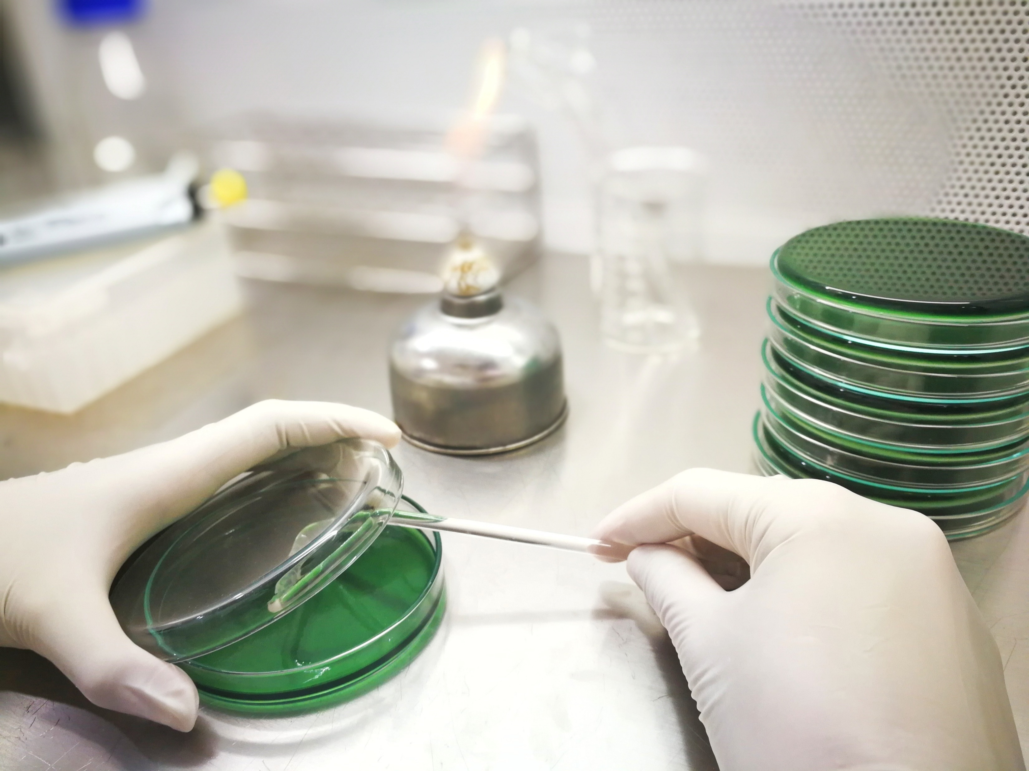

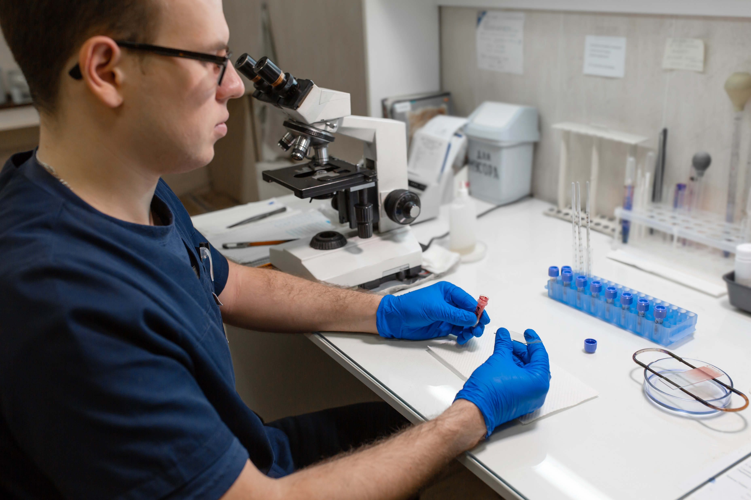
The role of laboratory technicians
Activity 1
Carry out a practical to develop your laboratory skills
Investigating antimicrobial chemicals
Using colorimetry
Making blood smear slides
Lesson 5: The role of laboratory technicians in the science sector
Notes:
CLEAPSS practicals in this slide:
science.cleapss.org.uk/resource-info/pp050-investigating-the-effects-of-antimicrobial-chemicals.aspx
science.cleapss.org.uk/resource-info/pp085-using-colorimetry-to-quantify-reducing-sugar-concentrations.aspx
science.cleapss.org.uk/resource-info/pp102-making-blood-smear-slides.aspx
Image credit:
© Shutterstock/PageSeven
Image credit:
© Shutterstock/Chokniti-Studio
Image credit:
© Shutterstock/Try_my_best

Slide 14
Study question
Activity 2
Answer the study question (Worksheet 1).
Mark a partner’s worksheet using the mark scheme (Worksheet 2).
Resources needed
L5 Activity 2 Worksheet 1
L5 Activity 2 Worksheet 2
Lesson 5: The role of laboratory technicians in the science sector

Slide 15
Study question – next steps
Plenary
Look at your marked response – what went well? What could you do better next time?
Update your notes to capture points you need to review and any exam tips. For example:
Did you finish the question in time?
Did you use technical language?
Was your answer balanced? Did you give reasons for and against the company’s claim?
Lesson 5: The role of laboratory technicians in the science sector

Slide 16
In this lesson, we have:
Consolidation
explored the diversity of work undertaken by science laboratory technicians
completed an exam-style question to consolidate learning from this topic.
Skills:
CS3.1 Identify their own role in relation to the wider team.
CS3.2 Meet their responsibilities when working in a wider team by ensuring that the project is compliant.
General competencies:
English:
GEC2 Present information and ideas
GEC4 Summarise information/ideas
GEC5 Synthesise information
GEC6 Take part in/lead discussions
Maths:
GMC1 Measuring with precision
Lesson 5: The role of laboratory technicians in the science sector

