Slide 1
Digital
Route: Digital
Topic: Culture and the impact of technology
Lesson 1: The costs and benefits of digital expansion
Notes:
Image © Shutterstock Inc. DedMityay

Slide 2
In this lesson, we will:
Introduction
explain the evolving nature of technology and the impacts of this on businesses and employees
discuss how methods of communication
are changing in organisations
define autonomous operation and provide examples of its use
consider the positive and negative impacts of autonomous operation.
General competencies:
English:
GEC1 Convey technical information to different audiences
GEC2 Present information and ideas
GEC4 Summarise information/ideas
GEC5 Synthesise information
GEC6 Take part in/lead discussions
Digital:
GDC1 Use digital technology and media effectively
GDC2 Design, create and edit documents and digital media
GDC3 Communicate and collaborate
Lesson 1: The costs and benefits of digital expansion

Slide 3
Discussion
Activity 1
What do we mean by morals and ethics?
Lesson 1: The costs and benefits of digital expansion

Slide 4
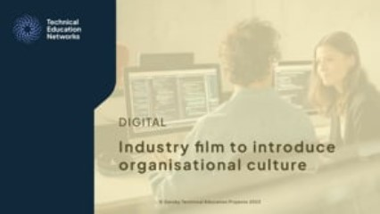
Interview: Morals and ethics
Activity 1
Video introducing morals and ethics in the workplace: interviews with Cisco and Mesma
Lesson 1: The costs and benefits of digital expansion
Notes:
Industry video can be watched here: Industry film: Introducing organisational culture on Vimeo
https://vimeo.com/875898394

Slide 5
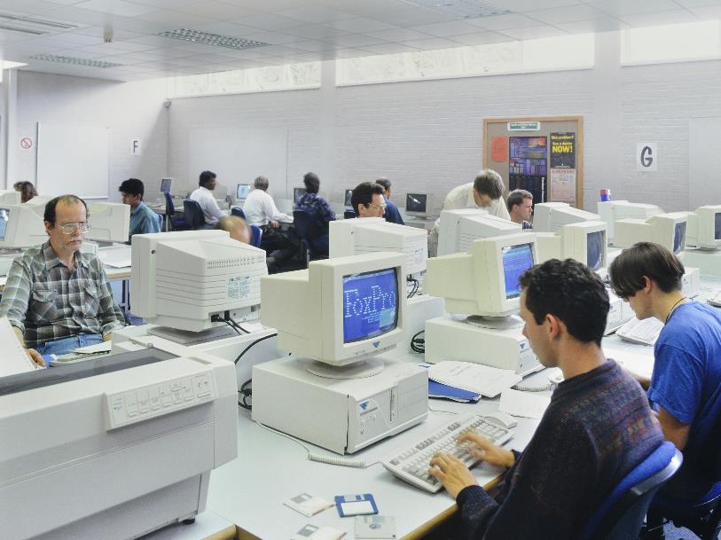

The workplace of today
Activity 2
A typical workplace from the 1990s (left) and a typical workplace from the 2020s (right)
Lesson 1: The costs and benefits of digital expansion
Notes:
Image credits:
Left image: © Alamy Stock Photo parkerphotography;
Right image: © Shutterstock Inc. insta_photos

Slide 6

Technology and our evolving society
Activity 2
The society we are part of is now so much bigger than ever before. Digital technology has changed the way we communicate with organisations, businesses, healthcare, banks, services and the Government and how they communicate with us.
We are living an ‘always connected’ lifestyle – the internet gives us access to the world through news, video and images. This has created a need for 24 hours services and people willing to work outside of office hours.
Social media allows us to see how people live and work around the world, however this is through a skewed “lens” of how they choose to be presented and seen.
Lesson 1: The costs and benefits of digital expansion
Notes:
Image © Shutterstock Inc. Sitophotostock

Slide 7

Technology and our evolving society
Activity 2
Employment, entertainment, news,
and education all now embed online services. To fully engage with these, access to the internet is essential.
However, not everyone in society has the same access to technology or opportunities.
We need to ask, is this lack of universal access fair? If not, how
can we make it fair for everyone?
Lesson 1: The costs and benefits of digital expansion
Notes:
Image © Shutterstock Inc. Gorodenkoff

Slide 8
Benefits of evolving technology
Activity 2
Some shy, introvert or neurodiverse individuals
see remote working as a
great opportunity.
We are more aware of different cultures and lifestyles, and we can reach out to others across the world with similar interests.
Increased access to technology means we can talk to friends and colleagues more than ever and in more locations.
Users and customers have access to world-wide organisations for products and services at any time.
Remote working provides flexible employment opportunities for those unable to travel, e.g. for medical reasons or caring responsibilities.
Evolving technology provides many efficiencies to individuals, such as banking, cloud computing, shared devices, and storage.
More affordable computers and consistent internet access means that many of us can work from home.
Lesson 1: The costs and benefits of digital expansion

Slide 9

Negative impacts of evolving technology
Activity 2
Not all users or customers have access to equipment, high speed internet, or physical space at home.
Remote working isn’t suitable for all, people working in service industries and healthcare for example still need to be in their place of work.
Remote working may mean never meeting our colleagues in person. It can lead to people being physically more isolated.
Remote working can increase the number of meetings in one day with little or no breaks, impacting health and wellbeing.
Increased social media use has changed the way we communicate with others. Instant messaging acronyms and emoticons often clash with traditional business formality.
Lesson 1: The costs and benefits of digital expansion
Notes:
Image © Shutterstock Inc. Rawpixel.com

Slide 10

Changes in communication
Activity 2
The way the modern workplace communicates has changed. Previously, fax and physical post were commonly used. Now, documents are only posted when legally required.
The modern ‘blended’ workplace uses a mix of digital and face to face communication.
Instant digital communication removes the need for excessive travel, improving productivity.
Cloud-based documents can be shared to allow collaborative working from any location.
Paperless communication can be an environmental benefit.
Lesson 1: The costs and benefits of digital expansion
Notes:
Image © Shutterstock Inc. Girts Ragelis

Slide 11
Internet communication
Activity 2
Communicating via the Internet provides access to many different
forms of communication, such as the examples below.
These systems are available from
any internet-connected location but
can require staff training.
A reliable, high-speed internet
connection will ensure uninterrupted
digital communication, including file
and media sharing, which is
essential when working remotely.
Instant messaging
Email
VoIP telephone calling (Voice over Internet Protocol)
Voice calling
Lesson 1: The costs and benefits of digital expansion

Slide 12

Business and employee expectations
Activity 2
The increased access to digital communication
has changed some of the expectations
and wishes of both businesses and employees.
Businesses wish to take advantage of the
increased access to communication and
the potential of technology to maximise
productivity and output.
Employers' awareness of, and access to, remote
working has increased. This makes flexible
remote working more desirable, and in some
cases expected.
Lesson 1: The costs and benefits of digital expansion

Slide 13

Business and employee expectations
Activity 2
Business expectations
Timely communications, especially in respect to absence.
Some businesses will expect a response to out-of-hours contact at any time.
Access to technology at home for communication can involve costs for employees.
Employees may end up undertaking unpaid work over time.
Employee expectations
Timely communications, including
up-to-date information and notices.
Access to internet communication systems in the workplace.
Ability to access work documents remotely.
The possibility of flexible working hours, including remote or hybrid working.
Lesson 1: The costs and benefits of digital expansion

Slide 14

Remote working challenges
Activity 2
Employers can make assumptions about the level of digital literacy of their employees. The use of remote software is expected but is not always understood.
Domestic connections can be less secure than those in the workplace, so it is important to ensure that employees understand cyber security rules and guidelines, and practise good online safety.
The flexibility of remote working means there is a danger of employees feeling 'always on’, and an expectation to respond outside of working hours. This can have a negative impact on wellbeing.
Lesson 1: The costs and benefits of digital expansion
Notes:
Image © Shutterstock, Inc. Olezzo

Slide 15
Reach and scale
Activity 2
The digital workplace removes some international barriers and allows organisations of all sizes to increase their reach and scale.
Customers, clients and suppliers
can be found anywhere in the world.
Websites and social media
can be used to promote products and services internationally.
Remote working can be used by an organisation to recruit globally from any location with internet access and skilled staff.
Virtual events can be attended by larger audiences, and from anywhere in the world with internet access.
Lesson 1: The costs and benefits of digital expansion

Slide 16
Working practices
Activity 2
Rules and regulations within all organisations must be updated to meet the needs of the digital world. Areas affected include:
Digital platforms
used to collect employee feedback/provide support and training.
Workplace communications
are supportive, suitable and focused.
Digital processes improving productivity, and virtual collaboration, including creation and sharing of documents
Employment flexibility for working hours and increased popularity of remote working.
Health and safety processes to address potential dangers when using technology.
Usage and access rules for remote working.
Lesson 1: The costs and benefits of digital expansion

Slide 17

Monitoring employees
Activity 2
The expansion of digital working means that employees spend more time at a workstation than ever before.
Remote and home working means that
an employer may have staff in multiple locations around the world. This has increased the need for monitoring of:
  workplace communications, for example, non-essential email use or internet browsing;
  time spent logged in at a workstation;
  start and finish times, especially with more people working flexible hours.
Lesson 1: The costs and benefits of digital expansion
Notes:
Image © Shutterstock, Inc. Travelpixs

Slide 18
Impact of digital expansion in real organisations
Activity 2
Finding an organisation with the right workplace
culture has become very important to employees
when choosing organisations to work for.
Consider one of these organisations and research
how they have adapted to the changing digital environment, and the impact this has had on
their culture.
    Microsoft
    X (Twitter)
    Mesma (https://mesma.co.uk)
Resources needed:
L1 Activity 2: Research and present worksheet
Lesson 1: The costs and benefits of digital expansion

Slide 19

Autonomous operation
Activity 3
Manufacturing plants often utilise digital technology
Lesson 1: The costs and benefits of digital expansion
Notes:
Image: © Shutterstock Inc. Blue Planet Studio

Slide 20

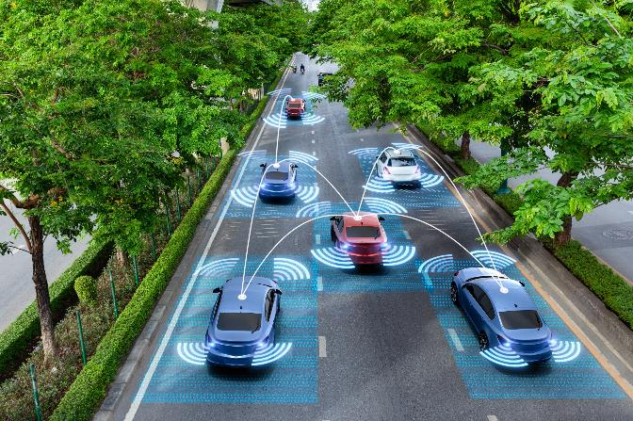
The rise of autonomous technology
Activity 3
Autonomous technology is designed to replace human activity in a more efficient way.
Autonomous technology can be:
  software automation
  industrial/physical automation systems
  part of ‘Industry 4.0’, the fourth Industrial Revolution.
Lesson 1: The costs and benefits of digital expansion
Notes:
Image credits
Phone: © Shutterstock, Inc. Tero Vesalainen (Customer service and support live chat with chatbot and automatic messages)
Automated traffic © Shutterstock, Inc. Suwen

Slide 21
Types of autonomous operation
Activity 3
Software automation examples include:
LLM (Large Language Model) systems that process large amounts of data to summarise, analyse and generate content on a specific topic.
AI (Artificial Intelligence) based Chatbot response programs;
automated data analysis of Big Data,
automated administrative tasks, auto generation of documentation.
Industrial/physical automation system examples include:
production line manufacture, from cars to smartphones;
food and drink processing;
transport systems across land, sea
and air.
Lesson 1: The costs and benefits of digital expansion

Slide 22
Positive impacts of autonomous operation
Activity 3
Autonomous systems can offer some benefits:
24-hour, 365-day operation;
potential to replace repetitive jobs, increased efficiency, and financial savings;
creation of new jobs and careers in programming and system design;
increased consistency of work product with lower
error rates;
recorded processes enabling thorough QA;
improved iteration of processes based on feedback;
removing danger risk to humans.
Positive impacts
in practice
Chatbot process are only limited by computer power and network capability rather than the number of employees.
Stock can be monitored and updated, with replacements ordered automatically.
Lesson 1: The costs and benefits of digital expansion

Slide 23
Dehumanisation
Activity 3
Physical jobs are being lost as factories become robot production lines; service jobs in call centres are being replaced by chatbots and online servers.
The attractive efficiency of 24-hour operation is seeing human jobs lost and replaced.
Decisions made by artificial intelligence (AI) and machine learning are based on user input and efficiency and don’t consider human impacts
or empathy.
AI decision-making
Consider an AI system delivering bad news, making financial decisions that could affect a number of people, or deciding on the optimum number of employees.
In examples such as these, most people appreciate human influence to ensure all situations are being considered with empathy.
Lesson 1: The costs and benefits of digital expansion

Slide 24
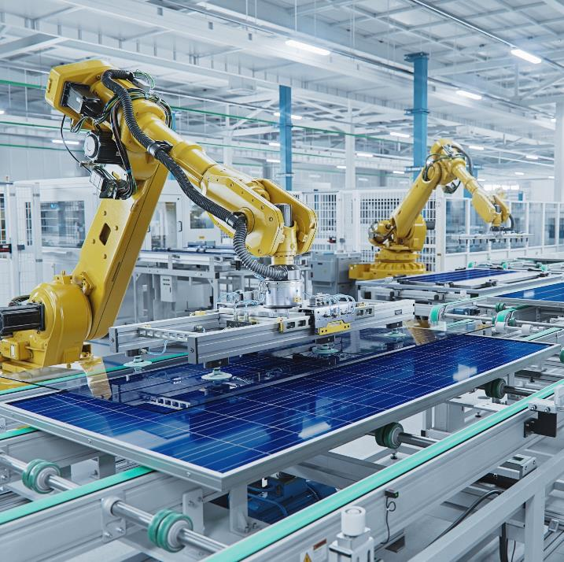
Dehumanisation
Activity 3
If an autonomous system replaces a human,
what happens to that person?
This question has been asked ever since the
industrial revolution in the 18th Century, but
the exponential increase in digital technology
has brought this to the forefront of modern
business.
Despite reducing the need for humans, autonomous systems still require failsafe procedures in case of system errors to enable human intervention to prevent harm.
Lesson 1: The costs and benefits of digital expansion
Notes:
Image:© Shutterstock, Inc. IM Imagery

Slide 25

Changes in skill requirements and deployment
Activity 3
Automated systems need to be designed, programmed and maintained.
The rapidly increasing usage of
these systems needs to be met
with skilled staff.
Loss of some jobs can be off-set
with the need for new jobs requiring digital skills.
Lesson 1: The costs and benefits of digital expansion
Notes:
Image:© Shutterstock, Inc. Monkey Business Images

Slide 26
Changes in skill requirements and deployment
Activity 3
The transition from traditional to autonomous
systems offers organisations opportunities to
up-skill their workforce.
Organisations can offer new positions and
apprenticeships to young people training and
learning digital skills
Organisations can offer training to existing
employees to enable them to learn how to
use and operate the latest systems.
Lesson 1: The costs and benefits of digital expansion

Slide 27
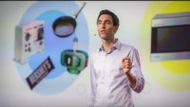

Artificial intelligence
Activity 3
TED video: The jobs we’ll lose to machines
BBC World video: Analysis on the potential impact of AI
Lesson 1: The costs and benefits of digital expansion
Notes:
AI videos can be watched here:
BBC: https://www.youtube.com/watch?v=skG3okhx2TU (with permission)
TED: https://www.youtube.com/watch?v=gWmRkYsLzB4

Slide 28
Autonomous operation: Case studies
Activity 3
Here are three examples of autonomous operations in different organisations:
  NHS Wales Chatbot
  https://velindre.nhs.wales/news/latest-news/velindre-cancer-centre-launches-artificial-intelligence-chatbot-rita1/
  BMW/Mini UK vehicle manufacturing
  https://www.mini.co.uk/en_GB/home/why-mini/mini-uk-production.html
  ALSTOM – Autonomous train developer
  https://www.alstom.com/autonomous-mobility-future-rail-automated
Research why and how these autonomous
operations were introduced, and the impacts the technology has had.
Resources needed:
L1 Activity 3: Research and present worksheet
Lesson 1: The costs and benefits of digital expansion

Slide 29
In this lesson, we have:
Plenary
explained the evolving nature of technology and the impacts of this on businesses and employees
discussed how methods of communication are changing in organisations
defined autonomous operation and provided examples of its use
considered the positive and negative impacts of autonomous operation.
General competencies:
English:
GEC1 Convey technical information to different audiences
GEC2 Present information and ideas
GEC4 Summarise information/ideas
GEC5 Synthesise information
GEC6 Take part in/lead discussions
Digital:
GDC1 Use digital technology and media effectively
GDC2 Design, create and edit documents and digital media
GDC3 Communicate and collaborate
Lesson 1: The costs and benefits of digital expansion

Slide 30
Next lesson, we will cover:
Plenary
what makes up our digital footprint
how digital surveillance can take place
different digital identities and how we use them
what is meant by the digital divide.
Lesson 1: The costs and benefits of digital expansion

