Slide 1
Digital
Route: Digital
Topic: Culture and the impact of technology
Lesson 2: Digital technology has changed our world
Notes:
Image © Shutterstock Inc. DedMityay

Slide 2
In this lesson, we will:
Introduction
consider what makes up our digital footprint
explain how digital surveillance can
take place
compare different digital identities and how we use them
describe what is meant by the digital divide.
General competencies:
English:
GEC1 Convey technical information to different audiences
GEC2 Present information and ideas
GEC3 Create texts for different purposes and audiences
GEC4 Summarise information/ideas
GEC5 Synthesise information
GEC6 Take part in/lead discussions
Digital:
GDC1 Use digital technology and media effectively
GDC2 Design, create and edit documents and digital media
GDC3 Communicate and collaborate
Lesson 2: Digital technology has changed our world

Slide 3
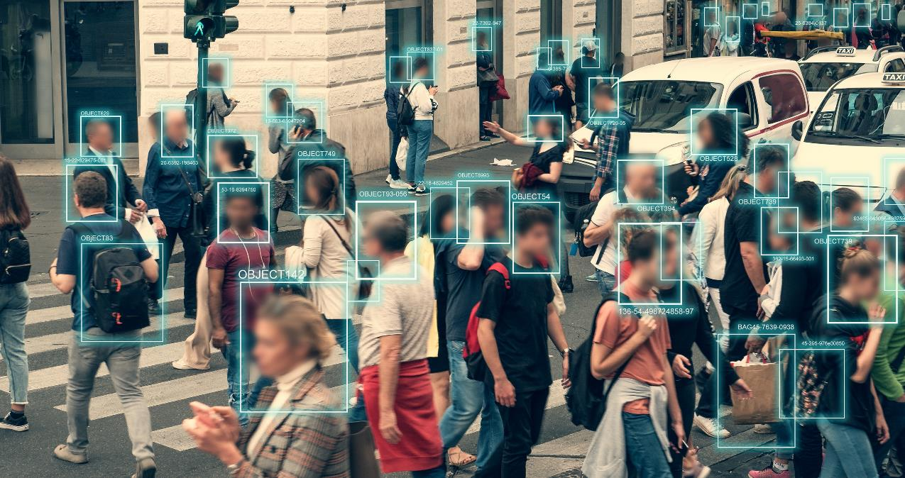
Digital privacy
Activity 1
Face recognition on the high street
Lesson 2: Digital technology has changed our world
Notes:
Image © Shutterstock Inc. DedMityay

Slide 4

Our digital footprint
Activity 1
Every time we access the internet, via any device, we leave a digital trace behind.
This trace can include personal information, search histories, posts, and comments on social media. Over time, this bank of evidence builds up to create our “digital footprint”.
A virtual network can help to hide our location and identity, but even with these we can still leave a digital trace, for example, with posts and comments on social media.
Employers often carry out “employee screening” where they research digital history of prospective employees.
Lesson 2: Digital technology has changed our world
Notes:
Image © Shutterstock Inc. Miha Creative

Slide 5

Our digital footprint: examples
Activity 1
Emails sent and received, both personal and work
Personal details and biometrics stored on our devices
Website histories and internet cookies accessible by other websites
Our digital
footprint
Viewing activity on streaming services, online purchasing habits
Posts and comments on social media, streaming and gaming services
IP network address of our devices, which allows for our physical location to be known
Lesson 2: Digital technology has changed our world
Notes:
Image © Shutterstock Inc. Miha Creative

Slide 6
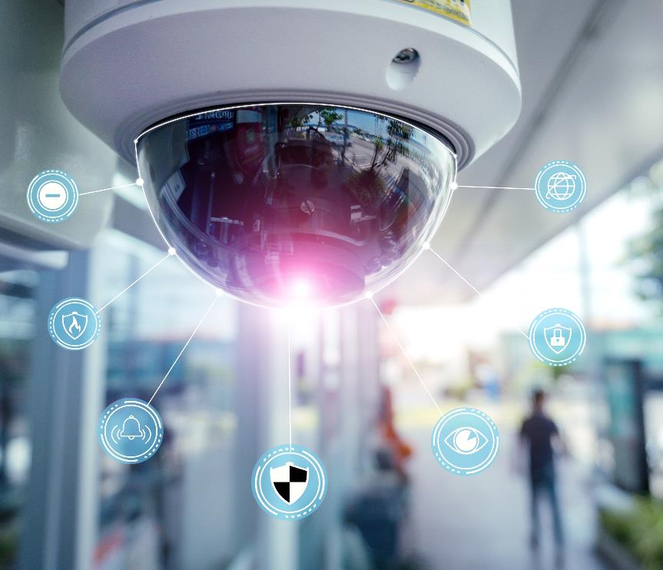
Increasing surveillance
Activity 1
Our increased use of digital services at home and at work has also increased the ways in which we can be monitored.
Digital surveillance can track both our digital and physical activity, and analyse our movements.
Lesson 2: Digital technology has changed our world
Notes:
Image © Shutterstock Inc. Sunshine Studio

Slide 7

Methods of surveillance: examples
Activity 1
CCTV (Closed Circuit Television) can be linked to facial recognition
Below The Line (BTL) marketing, where devices record search/shopping habits to market personalised content.
Sharing of location data with apps and social media services
Digital surveillance
Sharing of digital images that include GPS satellite data and physical landmarks
Sharing of biometric data
(face scans, fingerprints, eye scans, voice patterns) with
our devices and the organisations that use them
Analysis of non-secure messaging and calls that look for keywords and phrases of concern
Lesson 2: Digital technology has changed our world
Notes:
Image © Shutterstock Inc. Miha Creative

Slide 8
Real-life examples
Activity 1
For each question below, find a real-life example.
  What might a digital footprint include?
  Why is this information valuable to others?
  Other than CCTV, what examples of surveillance are used now?
Resources needed:
L2 Activity 1: Research and discuss worksheet
Lesson 2: Digital technology has changed our world

Slide 9
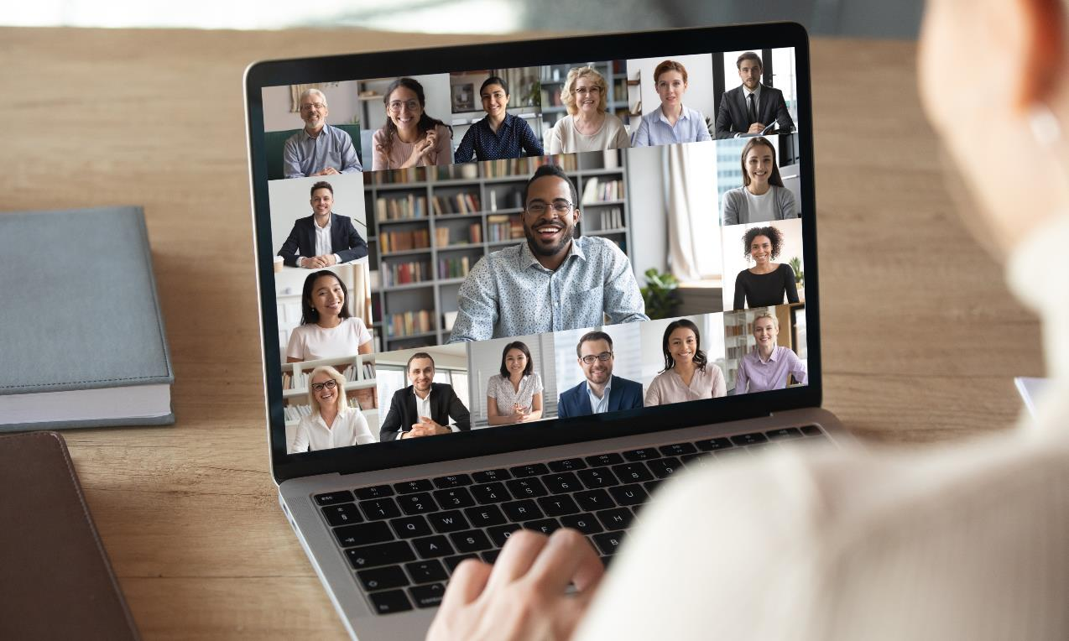
Our digital behaviour
Activity 2
Lesson 2: Digital technology has changed our world
Notes:
Image © Shutterstock Inc. fizkes

Slide 10

Digital social skills and remote working
Activity 2
Our increased digital socialising and remote working has meant dealing with new challenges and ensuring that we have good digital literacy.
Text and email requires careful use of language and etiquette, especially in the workplace.
Video conferencing with multiple people can be challenging, and positions of webcams need to
be considered.
Sharing and liking social media content allows us to make judgements and give opinions
on people we do
not know.
Collaborative working allows colleagues to work simultaneously from any location on the same online-based project.
Lesson 2: Digital technology has changed our world

Slide 11

Peer and professional networks
Activity 3
Organisations of all sizes need to manage the remote
engagement of staff to ensure standards are met.
Joining an organisation means that we become
part of new peer networks; we take part in
digital discussions and post messages to
multiple different groups.
There is an expectation to join professional
networks such as LinkedIn. We build online
professional profiles and connect to those
in similar roles and industries around the world.
When shortlisting and interviewing potential employees,
organisations will check both our peer and professional networks.
Lesson 2: Digital technology has changed our world

Slide 12
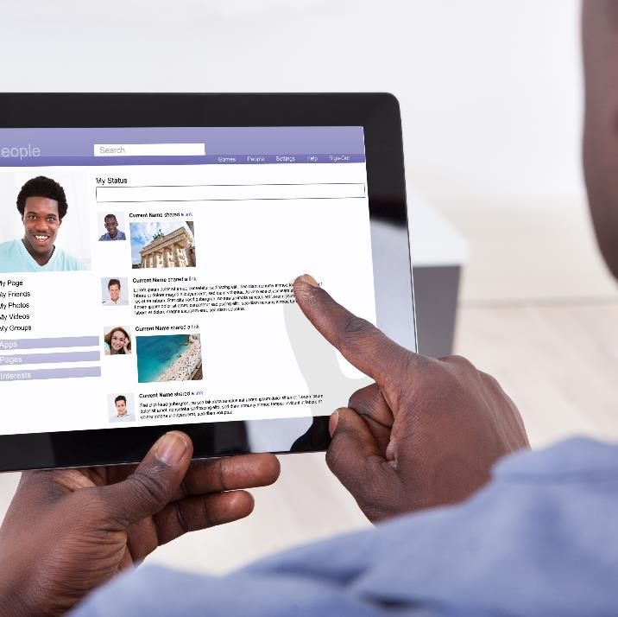
Our digital identity
Activity 2
We spend time creating a digital identity; the person that others see when they search for us online and the impression that we give of ourselves.
Many of us build two digital identities, one personal and one professional.
New and potential employers will search for information on both of these identities.
Lesson 2: Digital technology has changed our world
Notes:
Image © Shutterstock Inc. Andrey_Popov

Slide 13
Our digital identity
Activity 2
Personal profile
The identity we want to present to friends and family on social networks. It can include:
interests, opinions, and hobbies;
personal life events;
names of our friends.
Professional profile
This is often on services such as LinkedIn and is aimed at employers and colleagues. It can include:
qualifications/achievements and job histories;
skills and attributes;
contacts and organisations we are connected to;
professional projects and collaborations.
Digital branding
The image we want to present online. This can include:
Our physical appearance on video calls, including the background;
Our social media profile images and descriptions;
The styling, colour choices and imagery used in our communications.
Lesson 2: Digital technology has changed our world

Slide 14
Digital profiles
Activity 2
Carry out a class survey asking these questions.
Tally the responses and discuss the results.
What are the social, gaming, and professional networks that you are using?
What are the benefits and drawbacks of
the networks that
you use?
Lesson 2: Digital technology has changed our world

Slide 15
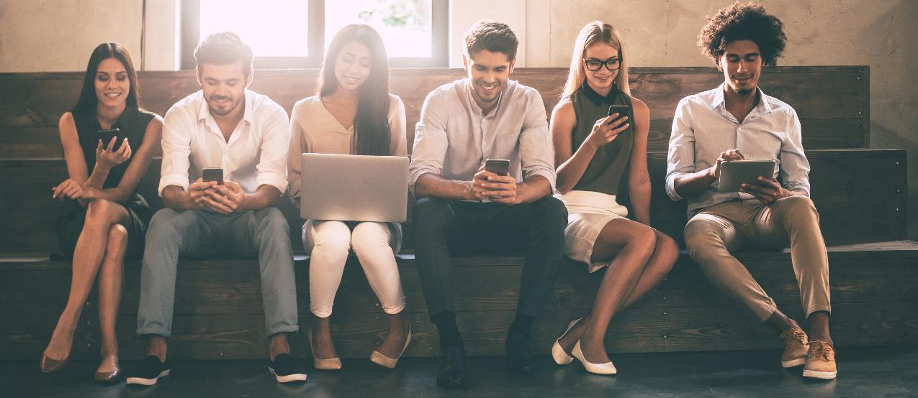
Digital access
Activity 3
Lesson 2: Digital technology has changed our world
Notes:
Image © Shutterstock Inc. G-Stock Studio

Slide 16
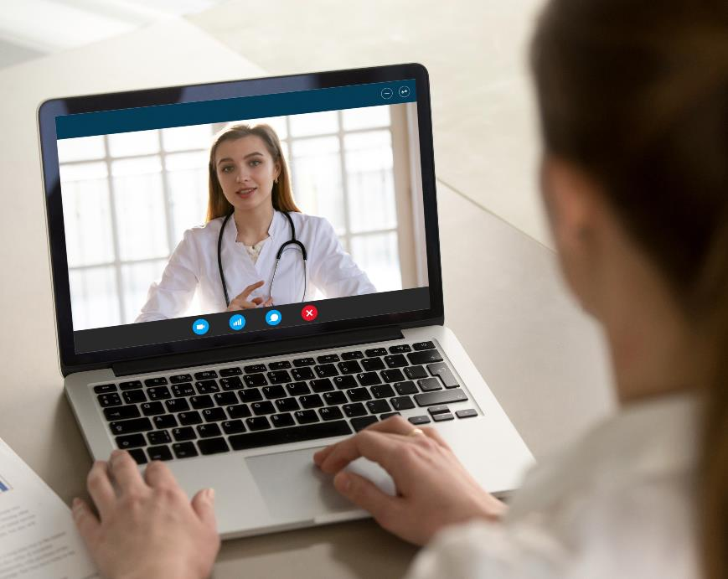
Improved access
Activity 3
Digital technology has improved access for some people and services, for example:
educational content;
job adverts;
NHS medical services and advice from home.
However, these services require a minimum level of digital literacy to access.
Lesson 2: Digital technology has changed our world
Notes:
Image © Shutterstock Inc. fizkes

Slide 17
Case study: Digital access to the NHS
Activity 3
The NHS has introduced digital services to help improve access to medical services and advice from home 24/7, including:
Chatbot-based advice related to minor medical queries, and video call appointments with doctors and nurses.
Online appointment booking through websites and apps to avoid waiting in phone queues.
Official webpages providing NHS approved information about medical conditions and symptoms.
Lesson 2: Digital technology has changed our world

Slide 18
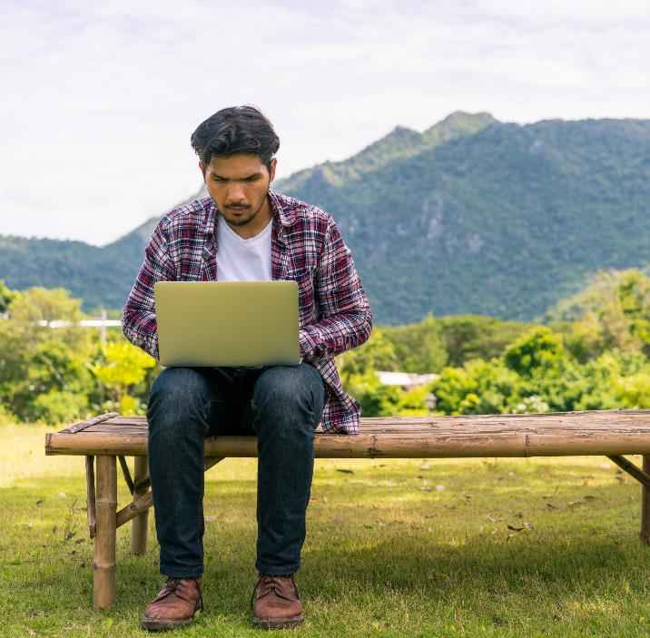
Unequal digital access
Activity 3
The increased use of digital technology means that organisations and individuals rely on access to modern devices and a stable communication network wherever we are.
In many places, it is possible to purchase devices from a commercial market designed for a range of budgets, and access high-speed internet access via telephone and 5G.
However, there are still barriers to technology for many people in many places.
Even within the same area, access can be inconsistent. Infrastructure is upgraded in stages, so some places can have much faster access than others. Poorer areas can be left with slower connectivity.
Lesson 2: Digital technology has changed our world
Notes:
Image © Shutterstock Inc. Blue Planet Studio

Slide 19

Unequal digital access
Activity 3
Many issues can contribute to a digital divide:
In some remote areas and developing countries, internet speeds
can be inconsistent and unreliable.
Access is linked to a person's financial situation; equipment and
internet connections are not affordable for everyone.
There are still many people who don’t want access to devices, and
many digital skills taught in schools today didn’t exist for older
generations, creating a skills gap.
A person with a physical or mental disability may not be able to access technology in the same way as a non-disabled person.
Limited access to online education, news, shopping, and employment opportunities can further perpetuate the effects of the digital divide.
Lesson 2: Digital technology has changed our world

Slide 20
Isolation due to the digital divide
Activity 3
The lack of digital communication access can lead to potential isolation from society. Some causes of this can be:
Not transferring to digital services at the same time as colleagues and friends.
Being physically unable to access services due to location, such as being in a rural area with limited broadband and mobile services.
Not having access to communication technology designed for someone with a disability.
Lacking the digital skills to access jobs and services that are only available online.
Lesson 2: Digital technology has changed our world

Slide 21
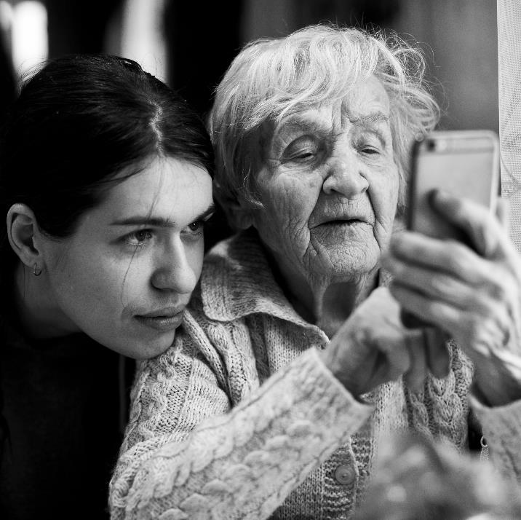
Resistance to technological change
Activity 3
In some cases, the digital divide can be exacerbated by those resistant to technological change. This could be for different reasons, such as:
being comfortable with the existing systems;
being “scared” of IT;
the belief that they don’t have, or cannot learn, the skills required to engage with the digital world.
Lesson 2: Digital technology has changed our world
Notes:
Image © Shutterstock Inc. De Visu

Slide 22
The digital divide
Activity 3
Consider and discuss these groups of people and why they may not be able to take full advantage of digital technology.
  Those resisting access because they don’t
  want to use it.
  Those that need to work from home.
  Those lacking digital skills and knowledge.
  Those in a remote rural location.
  Those that cannot afford access (digital poverty).
  Those with a disability.
Resources needed:
L2 Activity 3: Research and discuss worksheet
Lesson 2: Digital technology has changed our world

Slide 23
Retrieval questions
Plenary
State three pieces of information that could be associated with a digital footprint.
State three types of digital surveillance.
Give one example of a digital social skill that you would need to use in a job in the digital industry.
Give one piece of information that you may add to a professional digital profile when applying for a job in the digital industry.
Identify an example of where a user may be impacted by the digital divide without choice.
Lesson 2: Digital technology has changed our world

Slide 24
Retrieval questions
Plenary
State three pieces of information that could be associated with a digital footprint.
Answers
Any three from:
Personal details
Biometric data
Internet history
Internet cookies
Social media posts, likes
and comments
Emails
Device IP Address
Lesson 2: Digital technology has changed our world

Slide 25
Retrieval questions
Plenary
State three types of digital surveillance.
Answers
Any three from:
CCTV
Biometric scans
Message content
Location data within apps and photos
Accept any other suitable response.
Lesson 2: Digital technology has changed our world

Slide 26
Retrieval questions
Plenary
Give one example of a digital social skill that you would need to use in a job in the digital industry.
Answers
Any one from:
Email or messaging etiquette
Video calling
Accept any other suitable response.
Lesson 2: Digital technology has changed our world

Slide 27
Retrieval questions
Plenary
Give one piece of information that you may add to a professional digital profile when applying for a job in the digital industry.
Answers
Any one from:
Qualifications
Employment history
Professional connections
Accept any other suitable response.
Lesson 2: Digital technology has changed our world

Slide 28
Retrieval questions
Plenary
Identify an example of where a user may be impacted by the digital divide without choice.
Answers
Any one from:
Unavailability of internet access
Unaffordability of devices or access
Lack of digital education
Health condition
Accept any other suitable response.
Lesson 2: Digital technology has changed our world

Slide 29
In this lesson, we have:
Plenary
considered what makes up our digital footprint
explained how digital surveillance can
take place
compared different digital identities and
how we use them
described what is meant by the digital divide.
General competencies:
English:
GEC1 Convey technical information to different audiences
GEC2 Present information and ideas
GEC3 Create texts for different purposes and audiences
GEC4 Summarise information/ideas
GEC5 Synthesise information
GEC6 Take part in/lead discussions
Digital:
GDC1 Use digital technology and media effectively
GDC2 Design, create and edit documents and digital media
GDC3 Communicate and collaborate
Lesson 2: Digital technology has changed our world

Slide 30
Next lesson, we will cover:
Plenary
the possible psychological impacts that spending time online can have
the physical impacts that working with digital technology can have
prevention strategies to mitigate the effects of the negative health impacts digital technology can cause
workstation assessments.
Lesson 2: Digital technology has changed our world

