Slide 1
Digital
Route: Digital
Topic: Culture and the impact of technology
Lesson 3: The impact of digital technology on our health
Notes:
Image © Shutterstock Inc. DedMityay

Slide 2
In this lesson, we will:
Introduction
discuss the possible psychological impacts that spending time online can have
consider the physical impacts that working with digital technology can have
compare prevention strategies to mitigate the effects of negative health impacts caused by digital technology
explain how to and carry out a workstation assessment.
General competencies:
English:
GEC1 Convey technical information to different audiences
GEC2 Present information and ideas
GEC3 Create texts for different purposes and audiences
GEC4 Summarise information/ideas
GEC5 Synthesise information
GEC6 Take part in/lead discussions
Digital:
GDC1 Use digital technology and media effectively
GDC2 Design, create and edit documents and digital media
GDC3 Communicate and collaborate
Lesson 3: The impact of digital technology on our health

Slide 3

Negative impacts of technology on our health
Introduction
What are some of the negative effects that digital technology can have on our lives?
Lesson 3: The impact of digital technology on our health
Notes:
Image © Shutterstock Inc. Fizkes

Slide 4

Psychological impacts
Activity 1
Being online can come with some negative impacts. Here are some examples:
Cyberbullying includes sending of abusive messages in any electronic form on any platform.
Stress can build in response to online abuse, but also to work pressure. Remote working and 24-hour access can blur the boundaries of our work life.
Addiction can form towards certain platforms or websites, such as social networks, gambling, or gaming sites, especially with the ‘always on’ nature of these platforms.
Lesson 3: The impact of digital technology on our health

Slide 5
Psychological impacts
Activity 1
Being connected for long periods of time can increase our exposure to negative impacts such as cyberbullying, stress, and addiction.
These have a serious impact on mental health and our ability to function from day-to-day.
It is important for organisations to be aware of these risks and support their employees.
Support and help is available:
The national bullying helpline:
www.nationalbullying helpline.co.uk/
Samaritans workplace support:
www.samaritans.org/ how-we-can-help/workplace/
Lesson 3: The impact of digital technology on our health
Notes:
Links on this slide:
National bullying helpline: https://www.nationalbullyinghelpline.co.uk/
Samaritans workplace support: https://www.samaritans.org/how-we-can-help/workplace/ (with permission)

Slide 6
Physical impacts
Activity 1
Using digital devices can impact our physical health. Here are some examples:
Poor posture in the way we sit, work and hold devices for long periods of time can lead to back, shoulder, neck, and leg strain.
Eye strain is caused by staring at a screen for long periods of time, leading to dry eyes and headaches.
Repetitive Strain Injury (RSI) is caused by repeated actions when using a keyboard, mouse, or controller.
Lesson 3: The impact of digital technology on our health

Slide 7

Physical impacts
Activity 1
Working with digital devices too much can impact our physical health, and can cause issues such as poor posture, eye strain and RSI.
A reduction in our physical activity, and staying in the same position for long periods of time, can lead to a range of cardiovascular and muscle conditions.
Using devices late at night can disturb our sleep patterns and prevent our bodies from resting fully.
Lesson 3: The impact of digital technology on our health
Notes:
Image © Shutterstock Inc. Okaycm’Stocker

Slide 8

Interview: Employees’ wellbeing
Activity 1
Film 1 How can businesses support the health and wellbeing of their employees, interviews with Cisco Corporate Social Responsibility (CSR) Programme Lead and Mesma Chief Executive Officer
Lesson 3: The impact of digital technology on our health
Notes:
Industry video can be watched here: Industry film: Introduction to how digital organisations support employee health & well-being
https://vimeo.com/875898616

Slide 9
Preventing negative impacts of digital technology
Activity 1
The most effective strategy to deal with the negative psychological and physical impacts of digital technology is mitigation and trying to prevent them from happening.
Think about these techniques and how they could be implemented:
Self-regulation: setting your own rules
Self-exclusion: removing the root cause
Reporting misuse: do not suffer in silence
Workstation assessments: is your workspace suitable?
Resources needed:
L3 Activity 1: Research and present worksheet
Lesson 3: The impact of digital technology on our health

Slide 10

Self-regulation
Activity 1
Self-regulation means setting rules for yourself to follow when using digital technology. These could include:
regular breaks from your desk and screen;
avoiding late night screen time and ensuring a good night’s sleep;
regular exercise and good diet;
sticking to agreed working hours;
disabling work notifications outside of working hours.
Lesson 3: The impact of digital technology on our health
Notes:
Image © Shutterstock Inc. Marjan Apostolovic

Slide 11

External regulation
Activity 3
Many platforms now offer support services to assist with regulating use of digital technology. These are built into the operating system and can include:
notifications on the time spent on a device;
the ability to set time limits on popular apps;
locks on certain apps at certain times;
bedtime and screen-break reminders;
do not disturb modes.
Lesson 3: The impact of digital technology on our health

Slide 12

Self-exclusion
Activity 1
Self-exclusion means staying away from apps and websites that may cause you problems. This can include:
blocking certain websites or platforms, or deleting apps;
carefully choosing the social networks you join, and accounts you follow;
adjusting privacy settings to share your profile only with those you’re comfortable with.
However, some self-exclusion tools can be software-based and reliant on options provided by the platforms.
Lesson 3: The impact of digital technology on our health
Notes:
Image © Shutterstock Inc. maicasaa

Slide 13
Reporting misuse
Activity 1
When you do come across misuse of platforms or apps, it is important to report this to the appropriate people. This could mean:
reporting cyberbullying to the platform owner, and the police if necessary.
reporting work-related issues or abuse through work platforms to the HR department of the organisation.
talking to family, friends, or a known support agency for advice on how to proceed.
Services supporting those affected by misuse:
National Crime Agency – Cyber crime
National Cyber Security Centre
Lesson 3: The impact of digital technology on our health
Notes:
Links on this slide:
National Crime Agency: https://www.nationalcrimeagency.gov.uk/what-we-do/crime-threats/cyber-crime
National Cyber Security Centre: https://www.ncsc.gov.uk/section/about-ncsc/what-we-do

Slide 14
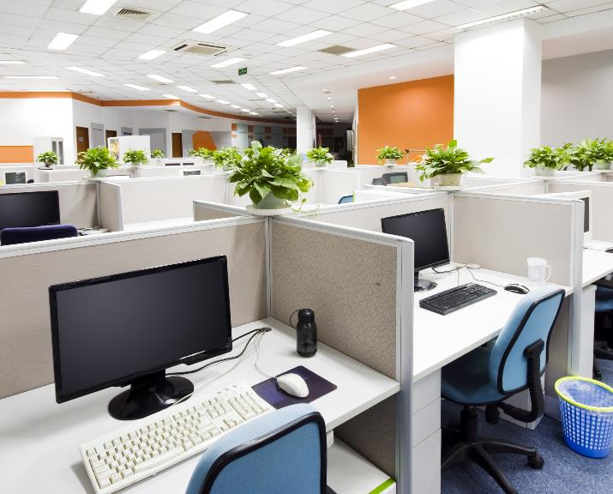
Workstation assessments
Activity 2
It is important to carry out a thorough workstation assessment to ensure that your physical workspace is suitable. This can include:
following the official workstation assessment on seating, desk, and device positioning;
using foot rests, arm rests and back supports if required;
regular eye-tests to check if glasses are needed;
using glare filters and ensuring that your workspace is correctly lit.
Question: What does this mean for any new digital business starting out?
Examples of 3D workstations
Lesson 3: The impact of digital technology on our health
Notes:
Image © Shutterstock Inc. 06photo
Link to examples of 3D workstations: https://sketchfab.com/search?q=office+workstation&type=models

Slide 15
Workstation assessments
Activity 2
Assess the example workstations.
Use the official HSE Display screen equipment workstation checklist: www.hse.gov.uk/pubns/ck1.pdf
HSE advice film:
Workstation set up at home and in the office - good posture
https://youtu.be/liaBs1-Zz3I
Lesson 3: The impact of digital technology on our health
Notes:
HSE advice film about workstation set up at home and in the office – good posture available at: https://youtu.be/liaBs1-Zz3I

Slide 16
In this lesson, we have:
Plenary
discussed the possible psychological impacts that spending time online can have
considered the physical impacts that working with digital technology can have
compared prevention strategies to mitigate the effects of the negative health impacts caused by digital technology
explained how to and carried out a workstation assessment.
General competencies:
English:
GEC1 Convey technical information to different audiences
GEC2 Present information and ideas
GEC3 Create texts for different purposes and audiences
GEC4 Summarise information/ideas
GEC5 Synthesise information
GEC6 Take part in/lead discussions
Digital:
GDC1 Use digital technology and media effectively
GDC2 Design, create and edit documents and digital media
GDC3 Communicate and collaborate
Lesson 3: The impact of digital technology on our health

