Slide 1

Lesson 1: Computer systems
Digital environments
Notes:
Version 1, June 2024

Slide 2


Starter activity
What is a digital environment? How are they used by organisations?
Notes:
Digital environments introduction film: https://vimeo.com/883954196

Slide 3
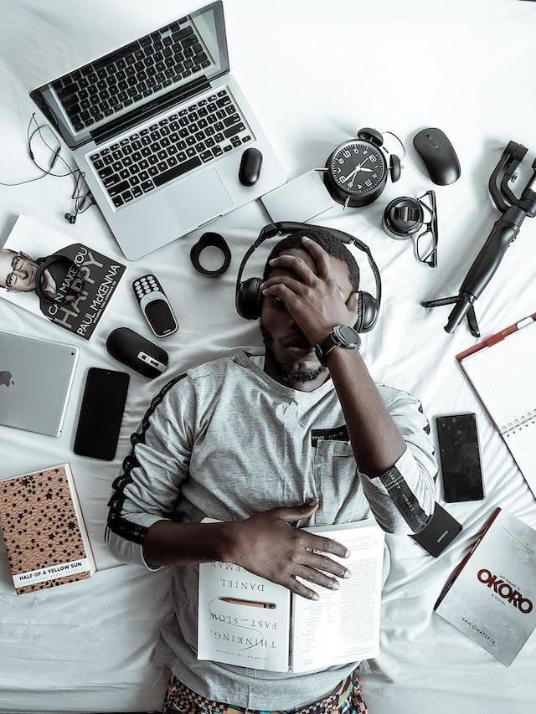
What is a computer?
Starter activity
What digital devices have you used in the past three days?
What does a device need to be considered a computer? What are the device’s characteristics?
Discuss with the person next to you.
Notes:
Photo by Ola Dapo from Pexels: https://www.pexels.com/photo/man-wearing-black-headset-3345882/

Slide 4
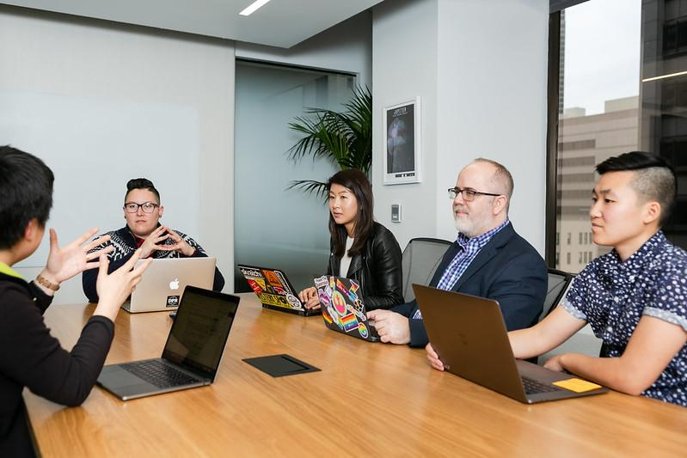
What is a computer?
Starter activity
Which of these devices are computers? Do they have the characteristics you discussed?
Mobile phone
Video game console
A tablet
Calculator
Smartwatch
Laser pointer
Coffee machine
Notes:
Photo by CC BY 3.0 US Mapbox Uncharted ERG

Slide 5
Lesson 1: Computer systems
Objectives
In this lesson, you will:
Recognise key features of a computer system
Compare a range of digital devices, considering purpose and features
Identify the role of key hardware components and peripherals
Apply your knowledge of computer systems and hardware to real-world scenarios
General competencies:
E1 - convey technical information
E2 - present information and ideas
E3 - create texts
E4 - summarise information
E6 - take part in discussions
D1 - use digital technology
D3 - communicate and collaborate

Slide 6
What is a computer?
Activity 1
A programmable device that takes data as inputs, processes it, and then outputs the data so it can be used.
During processing, data may be stored for later retrieval.
This is often described as the Input, Process, Output and Storage model.
Input
Process
Output
Storage

Slide 7
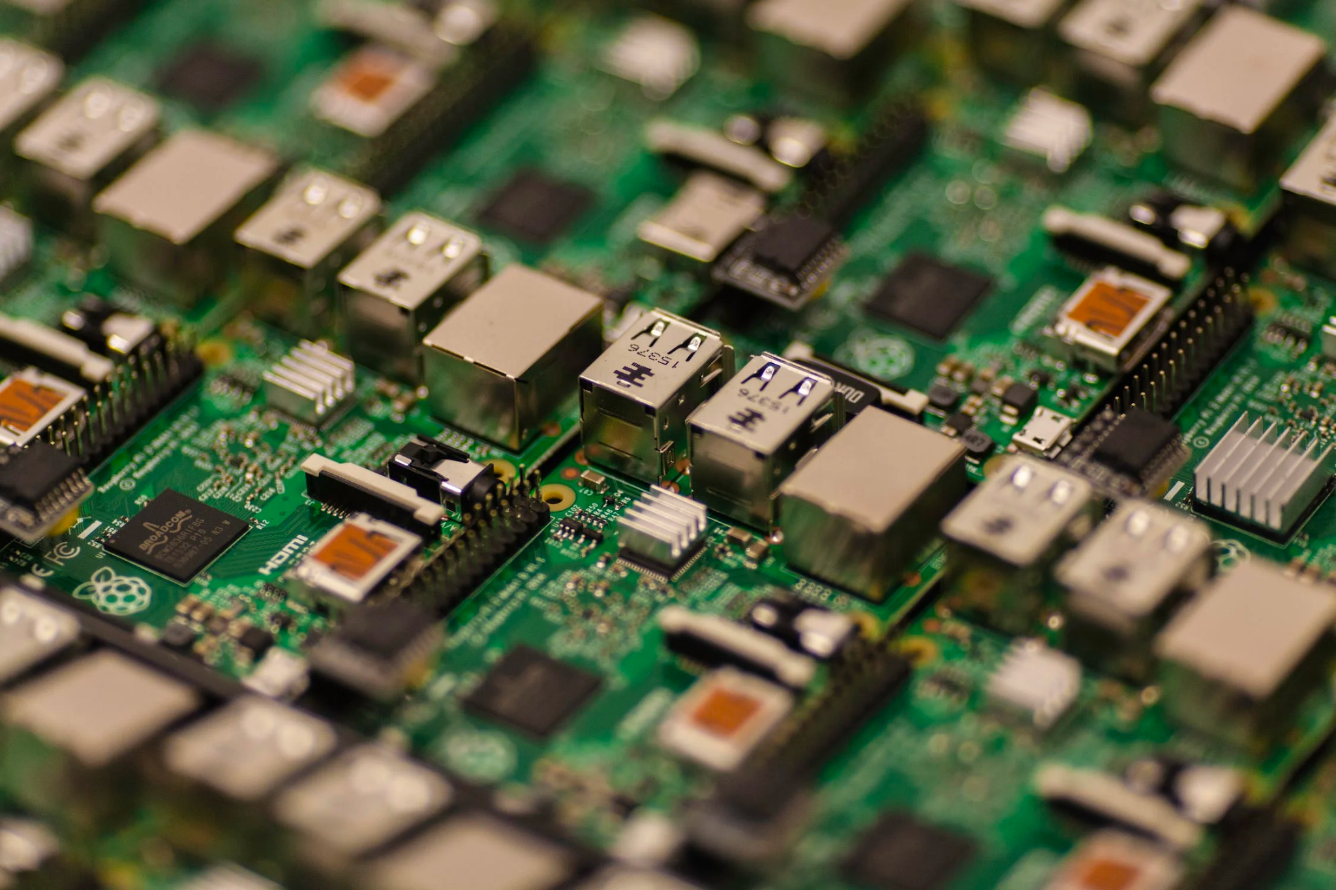
Categories of computer
Activity 1
Computers can be put into different categories depending on their use and features. Common categories include:
Personal computers
Mobile devices
Servers
Smart/internet-enabled devices
What would an organisation have to consider when buying new computers?
As with many computers, the COVID-19 pandemic caused supply chain issues for Raspberry Pi manufacturing, and some end users simply could not get hold of one. In 2023, manufacturing numbers were increased to 1 million units a month to meet demand!
Notes:
Photo by Craig Dennis from Pexels: https://www.pexels.com/photo/green-and-grey-circuit-board-57007/
Article available here: https://arstechnica.com/gadgets/2023/08/some-shops-will-let-you-buy-more-than-one-raspberry-pi-at-a-time-again/

Slide 8

Considerations when buying a personal computer
Activity 1
A personal computer (PC) is a computer that is designed to be used in a home or office environment
PCs are typically desktop computers or laptops
What should be considered when buying a new PC?
Physical size
Storage type
Storage size
Processor speed
Random Access Memory (RAM) capacity
Network connectivity
Cost
Purpose – when assessing the suitability of digital devices, it is important to consider the intended use of the device.
Notes:
Photo by Christina Morillo from Pexels: https://www.pexels.com/photo/woman-sittin-on-gray-couch-while-holding-her-apple-macbook-air-1181498/

Slide 9

Considerations when buying a mobile device
Activity 1
A mobile device is a portable digital device that is designed to be carried around and used on the go
Common types of mobile devices include smartphones, tablets, and handheld game consoles
What should be considered when buying a mobile device?
Camera specification
Battery duration
User interface and OS version
Size and resolution of display
Storage
Processing power
Audio and speaker quality
Cost
Purpose – when assessing the suitability of digital devices, it is important to consider the intended use of the device.
Notes:
Photo by Amine from Pexels: https://www.pexels.com/photo/sitting-woman-using-a-smart-phone-16025796/

Slide 10
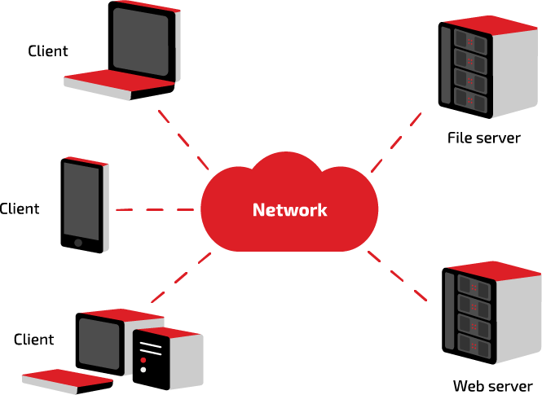
Servers
Activity 1
A server is a computer system on a network that provides services to any authorised client
A client is a device or service that makes a request
There are many types of servers. For example, a file server stores and provides access to files and a web server stores and provides webpages
You will learn more about the specific role of servers later on in this unit

Slide 11
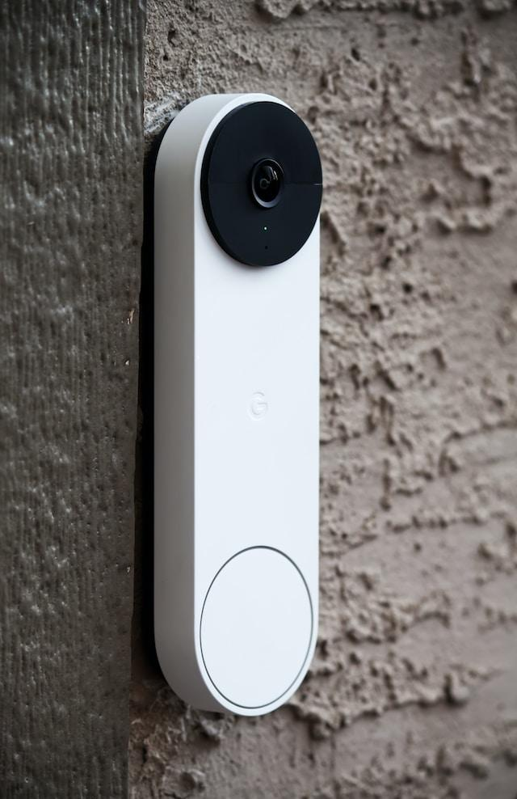
Internet of Things (IoT)
Activity 1
IoT is a way of describing devices that are connected to the internet and to each other, so they can share information and work together.
These devices are also known as smart/internet-enabled devices.
Notes:
Image source: Photo by James Yarema on Unsplash https://unsplash.com/photos/zdjZ4kCaJaY

Slide 12
Smart/internet-enabled devices
Activity 1
Smart home devices: Smart thermostats, smart lighting systems, and smart locks
Smart speakers: Amazon Echo and Google Home
Wearable technology: Smartwatches and fitness trackers
Smart appliances: Smart refrigerators, ovens, and washing machines
Smart security systems: Cameras and sensors that can be monitored remotely
Smart healthcare devices: Connected blood pressure monitors and glucose meters

Slide 13
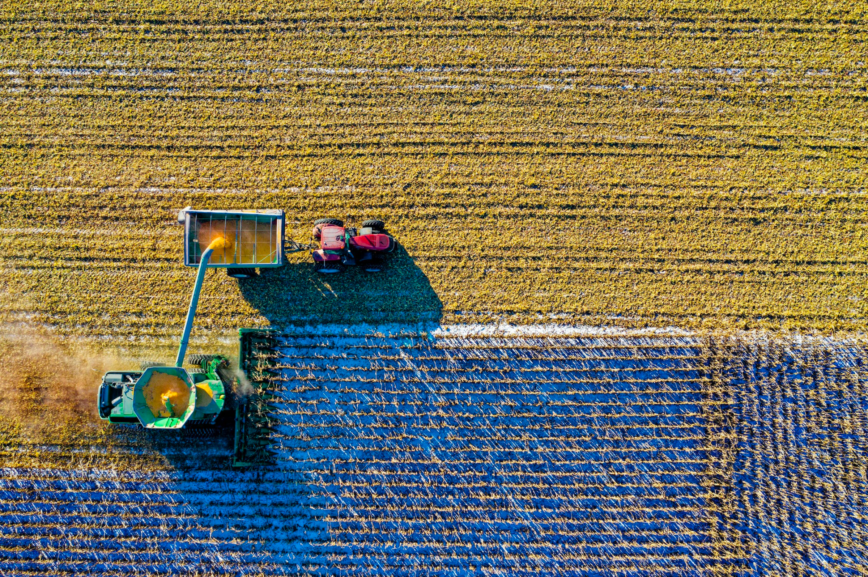
Smart/internet-enabled devices
Activity 1
Smart cars and transportation systems: Features like GPS tracking and remote start
Industrial IoT devices: Sensors and robots used in manufacturing and logistics
Smart farming equipment: Connected sensors and drones used for precision agriculture
Smart city infrastructure: Connected traffic lights and waste management systems
Notes:
Image source: Photo by Tom Fisk from Pexels https://www.pexels.com/photo/top-view-of-green-field-1595104/

Slide 14
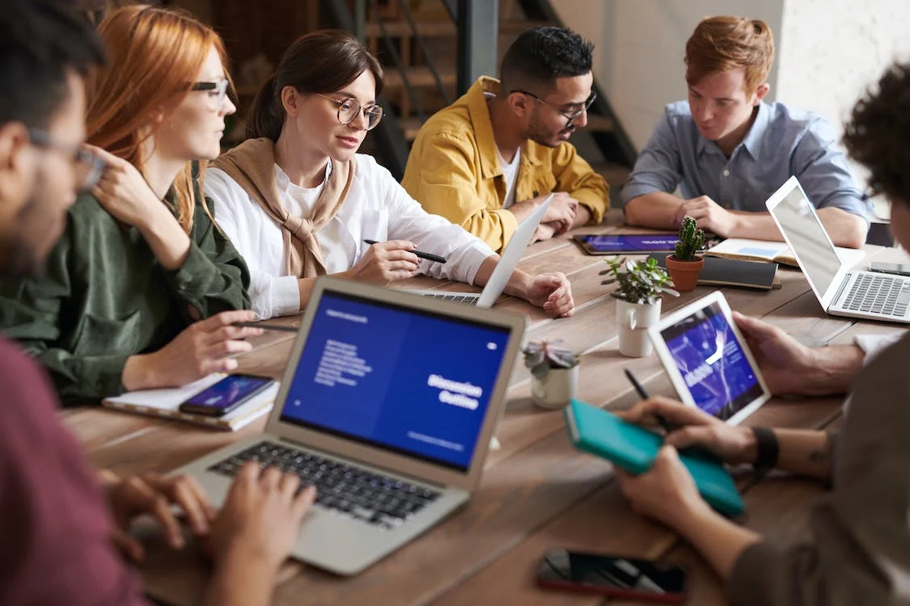
Smart/internet-enabled devices
Activity 1
Choose one of the smart devices from the previous slides and research how this smart device is used in industry
You should prepare a debate on whether or not the use of smart/internet-enabled devices in your chosen industry is a positive development.
Smart home devices
Smart speakers
Wearable technology
Smart appliances
Smart security systems
Smart healthcare devices
Smart cars and transportation devices
Industrial IoT devices
Smart farming equipment
Smart city infrastructure
Notes:
Photo by fauxels from Pexels: https://www.pexels.com/photo/photo-of-people-leaning-on-wooden-table-3184325/

Slide 15

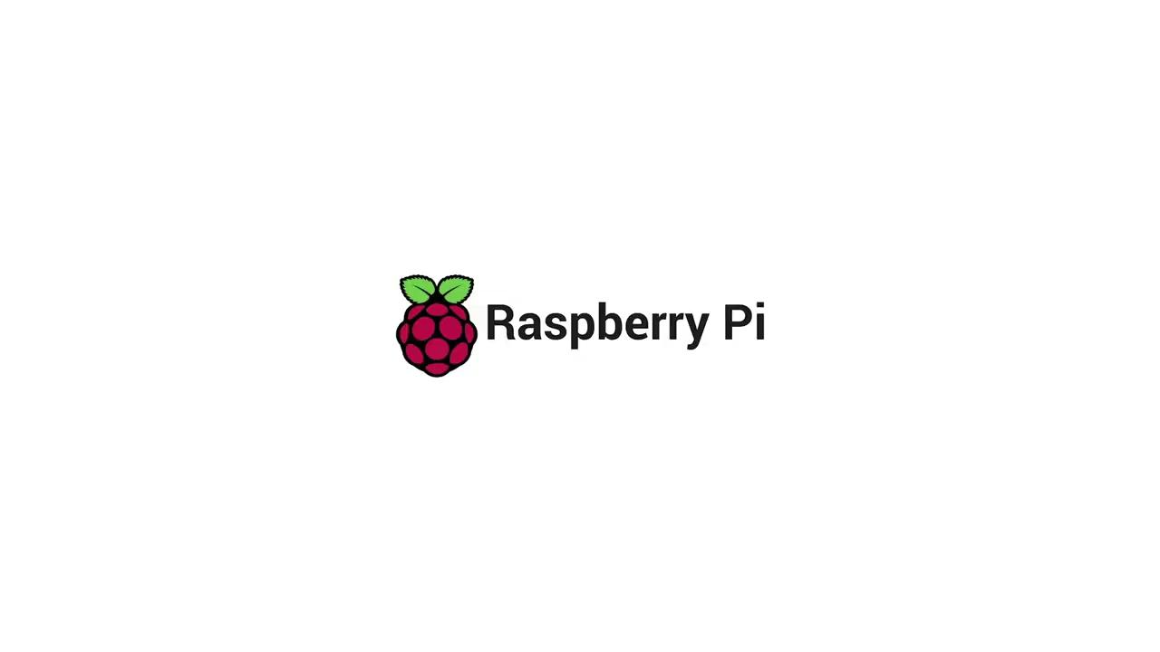
Activity 2
What is the difference between a general purpose and embedded system?
Notes:
A2 Embedded and general purpose film: https://vimeo.com/883954579

Slide 16
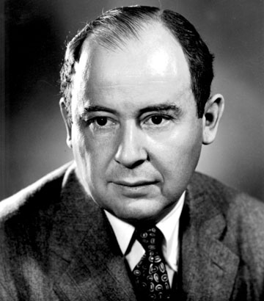
Von Neumann architecture
Activity 2
Computer architecture is a term used to describe the design of a computer system.
Most personal computer systems use the von Neumann architecture designed by John von Neumann.
In the 1940s, John von Neumann and his team developed the concept of the stored program computer where program instructions and data are stored together in a memory unit that can communicate directly with the processor, called main memory.
The von Neumann architecture consists of:
A processor
Main memory
Connections for input and output devices
Secondary storage for saving/backing up data
Notes:
Image source: https://upload.wikimedia.org/wikipedia/commons/a/a9/John_von_Neumann.jpg

Slide 17
Activity 2
Input devices
Processor
Main
memory
Input / Output controllers
Secondary storage
Output devices

Slide 18
Activity 2
Input devices
Processor
Main
memory
Input / Output controllers
Secondary storage
Output devices

Slide 19
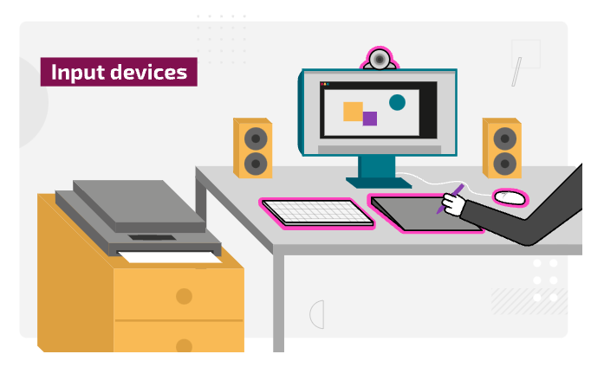
Input devices
Activity 2
Input devices are peripherals used to provide data and control signals to a computer system.
Input data comes in many different forms, and there are a wide range of devices that can be used to capture this data.
For example, a keyboard, a mouse or a sensor.

Slide 20
Activity 2
Input devices
Processor
Main
memory
Input / Output controllers
Secondary storage
Output devices

Slide 21
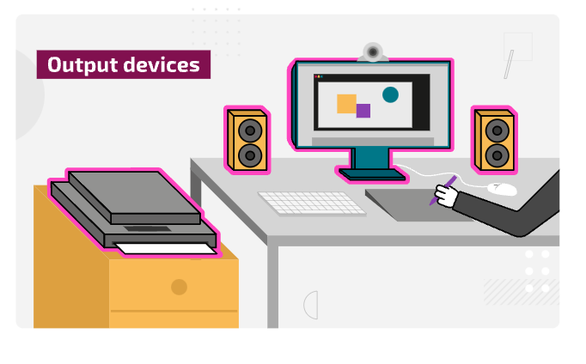
Output devices
Activity 2
Output devices are peripherals that reproduce or display data and information from a computer system.
Information is data that has been processed and formatted in a way that is meaningful for the end user.

Slide 22
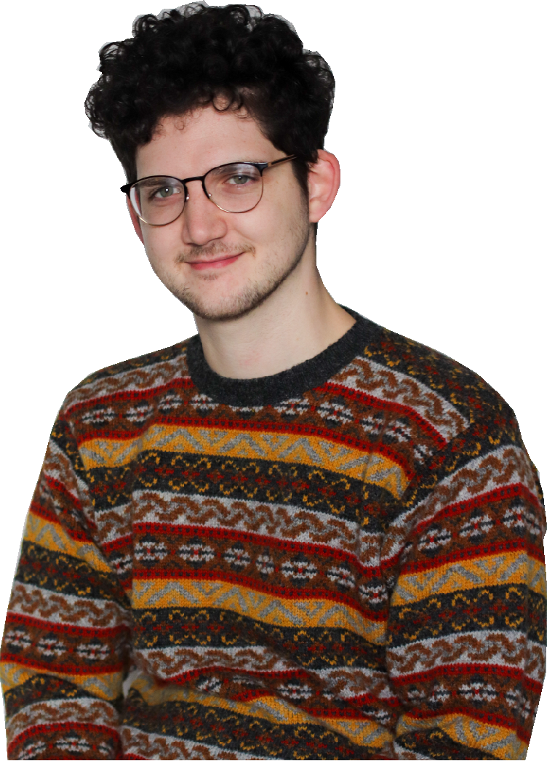
Industry spotlight
Activity 2
Matthew is a Software Engineer at the Raspberry Pi Foundation, a UK-based educational charity with the mission to enable young people to realise their full potential through the power of computing and digital technologies.
Matthew develops code in Python, JavaScript, and SQL that sits behind some online tools such as the Ada Computer Science website.
Matthew works remotely and collaboratively with a team of product managers, engineers, and product designers.
What peripheral devices would Matthew use?

Slide 23
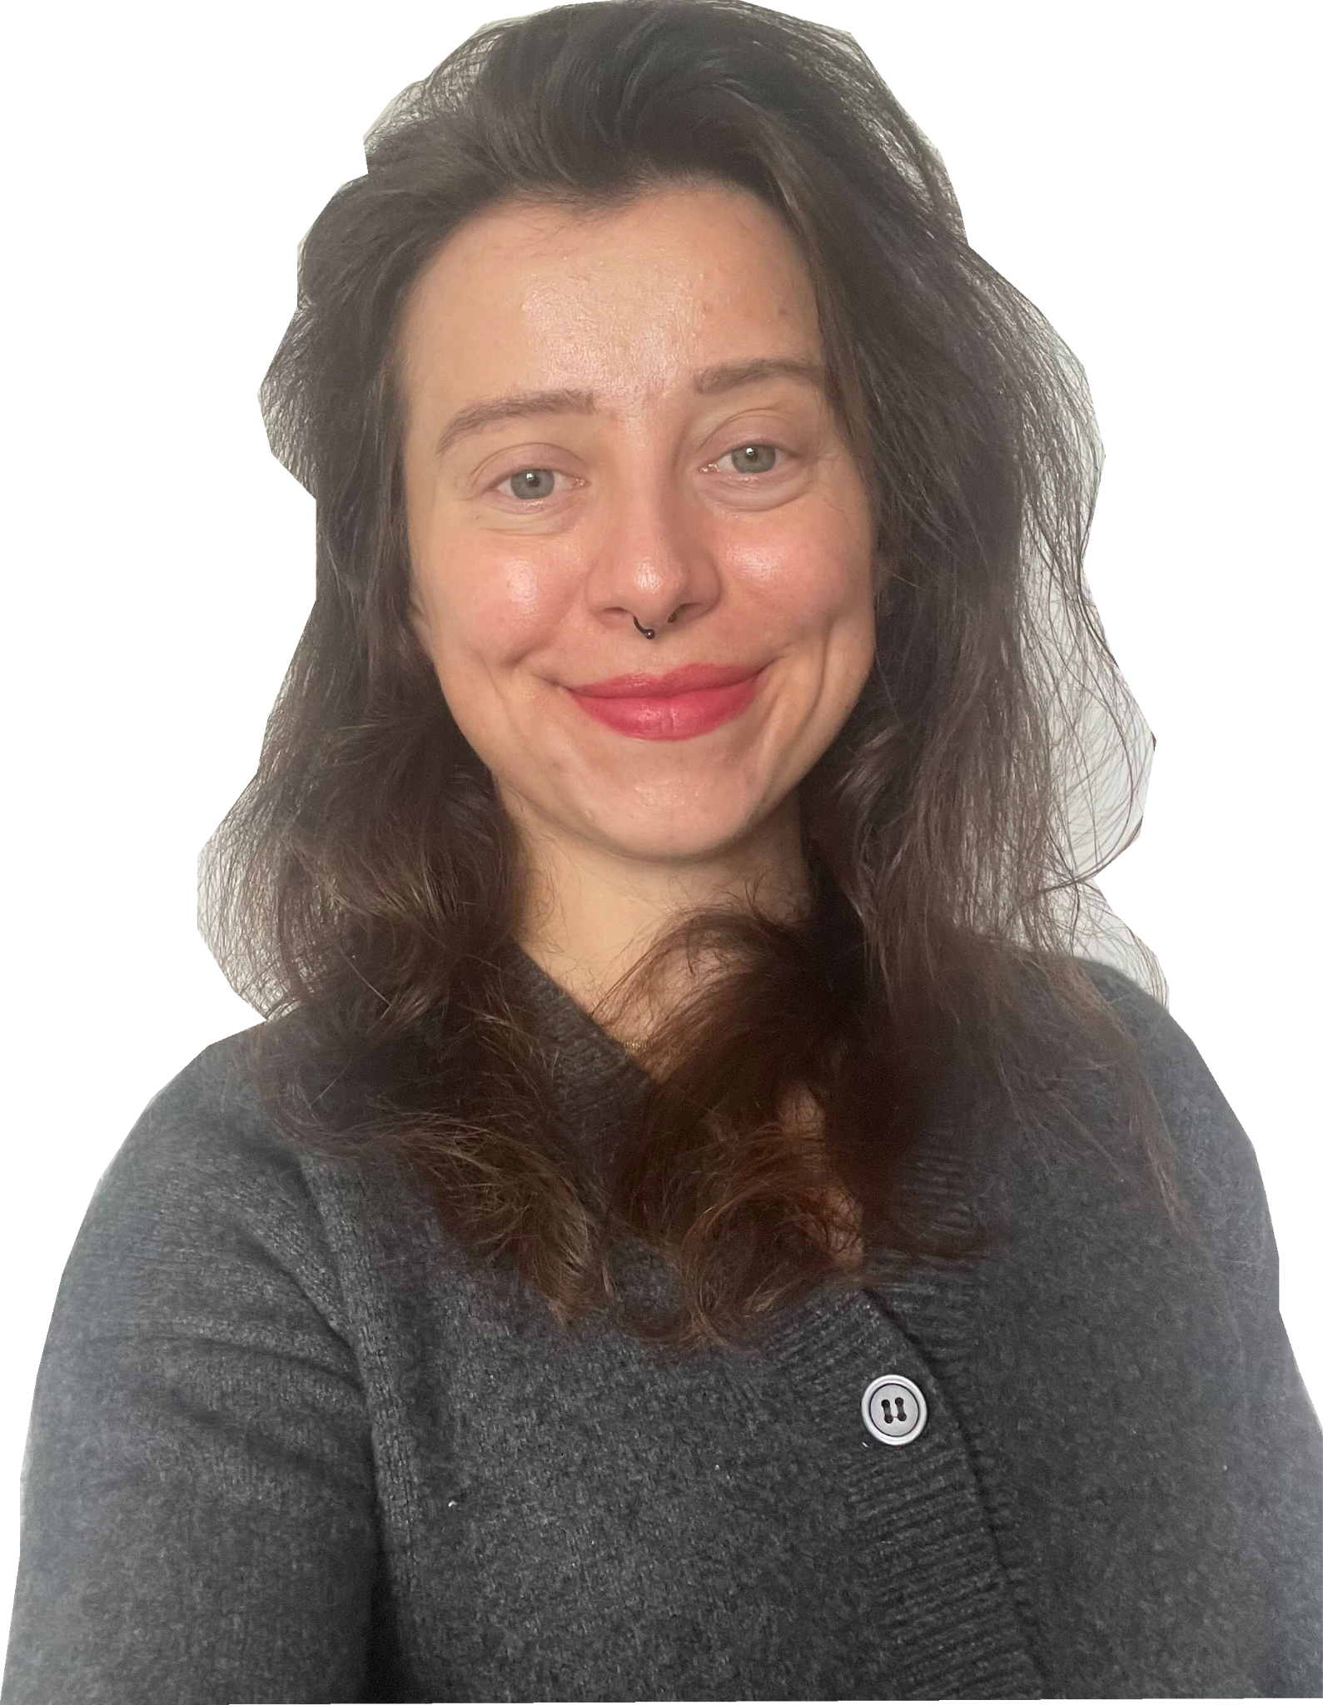
Industry spotlight
Activity 2
Magda is a software developer at the Raspberry Pi Foundation, a UK-based educational charity with the mission to enable young people to realise their full potential through the power of computing and digital technologies.
Magda develops code in JavaScript and Ruby on Rails. She helps develop the projects site and the code editor which is an online platform to write and compile code.
Magda works remotely from the UK, but from time to time also from EU countries as she travels frequently.
What peripheral devices would Magda use?

Slide 24
Input or output
Activity 2
Hardware peripherals
In pairs or small groups, create a list of computer peripherals. Then, decide whether they would be considered input or output devices and explain their purpose.
In pairs or small groups create a list of peripheral devices that a software engineer like Matthew may use. Open and complete the ‘A2 Activity sheet – Hardware peripherals’ to record your ideas.
Make sure you include a description about the common features these devices include. For example, a mouse has left and right buttons for different operations.
Device | Input or output? | Types | Purpose and features
Mouse | Input | USB Wireless Trackball | Allows the software developer to move the cursor around the screen and use the buttons to select. For example, they may use the mouse to open an application.

Slide 25
Activity 3
Input devices
Processor
Main
memory
Input / Output controllers
Secondary storage
Output devices

Slide 26
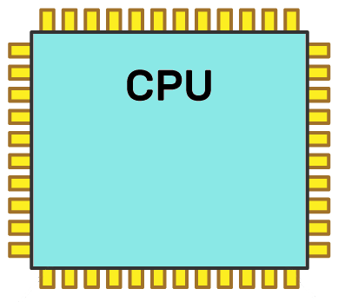
Processor
Activity 3
The processor is the part of a computer system that is responsible for executing program instructions.
The processor is made up of several important components, each of which has a specific role.
A central processing unit (CPU) can contain one or more processors. In this case they are called processing cores or just ‘cores’.
Bus
Clock
Bus
ALU
Control Unit
Bus
Registers
Bus
Notes:
ALU (Arithmetic and logic unit)

Slide 27
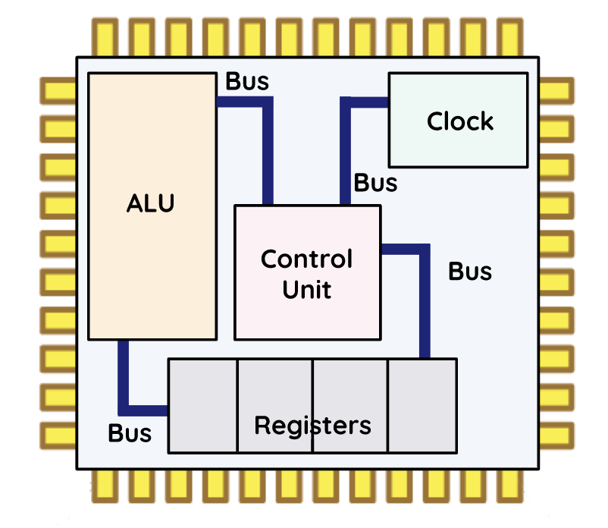
Inside the processor
Activity 3
Processor components
To help you understand how the processor works, you can use this activity sheet to capture your notes.
Open and complete the ‘A3 Activity sheet – Processor components’.
Conduct some research to find out about the components within the processor.
Use the space provided to make some notes about each component’s role within the processor.
Arithmetic logic unit |  | Clock
 |  | Buses
Control unit |  | Registers

Slide 28
Inside the processor – Answers
Arithmetic logic unit Performs calculations and logical operations such as checking if two values are the same. |  | Clock Sends pulses to regulate the processing cycle.
 |  | Buses Wires connecting components.
Control unit Runs the show – tells other components what to do. |  | Registers Fast access memory locations.

Slide 29
Processor performance
Activity 3
Processors have characteristics that affect their performance. These characteristics include:
Word size: This is the number of bits that the architecture can handle at any one time. When you see the term ‘64-bit processor’, this means that the components of the processor can handle or store 64 bits at once.
Cache size: Processor cache is used to store frequently used data and instructions. More cache will reduce the amount of time spent accessing main memory.
Clock speed: The processor clock synchronizes the operation of the processor. Higher clock speeds will mean that processing is faster but the computer will use more power and generate more heat.
Modern computer systems have multi-core processors that allow instructions to be run on separate cores at the same time, increasing overall speed for programs that support parallel processing.

Slide 30
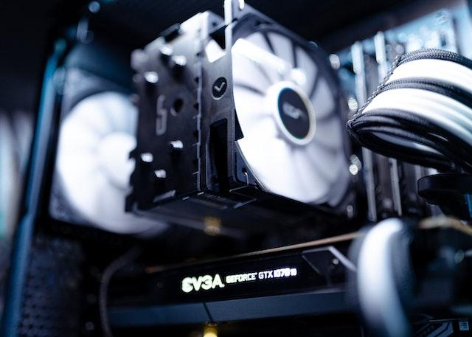
Cooling
Activity 3
Processors generate heat and in order to maintain their performance, they need to have cooling systems.
Mineral air cooling: Components are submerged in mineral oil. The mineral oil acts as a heat transfer fluid, allowing heat to be efficiently dissipated from the components.
Passive cooling: Cooling components by reducing the speed at which they operate and relying on heat sinks or vents to allow the heat to dissipate.
Active cooling: Using a fan to circulate air or a pump to distribute water in order to cool components.
Thermal paste is often applied between the heat sink and the processor to help transfer heat away from the processor.
Notes:
Photo by Martin Lopez from Pexels https://www.pexels.com/photo/white-and-black-computer-fan-2225617/

Slide 31
Activity 3
Input devices
Processor
Main
memory
Input / Output controllers
Secondary storage
Output devices

Slide 32
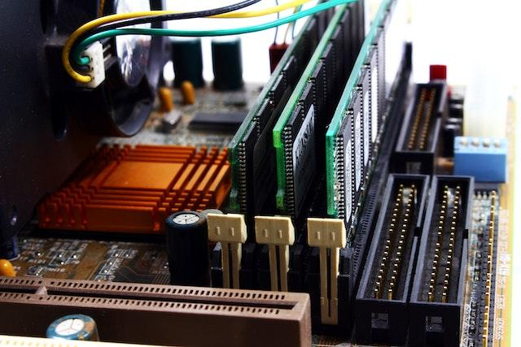
Main memory
Activity 3
Main memory is memory that can be accessed directly by the processor.
RAM (Random Access Memory) is main memory that consists of memory locations that store instructions or data which is being processed.
You will learn more about main memory and secondary storage in subsequent sessions.
Notes:
Photo by Valentine Tanasovich from Pexels https://www.pexels.com/photo/black-and-gray-computer-motherboard-2588757/

Slide 33
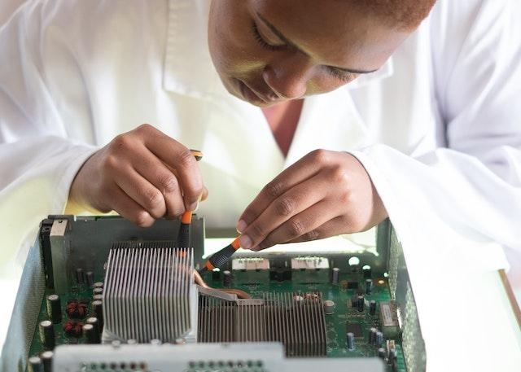
Motherboard
Activity 3
Motherboards can vary in size and shape depending on the device.
They are the main printed circuit board within a computer and hold the components such as the:
CPU (Central Processing Unit)
RAM (Random Access Memory)
GPU (Graphics Processing Unit)
BIOS (Basic Input/Output System)
Heatsink and fan assembly
Notes:
Photo by RF._.studio from Pexels https://www.pexels.com/photo/crop-focused-repairman-fixing-graphics-card-on-computer-3825582/

Slide 34
Retrieval practice
Retrieval activity
Question 3 .
Which of these cooling methods relies on a fan or pump?
Passive cooling
Mineral air cooling
Active cooling
Question 1 .
Which of the following are not included in the von Neumann architecture model?
Input/output controllers
Sensors
Main memory
Question 3 .
Which of these cooling methods relies on a fan or pump?
Passive cooling
Mineral air cooling
Active cooling
Question 1 .
Which of the following are not included in the von Neumann architecture model?
Input/output controllers
Sensors
Main memory
Question 4 .
Which component of a computer system can execute an instruction?
Arithmetic and logic unit
Bus
Clock
Question 2 .
Which two peripherals are classed as input devices?
Scanner and printer
Mouse and monitor
Sensor and microphone
Question 4 .
Which component of a computer system can execute an instruction?
Arithmetic and logic unit
Bus
Clock
Question 2 .
Which two peripherals are classed as input devices?
Scanner and printer
Mouse and monitor
Sensor and microphone
Notes:
Answers: Q1 – B; Q2 – C; Q3 – C; Q4 - A

Slide 35
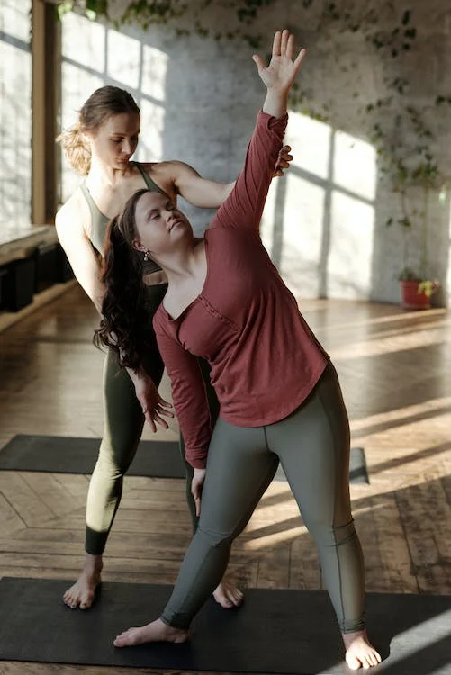
Apply it – activity
Apply it
Ella is a personal trainer who has decided to set up her own fitness suite. She has rented a room at the local leisure centre, which already has some fitness machines and weights.
She has a high-specification laptop which she can use for administrative tasks, but is keen to invest in more technology for other areas of the business. She has received a grant of £10,000 from the local council through an initiative to improve the health and wellbeing of the local population.
There are two areas that Ella would like to focus on:
Entry/exit to the fitness suite as she doesn’t want general leisure centre visitors to have access to the fitness suite
Entertainment for clients using the fitness suite
Produce a proposal that specifies the hardware Ella should invest in. You should explain the purpose of each device and justify your choices by explaining how they would benefit the business.
Notes:
Photo by Cliff Booth from Pexels: https://www.pexels.com/photo/photo-of-women-exercising-4056616/

Slide 36
Apply it – possible solutions
Apply it
Device | Purpose | Justification
Swipe entry/exit system | To open the door when triggered by an authorised entry device. | Would allow clients to enter/exit the room without Ella having to go to the door. Would record who came in and at what time, and when they exited the room.
Music streaming system | Smart speakers connected to a control system. | The music could be streamed from the laptop and could provide sound to suit the particular type of training session/activity being undertaken.
Smart TV | Smart TV to play news or music channels. | The TV could be in a location that customers can watch whilst they are using fitness equipment. Ella could connect via the internet.

Slide 37
Next lesson
Summary
In this lesson, you…
Recognised key features of a computer system
Compared a range of digital devices, considering purpose and features
Identified the role of key hardware components and peripherals
Applied your knowledge of computer systems and hardware to real-world scenarios
Next lesson, you will…
Identify the purpose of software used in computer systems
Compare different types of software, considering purpose and features
Explore the role of the operating system
Apply your knowledge of computer systems and software to real-world scenarios

