Slide 1

Lesson 10: Resilience of environment
Digital environments
Notes:
Version 1, June 2024

Slide 2
DaaS – study question
Starter activity
A supermarket employs data scientists to analyse sales and performance of particular products, stores, and promotions.
Discuss how Data as a Service (DaaS) could be used by the data scientists.

Slide 3
DaaS – study question
Starter activity
Sample answer:
Data is extremely important for the supermarket so they can effectively monitor the sales of particular products and change marketing strategies. Data dashboards could be used to visualise the performance of certain products or to compare sales in different stores or locations. This data would allow the supermarket management to make informed decisions about issues such as future promotions or stock levels.
As the DaaS is cloud-based, this would mean managers from lots of different stores and locations could share and access the information. Having a centralised location for the data means the whole organisation can add to and benefit from the information.

Slide 4
Lesson 10: Resilience of environment
Objectives
In this lesson you will:
Recognise the need to ensure digital environments are resilient
Compare a range of methods used to improve the resilience of digital environments
Identify the impact on organisations and stakeholders if resilience is not achieved
Apply your knowledge to enhance the resilience of digital environments in a real-world scenario
General competencies:
E1 - convey technical information
E2 - present information and ideas
E4 - summarise information
E5 - synthesise information
E6 - take part in discussions
M6 - understand data and risk
D1 - use digital technology
D2 - design digital media
D3 - communicate and collaborate

Slide 5

What are digitally resilient environments?
Activity 1
Computer systems and infrastructures that are designed to withstand and recover from disruptions, threats, and unexpected events.
These environments ensure the continuity of digital services and operations even in challenging circumstances.
Notes:
Photo by Christina Morillo from Pexels: https://www.pexels.com/photo/software-engineer-looking-at-an-ipad-1181335/

Slide 6

Steps to achieve digital resilience
Activity 1
Understand the risks and threats to computer systems
Develop plans to mitigate (reduce) the risks
Identify the causes of problems in computer systems
Prepare how to recover from problems
Review and update a plan to mitigate any future similar problems
Notes:
Photo by Andrea Piacquadio from Pexels: https://www.pexels.com/photo/young-troubled-woman-using-laptop-at-home-3755755/

Slide 7
Reasons for digital resilience
Activity 1
Ensures that critical systems and services can continue functioning even during disruptions caused by unexpected events
Mitigates risks by implementing measures to prevent or minimise the impact of loss of digital services
Protects sensitive information and maintain privacy
Adapts to technological advancements, changing business needs, and evolving threats
Complies with rules and regulations by implementing appropriate security measures

Slide 8
Threats to computer systems
Activity 1
There are many different types of threats to computer systems. These can range from deliberate attempts to disrupt a service through to natural disasters, such as flooding.
In groups, identify some threats to computer systems and then open and complete ‘A1 Activity sheet – Threats to computer systems’ to record your discussion.
Threats to computer systems
In your groups, identify threats to computer systems. Record your discussion in the space below. You may want to use diagrams or text. Here are a few suggestions for you to include:
Flooding
Power supply outage
Not updating software
Threats to computer systems

Slide 9
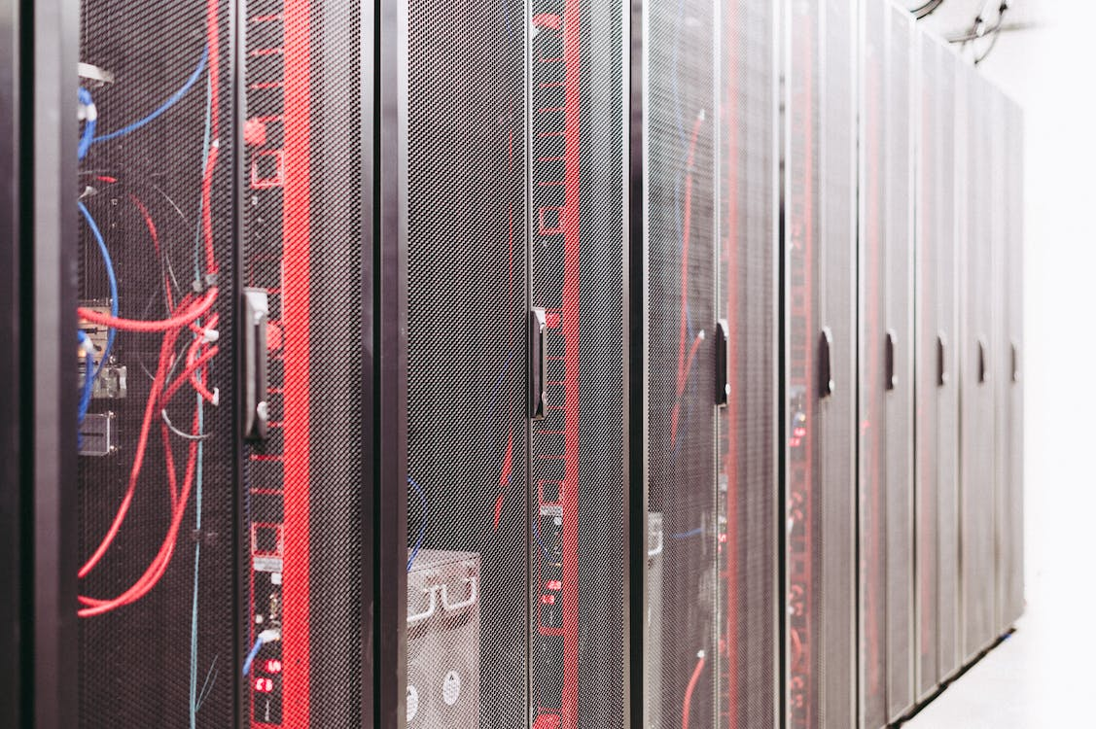
Methods for improving resilience
Activity 2
Disaster recovery sites
Disaster recovery sites are locations or facilities that organisations use to restore their IT infrastructure and operations in the event of a significant disruption or disaster.
These sites serve as backup environments that can be activated when the primary systems are unavailable or compromised.
The purpose of disaster recovery sites is to minimise downtime, ensure business continuity, and recover critical data and services.
Notes:
Photo by Brett Sayles from Pexels: https://www.pexels.com/photo/server-racks-on-data-center-5480781/

Slide 10


Disaster Recovery Sites
Activity 2
Hot site | Cold site | Warm site
Fully operational backup facility equipped with all the necessary hardware and software It mirrors the main systems in real-time, meaning it is continuously updated with the latest changes In the event of a disaster, the hot site can quickly take over and seamlessly continue operations with minimal downtime | Basic facility that provides only the physical space and infrastructure necessary to restore operations When a disaster occurs, organisations must procure and install the required hardware and software, and perform data backups manually This process can take a significant amount of time, resulting in longer downtime compared to hot or warm sites | A partially configured backup facility that has some hardware and software in place May not have the same level of up-to-date data replication as a hot site It requires additional setup and configuration before it can become fully operational When activated, it can restore operations within a reasonable timeframe, but there may be a short interruption in services
Notes:
Images from https://pixabay.com/vectors/cold-thermometer-weather-159379/

Slide 11
Data backup and recovery
Activity 2
Data backup is the process of creating duplicate copies of important files, documents, databases, or entire systems. These can then be used to recover data following a disaster.
Full backups provide a complete copy of data but require large storage space and more time for saving and restoring
Incremental backups require less storage space than full backups and are faster to save, but restoring data may take longer as multiple backups need to be restored sequentially
Differential backups strike a balance between backup time and restore time, requiring a full backup and the most recent differential backup for restoration
Mirror backups provide real-time or near real-time replication, enabling quick recovery but requiring sufficient storage space and network bandwidth

Slide 12
Types of backup
Activity 2
Different situations and organisations will have different backup and recovery needs.
Open and complete ‘A2 Activity sheet – Types of backup’ to identify and justify which backup method is most suitable for each industry scenario.
Types of backup
There are four different vocational scenarios, each representing a specific backup type. Identify which backup method: full, incremental, differential, or mirror is most suitable for each scenario. Try to justify your decision.
Industry scenario | Chosen backup type
Kai is working on a major website development project for their client in the UK. They have spent several weeks creating and editing numerous files, including graphics, videos, and documents. Kai has plenty of unused storage and would like the data to be quickly restored in case of loss. They work on the project every day and make changes regularly. The devices are not used in the evenings or overnight.

Slide 13
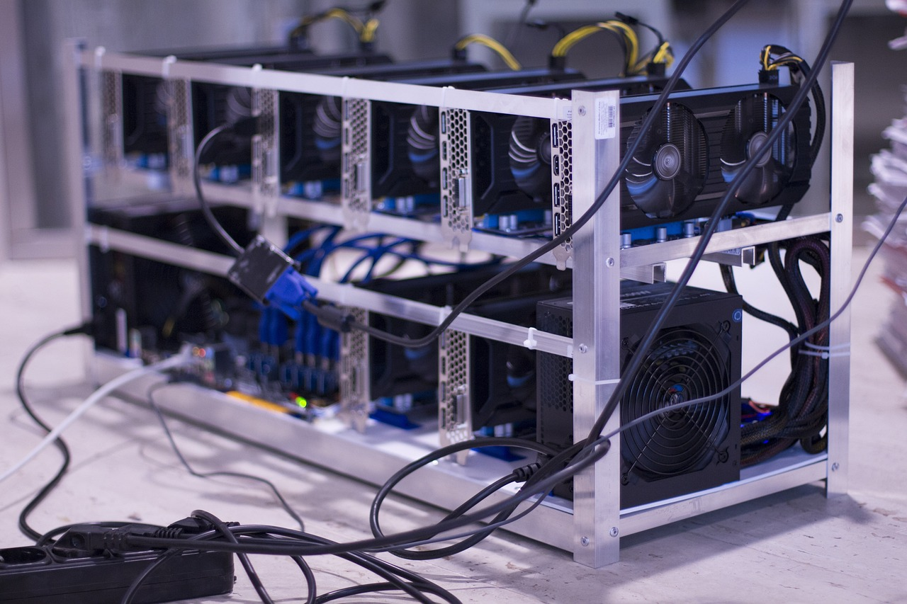
Hardware redundancy
Activity 3
Hardware redundancy involves having backup or duplicate hardware components in a computer system or network
The purpose of hardware redundancy is to ensure that the system continues to function properly even if one or more hardware components fail
It's like having a spare part ready to take over if something goes wrong
Notes:
Photo by rebcenter-moscow from Pixabay: https://pixabay.com/photos/farm-mining-the-ethereum-market-2852024

Slide 14

Software redundancy
Activity 3
This is having mirrored or duplicate software systems in place
The goal is to ensure that even if the primary system encounters a problem, there's a recovery mechanism ready to take over and keep things running smoothly
Notes:
Photo by PhotoMIX Company from Pexels: https://www.pexels.com/photo/black-samsung-tablet-computer-106344/

Slide 15

Benefits and drawbacks of redundancy
Activity 3
You have been asked by your network manager to research hardware and software redundancy and to present your findings at the next team meeting.
To prepare for this, you should make a list of benefits and drawbacks of hardware and software redundancy.
Complete the task in small groups and use any resources available to you.
Notes:
Photo by Tumisu from Pixabay: https://pixabay.com/photos/pros-and-cons-compare-choice-5201376/

Slide 16

Benefits and drawbacks of redundancy
Activity 3
Improved reliability by providing mirrored components or systems that can take over in case of failures. This ensures uninterrupted operation and minimises downtime.
Add complexity to system design and management. Multiple components or systems need to be properly configured, synchronised, and monitored.
Over reliance on redundancy: Depending too heavily on redundancy can create a false sense of security. It's important to remember that redundancy is not foolproof and can still experience failures. A comprehensive backup and recovery strategy should be in place to mitigate risks.
Allows for scalability and flexibility. Additional hardware or software components can be added as needed without disrupting ongoing operations, providing the ability to adapt to changing requirements.
Notes:
Images from https://pixabay.com/vectors/tick-complete-check-right-correct-27406/

Slide 17
Device hardening
Activity 3
Device hardening involves implementing measures to enhance the security of digital devices, making them more resilient against hacker attacks. This can be achieved in a number of ways:
Auto logout: Set up an automatic logout feature that logs users out after a specified period of inactivity
Port disabling: Disable unnecessary ports on digital devices to prevent unauthorised access
User access restriction: Implement user access controls to restrict privileges based on user roles and responsibilities
Two-Factor Authentication (2FA): Enable two-factor authentication to add an extra layer of security during login
Removing unnecessary applications: Remove or disable applications that are not required for the device's intended functionality

Slide 18
Retrieval practice
Retrieval activity
Question .
Which of the following is the correct description of a warm backup site?
A basic facility that provides only the physical space and infrastructure necessary to restore operations.
A partially configured backup facility that has some hardware and software in place.
A fully operational backup facility equipped with all the necessary hardware and software.
Question .
Which of the following is a reason for building digital resilience?
Mitigate risks by implementing measures to prevent or minimise the impact loss of digital services.
Add complexity to system design and management. Multiple components or systems need to be properly configured, synchronised, and monitored.
To increase business costs in relation to the storage of data.
Question .
Which of the following is the correct description of a warm backup site?
A basic facility that provides only the physical space and infrastructure necessary to restore operations.
A partially configured backup facility that has some hardware and software in place.
A fully operational backup facility equipped with all the necessary hardware and software.
Question .
Which of the following is a reason for building digital resilience?
Mitigate risks by implementing measures to prevent or minimise the impact loss of digital services.
Add complexity to system design and management. Multiple components or systems need to be properly configured, synchronised, and monitored.
To increase business costs in relation to the storage of data.
Notes:
Answers: warm backup site – B; reason for building digital resilience - A

Slide 19



Apply it – activity
Apply it
Resilience is important for any organisation. Pick any of the case studies you have seen during the unit and explain:
Why is resilience important for the organisation?
What data is particularly important for the organisation?
Recommend how the organisation could build in resilience to their systems.
Notes:
Photo by Artem Podrez from Pexels: https://www.pexels.com/photo/man-in-white-polo-shirt-using-a-tablet-computer-5025643/
Photo by Thirdman from Pexels: https://www.pexels.com/photo/a-person-checking-the-blood-pressure-of-the-patient-5327862/
Photo by Dmitry Zvolskiy from Pexels: https://www.pexels.com/photo/top-view-photo-of-restaurant-2253643/

Slide 20
This lesson
Summary
In this lesson, you…
Recognised the need to ensure digital environments are resilient
Compared a range of methods used to improve the resilience of digital environments
Identified the impact on organisations and stakeholders if resilience is not achieved
Applied your knowledge to enhance the resilience of digital environments in a real-world scenario

