Slide 1

Lesson 2: Software in computer systems
Digital environments
Notes:
Version 1, June 2024

Slide 2
Key components of the processor — retrieval practice
Starter activity
Carries data around the processor
Buses
Instructs the other components
Regulates the cycles per second
Control unit
Clock
Fast access memory locations in the processor
Carries out mathematical operations
Registers
ALU
Name the components within the processor that carry out the tasks described.

Slide 3


Starter activity
What is an operating system and what does it do?
Notes:
A0 Operating system film: https://vimeo.com/883954171

Slide 4
Lesson 2: Software in computer systems
Objectives
In this lesson, you will:
Identify the purpose of software used in computer systems
Compare different types of software, considering purpose and features
Explore the role of the operating system
Apply your knowledge of computer systems and software to real-world scenarios
General competencies:
E1 - convey technical information
E2 - present information and ideas
E3 - create texts
E4 - summarise information
E5 - synthesise information
E6 - take part in discussions
M5 - process data
D1 - use digital technology
D3 - communicate and collaborate

Slide 5

Operating systems
Activity 1
Operating systems (OS) regulate interactions between software and computer system hardware.
There are lots of different operating systems. The most popular are:
Microsoft Windows
macOS
Linux
Android
iOS
Notes:
Photo by Teona Swift from Pexels: https://www.pexels.com/photo/businesswoman-checking-smartphone-while-using-laptop-6913714/

Slide 6

Operating systems
Activity 1
Roles of the operating system:
Memory management
Program management
Interaction with the user
Processor management
Handling input and output
Security
Error handling
File management
Notes:
Photo by Sora Shimazaki from Pexels: https://www.pexels.com/photo/crop-faceless-developer-working-on-software-code-on-laptop-5926382/

Slide 7
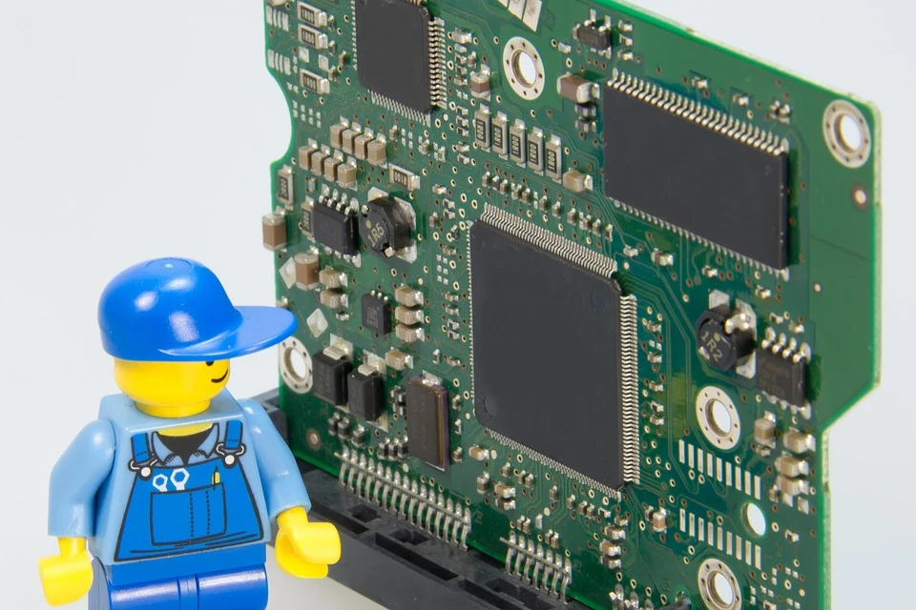
Operating systems (OS)
Activity 1
There are five main types of OS:
Batch OS
Multitasking/time-sharing OS
Real-time OS
Network OS
Mobile OS
Notes:
Image by blickpixel from Pixabay: https://pixabay.com/photos/electrician-lego-repair-craftsmen-499799/

Slide 8

Batch operating system
Activity 1
Mostly used before modern-day multitasking operating systems were developed
Processes large batches of data
In sequential order, one after the other
Without human intervention
Processed when processing power is in less demand
Weekends and overnight
Can be automatically run at specific times
Used where large volumes of data need to be processed without interruption, such as:
Large-scale data processing centres
Banking — processing transactions, generating statements, and calculating interest rates
Data analytics — processing large volumes of data to generate insights and predictions
Notes:
Photo by Breakingpic from Pexels: https://www.pexels.com/photo/gold-colored-coins-near-calculator-3305/

Slide 9
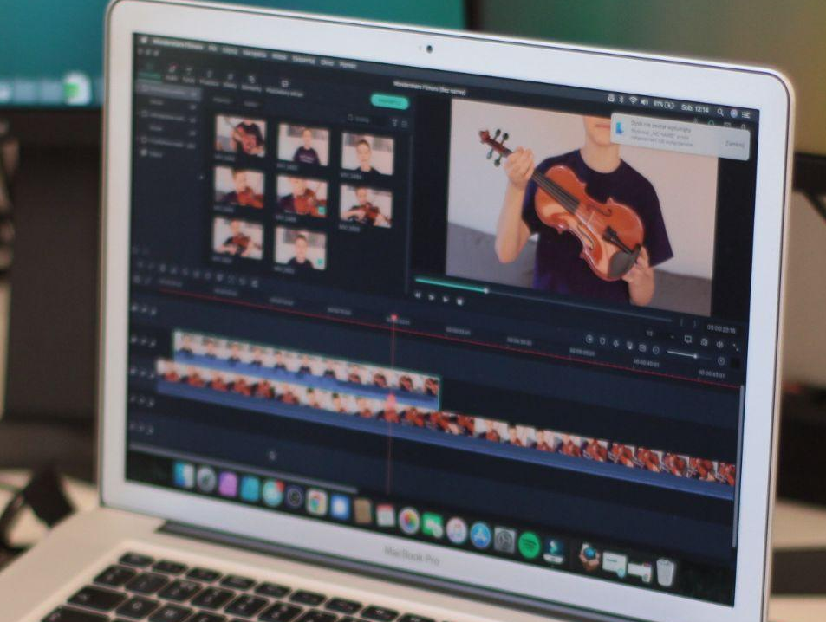
Multitasking/time-sharing operating system
Activity 1
Multiple processes run at the same time on a single computer
Multiple applications run simultaneously
This improves productivity and efficiency, as users can perform multiple tasks at the same time
Most modern day personal computers, servers, and mobile devices use multitasking operating systems
Useful for applications that require a lot of processor time, such as:
Video rendering
Data processing
Scientific simulations
Notes:
Photo by Adam Sondel from Pexels: https://www.pexels.com/photo/laptop-notebook-internet-connection-9317525/

Slide 10
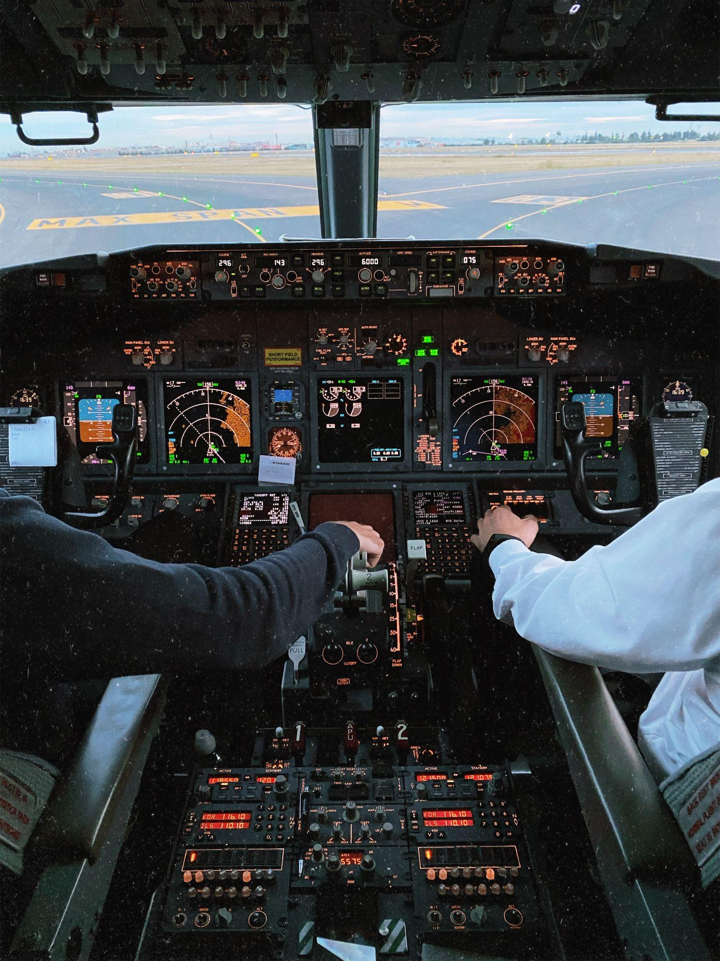
Real-time operating system (RTOS)
Activity 1
Responds to events or inputs within a guaranteed time frame.
Used in applications where the response time of the system is critical, and even a small delay can result in system failure.
Uses a priority-based scheduling algorithm, which assigns higher priorities to tasks that require immediate attention.
Reliable, with features such as fault tolerance and error recovery. These features ensure that the system can continue to operate even if one or more components fail.
Deterministic, because it will produce the same output if the same input is used.
Used in applications such as:
Medical devices
Aerospace systems
Military systems
Notes:
Photo by Adrian Gagea from Pexels: https://www.pexels.com/photo/pilots-in-the-cockpit-4207314/

Slide 11
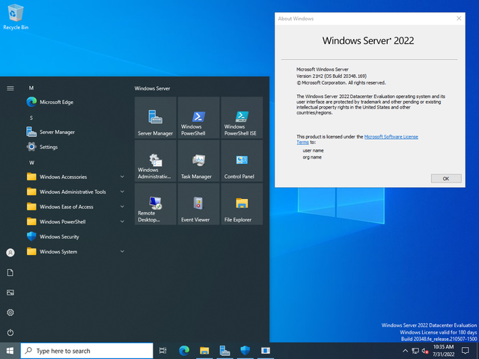
Network operating system (NOS)
Activity 1
Manages and controls a computer network
Enables multiple computers to communicate with each other and share resources such as printers, files, and data
Typically includes features such as:
Network security
User authentication
Data backup and recovery
User groups and access levels
Facilitating remote access from devices and servers not on the network
Commonly used in large organisations, where multiple computers are connected to central servers
Notes:
Image by Kacperq99, CC BY-SA 4.0, via Wikimedia Commons: https://commons.wikimedia.org/wiki/File:Windows_Server_2022_zrut_ekranu.png

Slide 12

Mobile operating system
Activity 1
Designed for mobile devices such as smartphones, tablets, and wearable devices
Provides features such as touch-based user interfaces, gesture controls, and voice recognition, making it easy for users to navigate and interact with their devices
Enables users to access a wide range of applications and media
Manages connectivity between devices and the internet
Provides security features such as device encryption, face recognition, password protection, and remote wipe, which protect users’ personal and sensitive data from theft or loss
Common examples include:
Apple’s iOS
Google’s Android
Notes:
Photo by Pixabay from Pexels: https://www.pexels.com/photo/close-up-photography-of-smartphone-icons-267350/

Slide 13
Types of operating system
Activity 1
You have seen the different types of operating system and some of their uses.
Open and complete the ‘A1 Activity sheet – Operating systems in industry’ to match the most appropriate type of operating system to the industry context.
Task 1
Match the description of the industry example to the most appropriate operating system for their needs.
Type of operating system |  | Industry example
Batch OS |  | A car manufacturing company uses robotics to weld joints on the car body. The robots are on a production line and perform a set number of welds before the car moves onto the next robot where the next stage of the production process is completed.
Multitasking/ time-sharing OS |  | An estate agency has branches in five towns within a county. The branches share information about clients looking for houses and properties that are currently on the market. Each branch needs access to central documents and resources.
Real-time OS |  | A highstreet bank chain provides monthly statements for customers which are always generated on the last day of the month. Customers can request whether these are printed and sent via post or sent electronically via email.

Slide 14

Activity 2
What is the difference between an application and system software?
Notes:
A2 Software film: https://vimeo.com/883954155

Slide 15
Types of software
Activity 2
As well as operating systems, software is often categorised into three different types.
Three types of software are:
Utility software
Application software
Integrated development environments (IDEs)

Slide 16
Utility software
Activity 2
Utility software performs specific tasks to improve machine performance and keep data secure. Utility software can be configured so that it is always running in the background. Examples of utility software are:
Security programs, including antivirus software that scans files or disks and detects viruses.
Optimisation programs, such as tools for system cleanup, disk defragmentation, and file compression. They have access to secondary storage such as a hard drive to keep them running as efficiently as possible.

Slide 17
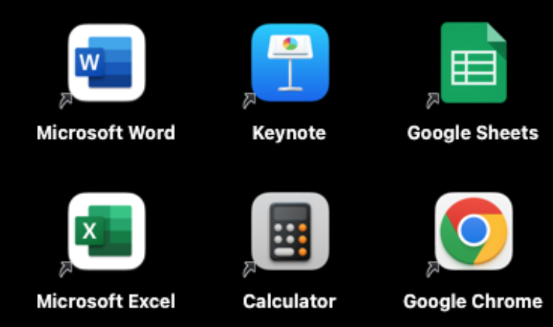
Application software
Activity 2
Application software is software that allows a computer to be useful to everyday users. This software can be stored on a local computer system or used via the internet.
Examples of application software are:
Word processor
Spreadsheet software
Web browser
Graphics software

Slide 18
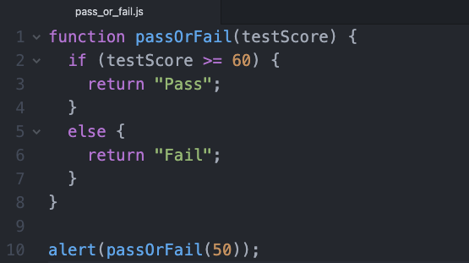
Code development tools
Activity 2
These are software applications that support programmers in developing, testing, and debugging code. These tools can improve efficiency, accuracy, and overall quality of the code.
Some tools are:
Integrated development environments (IDEs): One central application that often includes code editing, debugging, syntax checking and testing tools
Source code editor
Debugger
Compiler
Assembler
Notes:
Screenshot of JavaScript code with the keywords highlighted

Slide 19
Types of software
Activity 2
Open and complete the ‘A2 Activity sheet – Types of software’
Use the internet to research and find examples of each type of utility and application software listed
Types of software
Complete the table by classifying each type of software as either a utility or an application. For each type, provide examples and describe its purpose and features.
Type of software | Utility or application | Examples | Description
Backup software
Compression software
Word processor
Web browser
Spreadsheet software

Slide 20

Retrieval activity — hot seat
Retrieval activity
Create two questions based on what you have covered in this lesson
Be prepared to ask and answer questions in the ‘hot seat’
Notes:
Photo by Leeloo Thefirst from Pexels: https://www.pexels.com/photo/question-marks-on-paper-crafts-5428833/

Slide 21


Apply it – activity
Apply it
Delivereaze is a grocery delivery business that delivers fresh fruit and produce to customers across the country.
Fasteatzs is a fast food delivery business that provides delivery services from a range of fast food restaurants to customers through an app.
Both delivery companies have offices in multiple locations which handle the administrative tasks relating to the business. The delivery drivers must be able to receive orders and provide proof of delivery remotely.
In small groups, pick one of the businesses and identify a list of requirements that the hardware and software solutions for the business need to fulfil.
A list of requirements like these is often referred to as KPIs (key performance indicators). Sometimes requirements include quantitative KPIs, such as “80% of all deliveries should be made within 48 hours of ordering”.
Notes:
Photo by Kindel Media from Pexels: https://www.pexels.com/photo/man-in-orange-shirt-holding-black-and-orange-plastic-box-with-fresh-vegetables-6868797/
Photo by Mizuno K from Pexels: https://www.pexels.com/photo/young-smiling-woman-from-food-delivery-service-13443788/

Slide 22
Apply it – possible solutions
Apply it
Hardware | Software
The administrative teams need hardware devices that enable them to: Connect to a network to enable collaboration and access to shared resources Access applications to book and schedule deliveries Communicate with customers Access applications to perform administrative tasks such as writing emails and generating documents The delivery drivers need hardware devices that enable them to: Connect to the office- and work-based systems remotely Move around easily Provide proof of delivery Provide a way of contacting customers and head office | The administrative teams need software solutions that enable them to: Perform administrative tasks such as writing emails, generating documents, creating sales reports, etc. Keep their devices and network secure Book and schedule deliveries Access web-based services The delivery drivers need software solutions that enable them to: Access specific applications that allow them to see and monitor bookings Access maps and navigation tools to find delivery locations Access web-based services

Slide 23
Next lesson
Summary
In this lesson, you…
Identified the purpose of software used in computer systems
Compared different types of software, considering purpose and features
Explored the role of the operating system
Applied your knowledge of computer systems and software to real-world scenarios
Next lesson, you will…
Identify the features of physical storage systems
Describe the role of main memory and its key characteristics
Recognise the need for secondary storage
Compare the different types of physical storage and recovery systems

