Slide 1
Health
Route: Health & Science
Topic: Good scientific and clinical practice
Lesson 2: Using a SOP
Notes:
Image © Shutterstock/Inside Creative House

Slide 2
In this lesson, we will:
Introduction
Follow a SOP to take a service user’s temperature.
Perform a search to locate a specific SOP for a given activity.
Identify missing statutory requirements on a SOP.
Skills:
CS3.2 Undertake collaborative work demonstrating an ability to follow standard operating procedure specific to the environment they are working in.
General competencies:
English:
GEC5 Synthesise information
GEC6 Take part in/lead discussions
Maths:
GMC1 Measuring with precision
GMC6 Understanding data and risk
Digital:
GDC1 Use digital technology and media effectively
Lesson 2: Using a SOP

Slide 3

What are the five key principles of good practice in scientific and clinical settings?
Introduction
Lesson 2: Using a SOP

Slide 4
What are the five key principles of good practice in scientific and clinical settings?
Introduction
Store materials and chemicals appropriately
Calibrate and maintain equipment
Maintain work areas
Effectively manage stock levels
Use standard operating procedures (SOPs)
Lesson 2: Using a SOP

Slide 5
Following a SOP
Activity 1
Follow a SOP on the worksheet to take a service user’s temperature.
Determine whether their temperature is in the normal range.
After you have followed the SOP, consider:
  Why is it important to follow a chronological process?
  What could you improve?
  Why is it essential that everyone follows a SOP?
Resources needed
L2 Activity 1 Worksheet
NHS handwashing procedure: www.infectionpreventioncontrol.co.uk
Equipment to measure temperature
Lesson 2: Using a SOP
Notes:
NHS handwashing procedure: www.infectionpreventioncontrol.co.uk/resources/hand-hygiene-compliance-monthly-audit-tool-for-care-homes/

Slide 6
Writing a SOP for a physiological measurement
Activity 2
In your group, research how to collect the physiological measurement you have been tasked with.
Using the template, write a SOP for how to collect this measurement.
Share your SOP with other members of the class for review.
Implement any key feedback.
Resources needed
L2 Activity 2 worksheet: SOP template
Lesson 2: Using a SOP

Slide 7
Finding and comparing SOPs
Activity 3
The following slides contain some scenarios that require SOPs.
Decide what key points should be in the SOP.
Find a relevant SOP for the scenario.
  How many of the key points had you suggested?
  Identify which points in the SOP are critical (i.e. could have disastrous outcomes if done wrongly). Did you include these?
Then compare some of the SOPs you’ve looked at. What features of SOPs are the same? How are they different?
Lesson 2: Using a SOP

Slide 8
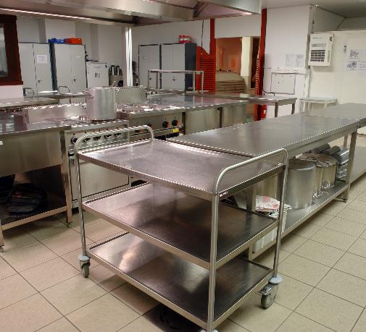
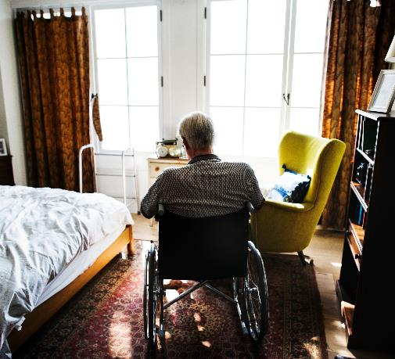
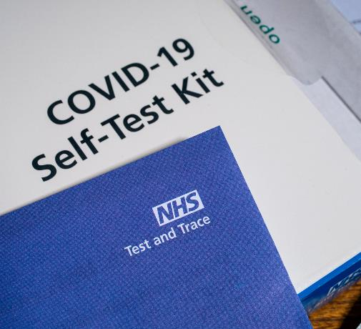
Finding and comparing SOPs
Activity 3
Scenario 1: You are asked to prepare a meal in a school kitchen for students.
Scenario 2: You have to move an elderly patient with very limited mobility from their bed.
Scenario 3: A new strain of COVID has emerged. You need to explain to how to use a test.
Lesson 2: Using a SOP
Notes:
Scenario 1: A SOP that outlines procedures to keep catering staff safe when working in a kitchen
Image © Shutterstock/Kris Vandereycken
Scenario 2: A SOP that outlines how to use a hoist to move a patient
Image © Shutterstock/Rawpixel.com
Scenario 3: A SOP that outlines how the correct procedure to use a COVID-19 lateral flow test
Image © Shutterstock/chrisdorney

Slide 9
Finding and comparing SOPs
Activity 3
Within organisations, SOPs are often contained on an intranet/online training manual and can be located through index searches.
This ensures that:
all staff can easily locate the relevant SOP
everyone uses the most up-to-date version of the SOP
a digital record is kept of who has used a particular SOP and when they have used it
staff induction and ongoing training is kept up to date and refresher training can be carried out where relevant.
Lesson 2: Using a SOP

Slide 10
Successful SOPs
Plenary
Good SOPs should:
be updated regularly (and the most up-to-date version used)
be reviewed, authorised, signed and dated
clearly outline the scope (what the SOP covers) and purpose of the SOP
clearly detail any required procedure.
Lesson 2: Using a SOP

Slide 11
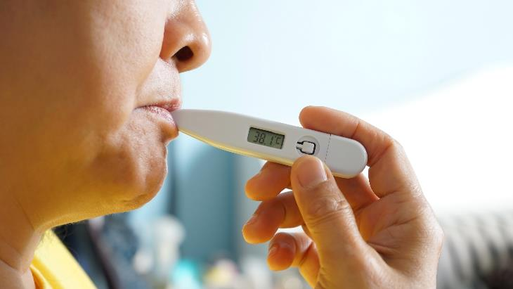
Spot the SOP errors
Plenary
The worksheet is a SOP on taking a person’s temperature using an oral thermometer.
How many errors can you spot?
Resources needed
L2 Plenary Worksheet
Lesson 2: Using a SOP
Notes:
Image © Shutterstock/Boontoom Sae-Kor

Slide 12
Spot the SOP errors
Plenary
The SOP has not been reviewed or authorised.
The users have not dated when they read the policy.
The scope and the purpose have been muddled up and placed in the wrong boxes.
The time to wait after eating is missing in the procedure.
The final step in the procedure is missing, where the healthcare professional should remove their PPE.
Lesson 2: Using a SOP

Slide 13
In this lesson, we have:
Plenary
Followed a SOP to take a service user’s temperature.
Performed a search to locate a specific SOP for a given activity.
Identified missing statutory requirements on a SOP.
Skills:
CS3.2 Undertake collaborative work demonstrating an ability to follow standard operating procedure specific to the environment they are working in.
General competencies:
English:
GEC5 Synthesise information
GEC6 Take part in/lead discussions
Maths:
GMC1 Measuring with precision
GMC6 Understanding data and risk
Digital:
GDC1 Use digital technology and media effectively
Lesson 2: Using a SOP

Slide 14
Compare SOPs
Consolidation
Search for two SOPS online for the same piece of equipment.
Compare them using the table on the worksheet.
Resources needed
L2 Consolidation Worksheet
Lesson 2: Using a SOP

