Slide 1
Construction
Route: Construction
Topic: Modern Methods of Construction
Lesson 1 & 2: Introduction to Modern Methods of Construction
Notes:
Image © Shutterstock/Amorn Suriyan

Slide 2
In these lessons, we will:
Introduction
Skills:
CS1 Participate in group and class discussions to examine concepts and approaches to produce solutions to construction problems
CS1 Synthesise information from given case studies, construction projects or site visits
General competencies:
English:
E2 Present information and idea
E4 Summarise information/ideas
E6 Take part in/leading discussions
Digital:
D3 Communicate and collaborate
describe what is meant by Modern Methods of Construction (MMC);
explain why MMC is used;
outline the impact that using MMC has on job roles in the industry;
discuss the use of MMC in placements (if applicable).
Lesson 1 & 2: Introduction to Modern Methods of Construction

Slide 3
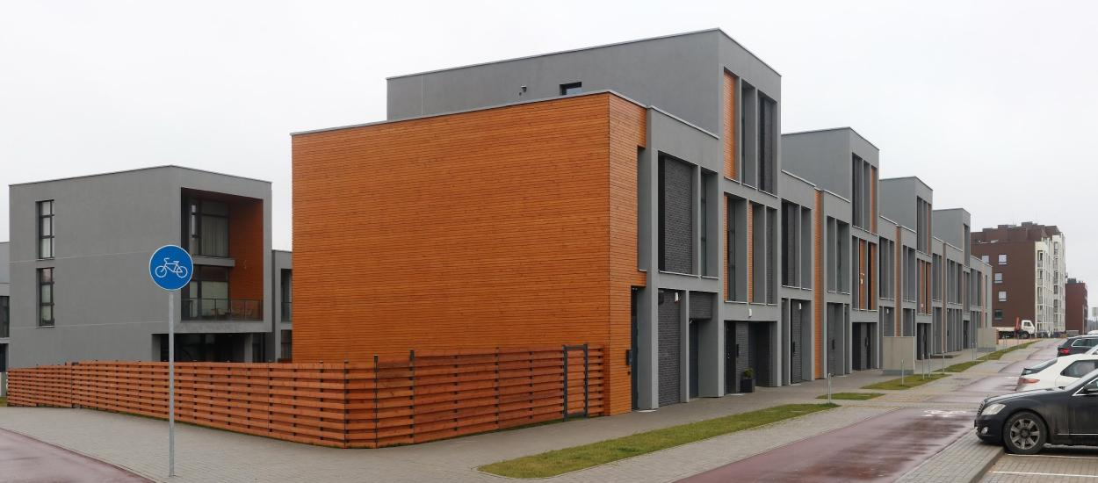
Class discussion
Introduction
What do you already know about MMC?
Lesson 1 & 2: Introduction to Modern Methods of Construction
Notes:
Image © Shutterstock/vilax

Slide 4
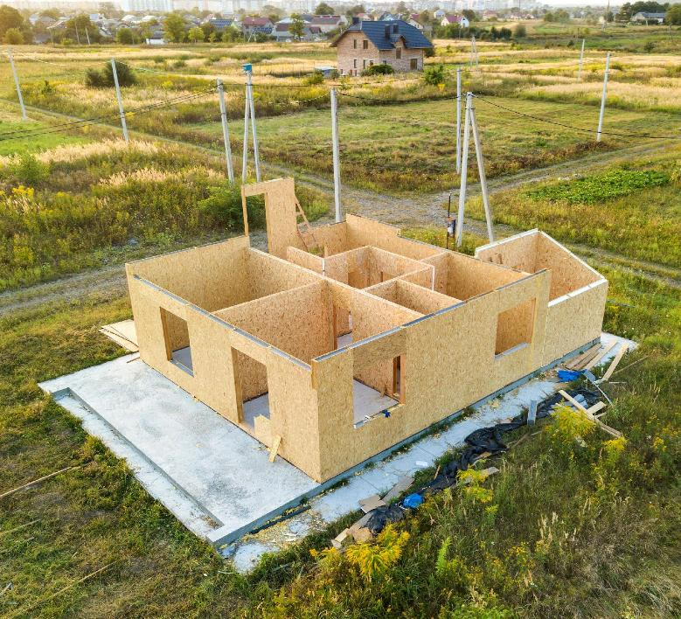
What is MMC?
Introduction
MMC is a way of combining manufacturing processes, new technologies and new methods of building to be more efficient and effective when compared to traditional forms of construction.
MMC involves moving away from traditional on-site construction and towards off-site manufacture in factories, to increase the quality of buildings.
Lesson 1 & 2: Introduction to Modern Methods of Construction
Notes:
Image © Shutterstock/Bilanol

Slide 5
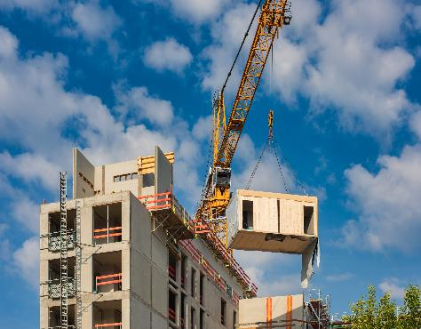
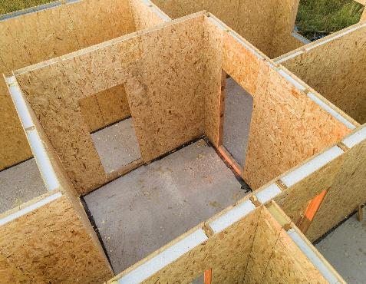
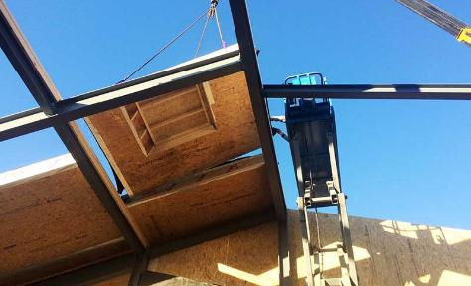
Types of off-site construction
Introduction
Volumetric systems
Panelised systems
Sub-assemblies and components
Lesson 1 & 2: Introduction to Modern Methods of Construction
Notes:
Image © Shutterstock/Jarama
Image © Shutterstock/Bilanol
Image supplied by McVeigh build@mcveighoffsite.com

Slide 6
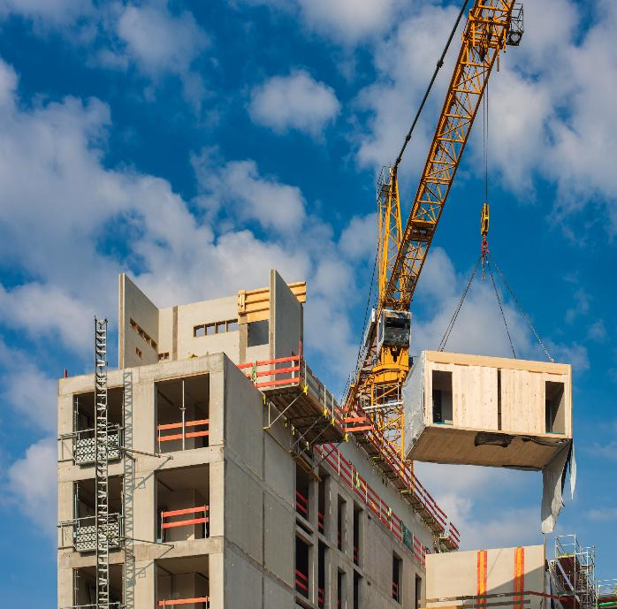
Volumetric construction
Introduction
Volumetric construction uses three-dimensional modules produced in controlled factory conditions prior to final installation.
Volumetric modules can be brought to the final site in a variety of forms ranging from basic structure only, to one with all internal and external finishes and services installed, ready for installation.
The system includes structural performance – the structural load-bearing properties of the building are designed into the modules.
Lesson 1 & 2: Introduction to Modern Methods of Construction
Notes:
Image © Shutterstock/Jarama

Slide 7
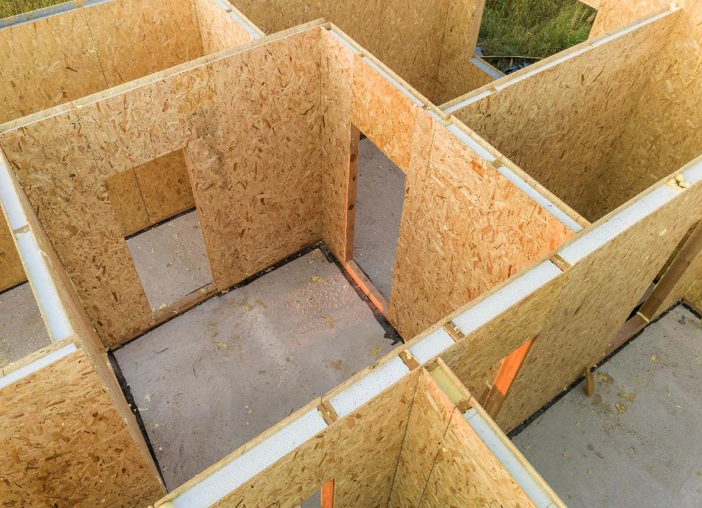
Panelised systems
Introduction
Flat panel units built in a factory and transported to site for assembly into a three-dimensional structure or to fit within an existing structure.
This includes structural insulated panels (SIP) and other sandwich panels. These consist of two layers of a rigid material bonded to either side of a lightweight core.
Lesson 1 & 2: Introduction to Modern Methods of Construction
Notes:
Image © Shutterstock/Bilanol

Slide 8
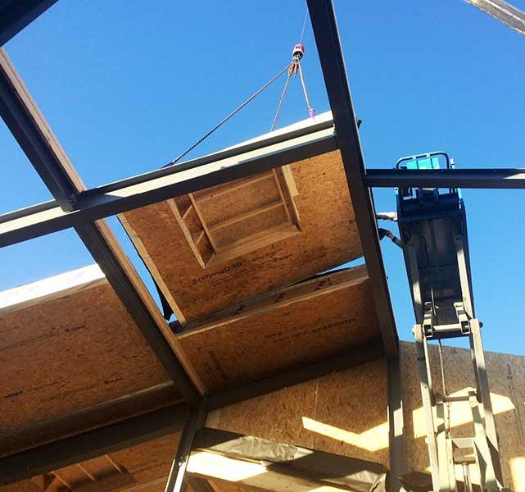
Sub-assemblies and components
Introduction
These are smaller elements of off-site construction. They include pre-manufactured components such as:
pre-assembled units, including roof
and floor cassettes;
precast concrete sections and cladding panels;
framed panels (timber, steel);
pre-assembled structural steelwork.
Lesson 1 & 2: Introduction to Modern Methods of Construction
Notes:
Image supplied by McVeigh build@mcveighoffsite.com

Slide 9
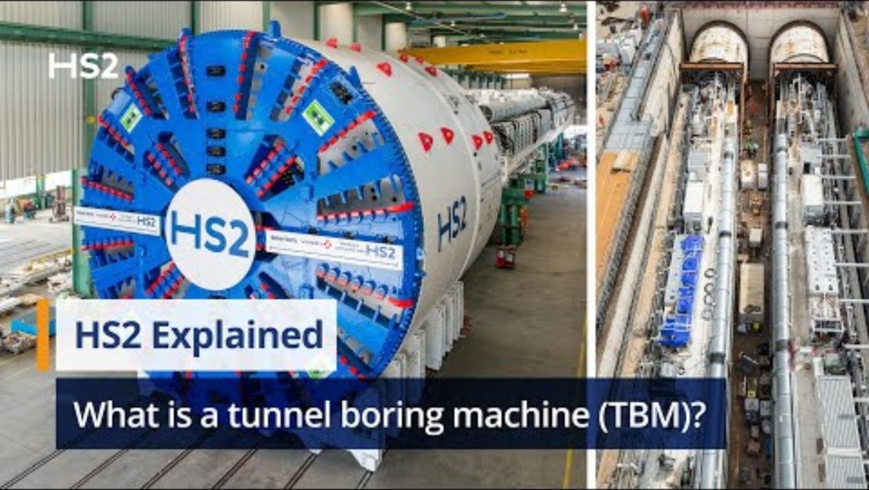
MMC – not just houses
Introduction
MMC is not just used for building houses and offices. They are also used in the construction of railways and large-scale power stations, for example.
This video demonstrates how MMC has been used in the construction of HS2, the UK’s high-speed rail network.
Lesson 1 & 2: Introduction to Modern Methods of Construction
Notes:
HS2 tunnel boring machine video: https://youtu.be/sGEMHn01p4g

Slide 10
Class discussion
Activity 1
How does using MMC compare with traditional construction?
Do you think MMC is important? If so, why/why not?
Do you think MMC will help us meet building regulations?
If so, why/why not?
Do you think MMC could help us meet construction targets?
If so, why/why not?
How do you think MMC impacts sustainability?
Summary question: Why do we use MMC?
Lesson 1 & 2: Introduction to Modern Methods of Construction

Slide 11
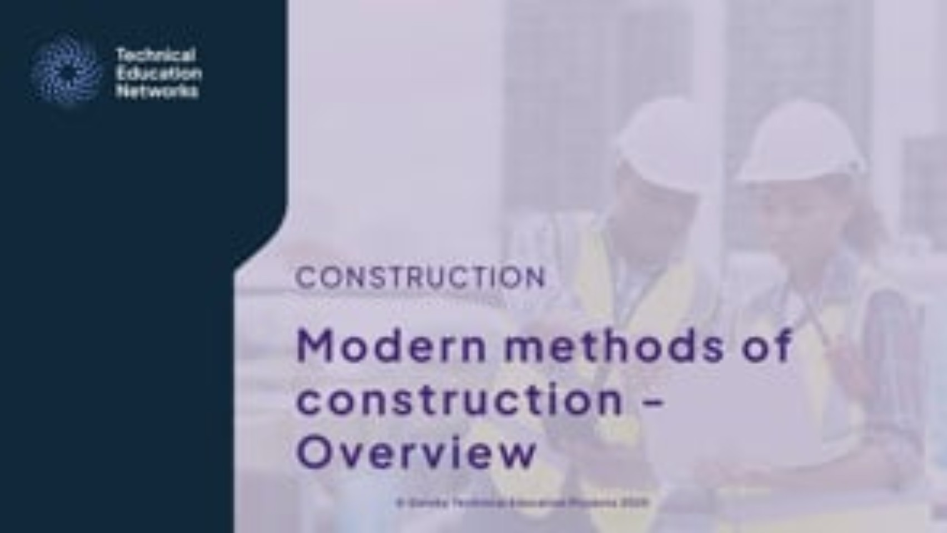
Overview of MMC
Activity 1
Lesson 1 & 2: Introduction to Modern Methods of Construction
Notes:
Overview of MMC video: https://vimeo.com/1069603912

Slide 12
Mind map
Activity 2
Digital compatibilities
Environmental benefits
Why use MMC?
Planning
Regulatory control
Waste reduction
Improved performance
Quality control
Complete the mind map using L1 & 2 Activity 2 worksheet
Lesson 1 & 2: Introduction to Modern Methods of Construction

Slide 13
Example mind map
Activity 2
  Well-insulated with minimal air gaps – less use of heating via fossil fuels
  Project management and design using BIM
Digital compatibilities
Environmental benefits
  Less waste on-site
  Computer Numerical Control (CNC) panel production
  Problems with Gas Safe and fireproofing in Building Control
  Useful for social housing due to speed of construction
Why use MMC?
Regulatory control
Planning
  Standard panels mean prior consultation, therefore it’s easier to meet regulations
  Can be issues with lack of individuality between dwellings
Waste reduction
Improved performance
Quality control
  Designed to use full sheets of timber
  Waste produced during manufacturing processes is kept within the factory for easy recycling
  Factory produced panels mean that quality checks are conducted on all materials and completed panels in a controlled environment
  Reduced risk of error
  Digital twins
Lesson 1 & 2: Introduction to Modern Methods of Construction

Slide 14
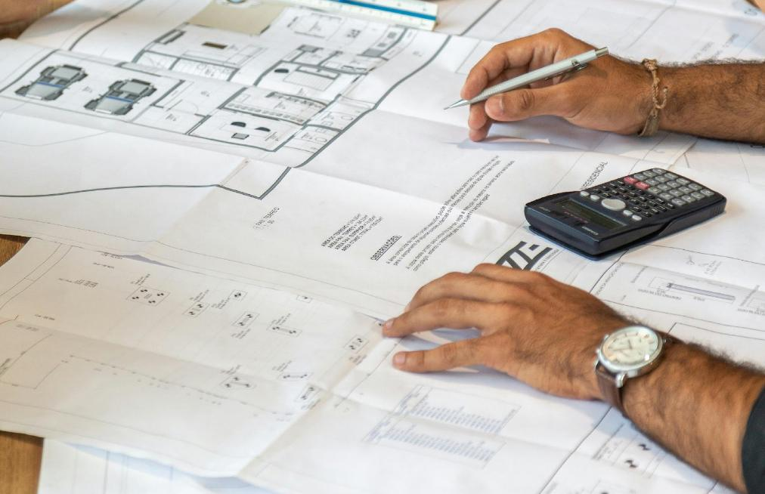
Professional roles in MMC
Activity 3
What professional and trade roles in construction would you expect to be involved with MMC?
What would you expect their roles to be?
Lesson 1 & 2: Introduction to Modern Methods of Construction
Notes:
Image © Unsplash/Pedro Miranda

Slide 15
Impact of MMC on job roles
Activity 3
While watching construction professionals discuss their roles in the videos, take notes on the following questions:
  How is the person’s role different using this method compared with traditional methods?
  What extra skills are required to use this method within the role?
  How does this person collaborate with other professionals that they might not work with when using traditional methods?
  How might MMC change their job in the future?
Make notes using L1 & 2 Activity 3 worksheet 1 or 2
Lesson 1 & 2: Introduction to Modern Methods of Construction

Slide 16
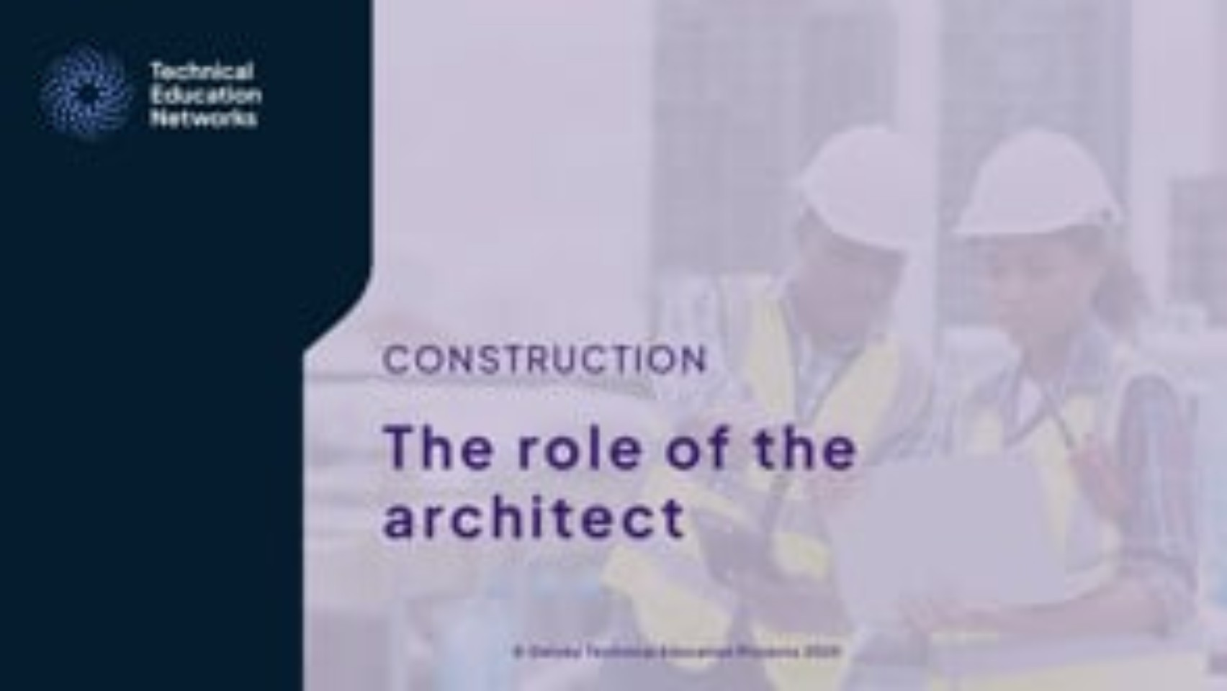
Interview with Architect
Activity 3
Lesson 1 & 2: Introduction to Modern Methods of Construction
Notes:
The role of the architect video: https://vimeo.com/1069605995

Slide 17

Interview with Project Manager
Activity 3
Lesson 1 & 2: Introduction to Modern Methods of Construction
Notes:
The role of the project manager video: https://vimeo.com/1069604569

Slide 18
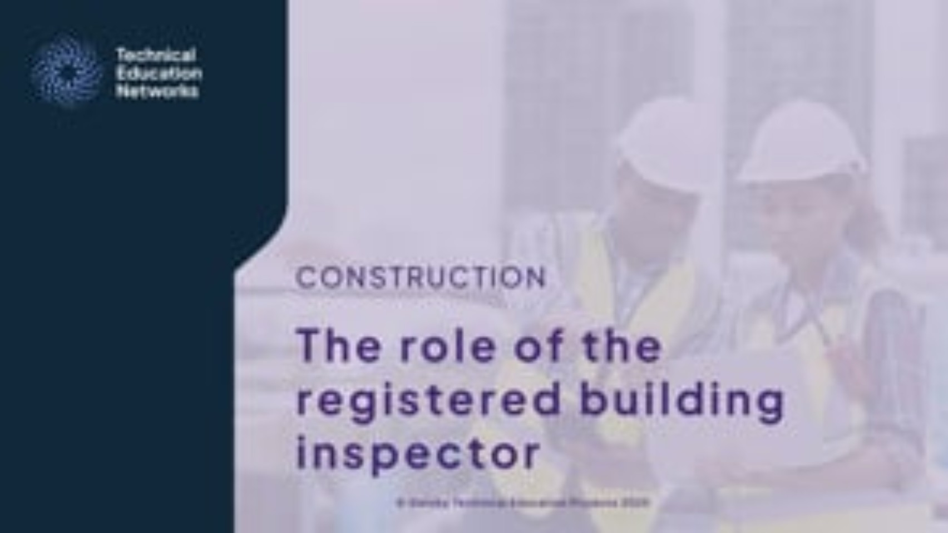
Interview with Registered Building Inspector
Activity 3
Lesson 1 & 2: Introduction to Modern Methods of Construction
Notes:
The role of the registered building inspector video: https://vimeo.com/1069604879

Slide 19
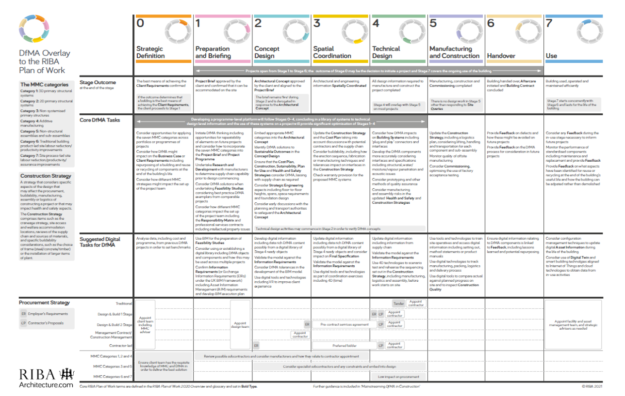
DfMA overlay to RIBA Plan of Work
Activity 3
Lesson 1 & 2: Introduction to Modern Methods of Construction
Notes:
DFMA overlay to RIBA Plan of Work https://www.architecture.com/knowledge-and-resources/resources-landing-page/dfma-overlay-to-the-riba-plan-of-work#available-resources (page 63)

Slide 20
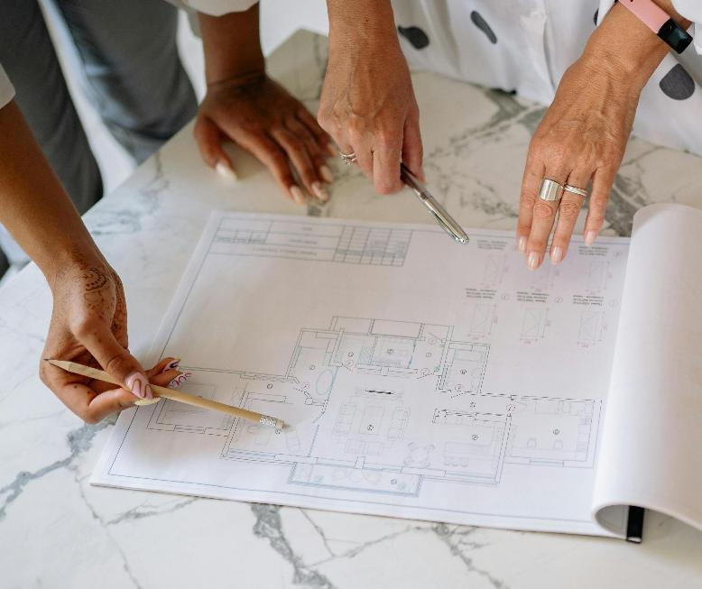
Make a video
Activity 3
Plan and film a one-minute video that answers the question, ‘How are construction roles different when MMC is involved?’
In small groups, collaborate to:
decide on the script
agree on any images
present this information.
Lesson 1 & 2: Introduction to Modern Methods of Construction
Notes:
Image © Pexels/Yan Krukau

Slide 21

Placement experience showcase
Plenary
Create a presentation slide show and answer the following questions:
What involvement have you had in your placement role?
How have you worked with other parties to deliver MMC?
Which modern methods of construction have been used on your site?
Include photos where possible.
Lesson 1 & 2: Introduction to Modern Methods of Construction
Notes:
Image © Shutterstock/Amorn Suriyan

Slide 22
In these lessons, we have:
Plenary
Skills:
CS1 Participate in group and class discussions to examine concepts and approaches to produce solutions to construction problems
CS1 Synthesise information from given case studies, construction projects or site visits
General competencies:
English:
E2 Present information and idea
E4 Summarise information/ideas
E6 Take part in/leading discussions
Digital:
D3 Communicate and collaborate
described what is meant by Modern Methods of Construction (MMC);
explained why MMC is used;
understood the impact that using MMC has on job roles in the industry;
discussed the use of MMC in placements (if applicable).
Lesson 1 & 2: Introduction to Modern Methods of Construction

Slide 23
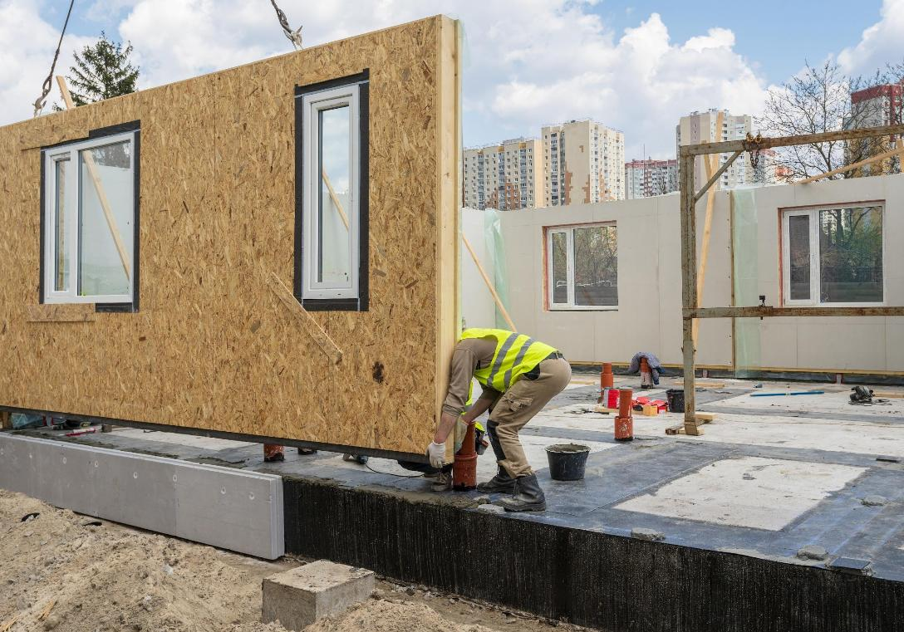
Consolidation
Key terms
Write definitions for:
  MMC
  Off-site construction
  Volumetric construction
  Panelised systems
  Sub-assemblies and components
  DfMA
  BIM software
  Digital twin
Lesson 1 & 2: Introduction to Modern Methods of Construction
Notes:
Image © Shutterstock/brizmaker

