Slide 1
Construction
Route: Construction
Topic: Modern Methods of Construction
Lesson 3: Types of Modern Methods of Construction
Notes:
Image © Shutterstock/Amorn Suriyan

Slide 2
In this lesson, we will:
Introduction
identify and describe different types of off-site construction methods;
discriminate between off-site methods and select appropriate methods for different situations.
Skills:
CS1 Participate in group and class discussions to examine concepts and approaches to produce solutions to construction problems
General competencies:
English:
E3 Create text for different purposes and audiences
E5 Synthesise information
E6 Take part in/leading discussions
Digital:
D1 Use digital technology and media effectively
D3 Communicate and collaborate
Lesson 3: Types of Modern Methods of Construction

Slide 3
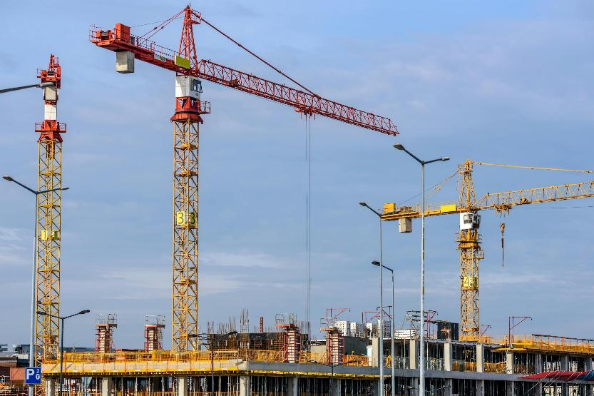
Recap
Introduction
What do you already know about MMC?
Have you seen any MMC used locally or on placement?
If so, why might the contractor have chosen MMC?
Lesson 3: Types of Modern Methods of Construction
Notes:
Image © Pexels/AS Photography

Slide 4
Research task
Activity 1
Follow the steps laid out in this research task to produce a guide for clients who have no construction experience. You will need to outline what types of MMC are available and what materials are used in each method.
You will need to discuss how emerging technologies can be used to enhance the process – for example, robotics, computer numerical control (CNC), building information modelling (BIM), 3D concrete printing.
Lesson 3: Types of Modern Methods of Construction

Slide 5
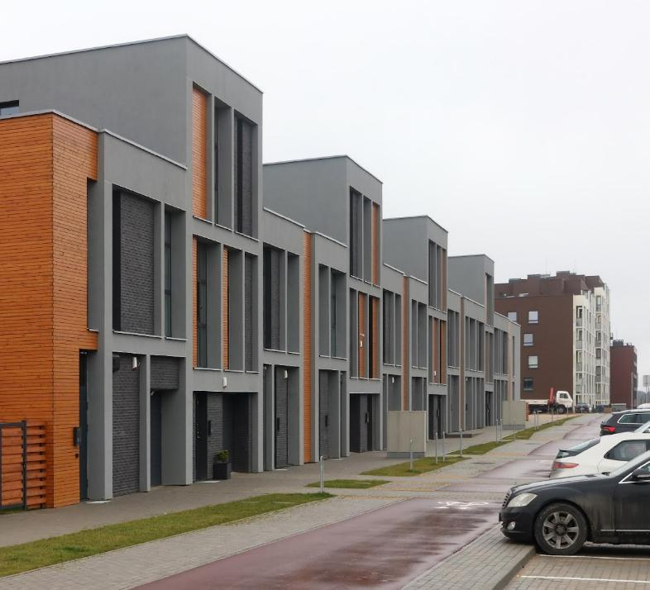
Warm-up
Activity 1
Write a short definition of MMC.
List five different types of MMC.
Lesson 3: Types of Modern Methods of Construction
Notes:
Image © Shutterstock/vilax

Slide 6
Step 1: Plan what you need
Activity 1
You are going to research 3D volumetric construction, structural insulated panels (SIPs) and pre-manufactured components. You need to find out:
how each method works and what materials are used;
benefits/limitations of each method and cost implications;
if and how emerging technologies are being used.
Ask yourself:
What do you already know about these technologies?
How will you record the information you need?
Are there any specific questions you would like answered?
Lesson 3: Types of Modern Methods of Construction

Slide 7
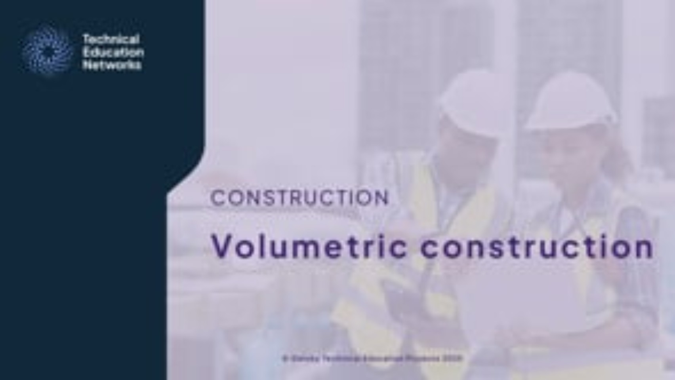
Step 2: Volumetric construction video
Activity 1
Activity 1
Lesson 3: Types of Modern Methods of Construction
Notes:
Volumetric construction video: https://vimeo.com/1069606578

Slide 8
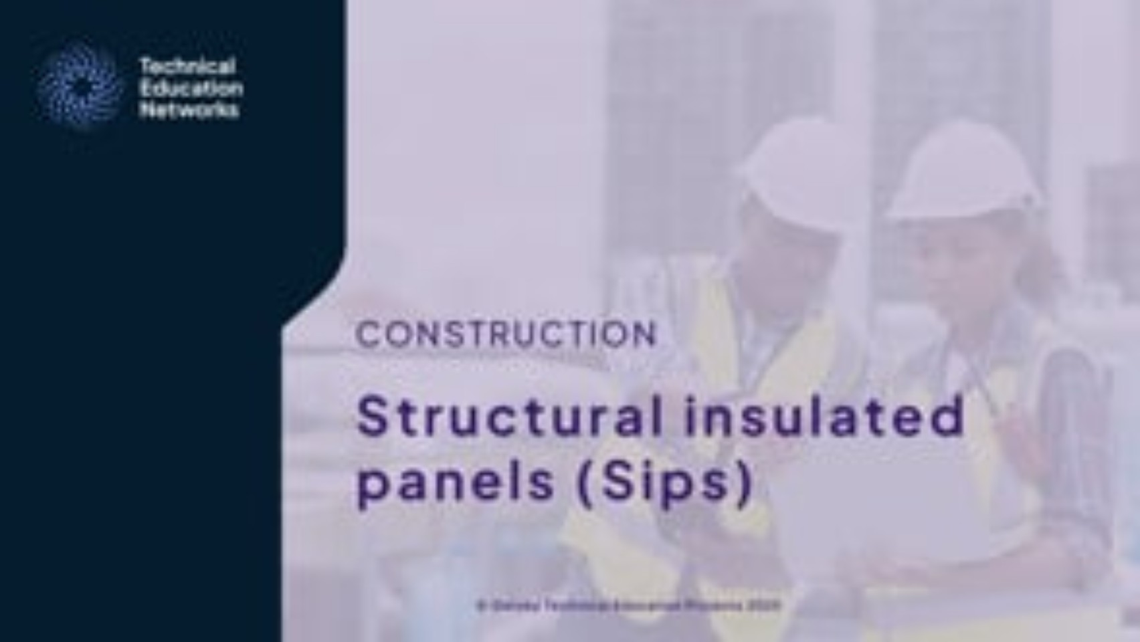
Step 2: Structural Insulated Panels video
Activity 1
Lesson 3: Types of Modern Methods of Construction
Notes:
Structural insulated panels video: https://vimeo.com/1070001660

Slide 9

Step 2: Pre-manufactured components video
Activity 1
Lesson 3: Types of Modern Methods of Construction
Notes:
Pre-manufactured components video: https://vimeo.com/1070001877

Slide 10

Step 3: Check your plan
Activity 1
Did you find all the information you need?
Go back to the videos to find any missing information from your plan.
Is there anything you need to research further before continuing?
Lesson 3: Types of Modern Methods of Construction
Notes:
Image © Pexels/Liza Summer

Slide 11
Step 4: Research other methods
Activity 1
Find out enough about these other methods to write a brief definition of the materials and techniques and describe any emerging technologies that are used to enhance the process.
Pre-assembled units/elements, such as floor and roof cassettes
Precast concrete sections and cladding panels
Framed panels (timber/steel)
  timber
  steel
3D printing
Steel framing systems
Pre-assembled structural steelwork
Lesson 3: Types of Modern Methods of Construction

Slide 12
Step 5: Write your guide
Activity 1
Write a guide for clients without construction experience about types of MMC.
You need to include:
an introduction – make it clear what the guide will be about;
a list of different types of MMC and a brief description of each;
a focus on one type of MMC – with in-depth information about how it works, the material used and the use of emerging technology (include diagrams and images);
any personal experience you have had with different types of MMC (e.g. on your placement);
a conclusion – a summary of the information you have included in your guide.
Lesson 3: Types of Modern Methods of Construction

Slide 13
Step 6: Reflect on your work
Activity 1
Did you find out everything you needed to?
What would you have done differently when researching?
What did you find hard when writing your guide?
How would you improve your research and writing next time?
What questions do you still have regarding types of MMC?
Lesson 3: Types of Modern Methods of Construction

Slide 14
Applying your knowledge
Plenary
Consider the benefits and drawbacks of using the different types of MMC for the following scenarios with specified restrictions:
one-off building design
collection of 22 houses for social housing
high-rise office block
outdoor pursuits centre.
Resources needed
L3 Plenary Worksheet
L3 Plenary Answer Sheet
Lesson 3: Types of Modern Methods of Construction

Slide 15
In this lesson, we have:
Plenary
identified and described different types of off-site construction methods;
discriminated between off-site methods and selected appropriate methods for different situations.
Skills:
CS1 Participate in group and class discussions to examine concepts and approaches to produce solutions to construction problems
General competencies:
English:
E3 Create text for different purposes and audiences
E5 Synthesise information
E6 Take part in/leading discussions
Digital:
D1 Use digital technology and media effectively
D3 Communicate and collaborate
Lesson 3: Types of Modern Methods of Construction

Slide 16
Take it further
Consolidation
If you enjoyed researching different types of off-site construction methods and would like to find out more, consider searching for ‘using emerging technologies for MMC’, or researching how the NHS are planning to adopt more MMC into their infrastructure.
Can you now answer any of the questions you raised yourself in Step 6?
Lesson 3: Types of Modern Methods of Construction

