Slide 1
Health
Route: Health & Science
Topic: An introduction to social care
Lesson 1: What is social care?
Notes:
Image © Shutterstock/Fizkes

Slide 2
In this lesson, we will:
Introduction
Define social care and person-centred care
Summarise a range of social care settings
Compare primary and secondary care
Analyse the professional’s role in delivering social care
Examine how an individual’s needs are met using a person-centred approach
Recognise potential barriers to accessing services
Skills:
CS1.1 Plan and develop person-centred care
CS3.2 Undertake collaborative work
CS4.1 Undertake reflective practice and record reflections and experiences
CS4.2 Make improvements to own practice
General competencies:
English:
GEC2 Present information and ideas
GEC4 Summarise information/ideas
Digital:
GDC1 Use digital technology and media effectively
Lesson 1: What is social care?

Slide 3

Support systems
Introduction
Discuss in pairs:
What support is available for people with disabilities to help them live their lives as independently as possible?
Why is this important?
Lesson 1: What is social care?
Notes:
Image © Shutterstock/Oksana Klymenko

Slide 4
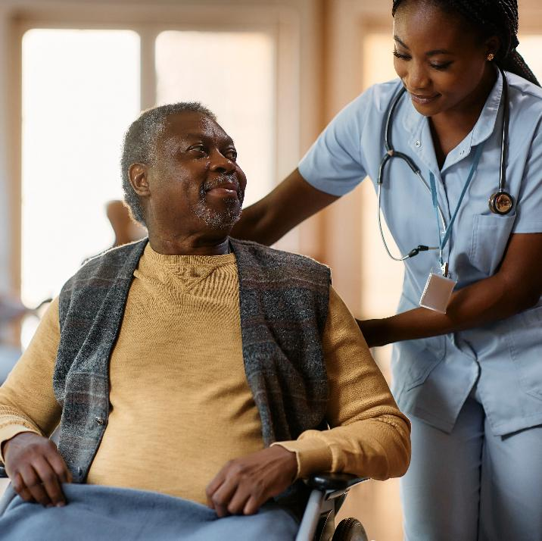
Empowerment
Key terms
Empowerment is about enabling a person to have as much control over their life as possible, for example by offering choices and consulting.
What choices do you make independently?
How would you feel if these choices were taken away?
Lesson 1: What is social care?
Notes:
Image © Shutterstock/Drazen Zigic

Slide 5
Person-centred care (source: NCFE)
Key terms
Focusing care on the needs, values and preferences of the individual and ensuring any decisions are guided by these needs, values and preferences. High-quality care focuses on the six Cs: care, compassion, communication, courage, commitment and competence.
Social care (source: NCFE)
The provision of specialist support to meet an individual’s personal needs in order for them to live as comfortably and independently as possible.
Lesson 1: What is social care?

Slide 6

Social care provision
Introduction
Lesson 1: What is social care?
Notes:
Change the script on social work video: https://www.youtube.com/watch?v=TvfNYlIRUjw - by Social Work England - https://www.socialworkengland.org.uk/about/about-social-work/

Slide 7
Social care provisions
Activity 1
List as many examples of social care provision as you can in 30 seconds.
Examples:
Residential home
Lesson 1: What is social care?

Slide 8
Social care provisions
Activity 1
List as many examples of social care provision as you can in 30 seconds.
Examples:
Residential home
At home (domiciliary care)
Shared house/community of Flats (supported living)
Children’s home
Hostel
Day centres
Lesson 1: What is social care?

Slide 9
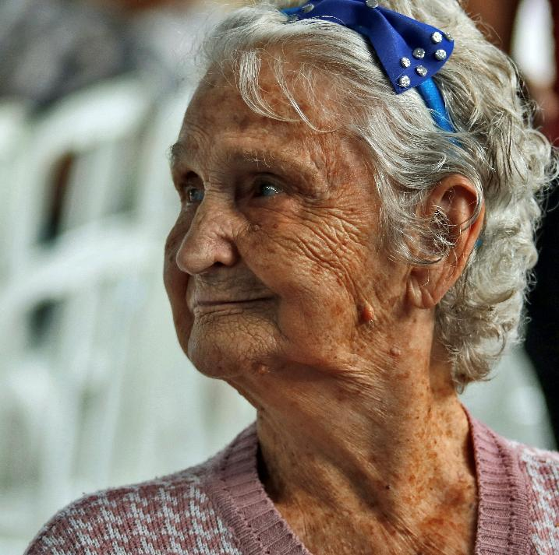
Janette
Activity 1
Janette is 90. Her husband passed away some years ago.
She is frail and at times is unable to get to the toilet on time.
She has difficulty with balance and has not been able to self-care or eat nutritious foods.
What social care support would you recommend?
Lesson 1: What is social care?
Notes:
Image © Unsplash/Vladimir Soares

Slide 10

Abel
Activity 1
Abel is 67. He has a sight impairment caused by type 2 diabetes. He lives alone in his own home. Abel is unable to read labels on food, or recipes, to enable him to lose weight. He is also unable to read laundry instructions, bills he gets in the post or his pinprick blood glucose reading.
What social care support would you recommend?
Lesson 1: What is social care?
Notes:
Image © Unsplash/Izzy Park

Slide 11

Alise
Activity 1
Alise is 19 and has cerebral palsy. She has some physical limitations and needs regular healthcare services. Her parents have decided to move back to Poland, but Alise is at university and has friends here. She manages herself well, but there are concerns that she may have a sudden decline.
What social care support would you recommend?
Lesson 1: What is social care?
Notes:
Image © Shutterstock/SeventyFour

Slide 12

Types of primary care service
Activity 2
Primary care services
111
Pharmacy
General practitioner
Optician
Dentist
Lesson 1: What is social care?
Notes:
Image © Shutterstock/Monkey Business Images

Slide 13

Overview of types of secondary care service
Activity 2
Hospital specialists
Healthcare
Allied healthcare professionals
Support for independence
Secondary care services
Social care
Therapies and counselling
Community and voluntary support
Services for children and young people
Lesson 1: What is social care?
Notes:
Image © Pexels/Vitaly Gariev

Slide 14
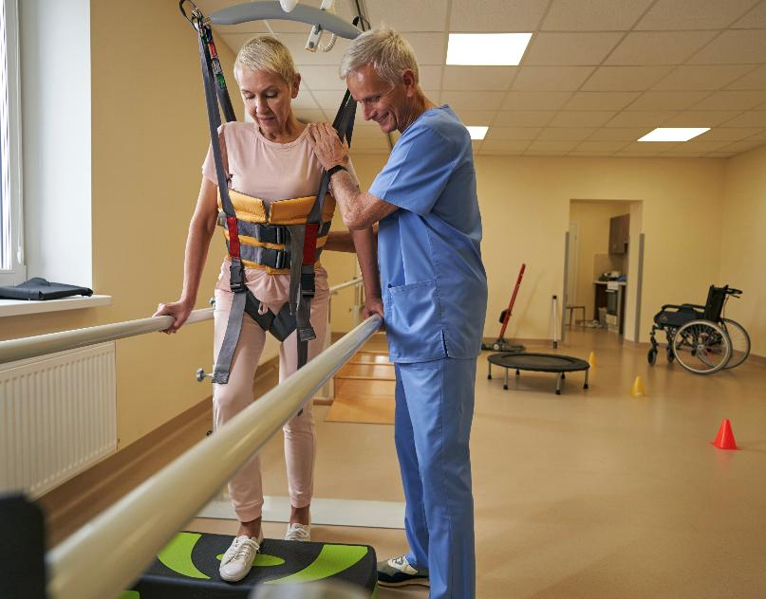
Tertiary care
Activity 2
Care for people needing complex treatments such as:
stroke rehabilitation;
transplants;
plastic surgery;
secure forensic mental health services.
People may be referred for tertiary care from either primary or secondary care.
Why are individuals not able to access secondary or tertiary care services without a referral?
Lesson 1: What is social care?
Notes:
Image © Shutterstock/Svitlana Hulko

Slide 15
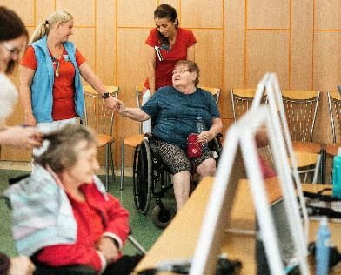

Social workers:
Activity 3
work with individuals with learning, sensory or physical disabilities;
find solutions to daily problems;
signpost to other services and support;
develop skills and safeguard.
work with the homeless, older people and individuals who have an addiction;
support access to suitable housing;
support independence and recovery;
help to maintain an individual’s rights.
Lesson 1: What is social care?
Notes:
Image © Pexels/Jsme MILA
Image © Unsplash/Dean Bennett
Teachers may also wish to invite a social worker to talk to the class about their role, or use a video clip such as youtu.be/eFUERpyTlp8?si=WJjijSVLf0FWLeiP

Slide 16

Social care professionals and job roles
Activity 3
Counsellor
Occupational therapist (OT)
Community support and outreach worker
Community therapist
Youth and community services
Rehabilitation worker
Advocate
Housing support officer
Postnatal depression support group
Lesson 1: What is social care?
Notes:
Image © Shutterstock/Studio Romantic

Slide 17

Barriers to accessing services
Activity 4
Lesson 1: What is social care?
Notes:
Barriers to accessing services video: https://vimeo.com/1077657773/809b9a258e

Slide 18
In this lesson, we have:
Plenary
Defined social care and person-centred care
Summarised a range of social care settings
Compared primary and secondary care
Analysed the professional’s role in delivering social care
Examined how an individual’s needs are met using a person-centred approach
Recognised potential barriers to accessing services
Skills:
CS1.1 Plan and develop person-centred care
CS3.2 Undertake collaborative work
CS4.1 Undertake reflective practice and record reflections and experiences
CS4.2 Make improvements to own practice
General competencies:
English:
GEC2 Present information and ideas
GEC4 Summarise information/ideas
Digital:
GDC1 Use digital technology and media effectively
Lesson 1: What is social care?

Slide 19
Personal factors
Consolidation
A range of personal factors dictates which care provisions people need to access. These include age, health and employment status.
For each of these people, list some care provisions they would need to access, and explain why.
Daisy is a 25-year-old single mother to Noah, aged six months. Daisy has been diagnosed with postnatal depression.
Ray is 52 years old. He recently had to have a big toe amputated because of complications from his diabetes. He is currently unemployed.
Lesson 1: What is social care?

