Slide 1
Science
Route: Health & Science
Topic: Refluxing
Lesson 1: Reflux and oxidation
Notes:
Image © Shutterstock/BalanceFormCreative

Slide 2
In this lesson, we will:
Introduction
Write word and symbol equations to show the oxidation of alcohols to form carboxylic acids
Describe the uses of refluxing during organic synthesis
Identify and justify the use of a reflux reaction
Identify the appropriate equipment and explain the correct setup for a reflux reaction
Skills:
S1.73 Apply scientific knowledge when undertaking scientific techniques
S1.79 Use the following practical scientific techniques to prepare, isolate and separate materials: Refluxing
S1.84 Select appropriate equipment to complete practical scientific techniques
General competencies:
English:
GEC2 Present information and ideas
GEC4 Summarise information/ideas
Maths:
GMC1 Measuring with precision
GMC10 Optimising work processes
Lesson 1: Refluxing and oxidation

Slide 3

Introduction to reflux
Introduction
THINK, PAIR, SHARE:
Why is heat required in some chemical reactions?
Lesson 1: Refluxing and oxidation
Notes:
Image © Wikimedia Commons/Arne Groh

Slide 4

Introduction to reflux
Introduction
THINK, PAIR, SHARE:
A company has a reaction with a high activation energy and a slow rate of reaction that contains ethanol (boiling point = 78ºC) as the solvent.
If they choose to heat the reaction mixture for a long period of time in a round-bottom flask (RBF) or beaker, what issues can you foresee?
How can they overcome this?
Lesson 1: Refluxing and oxidation
Notes:
Image © Pexels/CupofCouple

Slide 5
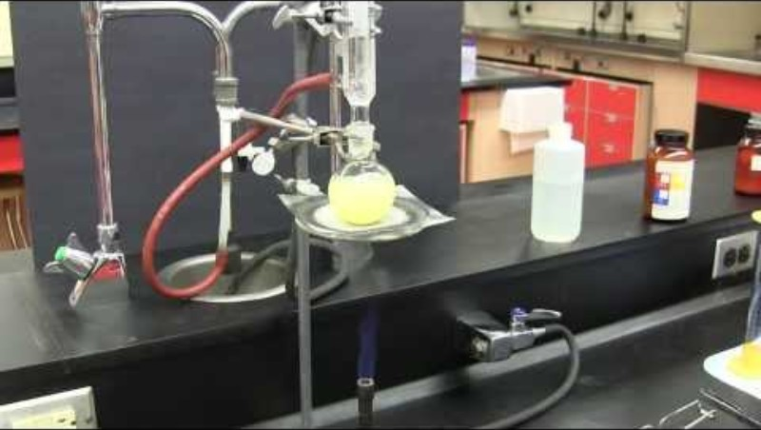
Reflux equipment
Introduction
Watch the video and use it and your knowledge to label the equipment in the diagram on your Activity sheet.
Lesson 1: Refluxing and oxidation
Notes:
Heating under reflux video: https://www.youtube.com/watch?app=desktop&v=_SzYqPdUkFQ

Slide 6
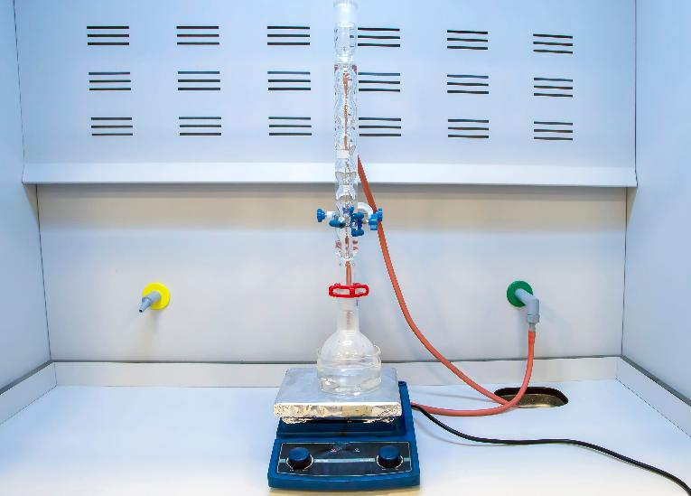
Activity 1 – Reflux demonstration
Activity 1
Watch your teacher perform a demonstration of a reflux reaction to oxidise ethanol.
Think about:
How does the process of reflux work? Why is there no solvent loss?
How does it differ from distillation?
What product is formed in this reaction?
Lesson 1: Refluxing and oxidation
Notes:
Image © Shutterstock/eczserapyilmaz

Slide 7

Reflux theory – Task 1
Activity 1
Explain briefly how reflux works.
Include a description of the state changes.
Lesson 1: Refluxing and oxidation

Slide 8
Reflux theory – Answer
Activity 1
The reaction mixture is heated from below – usually using a heating mantle.
When a reactant/solvent reaches its boiling point, it boils/evaporates and changes state to a gas and rises up into the condenser.
The condenser is continuously cooled and cools down any vapour in the condenser until its temperature falls below its boiling point.
The vapour condenses back into the liquid state and drips back down into the reaction vessel (where it is heated again).
Lesson 1: Refluxing and oxidation

Slide 9
Oxidation – Task 2
Activity 1
What is the definition of oxidation?
Write the word and symbol equation for the oxidation of ethanol into ethanoic acid.
How can we verify that ethanoic acid was made in the reaction?
H
H
potassium dichromate (VI)
dilute sulfuric acid
H
O
H
C
C
OH
H
C
C
heat
H
OH
H
H
ethanol
ethanoic acid
Lesson 1: Refluxing and oxidation

Slide 10
Oxidation – Answers
Activity 1
Definition of oxidation: Addition of oxygen, loss of hydrogen, loss of electrons.
Word equation: ethanol + [O] ethanoic acid + water
Symbol equation: CH₃CH₂OH + 2[O] CH₃COOH + H₂O
The product can be verified as ethanoic acid by distilling off the ethanoic acid, then checking its boiling point is 118ºC.
Lesson 1: Refluxing and oxidation

Slide 11
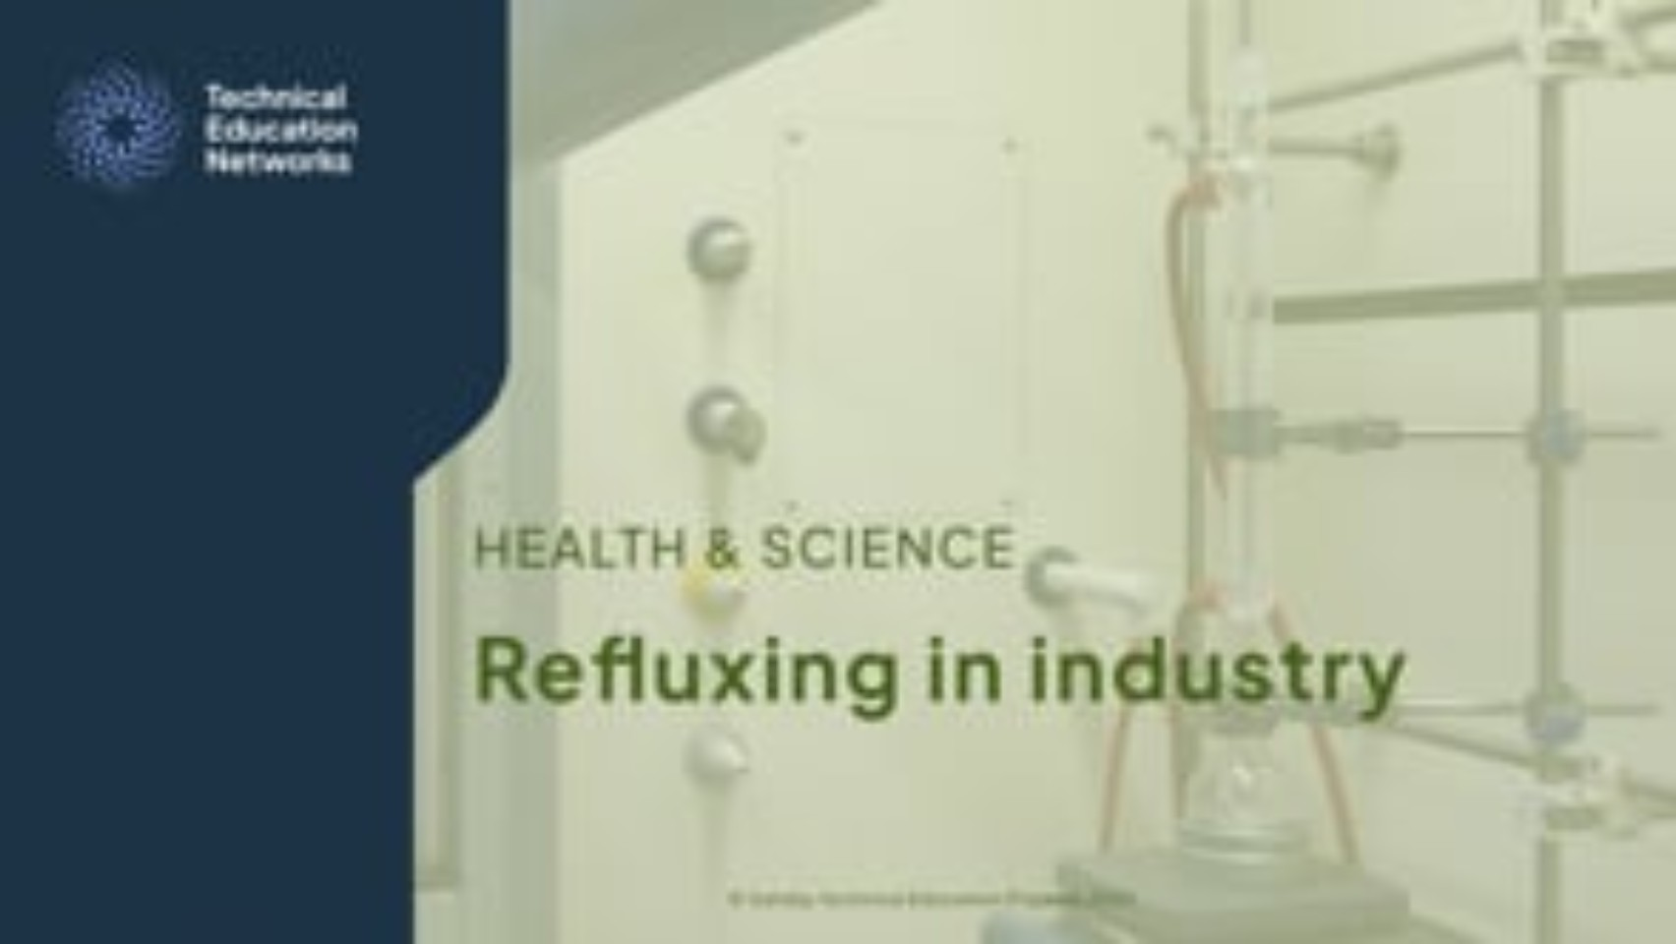
Reflux in industry
Activity 2
Watch the video on reflux in industry and answer these questions from the Activity sheet.
Identify three different uses of reflux in industry.
Undertake some research to explain how the use of reflux is beneficial in each case.
Lesson 1: Refluxing and oxidation
Notes:
Refluxing in industry video: https://vimeo.com/1060452181

Slide 12
Reflux in industry – Suggested answers
Activity 2
Some uses of reflux in industry:
In laboratory batch processes – to keep a constant high temperature and continuous mixing without loss of solvent/reactants.
In crude oil refineries/petrochemical plants – to increase efficacy of continuous distillation towers.
In the manufacture of medicines/food additives – to maintain a high temperature environment without the loss of solvent.
Lesson 1: Refluxing and oxidation

Slide 13
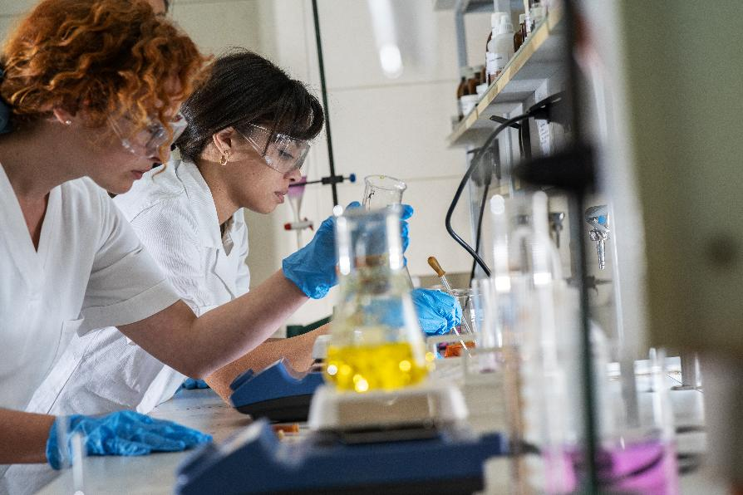
Troubleshooting reflux
Activity 3
Consider the reported problems/observations in the Activity sheet relating to a reaction under reflux.
Suggest solutions or explanations for what is going wrong.
Lesson 1: Refluxing and oxidation
Notes:
Image © Shutterstock/BalanceFormCreative

Slide 14
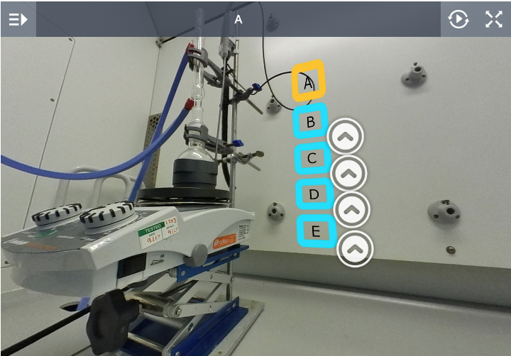
Troubleshooting reflux
Activity 3
As a whole class, examine the five scenarios (A–E) on this interactive exercise.
In pairs, decide which is the correct setup – be prepared to justify your choice to the rest of the class!
Lesson 1: Refluxing and oxidation
Notes:
Interactive exercise: www.chemtube3d.com/reflux-apparatus-360-interactive-exercise/

Slide 15
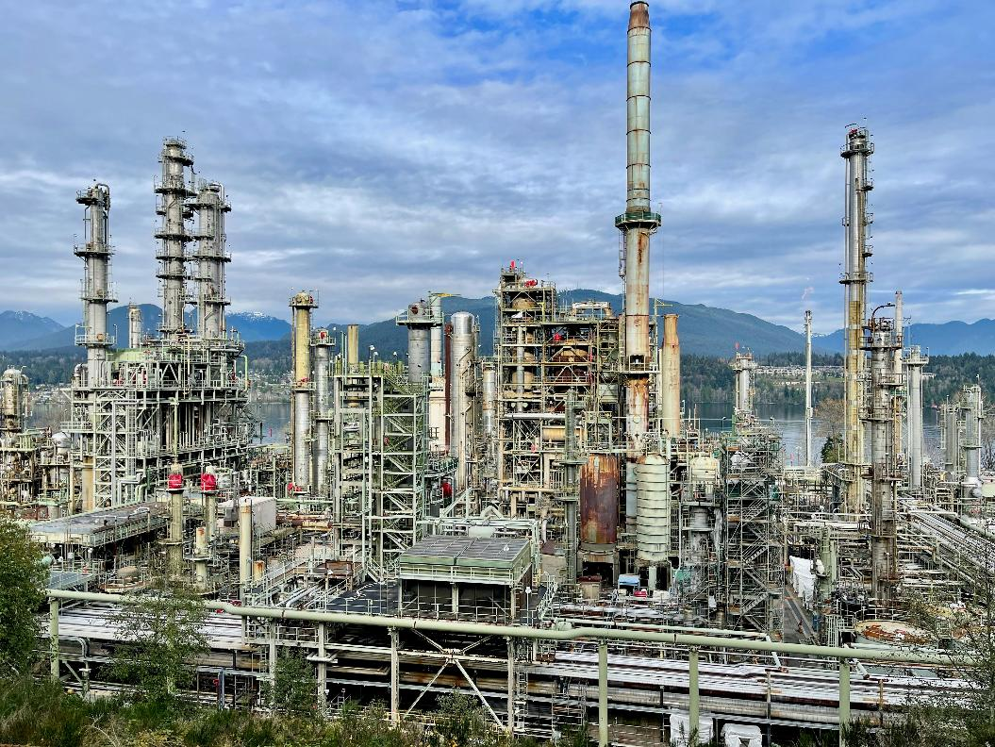
Plenary
Plenary
Answer the questions in the Activity sheet to check your knowledge about reflux.
Lesson 1: Refluxing and oxidation
Notes:
Image © Unsplash/Anthony Maw

Slide 16
In this lesson, we have:
Plenary
Written word and symbol equations to show the oxidation of alcohols to form carboxylic acids
Described the uses of refluxing during organic synthesis
Identified and justified the use of a reflux reaction
Identified the appropriate equipment and explained the correct setup for a reflux reaction
Skills:
S1.73 Apply scientific knowledge when undertaking scientific techniques
S1.79 Use the following practical scientific techniques to prepare, isolate and separate materials: Refluxing
S1.84 Select appropriate equipment to complete practical scientific techniques
General competencies:
English:
GEC2 Present information and ideas
GEC4 Summarise information/ideas
Maths:
GMC1 Measuring with precision
GMC10 Optimising work processes
Lesson 1: Refluxing and oxidation

Slide 17
Consolidation
Consolidation
Research a waterless air condenser – a ‘greener alternative’ to using a (Liebig) water condenser in a batch process laboratory.
Write a short article about this alternative, aimed to go into a company bulletin.
Your article should evaluate and justify its use in a laboratory setting.
Lesson 1: Refluxing and oxidation

