Slide 1
Construction
Route: Construction
Topic: Law and contracts in construction
Lesson 4: I want to extend my house. What do I need to know?
Notes:
Image © Shutterstock/CrizzyStudio

Slide 2
In this lesson, we will:
Introduction
Skills:
Develop ability to appraise and form valid arguments from information given in a case study.
Improve communication skills by creating reports and presentations for different audiences.
Build teamwork and discussion skills by participating in group and class discussion to explore ideas.
General competencies:
English:
E2 Present information and ideas.
E5 Synthesise information.
E6 Take part in/lead discussions.
Digital:
D1 Use digital technology and media effectively.
D3 Communicate and collaborate.
describe the planning application process;
explain delegated and permitted permission;
explain the basic provisions of the Party Wall Act and when it applies.
Lesson 4: I want to extend my house. What do I need to know?

Slide 3
Knowledge recap
Introduction
What are the key differences between leasehold and freehold property ownership?
What are some of the main drawbacks with leasehold property?
Lesson 4: I want to extend my house. What do I need to know?

Slide 4
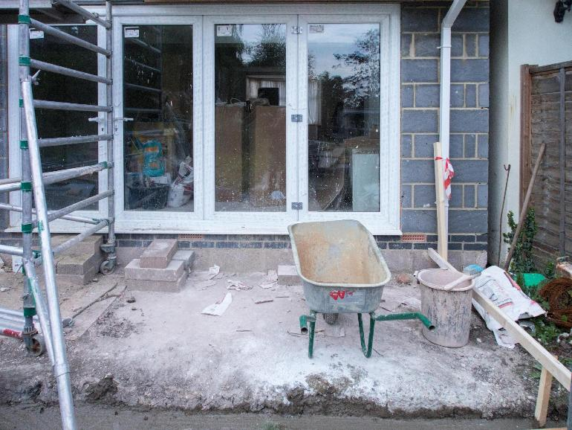
Icebreaker questions
Introduction
Would a planning application be needed for a new development of five houses?
What about an extension to a house?
What about fitting a new kitchen?
What do you think a planning application consists of?
What do you think is the purpose of planning applications in property development?
Lesson 4: I want to extend my house. What do I need to know?
Notes:
Image © Pexels/Brett Jordan

Slide 5

Planning Applications and Planning Permission
Introduction
Watch the video and answer the questions in Lesson 4 Introduction Worksheet.
Lesson 4: I want to extend my house. What do I need to know?
Notes:
Planning permission video: https://vimeo.com/1095618885/8872707b8f

Slide 6
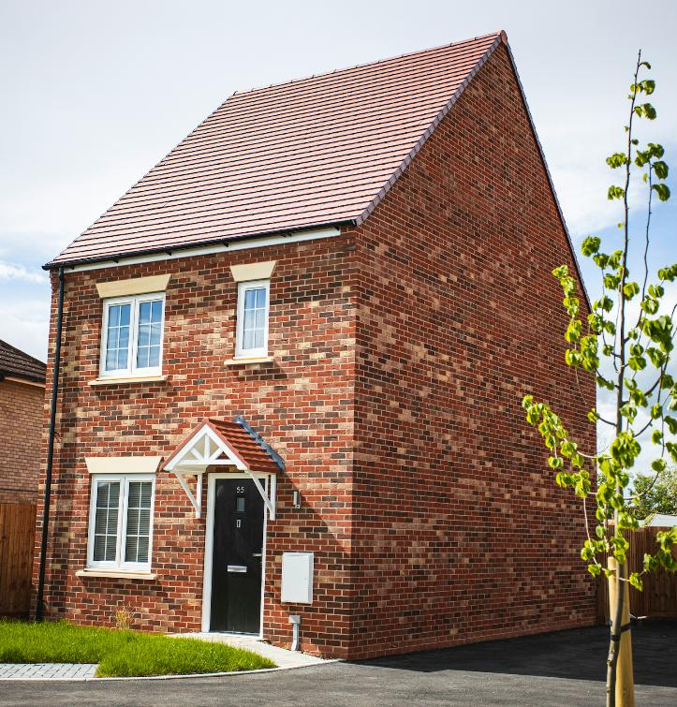
Case study analysis
Activity 1
You will be using the UK Government’s interactive planning portal to explore if different case study examples of proposed home improvements require planning permission.
Case study 1
The property is a detached house in a suburban area. Mr Turner and Ms Kowalska wish to add a single-storey extension to the rear of the property to create a large kitchen and dining area. The proposed extension will be four metres in length and feature bi-fold doors leading to the garden.
Lesson 4: I want to extend my house. What do I need to know?
Notes:
Image © Unsplash/James Feaver

Slide 7
Case study analysis
Activity 1
Go to: interactive.planningportal.co.uk
Use the clickable areas of the interactive house to explore common home improvements.
Navigate to the section that applies to your given case study scenario.
Once you have clicked on an area, detailed information will appear about whether planning permission is required.
Record key points, such as whether planning permission is required, any size or height restrictions and special rules for conservation areas or listed buildings.
After gathering the necessary information, discuss your findings with your group and be ready to discuss your findings with the class.
Lesson 4: I want to extend my house. What do I need to know?
Notes:
interactive.planningportal.co.uk

Slide 8
Instructions for group discussion
Activity 1
Discuss the assigned case study within your group.
Assign roles: notetaker, spokesperson and timekeeper.
Explore the planning portal, focusing on your case study.
Present your findings and explain whether the improvements require planning permission.
Notetaker – this student is responsible for writing down the group’s ideas on the worksheet.
Spokesperson – this student will present the group’s findings to the class.
Timekeeper – this student ensure the group stays on track and finishes within the given time.
Lesson 4: I want to extend my house. What do I need to know?

Slide 9
Case study answers
Activity 1
Case study 1: Mr Turner and Ms Kowalska would need to apply for planning permission if more than half the area of the land around the ‘original house’ would be covered by the extension, and if it was higher than the highest part of the existing roof or eaves of their home.
Case study 2: Converting the loft of a house is considered to be permitted development and does not require planning permission. However, planning may still be needed if Ms Patel has previously extended the house. Any materials used must be similar to the appearance of the existing house.
Case study 3: The new sign will require planning permission as it is illuminated. This is because signage can harm an area visually and must be designed in a manner to meet the guidance prepared by a local planning body.
Lesson 4: I want to extend my house. What do I need to know?

Slide 10

Case study answers
Activity 1
Case study 4: As the extension extends five metres beyond the rear wall of the house, planning permission will be required.
Case study 5: The addition of solar panels to the roof of the property is likely to be considered ‘permitted development’ with no requirement for planning permission. However, permission may be needed if the property is listed or in a conservation area, so Ms Taylor would still need to check with her local planning office.
Lesson 4: I want to extend my house. What do I need to know?
Notes:
Image © Pexels/Kindel Media

Slide 11
Discussion questions
Activity 1
Why do some types of development require planning permission?
What might happen if certain developments were allowed without permission?
Lesson 4: I want to extend my house. What do I need to know?

Slide 12

Discussion answers
Activity 1
Why do some types of development require planning permission?
Certain developments require planning permission to ensure they meet the regulations that protect the environment, local character and community wellbeing. This process ensures that any changes are in harmony with the surroundings, avoid causing disruptions and consider the impact on neighbouring properties.
Lesson 4: I want to extend my house. What do I need to know?
Notes:
Image © Unsplash/Éole Wind

Slide 13

Discussion answers
Activity 1
What might happen if certain developments were allowed without permission?
If developments were allowed without permission, it could lead to overdevelopment, environmental damage and harm to the community.
For example, inappropriate building extensions might block natural light or reduce privacy for neighbours, while unregulated construction could disrupt local ecosystems, worsen traffic congestion or increase the strain on utilities and public services.
Ultimately, this could decrease property values and damage the overall quality of life in the area.
Lesson 4: I want to extend my house. What do I need to know?
Notes:
Image © Unsplash/the blowup

Slide 14
Key steps in the planning application process
Activity 2
Pre-application advice
Submit planning application
Validation and consultation
Site visit and assessment
Decision- making
Decision notification
Appeals process
Lesson 4: I want to extend my house. What do I need to know?

Slide 15
Multiple-choice questions
Activity 2
1. Which step comes first in the planning application process?
a) submit the application
b) pre-application advice
c) validation
d) decision issued
Lesson 4: I want to extend my house. What do I need to know?

Slide 16
Multiple-choice answers
Activity 2
1. Which step comes first in the planning application process?
a) submit the application
b) pre-application advice
c) validation
d) decision issued
Lesson 4: I want to extend my house. What do I need to know?

Slide 17
Multiple-choice questions
Activity 2
2. What does the planning authority check during the validation step?
a) whether the development fits the local plan
b) if the application is complete with all necessary documents
c) the consultation feedback
d) the design of the building
Lesson 4: I want to extend my house. What do I need to know?

Slide 18
Multiple-choice answers
Activity 2
2. What does the planning authority check during the validation step?
a) whether the development fits the local plan
b) if the application is complete with all necessary documents
c) the consultation feedback
d) the design of the building
Lesson 4: I want to extend my house. What do I need to know?

Slide 19
Multiple-choice questions
Activity 2
3. What is the purpose of the consultation step in the planning application process?
a) to get feedback from local residents and other organisations, like the highway agency
b) to confirm the site measurements
c) to collect payment for planning fees
d) to finalise the design of the development
Lesson 4: I want to extend my house. What do I need to know?

Slide 20
Multiple-choice answers
Activity 2
3. What is the purpose of the consultation step in the planning application process?
a) to get feedback from local residents and other organisations, like the highway agency
b) to confirm the site measurements
c) to collect payment for planning fees
d) to finalise the design of the development
Lesson 4: I want to extend my house. What do I need to know?

Slide 21
Multiple-choice questions
Activity 2
4. Which of the following is typically required to validate a planning application?
a) site plans
b) neighbours’ signatures
c) community support letters
d) local council meeting minutes
Lesson 4: I want to extend my house. What do I need to know?

Slide 22
Multiple-choice answers
Activity 2
4. Which of the following is typically required to validate a planning application?
a) site plans
b) neighbours’ signatures
c) community support letters
d) local council meeting minutes
Lesson 4: I want to extend my house. What do I need to know?

Slide 23
Multiple-choice questions
Activity 2
5. Who usually makes the final decision on straightforward planning applications?
a) the local community
b) a planning officer using delegated powers
c) the full planning committee
d) the property owner
Lesson 4: I want to extend my house. What do I need to know?

Slide 24
Multiple-choice answers
Activity 2
5. Who usually makes the final decision on straightforward planning applications?
a) the local community
b) a planning officer using delegated powers
c) the full planning committee
d) the property owner
Lesson 4: I want to extend my house. What do I need to know?

Slide 25
Multiple-choice questions
Activity 2
6. When would a planning application typically go to the full planning committee?
a) for small home extensions
b) for permitted developments
c) for large or complex developments
d) for solar panel installations
Lesson 4: I want to extend my house. What do I need to know?

Slide 26
Multiple-choice answers
Activity 2
6. When would a planning application typically go to the full planning committee?
a) for small home extensions
b) for permitted developments
c) for large or complex developments
d) for solar panel installations
Lesson 4: I want to extend my house. What do I need to know?

Slide 27
Multiple-choice questions
Activity 2
7. Which of these developments is likely to fall under permitted development rights?
a) building a new house
b) adding a single-storey rear extension to a house
c) building a new school
d) demolishing an existing property
Lesson 4: I want to extend my house. What do I need to know?

Slide 28
Multiple-choice answers
Activity 2
7. Which of these developments is likely to fall under permitted development rights?
a) building a new house
b) adding a single-storey rear extension to a house
c) building a new school
d) demolishing an existing property
Lesson 4: I want to extend my house. What do I need to know?

Slide 29
Multiple-choice questions
Activity 2
8. Which of the following is a common condition for loft conversions to be considered permitted development?
a) The loft does not extend beyond the plane of the existing roof slope facing the highway.
b) The roof is completely replaced.
c) The loft has windows larger than 1m².
d) The loft extends onto neighbouring properties.
Lesson 4: I want to extend my house. What do I need to know?

Slide 30
Multiple-choice answers
Activity 2
8. Which of the following is a common condition for loft conversions to be considered permitted development?
a) The loft does not extend beyond the plane of the existing roof slope facing the highway.
b) The roof is completely replaced.
c) The loft has windows larger than 1m².
d) The loft extends onto neighbouring properties.
Lesson 4: I want to extend my house. What do I need to know?

Slide 31
Multiple-choice questions
Activity 2
9. What is delegated permission?
a) the authority given to homeowners to decide their own planning applications
b) the power given to planning officers to make decisions on certain applications without the full committee
c) a rule that allow immediate approval of large-scale developments
d) a law that allows automatic approval after ten days
Lesson 4: I want to extend my house. What do I need to know?

Slide 32
Multiple-choice answers
Activity 2
9. What is delegated permission?
a) the authority given to homeowners to decide their own planning applications
b) the power given to planning officers to make decisions on certain applications without the full committee
c) a rule that allow immediate approval of large-scale developments
d) a law that allows automatic approval after ten days
Lesson 4: I want to extend my house. What do I need to know?

Slide 33
Multiple-choice questions
Activity 2
10. What is the purpose of the site visit step in the planning process?
a) to collect feedback from neighbours
b) to review the condition of the property and its surroundings
c) to measure the financial value of the project
d) to ensure that all documents have been submitted
Lesson 4: I want to extend my house. What do I need to know?

Slide 34
Multiple-choice answers
Activity 2
10. What is the purpose of the site visit step in the planning process?
a) to collect feedback from neighbours
b) to review the condition of the property and its surroundings
c) to measure the financial value of the project
d) to ensure that all documents have been submitted
Lesson 4: I want to extend my house. What do I need to know?

Slide 35
Multiple-choice questions
Activity 2
11. What might happen if certain developments were allowed without planning permission?
a) There would be no need for consultation.
b) Developments could negatively impact neighbours or the environment.
c) Property values would automatically increase.
d) All developments would be delayed.
Lesson 4: I want to extend my house. What do I need to know?

Slide 36
Multiple-choice answers
Activity 2
11. What might happen if certain developments were allowed without planning permission?
a) There would be no need for consultation.
b) Developments could negatively impact neighbours or the environment.
c) Property values would automatically increase.
d) All developments would be delayed.
Lesson 4: I want to extend my house. What do I need to know?

Slide 37
Multiple-choice questions
Activity 2
12. What happens after the decision is issued in the planning process?
a) The applicant must resubmit the application.
b) The project is reviewed by another planning authority.
c) The applicant can either proceed or appeal the decision.
d) The consultation process begins again.
Lesson 4: I want to extend my house. What do I need to know?

Slide 38
Multiple-choice answers
Activity 2
12. What happens after the decision is issued in the planning process?
a) The applicant must resubmit the application.
b) The project is reviewed by another planning authority.
c) The applicant can either proceed or appeal the decision.
d) The consultation process begins again.
Lesson 4: I want to extend my house. What do I need to know?

Slide 39
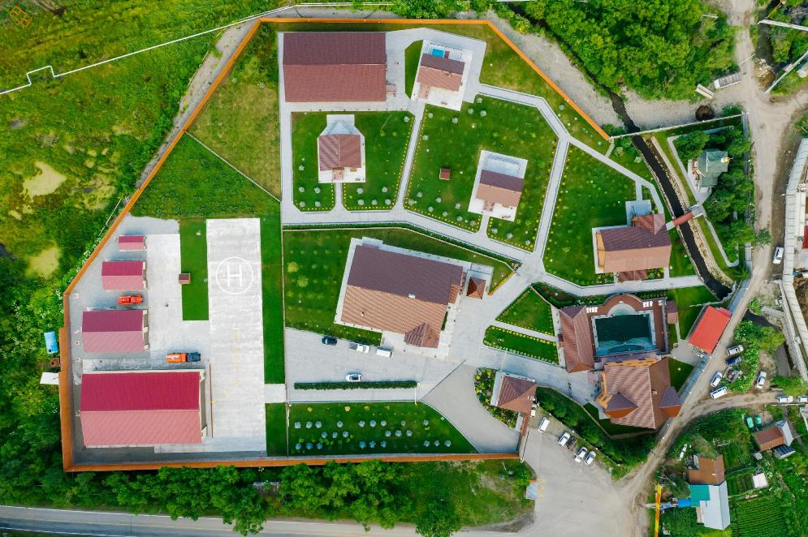
Introduction to the Party Wall Act
Activity 3
The Party Wall Act 1996 provides a legal framework to prevent and resolve disputes between neighbours regarding party walls, boundary walls and excavations near adjoining buildings.
Lesson 4: I want to extend my house. What do I need to know?
Notes:
Image © Pexels/Mikhail Nilov

Slide 40
Introduction to the Party Wall Act 1996
Activity 3
The Act applies when any construction or alterations are proposed that may affect a shared wall or boundary between two properties.
The building owner(s) must follow a process outlined in the Act to ensure both parties understand the proposed work and are protected from any potential damage or disputes.
Lesson 4: I want to extend my house. What do I need to know?

Slide 41
Key provisions of the Party Wall Act 1996
Activity 3
The building owner must give formal notice to the adjoining owner before beginning any work on a shared or boundary wall. This notice includes details about the proposed work and must be served at least two months before the work starts.
If the adjoining owner does not agree to the work or fails to respond, both parties must appoint a Party Wall Surveyor. The surveyor will resolve the dispute and agree on how the work can be carried out safely.
Once the Party Wall Notice is served, the adjoining owner has 14 days to respond. If no response is given, it automatically triggers the dispute resolution process with surveyors.
Lesson 4: I want to extend my house. What do I need to know?

Slide 42
The Party Wall Agreement
Activity 3
A Party Wall Agreement is a legal document that sets out the details of the planned work on or near a party wall and ensures that both the building owner and the adjoining owner are protected.
The agreement is drawn up after the building owner serves a Party Wall Notice, even if there is no dispute.
Its purpose is to provide a clear framework for the work, including how it will be carried out, access rights and compensation for any potential damage.
This agreement ensures that the work is done fairly and with minimal disruption to both parties.
If the adjoining owner does not agree to the proposed work, both parties appoint a Party Wall Surveyor to help resolve the dispute and draft the agreement.
Lesson 4: I want to extend my house. What do I need to know?

Slide 43
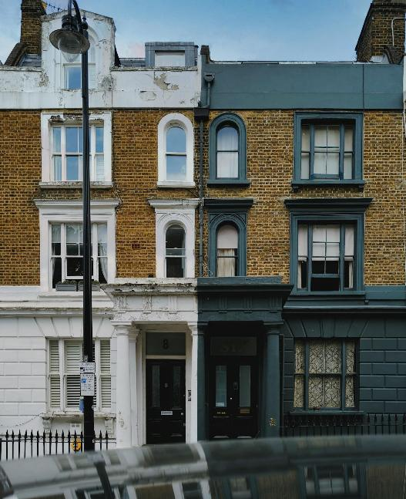
Party Wall Act 1996 – Compensation and access rights
Activity 3
If the building work causes any damage to the adjoining owner’s property, the building owner is responsible for paying for repairs. This must be outlined in the Party Wall Agreement.
The building owner may require access to the adjoining owner’s property to complete the work, but this must be agreed upon and documented in the Party Wall Agreement. Access must be respectful and planned to minimise disruption.
Lesson 4: I want to extend my house. What do I need to know?
Notes:
Image © Unsplash/Dmitry Novikov

Slide 44
Multiple-choice questions
Activity 3
1. What is a party wall?
a) a wall shared by two properties on the boundary line
b) a wall that stands entirely on one property
c) a decorative wall inside a home
d) a wall between two rooms in a house
Lesson 4: I want to extend my house. What do I need to know?

Slide 45
Multiple-choice answers
Activity 3
1. What is a party wall?
a) a wall shared by two properties on the boundary line
b) a wall that stands entirely on one property
c) a decorative wall inside a home
d) a wall between two rooms in a house
Lesson 4: I want to extend my house. What do I need to know?

Slide 46
Multiple-choice questions
Activity 3
2. Who is required to serve a Party Wall Notice?
a) the adjoining owner
b) the building owner planning the work
c) the local council
d) the contractor hired to do the work
Lesson 4: I want to extend my house. What do I need to know?

Slide 47
Multiple-choice answers
Activity 3
2. Who is required to serve a Party Wall Notice?
a) the adjoining owner
b) the building owner planning the work
c) the local council
d) the contractor hired to do the work
Lesson 4: I want to extend my house. What do I need to know?

Slide 48
Multiple-choice questions
Activity 3
3. How long does an adjoining owner have to respond to a Party Wall Notice?
a) 7 days
b) 60 days
c) 30 days
d) 14 days
Lesson 4: I want to extend my house. What do I need to know?

Slide 49
Multiple-choice answers
Activity 3
3. How long does an adjoining owner have to respond to a Party Wall Notice?
a) 7 days
b) 60 days
c) 30 days
d) 14 days
Lesson 4: I want to extend my house. What do I need to know?

Slide 50
Multiple-choice questions
Activity 3
4. What happens if the adjoining owner does not agree to the proposed work?
a) The building owner can proceed without agreement.
b) Both parties must appoint a Party Wall Surveyor.
c) The adjoining owner must pay for the surveyor.
d) The building owner must stop the work completely.
Lesson 4: I want to extend my house. What do I need to know?

Slide 51
Multiple-choice answers
Activity 3
4. What happens if the adjoining owner does not agree to the proposed work?
a) The building owner can proceed without agreement.
b) Both parties must appoint a Party Wall Surveyor.
c) The adjoining owner must pay for the surveyor.
d) The building owner must stop the work completely.
Lesson 4: I want to extend my house. What do I need to know?

Slide 52
Multiple-choice questions
Activity 3
5. What does a Party Wall Surveyor do?
a) refuses the proposed work
b) carries out the building work
c) ensures that the work is done fairly and resolves disputes between the neighbours
d) hires a contractor to carry out the work
Lesson 4: I want to extend my house. What do I need to know?

Slide 53
Multiple-choice answers
Activity 3
5. What does a Party Wall Surveyor do?
a) refuses the proposed work
b) carries out the building work
c) ensures that the work is done fairly and resolves disputes between the neighbours
d) hires a contractor to carry out the work
Lesson 4: I want to extend my house. What do I need to know?

Slide 54
Questions
Plenary
What are the differences between delegated and permitted development?
What types of home improvement typically fall under permitted development?
What is the purpose of the Party Wall Act 1996?
What are the key steps in the planning application process?
Who is responsible for serving a Party Wall Notice?
How do conservation areas and listed buildings affect planning applications?
Lesson 4: I want to extend my house. What do I need to know?

Slide 55
Answers
Plenary
Delegated powers allow planning officers to make decisions on certain applications (such as minor home extensions) without going through the full planning committee. Permitted development refers to specific types of building work or alterations that do not require planning permission, as long as they meet certain conditions (e.g. small extensions or installing solar panels).
Home improvements, such as single-storey rear extensions, loft conversions, garage conversions, outbuildings (sheds, garages) and installing solar panels typically fall under permitted development if they meet the size and location criteria.
Lesson 4: I want to extend my house. What do I need to know?

Slide 56
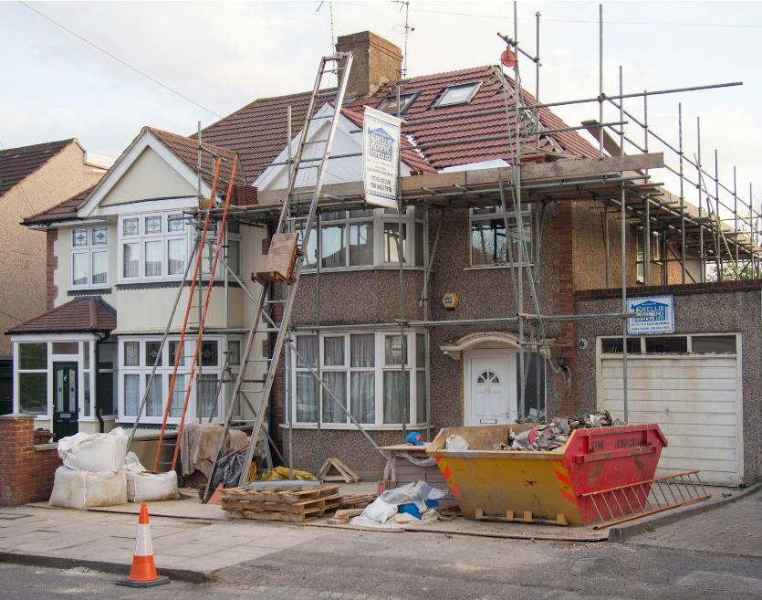
Answers
Plenary
The Party Wall Act 1996 aims to prevent and resolve disputes between neighbours regarding work that affects shared or boundary walls, as well as excavations near neighbouring properties. It ensures both parties agree to the work and outlines how disputes are resolved.
Lesson 4: I want to extend my house. What do I need to know?
Notes:
Image © Unsplash/Brett Jordan

Slide 57
Answers
Plenary
The planning application process typically begins with pre-application advice, where the applicant seeks guidance from the local planning authority before officially submitting their application.
Once ready, the application is submitted along with necessary documents and fees.
The next step is validation, where the local authority checks to ensure the application meets all legal and technical requirements.
Lesson 4: I want to extend my house. What do I need to know?

Slide 58
Answers
Plenary
After validation, the consultation stage takes place, allowing neighbours and other stakeholders to provide feedback on the proposed development.
Once feedback is considered, the decision-making phase begins, during which the planning authority evaluates the application against local planning policies.
Following this, the decision is issued, either granting approval or refusal.
If the application is refused, the applicant has the option to appeal the decision.
Lesson 4: I want to extend my house. What do I need to know?

Slide 59
Answers
Plenary
The building owner planning to carry out work on or near a party wall is responsible for serving a Party Wall Notice to the adjoining owner before starting the work.
Conservation areas and listed buildings have stricter rules for development. In these cases, even minor changes (such as changing windows or doors) may require planning permission to ensure that the character of the area or the historic integrity of the building is preserved.
Lesson 4: I want to extend my house. What do I need to know?

Slide 60
In this lesson, we have:
Plenary
Skills:
Develop ability to appraise and form valid arguments from information given in a case study.
Improve communication skills by creating reports and presentations for different audiences.
Build teamwork and discussion skills by participating in group and class discussion to explore ideas.
General competencies:
English:
E2 Present information and ideas.
E3 Create texts for different purposes and audiences.
E5 Synthesise information.
E6 Take part in/lead discussions.
Digital:
D1 Use digital technology and media effectively.
D3 Communicate and collaborate.
described the planning application process;
explained delegated and permitted permission;
explained the basic provisions of the Party Wall Act and when it applies.
Lesson 4: I want to extend my house. What do I need to know?

Slide 61
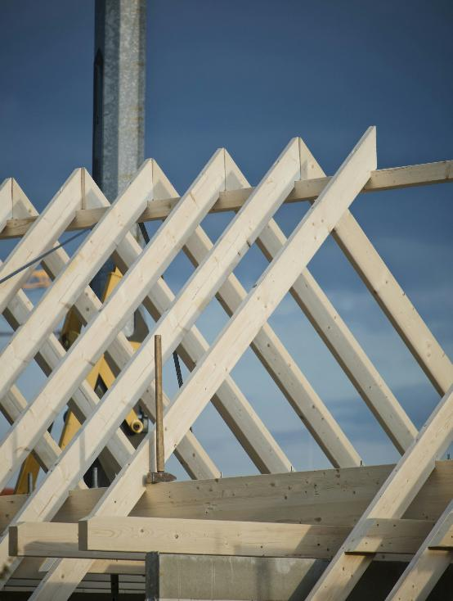
Follow-up
Follow-up
Visit the planning portal of your local planning authority and investigate one current planning application in your area.
Prepare a summary that includes:
the type of development being proposed (e.g. home extension, new business or change of use);
any feedback or concerns raised by the community, if available;
the status of the planning application (e.g. under review, approved or refused).
Lesson 4: I want to extend my house. What do I need to know?
Notes:
Image © Unsplash/Yves Cedric Schulze

