Slide 1
Construction
Route: Construction
Topic: Law and contracts in construction
Lesson 2: Whose is it? How to check the Land Registry
Notes:
Image © Shutterstock/CrizzyStudio

Slide 2
In this lesson, we will:
Introduction
Skills:
Develop ability to appraise and form valid arguments from information given in a case study.
Improve communication skills by creating reports and presentations for different audiences.
Build teamwork and discussion skills by participating in group and class discussion to explore ideas.
General competencies:
English:
E2 Present information and ideas.
E5 Synthesise information.
Digital:
D3 Communicate and collaborate.
describe the Land Registry and its role in the property system;
explain the meaning of freehold and leasehold property ownership;
describe the key parts of a title deed.
Lesson 2: Whose is it? How to check the Land Registry

Slide 3

Knowledge recap
Introduction
Based on what we learned last lesson, have you seen any media stories about property ownership and/or real-life examples of disputes involving joint tenants or tenants in common?
Lesson 2: Whose is it? How to check the Land Registry
Notes:
Image © Unsplash/Alexander Andrews

Slide 4

Who holds responsibility?
Introduction
In 2017, a fire broke out at Grenfell Tower, a residential high-rise building in London, leading to the tragic loss of 72 lives.
The building was reportedly managed under a complex leasehold system, with leaseholders living in the flats but not owning the building’s structure. The cladding used in recent renovations was found to be highly flammable, contributing to the rapid spread of the fire.
Residents had reportedly raised concerns about safety prior to the fire.
Lesson 2: Whose is it? How to check the Land Registry
Notes:
Image © Shutterstock/JessicaGirvan

Slide 5
Who holds responsibility?
Introduction
Spend a few minutes considering the following questions.
Who holds responsibility for ensuring a building’s safety? (Consider the roles of leaseholders, freeholders, construction companies and government regulators.)
In a leasehold system, how can leaseholders raise concerns about building safety, and what recourse do they have if their concerns are ignored?
What lessons can be learned from Grenfell about the importance of communication and accountability in property management?
Lesson 2: Whose is it? How to check the Land Registry

Slide 6
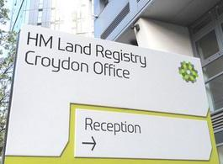
HM Land Registry and its role in the property system of England and Wales
Introduction
Lesson 2: Whose is it? How to check the Land Registry
HM Land Registry is a government department responsible for the recording and ownership of land and property in England and Wales.
It provides a central, reliable record of who owns property, helping to protect buyers, sellers and lenders.
It ensures clarity in property transactions, reduces fraud and helps resolve disputes over ownership.
Lesson 2: Whose is it? How to check the Land Registry
Notes:
Image: HM Land Registry

Slide 7
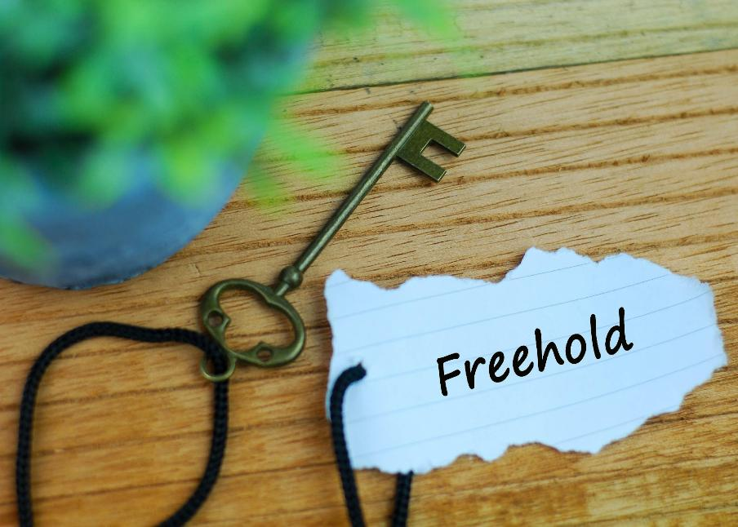
Freehold ownership
Introduction
Lesson 2: Whose is it? How to check the Land Registry
Lesson 2: Whose is it? How to check the Land Registry
Freehold means owning both the property and the land it stands on outright.
A freeholder has complete control over the property and land.
Ownership is indefinite, as long as no legal restrictions or obligations are breached.
Houses are usually sold as freehold properties.
Lesson 2: Whose is it? How to check the Land Registry
Notes:
Image © Shutterstock/arfa adam

Slide 8
Leasehold ownership
Introduction
Leasehold means owning the property for a set number of years, but not the land.
Lease agreements usually last between 99 and 999 years, but many are between 99 and 125 years.
A leaseholder must adhere to the lease agreement, which often involves maintaining the property and paying a ground rent.
Flats and apartments are typically sold as leasehold properties.
Short leases are less than 80 years and can be harder to sell and mortgage.
Lesson 2: Whose is it? How to check the Land Registry

Slide 9
What is ground rent?
Introduction
Ground rent is a periodic payment that a leaseholder makes to the freeholder in exchange for the lease of the land.
Ground rent is typically annual but may increase over time, as specified in the lease agreement.
Leaseholders must ensure they keep up with payments, as failing to pay could result in legal consequences.
The cost of ground rent can vary. It is often a nominal fee but could rise over time as per the lease agreement.
Some leaseholders may also pay service charges and maintenance fees.
Lesson 2: Whose is it? How to check the Land Registry

Slide 10

HM Land Registry, freehold and leasehold property
Activity 1
The aim of this activity is to consider the implications for different types of property ownership.
In groups of 4–5, work collaboratively on each scenario on Activity 1 Worksheet.
Lesson 2: Whose is it? How to check the Land Registry
Notes:
Image © Unsplash/Lloyd Kearney

Slide 11
Answers for scenario 1
Activity 1
Alice’s right to quiet enjoyment is protected by her leasehold agreement, which generally ensures that she can use and enjoy her property without unreasonable interference. This right impacts BuildRight4U Ltd because, even though the deed doesn’t specifically mention construction activities, the company must still ensure that its work does not cause unreasonable disruption. Noise, dust, vibrations or restricted access could infringe on this right if they are excessive or persistent.
Lesson 2: Whose is it? How to check the Land Registry

Slide 12
Answers for scenario 1
Activity 1
Examples include:
Mitigation measures: BuildRight4U Ltd should implement noise and dust control measures, restrict construction to reasonable hours (e.g. no early mornings or late evenings) and maintain access to Alice’s flat.
Communication: BuildRight4U Ltd should provide Alice with clear timelines and updates about the project, so she is aware of any potential disturbances.
Negotiation with the freeholder: As the freeholder typically commissions renovations BuildRight4U Ltd should co-ordinate with them to balance Alice’s right to quiet enjoyment with the renovation work.
Lesson 2: Whose is it? How to check the Land Registry

Slide 13
Answers for scenario 1
Activity 1
If the deed specified restrictions (e.g. limiting construction to specific hours or days), BuildRight4U Ltd would need to adjust its project schedule to comply with those conditions. Additionally, if the title deed required advance notice or compensation for disruptions, the company would need to account for these obligations in its project planning and budgeting.
Lesson 2: Whose is it? How to check the Land Registry

Slide 14
Answers for scenario 2
Activity 1
Emma’s title deed indicates she is responsible for interior issues, while Tom’s deed specifies he must maintain the structure of the building. However, because the leak resulted from BuildRight4U Ltd’s work, they are directly responsible for the damage caused, regardless of the maintenance clauses in the title deeds. BuildRight4U Ltd is obligated to repair both the structural damage (Tom’s responsibility) and any interior damage (Emma’s responsibility) since their work caused the issue.
Lesson 2: Whose is it? How to check the Land Registry

Slide 15
Answers for scenario 2
Activity 1
2. Due diligence: BuildRight4U Ltd should thoroughly review both title deeds to understand the responsibilities of the leaseholder and the freeholder before commencing construction.
Insurance: BuildRight4U Ltd should carry appropriate liability insurance to cover damages caused by construction errors or oversights.
Clear communication: BuildRight4U Ltd should communicate with both Emma and Tom regarding the extent of the damage and the timeline for repairs, ensuring both parties’ expectations are managed.
Repair accountability: BuildRight4U Ltd should directly oversee and expedite repairs to both the structure (for Tom) and the interior (for Emma), ensuring their work complies with legal and contractual obligations.
Lesson 2: Whose is it? How to check the Land Registry

Slide 16
Answers for scenario 3
Activity 1
BuildRight4U Ltd needs to consider that any disruptions to John’s business during lease renewal negotiations could impact John’s ability or willingness to renew the lease. If construction creates substantial disruption, John might seek concessions from the freeholder, such as a rent reduction or a delayed renewal, which could indirectly affect the construction timeline. BuildRight4U Ltd should coordinate with the freeholder to ensure that construction does not interfere with the negotiation window.
Lesson 2: Whose is it? How to check the Land Registry

Slide 17
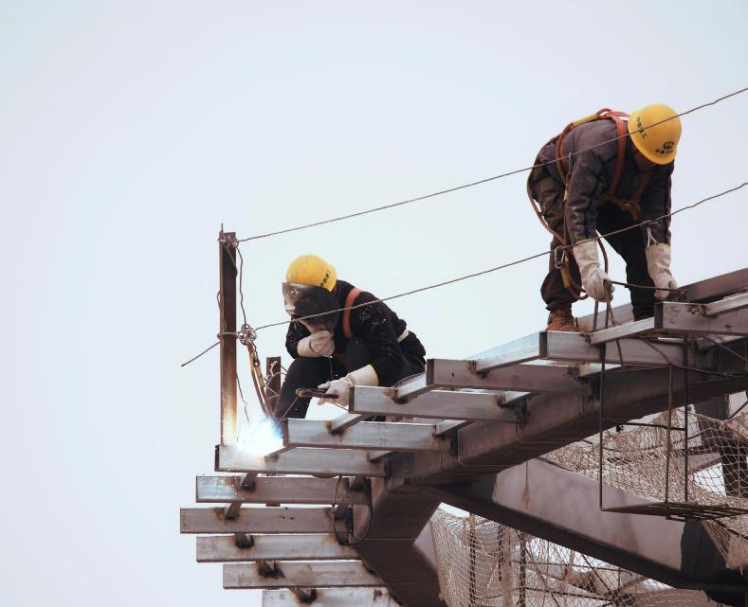
Answers for scenario 3
Activity 1
BuildRight4U Ltd should proactively reach out to both John and the freeholder to outline the construction timeline and discuss how it may affect John’s business. This includes offering a plan to minimise disruption during the lease renewal window, such as scheduling the most intrusive work outside of business hours or during John’s quieter business periods.
Lesson 2: Whose is it? How to check the Land Registry
Notes:
Image © Unsplash/Eric Wang

Slide 18
Answers for scenario 3
Activity 1
If John experiences financial losses or operational difficulties due to the construction, he could potentially seek compensation from either the freeholder or BuildRight4U Ltd through claims of breach of quiet enjoyment or interruption of his business. BuildRight4U Ltd could be held liable if the disruptions are considered unreasonable or if they violate lease terms. To mitigate liability, BuildRight4U Ltd should negotiate construction schedules and minimise interference with John’s business operations.
Lesson 2: Whose is it? How to check the Land Registry

Slide 19

Real-world relevance
Activity 1
Research the following:
What happened to Citiscape (in Croydon) leaseholders post-Grenfell?
How much control did leaseholders have over management decisions?
Which legal options are available to leaseholders to challenge excessive charges or request lease extensions?
Lesson 2: Whose is it? How to check the Land Registry
Notes:
Image © Unsplash/the blowup

Slide 20
Title deeds
Activity 2
A title deed is a legal document that proves the ownership of a property or piece of land. It contains important details such as:
owner’s details: the name(s) of the person(s) who legally own(s) the property;
property description: information about the property, including its boundaries and whether it is freehold or leasehold;
mortgage or financial charges: any loans or mortgages secured against the property;
covenants or restrictions: rules or obligations that the owner must follow regarding the property.
The title deed is essential for property transactions and ensures the legal transfer of ownership.
Lesson 2: Whose is it? How to check the Land Registry

Slide 21

Example of a title deed
Activity 2
Scan this QR code and explore how to read a title deed. Conduct research and answer the question in Activity 2 Worksheet: What is a title deed?
Lesson 2: Whose is it? How to check the Land Registry
Notes:
Link in QR code - https://www.gov.uk/government/publications/how-to-read-a-title-register-and-title-plan/how-to-read-a-title-register

Slide 22
Key parts of a title deed
Activity 2
Charges register: If there is a mortgage on the property, the lender’s interest will be noted, meaning the property serves as security for the loan. The interests of the charge holder would need to be taken into account in any transactions relating to the land, such as sale or remortgaging. There may be more than one charge on the property and they may rank in priority
Covenant: Legal obligations or restrictions that the property owner must adhere to, such as maintaining certain standards or restrictions on building
Property register: The name(s) of the current owner(s) of the property
Proprietorship register: Indicates whether the property is freehold or leasehold; provides the address of the property and refers to a plan showing the legal boundary
Lesson 2: Whose is it? How to check the Land Registry

Slide 23
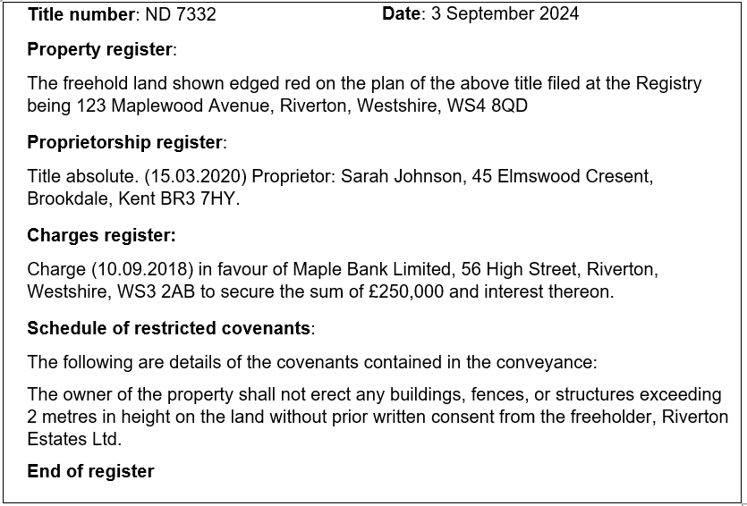
Key parts of a title deed
Activity 2
Lesson 2: Whose is it? How to check the Land Registry

Slide 24
Answer – What is a title deed?
Activity 2
A title deed is a legal document that serves as official proof of ownership for a property or piece of land. It outlines key details such as the owner’s name, the type of ownership (freehold or leasehold) and any legal obligations or restrictions, known as covenants, that apply to the property. The title deed also records any interest a mortgage company may have if the property was purchased with a loan. Additionally, a title deed will often have an attached plan that provides a visual representation of the property’s boundaries and layout. This plan helps to clearly define the extent of the property, ensuring all parties understand what is included in the ownership.
Lesson 2: Whose is it? How to check the Land Registry

Slide 25
Case study analysis
Activity 3
Case study 1 answers:
Who is the current owner of 47 Oakwood Road?
Answer: Jack Williams
When was the charge placed on the property, and what was the amount secured?
Answer: The charge was placed on 1 June 2019, securing £150,000.
What restriction does the covenant place on the property owner?
Answer: The owner cannot keep any animals on the property without written consent from Elmbridge Land Ltd.
What is the address of the bank holding the charge on the property?
Answer: Greenacre Bank PLC, 15 Elm Street, Elmbridge, Westshire, WS2 5DA
Lesson 2: Whose is it? How to check the Land Registry

Slide 26
Case study analysis
Activity 3
Case study 2 answers:
Is the property freehold or leasehold?
Answer: Leasehold
What is the restriction in the covenant regarding the use of the property?
Answer: The leaseholder must not use the property for any commercial activities or business purposes without prior consent from the freeholder.
Who is the current owner of 89 Willow Street?
Answer: Emily Taylor
How much was secured by the charge placed in favour of Brookgold Finance Ltd?
Answer: £200,000
Lesson 2: Whose is it? How to check the Land Registry

Slide 27
Case study analysis
Activity 3
Case study 3 answers:
What restriction does the covenant place on parking?
Answer: The owner cannot park any commercial vehicles, trailers or caravans on the property without written permission.
Who is the current owner of 22 Pine Grove?
Answer: Olivia Barnes
When was the title registered in Olivia Barnes' name?
Answer: 2 February 2021.
What is the value of the charge placed by Eastshire Loans Ltd?
Answer: £300,000
Lesson 2: Whose is it? How to check the Land Registry

Slide 28
Case study analysis
Activity 3
Case study 4 answers:
What is the responsibility of the leaseholder regarding the garden?
Answer: The leaseholder must maintain the garden in a neat and tidy condition and not allow refuse or debris to accumulate.
What type of ownership does James O’Connor have for 12 Cedar Lane?
Answer: Leasehold ownership
When was the charge placed on the property, and by whom?
Answer: The charge was placed on 19 April 2021 by Fairfield Banking Corp.
How much was secured by the charge in favour of Fairfield Banking Corp.?
Answer: £180,000
Lesson 2: Whose is it? How to check the Land Registry

Slide 29
Multiple-choice questions
Plenary
1. What is the primary role of HM Land Registry in England and Wales?
a) to collect taxes on property sales
b) to record ownership of land and property
c) to manage building regulations
d) to decide property prices
Lesson 2: Whose is it? How to check the Land Registry

Slide 30
Multiple-choice answers
Plenary
1. What is the primary role of HM Land Registry in England and Wales?
a) to collect taxes on property sales
b) to record ownership of land and property
c) to manage building regulations
d) to decide property prices
Lesson 2: Whose is it? How to check the Land Registry

Slide 31
Multiple-choice questions
Plenary
2. What does freehold ownership mean?
a) Owning the property but renting the land
b) Owning both the property and the land it stands on outright
c) Owning the property for a limited time
d) Paying ground rent for the property
Lesson 2: Whose is it? How to check the Land Registry

Slide 32
Multiple-choice answers
Plenary
2. What does freehold ownership mean?
a) Owning the property but renting the land
b) Owning both the property and the land it stands on outright
c) Owning the property for a limited time
d) Paying ground rent for the property
Lesson 2: Whose is it? How to check the Land Registry

Slide 33
Multiple-choice questions
Plenary
3. In leasehold ownership, who owns the land?
a) the leaseholder
b) the mortgage company
c) the freeholder
d) the local government
Lesson 2: Whose is it? How to check the Land Registry

Slide 34
Multiple-choice answers
Plenary
3. In leasehold ownership, who owns the land?
a) the leaseholder
b) the mortgage company
c) the freeholder
d) the local government
Lesson 2: Whose is it? How to check the Land Registry

Slide 35
Multiple-choice questions
Plenary
4. Which of the following is a typical lease length in the UK?
a) 25 to 50 years
b) 1 to 5 years
c) 99 to 125 years
d) 50 to 100 years
Lesson 2: Whose is it? How to check the Land Registry

Slide 36
Multiple-choice answers
Plenary
4. Which of the following is a typical lease length in the UK?
a) 25 to 50 years
b) 1 to 5 years
c) 99 to 125 years
d) 50 to 100 years
Lesson 2: Whose is it? How to check the Land Registry

Slide 37
Multiple-choice questions
Plenary
5. What is ground rent?
a) a one-time payment made when buying a leasehold property
b) a tax paid to the government for owning land
c) a regular payment made by the leaseholder to the freeholder for use of the land
d) a fee for maintaining the property
Lesson 2: Whose is it? How to check the Land Registry

Slide 38
Multiple-choice answers
Plenary
5. What is ground rent?
a) a one-time payment made when buying a leasehold property
b) a tax paid to the government for owning land
c) a regular payment made by the leaseholder to the freeholder for use of the land
d) a fee for maintaining the property
Lesson 2: Whose is it? How to check the Land Registry

Slide 39
Multiple-choice questions
Plenary
6. What happens when a leasehold expires?
a) The leaseholder renews it automatically.
b) The ownership returns to the freeholder.
c) The property becomes freehold.
d) The leaseholder must pay additional ground rent.
Lesson 2: Whose is it? How to check the Land Registry

Slide 40
Multiple-choice answers
Plenary
6. What happens when a leasehold expires?
a) The leaseholder renews it automatically.
b) The ownership returns to the freeholder.
c) The property becomes freehold.
d) The leaseholder must pay additional ground rent.
Lesson 2: Whose is it? How to check the Land Registry

Slide 41
Multiple-choice questions
Plenary
7. What does the ‘charges register’ section of a title deed indicate?
a) the mortgage rate
b) the lender’s legal interest in the property
c) the lease length
d) the owner’s interest in selling the property
Lesson 2: Whose is it? How to check the Land Registry

Slide 42
Multiple-choice answers
Plenary
7. What does the ‘charges register’ section of a title deed indicate?
a) the mortgage rate
b) the lender’s legal interest in the property
c) the lease length
d) the owner’s interest in selling the property
Lesson 2: Whose is it? How to check the Land Registry

Slide 43
Multiple-choice questions
Plenary
8. What does the ‘property register’ section of a title deed indicate?
a) whether the property has been sold before
b) if the property is freehold or leasehold
c) the amount of ground rent due
d) the date the property was built
Lesson 2: Whose is it? How to check the Land Registry

Slide 44
Multiple-choice answers
Plenary
8. What does the ‘property register’ section of a title deed indicate?
a) whether the property has been sold before
b) if the property is freehold or leasehold
c) the amount of ground rent due
d) the date the property was built
Lesson 2: Whose is it? How to check the Land Registry

Slide 45
Multiple-choice questions
Plenary
9. What are covenants in the context of a title deed?
a) restrictions or obligations related to the property
b) a list of taxes paid by the owner
c) legal actions taken against the property
d) the owner’s rights to sell the property
Lesson 2: Whose is it? How to check the Land Registry

Slide 46
Multiple-choice answers
Plenary
9. What are covenants in the context of a title deed?
a) restrictions or obligations related to the property
b) a list of taxes paid by the owner
c) legal actions taken against the property
d) the owner’s rights to sell the property
Lesson 2: Whose is it? How to check the Land Registry

Slide 47
Questions
Plenary
What are the main differences between tenants in common and joint tenants?
What is the role of the Land Registry in the property system of England and Wales?
What is the difference between freehold and leasehold ownership?
What information is included in a title deed, and why is it important?
How do covenants protect a property owner’s rights?
Lesson 2: Whose is it? How to check the Land Registry

Slide 48
Answers
Plenary
1. What are the main differences between tenants in common and joint tenants?
With tenants in common, each person owns a separate part of the property, which can be passed on to someone else when they die. In joint tenancy, everyone owns the property equally, and if one person dies, their share goes automatically to the other owner(s). Tenants in common can sell or give away their share, but joint tenants cannot do this without severing the joint tenancy.
2. What is the role of the Land Registry in the property system of England and Wales?
The Land Registry keeps records of who owns land and property in England and Wales, making sure this information is accurate and easy to check. It helps prevent fraud by keeping an official list of all property ownership details. This information is essential for buying, selling or resolving property disputes.
Lesson 2: Whose is it? How to check the Land Registry

Slide 49
Answers
Plenary
3. What is the difference between freehold and leasehold ownership?
Freehold means owning the property and the land it sits on forever. Leasehold means only owning the property for a set period. After that, ownership goes back to the freeholder unless renewed. Leaseholders usually pay a ground rent to the freeholder and may have to follow certain rules.
4. What information is included in a title deed, and why is it important?
A title deed shows who owns the property, where its boundaries are and any rules or rights linked to it. This document is important because it legally proves who owns the property and helps solve any disagreements.
Lesson 2: Whose is it? How to check the Land Registry

Slide 50
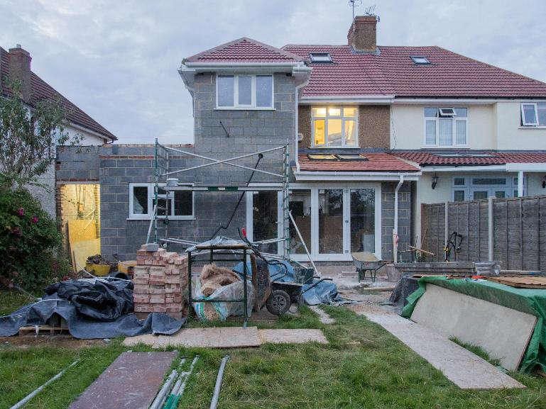
Answers
Plenary
5. How do covenants protect a property owner’s rights?
Covenants are promises in property agreements that set rules about how the property can be used. They help protect property owners by ensuring neighbouring properties follow certain rules, such as not building too high or only using the property for residential purposes. These rules help keep the area’s value and character stable.
Lesson 2: Whose is it? How to check the Land Registry
Notes:
Image © Pexels/BrettJordan

Slide 51
In this lesson, we have:
Plenary
Skills:
Develop ability to appraise and form valid arguments from information given in a case study.
Improve communication skills by creating reports and presentations for different audiences.
Build teamwork and discussion skills by participating in group and class discussion to explore ideas.
General competencies:
English:
E2 Present information and ideas.
E3 Create texts for different purposes and audiences.
E5 Synthesise information.
Digital:
D1 Use digital technology and media effectively.
D3 Communicate and collaborate.
described the Land Registry and its role in the property system;
explained the meaning of freehold and leasehold property ownership;
described the key parts of a title deed.
Lesson 2: Whose is it? How to check the Land Registry

Slide 52
Consolidation
Consolidation
Explore the BBC report on Grenfell: www.bbc.co.uk/news/articles/c049yvrd5qxo
Alternatively, find a real-life example of a property issue related to freehold or leasehold ownership, ground rent dispute or title deed-related matters. Prepare a summary that includes:
what the dispute was about;
the key details of the situation;
any important legal or financial issues;
the outcome of the dispute (if known).
Lesson 2: Whose is it? How to check the Land Registry
Notes:
BBC report on Grenfell: www.bbc.co.uk/news/articles/c049yvrd5qxo

