Slide 1
Construction
Route: Construction
Topic: Law and contracts in construction
Lesson 1: Is it mine? How to legally own land
Notes:
Image © Shutterstock/CrizzyStudio

Slide 2
In this lesson, we will:
Introduction
Skills:
Develop ability to appraise and form valid arguments from information given in a case study.
Improve communication skills by creating reports and presentations for different audiences.
Build teamwork and discussion skills by participating in group and class discussion to explore ideas.
General competencies:
English:
E2 Present information and ideas.
E3 Create text for different purposes and audiences.
E5 Synthesise information.
Digital:
D1 Use digital technology and media effectively.
D3 Communicate and collaborate.
describe the legal implications of owning property as joint tenants where two or more individuals hold property jointly with the right of survivorship;
describe the legal implications of owning property as tenants in common where two or more individuals hold property in specific shares, which may be equal or unequal;
explain what happens when the owner of a property dies.
Lesson 1: Is it mine? How to legally own land

Slide 3

The different types of ownership
Introduction
What do you think are some ways people can own property together?
Discussion points could include:
mortgage;
co-ownership/joint ownership;
leasehold;
inherited.
Lesson 1: Is it mine? How to legally own land
Notes:
Image © Pexels/Jakub Zerdzicki

Slide 4

The different types of land ownership
Activity 1
In England and Wales, land ownership can be categorised into three main types:
sole proprietor/owner;
concurrent ownership;
government/council ownership.
Each type of ownership comes with different rights, responsibilities and legal implications.
Summarise the main features of each type of land ownership in the table in Activity 1 Worksheet and make a note of some of the main legal obligations of each type and examples of when each would be used.
Lesson 1: Is it mine? How to legally own land
Notes:
Image © Unsplash/Luke Stackpoole

Slide 5
How to legally own land or property concurrently
Activity 1
We are going to watch a video which will introduce you to some of the key concepts related to property ownership. As you watch, make notes and try to answer the following questions:
Can you explain the ‘right of survivorship’ in joint tenancy?
How do joint tenants share ownership of a property?
What does it mean to own property as tenants in common?
Can tenants in common sell or transfer their shares independently?
Extension question: Share with the group any common misconceptions about joint tenancy or tenants in common that you’ve heard or believe.
Video: Joint Tenants & Tenants in Common Explained – https://www.youtube.com/watch?v=bbnseBDur6M (start – 02:10)
Lesson 1: Is it mine? How to legally own land
Notes:
Video: Joint Tenants & Tenants in Common Explained – https://www.youtube.com/watch?v=bbnseBDur6M

Slide 6
Instructions for group discussion
Activity 2
Watch the rest of the video https://www.youtube.com/watch?v=bbnseBDur6M (play from 02:10 until the end)
Analyse the pros and cons of joint tenancy and tenants in common, in your groups
Use Table 2 in Activity 2 Worksheet to help organise your thoughts.
Assign roles: notetaker, spokesperson and timekeeper.
Prepare to present your findings to the class.
Notetaker – this student is responsible for writing down the group’s ideas on the worksheet.
Spokesperson – this student will present the group’s findings to the class.
Timekeeper – this student ensures the group stays on track and finishes within the given time.
Lesson 1: Is it mine? How to legally own land
Notes:
Video: Joint Tenants & Tenants in Common Explained – https://www.youtube.com/watch?v=bbnseBDur6M

Slide 7
Example of a complete table for joint tenants
Activity 2
Type of ownership | Pros | Cons | Examples/ additional thoughts
Joint tenants | Simplified transfer of ownership | No flexibility in bequeathing property | Grandparents’ house automatically went to the surviving spouse
 | Avoids probate | All owners must agree to sell | There is the potential for disagreement May be difficult to get all owners to agree to sell the property
 | Equal ownership shares | Not suitable for business partners
Lesson 1: Is it mine? How to legally own land

Slide 8

What have you learned?
Activity 2
Discuss the benefits of owning property with someone else as a joint tenant.
Discuss the benefits of owning property with someone else as a tenant in common.
Discuss whether it’s better to have equal ownership shares or different ownership shares. Why?
Discuss how the choice of ownership type affects relationships between co-owners.
Lesson 1: Is it mine? How to legally own land
Notes:
Image © Unsplash/Tierra Mallorca

Slide 9

Case study analysis
Activity 3
In groups, analyse the case study in the worksheet.
Read through the scenario and reach a decision whether joint tenancy or tenants in common is the best option.
Answer the case study questions in Activity 3 Worksheet.
Be prepared to feed back your thoughts to the class.
Lesson 1: Is it mine? How to legally own land
Notes:
Image © Shutterstock/Andrii Yalanskyi

Slide 10
Case study 1 – Answers
Activity 3
Sarah’s share automatically passes to Theo, the surviving joint tenant, due to the right of survivorship.
No, the property does not need to go through probate for Theo to gain full ownership.
Theo has full ownership of the property, including the right to use, sell or transfer it.
Theo can sell the entire property since he now owns it fully.
They might have chosen joint tenancy because they wanted the property to automatically transfer to the surviving owner without going through probate.
The right of survivorship benefits Theo by allowing him to immediately and automatically gain full ownership of the property without legal delays or costs associated with probate.
Lesson 1: Is it mine? How to legally own land

Slide 11
Case study 2 – Answers
Activity 3
Aiko can sell her share without Kenji’s and Mei’s consent because tenants in common have independent ownership rights.
If Aiko dies before selling her share, her share will go to her heirs or as directed by her will, not automatically to Kenji and Mei.
Decisions about management and income distribution are typically made in proportion to ownership of shares, meaning Aiko would have more influence and receive more income than Kenji and Mei.
Lesson 1: Is it mine? How to legally own land

Slide 12
Case study 2 – Answers
Activity 3
Kenji and Mei continue to own their shares, and the new person would become a tenant in common with them, owning Aiko’s former 50%.
They might have chosen tenants in common to reflect their unequal contributions and to retain the ability to independently manage their shares.
Owning unequal shares means each person’s responsibilities and benefits, like decision-making power and income distribution, are proportional to their ownership percentage. Aiko, with 50%, has more responsibilities and benefits compared to Kenji and Mei.
Lesson 1: Is it mine? How to legally own land

Slide 13
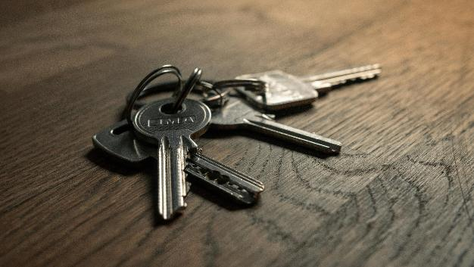
Case study 3 – Answers
Activity 3
Tenants in common is the best option because it allows the siblings to own unequal shares based on their contributions.
If the siblings own the house as tenants in common, Aiden can sell his share without Bella and Claire’s consent. This is because tenants in common allow for independent ownership and the ability to transfer shares independently.
Lesson 1: Is it mine? How to legally own land
Notes:
Image © Unsplash/Filip Szalbot

Slide 14
Case study 3 – Answers
Activity 3
Bella can leave her share to her children in her will because tenants in common allows each owner to pass on their shares according to their wishes.
If Claire passed away without a will, her share would be distributed according to the law of intestacy, not automatically to Aiden and Bella. The laws of intestacy govern how a deceased person’s estate is distributed when they die without a valid will, typically prioritising close relatives, such as spouses and children.
Lesson 1: Is it mine? How to legally own land

Slide 15
Case study 4 – Answers
Activity 3
Joint tenancy is the most suitable because it includes the right of survivorship, ensuring that the surviving spouse automatically inherits the entire property.
The property would automatically pass to Liam, the surviving joint tenant, due to the right of survivorship.
The property would not need to go through probate because joint tenancy bypasses the probate process.
Neither Priya nor Liam can sell the property without the other’s consent because joint tenancy requires agreement from both owners for major decisions.
Lesson 1: Is it mine? How to legally own land

Slide 16
Case study 5 – Answers
Activity 3
Section 123 of the Local Government Act 1972: This section requires the council to dispose of land in a manner that achieves the best price reasonably obtainable. However, the council must also consider the public interest and any objections raised by the community.
Public consultation: The council must advertise the intended disposal in a local newspaper for two consecutive weeks and consider any objections before making a final decision. The council must demonstrate that it has genuinely considered all objections with an open mind.
Lesson 1: Is it mine? How to legally own land

Slide 17
Case study 5 – Answers
Activity 3
Judicial review: If the council proceeds with the sale despite significant objections, the residents can challenge the decision through a judicial review, arguing that the council did not properly consider the public interest or the objections raised. In this scenario, the council must balance its duty to achieve the best price for the land with its responsibility to consider the public interest and the objections of the community. If the council fails to do so, it may face legal challenges and potential delays in the sale process.
Lesson 1: Is it mine? How to legally own land

Slide 18

Role play
Activity 4
Read the scenario on Activity 4 Worksheet.
In groups, follow the instructions.
Lesson 1: Is it mine? How to legally own land
Notes:
image © Pexels/Melike B

Slide 19

Assessment practice
Plenary
Define each of the three main types of land ownership in England and Wales.
Outline the main differences between tenants in common and joint tenants.
Describe how concurrent property ownership occurs.
Describe what happens to a share of property in joint tenancy if one owner passes away.
Explain the four main options that tenants in common can do with their respective shares in property.
Lesson 1: Is it mine? How to legally own land
Notes:
Image © Shutterstock/CrizzyStudio

Slide 20
Answers
Plenary
1. Describe the three main types of land ownership in England and Wales.
Sole ownership: A single individual or entity has full control over the land, with the right to use, lease or sell it independently.
Concurrent ownership: Two or more individuals share ownership. Joint tenants have equal shares with survivorship rights, while tenants in common can hold unequal shares and pass them to heirs.
Government ownership: Land owned by the government or local councils for public use (e.g. parks, schools) with regulated usage, leasing or sales.
Lesson 1: Is it mine? How to legally own land

Slide 21
Answers
Plenary
2. Outline the main differences between tenants in common and joint tenants.
Tenants in common:
Each owner holds a distinct share (e.g. 50/50 or 70/30) and can sell or transfer their share independently.
There is no automatic right of survivorship – if one owner dies, their share passes according to their will or intestacy rules.
Joint tenants:
Owners hold equal shares in the entire property (not distinct portions).
The right of survivorship applies – when one owner dies, their share automatically passes to the other owner(s), overriding any will.
Lesson 1: Is it mine? How to legally own land

Slide 22
Answers
Plenary
3. Describe how concurrent property ownership occurs.
Concurrent ownership happens when two or more people own a property at the same time.
It can take the form of joint tenancy or tenancy in common.
Ownership can arise from purchasing a property together, inheritance or by transferring shares in an existing property to another party.
The method of ownership is usually specified in the property deed or a formal agreement between the owners.
Lesson 1: Is it mine? How to legally own land

Slide 23
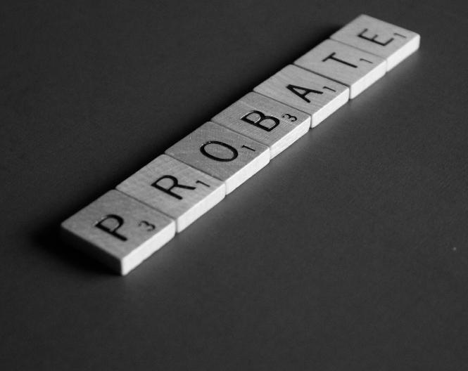
Answers
Plenary
4. Describe what happens to a share of property in joint tenancy if one owner passes away.
The deceased owner’s share automatically transfers to the surviving joint tenant(s) under the right of survivorship.
This process occurs outside of probate, meaning the share does not pass through the deceased’s will or estate.
Once only one joint tenant remains, they hold the property as a sole owner with full control.
Lesson 1: Is it mine? How to legally own land
Notes:
Image © Pexels/Melinda Gimpel

Slide 24
Answers
Plenary
5. Explain what tenants in common can do with their respective shares in property.
Sell or transfer: A tenant in common can sell or transfer their share without needing consent from the other owners (subject to any agreement in place).
Mortgage: They can use their share as security for a loan or mortgage.
Leave it in their will: Their share can be left to beneficiaries in a will rather than passing to the other owners.
Request a sale.
Lesson 1: Is it mine? How to legally own land

Slide 25
In this lesson, we have:
Plenary
Skills:
Develop ability to appraise and form valid arguments from information given in a case study.
Improve communication skills by creating reports and presentations for different audiences.
Build teamwork and discussion skills by participating in group and class discussion to explore ideas.
General competencies:
English:
E2 Present information and ideas.
E3 Create text for different purposes and audiences.
E5 Synthesise information.
Digital:
D1 Use digital technology and media effectively.
D3 Communicate and collaborate.
described the legal implications of owning property as joint tenants where two or more individuals hold property jointly with the right of survivorship;
described the legal implications of owning property as tenants in common where two or more individuals hold property in specific shares, which may be equal or unequal;
explained what happens when the owner of a property dies.
Lesson 1: Is it mine? How to legally own land

Slide 26
Consolidation
Consolidation
Find a real-life example of a property dispute involving joint tenants or tenants in common.
Prepare a six- to ten-sentence summary. Make sure you include:
what the dispute was about;
the key details of the situation;
any important legal or financial issues;
the outcome of the dispute (if known).
Lesson 1: Is it mine? How to legally own land

