Slide 1
Digital
Route: Digital
Topic: The business environment and technical change management
Resource 4: Meeting the needs of the end user
Notes:
Image © Shutterstock Gorodenkoff

Slide 2
In this resource, we will:
Introduction
Skills
1 Be able to reflectively evaluate
2 Communicate information clearly to a technical and non-technical audience
3 Work with others in a collaborative manner to allow for/encourage faster, better and more efficient achievement of goals
General competencies
English:
E2 Present information and ideas
E4 Summarise information/ideas
E5 Synthesise information
E6 Take part in/leading discussions
Digital:
D3 Communicate and collaborate
understand the importance of considering user needs and end user characteristics when developing digital projects;
watch and make notes about a case study video featuring examples of new digital project development;
discuss the key considerations and potential benefits for any organisation developing their own digital projects.
Resource 4: Meeting the needs of the end user

Slide 3
Icebreaker activity
Introduction
In what ways is digital access limited for some people around the world?
Create a mind map together.
Digital access problems
Resource 4: Meeting the needs of the end user

Slide 4

User needs
Introduction
When developing a digital product, the following should be considered:
What functionality does the user need?
How can pain points be prevented?
Does it meet accessibility needs?
What compatibility is needed with other devices and systems?
Can it be easily installed and accessed?
How will users be supported once the product is released?
Resource 4: Meeting the needs of the end user
Notes:
Image © Shutterstock/kenchiro168

Slide 5

User characteristics
Introduction
User characteristics have an impact on how a digital product will be used.
Consider:
the age of the users;
what level of digital and literacy skills they have;
whether they are internal (part of the organisation) or external (public);
cultural issues and potential bias;
if there are any additional needs.
Resource 4: Meeting the needs of the end user
Notes:
Image © Shutterstock/Tint Media

Slide 6
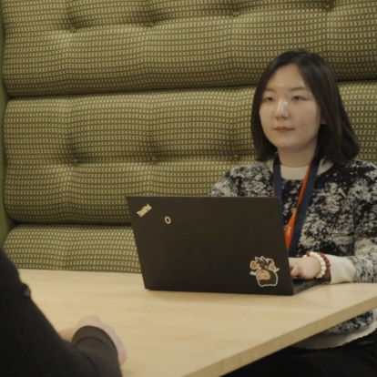
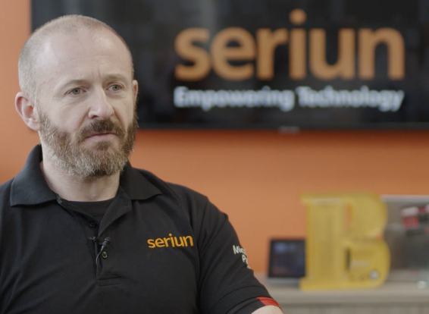
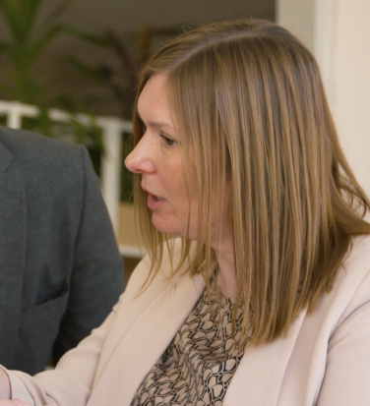
Case study contributors
Activity 1
Stefanie
Wayne
Louise
Senior Service Designer
Head of Cyber Security
Managing Director
National Highways Government road network management
Seriun Managed IT services provider
Peak Demand Small independent estate agents (fictional)
Resource 4: Meeting the needs of the end user
Notes:
Images © Gatsby Technical Education Projects

Slide 7
Case study videos
Activity 1
Each video describes the importance of considering the end user when developing digital projects.
Use Activity 1 Worksheet to help you make notes on:
the digital project involved;
examples of considering users’ needs;
what else they could have done;
any evaluative comments.
Also note any keywords mentioned that you are not familiar with, to discuss afterwards.
Available videos:
National Highways
Stephanie Shen: Senior Service Designer (User’s needs – collecting feedback) https://vimeo.com/1095537275/40bce2126b
Seriun
Wayne Fulton: Head of Cyber Security (User’s needs – training needs) https://vimeo.com/1095537731/1367e0310d
Peak Demand Estate Agents (fictional)
Louise: Managing Director (User’s needs – smartphone app design) https://vimeo.com/1095536964/9601511327
Resource 4: Meeting the needs of the end user
Notes:
National Highways
Stephanie Shen: Senior Service Designer (User’s needs – collecting feedback) https://vimeo.com/1095537275/40bce2126b
Seriun
Wayne Fulton: Head of Cyber Security (User’s needs – training needs) https://vimeo.com/1095537731/1367e0310d
Peak Demand Estate Agents (fictional)
Louise: Managing Director (User’s needs – smartphone app design) https://vimeo.com/1095536964/9601511327

Slide 8
Case study discussion
Activity 2
You should have notes on:
the digital project;
user needs;
suggestions;
evaluative comments.
Class discussion points:
Describe three ways the organisation considers the needs of the user.
Explain two further ways they could think about user needs.
Evaluate how well they achieved their goal of meeting user needs in the form of success, failure and improvements.
Close the discussion with these questions:
What value does considering user needs and user characteristics add to any organisation?
How can we improve digital access for all?
Resource 4: Meeting the needs of the end user

Slide 9
In this resource, we have:
Plenary
Skills
1 Be able to reflectively evaluate
2 Communicate information clearly to a technical and non-technical audience
3 Work with others in a collaborative manner to allow for/encourage faster, better and more efficient achievement of goals
General competencies
English:
E2 Present information and ideas
E4 Summarise information/ideas
E5 Synthesise information
E6 Take part in/leading discussions
Digital:
D3 Communicate and collaborate
understood the importance of considering user needs and end user characteristics when developing digital projects;
watched and made notes about a case study video featuring examples of new digital project development;
discussed the key considerations and potential benefits for any organisation developing their own digital projects.
Resource 4: Meeting the needs of the end user

Slide 10
Digital systems
Plenary
Describe an important consideration of user needs or end user characteristics for any of the following digital systems:
social media app;
company product database;
word processor;
instant messaging app;
business email app;
school register app.
How might the considerations of user needs and end user characteristics change in the future, especially as our use of digital increases?
Resource 4: Meeting the needs of the end user

Slide 11
Consolidation
Follow-up
Consider a new digital project for your school or college. Write a brief outline of the most important user needs (all stakeholders) and end user characteristics to consider.
What is important to consider with respect to user needs and end user characteristics for the following types of organisation?
School/college
Web design company
Electronic entry system in a doctor’s surgery
An e-bike manufacturer
Resource 4: Meeting the needs of the end user

