Slide 1
Digital
Route: Digital
Topic: The business environment and technical change management
Resource 2: Role play – Key organisation areas
Notes:
Image © Shutterstock Gorodenkoff

Slide 2
In this resource, we will:
Introduction
Skills
1 Be able to reflectively evaluate
2 Communicate information clearly to a technical and non-technical audience
3 Work with others in a collaborative manner to allow for/encourage faster, better and more efficient achievement of goals
General competencies
English:
E1 Convey technical information to different audiences
E2 Present information and ideas
E4 Summarise information/ideas
E5 Synthesise information
E6 Take part in/leading discussions
Maths:
M9 Cost a project
Digital:
D3 Communicate and collaborate
define the key areas of an organisation;
demonstrate roles within the business environment and how IT is used to support them.
Resource 2: Role play – Key organisation areas

Slide 3

‘Peak Demand’ Estate Agents – Case study
Activity 1
Peak Demand was set up in 2019 as an independent estate agent.
They market and sell homes to the public (B2C) and help businesses find properties (B2B) in the area around Manchester.
They specialise in unusual and unique properties.
Key departments:
Management
Sales and Marketing
Human Resources
Research, Design and Development
Operations
Logistics
Finance
What IT/digital technology might this sort of company use?
Resource 2: Role play – Key organisation areas
Notes:
Image © Pexels/Gustavo Fring Reminder: Peak Demand Estate Agents is a fictional case study created to support the learning in this suite of teaching materials. Please refer to the Teaching Guide for full details.

Slide 4
Role play scenarios
Activity 2
Resources needed
Activity 2: Role play scripts
Activity 2: Scenarios Answers
Group 1 – Scenario 1 – Company leaflets
Group 2 – Scenario 2 – Distribution query
Group 3 – Scenario 3 – New technology
Group 4 – Scenario 4 – Support query
Group tasks
1. Complete any gaps in the script.
2. Practise and discuss as a group.
3. Role play your scene to the class.
4. Be prepared to discuss the questions.
Resource 2: Role play – Key organisation areas

Slide 5
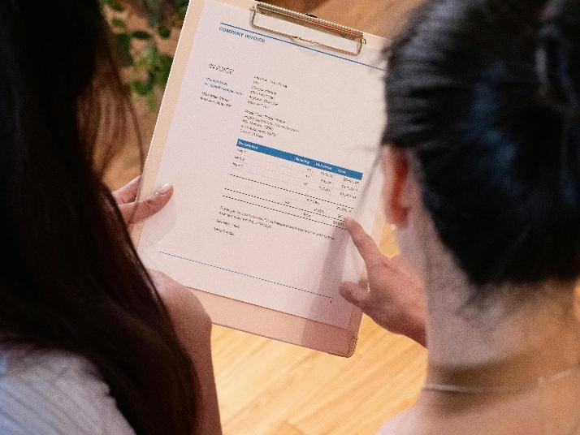
Scenario 1 questions
Activity 2
Which two key department areas are involved in this scenario?
Describe what is happening in this scenario.
Could anything have been done in a different way? What are the potential benefits and dangers of negotiating prices with a supplier?
What are the potential risks of working with a new supplier in respect to payments made and quality issues?
What does the term capital mean?
Is the invoice discussed receivable or payable? Explain your choice.
Explain the impact character C1 might have on company culture.
Resource 2: Role play – Key organisation areas
Notes:
Image © Pexels/KindelMedia

Slide 6
Scenario 1 answers
Activity 2
Finance and Management
They are discussing an invoice from a new leaflet supplier.
Students' own answers. Benefits: cheaper prices, reputation as good negotiator. Dangers: supplier may be offended, may be offered higher prices in future.
Payment risks: supplier may have short payment demands, payment delays result in later deliveries. Quality issues: standards unknown on first delivery, different suppliers have different standards.
Money that the business has for essential purchases.
Payable, as they were supplied the leaflets.
Creates a positive environment with colleagues, willingness to ask and answer questions.
Resource 2: Role play – Key organisation areas
Notes:
Image © Pexels/KindelMedia

Slide 7
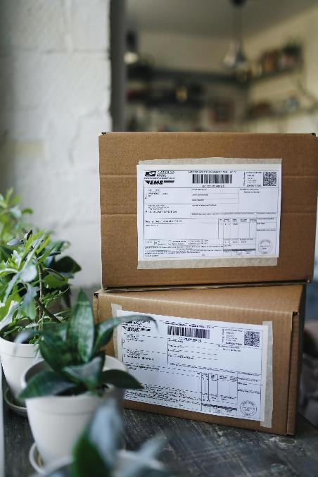
Scenario 2 questions
Activity 2
Which two key department areas are involved in this scenario?
Describe what is happening in this scenario.
Explain the difference between physical and digital distribution of the leaflet content.
Explain which method is the most cost-effective.
Describe a positive and negative implication of storing leaflets in the office.
Explain why asking office employees is not a cost-effective way to deliver leaflets.
Other than linking to a website address, how else can QR codes be used?
Resource 2: Role play – Key organisation areas
Notes:
Image © Pexels/Polina Takilevitch

Slide 8
Scenario 2 answers
Activity 2
Marketing and Logistics
Marketing is asking logistics how best to distribute a new leaflet.
Should include: physical distribution is given directly to potential customers and needs to be printed. Digital distribution requires customers to have an internet connection and can be delivered via email, messaging and websites.
Digital distribution is quicker, requires no physical materials and can be instantly delivered around the world, making it more cost-effective.
Can be quickly handed out to customers when required. Uses valuable space and not generating any interest or income if not sent out.
Their salary will be higher than hiring a delivery company and they are not able to work on their role if delivering leaflets.
Potential uses: direct links to app store products, can be used on packaging instead of barcodes, can be used a discount codes, delivery/parcel details, as a direct link to a Wi-Fi network.
Resource 2: Role play – Key organisation areas
Notes:
Image © Pexels/Polina Takilevitch

Slide 9

Scenario 3 questions
Activity 2
Which two key department areas are involved in this scenario?
Describe what is happening in this scenario.
Could anything have been done in a different way?
Explain how new jobs are advertised today.
Describe how the company could potentially monitor how their competitors are using AR and VR.
Explain, with examples, the reason for discrimination and equality rules when advertising a new role.
Resource 2: Role play – Key organisation areas
Notes:
Image © Pexels/Gustavo Fring

Slide 10
Scenario 3 answers
Activity 2
Human Resources and Research, Design and Development
RDD would like a new member of the team to focus on new technology.
Students' own answers
Online via recruitment websites, apps, email, newspapers
Download and test apps, purchase VR and AR equipment to test, ask competitors, collect user feedback.
It is against the law to treat someone less favourably than someone else because of a personal characteristic such as religion, sex, gender reassignment or age.
Resource 2: Role play – Key organisation areas
Notes:
Image © Pexels/Gustavo Fring

Slide 11

Scenario 4 questions
Activity 2
Which two key department areas are involved in this scenario?
Describe what is happening in this scenario.
Could anything have been done in a different way?
What opportunities might there be for remote working and shared online storage for the agents?
What sort of KPIs (Key Performance Indicators) might an estate agent use?
How might real-time monitoring be used at Peak Demand Estate Agents?
Resource 2: Role play – Key organisation areas
Notes:
Image © Shutterstok/PeopleImages.com - Yuri A

Slide 12
Scenario 4 answers
Activity 2
Management and Operations
Management is asking operations about their readiness to embed two digital projects into their roles as client-facing estate agents.
The projects could be tested with potential users before asking operations to look at potential issues.
When working with clients, the agents could be working from home or any location via phone, messaging, video calls.
Number of houses bought/sold, percentage of repeating clients, number of viewings per property.
Management could also view any online documents being created or watch live streams of remote house viewings.
Resource 2: Role play – Key organisation areas
Notes:
image © Shutterstok/PeopleImages.com - Yuri A

Slide 13
In this resource, we have:
Plenary
Skills
1 Be able to reflectively evaluate
2 Communicate information clearly to a technical and non-technical audience
3 Work with others in a collaborative manner to allow for/encourage faster, better and more efficient achievement of goals
General competencies
English:
E1 Convey technical information to different audiences
E2 Present information and ideas
E4 Summarise information/ideas
E5 Synthesise information
E6 Take part in/leading discussions
Maths:
M9 Cost a project
Digital:
D3 Communicate and collaborate
defined the key areas of an organisation;
demonstrated roles within the business environment and how IT is used to support them.
Resource 2: Role play – Key organisation areas

Slide 14

Plenary
Plenary
Your teacher will name two departments. Discuss what common conversations might happen between the departments.
Think about roles in small organisations.
Which departments might fit well together?
Are there any roles that it would be difficult for the same person to do?
Resource 2: Role play – Key organisation areas
Notes:
image © Pexels/RDNE Stock project

Slide 15
Research
Follow-up
Research a business that you are already familiar with. Find out how it is structured.
What roles do you recognise?
What additional roles are different to the key roles you have studied?
What do you think these different roles mean/include?
There are lots of case studies online, including the management structure of companies like Amazon, Apple and McDonalds.
Resource 2: Role play – Key organisation areas

