Slide 1
Engineering & Manufacturing
Route: Engineering & Manufacturing
Topic: Professional responsibilities, attitudes and behaviours
Resource 4: Human factors
Notes:
Image © Shutterstock/Halfpoint

Slide 2
In these activities, we will:
Introduction
Skills:
Analysing and interpreting
Planning and preparation
Evaluating
Communication
General competencies:
English:
EC2 Present information and ideas
EC4 Summarise information/ideas
EC5 Synthesise information
EC6 Take part in/lead discussions
Digital:
DC3 Communicate and collaborate
explore the nature of human characteristics, how they affect performance in work and the difference between mental and physical characteristics;
consider how workplaces are designed to suit different workplace environments;
study a real-life case study, exploring the link between workplace design and performance;
look at human factors and human error, why they happen and ways to minimise their impact.
Resource 4: Human factors

Slide 3
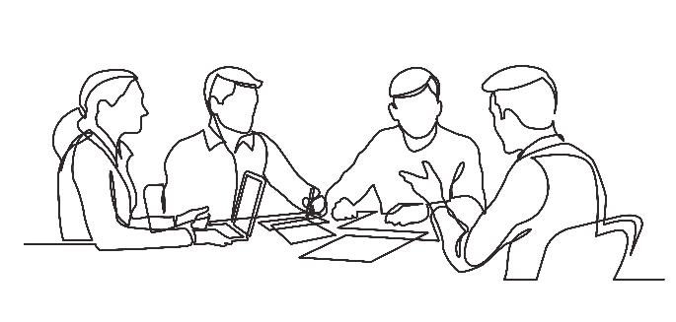
Human characteristics
Introduction
Suggest examples of human characteristics.
Which characteristics are physical and which are mental?
Resource 4: Human factors
Notes:
Image © Shutterstock/OneLineStock

Slide 4
Physical and mental human characteristics
Introduction
Physical characteristics:
Strength
Stamina
Dexterity
Appearance
Size
Mental characteristics:
Ability to solve problems
Confident in making decisions
Communication & social skills
Personal drive
Resilience
Resource 4: Human factors

Slide 5
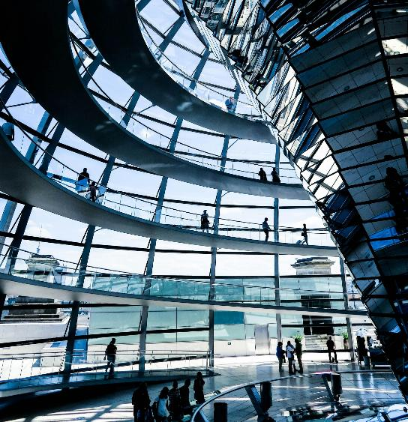
Workplace areas
Activity 1
Name the different areas you would find in a typical engineering organisation.
Resource 4: Human factors
Notes:
Image © Pexels/Lilli Waugh

Slide 6
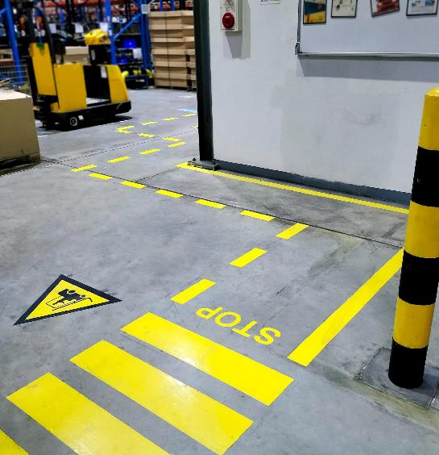
Workplace design and safety
Activity 1
Minimise hazards by ensuring ease of access and adequate spacing between workstations.
Walkways and emergency exits must be clearly marked and easily accessible for all.
Good lighting reduces eye strain and prevents accidents, especially in units with limited natural lighting.
Good ventilation and fresh air reduces the risk of respiratory problems and ensures a healthy environment.
Resource 4: Human factors
Notes:
Image © Shutterstock/Gohang

Slide 7
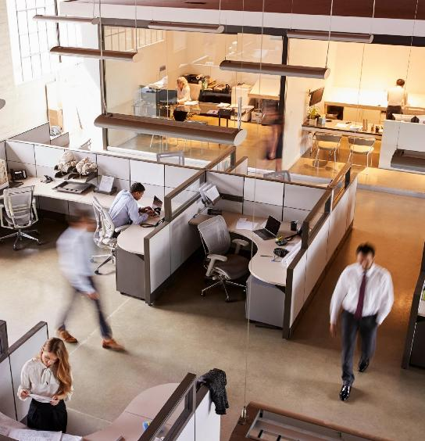
Productivity and process flow design
Activity 1
Integration of workstation technology can reduce the time taken to complete tasks.
Access to natural light boosts mood, energy levels and productivity.
Flexible workspaces can be reconfigured for different tasks to support collaboration and adaptability.
Adequate storage and organisation of tools and equipment maintain a tidy workspace, reducing time spent searching for items and potential accidents.
Resource 4: Human factors
Notes:
Image © Shutterstock/Monkey Business Images

Slide 8

Employee comfort
Activity 1
Ergonomics is the design of equipment and furniture that reduces the risk of musculoskeletal disorders and repetitive strain injuries.
Maintaining a comfortable temperature prevents discomfort and distractions.
Soundproofing and quiet zones minimise noise distractions and improve concentration.
Designated break areas with comfortable seating promote relaxation and social interaction, and reduce stress.
Resource 4: Human factors
Notes:
Image © Shutterstock/PintoArt

Slide 9
Workplace design
Activity 1
Answer question 1 on your Activities 1 + 2 Worksheet: for each of the areas, consider workplace design with particular reference to:
safety;
productivity;
comfort.
Resources needed:
R4 Activities 1 + 2 Worksheet
R4 Activities 1 + 2 Worksheet answers
Resource 4: Human factors

Slide 10

Case study: Workplace design
Activity 2
Watch the video and make notes on question 2 on Activities 1 + 2 Worksheet.
The video explores how workplace design can have a positive impact on people and productivity.
Resource 4: Human factors
Notes:
Workplace design video: https://vimeo.com/1096187067/542b455150

Slide 11

Mistakes happen…
Activity 3
What was the last error you made (in a practical sense)?
Describe it to the rest of the class.
Why do you think it happened?
Resource 4: Human factors
Notes:
Image © Pexels/Mikhail Nilov

Slide 12



Human factors and human errors
Activity 3
Physical ability
Tiredness, lack of training or experience, poor coordination, physical strain
Workplace stress
Deadlines, high-pressure discussions, misunderstandings
Safety and workplace design
Using equipment incorrectly, ignoring safety measures
What types of human error can happen in these situations?
Resource 4: Human factors
Notes:
Image left © Shutterstock/PeopleImages.com - Yuri A
Image centre © Shutterstock/Dusan Petkovic
Image right © Shutterstock/kelvn

Slide 13
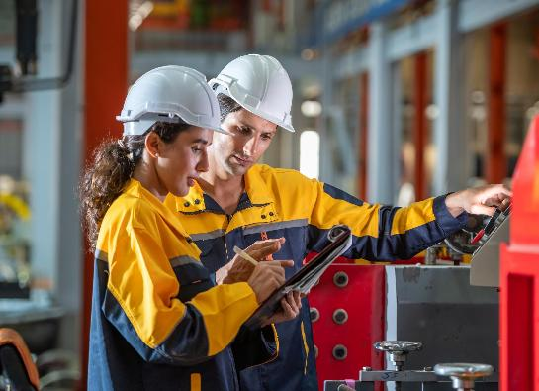
Preventing human errors
Activity 3
Errors can never be completely prevented. The chances of errors can be reduced, safety levels improved and productivity increased.
Train employees about potential risks, safety procedures and legal requirements.
Employee considerate workplace design, including ergonomics, will reduce fatigue and absences.
Automation and support tools: use automated technology to minimise manual errors and reduce fatigue.
Encourage a safety culture that promotes accountability and open communication at all levels.
A Health & Safety Executive (HSE) video on risk management can be found here:
https://youtu.be/xyANahuhGs0
Resource 4: Human factors
Notes:
Image © Shutterstock/worradirek
Health & Safety Executive (HSE) video on risk management: https://youtu.be/xyANahuhGs0

Slide 14
Workplace scenarios
Activity 3
In your group, consider the workplace scenario(s). For each one:
identify the potential danger;
suggest preventative actions the organisation could take.
Resources needed:
R4 Activity 3 Worksheet
R4 Activity 3 Worksheet answers
Resource 4: Human factors

Slide 15
In these activities, we have:
Plenary
Skills:
Analysing and interpreting
Planning and preparation
Evaluating
Communication
General competencies:
English:
EC2 Present information and ideas
EC4 Summarise information/ideas
EC5 Synthesise information
EC6 Take part in/lead discussions
Digital:
DC3 Communicate and collaborate
discussed the nature of human characteristics, how they affect performance in work and the difference between mental and physical characteristics;
considered how workplaces are designed to suit different workplace environments;
studied a real-life case study, exploring the link between workplace design and performance;
examined human factors and human error, why they happen and ways to minimise their impact.
Resource 4: Human factors

Slide 16
Consolidation
Consolidation
Update your self-review (Resource 1, Activity 4 Worksheet) to consider:
professional conduct;
job descriptions and organisational structure;
equality, diversity, accessibility and inclusion;
behaviour in the workplace;
career development programmes;
workplace design;
human error.
Identify areas to actively pursue and improve during placement.
Add potential ideas after each placement day.
Resource 4: Human factors

