Slide 1
Engineering & Manufacturing
Route: Engineering & Manufacturing
Topic: Professional responsibilities, attitudes and behaviours
Resource 1: Professional conduct and responsibilities in the workplace
Notes:
Image © Shutterstock/Halfpoint

Slide 2
In these activities, we will:
Introduction
understand the purpose of job descriptions;
explore professional expectations for conduct and behaviour in industry;
understand the need for organisational structures that provide a link between accountability and responsibility;
explore the interaction and communication between people in work;
consider the benefits of setting professional career targets for the future.
Skills:
Analysing and interpreting
Evaluating
Communication
General competencies:
English:
EC2 Present information and ideas
EC4 Summarise information/ideas
EC5 Synthesise information
EC6 Take part in/lead discussions
Digital:
DC3 Communicate and collaborate
Resource 1: Professional conduct and responsibilities in the workplace

Slide 3

Business, commercial & financial awareness
Introduction
What do you remember about the following?
Commercial priorities
Supply and demand
Competition
Legal practices
Policies and procedures
Profit and loss
Resource 1: Professional conduct and responsibilities in the workplace
Notes:
Image © Shutterstock/NuPenDekDee

Slide 4
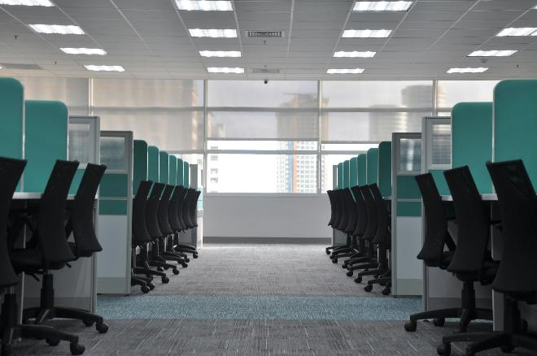
Engineering departments
Introduction
In small groups, think about your own placement or work experience (or research) and produce a list of the typical departments you would find in an engineering business.
Challenge: You could present this information to the rest of the class as a branching diagram, feeding out from the Managing Director, CEO or similar.
Resource 1: Professional conduct and responsibilities in the workplace
Notes:
Image © Unsplash/kate.sade

Slide 5

Job titles and job descriptions
Activity 1
In your groups, tell each other:
your job placement title (if you have a placement)
your job description.
As a class, discuss:
What is the purpose of a job description?
Why is it important?
Resource 1: Professional conduct and responsibilities in the workplace
Notes:
Image © Pexels/Andy Barbour

Slide 6

Job description: purpose
Activity 1
Purpose:
Appeal to candidates – the role needs to sound appealing and make either an internal or external applicant want to apply.
Clearly define the role – this means someone with the role can refer to it if the need arises.
Employer reference – management can refer to this when discussing the responsibility and accountability.
Resource 1: Professional conduct and responsibilities in the workplace
Notes:
Image © Pexels/Ron Lach

Slide 7
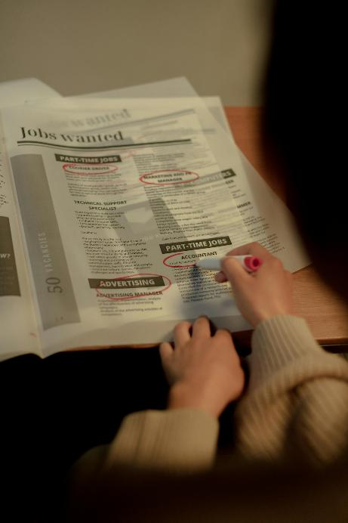
Job description: information
Activity 1
Information normally included:
job title, employer details;
areas of responsibility and place in overall structure;
location and travel requirements;
pay range and benefits available;
a job specification – defining the role in terms of personal qualities, qualifications, skills and training.
Notes:
Image © Pexels/Ron Lach

Slide 8
Exploring job roles
Activity 1
For two job roles, you need to describe:
the purpose and main responsibilities;
the relevant skills and qualifications required.
Resources needed:
R1 Activity 1 Worksheet
R1 Activity 1 Worksheet answers
Resource 1: Professional conduct and responsibilities in the workplace

Slide 9
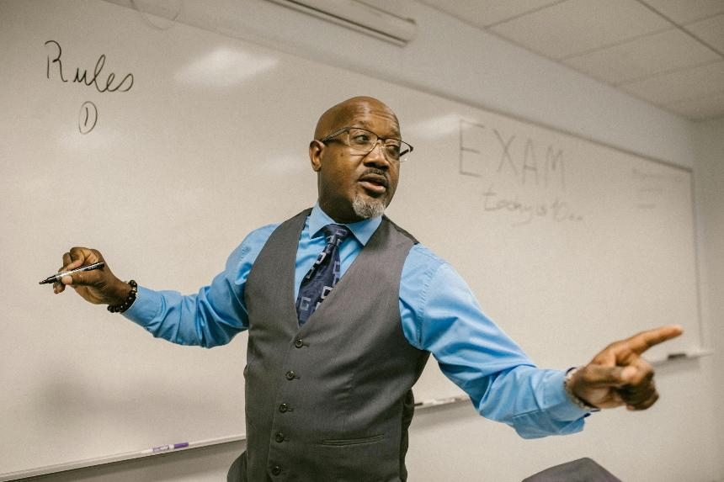
Personal conduct and behaviour
Activity 2
Name the rules which relate to personal behaviour and conduct in this school/college.
Can they be grouped into categories?
Resource 1: Professional conduct and responsibilities in the workplace
Notes:
Image © Pexels/RDNE Stock project

Slide 10

Personal conduct advice
Activity 2
In the workplace, you should consider:
your communication – all communication with stakeholders needs to be courteous, including on digital platforms;
being respectful – use professional language and behaviour with all stakeholders, and comply with equality, diversity, accessibility and inclusion (EDAI) legislation;
your professional appearance – observe the dress code, and adhere to health and safety clothing and equipment requirements
Resource 1: Professional conduct and responsibilities in the workplace
Notes:
Image © Shutterstock/New Africa

Slide 11

Personal conduct advice continued
Activity 2
your professional attitude – be responsible, attentive and consider your own health and well-being;
your personal development – take opportunities offered and seek out new learning and skills (there is more on continuous professional development (CPD) in Resource 3). Be aware of how/who you can ask for advice and guidance if necessary.
Why do you think each of these personal conduct points is important?
What impact can it have on individuals and the reputation of the business if you don’t uphold them?
Resource 1: Professional conduct and responsibilities in the workplace
Notes:
Image © Shutterstock/Halfpoint

Slide 12

Ethics and values
Activity 2
You are going to watch a short video about an engineering company called Ignys.
Ignys prides itself on being an ethical company which strongly upholds its adopted values.
Discuss what you understand by the terms:
ethics
values.
Resources needed:
R1 Activity 2 Worksheet
R1 Activity 2 Worksheet answers
Resource 1: Professional conduct and responsibilities in the workplace
Notes:
Image © Ignys

Slide 13

Case study: Ignys
Activity 2
Watch the video and take notes to answer the following questions:
What are some of the key values of Ignys?
Why are values, conduct and behaviours of employees important to Ignys?
What are the everyday expectations for behaviours and how does this impact the business?
Resource 1: Professional conduct and responsibilities in the workplace
Notes:
Image © Ignys
Professional conduct Ignys video:https://vimeo.com/1096186970/e6db8d4e90

Slide 14
Organisational structure
Activity 3
This is the start of a typical structure.
What other roles and departments can you add?
Which departments would they be part of?
Managing director
Sales / Marketing
Human resources
Finance
Design / CAD
Quality control
Supply chain manager
Production
Designers
Planning
Workshop manager
Engineers
Logistics
Machine operators
Purchasing
Resource 1: Professional conduct and responsibilities in the workplace

Slide 15
The role of a workshop manager
Activity 3
Explaining new rules and procedures
Production manager
Ensuring workshop runs efficiently
Managing director
Responsible for (role) ?
Responsible to ?
Health & Safety
Workshop Manager
Staff issues
Additional staff, e.g. cleaners
Workshop visitors
Contact with ?
Responsible for (people) ?
Machine operators
Workshop visitors
Production manager
Other managers
Machine operators
Resource 1: Professional conduct and responsibilities in the workplace

Slide 16
Responsibility and accountability
Activity 3
In your pairs, you are going to choose a role within an organisation and complete a mind map to show:
what they are responsible for;
who they are responsible to;
if they are responsible for other employees;
who they will be in regular contact with.
Resource needed:
R1 Activity 3 Worksheet
Resource 1: Professional conduct and responsibilities in the workplace

Slide 17
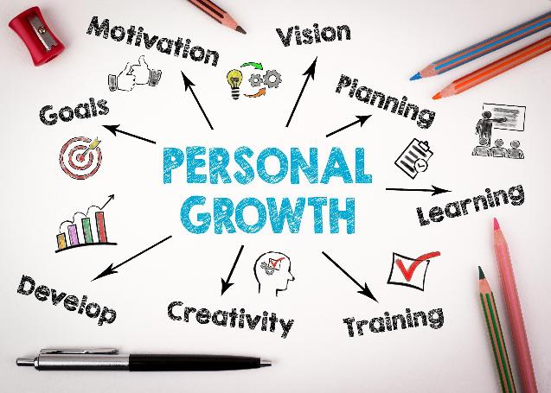
Self-review
Activity 4
Throughout your career, it is essential to set personal targets. These include self-directed and employer opportunities:
personal conduct and behaviour – thinking about how you interact with all stakeholders;
CPD (continuing professional development) – gaining recognised qualifications, knowledge and skills;
practical personal skills
– I want to learn how to…;
identifying areas of need
– what do you need to improve on?
This process should be returned to throughout your career.
Resource 1: Professional conduct and responsibilities in the workplace
Notes:
Image © Shutterstock/stoatphoto

Slide 18
Self-review
Activity 4
Complete Activity 4 Worksheet, which includes a self-evaluation document you could typically find in industry.
Resource needed:
R1 Activity 4 Worksheet
Resource 1: Professional conduct and responsibilities in the workplace

Slide 19
In these activities, we have:
Plenary
understood the purpose of job descriptions;
explored professional expectations for conduct and behaviour in industry;
understood the need for organisational structures that provide a link between accountability and responsibility;
explored the interaction and communication between people in work;
considered the benefits of setting professional career targets for the future.
Skills:
Analysing and interpreting
Evaluating
Communication
General competencies:
English:
EC2 Present information and ideas
EC4 Summarise information/ideas
EC5 Synthesise information
EC6 Take part in/lead discussions
Digital:
DC3 Communicate and collaborate
Resource 1: Professional conduct and responsibilities in the workplace

Slide 20
Consolidation
Consolidation
Consider all the elements you have explored that impact an employee in an engineering/manufacturing organisation, for example:
behaviour around other people;
knowing where they belong in the organisational structure.
Can you think of any other elements?
List anything you are unsure about and check with your teacher.
Resource 1: Professional conduct and responsibilities in the workplace

