Slide 1
Health
Route: Health & Science
Topic: Cancer care
Lesson 2: Cancer types and their treatments – Part 1
Notes:
Image © Shutterstock/Elnur

Slide 2
In this lesson, we will:
Introduction
Skills:
CS1.1 Plan and develop person-centred care
CS3.2 Undertake collaborative work
CS4.1 Undertake reflective practice and record reflections and experiences
CS5.1 Apply research skills
CS6.1 Present their project findings in a range of formats
General competencies:
English
GEC2 Present information and ideas
GEC4 Summarise information/ideas
GEC5 Synthesise information
GEC6 Take part in/lead discussions
Digital
GDC1 Use digital technology and media effectively
GDC3 Communicate and collaborate
GDC5 Be safe and responsible online
Describe three types of cancer: thyroid cancer (TC), acute myeloid leukaemia (AML), and germ cell testicular cancer (GCTC)
Explain common cancer treatments
Compare and contrast the impact of different cancers within the body and on physical health
Compare and contrast different cancer treatments depending on the tumour
Lesson 2: Cancer types and their treatment – Part 1

Slide 3

Starter task: Think, pair, share
Introduction
Write down everything you already know about medical treatments for cancer.
Pair up and compare notes. Capture any information that improves your first attempt.
Join with another pair and capture any information that improves your second attempt.
Lesson 2: Cancer types and their treatment – Part 1
Notes:
Image © Pixabay/manfredsteger

Slide 4
Cancer can be treated in four ways
Activity 1
Surgery
Radiotherapy
Chemotherapy
Tumour-specific treatments, e.g. immunotherapy and hormone therapy
Lesson 2: Cancer types and their treatment – Part 1

Slide 5
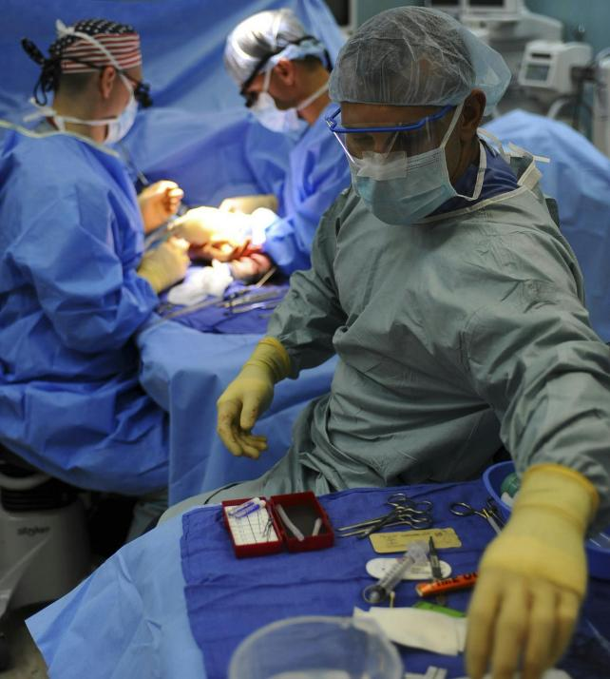
Surgery
Activity 1
Tumours can be surgically removed.
This could work for a benign tumour, or a malignant tumour that isn’t too large or too embedded in other important tissues such as nerves and/or blood vessels.
Lesson 2: Cancer types and their treatment – Part 1
Notes:
Image © Pexels/Pixabay

Slide 6
Chemotherapy
Activity 1
Drugs are used to kill cancer cells by damaging them so they can’t reproduce and spread.
The main uses of chemotherapy are:
to try to cure cancer completely (curative chemotherapy);
to help make other treatments more effective – for example, chemotherapy can be combined with radiotherapy, or it can be used before surgery;
to reduce the risk of the cancer returning after radiotherapy or surgery;
to relieve the symptoms of advanced cancer and slow it down (palliative chemotherapy).
Lesson 2: Cancer types and their treatment – Part 1

Slide 7
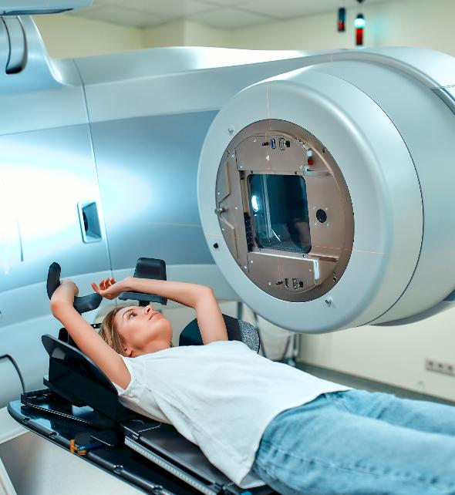
Radiotherapy
Activity 1
Radiotherapy is a treatment involving the use of high-energy radiation.
Radiotherapy can be used alone or in combination with chemotherapy (chemoradiotherapy).
For people with incurable cancers, radiotherapy is a very effective way of controlling symptoms.
Radiotherapy can also be used after surgery to destroy very small amounts of tumour that June be left (known as adjuvant treatment).
Lesson 2: Cancer types and their treatment – Part 1
Notes:
Image © Shutterstock/ORION PRODUCTION

Slide 8
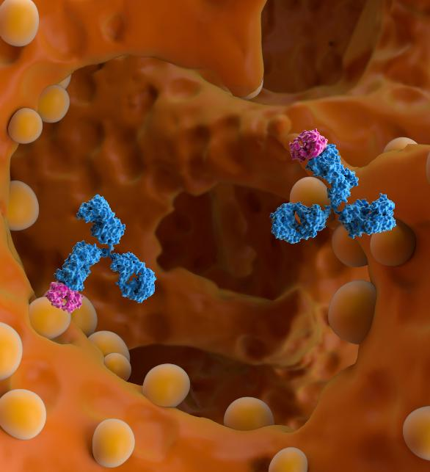
Tumour-specific treatments
Activity 1
Some newer cancer therapies target a specific cancer cell based on their hormone receptors or their antigen receptors.
1. Hormonal therapy
Reduces the level of hormones in the body or blocks hormones from reaching cancer cells to stop them growing and reproducing.
2. Targeted immune therapies
Destroys cancer cells, usually by interfering with the cancer’s ability to grow and using antibodies to flag tumours for destruction by the immune system.
Lesson 2: Cancer types and their treatment – Part 1
Notes:
Image © Shutterstock/Nemes Laszlo

Slide 9
Choice of cancer treatments
Activity 1
Treatment of a cancer might include a selection from surgery, radiotherapy, chemotherapy or immunotherapy, depending on the tumour type, location, malignancy and how far into other tissues it has invaded.
Here are some examples of how cancers are treated:
Surgery – thyroid cancer (TC), invasive breast cancer (IBC) and testicular cancers
Radiotherapy – invasive breast cancer
Chemotherapy – acute myeloid leukaemia (AML)
Immunotherapy – non-Hodgkin lymphoma (NHL)
Lesson 2: Cancer types and their treatment – Part 1

Slide 10
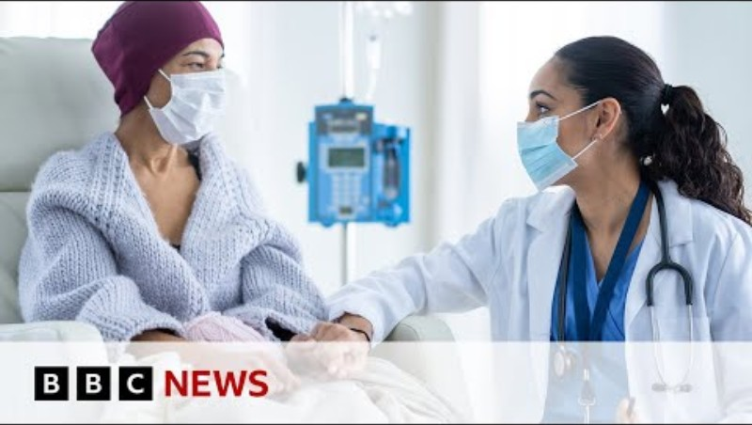
Advances in cancer treatment
Activity 1
Watch the BBC News video that outlines how technology, such as AI and robotics are helping to discover more effective drugs with fewer side-effects.
Lesson 2: Cancer types and their treatment – Part 1
Notes:
BBC News video: https://www.youtube.com/watch?v=FtdXAZ048hA

Slide 11

Cancer types: What you need to know
Activity 2
In this lesson, we will be writing a profile to describe three types of cancer:
acute myeloid leukaemia (AML);
thyroid cancer (TC);
germ cell testicular cancer (GCTC).
Look through the Activity 2 information sheet, which is a best-practice example for AML.
Lesson 2: Cancer types and their treatment – Part 1
Notes:
Image © Shutterstock/THICHA SATAPITANON

Slide 12
Acute myeloid leukaemia (AML)
Activity 2
Decode these medical terms:
Acute
Myeloid
Leukaemia
Bone marrow
Stem cell
Lesson 2: Cancer types and their treatment – Part 1

Slide 13
Acute myeloid leukaemia (AML)
Activity 2
Decode these medical terms:
Acute
It progresses rapidly and aggressively.
Myeloid
White blood cells that fight bacterial infections and prevent the spread of tissue damage.
Leukaemia
Cancer of the white blood cells. It causes a lack of mature functioning white blood cells, so is a kind of anaemia.
Bone marrow
Found in the long bones of the skeletal system. It contains blood stem cells.
Stem cell
Unspecialised cells that have the potential to develop into many different types of cell.
Lesson 2: Cancer types and their treatment – Part 1

Slide 14
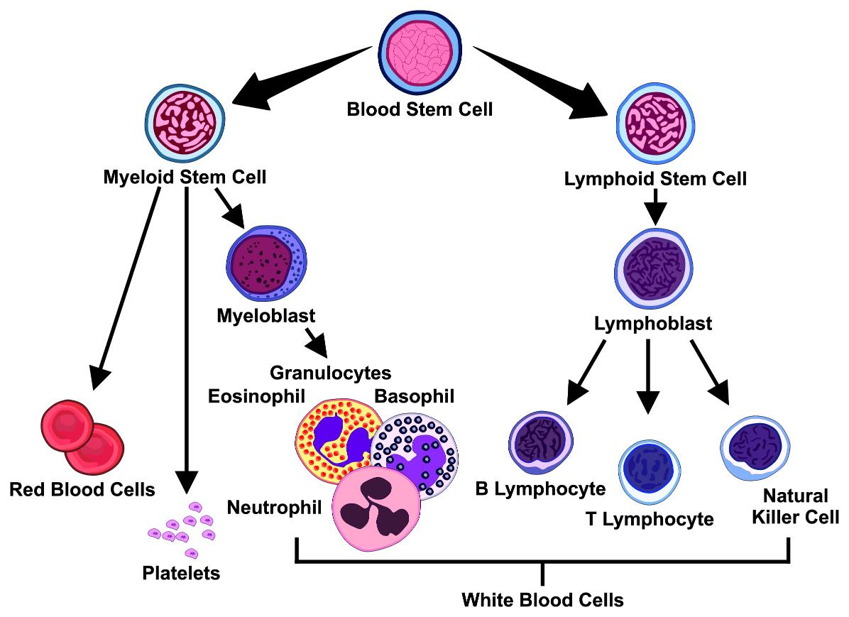
Blood cells
Activity 2
Lesson 2: Cancer types and their treatment – Part 1
Notes:
Image © Shutterstock/udaix

Slide 15
Complete profiles
Activity 2
Work in pairs. One person will complete a profile for thyroid cancer (TC) and the other for germ cell testicular cancer (GCTC).
Use the profile templates on the Activity 2 worksheet.
Decode the medical terms to simplify and remember each cancer type.
Add in a picture or two that represents the information you have found out.
Use reputable sources and reference where you got your information from.
Suggested sources:
www.nhs.uk
cks.nice.org.uk/specialities/cancer
www.cancerresearchuk.org
Age of onset: People over 65
Causes: Stem cells in bone marrow produce too many immature white blood cells called blast cells. These cells cannot fight infections like a normal white blood cell and their over production leads to a decrease in red blood cells.
Risk factors: previous chemotherapy or radiotherapy, having an underlying blood disorder or genetic disorder e.g. Down’s, exposure to benzene a chemical in cigarette smoke, increasing age
Symptoms: pale skin, tiredness, breathlessness, frequent infections, unusual and frequent bleeding e.g. nosebleeds – tends to develop over a few weeks
Lesson 2: Cancer types and their treatment – Part 1
Notes:
Suggested sources: www.nhs.uk
cks.nice.org.uk/specialities/cancer
www.cancerresearchuk.org

Slide 16
How do you ‘explain’ in an exam?
Activity 3
1
What vocabulary do you choose to use?
2
How do you structure your writing?
3
Which facts do you need to introduce to support the explanation?
4
What examples illustrate your explanation?
5
How will you summarise, to ensure you have answered the question?
Lesson 2: Cancer types and their treatment – Part 1

Slide 17
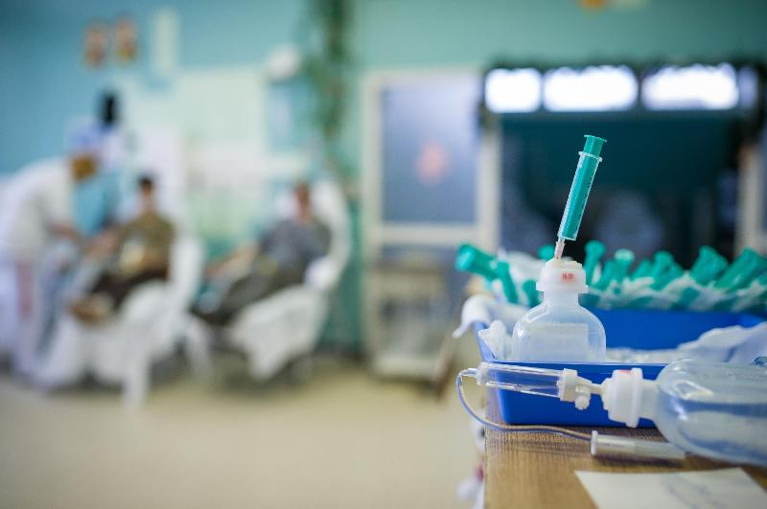
Question 1
Activity 3
Using the profiles and your own knowledge, explain why acute myeloid leukaemia (AML) is treated with chemotherapy and bone marrow transplant/stem cell transplant.
Challenge: Why does AML have such system-wide symptoms?
Lesson 2: Cancer types and their treatment – Part 1
Notes:
Image © Shutterstock/goodbishop

Slide 18

Question 2
Activity 3
Using the profiles and your own knowledge, compare the cancer treatment for germ cell testicular cancer (GCTC) and thyroid cancer (TC).
Challenge: Why would talking therapies be offered to a patient undergoing cancer treatment?
Lesson 2: Cancer types and their treatment – Part 1
Notes:
Image © Shutterstock/wutzkohphoto

Slide 19

Plenary task: Reflect on your learning
Plenary
Share between your pairs:
something new that you learned;
something that surprised you;
something you’re going to look up.
Lesson 2: Cancer types and their treatment – Part 1
Notes:
Image © Pexels/Pixabay

Slide 20
In this lesson, we have:
Plenary
Skills:
CS1.1 Plan and develop person-centred care
CS3.2 Undertake collaborative work
CS4.1 Undertake reflective practice and record reflections and experiences
CS5.1 Apply research skills
CS6.1 Present their project findings in a range of formats
General competencies:
English
GEC2 Present information and ideas
GEC4 Summarise information/ideas
GEC5 Synthesise information
GEC6 Take part in/lead discussions
Digital
GDC1 Use digital technology and media effectively
GDC3 Communicate and collaborate
GDC5 Be safe and responsible online
Described three types of cancer: thyroid cancer (TC), acute myeloid leukaemia (AML), germ cell testicular cancer (GCTC)
Explained common cancer treatments
Compared and contrasted the impact of different cancers within the body and on physical health
Compared and contrasted different cancer treatments depending on the tumour
Lesson 2: Cancer types and their treatment – Part 1

Slide 21
Consolidation
Consolidation
Do your own research on a new form of cancer treatment or diagnosis tool for testicular cancer (GCTC), thyroid cancer (TC) or acute myeloid leukaemia (AML) that interests you.
Use what you have found out to write a report that outlines:
how the cancer is normally treated/diagnosed
what the new treatment/diagnosis tool aims to do
how it will do this
what its impact might be on cancer care.
Lesson 2: Cancer types and their treatment – Part 1

