Slide 1
Health
Route: Health & Science
Topic: Cancer care
Lesson 3: Cancer types and their treatments – Part 2
Notes:
Image © Shutterstock/Elnur

Slide 2
In this lesson, we will:
Introduction
Skills:
CS3.2 Undertake collaborative work
CS5.1 Apply research skills
CS6.1 Present their project findings in a range of formats
General competencies:
English
GEC2 Present information and ideas
GEC4 Summarise information/ideas
GEC5 Synthesise information
Digital
GDC1 Use digital technology and media effectively
Describe two types of cancer:
  non-Hodgkin lymphoma (NHL);
  invasive breast cancer (IBC).
Explain common cancer treatments:
  breast-conserving surgery and mastectomy;
  monoclonal antibody therapy;
  talking therapies.
Explain the impact on systems within the body and on physical and mental health.
Lesson 3: Cancer types and their treatment – Part 2

Slide 3

Check your understanding
Introduction
Recall four ways of treating cancer.
Describe the difference between a benign and a malignant tumour.
Explain why treatment for acute myeloid leukaemia includes chemotherapy and a bone marrow transplant.
Suggest possible treatments for breast cancer and explain your choices.
Lesson 3: Cancer types and their treatment – Part 2
Notes:
Image © Pexels/Pixabay

Slide 4
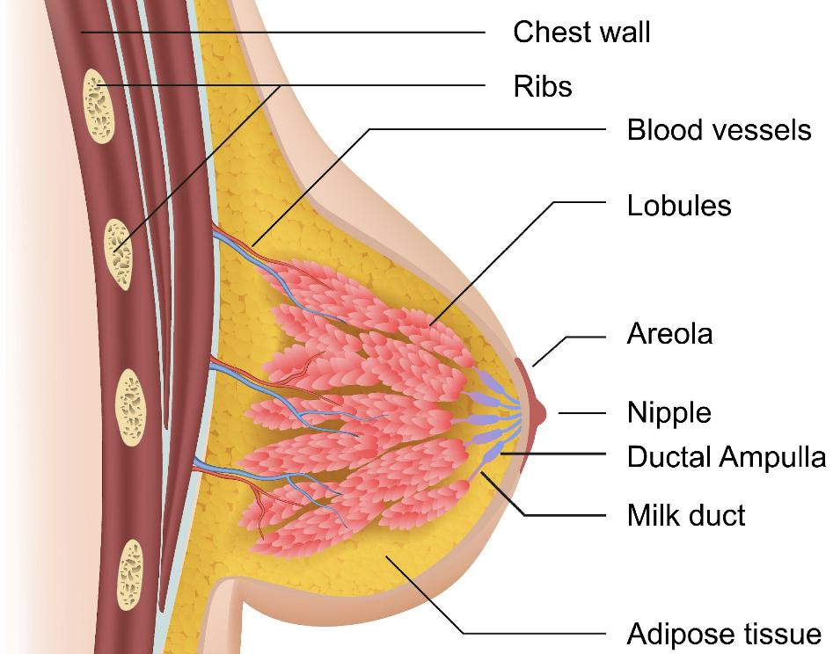
A quick recap of breast anatomy
Introduction
Both men and women have breast tissue which consists of adipose (fatty) tissue, fibrous tissue, nipples, areola, ducts and lobules.
The different hormones in puberty cause female breast tissue to grow while restricting it in males.
Notes:
Image © Shutterstock/medicalstocks

Slide 5
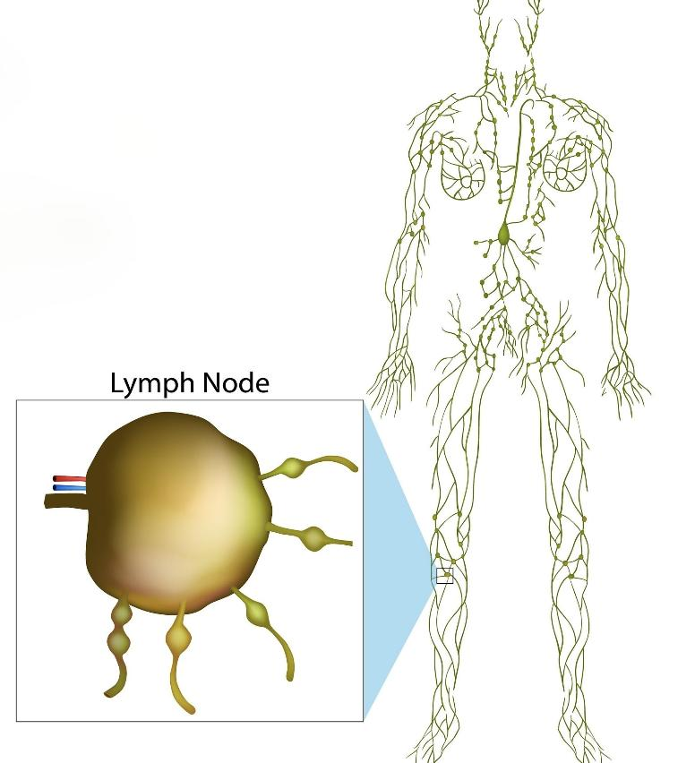
A quick recap of the lymphatic system
Introduction
The lymphatic system is made up of lymphatic capillaries, lymphatic vessels and lymph nodes, which collect and transport lymph.
Lymph is a clear fluid that passes into the venous ends of the lymphatic capillaries.
It contains white blood cells, which are part of the body’s defence system.
Notes:
Image © Shutterstock/Sakurra

Slide 6
NHL and IBC profiles
Activity 1
Work in pairs.
One person writes a profile on the Activity 1 worksheet to describe non-Hodgkin lymphoma (NHL). The other person writes a profile on invasive breast cancer (IBC).
Include three short questions.
Swap profiles and answer the questions.
Suggested sources:
www.nhs.uk
cks.nice.org.uk/specialities/cancer
www.cancerresearchuk.org
Notes:
Suggested sources:
www.nhs.uk
cks.nice.org.uk/specialities/cancer
www.cancerresearchuk.org

Slide 7
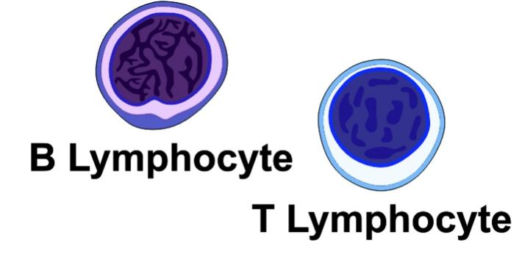
Non-Hodgkin lymphoma (NHL)
Activity 1
Non-Hodgkin lymphoma (NHL) is one of a group of cancers known as blood cancers.
It affects B and T lymphocytes (a type of white blood cell). These cells play an important role in the immune system.
NHL is also referred to as lymphatic cancer, as it starts in the lymph nodes.
Notes:
Image © Shutterstock/udaix

Slide 8
Treatment for Non-Hodgkin lymphoma (NHL)
Activity 1
The most common treatments for NHL are:
chemotherapy;
radiotherapy;
immunotherapy – monoclonal antibody therapy.
Treatment is decided by the multidisciplinary team and depends on:
the type of NHL;
how fast it is growing;
what stage it has reached;
the patient’s general health;
the patient’s age.
(Cancer Research UK)

Slide 9

Monoclonal antibody therapy
Activity 2
Discuss in a pair the meaning of these terms:
mono;
clonal;
antibody;
therapy.
Notes:
Image © Pixabay/manfredsteger

Slide 10
Monoclonal antibody therapy
Activity 2
Discuss in a pair the meaning of these terms:
mono;
clonal;
antibody;
therapy.
one
copied
a protein that attaches to an antigen
treatment

Slide 11
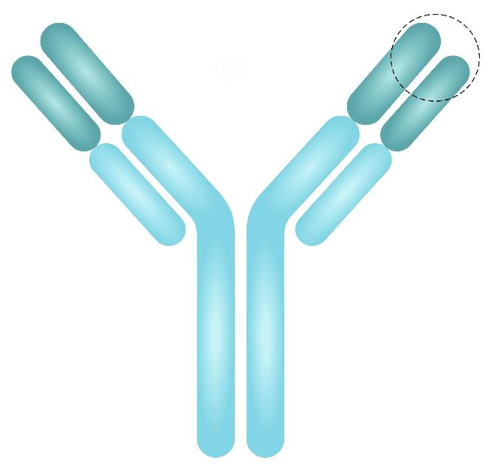
Antibody
Activity 2
Antigen binding site
An antibody is a protein produced by B-lymphocytes (a type of white blood cell) to neutralise or destroy a specific antigen.
Antibodies are specific – each antibody only attaches to one type of antigen.
What is an antigen?
Notes:
Image © Shutterstock/Twinkle picture

Slide 12
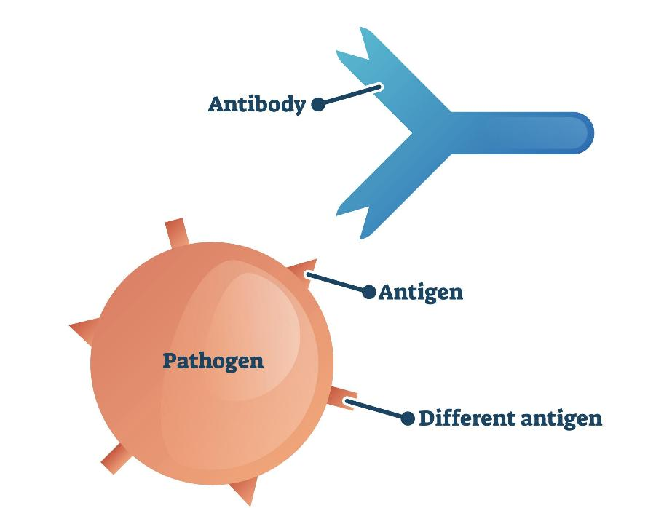
Antigen
Activity 2
Antigens are chemical markers on the surface of cells.
Antigens recognised by the immune system as ‘non-self’ trigger a response, prompting the body to make antibodies.
Do cancer cells have antigens?
Notes:
Image © Shutterstock/VectorMine

Slide 13
Cancer cells
Activity 2
Cancer cells have antigens:
Tumour-specific antigens (TSA) – found only on cancer cells, not on normal cells, e.g. mutated p53 protein in some cancers.
Tumour-associated antigens (TAA) – found on both cancer and normal cells, but in much higher numbers in cancer cells, e.g. HER2 in breast cancer, AFP in liver cancer.
How could antibodies help fight cancer?

Slide 14
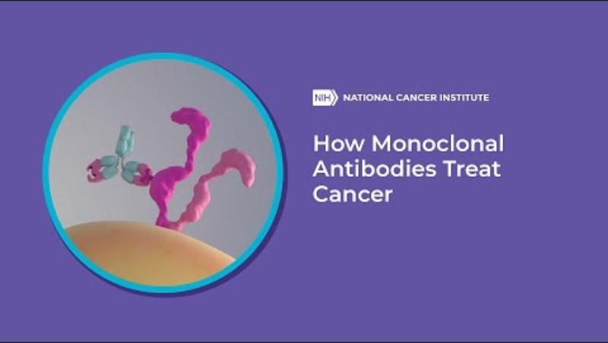
Monoclonal antibody therapy
Activity 2
Watch the video, which outlines how this cancer therapy works.
Draw short cartoon strips on the template on the Activity 2 worksheet to show the different ways in which monoclonal antibody therapy works.
Include a description of what is happening.
Notes:
Monoclonal antibody therapy video: https://www.youtube.com/watch?v=dxnjAc-rqz8

Slide 15
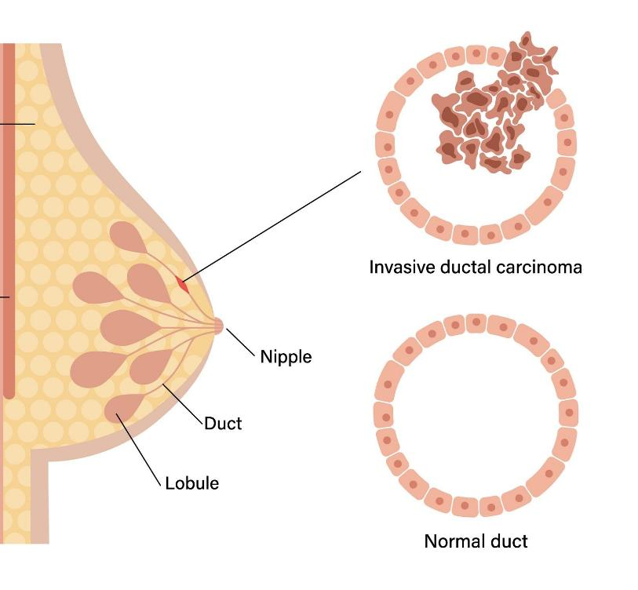
What is invasive breast cancer (IBC)?
Activity 3
This is the most common form of breast cancer.
Cells have grown outside of the duct into the surrounding tissues.
When the cells reach this stage, they can evade the body’s immune system and metastasise.
Notes:
Image © Shutterstock/Pikovit

Slide 16
Treatment for invasive breast cancer (IBC)
Activity 3
Removal of breast tissue:
  breast-conserving surgery (wide local excision or lumpectomy) removes the cancerous area with a small margin of tissue while preserving most of the breast;
  full removal of breast/breasts (mastectomy).
chemotherapy;
radiotherapy;
monoclonal antibody therapy.
Treatment for breast cancer depends on several factors.
These include where the cancer is, how big it is, whether the cancer cells have certain antigens and general health.
(Cancer Research UK)

Slide 17
Invasive breast cancer (IBC) case studies
Activity 3
Sources:
Carina’s story: https://www.youtube.com/watch?v=KZAawwDjNvI
Julie’s story: https://www.youtube.com/watch?v=ANAqBf8f3O8
Watch the two case study videos in which breast cancer survivors – Carina and Julie – talk about their experiences with diagnosis and treatment.
Answer the questions on the Activity 3 worksheet, which focus on treatment plans and the impact of IBC on mental and physical health.
Notes:
Carina’s breast cancer case study video: https://www.youtube.com/watch?v=KZAawwDjNvI
Julie’s breast cancer case study video: https://www.youtube.com/watch?v=ANAqBf8f3O8

Slide 18

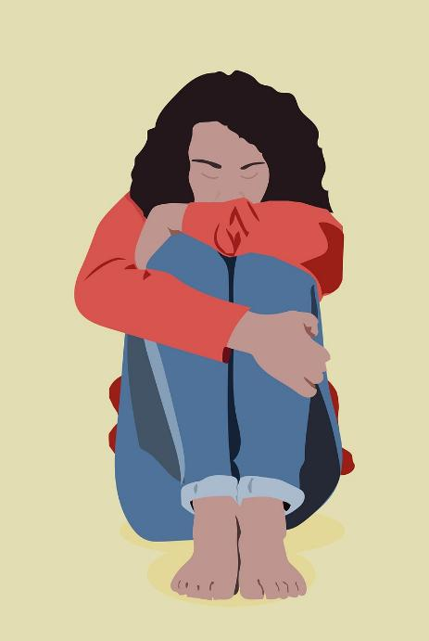
The impact of invasive breast cancer (IBC) on mental health
Common feelings at diagnosis of all cancers are feeling overwhelmed, shocked, numb and angry.
There can be feelings of anxiety around treatment, the future and how loved ones will feel.
Removal of breast tissue, even if the breast is reconstructed, can impact on how a person views their body, and this can impact on relationships.
Notes:
Image © Pixabay/BiancaVanDijk

Slide 19

Available support
talking to friends and family;
talking therapy like counselling and cognitive behavioural therapy (CBT);
spiritual support – local minister, faith leader or hospital chaplain;
Breast Cancer Care nurses;
specialist services: Macmillan Cancer Support, Maggie’s, prosthesis/wig services.
Notes:
Image © Pexels/Jack Sparrow

Slide 20
In this lesson, we have:
Plenary
Skills:
CS3.2 Undertake collaborative work
CS5.1 Apply research skills
CS6.1 Present their project findings in a range of formats
General competencies:
English
GEC2 Present information and ideas
GEC4 Summarise information/ideas
GEC5 Synthesise information
Digital
GDC1 Use digital technology and media effectively
Described two types of cancer:
  non-Hodgkin lymphoma (NHL);
  invasive breast cancer (IBC).
Explained common cancer treatments:
  breast-conserving surgery and mastectomy;
  monoclonal antibody therapy;
  talking therapies.
Explained the impact on systems within the body and on physical and mental health.

Slide 21
Non-Hodgkin lymphoma (NHL) case study
Consolidation
Read Elara’s case study on the Consolidation worksheet.
Answer the questions.
You June need to do research to support your answers. Reliable sources of information are Cancer Research UK and the NHS websites.

