Slide 1
Health
Route: Health & Science
Topic: Cancer care
Lesson 4: Occupational roles in cancer care
Notes:
Image © Shutterstock/Elnur

Slide 2
In this lesson, we will:
Introduction
Skills:
CS1 Demonstrate person-centred care skills
CS2 Communication
CS3 Team working
CS4 Reflective evaluation
CS6 Presenting
General competencies:
English
GEC1 Convey technical information to different audiences
GEC2 Present information and ideas
GEC3 Create texts for different purposes and audiences
GEC4 Summarise information/ideas
GEC5 Synthesise information
GEC6 Take part in/lead discussions
Digital
GDC1 Use digital technology and media effectively
GDC3 Communicate and collaborate
Explain holistic approaches to cancer treatment and their importance
Discuss cancer treatment pathways from different professionals’ perspectives
Consider how could the role of each person in a multidisciplinary team (MDT) contributes to the physical and mental health of the patient
Describe a person-centred treatment plan
Lesson 4: Occupational roles in cancer care

Slide 3

Starter
Introduction
In small groups, write a list of all the individuals you think are involved in caring for a patient with cancer.
Lesson 4: Occupational roles in cancer care
Notes:
Image © Pixabay/OpenClipart-Vectors

Slide 4
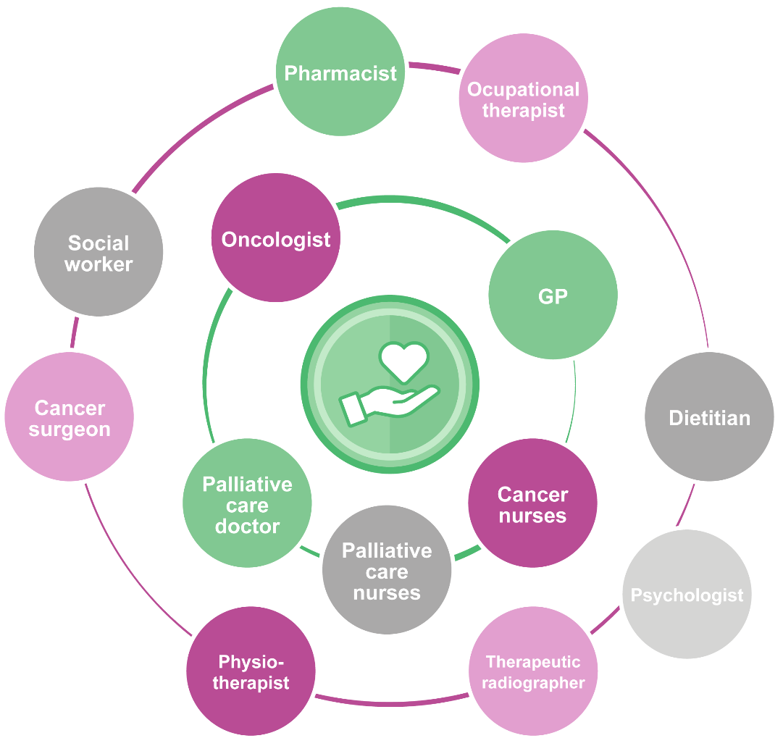
Introduction
Occupational roles
How many of these did you identify?
Lesson 4: Occupational roles in cancer care
Notes:
Image © Gatsby Technical Education Projects

Slide 5

The multidisciplinary team (MDT)
Introduction
The multidisciplinary team (MDT)
Multidisciplinary teams, or MDTs, are teams consisting of individuals drawn from different disciplines who come together to achieve a common goal, whether that be a project to introduce a new role, the redesign of a patient pathway or providing care in a different way.
(NHS Health Education England 2021)
Lesson 4: Occupational roles in cancer care
Notes:
Image © Pixabay/Wallusy

Slide 6
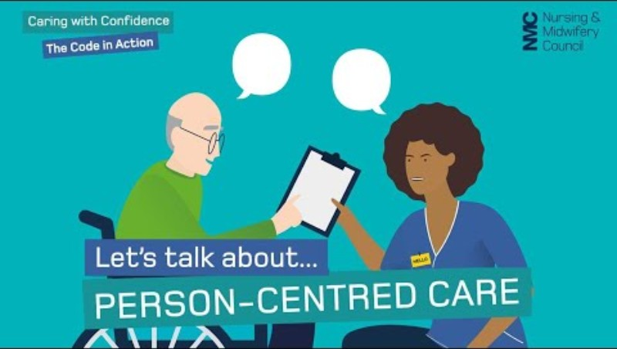
Activity 1
Person-centred care
Write a short definition of person-centred care.
How does person-centred care reflect the core NHS values?
Lesson 4: Occupational roles in cancer care
Notes:
Person-centred care video: https://www.youtube.com/watch?v=rM9QAxFSBMU

Slide 7

Person-centred care
Activity 1
Being person-centred is about focusing care on the needs of individual – ensuring that people's preferences, needs and values guide clinical decisions and providing care that is respectful of and responsive to them.
(NHS Health Education England 2021)
Lesson 4: Occupational roles in cancer care
Notes:
Image © Pexels/cottonbro studio

Slide 8


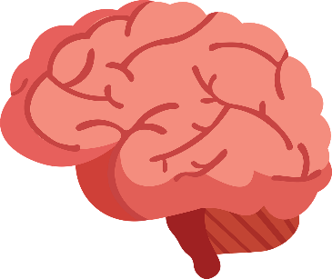



The 6 Cs
Activity 1
1
2
3
4
5
6
Lesson 4: Occupational roles in cancer care
Notes:
Image 1 © Pixabay/Mohamed_hassan
Image 2 © Pixabay/HtcHnm
Image 3 © Pixabay/Mohamed_hassan
Image 4 © Pixabay/GDJ
Image 5 © Pixabay/mcmurryjulie
Image 6 © Pixabay/OpenClipart-Vectors

Slide 9
The 6 Cs
Activity 1
1
Care
The core of our business. Caring defines nurses and our work.
2
Competence
Having the expertise, clinical and technical knowledge to deliver effective care.
3
Courage
The ability to speak up about concerns and the strength to embrace change.
Care
The core of our business. Caring defines health professionals and our work.
Competence
Having the expertise, clinical and technical knowledge to deliver effective care.
Courage
The ability to speak up about concerns and the strength to embrace change.
Lesson 4: Occupational roles in cancer care
Notes:
Image 1 © Pixabay/Mohamed_hassan
Image 2 © Pixabay/HtcHnm
Image 3 © Pixabay/Mohamed_hassan

Slide 10
The 6 Cs
Activity 1
4
Compassion
Defined by care given empathetically, respectfully and maintaining commitment.
5
Communication
Essential for effective patient care and effective team working.
6
Commitment
Build on this to improve the care experience of patients.
Compassion
Defined by care given empathetically, respectfully and maintaining commitment.
Communication
Essential for effective patient care and effective team working.
Commitment
We need to build on our commitment to improve the care and experience of our patients.
Lesson 4: Occupational roles in cancer care
Notes:
Image 4 © Pixabay/GDJ
Image 5 © Pixabay/mcmurryjulie
Image 6 © Pixabay/OpenClipart-Vectors

Slide 11
Researching different roles
Activity 2
Work in pairs.
You will be assigned two roles – decide which you will each take:
  Oncologist and therapeutic radiographer
  Nurse and pharmacist
  Physiotherapist and occupational therapist
Research how your specialist professional would support a patient with cancer.
How might they work in a team of other professionals to support the patient?
Suitable weblinks for research are provided on the Activity 2 Worksheet.
Lesson 4: Occupational roles in cancer care

Slide 12
Researching different roles
Activity 2
Oncologist: www.youtube.com/watch?v=AbWXt1boxXQ (from 2.48 to 5.01)
Therapeutic radiographer: www.youtube.com/watch?v=pDBH2OYHvMc (until 3.44)
Nurse: www.youtube.com/watch?v=DtO5kKF-VqI
Pharmacist: www.youtube.com/watch?v=zKkVZWXfwFA (until 2.25)
Physiotherapist: www.youtube.com/watch?v=6SXU9-d1WB8
Occupational therapist: www.youtube.com/watch?v=YUmgwnCUb4o
Lesson 4: Occupational roles in cancer care
Notes:
Oncologist: www.youtube.com/watch?v=AbWXt1boxXQ (from 2.48 to 5.01)
Therapeutic radiographer: www.youtube.com/watch?v=pDBH2OYHvMc (until 3.44)
Nurse: www.youtube.com/watch?v=DtO5kKF-VqI
Pharmacist: www.youtube.com/watch?v=zKkVZWXfwFA (until 2.25)
Physiotherapist: www.youtube.com/watch?v=6SXU9-d1WB8
Occupational therapist: www.youtube.com/watch?v=YUmgwnCUb4o
Please note: All information available in the linked videos was correct at the time of filming.

Slide 13
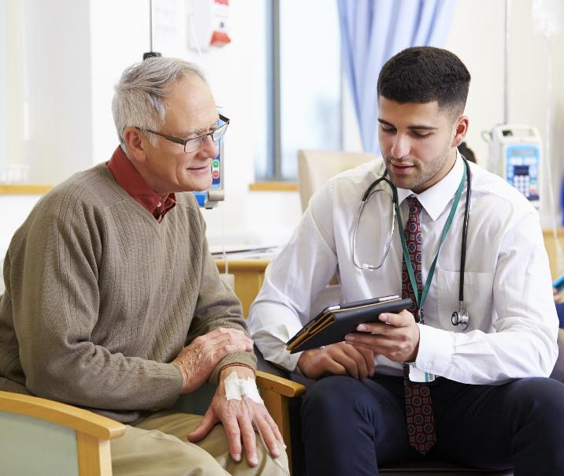
Activity 2
Oncologist
An oncologist is a doctor involved with the diagnosis and assessment of cancer patients along with their subsequent treatment pathways.
They combine their clinical careers with research.
Clinical oncologists treat patients using a combination of chemotherapy, radiotherapy and other systemic treatments, while medical oncologists use non-radiological treatments (for example systemic treatments such as chemotherapy, hormone therapy and immunotherapy).
Lesson 4: Occupational roles in cancer care
Notes:
Image © Shutterstock/Monkey Business Images

Slide 14
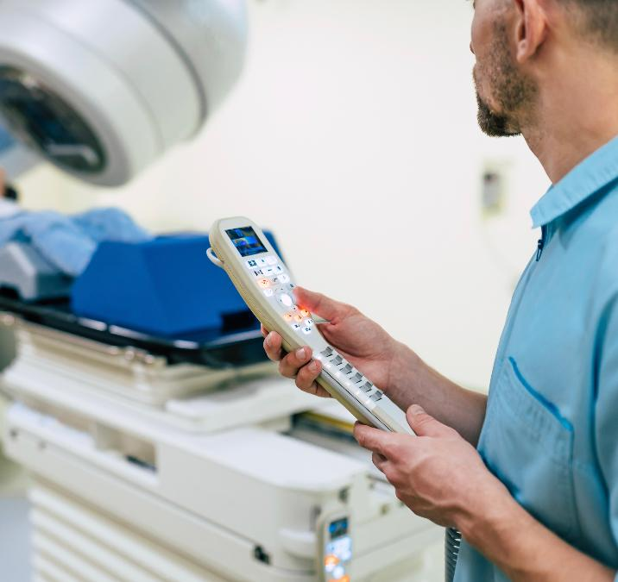
Activity 2
Therapeutic radiographer
Therapeutic radiographers are trained in various imaging techniques, radiotherapy planning and delivering high-dose X-ray treatment.
They precisely align treatment plans to a patient’s anatomy, ensuring the tumour is targeted effectively while minimising exposure to healthy tissue.
Additionally, they help manage radiotherapy side-effects during and after treatment, providing continuous care and support to improve patient outcomes.
Lesson 4: Occupational roles in cancer care
Notes:
Image © Shutterstock/My Ocean Production

Slide 15
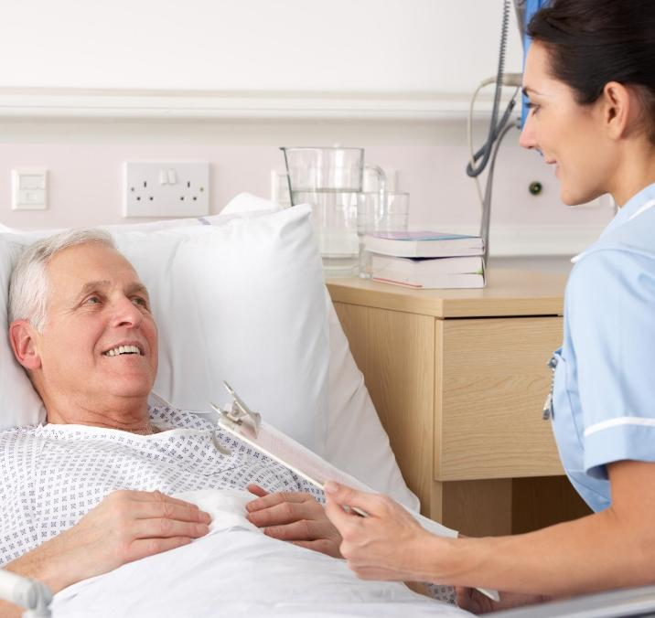
Activity 2
Nurse
Nurses are involved in all aspects of patient care, including:
assessment of care needs;
helping with the activities of daily living (ADLs);
giving prescribed medication;
dressing wounds;
supporting patients and their families’ emotional and mental health, as well as the patient’s physical health.
Lesson 4: Occupational roles in cancer care
Notes:
Image © Shutterstock/Monkey Business Images

Slide 16
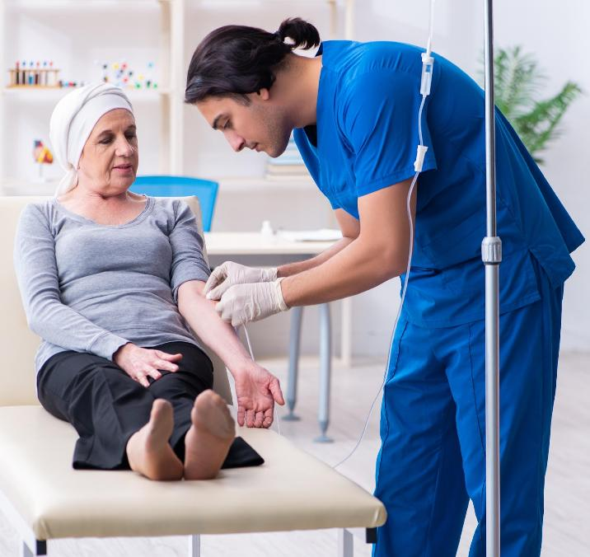
Activity 2
Pharmacist
Pharmacists play an essential role in the patient’s cancer journey. As well as preparing the chemotherapy, they:
educate patients on their chemotherapy;
help design, monitor and adjust chemotherapy regimens for patients, taking into account drug toxicity, infections and other side effects of the chemotherapy;
work as part of the multidisciplinary team to ensure the safe and effective care of patients.
Lesson 4: Occupational roles in cancer care
Notes:
Image © Shutterstock/Elnur

Slide 17
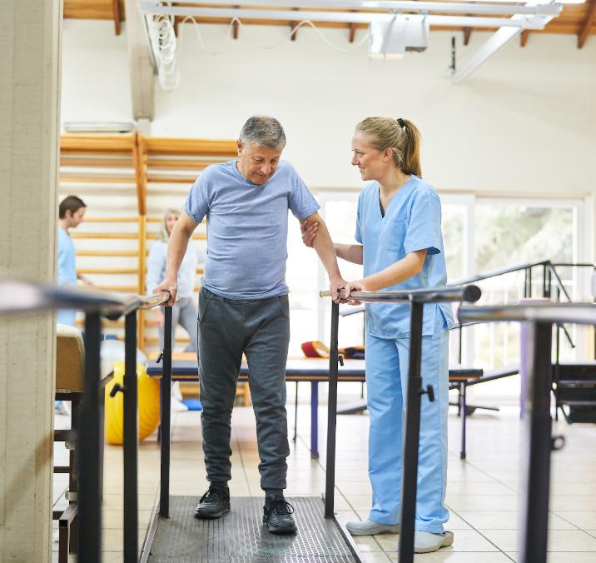
Activity 2
Physiotherapist
Physiotherapists help patients regain physical movement and function.
They help cancer patients stay active by creating tailored exercise plans.
They play a key role in pain management, helping patients move confidently and improve their quality of life.
For those of working age, physiotherapy can aid in regaining strength and mobility to return to work.
Lesson 4: Occupational roles in cancer care
Notes:
Image © Shutterstock/Robert Kneschke

Slide 18

Activity 2
Occupational therapist
Occupational therapists help patients perform daily activities independently by adapting tasks or environments. They:
assess the physical ability of the patient;
set goals and interventions to help the patient meet these;
help patients with their Activities of Daily Living (ADL);
work holistically with the patient and their families/carers.
Lesson 4: Occupational roles in cancer care
Notes:
Image © Shutterstock/Hananeko_Studio

Slide 19
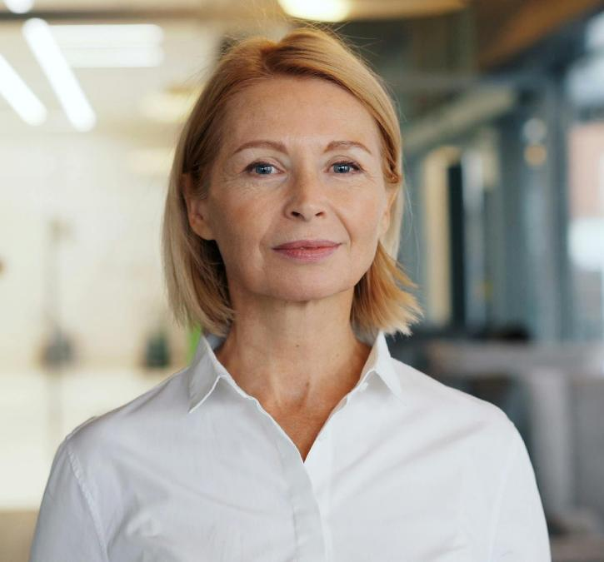
Activity 3
IBC case study
In your pairs, read the case study about Zara, an IBC patient, on the Activity 3 worksheet.
Together, discuss and decide answers to the questions.
Lesson 4: Occupational roles in cancer care
Notes:
Image © Pexels/Vitaly Gariev

Slide 20
Collaborative project
Activity 4
In a group, create a visual, colourful representation of how an MDT of multiple professionals involved in would support Zara from presentation through diagnosis and treatment to end-of-life care.
Suggestions:
Create a spiral pathway as a poster, labelling and identifying key points on Zara’s journey where support from professionals would be offered.
Colour-code each section according to which professionals are involved.
Add annotations to explain and justify when and how each professional would support Zara’s holistic needs (physical, emotional, spiritual and social).
You could also do this with LEGO ®, modelling clay, digitally or as a stop-motion video. – be creative!
Lesson 4: Occupational roles in cancer care

Slide 21
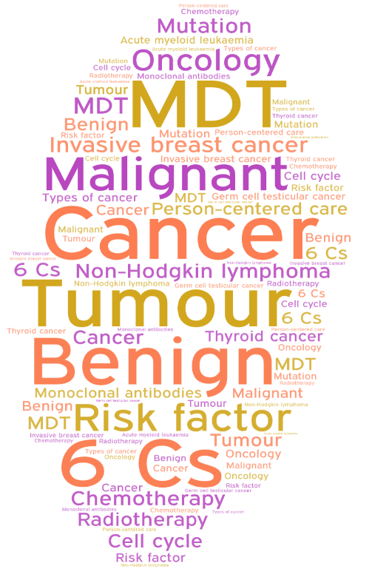
Reflect on your learning
Plenary
Sketch out or bullet point a learning journey of your own learning from Lesson 1 to Lesson 4.
What are your key memories and milestones when you realised you had learned something significant, or your understanding had changed?
What learnings from these lessons will you take forward into other curriculum areas of the T level?
What do you need to revise or spend more time on?
Lesson 4: Occupational roles in cancer care
Notes:
Image generated using https://wordart.com/

Slide 22
In this lesson, we have:
Plenary
Skills:
CS1 Demonstrate person-centred care skills
CS2 Communication
CS3 Team working
CS4 Reflective evaluation
CS6 Presenting
General competencies:
English
GEC1 Convey technical information to different audiences
GEC2 Present information and ideas
GEC3 Create texts for different purposes and audiences
GEC4 Summarise information/ideas
GEC5 Synthesise information
GEC6 Take part in/lead discussions
Digital
GDC1 Use digital technology and media effectively
GDC3 Communicate and collaborate
Explained holistic approaches to cancer treatment and their importance
Discussed cancer treatment pathways from different professionals’ perspectives
Considered how could the role of each person in a multidisciplinary team (MDT) contributes to the physical and mental health of the patient
Described a person-centred treatment plan
Lesson 4: Occupational roles in cancer care

Slide 23
Person-centred care plan
Consolidation
Fill in the person-centred care plan on the Consolidation worksheet. You will need to imagine that you have talked to Zara at the start of her pathway (diagnosis) and write the answers you expect her to give, based on the information you have about her.
Explain the outcomes of key points (healthcare needs and approach, people involved and future actions) to Zara in patient-friendly language.
Lesson 4: Occupational roles in cancer care

