Slide 1
Health
Route: Health & Science
Topic: Cancer care
Lesson 1: What is cancer?
Notes:
Image © Shutterstock/Elnur

Slide 2
In this lesson, we will:
Introduction
Skills:
CS2.1 Communicate clearly and effectively with a variety of stakeholders
CS3.2 Undertake collaborative work
CS5.1 Apply research skills
General competencies:
English
GEC2 Present information and ideas
GEC4 Summarise information/ideas
GEC5 Synthesise information
Maths
GMC5 Processing data
GMC6 Understanding data and risk
Digital
GDC1 Use digital technology and media effectively
GDC3 Communicate and collaborate
GDC4 Process and analyse numerical data
Explain what cancer is
Describe the difference between benign and malignant tumours
Analyse statistics surrounding cancer survival rates
Explain how the failure of the cell cycle leads to cancer
Describe the risk factors for different types of cancer
Lesson 1: What is cancer?

Slide 3

What is cancer?
Introduction
In pairs, discuss and define cancer. Provide examples.
Lesson 1: What is cancer?
Notes:
Image © Pixabay/gdakaska

Slide 4
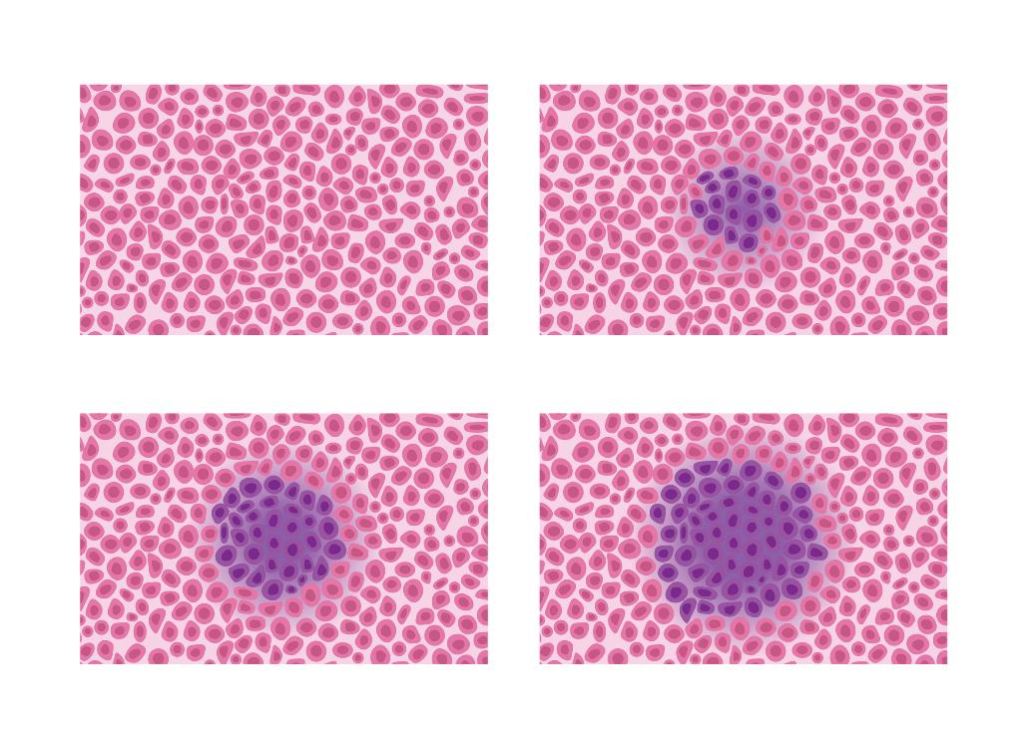
What is cancer?
Introduction
Cancer is when abnormal body cells divide in an uncontrolled way. Some cancers June eventually spread into other tissues.
There are more than 200 different types of cancer
(Cancer Research UK 2023).
Lesson 1: What is cancer?
Notes:
Image © Shutterstock/gritsalak karalak

Slide 5

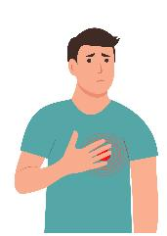
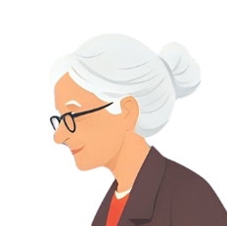


Fact or myth?
Introduction
1
You can catch cancer
2
Breast cancer does not affect men
3
Only old people get cancer
4
You cannot survive cancer
5
Mobile phones
cause
cancer
Lesson 1: What is cancer?
Notes:
Image 1 © Pixabay/Jeff-Création
Image 2 © Shutterstock/Sunbeam_ks
Image 3 © Pixabay/Mohamed_hassan
Image 4 © Pixabay/bricketh
Image 5 © Pixabay/guaxipo

Slide 6


Fact or myth?
Introduction
1
Cancer is not a bacterial infection or a virus – you cannot catch it.
You can catch cancer
2
It is rare but around 360 men are diagnosed in the UK each year
(Cancer Research UK 2023)
Breast cancer does not affect men
3
Whilst more prevalent in adults, infants, toddlers and children can have cancer. (Morgan 2022)
Only old people get cancer
Cancer is not a bacterial infection or a virus – you cannot catch it
It’s rare, but around 360 men are diagnosed in the UK each year
(Cancer Research UK 2023)
While it is more prevalent in adults, children can have cancer
Lesson 1: What is cancer?
Notes:
Image 1 © Pixabay/Jeff-Création
Image 2 © Shutterstock/Sunbeam_ks
Image 3 © Pixabay/Mohamed_hassan

Slide 7

Fact or myth?
Introduction
4
You cannot survive cancer
5
Mobile phones
cause
cancer
Thanks to research, survival rates are increasing all the time
Research from several studies have shown that there is no association between the two
(National Cancer Institute 2024).
Lesson 1: What is cancer?
Notes:
Image 4 © Pixabay/bricketh
Image 5 © Pixabay/guaxipo

Slide 8
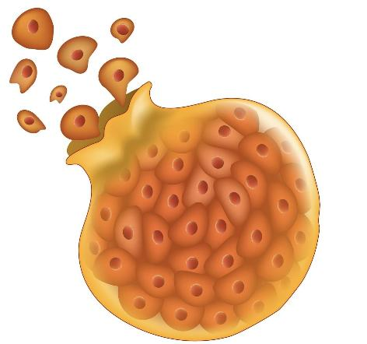
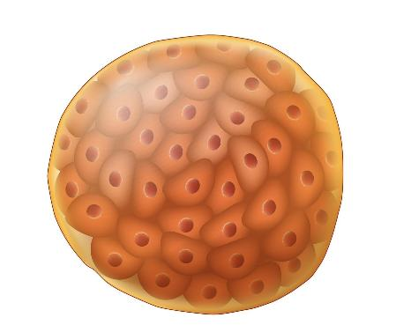
Types of tumour
Introduction
Introduction
Uncontrolled cell division leads to tumours forming.
These can be malignant (cancerous) or benign.
Malignant tumour
Benign tumour
Lesson 1: What is cancer?
Notes:
Image © Shutterstock/Designua

Slide 9

Malignant tumours
Introduction
Malignant tumours grow rapidly and are invasive, meaning they spread into surrounding tissues.
They can metastasise, meaning cancer cells break away and travel through the bloodstream or lymphatic system to form new tumours in other parts of the body.
The cells look abnormal.
What is cancer?
Lesson 1: What is cancer?
Notes:
Image © Shutterstock/Designua

Slide 10
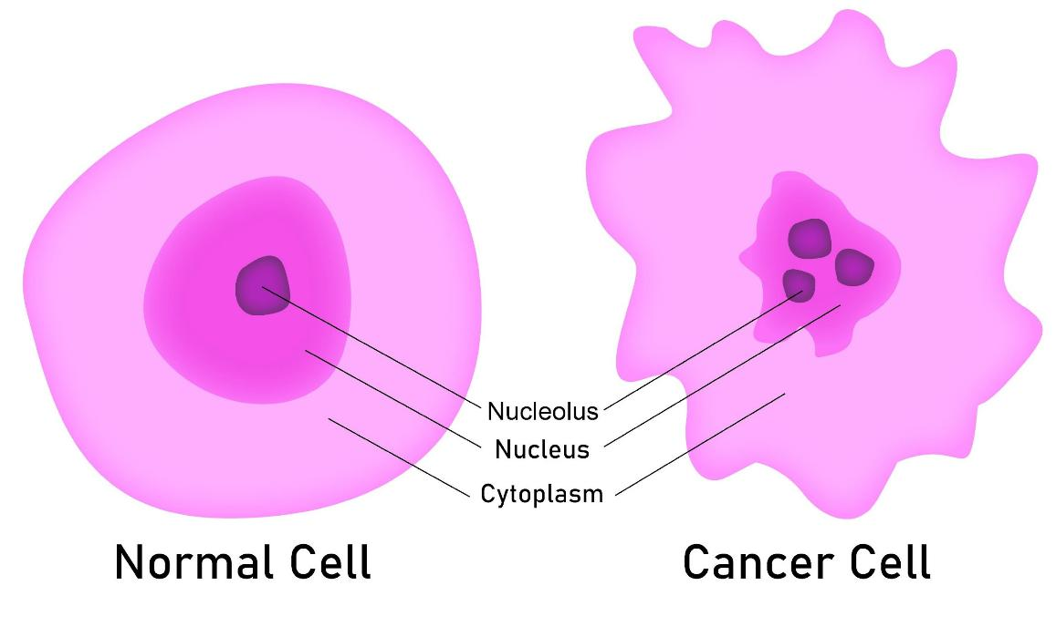
Normal versus cancer cell
Introduction
Regular shape.
They lie
in rows
stacked up on each other.
Irregular shape, which means they lie in a haphazard way forming
a lump
(a tumour).
Lesson 1: What is cancer?
Notes:
Image © Shutterstock/Tang Yan Song

Slide 11
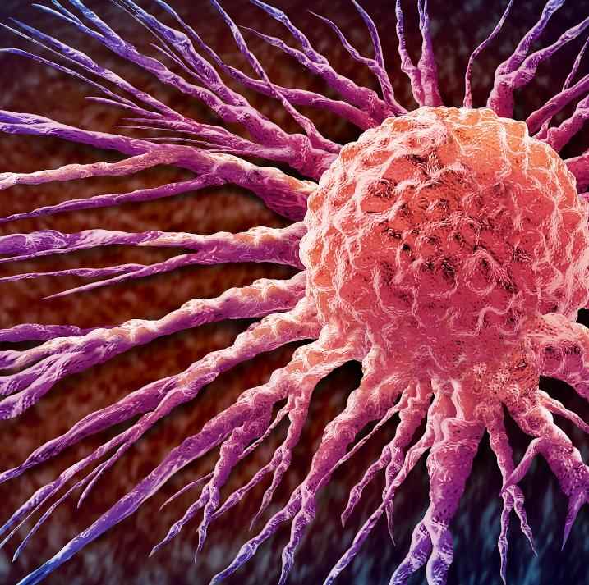
Malignant tumours
Introduction
Malignant tumours are classified as either primary or secondary.
Primary is the term used to refer to the area in which the tumour originated.
Secondary is the term used to refer to any cancer that has spread from the primary area.
Lesson 1: What is cancer?
Notes:
Image © Shutterstock/Lightspring

Slide 12

Benign tumours
Introduction
Benign tumours grow slowly and remain localised (do not spread to other parts of the body).
They do not invade nearby tissues or metastasise (spread) to distant organs.
They are usually not life-threatening, unless they press on vital organs (e.g. brain tumours).
The cells look normal, resembling healthy cells.
What is cancer?
Lesson 1: What is cancer?
Notes:
Image © Shutterstock/Designua

Slide 13

Cancer statistics activity
Activity 1
Use the Activity 1 worksheet to help you research and analyse cancer survival rates in the UK, identify trends over time and present your findings.
Lesson 1: What is cancer?
Notes:
Image © Pexels/Fauxels

Slide 14
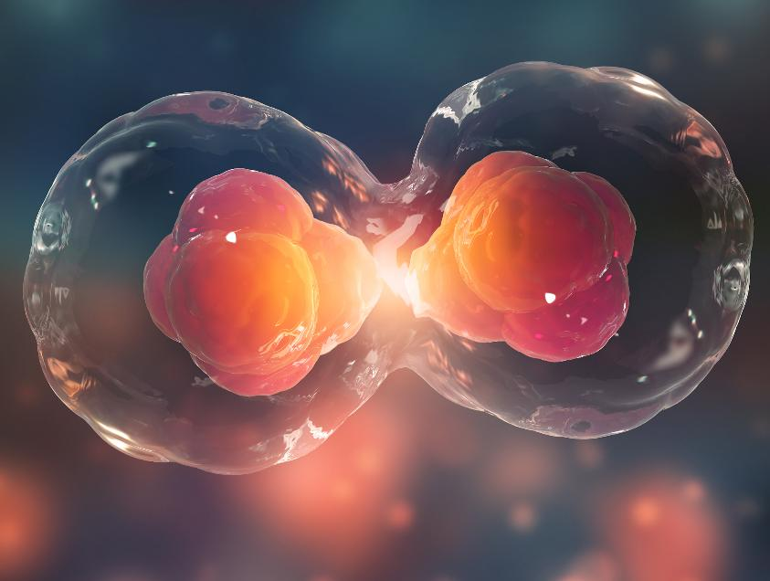
Cell division
Activity 2
Cell division is used to replace damaged cells, and for growth.
This takes place in the cell cycle.
Mutations in cells can interfere with this process and cause them to become cancerous.
Lesson 1: What is cancer?
Notes:
Image © Shutterstock/Yurchanka Siarhei

Slide 15
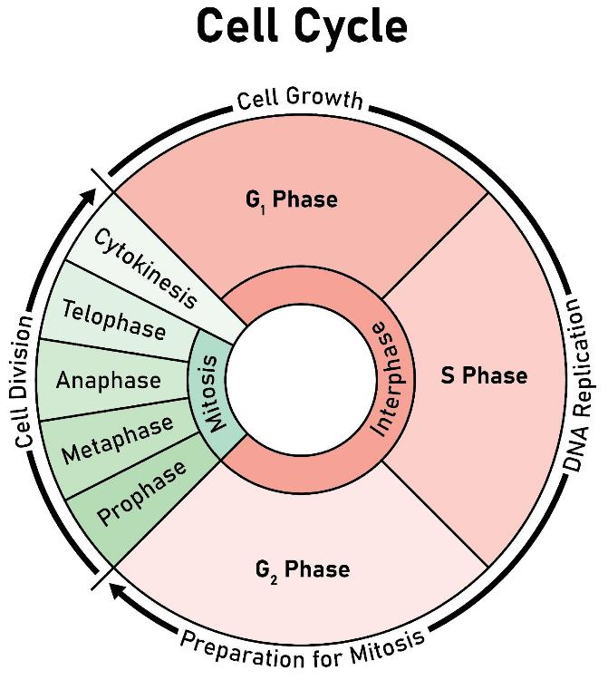
Cell division activity
Activity 2
Cells divide in a process called the cell cycle.
Complete the Activity 2 worksheet to:
describe what happens at each stage of the cell cycle;
consider the different possible ways in which mutation can cause a cell to become cancerous.
Lesson 1: What is cancer?
Notes:
Image © Shutterstock/Kooto

Slide 16
The cell cycle
Activity 2
Name of stage | Description
G₁ phase | The cell grows, produces proteins and prepares for DNA replication.
S phase | DNA is replicated, creating two identical copies for the daughter cells.
G₂ phase | The cell prepares for mitosis, checking for DNA integrity and errors.
Mitosis | DNA is copied.
Cytokinesis | The cell divides into two identical daughter cells.
Lesson 1: What is cancer?
Notes:
Image © Shutterstock/Kooto

Slide 17
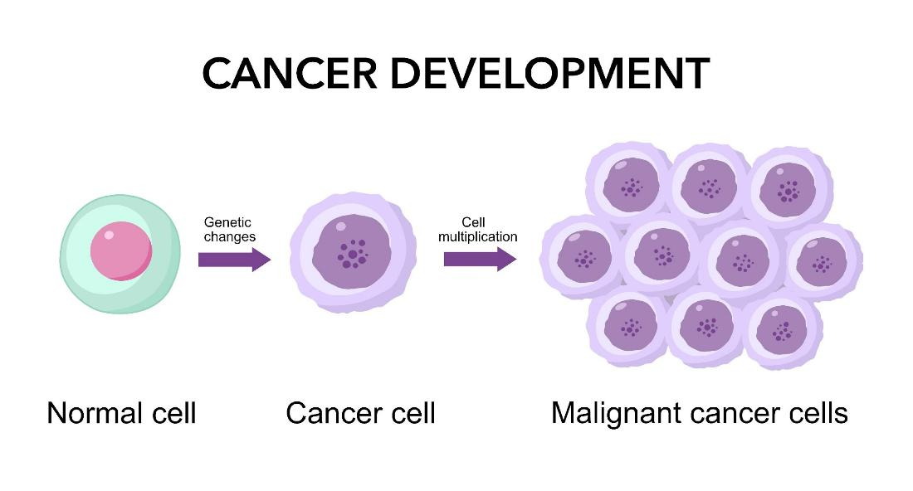
What if cell division goes wrong?
Activity 2
If a mutation occurs, this is replicated during cell division and is sometimes referred to as the ‘driver’ of cancer.
These mutations can affect oncogenes, tumour suppressor genes and DNA repair genes.
Lesson 1: What is cancer?
Notes:
Image © Shutterstock/Blueastro

Slide 18
What if cell division goes wrong?
Activity 2
Proto-oncogenes are normal genes that promote cell growth and division. When these genes mutate, they can become oncogenes, which cause the cell to grow and divide uncontrollably.
Tumour suppressor genes (p53) normally prevent uncontrolled growth. When these genes are mutated, they lose their ability to stop the cell cycle, allowing the cell to continue dividing.
Mutations in DNA repair genes can increase the risk of cancer because these genes help repair DNA damage, and when they are not functioning properly, damaged cells can survive and grow uncontrollably.
Lesson 1: What is cancer?

Slide 19
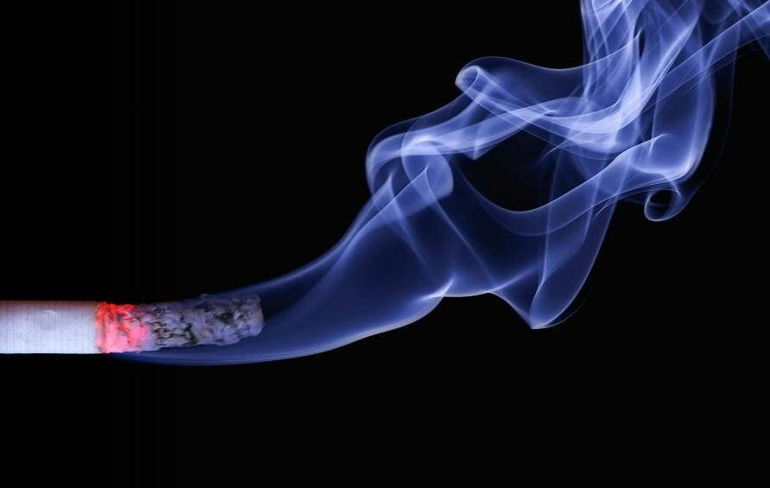
Risk factors for cancer
Activity 3
Cancer is caused by genetic mutations.
Certain risk factors increase the likelihood of these mutations occurring.
Risk factors can be grouped as:
genetic (inherited mutations);
lifestyle;
environmental;
biological.
Lesson 1: What is cancer?
Notes:
Image © Pexels/Pixabay

Slide 20

Risk factors activity
Activity 3
Watch the video on risk factors.
Complete the table on the Activity 3 worksheet to show a type of cancer caused by each risk factor.
Do your own research to add how to reduce the risk.
Lesson 1: What is cancer?
Notes:
Risk Factors for cancer video: https://vimeo.com/1092718134/a70ee2e539

Slide 21
Check your knowledge
Plenary
Compare benign and malignant tumours
Explain how a mutation in DNA repair genes June lead to cancer
Give one reason why cancer survival rates are improving
Name five risk factors for cancer
For one of these risks, explain how to reduce it
Lesson 1: What is cancer?

Slide 22
In this lesson, we have:
Plenary
Skills:
CS2.1 Communicate clearly and effectively with a variety of stakeholders
CS3.2 Undertake collaborative work
CS5.1 Apply research skills
General competencies:
English
GEC2 Present information and ideas
GEC4 Summarise information/ideas
GEC5 Synthesise information
Maths
GMC5 Processing data
GMC6 Understanding data and risk
Digital
GDC1 Use digital technology and media effectively
GDC3 Communicate and collaborate
GDC4 Process and analyse numerical data
Explained what cancer is
Described the difference between benign and malignant tumours
Analysed statistics surrounding cancer survival rates
Explained how the failure of the cell cycle leads to cancer
Described the risk factors for different types of cancer
Lesson 1: What is cancer?

Slide 23

Cancer campaigns
Consolidation
There are many campaigns in the UK whose aim is to increase public understanding of cancer, highlighting prevention strategies and offering support for those affected.
Read through the Consolidation worksheet.
Research a campaign.
Describe its key features.
Evaluate the campaign’s effectiveness in improving cancer outcomes.
Lesson 1: What is cancer?
Notes:
Image © Pexels/Klaus Nielsen

