Slide 1
Construction
Route: Construction
Topic: Practical construction calculus
Lesson 1: Using the mid-ordinate rule in construction
Notes:
Image © Shutterstock/Freedomz

Slide 2
In this lesson, we will:
Introduction
General competencies
English:
E2 Present information and ideas
E5 Synthesise information
Maths:
M2 Estimate, calculate and spot errors
M3 Work with proportion
M4 Use rules and formulae
M5 Process data
Digital:
D3 Communicate and collaborate
explain the concept of cut and fill;
explain how an embankment is created and its purpose in construction;
estimate the area under a curve and apply this to a range of construction situations using the mid-ordinate rule.
Lesson 1: Using the mid-ordinate rule in construction

Slide 3
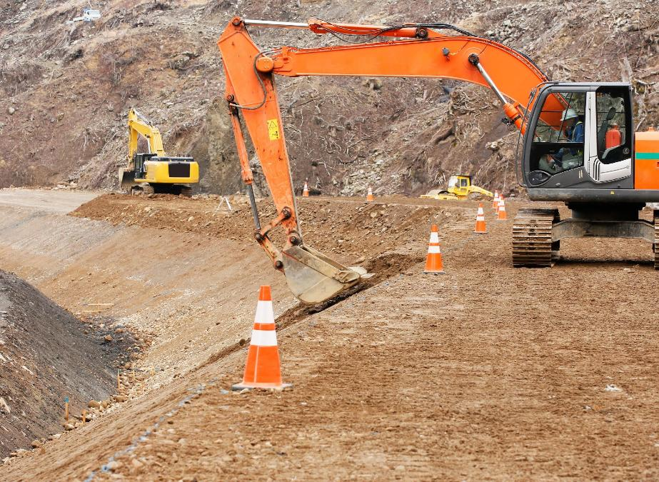
Construction techniques
Introduction
What do you think is meant by the concept of cut and fill?
Why is it important in the construction industry?
Why is it an environmentally friendly construction method?
Lesson 1: Using the mid-ordinate rule in construction
Notes:
Image © Shutterstock/Hachi888

Slide 4

Cut and fill
Introduction
Cut and fill is used to modify the topography of a site by:
cut: excavating material from one location;
fill: using the material to fill another location.
Soil, rocks, gravel or other debris are moved to create a level surface or desired slope for various construction activities.
This method minimises the amount of material that needs to be transported to or from the site.
Lesson 1: Using the mid-ordinate rule in construction

Slide 5
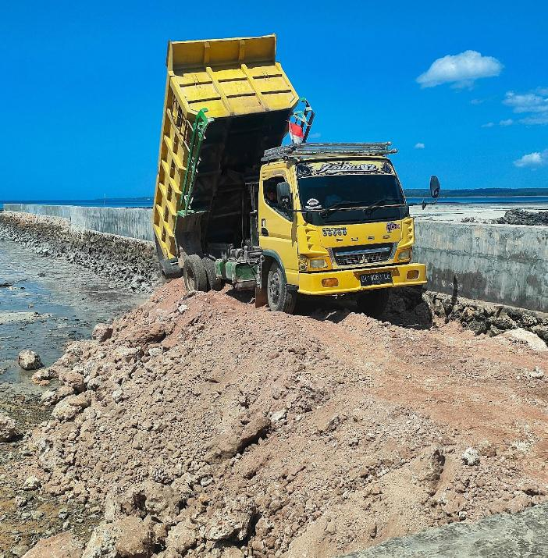
Embankments
Activity 1
What do you think an embankment is?
Have you seen one before? If so, where?
Why are embankments important in road construction?
Lesson 1: Using the mid-ordinate rule in construction
Notes:
Image © Shutterstock/syarifjmt

Slide 6

What are embankments?
Activity 1
What are embankments used for?
What materials are used to build embankments?
Why are profile boards used?
What are the main steps in the construction of an embankment?
Lesson 1: Using the mid-ordinate rule in construction
Notes:
Understanding embankments and their role in road construction video: https://vimeo.com/1111914267/5caffc9b4b

Slide 7
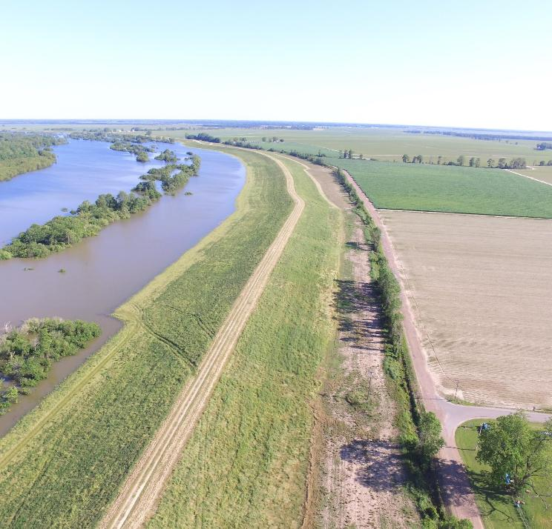
Embankments
Activity 1
An embankment is a raised structure made of soil, rocks or other materials. They are:
used to support roads, railways or other infrastructure;
used to hold back water with the addition of an impermeable clay core (dam, levee);
carefully compacted in layers to ensure strength and stability.
Lesson 1: Using the mid-ordinate rule in construction
Notes:
Image © Shutterstock/Johnny G Bowers

Slide 8
Construction of an embankment
Activity 1
Preparation: Clear the area of vegetation and debris.
Layering and compacting: Add soil in layers, compacting each layer thoroughly before adding the next.
Using profile boards: Place profile boards along the length of the embankment to guide the shape and height.
Final shaping: Smooth the shape of the embankment to the desired dimensions.
Lesson 1: Using the mid-ordinate rule in construction

Slide 9
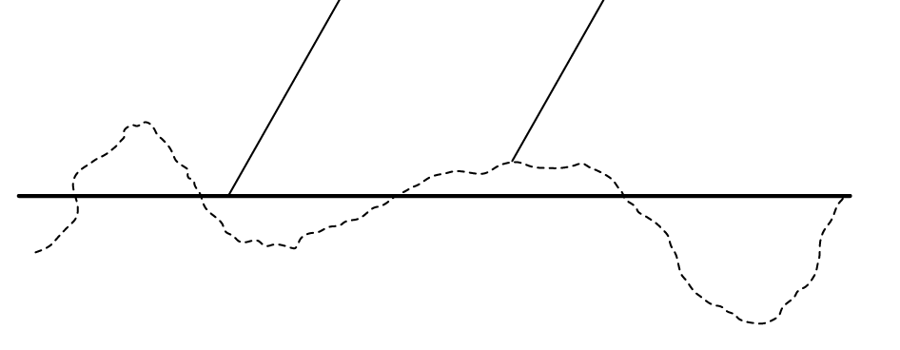
Example of cut and fill
Activity 1
This image shows a proposed longitudinal elevation for a new road over an area of terrain.
Sketch the image and colour in the areas that you think should be ‘cut’ and those that should be ‘fill’.
Why is it important that the finished road is flat?
Proposed formation level
Level of existing terrain
Lesson 1: Using the mid-ordinate rule in construction

Slide 10
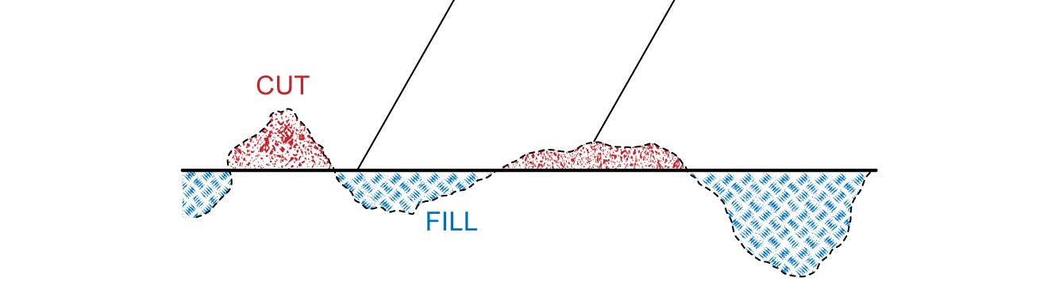
Example of cut and fill
Activity 1
Proposed formation level
Level of existing terrain
Lesson 1: Using the mid-ordinate rule in construction

Slide 11
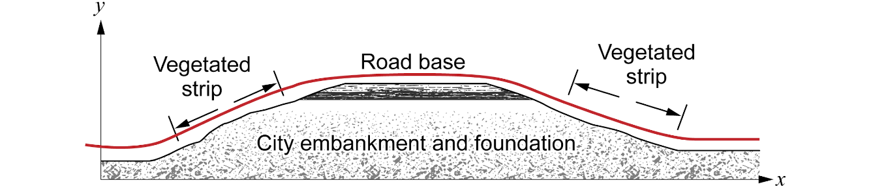
Using the mid-ordinate rule
Activity 2
When building an embankment, it is important to determine how much material needs to be brought onto site.
The area of a road embankment cross-section forms an approximate curve when plotted on a graph.
In mathematics, the mid-ordinate rule is one technique that is used to estimate the area under a curve.
Lesson 1: Using the mid-ordinate rule in construction

Slide 12
Case study: HS2
Activity 2
Miles of embankments are being created for HS2.
Calculating correct numbers ensures avoiding logistical challenges, such as creating extra material to be disposed of or areas left without enough material.
Construction workers need to determine which areas to borrow material from, using factors such as distance and type of materials to decide.
Mathematical techniques, such as the mid-ordinate rule, can be used to determine the volume of material that must be moved.
Lesson 1: Using the mid-ordinate rule in construction

Slide 13
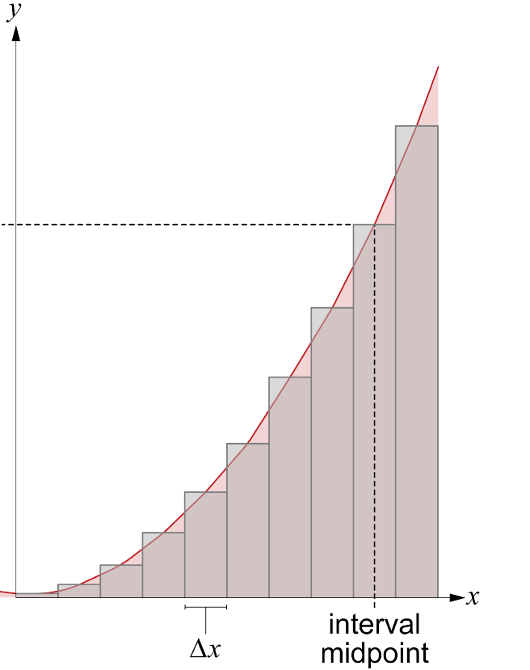
Mid-ordinate rule
Activity 2
The mid-ordinate rule is used to estimate the area under the curve.
An ordinate is the y-coordinate on a graph for a given x-coordinate.
The mid-ordinate is the ordinate at the interval midpoint.
mid-ordinate, y_{i}
Lesson 1: Using the mid-ordinate rule in construction

Slide 14
Mid-ordinate rule
Activity 2
Split the width of the curve into equal intervals.
Draw rectangles with:
width = interval width (Δx)
height = height of curve at interval midpoint (y_{i})
Approximate area under curve = sum of all rectangle areas
mid-ordinate, y_{i}
Lesson 1: Using the mid-ordinate rule in construction

Slide 15
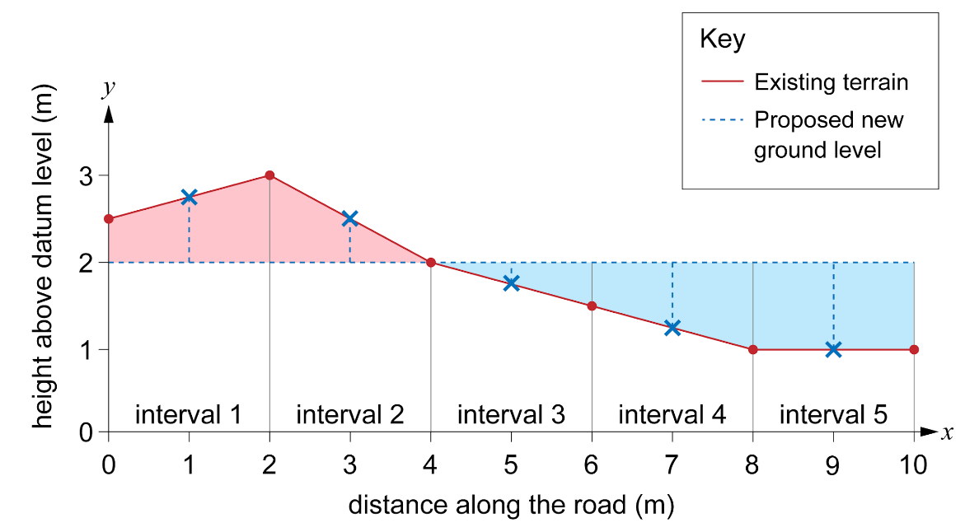
Applying mid-ordinate rule to cut and fill
Activity 2
The cross-section of land can be drawn on a graph.
The proposed new level can also be drawn.
To apply the mid-ordinate rule to find the cut cross-section area and fill cross-section area, use rectangles drawn from the proposed new level.
The new level could be the same as the x-axis, but it may be in a different place, as in this diagram.
Lesson 1: Using the mid-ordinate rule in construction

Slide 16
Worked example: Mid-ordinate rule
Activity 2
You are tasked with designing a road that must pass through uneven terrain. To create a level road, you will need to cut soil from higher areas and fill soil to lower areas.
The cross-section of the terrain along a 10-metre stretch of road is shown in the table.
Use the mid-ordinate rule to calculate how much material will need to be brought onto site to create a suitable ground level to construct the road. The road is to be 8 metres wide.
Position (m) | Existing elevation (m) | Desired elevation (m)
0 | 2.5 | 2
2 | 3 | 2
4 | 2 | 2
6 | 1.5 | 2
8 | 1 | 2
10 | 1 | 2
Activity 2 worked example sheet can be used.
Lesson 1: Using the mid-ordinate rule in construction

Slide 17
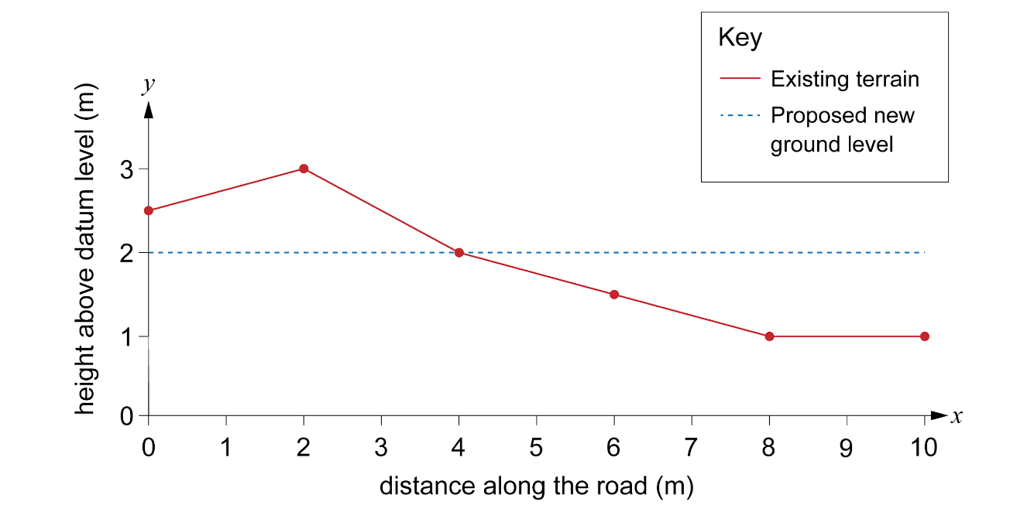
Worked example: Mid-ordinate rule
Activity 2
Step 1: Plot the existing and desired elevation on graph paper.
Position (m) | Existing elevation (m) | Desired elevation (m)
0 | 2.5 | 2
2 | 3 | 2
4 | 2 | 2
6 | 1.5 | 2
8 | 1 | 2
10 | 1 | 2
Lesson 1: Using the mid-ordinate rule in construction

Slide 18
Worked example: Mid-ordinate rule
Activity 2
Step 2: Divide the base width of the cross-section into equal intervals.
The base width is 10 m.
Use 5 intervals.
10 ÷ 5 = 2 m
Add the intervals to the graph.
Lesson 1: Using the mid-ordinate rule in construction

Slide 19
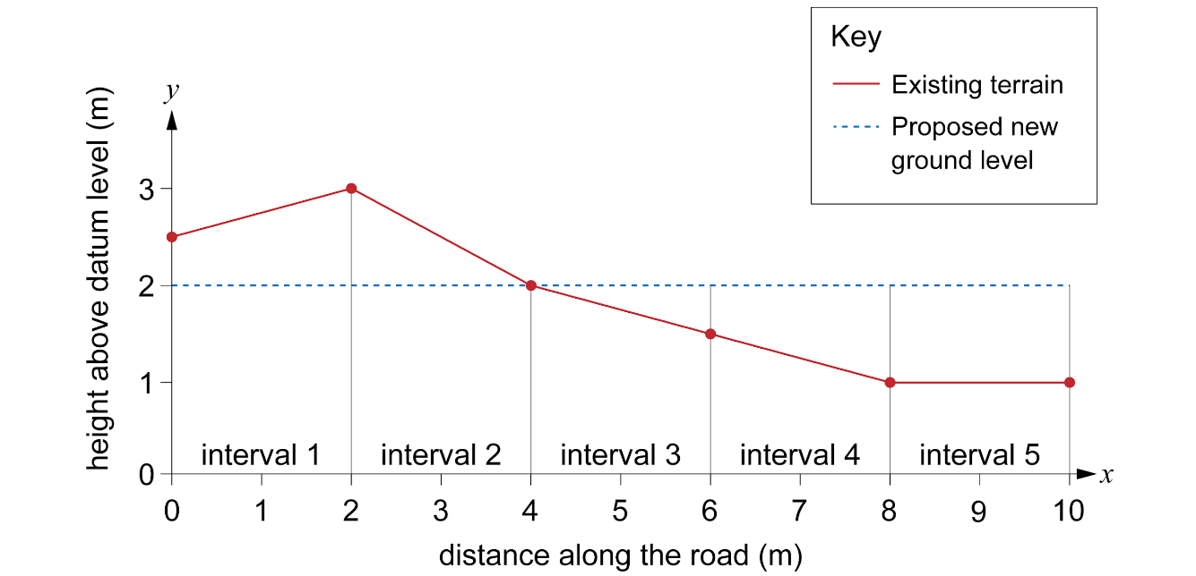
Worked example: Mid-ordinate rule
Activity 2
Step 2: Divide the base width of the cross-section into equal intervals.
Lesson 1: Using the mid-ordinate rule in construction

Slide 20
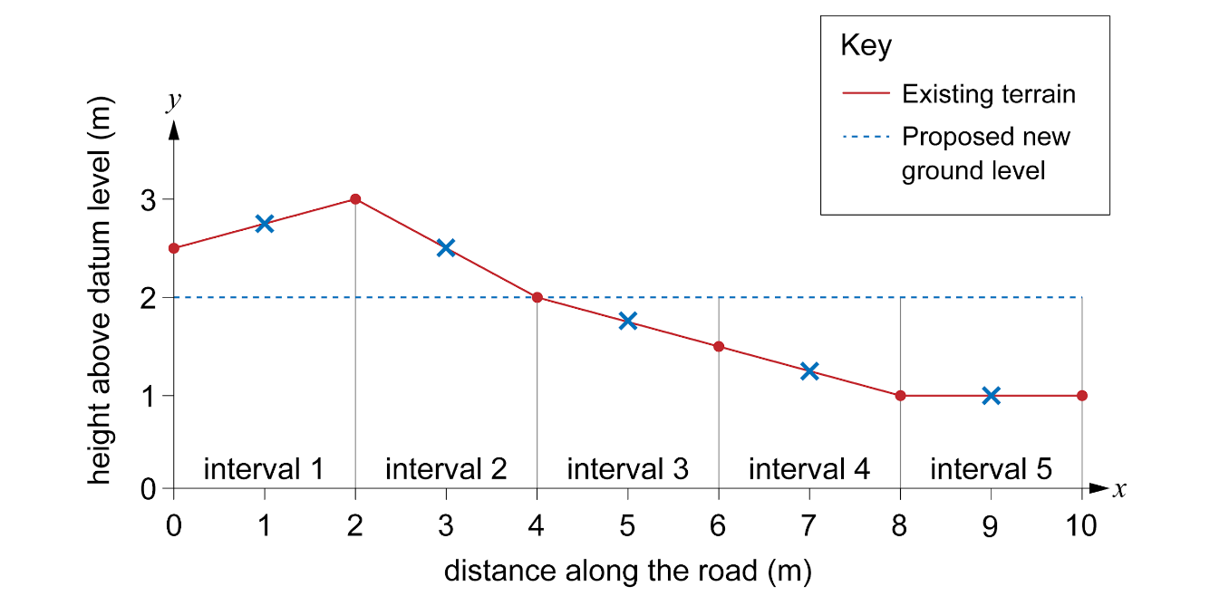
Worked example: Mid-ordinate rule
Activity 2
Step 3: Determine the midpoint of each interval.
Midpoints
Interval 1: 2.75 m
Interval 2: 2.5 m
Interval 3: 1.75 m
Interval 4: 1.25 m
Interval 5: 1 m
Lesson 1: Using the mid-ordinate rule in construction

Slide 21
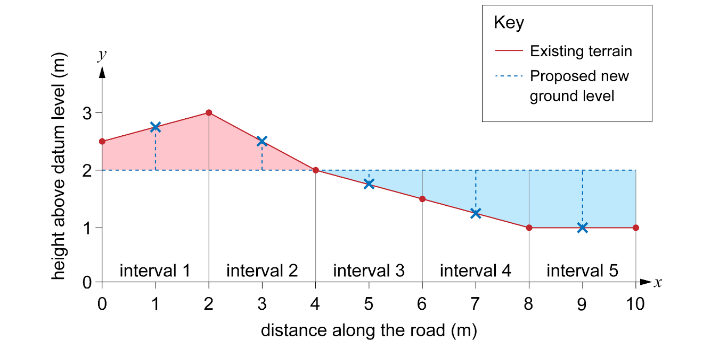
Worked example: Mid-ordinate rule
Activity 2
Step 4: Measure the height of the cut or fill at each point.
Measure from the proposed level to the mid-ordinate:
Cut
Interval 1 = 0.75 m
Interval 2 = 0.5 m
Fill
Interval 3 = –0.25 m
Interval 4 = –0.75 m
Interval 5 = –1 m
Lesson 1: Using the mid-ordinate rule in construction

Slide 22
Worked example: Mid-ordinate rule
Activity 2
Step 5: Calculate the area of each interval
Multiply the height by the interval width (2 m) to find the area of each interval.
Interval 1 = 0.75 m Area = 0.75 × 2 m = 1.5 m²
Interval 2 = 0.5 m Area = 0. 5 × 2 m = 1 m²
Interval 3 = –0.25 m Area = –0.25 × 2 m = –0.5 m²
Interval 4 = –0.75 m Area = –0.75 × 2 m = –1.5 m²
Interval 5 = –1 m Area = –1 × 2 m = –2 m²
Lesson 1: Using the mid-ordinate rule in construction

Slide 23
Worked example: Mid-ordinate rule
Activity 2
Step 6: Add up the areas of all the intervals
Find the sum of the areas to get the total area of the cross-section.
Interval 1 Area = 0.75 × 2 m = 1.5 m²
Interval 2 Area = 0. 5 × 2 m = 1 m²
Interval 3 Area = –0.25 × 2 m = –0.5 m²
Interval 4 Area = –0.75 × 2 m = –1.5 m²
Interval 5 Area = –1 × 2 m = –2 m²
Total area = 1.5 + 1 – 0.5 – 1.5 – 2 = –1.5 m²
As the result is negative, this means the fill area is greater than the cut area.
The earthworks contractor will need to bring 1.5 m² extra of earth per metre width of road.
Lesson 1: Using the mid-ordinate rule in construction

Slide 24
Worked example: Mid-ordinate rule
Activity 2
Step 7: Calculate the volume of earth to be added or removed
Find the sum of the areas to get the total area of the cross-section.
Total area = –1.5 m²
Volume = cross-section area × width of road
12 m³ of earth needs to be added.
= 1.5 m² × 8 m
= 12 m³
Lesson 1: Using the mid-ordinate rule in construction

Slide 25

Using the mid-ordinate rule
Activity 2
Steps to using the mid-ordinate rule:
Step 1: Plot the ‘x’ and ‘y’ co-ordinates on graph paper.
Step 2: Divide the base width of the cross-section into equal intervals.
Step 3: Determine the midpoint of each interval.
Step 4: Measure the height of the cut or fill at each point.
Step 5: Calculate the area of each interval.
Step 6: Find the sum of the areas of all the intervals to estimate the area of the cross-section.
Step 7: Calculate the volume of earth to be added or removed.
Follow along using the Activity 2 Worked example.
Lesson 1: Using the mid-ordinate rule in construction

Slide 26
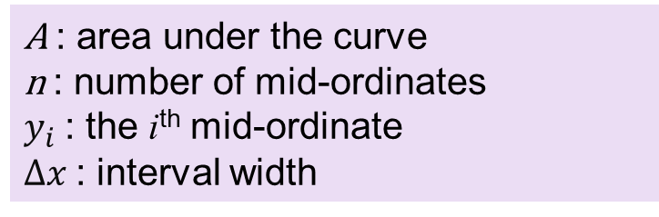
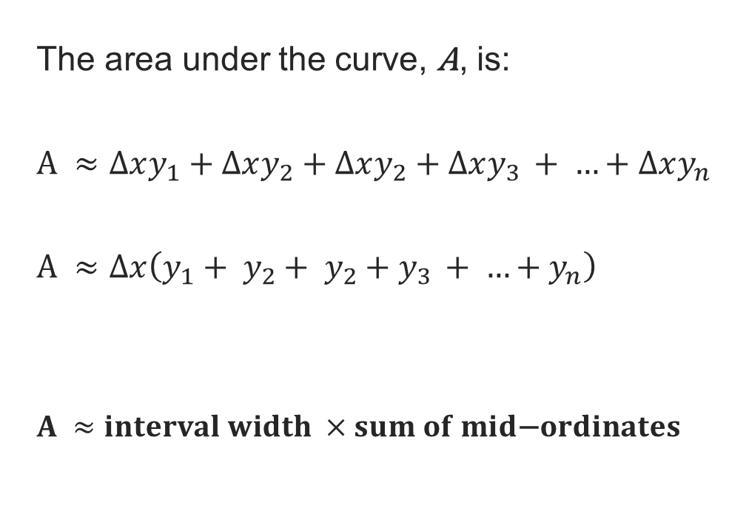

Using the mid-ordinate rule
Activity 2
mid-ordinate, y_{i}
A ≈ interval width × sum of mid-ordinates
Lesson 1: Using the mid-ordinate rule in construction

Slide 27
Using the mid-ordinate rule: practice
Activity 2
Complete the practice questions on the worksheet.
Resources needed
L1 Activity 2 Worksheet
L1 Activity 2 Worksheet answers
Calculator
Graph paper
Lesson 1: Using the mid-ordinate rule in construction

Slide 28
Reflection questions
Plenary
Why is it important to divide the base width into equal segments when using the mid-ordinate rule?
How might the shape of the embankment affect the accuracy of your area calculation using the mid-ordinate rule?
In what other real-world situations may the mid-ordinate rule be useful?
Lesson 1: Using the mid-ordinate rule in construction

Slide 29
In this lesson, we have:
Plenary
General competencies
English:
E2 Present information and ideas
E5 Synthesise information
Maths:
M2 Estimate, calculate and spot errors
M3 Work with proportion
M4 Use rules and formulae
M5 Process data
Digital:
D3 Communicate and collaborate
explained the concept of cut and fill;
explained how an embankment is created and its purpose in construction;
estimated the area under a curve and applied this to a range of construction situations using the mid-ordinate rule.
Lesson 1: Using the mid-ordinate rule in construction

Slide 30
Consolidation
Consolidation
Complete additional practice using the mid-ordinate rule to calculate the area of material needed for other road constructions.
Carry out some research into other situations where engineers would use the mid-ordinate rule and other roles in the construction industry that may use the mid-ordinate rule.
Resources needed
L1 Consolidation Worksheet
Calculator
Graph paper
Lesson 1: Using the mid-ordinate rule in construction

