Slide 1
Engineering and Manufacturing
Route: Engineering and Manufacturing
Topic: Stock and asset management
Resource 4: Asset management breakdown
Notes:
Image © Shutterstock/Halfpoint

Slide 2
In this resource, we will:
Introduction
Skills
MPC-CSD Evaluate and quality assure processes and outcomes
MPC-CSA Analyse and interpret an Employer Set Brief
MPC-CSB Plan and prepare suitable responses to the brief
MPC-CSE Communicate and present outcomes and evidence
General competencies
English:
EC2 Present information and ideas
EC4 Summarise information/ideas
EC6 Take part in/lead discussions
Maths:
MC2 Estimating, calculating and error spotting
MC5 Processing data
Digital:
DC3 Communicate and collaborate
DC4 Process and analyse numerical data
recognise the critical role of asset management in ensuring operational efficiency, minimising downtime and maximising asset lifecycle.
Resource 4: Asset management breakdown

Slide 3
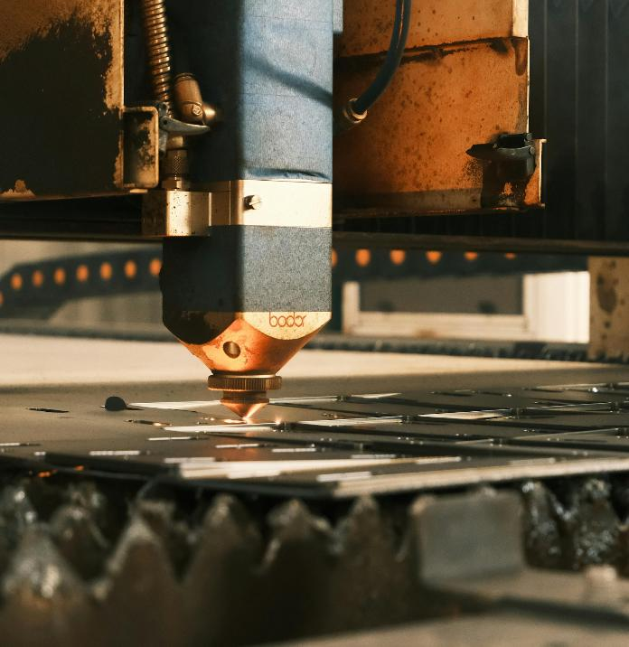
Asset maintenance
Activity 1
Think of examples of asset management breakdown.
Is all production 100% efficient?
Resource 4: Asset management breakdown
Notes:
Image © Pexels/Cemrecan Yurtman

Slide 4
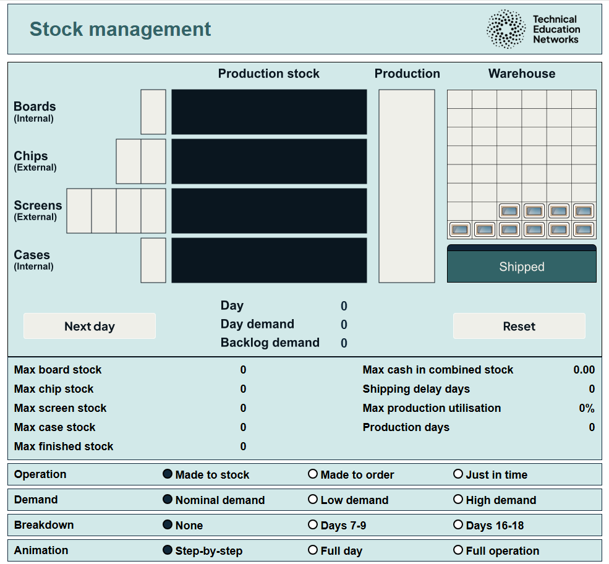
Stock management interactive
Activity 1
Stock management interactive: https://www.technicaleducationnetworks.org.uk/interactive/stock (Firefox is not recommended for the interactive)
How to use the stock management interactive video walkthrough: https://vimeo.com/1119123407/7990708158 For written instructions see Stock management interactive user guidance.
Resource 4: Asset management breakdown
Notes:
Stock management interactive: https://www.technicaleducationnetworks.org.uk/interactive/stock
Stock management interactive video walkthrough - https://vimeo.com/1119123407/7990708158

Slide 5
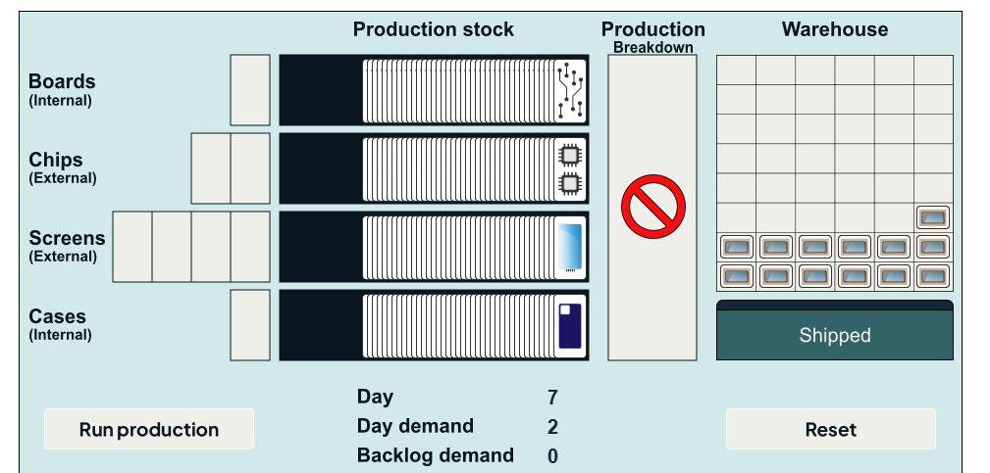
Asset management – machine breakdown
Activity 1
There is a breakdown on the machine that populates the printed circuit board (PCB) with components. The breakdown has happened on Day 7 and will take 5 days to repair.
Predict which areas breaking down would have the most significant impact on the production overall.
How could the impact be minimised?
Resource 4: Asset management breakdown
Notes:
Stock

Slide 6
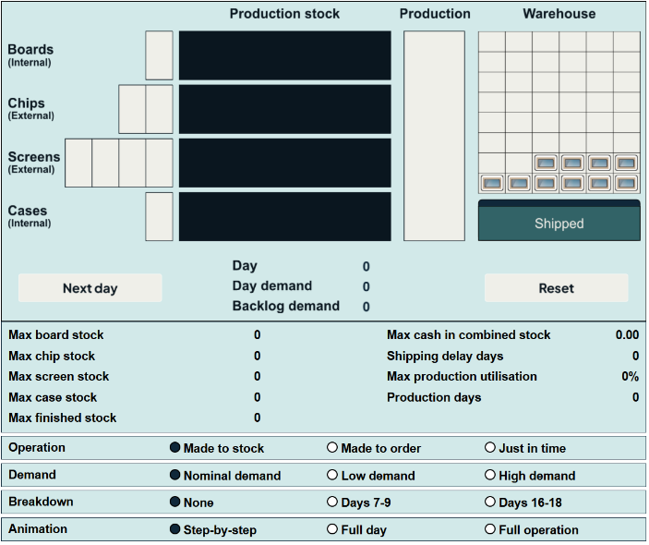
Asset management – machine breakdown
Activity 1
In your group, consider the impact on the stock management process you have been assigned. This will be one of:
MTS;
MTO;
JIT.
Discuss what impact an early or late breakdown would have on production.
Share your ideas with another group that has also considered the same stock management process.
Resource 4: Asset management breakdown
Notes:
Stock

Slide 7
Discussion
Plenary
What other source of disruption might a company be faced with?
How might this have an impact on the line for each of the stock approaches we have looked at?
Should some sub-component assembly continue? (Think about display items – delivery time, cost of raw materials, cost of work in progress, etc.)
How could this be prevented?
Resource 4: Asset management breakdown

Slide 8
In this resource, we have:
Plenary
Skills
MPC-CSD Evaluate and quality assure processes and outcomes
MPC-CSA Analyse and interpret an Employer Set Brief
MPC-CSB Plan and prepare suitable responses to the brief
MPC-CSE Communicate and present outcomes and evidence
General competencies
English:
EC2 Present information and ideas
EC4 Summarise information/ideas
EC6 Take part in/lead discussions
Maths:
MC2 Estimating, calculating and error spotting
MC5 Processing data
Digital:
DC3 Communicate and collaborate
DC4 Process and analyse numerical data
recognised the critical role of asset management in ensuring operational efficiency, minimising downtime and maximising asset lifecycle.
Resource 4: Asset management breakdown

Slide 9
Consolidation
Consolidation
Answer the questions on the Consolidation Worksheet to check your knowledge.
Check your answers using the answer sheet provided.
Resources needed
R4 Consolidation Worksheet
R4 Consolidation Worksheet answers
Resource 4: Asset management breakdown

