Slide 1
Engineering and Manufacturing
Route: Engineering and Manufacturing
Topic: Stock and asset management
Resource 3: Impact of poor stock and asset management
Notes:
Image © Shutterstock/Halfpoint

Slide 2
In this resource, we will:
Introduction
Skills
MPC-CSD Evaluate and quality-assure processes and outcomes
MPC-CSA Analyse and interpret an employer set brief
MPC-CSB Plan and prepare suitable responses to the brief
MPC-CSE Communicate and present outcomes and evidence
General competencies
English:
EC4 Summarise information/ideas
EC5 Synthesise information
EC6 Take part in/lead discussions
Digital:
DC3 Communicate and collaborate
analyse the impact of poor stock and asset management on a company.
Resource 3: Impact of poor stock and asset management

Slide 3

Discussion
Introduction
Think of examples of when poor stock and asset management has caused issues for a company.
Resource 3: Impact of poor stock and asset management
Notes:
Image © Pexels/Leeloo The First

Slide 4

Amazon – quality assurance video
Activity 1
Watch the video about Amazon and how they approach stock management and quality assurance.
There will be review questions to complete, so take notes.
Resource 3: Impact of poor stock and asset management
Notes:
Amazon – quality assurance video: https://vimeo.com/1119720799/906463fa91

Slide 5
Amazon – quality assurance video questions
Activity 1
What would the impact be on Amazon if they did not have contingency plans in place?
What do you think would happen to the company’s reputation if the stock was not managed effectively?
Resource needed
R3 Activity 1 Worksheet
Resource 3: Impact of poor stock and asset management

Slide 6

Case study: IC Chip Manufacture Ltd
Activity 2
The following slides contain background information on a fictional manufacturing business: IC Chip Manufacture Ltd.
Using the information, you are going to consider the issues raised and consider how the approach to stock and asset management could be improved.
Resource 3: Impact of poor stock and asset management

Slide 7

What the company currently does
Activity 2
The company:
produces and distributes semiconductor integrated chips (IC) globally to large-scale suppliers in the automotive, pharmaceutical and technology industries;
sources the required raw materials from an external provider overseas in bulk quantities;
operates a JIT approach, as this has worked for the company in previous financial years;
does not have a scheduled maintenance plan and uses a local contractor on call for breakdowns.
Resource 3: Impact of poor stock and asset management
Notes:
Image © Pexels/TimSon Foox

Slide 8
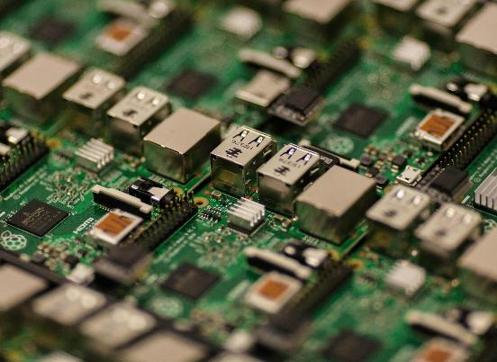
Issues
Activity 2
The supplier of the raw materials has informed the company that there is currently a shortage in the silicon required to make the IC.
Current lead time has risen from two weeks to three months.
Freight costs have also increased due to a change in the global market and fuel costs.
A return customer has an order waiting to be fulfilled that includes penalty clauses for any order which is not delivered as agreed.
Resources needed
R3 Activity 2 Worksheet
R3 Activity 2 Information sheet
Resource 3: Impact of poor stock and asset management
Notes:
Image © Pexels/Craig Dennis

Slide 9
Discussion
Activity 2
Based upon the information you have been given, the business has asked you to:
identify how the issues identified could impact the business, its suppliers, the local economy and the global market;
suggest the most suitable stock management process;
suggest how asset management could be improved.
Resource 3: Impact of poor stock and asset management
Notes:
Image © Pexels/Leeloo The First

Slide 10
Plenary
Plenary
True or false?
Summary questions
Resources needed
R3 Plenary Worksheet
R3 Plenary Worksheet answers
Resource 3: Impact of poor stock and asset management

Slide 11
In this resource, we have:
Plenary
Skills
MPC-CSD Evaluate and quality-assure processes and outcomes
MPC-CSA Analyse and interpret an employer set brief
MPC-CSB Plan and prepare suitable responses to the brief
MPC-CSE Communicate and present outcomes and evidence
General competencies
English:
EC4 Summarise information/ideas
EC5 Synthesise information
EC6 Take part in/lead discussions
Digital:
DC3 Communicate and collaborate
analysed the impact of poor stock and asset management on a company.
Resource 3: Impact of poor stock and asset management

Slide 12

Further research
Consolidation
Carry out independent research into the production delays experienced by either:
Sony in 2021;
Intel from 2020.
Use reputable and credible sources of information and be prepared to explain how you have checked this is the case.
Resource 3: Impact of poor stock and asset management
Notes:
Image © Pexels/FOX ^.ᆽ.^= ∫

