Slide 1
Engineering and Manufacturing
Route: Engineering and Manufacturing
Topic: Stock and asset management
Resource 5: Inventory management using Kanban
Notes:
Image © Shutterstock/Halfpoint

Slide 2
In this resource, we will:
Introduction
Skills
MPC-CSD Evaluate and quality-assure processes and outcomes
MPC-CSA Analyse and interpret an employer set brief
MPC-CSB Plan and prepare suitable responses to the brief
MPC-CSE Communicate and present outcomes and evidence
General competencies
English:
EC2 Present information and ideas
EC4 Summarise information/ideas
EC6 Take part in/lead discussions
Maths:
MC2 Estimating, calculating and error spotting
MC5 Processing data
Digital:
DC1 Use digital technology and media effectively
DC4 Process and analyse numerical data
recognise how Kanban is used in modern manufacturing to control inventory;
be able to discuss the advantages of using Kanban in inventory control.
Resource 5: Inventory management using Kanban

Slide 3

Inventory management using Kanban
Activity 1
One way of controlling inventory is by automatically triggering orders for new stock at different points in the workflow.
This is often done using visual markers or signal cards which indicate when more goods are needed.
These visual markers or signal cards are known as kanbans.
Resource 5: Inventory management using Kanban
Notes:
Image © Shutterstock/Halfpoint

Slide 4
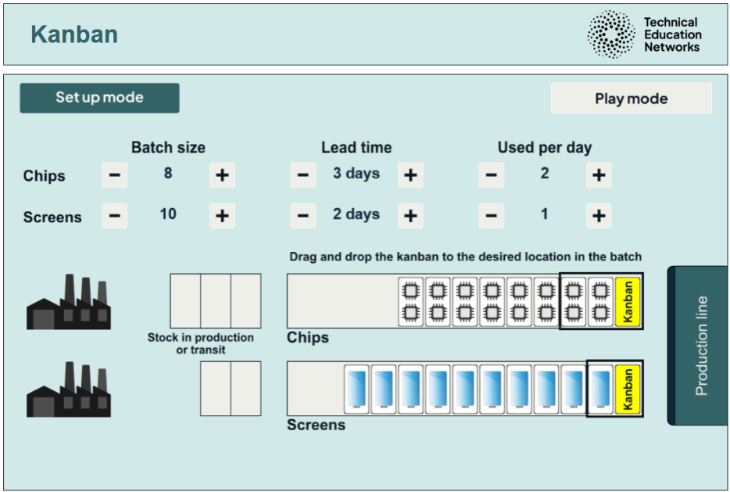
Kanban interactive & walkthrough
Activity 1
Link to the Kanban interactive – this includes written user instructions:
https://www.technicaleducationnetworks.org.uk/interactive/kanban
Please note – the Firefox browser is not recommended for the interactive.
Link to How to use the kanban interactive video walkthrough:
https://vimeo.com/1118131685/4406764c1a
Resource 5: Inventory management using Kanban
Notes:
Kanban interactive: https://www.technicaleducationnetworks.org.uk/interactive/kanban
Kanban interactive video walkthrough: https://vimeo.com/1118131685/4406764c1a

Slide 5

Kanban interactive
Activity 1
Experiment with deciding where the kanban goes to ensure stock arrives just in time.
Set the values to:
batch size: 8 for chips; 10 for screens
lead time: 3 days for chips; 2 days for screens
used per day: 2 for chips; 1 for screens.
Where should you place the kanban so that you don’t overstock or run out of components?
Why?
Resource 5: Inventory management using Kanban

Slide 6
Discussion
Activity 1
What does ‘lead time’ mean? Is this stock to site or actually in use?
What impact does batch size have on where the kanban goes?
What impact does the lead time have on where the kanban goes?
Resource 5: Inventory management using Kanban

Slide 7
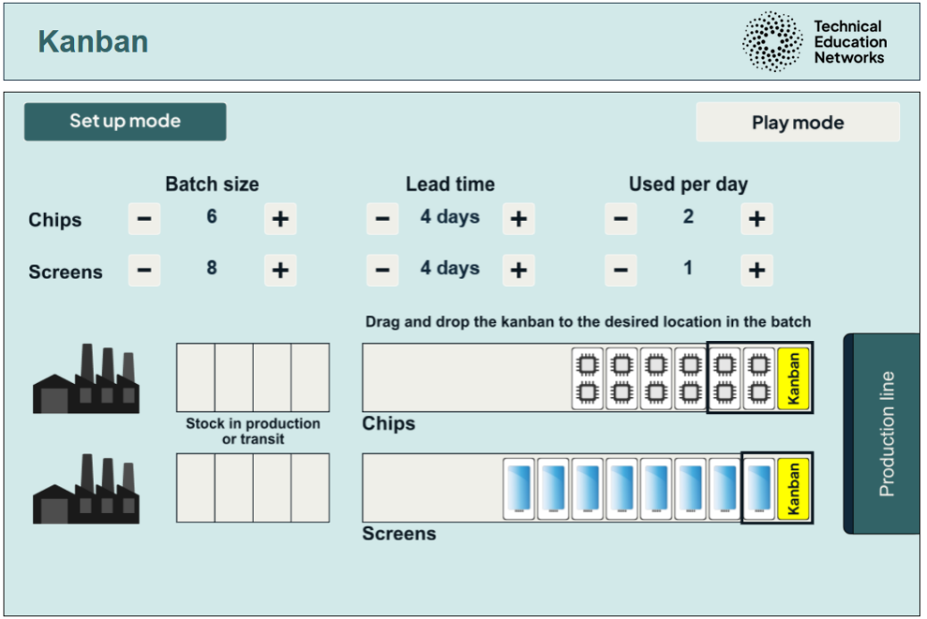
Scenario
Activity 2
Using the Kanban interactive, run this scenario:
batch size: 6 for chips; 8 for screens
lead time: 4 days for chips; 4 days for screens
number used per day: 2 for chips; 1 for screens.
Resource 5: Inventory management using Kanban

Slide 8
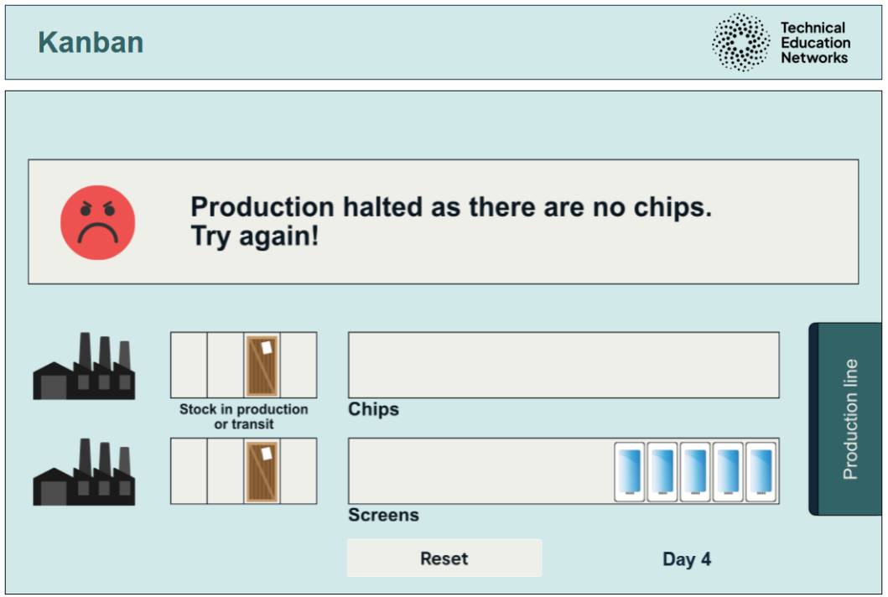
Scenario result
Activity 2
You will always run out of chip components – no matter where you place the kanban.
Resource 5: Inventory management using Kanban

Slide 9

Plenary
Plenary
Discuss the advantages of using the Kanban system, as shown in the interactive.
Resource 5: Inventory management using Kanban
Notes:
Image © Shutterstock/Amorn Suriyan

Slide 10
Plenary answers
Plenary
Stock does not have to be reordered manually – an order is triggered automatically.
Stock will arrive just in time.
This avoids overstock, which can tie up cash in unnecessary stock and lead to a lack of storage space.
It also avoids understock, which can lead to a stop in production and loss of income.
Resource 5: Inventory management using Kanban

Slide 11
In this resource, we have:
Plenary
Skills
MPC-CSD Evaluate and quality-assure processes and outcomes
MPC-CSA Analyse and interpret an employer set brief
MPC-CSB Plan and prepare suitable responses to the brief
MPC-CSE Communicate and present outcomes and evidence
General competencies
English:
EC2 Present information and ideas
EC4 Summarise information/ideas
EC6 Take part in/lead discussions
Maths:
MC2 Estimating, calculating and error spotting
MC5 Processing data
Digital:
DC1 Use digital technology and media effectively
DC4 Process and analyse numerical data
recognised how Kanban is used in modern manufacturing to control inventory;
been able to discuss the advantages of using Kanban in inventory control.
Resource 5: Inventory management using Kanban

Slide 12
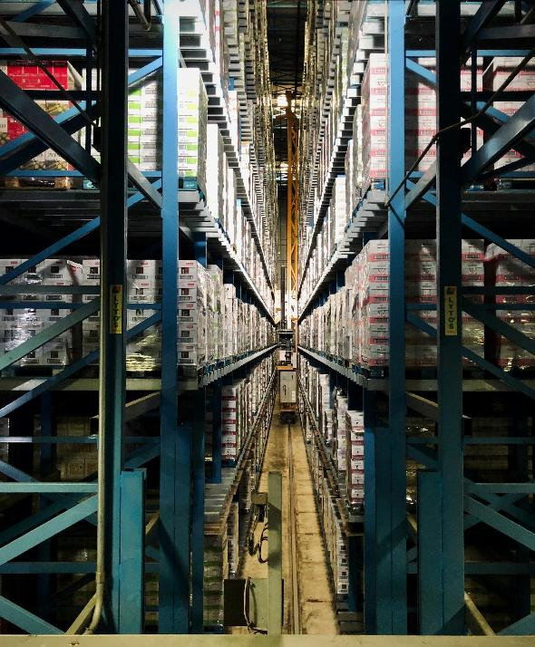
Consolidation
Consolidation
Carry out some research into how companies use the Kanban inventory control system. Suggested companies include:
Toyota
Boeing
Intel
Zara
Dell.
Resource 5: Inventory management using Kanban
Notes:
Image © Unsplash/Arno Senoner

