Slide 1
Engineering and Manufacturing
Route: Engineering and Manufacturing
Topic: Stock and asset management
Resource 2: Stock control
Notes:
Image © Shutterstock/Halfpoint

Slide 2
In this resource, we will:
Introduction
Skills
MPC-CSD Evaluate and quality-assure processes and outcomes
MPC-CSA Analyse and interpret an employer set brief
MPC-CSB Plan and prepare suitable responses to the brief
MPC-CSE Communicate and present outcomes and evidence
General competencies
English:
EC2 Present information and ideas
EC6 Take part in/lead discussions
Maths:
MC2 Estimating, calculating and error spotting
MC6 Understanding data and risk
MC8 Communicating using mathematics
MC10 Optimising work processes
Digital:
DC1 Use digital technology and media effectively
DC3 Communicate and collaborate
understand methods of stock management and the factors that contribute to an effective stock management process, with a particular focus on made-to-stock (MTS), made-to-order (MTO) and just-in-time (JIT);
understand rolling averages and their uses;
use mathematical reasoning to make decisions around a stock management process and its efficiency;
select different stock management processes and see the impacts of each choice.
Resource 2: Stock control

Slide 3

Stock management approaches
Introduction
Made-to-stock (MTS)
Made-to-order (MTO)
Just-in-time (JIT)
Minimum order quantity (MOQ)
Economic order quantity (EOQ)
Inventory management software
Resource 2: Stock control
Notes:
Image © Pexels/Blaz Erzetic

Slide 4
Stock management approaches
Introduction
Made-to-stock (MTS): Products are manufactured in anticipation of customer demand. This means that goods are produced and stocked in warehouses before they are sold.
Made-to-order (MTO): Products are manufactured only after a customer order is received. This approach is often used for customised or low-volume products.
Just-in-time (JIT): Aimed at minimising inventory levels by producing goods only when needed. It involves a pull system, where production is triggered by customer demand.
Resource 2: Stock control
Notes:
Image © Pexels/Blaz Erzetic

Slide 5

Stock management approaches
Introduction
Minimum order quantity (MOQ): The smallest number of units a supplier is willing to sell in a single order. This quantity is often set by suppliers to cover production costs and ensure profitability.
Economic order quantity (EOQ): The optimal order quantity that minimises the total cost of inventory, which includes ordering costs and holding costs.
Inventory management software: Designed to help businesses keep track of their inventory levels, orders, sales and deliveries. It can also be used in the manufacturing industry to create work orders, bills of materials and other production-related documents.
Resource 2: Stock control
Notes:
Image © Pexels/Tiger Lily

Slide 6

Made-to-stock
Introduction
How does the use of made-to-stock (MTS) compare to other production strategies like made-to-order (MTO)?
Think about:
cost;
lead time;
customer satisfaction.
Resources needed
R2 Introduction Information sheet
Resource 2: Stock control
Notes:
Image © Pexels/Tiger Lily

Slide 7
Just-in-time
Introduction
How does the just-in-time (JIT) inventory management approach impact the relationship between a manufacturer and its suppliers in today’s globalised industries?
Resources needed
R2 Introduction Information sheet
Resource 2: Stock control
Notes:
Image © Pexels/Tiger Lily

Slide 8
Made-to-order
Introduction
How does the made-to-order approach optimise resource allocation and minimise waste in industries with highly variable demand?
Resources needed
R2 Introduction Information sheet
Resource 2: Stock control
Notes:
Image © Pexels/Tiger Lily

Slide 9

Rolling averages
Activity 1
Rolling averages (also known as moving averages) are used by businesses to show previous demand and anticipate future customer demand.
This is then used to determine realistic stock levels and is also linked to lead times for delivery, etc.
If stock takes an excessive time to arrive, it can impact production.
Resource 2: Stock control
Notes:
Image © Pexels/Lukas

Slide 10
Rolling averages continued
Activity 1
Rolling averages are a statistical tool used to smooth out fluctuations in data over time.
They are calculated by taking the average of a specific number of data points within a moving window.
As new data points become available, the window moves forward and the average is recalculated.
This process helps to identify trends and patterns that might be obscured by short-term variations.
Resource 2: Stock control

Slide 11
Calculating rolling averages
Activity 1
The calculation of a rolling average depends on the type of moving average you choose. Here are two common types:
Simple moving average (SMA)
This is the most basic type of moving average.
It is calculated by summing the values of a specified number of data points and then dividing the sum by the number of data points.
For example, a 5-day SMA would be calculated by summing the values of the last 5 days and dividing by 5.
Resource 2: Stock control

Slide 12
Calculating rolling averages continued
Activity 1
2. Weighted moving average (WMA)
This type of moving average assigns more weight to recent data points than to older ones.
This is done by multiplying each data point by a weight factor and then summing the products.
The sum of the products is then divided by the sum of the weights.
For example, a 3-day WMA might assign weights of 3, 2 and 1 to the most recent, second most recent and third most recent data points, respectively.
This can make the average more sensitive to new trends, while still considering historical information.
Resource 2: Stock control

Slide 13
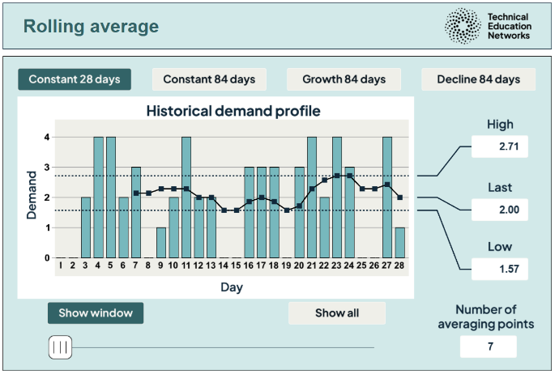
Rolling average interactive
Activity 1
The rolling average interactive shows averages calculated using a different number of averaging points.
It includes a rolling average over several months as a tool for identifying demand trends.
This is calculated using a simple moving average (SMA).
The interactive can be accessed at: https://www.technicaleducationnetworks.org.uk/interactive/rolling-average Please note – the Firefox browser is not recommended for the interactives.
Resource 2: Stock control
Notes:
Rolling averages interactive: https://www.technicaleducationnetworks.org.uk/interactive/rolling-average

Slide 14

Rolling average interactive walkthrough
Activity 1
For written instructions see Rolling average interactive user guidance.
Resource 2: Stock control
Notes:
Rolling averages interactive video walkthrough - https://vimeo.com/1118129817/d46b8ceec0

Slide 15
Rolling averages questions
Activity 1
How would increasing the number of data points in a rolling average of daily production rates have an impact upon:
identification of the start and end of the peak production season
predicting potential material shortages during peak demand?
How would a rolling average of the defect rate with a larger number of data points help identify a gradual increase in defects due to a slow-developing equipment malfunction?
Resources needed
R2 Activity 1 Information sheet
Resource 2: Stock control

Slide 16
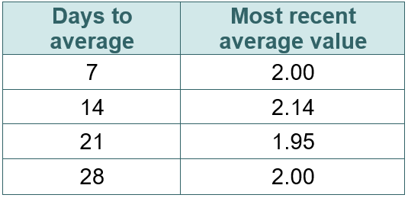
Rolling averages activity
Activity 1
Look at the rolling 7-, 14- and 21-day averages in the interactive. What happens to the range of the rolling average as the number of averaging points increases?
The last value in each case is given in the table. The most recent average values are 2. Does this mean that a 7-day average is the same as a 28-day average?
The organisation will use a 28-day rolling average value to predict the demand for the next 28 days. In this case, the demand will be taken as 2 per day for 28 days, giving a total of 56 items.
Is taking the average in this way sensible?
What factors could lead to problems with the approach?
How could you correct for these issues?
Resources needed
R2 Activity 1 Worksheet
R2 Activity 1 Worksheet answers
Resource 2: Stock control

Slide 17
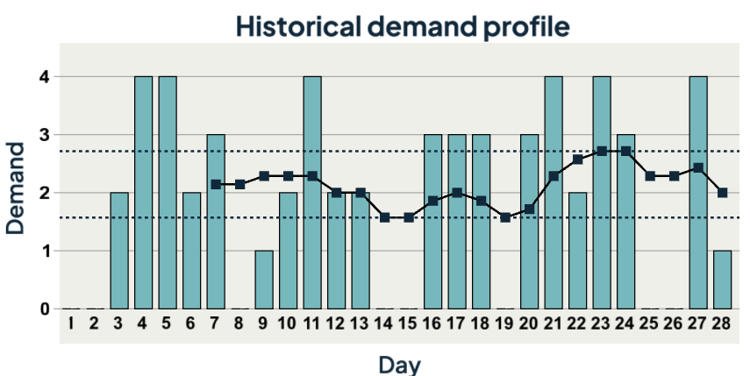
Demand profiles
Activity 2
A demand profile is a graphical representation of how much of a product or service is demanded over a specific period of time.
It usually shows fluctuations based on factors like time of day, day of the week, season or other relevant variables.
It outlines the pattern of demand for a product or service across different timeframes.
Resource 2: Stock control

Slide 18
Demand profiles continued
Activity 2
Demand profiles are typically displayed as graphs or charts.
The x-axis shows time and the y-axis represents the level of demand.
Companies use demand profiles to:
understand customer behaviour;
plan inventory levels;
optimise production schedules;
forecast future demand.
Resource 2: Stock control

Slide 19
Demand profile types
Activity 2
Seasonal demand: fluctuations based on seasons of the year.
Cyclic demand: fluctuations over longer periods, like economic cycles.
Daily demand: variations throughout the day (e.g. peak electricity usage during evening hours).
Intermittent demand: irregular demand with unpredictable spikes.
Resource 2: Stock control

Slide 20
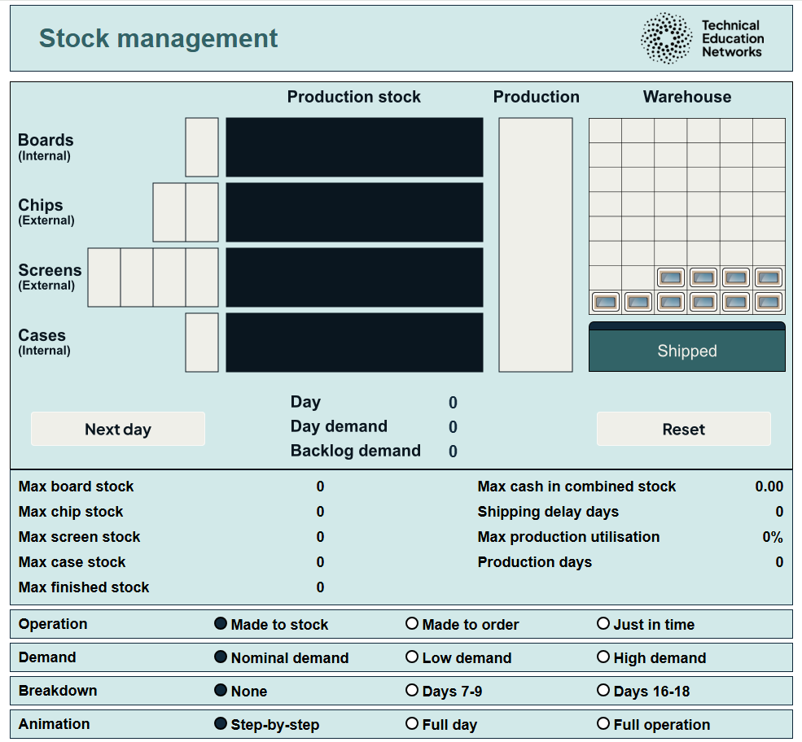
Stock management interactive
Activity 2
Stock management interactive: https://www.technicaleducationnetworks.org.uk/interactive/stock (Firefox is not recommended for the interactive) How to use the stock management interactive video walkthrough: https://vimeo.com/1119123407/7990708158
For written instructions see Stock management interactive user guidance.
Resource 2: Stock control
Notes:
Stock management interactive: https://www.technicaleducationnetworks.org.uk/interactive/stock-management/ Stock interactive walkthrough video: https://vimeo.com/1119123407/7990708158

Slide 21
Stock management interactive
Activity 2
The interactive shows a four-component manufacturing system making hypothetical mobile phones.
Two components (the boards and the cases) are produced internally and, if ordered, take a day to produce.
The other two components (the chips and the screens) are sourced externally and have lead times of 2 and 4 days respectively.
It is a 7-day production.
The simulation will run for 28 days.
Historical/projected demand is an average of two items per day. An item is a batch of hundreds of phones.
Each single block in the simulation represents a pallet or container of products and not an individual item.
Projected demand for 28 days of operation
28 × 2 = 56 items
Resource 2: Stock control

Slide 22
Interactive demand profiles
Activity 2
In the interactive, there are three different demand profiles, each running over 28 days:
Nominal demand profile
Total demand is 56 items.
Low demand profile
Total demand is 50 items.
High demand profile
Total demand is 62 items.
Using the interactive, fill in the table in R2 Activity 2 Worksheet.
Resources needed
R2 Stock management interactive
R2 Activity 2 Worksheet
R2 Activity 2 Worksheet answers
Resource 2: Stock control

Slide 23
Discussion
Activity 2
For made-to-stock (MTS):
What does the machine do when it is not assembling the phone items?
Can it be used for something else, or does it sit idle?
For made-to-order (MTO) and just-in-time (JIT):
Is the production capacity too high?
Would smaller/fewer machines be better?
Can the machine be used for something else?
If the machine can be used for something else, how long does it take to change over?
Resources needed
R2 Activity 2 Information sheet
Resource 2: Stock control

Slide 24
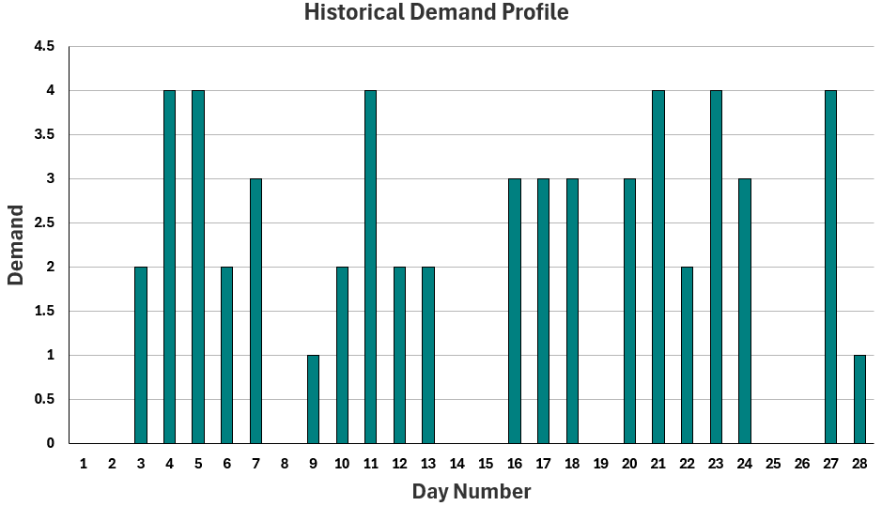
Nominal demand forecasting: questions
Activity 3
Resources needed
R2 Activity 3 Spreadsheet
Here is a four-week example of previous demand data.
Estimate what the expected daily demand will be for the next 28-day period.
How could the data be used to make a prediction about demand over the next 28 days?
Resource 2: Stock control

Slide 25
Nominal demand forecasting: answers
Activity 3
1. Daily demand is not constant.
There is an expected maximum daily demand.
The daily demand can be zero.
There is no apparent structure or trend to the daily demand values.
2. Use the same data and assume the daily variation is as before. OR
Take an average of some or all of the values and apply a constant daily average value.
Resources needed
R2 Activity 3 Spreadsheet
Resource 2: Stock control

Slide 26

Plenary discussion
Plenary
Which production system is most appropriate for industries with high product variety?
What are the advantages of made-to-order (MTO) for industries with short product life cycles?
How can just-in-time (JIT) be implemented in industries with seasonal demand patterns?
Resource 2: Stock control
Notes:
Image © Pexels/Tiger Lily

Slide 27
In this resource, we have:
Plenary
Skills
MPC-CSD Evaluate and quality-assure processes and outcomes
MPC-CSA Analyse and interpret an employer set brief
MPC-CSB Plan and prepare suitable responses to the brief
MPC-CSE Communicate and present outcomes and evidence
General competencies
English:
EC2 Present information and ideas
EC6 Take part in/lead discussions
Maths:
MC2 Estimating, calculating and error spotting
MC6 Understanding data and risk
MC8 Communicating using mathematics
MC10 Optimising work processes
Digital:
DC1 Use digital technology and media effectively
DC3 Communicate and collaborate
understand methods of stock management and the factors that contribute to an effective stock management process, with a particular focus on made-to-stock (MTS), made-to-order (MTO) and just-in-time (JIT);
understand rolling averages and their uses;
use mathematical reasoning to make decisions around a stock management process and its efficiency;
select different stock management processes and see the impacts of each choice.
Resource 2: Stock control

Slide 28
Consolidation
Consolidation
Work through the questions on the consolidation worksheet.
Resources needed
R2 Consolidation Worksheet
R2 Consolidation Worksheet answers
Resource 2: Stock control

