Slide 1
Engineering and Manufacturing
Route: Engineering and Manufacturing
Topic: Stock and asset management
Resource 1: What is stock and what are assets?
Notes:
Image © Shutterstock/Halfpoint

Slide 2
In this resource, we will:
Introduction
define stock and assets within the context of an engineering and manufacturing company;
understand the importance of effective stock and asset management.
Skills
MPC-CSE Communicate and present outcomes and evidence
MPC-CSD Evaluate and quality-assure processes and outcomes
General competencies
English:
EC2 Present information and ideas
EC4 Summarise information/ideas
EC6 Take part in/lead discussions
Maths:
MC10 Optimising work processes
Digital:
DC3 Communicate and collaborate
Resource 1: What is stock and what are assets?

Slide 3
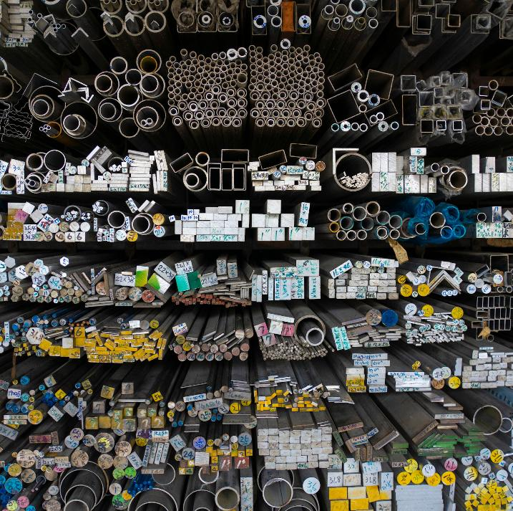
Stock and assets
Introduction
Define the term ‘stock’.
Define the term ‘assets’.
Resource 1: What is stock and what are assets?
Notes:
Image © Pexels/Jimmy Liao

Slide 4
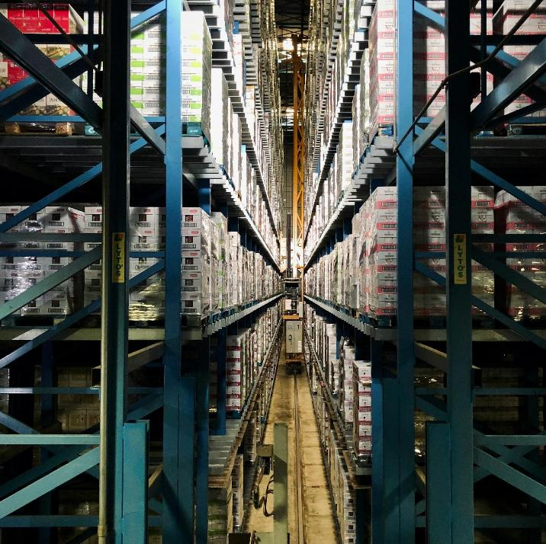
What is stock?
Introduction
Stock is the things a company owns that it needs to carry out its business.
Stock is anything tangible that is made or processed. For example:
goods or raw materials – which the company’s product(s) is based on;
completed, manufactured or repaired items which have not been sold, or paid for.
Stock typically has a value attached to it, as do assets.
Resource 1: What is stock and what are assets?
Notes:
Image © Unsplash/Arno Senoner

Slide 5

What are assets?
Introduction
Assets can be divided into three categories:
current (cash, inventory, money owed to the business, etc.);
capital (equipment, machinery, land, buildings, vehicles, etc.);
intangible assets (reputation, trademarks, patents, etc.)
Assets are also the things that a company owns to do business and/or create stock, such as computers, hand tools, desks, chairs, etc.
People who work in a company are also assets.
Resource 1: What is stock and what are assets?
Notes:
Image © Pexels/Pixabay

Slide 6

What is stock management?
Activity
Stock management, also known as inventory management or inventory control, is the process of ordering, storing, tracking and controlling a business’s inventory.
Many UK manufacturing companies use tools to manage their inventories effectively.
Tools help them meet production demands and minimise excess stock and associated costs.
Resource 1: What is stock and what are assets?
Notes:
Image © Shutterstock/Halfpoint

Slide 7
The importance of stock management
Activity
Stock control helps businesses to meet customers’ demands without running out of stock or causing delays in delivery times.
Stock control minimises the costs of holding or storing stock a business doesn’t need.
Businesses must consider seasonal variations, peaks in demand or any unforeseen circumstances which might disrupt the supply chain and impact customer service.
Resource 1: What is stock and what are assets?
Notes:
Image © Pexels/Jimmy Liao

Slide 8
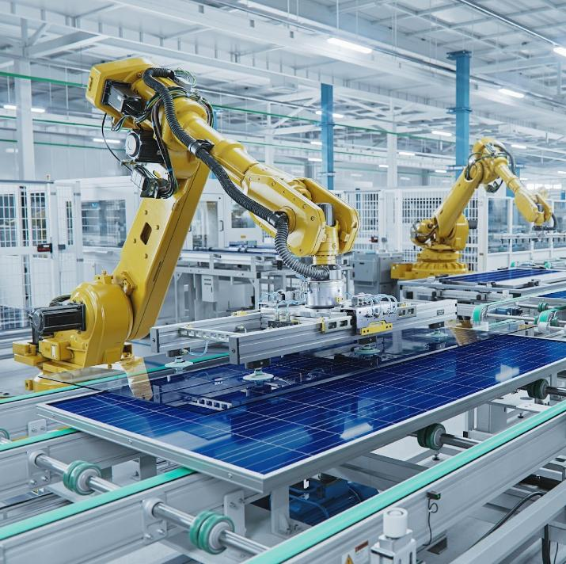
What is asset management?
Activity
Asset management means managing and optimising assets to maximise their value and achieve objectives.
Asset management can involve:
identifying and cataloguing assets;
establishing goals and objectives;
maintaining and repairing assets;
tracking and forecasting performance;
investing in new assets.
Resource 1: What is stock and what are assets?
Notes:
Image © Shutterstock/IM Imagery

Slide 9

The importance of asset management
Activity
A lack of asset management can lead to increased operational costs due to inefficient use of assets and frequent breakdowns.
This can also result in reduced productivity and missed opportunities, e.g. employee time is lost looking for tools and equipment.
Poor asset management can lead to compliance issues and increased risks, such as unexpected asset failures that disrupt business operations.
Resource 1: What is stock and what are assets?
Notes:
Image © Unsplash/Jo Smiley Hailey

Slide 10
Lotus and Amazon
Activity
We will watch videos regarding stock and asset management at two companies – Lotus and Amazon. Before we do, discuss:
Why do you think stock and asset management is important to these companies?
What might the real-world consequences be if this goes wrong?
Resource 1: What is stock and what are assets?

Slide 11
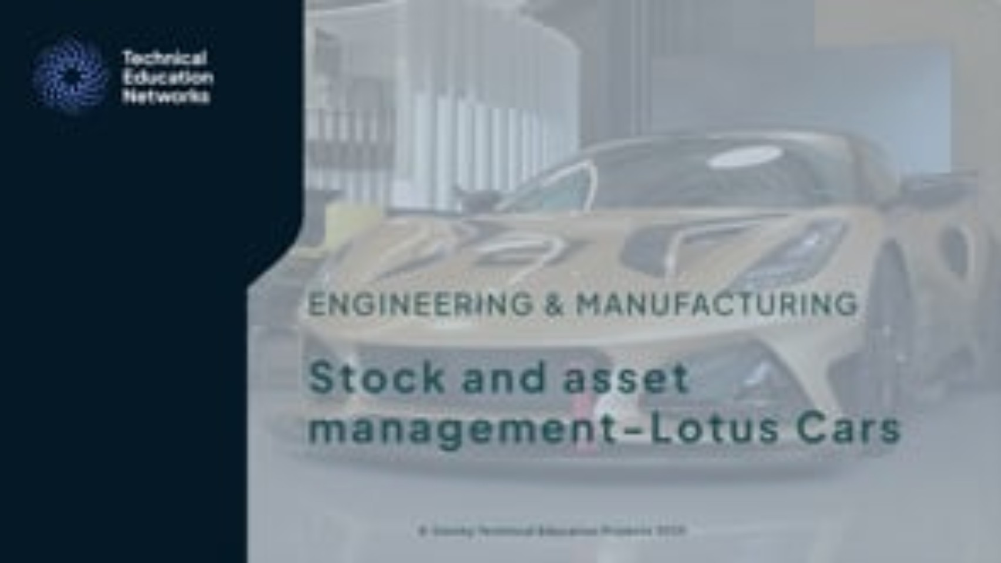
Industrial applications: Lotus
Resource 1: What is stock and what are assets?
Activity
Resources needed
R1 Activity Worksheet
Resource 1: What is stock and what are assets?
Notes:
Lotus cars stock and asset management video - https://vimeo.com/1118703281/4c68582141

Slide 12
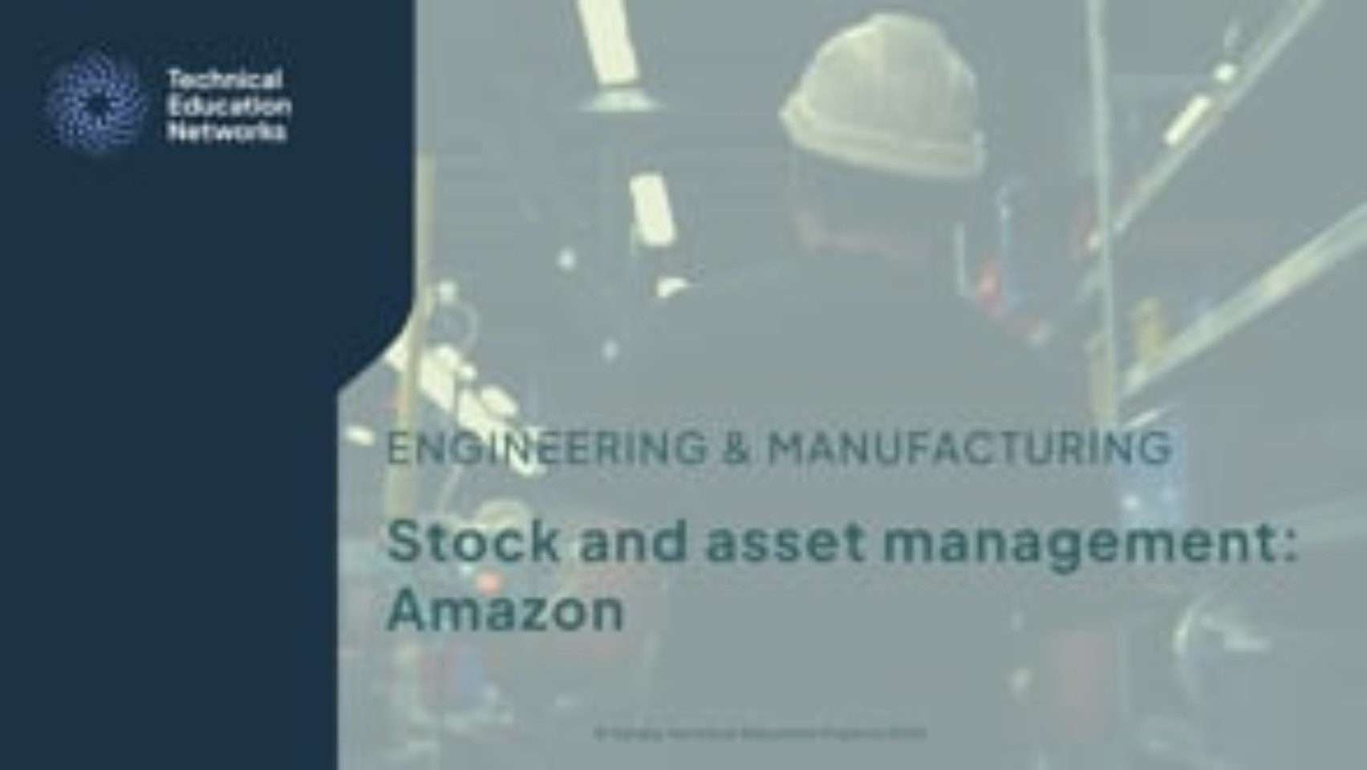
Industrial applications: Amazon
Resource 1: What is stock and what are assets?
Activity
Resources needed
R1 Activity Worksheet
Resource 1: What is stock and what are assets?
Notes:
Amazon stock and asset management video - https://vimeo.com/1096306615/17594c097c

Slide 13
Discussion
Resource 1: What is stock and what are assets?
Activity
How can a business determine the resources required for each customer/product?
How might a business deal with issues if materials are delayed or unavailable?
How would delays due to poor stock and asset management impact a business? Think about the company’s reputation and future business.
Resource 1: What is stock and what are assets?

Slide 14
The role of technology
Resource 1: What is stock and what are assets?
Plenary
In your groups, discuss one of these questions:
How can technology improve inventory tracking and control?
What are the benefits of using asset management software?
What are the potential challenges and risks associated with relying on technology?
Resource 1: What is stock and what are assets?

Slide 15
True or false quiz
Plenary
Are the following statements true or false?
Stocks are tangible assets.
Asset management involves planning, organising and controlling physical resources.
Depreciation is the decrease in value of an asset over time.
Resource 1: What is stock and what are assets?

Slide 16
True or false quiz – answers
Plenary
Are the following statements true or false?
Stocks are tangible assets. True
Asset management involves planning, organising and controlling physical resources. True
Depreciation is the decrease in value of an asset over time. True
Resource 1: What is stock and what are assets?

Slide 17
In this resource, we have:
Plenary
defined stock and assets within the context of an engineering and manufacturing company;
understood the importance of effective stock and asset management.
Skills
MPC-CSE Communicate and present outcomes and evidence
MPC-CSD Evaluate and quality-assure processes and outcomes
General competencies
English:
EC2 Present information and ideas
EC4 Summarise information/ideas
EC6 Take part in/lead discussions
Maths:
MC10 Optimising work processes
Digital:
DC3 Communicate and collaborate
Resource 1: What is stock and what are assets?

Slide 18
Case study
Consolidation
Choose an organisation to research independently to assess the importance of stock and asset management. Document your research in your chosen format.
You may be asked to present your research to the class.
Consider these questions in your research:
What stock and assets does the organisation manage?
Why is stock and asset management important to this company?
What process(es) do they use to manage stock and assets?
What might the consequences be if this goes wrong?
Resource 1: What is stock and what are assets?

