Slide 1
Health
Route: Health and Science
Topic: Good scientific and clinical practice
Lesson 5: Ordering and storing stock correctly
Notes:
Image © Shutterstock/Inside Creative House

Slide 2
In this lesson, we will:
Introduction
Skills:
CS6.1 Present their project findings in a range of formats
CS6.3 Apply considerations for adapting presentation style when presenting to a range of stakeholders
General competencies:
English:
GEC2 Present information and ideas
GEC4 Summarise information and ideas
GEC6 Take part in/lead discussions
Maths:
GMC2 Estimating, calculating and error spotting
GMC8 Communicating using mathematics
GMC10 Optimising work processes
Digital:
GDC3 Communicate and collaborate
GDC4 Process and analyse numerical data
Discuss reasons why it is important to order and manage stock effectively.
Explain some potential impacts of not storing materials and chemicals properly.
Lesson 5: Ordering and storing stock correctly

Slide 3

Introduction
Introduction
Why is it important to order and manage stock effectively?
List as many reasons as you can.
Lesson 5: Ordering and storing stock correctly
Notes:
Image © Shutterstock/Gorodenkoff

Slide 4
Managing stock
Activity 1
Managing stock is important to:
ensure a sufficient supply of required consumables and materials
ensure that materials are used before their expiry date
reduce the costs of holding excess stock
minimise wastage
improve efficiency
improve productivity
ensure safety of stock, for example, to check bottles for damage or broken seals, or to prevent a product degrading over time.
Lesson 5: Ordering and storing stock correctly

Slide 5
Managing stock
Activity 1
Complete the maths activity on Worksheet 1, where you are asked to perform a series of calculations to identify some of the challenges around managing pharmaceutical stock levels.
Mark your answers using Worksheet 2.
Resources needed
L5 Activity 1 Worksheet 1
L5 Activity 1 Worksheet 2
Lesson 5: Ordering and storing stock correctly

Slide 6
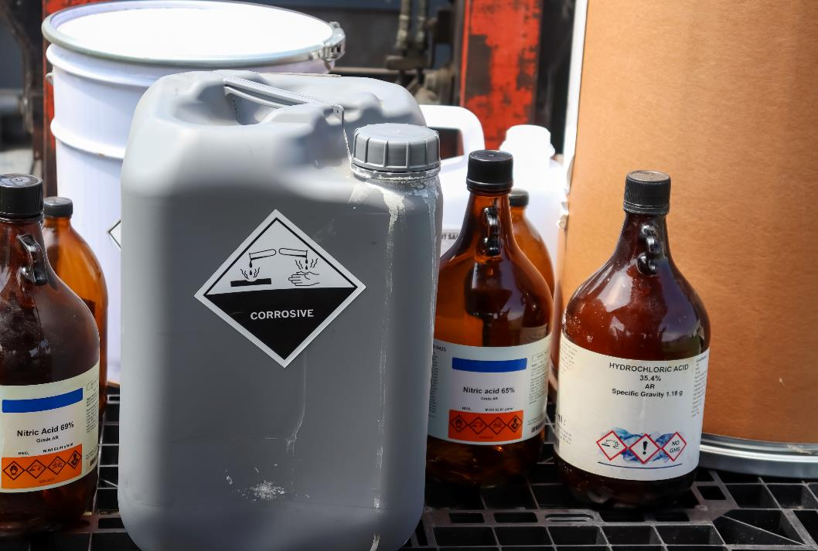
Storing products, materials and equipment
Activity 2
In pairs, discuss:
What are the potential consequences of not storing products, equipment and materials correctly?
Lesson 5: Ordering and storing stock correctly
Notes:
Image © Shutterstock/chemical industry

Slide 7
Storing products, materials and equipment
Activity 2
Incorrect storage can cause:
cross-contamination
breakdown of limited stability products
products exceeding their expiry date (resulting in a financial loss as products have to be disposed of)
loss of samples or degradation of reagents not stored at the correct temperature
a health and safety risk to employees (e.g., from a spill/toxic gas release, spread of infection or injury caused by lifting)
difficulties in locating stock which has been stored for extended periods of time.
Lesson 5: Ordering and storing stock correctly

Slide 8
Storing products, materials and equipment
Activity 2
Identify a scenario in which products, materials or equipment may be stored incorrectly and the potential consequences of this, both for individuals and the organisation.
Present your scenario to the group to produce an overall class table, which summarises the main consequences of storing materials incorrectly.
Resources needed
L5 Activity 2 Worksheet 1
Lesson 5: Ordering and storing stock correctly

Slide 9
Study question
Plenary
Complete the study question on Worksheet 1.
Swap your answer with a partner and mark their response using the mark scheme provided on Worksheet 2.
Go back through your marked response and add detail where appropriate to improve your answer.
Resources needed
L5 Plenary Worksheet 1
L5 Plenary Worksheet 2
Lesson 5: Ordering and storing stock correctly

Slide 10
In this lesson, we have:
Plenary
Skills:
CS6.1 Present their project findings in a range of formats
CS6.3 Apply considerations for adapting presentation style when presenting to a range of stakeholders
General competencies:
English:
GEC2 Present information and ideas
GEC4 Summarise information and ideas
GEC6 Take part in/lead discussions
Maths:
GMC2 Estimating, calculating and error spotting
GMC8 Communicating using mathematics
GMC10 Optimising work processes
Digital:
GDC3 Communicate and collaborate
GDC4 Process and analyse numerical data
Discussed reasons why it is important to order and manage stock effectively.
Explained some potential impacts of not storing materials and chemicals properly.
Lesson 5: Ordering and storing stock correctly

Slide 11
Consolidation
Consolidation
Produce a timeline for the storage of vaccines with an expiration date of a maximum of six months from manufacture. Mark the changes in the way the vaccine can be stored. Use: www.cdc.gov/vaccines/covid-19/info-by-product/pfizer/downloads/storage-handling-label.pdf
Create a SOP for storage of a temperature-sensitive drug of your choice: chloramphenicol, amoxicillin, leukeran, insulin or botox.
Lesson 5: Ordering and storing stock correctly
Notes:
www.cdc.gov/vaccines/covid-19/info-by-product/pfizer/downloads/storage-handling-label.pdf

