Slide 1
Health
Route: Health and Science
Topic: Good scientific and clinical practice
Lesson 3: Use of equipment
Notes:
Image © Shutterstock/Inside Creative House

Slide 2
In this lesson, we will:
Introduction
Skills:
CS3.2: Undertake collaborative work
CS4.1: Undertake reflective practice and record reflections and experiences
CS6.1: Present findings in a range of formats: using digital formats (video)
General competencies:
English:
GEC5 Synthesise information
GEC6 Take part in/lead discussions
Maths:
GMC1 Measuring with precision
GMC2 Estimating, calculating and error spotting
Explain why it is important to calibrate and test equipment so that it is fit for use.
Describe the potential impacts of not maintaining, cleaning and servicing equipment.
Outline how to escalate concerns over faulty or unsuitable equipment.
Lesson 3: Use of equipment

Slide 3
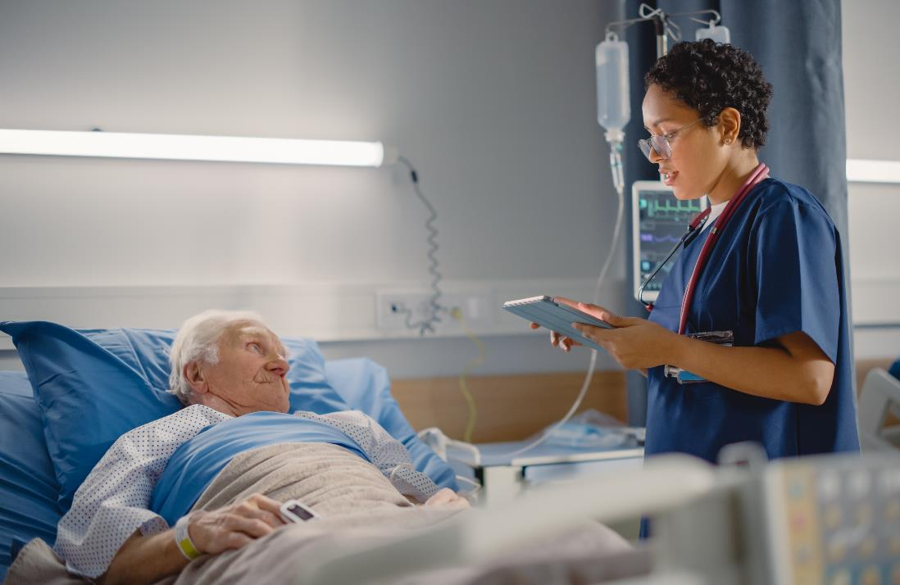
Look at the image
Introduction
What measurements do people working in healthcare take?
Why are they important?
Lesson 3: Use of equipment
Notes:
Image © Shutterstock/Gorodenkoff

Slide 4
Look at the image
Introduction
What measurements did you come up with?
Urine output
Temperature
Heart rate
Blood pressure
Respiratory rate
Height and weight
Oxygen saturation levels
Lesson 3: Use of equipment
Notes:
Image © Shutterstock/Gorodenkoff

Slide 5
Why is it important to regularly test equipment?
Activity 1
You will be given some pieces of equipment to take a range of measurements. Your teacher will tell you which measurements to take.
Once all groups have collected their data, compare your readings:
Which group(s) had the correct readings? How do you know?
Which piece(s) of equipment is/are faulty? How do you know?
Why is it important to regularly test equipment to check it is not faulty?
Resources needed
A range of equipment
Lesson 3: Use of equipment

Slide 6
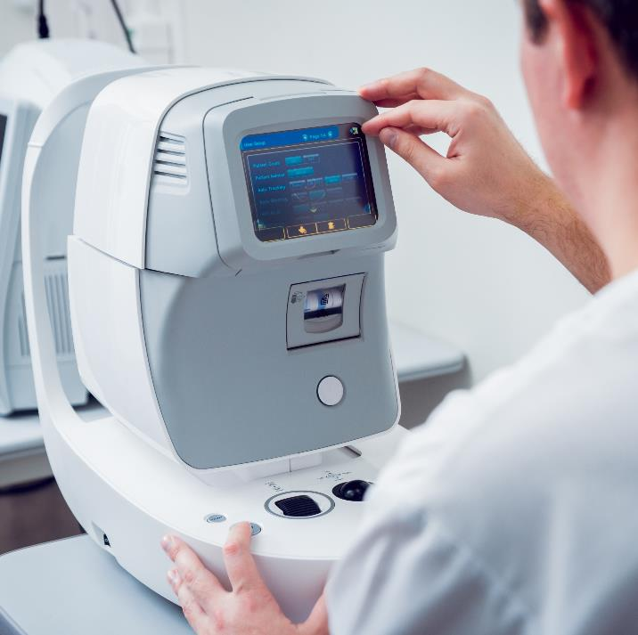
Why is it important to test equipment regularly?
Activity 1
Testing equipment regularly:
ensures the accuracy of measurements
prolongs the life of equipment
is often required to meet legal requirements.
Lesson 3: Use of equipment
Notes:
Image © Shutterstock/Roman Zaiets

Slide 7
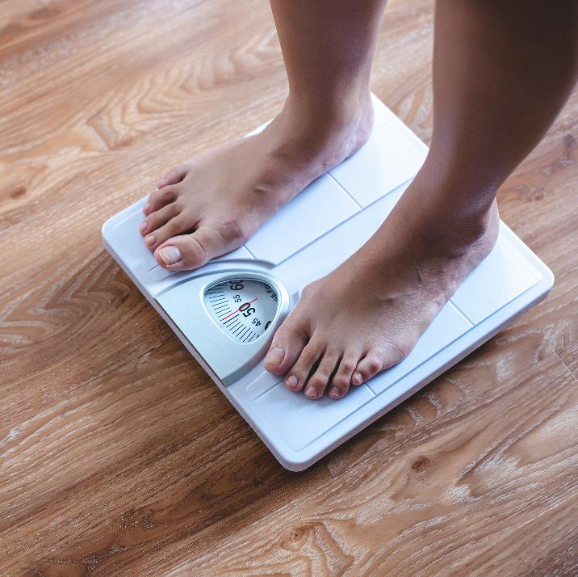
Calibrating equipment
Activity 2
Calibrating bathroom scales
Why might bathroom scales need calibrating in a health setting?
Is it sufficient just to set the zero reading?
Is a single calibration mass enough to calibrate bathroom scales?
Lesson 3: Use of equipment
Notes:
Image © Shutterstock/Ticketcraft

Slide 8
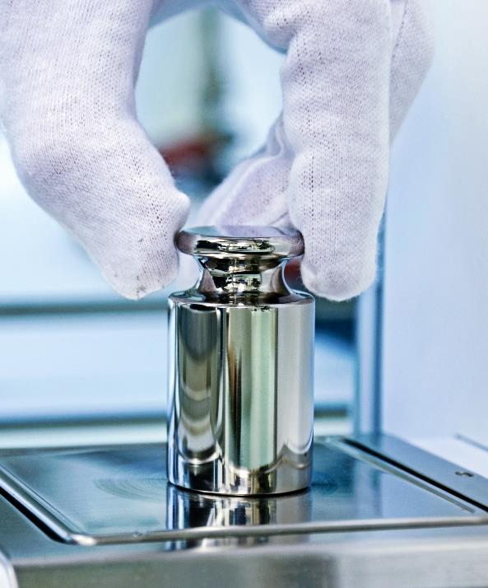
Calibrating equipment
Activity 2
Calibration ensures that a scientific process or piece of equipment will produce accurate results every time.
Over time, instruments can 'drift' due to normal wear and tear, resulting in inaccurate results. Therefore, it is important that pieces of equipment are properly calibrated before use.
Calibration involves comparing measurement values obtained by a piece of equipment under test, with those of known accuracy. (If found to be incorrect the piece of equipment is then adjusted.)
Lesson 3: Use of equipment
Notes:
Image © Shutterstock/Markus Thoenen

Slide 9
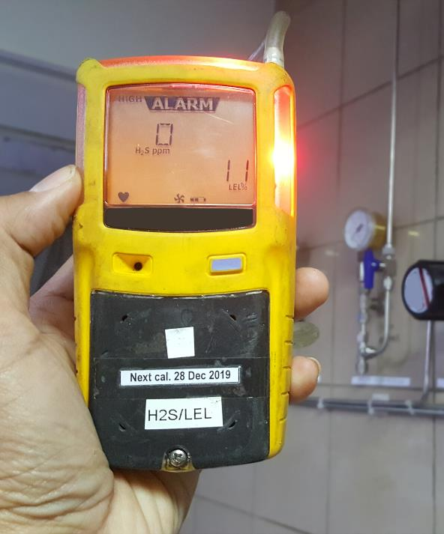
Calibrating equipment
Activity 2
As well as ensuring an instrument provides an accurate reading, calibration extends the life of a piece of equipment.
The calibration lifecycle of a piece of equipment varies by instrument. It is also determined by manufacturers’ recommendations, usage and environment of the instrument.
It is a legal requirement to calibrate some instruments, for example, gas detectors. This is to ensure safety standards are met.
Lesson 3: Use of equipment
Notes:
Image © Shutterstock/petroleum man

Slide 10
Identifying mistakes
Activity 3
For each scenario (1-4), read how a student made a measurement.
Decide where they went wrong.
Repeat the procedure correctly using the equipment supplied.
Resources needed
Cards cut from L3 Activity 3 Worksheet
Lesson 3: Use of equipment

Slide 11
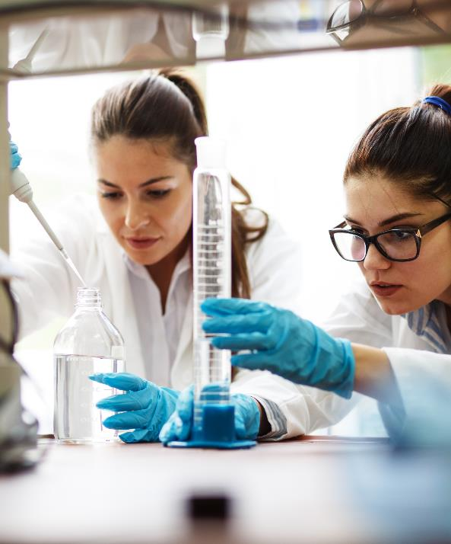
Identifying mistakes – correct procedures
Activity 3
Scenario 1 – Place the empty beaker on the balance, press tare, then remeasure the mass of the beaker with the salt added.
Scenario 2 – Place the measuring cylinder on a table whilst filling the cylinder and reading the volume. To determine the correct volume of liquid, line up the eye to the level of where the liquid sits on the scale before taking the reading. (This avoids parallax error.)
Scenario 3 – The thermometer should be held in the liquid away from the beaker sides when measuring the temperature. The liquid should be stirred before a measurement is taken.
Scenario 4 – Use a pipette/syringe to accurately measure out the volume of liquid and transfer to the beaker. Beakers are not suitable for accurate volume measurements due to their larger graduations.
Lesson 3: Use of equipment
Notes:
Image © Shutterstock/BalanceFormCreative

Slide 12
Escalating concerns
Activity 4
When on placement, a trainee nurse had concerns that a fridge, which was being used to store drugs, was not registering the correct temperature. The fridge temperature display showed fluctuations, even when the door had been closed for a period of time.
Discuss with a partner which of the following steps the student should take:
Switch the appliance off at the wall, wait for five minutes, and switch on again. Check the fridge display resets correctly.
Remove all the drugs from the fridge and store in an alternative fridge.
Place a note on the equipment stating that it is faulty and cannot be used and complete a report form.
Tell a more senior member of staff about the issue.
Lesson 3: Use of equipment

Slide 13
Escalating concerns
Activity 4
If a piece of equipment is unsuitable for intended use, due to a fault or not being correctly calibrated, you should:
not use the piece of equipment
label the piece of equipment as unfit for use
tell your supervisor/line manager
fill in any organisational documentation if required.
Lesson 3: Use of equipment

Slide 14
Plenary
Plenary
Write down three reasons why it is important to calibrate equipment.
Lesson 3: Use of equipment

Slide 15
In this lesson, we have:
Plenary
Skills:
CS3.2: Undertake collaborative work
CS4.1: Undertake reflective practice and record reflections and experiences
CS6.1: Present findings in a range of formats: using digital formats (video)
General competencies:
English:
GEC5 Synthesise information
GEC6 Take part in/lead discussions
Maths:
GMC1 Measuring with precision
GMC2 Estimating, calculating and error spotting
Explained why it is important to calibrate and test equipment, so that it is fit for use.
Described the potential impacts of not maintaining, cleaning and servicing equipment.
Outlined how to escalate concerns over faulty or unsuitable equipment.
Lesson 3: Use of equipment

Slide 16
Consolidation
Consolidation
Make a video of either correct, or subtly incorrect, procedures to show to the rest of the group in a later session.
Look at online animations to help develop practical skills you lack confidence in, e.g. How to make a solution. Suitable examples can be found here: www.labxchange.org/library
Lesson 3: Use of equipment

