Slide 1
Health
Route: Health and Science
Topic: Good scientific and clinical practice
Lesson 1: What is a standard operating procedure (SOP)?
Notes:
Image © Shutterstock/Inside Creative House

Slide 2
In this lesson, we will:
Introduction
Describe what a standard operating procedure (SOP) is and why their use is essential.
State the key principles of good practice in scientific and clinical settings.
Discuss potential consequences of not following good practice in scientific and clinical settings.
Skills:
CS3.2 Undertake collaborative work demonstrating an ability to follow standard operating procedure specific to the environment they are working in.
General competencies:
English:
GEC4 Summarise information/ideas
GEC6 Take part in/lead discussions
Lesson 1: What is a standard operating procedure (SOP)?

Slide 3
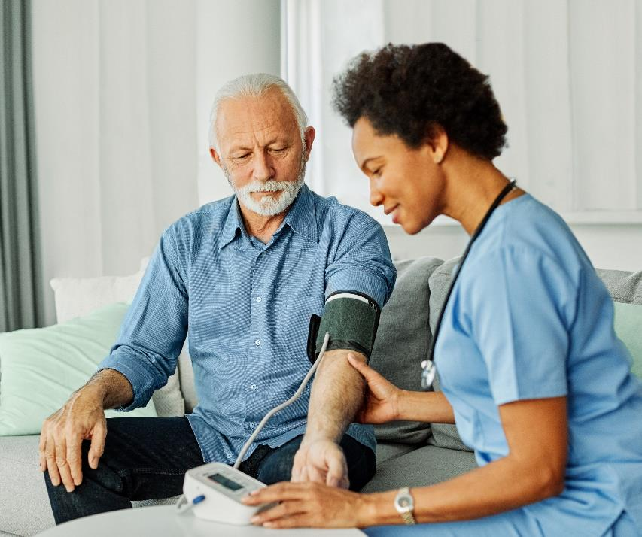
Introduction
Introduction
Look at the picture on the left.
What is happening here?
Read the SOP.
In groups, discuss your initial ideas about what a SOP is.
What is the purpose of this SOP?
Why do you think they are used in healthcare?
Resources needed
NHS Scotland blood pressure SOP:
https://www.clinicalguidelines.scot.nhs.uk/nhsggc-guidelines/nhsggc-guidelines/kidney-diseases/sop-manual-doppler-blood-pressure/
Lesson 1: What is a standard operating procedure (SOP)?
Notes:
NHS Scotland blood pressure SOP: https://www.clinicalguidelines.scot.nhs.uk/nhsggc-guidelines/nhsggc-guidelines/kidney-diseases/sop-manual-doppler-blood-pressure/
Image © Shutterstock/pics five

Slide 4
Introduction
Introduction
A SOP is a set of sequential steps or instructions designed to standardise the approach to a process or action.
It is important everyone follows SOPS to:
  maintain health and safety
  enable consistency of approach
  meet any legal or organisational requirements
  uphold industry standards
  demonstrate compliance for audit purposes.
Lesson 1: What is a standard operating procedure (SOP)?

Slide 5
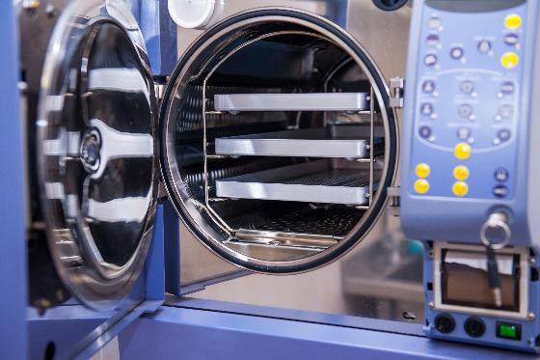
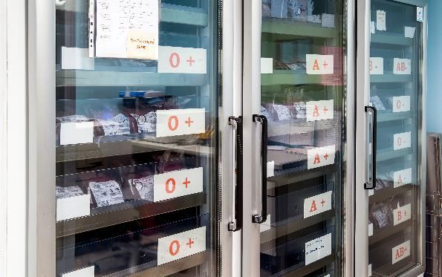
Purpose of SOPs
Activity 1
Look at the images below.
Identify what each image shows and why it needs a SOP.
Click on the image to read the SOP.
1
2
Lesson 1: What is a standard operating procedure (SOP)?
Notes:
Picture 1 = https://www.pharmaguideline.com/2008/04/sop-for-autoclave.html (SOP for autoclave)
Image © Shutterstock/Okrasiuk
Picture 2 = https://www.plymouthhospitals.nhs.uk/blood-bank/ (Blood bank information)
Image © Shutterstock/ANTONIO TRUZZI

Slide 6
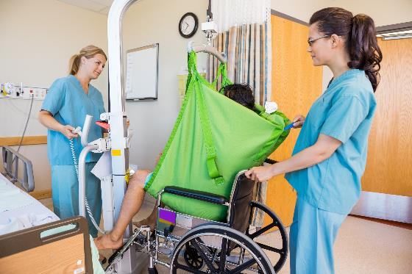
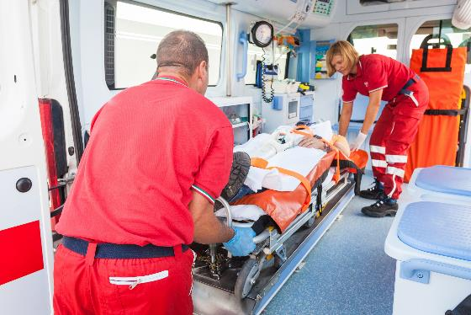
Purpose of SOPs
Activity 1
Look at the images below.
Identify what each image shows and why it needs a SOP.
Click on the image to read the SOP.
3
4
Lesson 1: What is a standard operating procedure (SOP)?
Notes:
Picture 3 = https://www.widgetlibrary.knowledge.scot.nhs.uk/media/WidgetFiles/1010876/D0.05%20Lifts%20procedures.pdf (SOP on using a hoist)
Image © Shutterstock/Tyler Olson
Picture 4 = https://www.tewv.nhs.uk/wp-content/uploads/2021/11/Manual-handling-of-objects.pdf
Image © Shutterstock/William Perugini

Slide 7
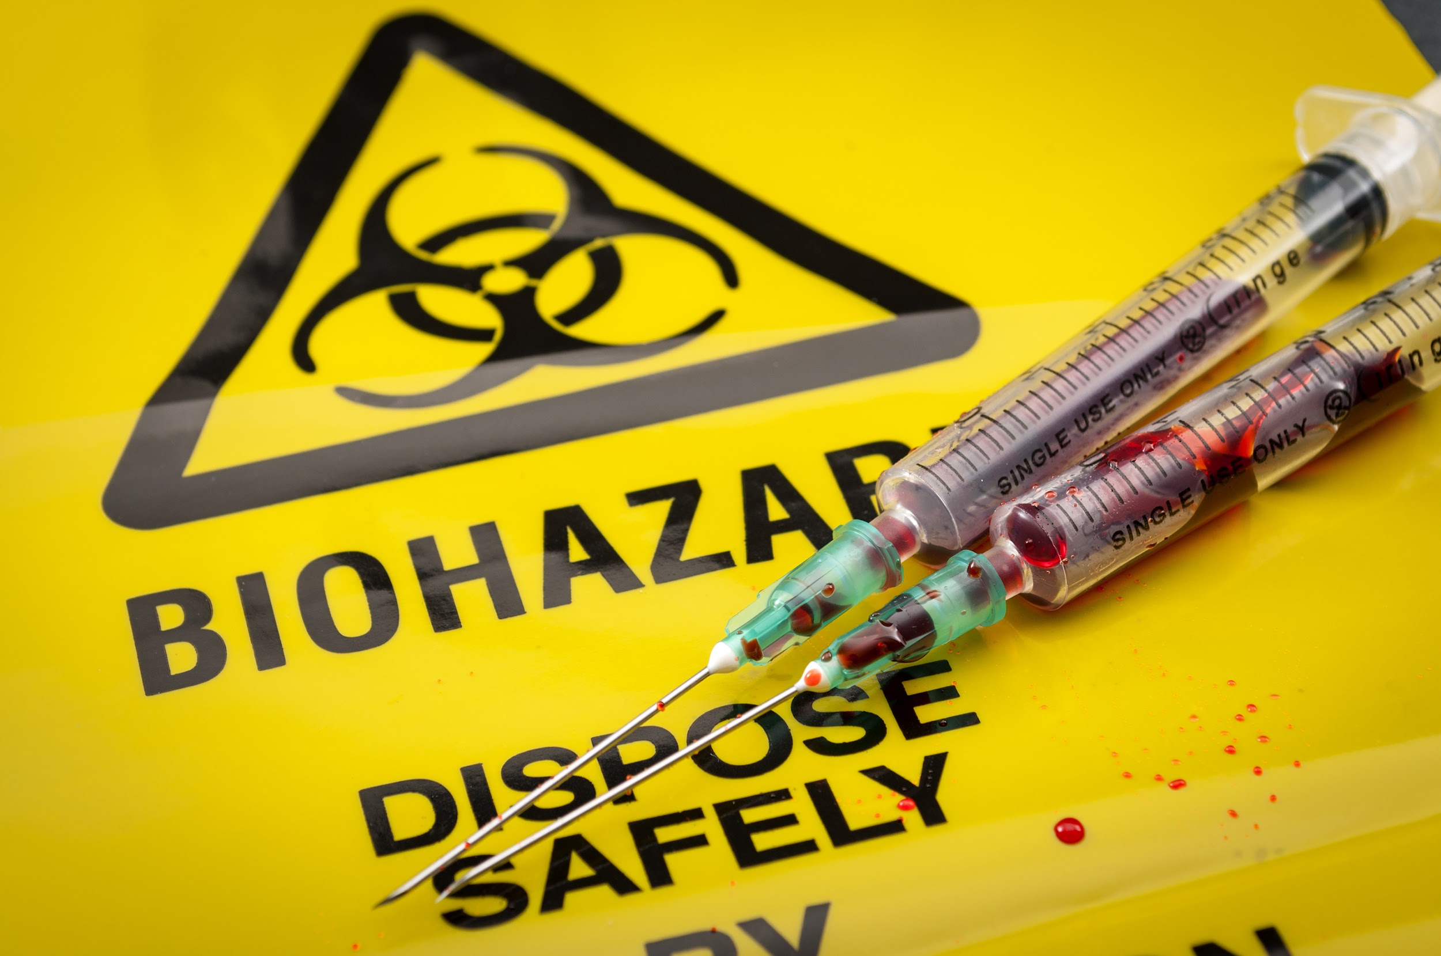
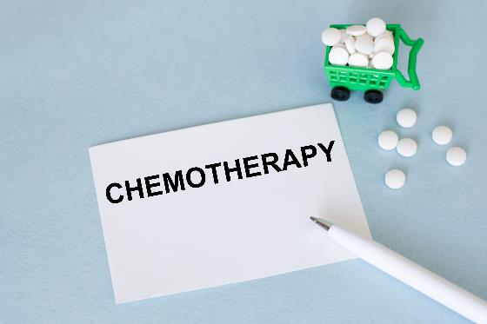
Purpose of SOPs
Activity 1
Look at image 5. What is a biohazard and why does it need a SOP for disposal? Find a SOP online for tissue sample disposal. Compare it with what you have learned so far.
Explain why chemotherapy drugs need a SOP for what to do if a spillage occurs.
Click on the image to read the SOP.
5
6
Lesson 1: What is a standard operating procedure (SOP)?
Notes:
Picture 5 - Image © Shutterstock/Victor Moussa
Picture 6 = https://www.england.nhs.uk/mids-east/wp-content/uploads/sites/7/2018/04/spillage-of-cytotoxic-and-anti-cancer-drugs.pdf (SOP on spillage of anti-cancer drugs)
Image © Shutterstock/Volha Barysevich

Slide 8
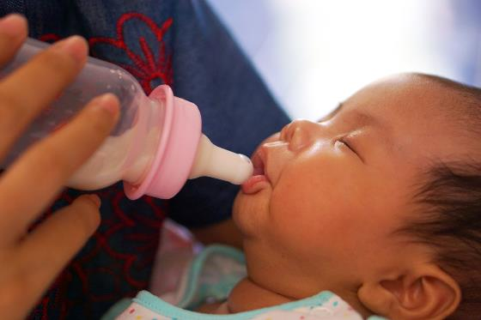
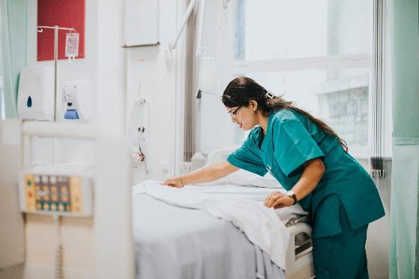
Purpose of SOPs
Activity 1
Look at the images below.
Explain why you need a SOP to make a bottle of formula for a baby.
Describe why you need a SOP for cleaning and making hospital beds.
Click on the image to read the SOP.
7
8
Lesson 1: What is a standard operating procedure (SOP)?
Notes:
Picture 7 = https://www.unicef.org.uk/babyfriendly/baby-friendly-resources/bottle-feeding-resources/guide-to-bottle-feeding/ (with permission)
Image © Shutterstock/sarawut muensang
Picture 8 = https://www.nursesclass.com/2021/04/bed-making.html
Image © Shutterstock/Rawpixel.com

Slide 9
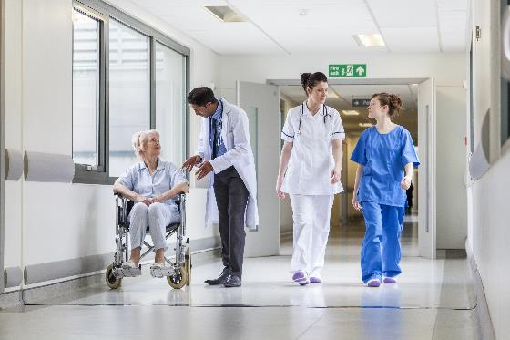
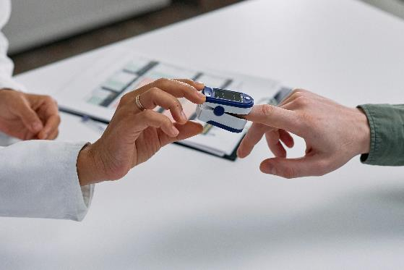
Purpose of SOPs
Activity 1
Look at the images below.
Identify what each image shows and why it needs a SOP.
Click on the image to read the SOP.
9
10
Lesson 1: What is a standard operating procedure (SOP)?
Notes:
Picture 9 = https://www.england.nhs.uk/coronavirus/documents/uniforms-and-workwear-guidance-for-nhs-employers/ (Uniforms and workwear information)
Image © Shutterstock/Spotmatik Ltd
Picture 10 = https://www.gov.uk/guidance/the-use-and-regulation-of-pulse-oximeters-information-for-healthcare-professionals (SOP for oximeter)
Image © Pexels/cottonbro studio

Slide 10
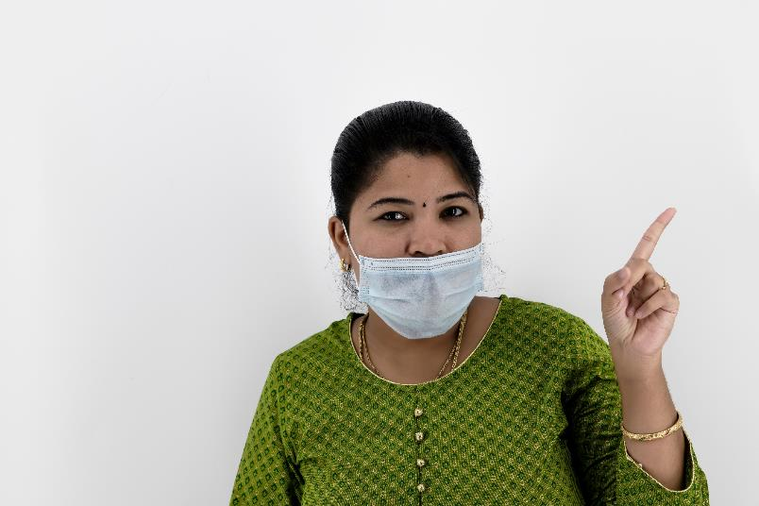
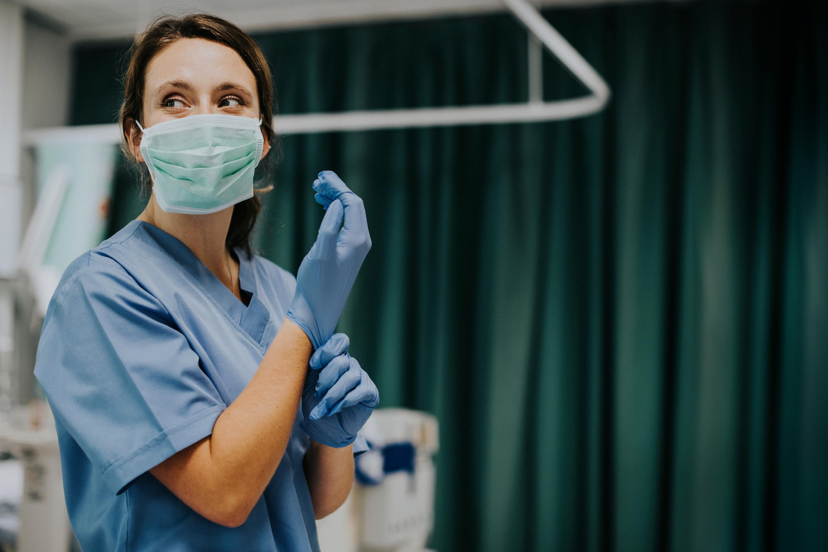
Principles of good practice
Activity 2
What principle is being shown?
Use PPE correctly
Lesson 1: What is a standard operating procedure (SOP)?
Notes:
Image © Shutterstock/Kiri Photography
Image © Shutterstock/Rawpixel.com

Slide 11
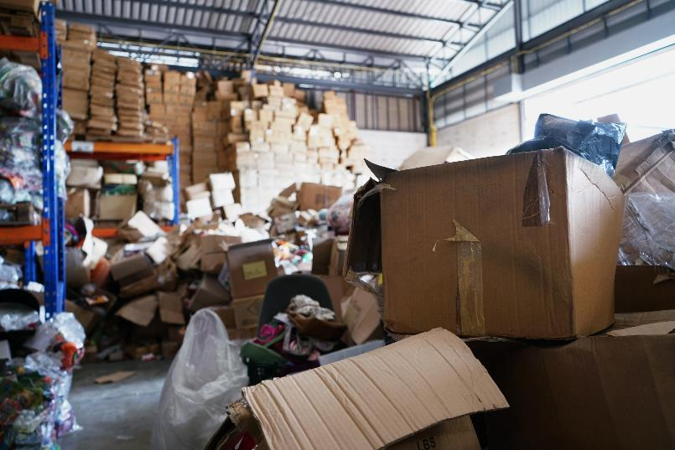

Principles of good practice
Activity 2
What principle is being shown?
Store materials appropriately
Lesson 1: What is a standard operating procedure (SOP)?
Notes:
Image © Shutterstock/TaraPatta
Image © Shutterstock/vichie81

Slide 12
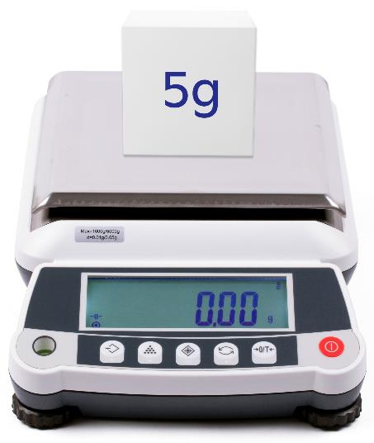
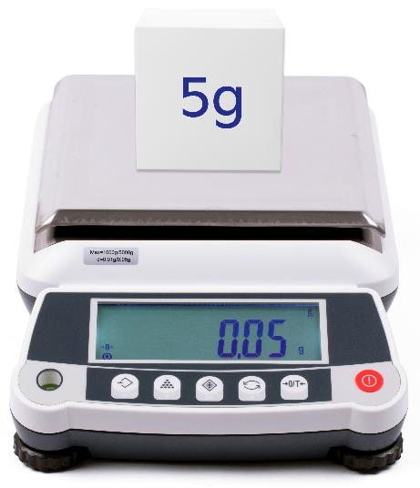
Principles of good practice
Activity 2
What principle is being shown?
Calibrate and maintain equipment
Lesson 1: What is a standard operating procedure (SOP)?
Notes:
Image © Shutterstock/litchima

Slide 13
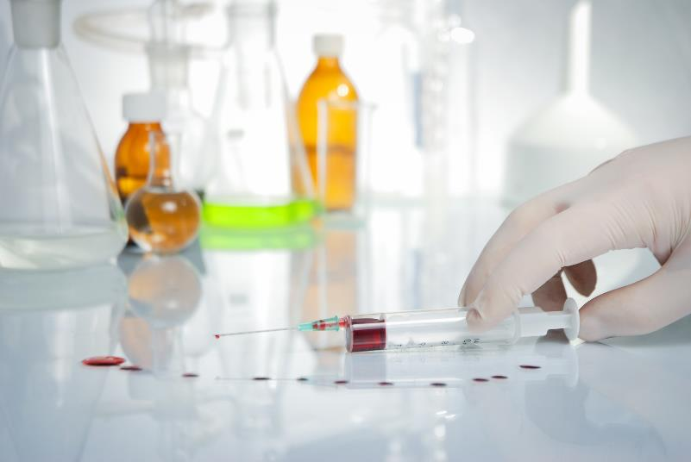
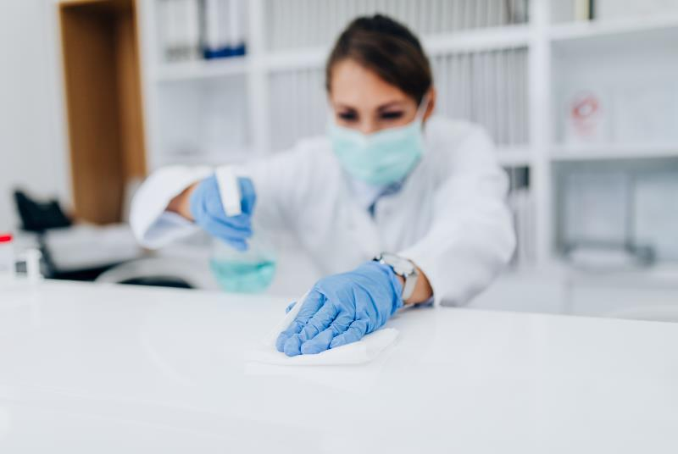
Principles of good practice
Activity 2
What principle is being shown?
Maintain work areas
Lesson 1: What is a standard operating procedure (SOP)?
Notes:
Image © Shutterstock/Anastasiia Lieonova
Image © Shutterstock/hedgehog94

Slide 14
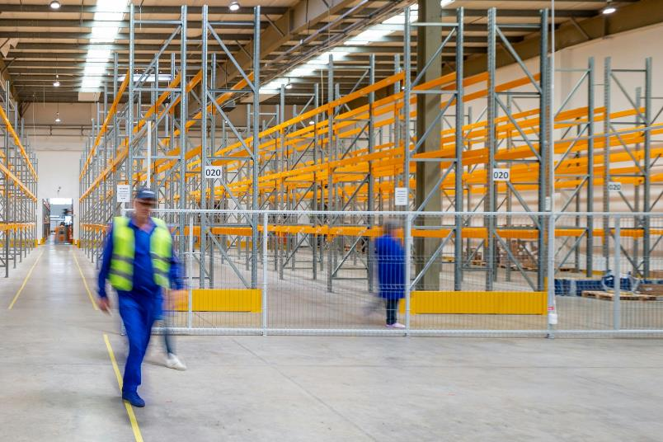

Principles of good practice
Activity 2
What principle is being shown?
Effectively manage stock levels
Lesson 1: What is a standard operating procedure (SOP)?
Notes:
Image © Unsplash/Adrian Sulyok
Image © Shutterstock/Shutter.B

Slide 15
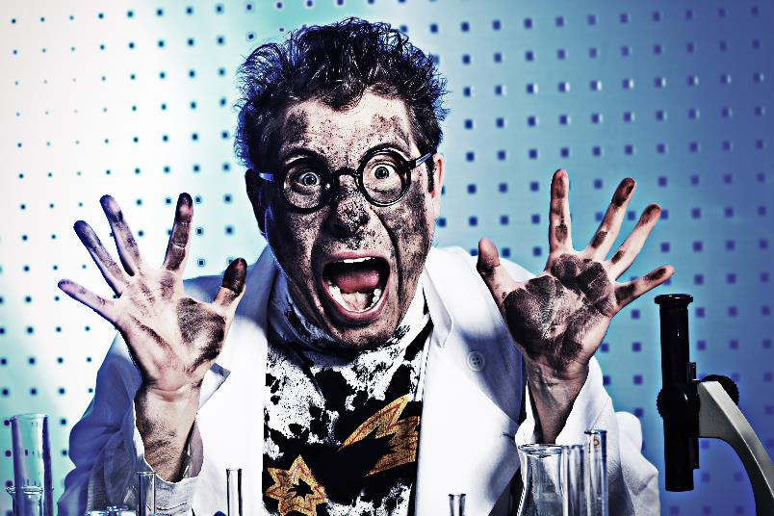

Principles of good practice
Activity 2
What principle is being shown?
Use standard operating procedures (SOPs)
Lesson 1: What is a standard operating procedure (SOP)?
Notes:
Image © Shutterstock/Kiselev Andrey Valerevich
Image © Shutterstock/tilialucida

Slide 16

Five key principles of good practice
Activity 2
Store materials and chemicals appropriately
Calibrate and maintain equipment
Maintain work areas
Effectively manage stock levels
Use standard operating procedures (SOPs)
Lesson 1: What is a standard operating procedure (SOP)?

Slide 17

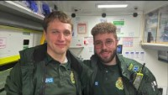
Principles of good practice
Activity 2
Watch these case studies and identify the principles of good practice shown in each one.
Case study 1: A day in the life of an NHS nurse
Case study 2: A day in the life of an ambulance crew
Lesson 1: What is a standard operating procedure (SOP)?
Notes:
Case study 1 (A day in the life of an NHS nurse): www.youtube.com/watch?v=CfVmGIojfX4
Case study 2 (A day in the life of an ambulance crew): www.youtube.com/watch?v=Zn2wyzOMqe0
East Midlands Ambulance Service NHS Trust

Slide 18
What could go wrong?
Activity 3
The following slides show a number of different scenarios where good practice has not been followed.
For each scenario, consider what could go wrong and how you could rectify the situation/prevent it having occurred.
Lesson 1: What is a standard operating procedure (SOP)?

Slide 19
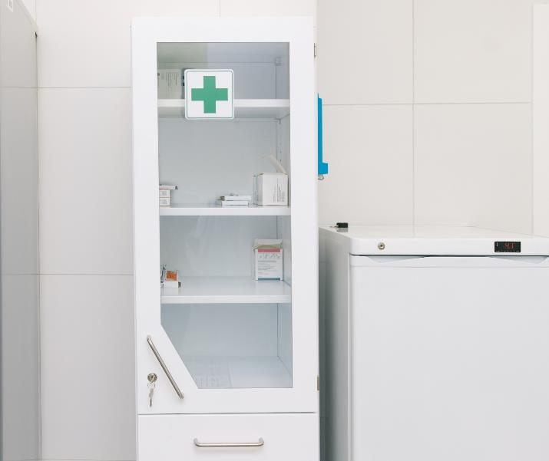
Scenario 1
Activity 3
You have lost the keys to a medicine cabinet.
What could go wrong?
How could the situation be rectified or prevented from happening?
Other questions to consider:
What should you do?
What are the consequences of not reporting it straight away?
Lesson 1: What is a standard operating procedure (SOP)?
Notes:
Image © Shutterstock/ml_photo

Slide 20
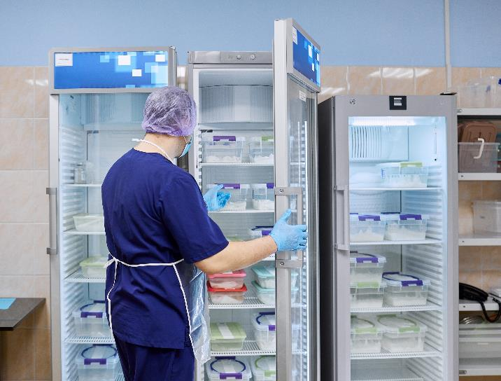
Scenario 2
Activity 3
The staff fridge is full, so you put your packed lunch into the medicine refrigerator for a short time.
What could go wrong?
How could the situation be rectified or prevented from happening?
Other questions to consider:
Is this acceptable?
What might the consequences be?
Lesson 1: What is a standard operating procedure (SOP)?
Notes:
Image © Shutterstock/Sergei Anishchenko

Slide 21
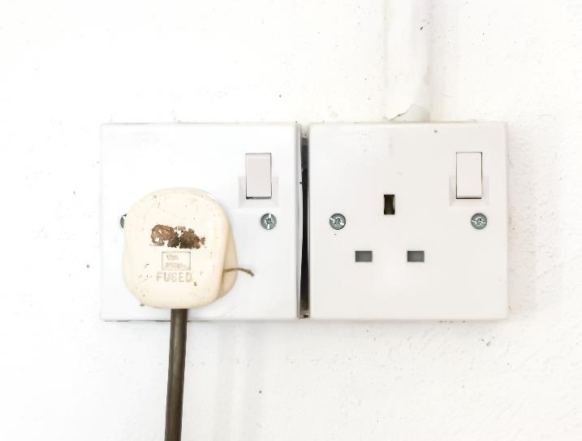
Scenario 3
Activity 3
You notice that the medicine refrigerator has been turned off. It still feels cold inside, so it probably hasn’t been switched off for long.
What could go wrong?
How could the situation be rectified or prevented from happening?
Other questions to consider:
Should you just turn it on again?
What are the possible consequences if you do not report it immediately?
Lesson 1: What is a standard operating procedure (SOP)?
Notes:
Image © Shutterstock/Ekahardiwito

Slide 22
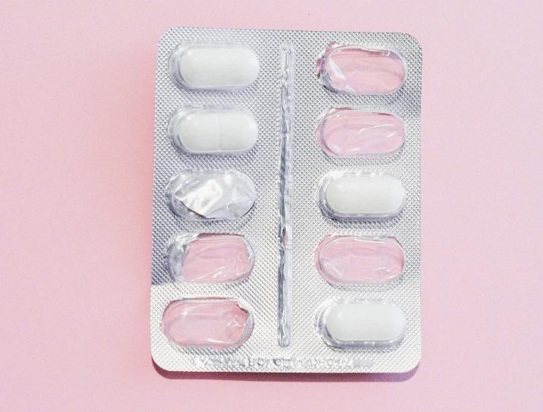
Scenario 4
Activity 3
Some drugs have gone missing from the cabinet. There are some incomplete packets.
You saw a senior colleague go into the drugs cabinet just before you checked.
What could go wrong?
How could the situation be rectified or prevented from happening?
Other questions to consider:
What should you do?
Should you challenge them?
Lesson 1: What is a standard operating procedure (SOP)?
Notes:
Image © Pexels/SHVETS production

Slide 23
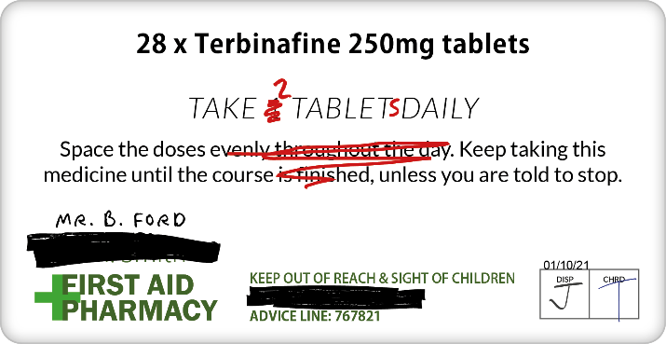
Scenario 5
Activity 3
A prescription has been altered by someone writing on it. You have been told to give the drugs to the patient whose name has been written on the prescription by hand.
What could go wrong?
How could the situation be rectified or prevented from happening?
Other questions to consider:
What should you do?
What could be the consequences?
Lesson 1: What is a standard operating procedure (SOP)?

Slide 24
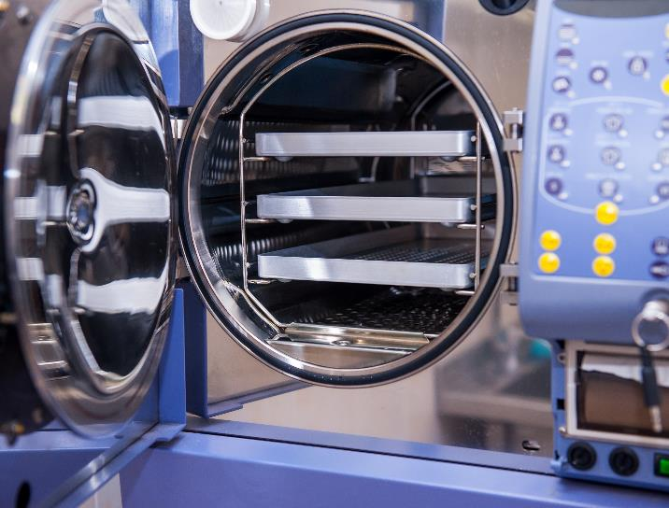
Scenario 6
Activity 3
A senior colleague has told you how to use the autoclave to sterilise a microbiology plate. They tell you that you do not need to use the SOP as they have done it loads of times.
What could go wrong?
How could the situation be rectified or prevented from happening?
Other questions to consider:
What should you do?
Lesson 1: What is a standard operating procedure (SOP)?
Notes:
Image © Shutterstock/Okrasiuk

Slide 25
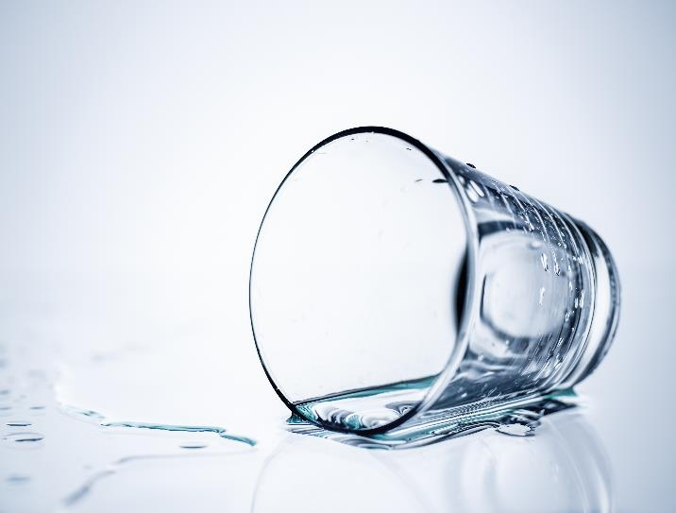
Scenario 7
Activity 3
There is a drinking glass on its side on the laboratory workbench and a spilled liquid that looks like water around it. There is an SOP on how to deal with chemical spills.
What could go wrong?
How could the situation be rectified or prevented from happening?
Other questions to consider:
Should you assume it is water?
What should you do?
Lesson 1: What is a standard operating procedure (SOP)?
Notes:
Image © Shutterstock/Makitalo

Slide 26
Consequences of not following good practice: Chemical Handling
Activity 3
Failure to follow SOPs for chemical handling resulted in a laboratory accident at the University of California, Los Angeles (UCLA) in 2008. A research assistant was working with a highly reactive compound called tert-Butyllithium without using proper safety precautions. The compound reacted violently with air, causing an explosion and subsequent fire that resulted in the death of the assistant, and injuries to other researchers.
Lesson 1: What is a standard operating procedure (SOP)?
Notes:
Source: www.wikipedia.org/wiki/Sheri_Sangji_case

Slide 27
Consequences of not following good practice: Hazardous Biological materials
Activity 3
In 2014, a laboratory accident occurred at the Centers for Disease Control and Prevention (CDC) in the United States. A mishandling of potentially live anthrax samples due to failure to follow proper SOPs resulted in the potential exposure of over 80 CDC employees to the bacterium. Although no one was seriously ill, the incident emphasised the critical importance of adhering to SOPs when working with hazardous biological materials.
Lesson 1: What is a standard operating procedure (SOP)?
Notes:
Source: https://archive.cdc.gov/#/details?url=https://www.cdc.gov/media/releases/2014/p0711-lab-safety.html

Slide 28
Multiple-choice questions
Plenary
Which of the following is a primary benefit of using standard operating procedures (SOPs) in healthcare?
Consistency in clinical practices and procedures
Increase in medical research funding
Improvement in facility aesthetics and ambience
Reduction in patient wait times
(1 mark)
Lesson 1: What is a standard operating procedure (SOP)?

Slide 29
Multiple-choice questions
Plenary
Which of the following is a primary benefit of using standard operating procedures (SOPs) in healthcare?
Consistency in clinical practices and procedures
Increase in medical research funding
Improvement in facility aesthetics and ambience
Reduction in patient wait times
(1 mark)
Answers
AO1
A – Consistency in clinical practices and procedures
Lesson 1: What is a standard operating procedure (SOP)?

Slide 30
Multiple-choice questions
Plenary
Which of the following best describes the purpose of using standard operating procedures (SOPs) for manual handling?
To effectively manage stock levels
To enhance communication within the organisation
To ensure compliance with regulatory requirements
To minimise the risk of injuries and accidents
(1 mark)
Lesson 1: What is a standard operating procedure (SOP)?

Slide 31
Multiple-choice questions
Plenary
Which of the following best describes the purpose of using standard operating procedures (SOPs) for manual handling?
To effectively manage stock levels
To enhance communication within the organisation
To ensure compliance with regulatory requirements
To minimise the risk of injuries and accidents
(1 mark)
Answers
AO1
D - To minimise the risk of injuries and accidents
Lesson 1: What is a standard operating procedure (SOP)?

Slide 32
In this lesson, we have:
Plenary
Described what a standard operating procedure (SOP) is and why their use is essential.
Stated the key principles of good practice in scientific and clinical settings.
Discussed potential consequences of not following good practice in scientific and clinical settings.
Skills:
CS3.2 Undertake collaborative work demonstrating an ability to follow standard operating procedure specific to the environment they are working in.
General competencies:
English:
GEC4 Summarise information/ideas
GEC6 Take part in/lead discussions
Lesson 1: What is a standard operating procedure (SOP)?

Slide 33
Consolidation
Consolidation
Critique elements of a healthcare SOP. Which parts are useful? What could be improved?
Alternatively, write a SOP for using a piece of standard laboratory equipment which you are confident in using, such as a light microscope or a practical procedure. Use the template on the worksheet.
Resources needed
A healthcare SOP
Consolidation Worksheet
Lesson 1: What is a standard operating procedure (SOP)?

