Slide 1
Science
Route: Health and Science
Topic: Health, safety and environmental regulations and practice
Lesson 4: Biohazards and their containment
Notes:
Image © iStockphoto/sanjeri

Slide 2
In this lesson we will:
Introduction
Recall and identify the four different biohazard categories, including examples of each.
Describe the containment measures required for the four different categories of biohazard.
Skills:
CS3.1: Identifying their own role in relation to the wider team, including establishing own accountability for tasks and deliverables, and establishing own and others’ area of expertise
CS3.2: Meet their responsibilities when working in a wider team by ensuring that project is compliant with relevant health and safety requirements (for example, if storing and handling hazardous substances)
CS5.1: Solve a problem within a science context, by evaluating the impact and continuing to monitor any changes and making recommendations for further improvement
General competencies:
English:
GEC2: Present information and ideas
GEC3: Create texts for different purposes and audiences
GEC4: Summarise information/ideas
GEC6: Take part in/lead discussions
Maths:
GMC6: Understanding data and risk
Lesson 4: Biohazards and their containment

Slide 3
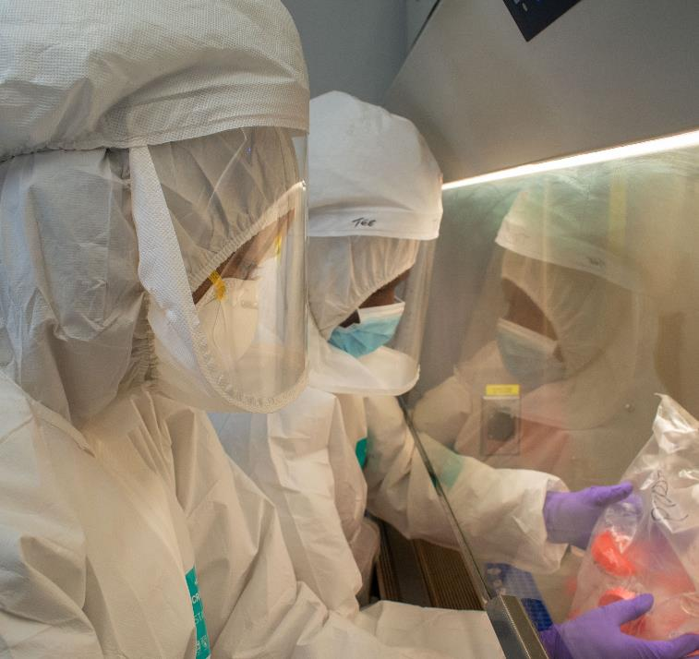
Biohazard containment scenario
Introduction
A business has been regularly working with common cold cell cultures but is investigating the possibility of working with HIV samples.
Determine which Hazard Group both these biohazards belong to and discuss whether this is likely to be a straightforward switch for the business, or if further measures will need to be put in place first.
THINK, PAIR, SHARE
Think about the differences in the descriptions of the Hazard Groups: what containment/control measures are likely to be necessary for each biohazard?
Lesson 4: Biohazards and their containment
Notes:
Image © Shutterstock/Delali Adogla-Bessa

Slide 4

Containment measures – Option 1
Activity 1
Live video chat with, or visit from, an industry professional about
containment measures.
Make notes on the different CLs discussed, and any differences in containment measures for the four CLs mentioned.
Lesson 4: Biohazards and their containment
Notes:
Image © Shutterstock/Tirachard Kumtanom

Slide 5

Containment measures – Option 1
Activity 1
Questions for an industry professional about containment measures:
What biohazards do you face on a daily basis?
Are you expected to wear PPE in the laboratory?
How long does it take your laboratory workers
to enter the lab?
Are there any entry or exit procedures needed?
(See the next slide for more questions.)
Lesson 4: Biohazards and their containment

Slide 6
Containment measures – Option 1
Activity 1
Questions continued:
Who oversees cleaning up spills?
What is the clean-up process?
Is the lab cleaned regularly?
How does your organisation stop potential
biohazards spreading into the rest of the
building or the environment?
What are your disposal procedures when you
have finished with a sample of a hazardous material?
Resources needed
Students’ completed copies of L3 Activity 2 Worksheet 2
Lesson 4: Biohazards and their containment

Slide 7

Containment measures – Option 2
Activity 1
Resources needed
Students’ completed copies of L3 Activity 2 Worksheet 2
Containment levels 1-4
Watch this video and make additional notes about the differences between containment levels 1–4 and the different protocols required for each.
Lesson 4: Biohazards and their containment
Notes:
Containment Levels 1-4 video: https://vimeo.com/1069552186

Slide 8
Containment measures – Option 3
Activity 1
Use slides 11–19 of Activity 2 to discuss
the different safety processes, protocols
and containment measures found in
CL1–4 laboratories.
Improve your notes/mind map/table
from Lesson 3 by including additional
information elicited from the slides.
Resources needed
Students’ completed copies of L3 Activity 2 Worksheet 2
Lesson 4: Biohazards and their containment

Slide 9

Containment level - Quiz
Activity 1
Watch this video and answer the True/False questions to test your knowledge on the four containment levels.
Containment levels - Quiz
Lesson 4: Biohazards and their containment
Notes:
Containment Levels - Quiz video: https://vimeo.com/1069550324

Slide 10
Comparing containment measures
Activity 2
Each group has three minutes to write down
as much information as they can about their given CL on their flip chart paper.
Then, in your group, rotate around the room
to the other CLs. You will have three
minutes to read through the information
already noted about that CL. You should
add in additional notes about that CL.
Keep rotating until you have visited all
four CLs.
Think about
Levels of personal protective equipment (PPE)
Laboratory location within building, and access and entry control measures
Required laboratory facilities and capabilities
Specific waste removal and disposal capabilities
Resources needed
L4 Activity 2 Teachers Notes
Lesson 4: Biohazards and their containment

Slide 11
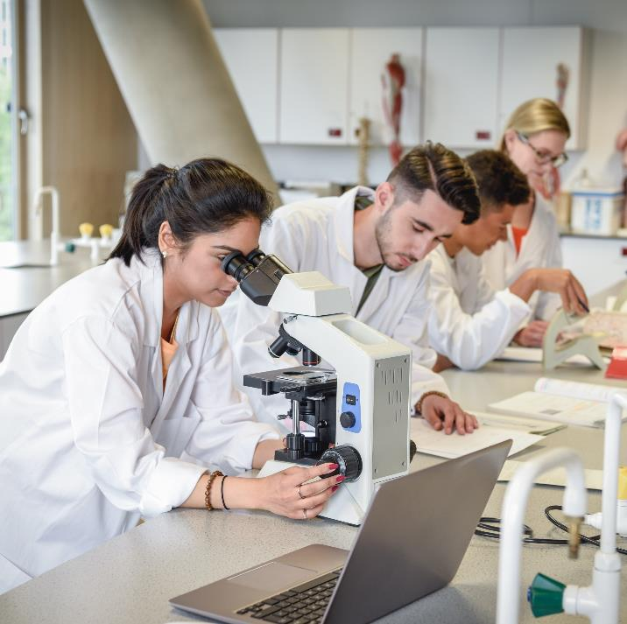
Hazard Group 1
Activity 2
Unlikely to cause harm to humans
Very unlikely to spread to the community
Cell lines that have been safely used
for years
Non-pathogenic strains of some bacteria/viruses
Disabled strains of bacteria/viruses
Attenuated strains of bacteria/viruses
Lesson 4: Biohazards and their containment
Notes:
Image © iStockphoto/JohnnyGrieg
Contains information from the Control of Substances Hazardous to Health Regulations 2002 https://www.legislation.gov.uk/uksi/2002/2677/schedule/3
All content is available under the Open Government Licence v3.0 except where otherwise stated. This site additionally contains content derived from EUR-Lex, reused under the terms of the Commission Decision 2011/833/EU on the reuse of documents from the EU institutions. For more information see the EUR-Lex public statement on re-use.

Slide 12
Hazard Group 1 = Containment Level 1 (CL-1)
Activity 2
Usual good aseptic techniques:
no cross contamination
Usual good microbiological techniques
Usual good laboratory practices:
no eating and drinking in the lab, etc.
Basic safety measures:
safety glasses, lab coats, good handwashing techniques, etc.
Lesson 4: Biohazards and their containment
Notes:
Image © iStockphoto/JohnnyGrieg
Contains information from the Control of Substances Hazardous to Health Regulations 2002 https://www.legislation.gov.uk/uksi/2002/2677/schedule/3
All content is available under the Open Government Licence v3.0 except where otherwise stated. This site additionally contains content derived from EUR-Lex, reused under the terms of the Commission Decision 2011/833/EU on the reuse of documents from the EU institutions. For more information see the EUR-Lex public statement on re-use.

Slide 13
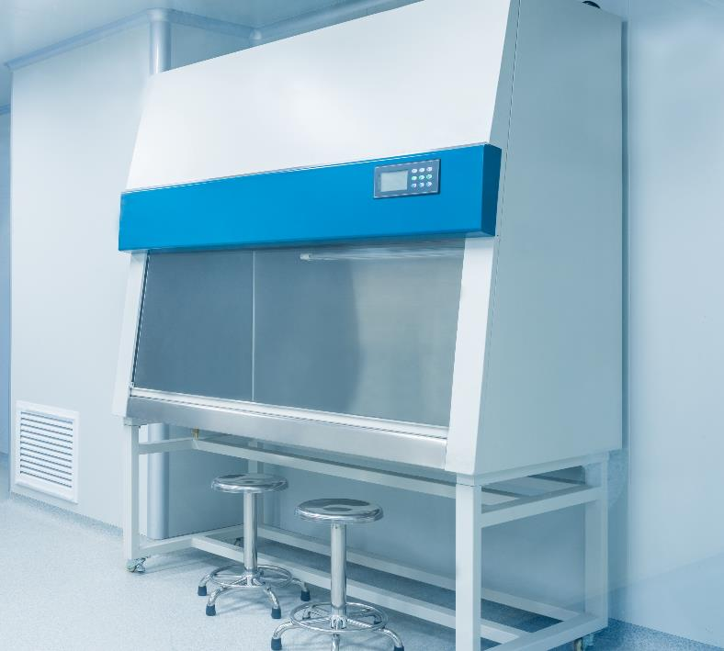
Hazard Group 2
Activity 2
Can cause human disease
May be a hazard to lab workers
Likelihood of infection spreading
to the community is low
There are usually effective vaccines
or treatments available
Lesson 4: Biohazards and their containment
Notes:
Image © Shutterstock/hrui
Contains information from the Control of Substances Hazardous to Health Regulations 2002 https://www.legislation.gov.uk/uksi/2002/2677/schedule/3
All content is available under the Open Government Licence v3.0 except where otherwise stated. This site additionally contains content derived from EUR-Lex, reused under the terms of the Commission Decision 2011/833/EU on the reuse of documents from the EU institutions. For more information see the EUR-Lex public statement on re-use.

Slide 14
Hazard Group 2 = Containment Level 2 (CL-2)
Activity 2
Same as Containment Level 1 but with
additional measures
Some control over the movement and release
of possible pathogen vectors
A separate controlled working area with limited access to authorised personnel only
Viable microorganisms are contained within
a closed system
Some decontamination and more in-depth
cleaning facilities.
Lesson 4: Biohazards and their containment
Notes:
Image © Shutterstock/hrui
Contains information from the Control of Substances Hazardous to Health Regulations 2002 https://www.legislation.gov.uk/uksi/2002/2677/schedule/3
All content is available under the Open Government Licence v3.0 except where otherwise stated. This site additionally contains content derived from EUR-Lex, reused under the terms of the Commission Decision 2011/833/EU on the reuse of documents from the EU institutions. For more information see the EUR-Lex public statement on re-use.

Slide 15
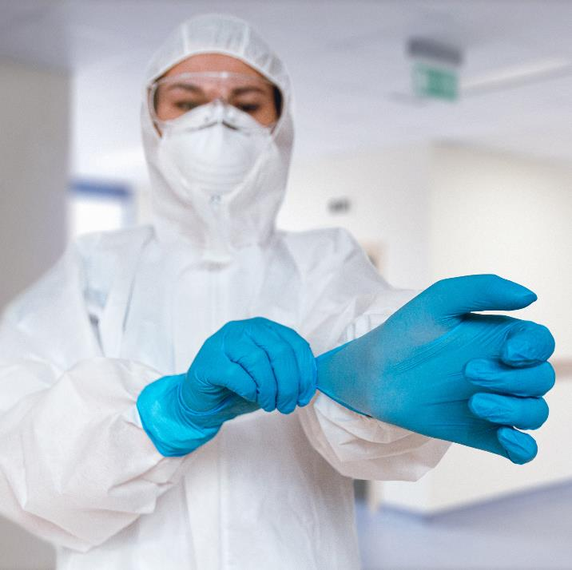
Hazard Group 3
Activity 2
Can cause severe human disease
Can be a serious hazard to lab workers
Infection may spread to the community
There are usually effective vaccines
or treatments available
Lesson 4: Biohazards and their containment
Notes:
Image © Shutterstock/perfectlab
Contains information from the Control of Substances Hazardous to Health Regulations 2002 https://www.legislation.gov.uk/uksi/2002/2677/schedule/3
All content is available under the Open Government Licence v3.0 except where otherwise stated. This site additionally contains content derived from EUR-Lex, reused under the terms of the Commission Decision 2011/833/EU on the reuse of documents from the EU institutions. For more information see the EUR-Lex public statement on re-use.

Slide 16
Hazard Group 3 = Containment Level 3 (CL-3)
Activity 2
Same as Containment Level 2 but with
additional measures
Stricter limits on what may leave the controlled
working area, including HEPA filtered extract air and
no release of microorganisms from the closed system
The workplace is under negative air pressure
Personnel wear protective clothing and there is
optional showering
There should also be an observation window so occupants of the working area can be seen
The workplace should also be sealable to permit disinfection and/or optional fumigation
Lesson 4: Biohazards and their containment
Notes:
Image © Shutterstock/perfectlab
Contains information from the Control of Substances Hazardous to Health Regulations 2002 https://www.legislation.gov.uk/uksi/2002/2677/schedule/3
All content is available under the Open Government Licence v3.0 except where otherwise stated. This site additionally contains content derived from EUR-Lex, reused under the terms of the Commission Decision 2011/833/EU on the reuse of documents from the EU institutions. For more information see the EUR-Lex public statement on re-use.

Slide 17
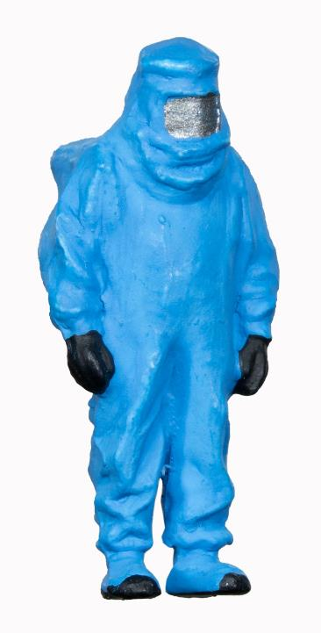
Hazard Group 4
Activity 2
Causes severe human disease
Is a serious hazard to lab workers
Infection is likely to spread
to communities
No effective vaccines or
treatments available
No effective preventative methods
Lesson 4: Biohazards and their containment
Notes:
Image © Shutterstock/TRADOL
Contains information from the Control of Substances Hazardous to Health Regulations 2002 https://www.legislation.gov.uk/uksi/2002/2677/schedule/3
All content is available under the Open Government Licence v3.0 except where otherwise stated. This site additionally contains content derived from EUR-Lex, reused under the terms of the Commission Decision 2011/833/EU on the reuse of documents from the EU institutions. For more information see the EUR-Lex public statement on re-use.

Slide 18
Hazard Group 4 = Containment Level 4 (CL-4)
Activity 2
Same as Containment Level 3 but with additional measures
Complete control over what goes into and out of the
controlled working area
Negative air pressure, with air being filtered with a HEPA or
equivalent filter on input, and then doubly filtered on extract
Personnel completely change their clothes to protective
clothing and then shower when leaving the controlled area
All waste (effluent) from sinks and showers is collected and inactivated before release
Access to the controlled area is restricted to authorised persons via air-lock key procedure and biological agents are stored securely
The controlled area must also be sealable to permit fumigation
Lesson 4: Biohazards and their containment
Notes:
Image © Shutterstock/TRADOL
Contains information from the Control of Substances Hazardous to Health Regulations 2002 https://www.legislation.gov.uk/uksi/2002/2677/schedule/3
All content is available under the Open Government Licence v3.0 except where otherwise stated. This site additionally contains content derived from EUR-Lex, reused under the terms of the Commission Decision 2011/833/EU on the reuse of documents from the EU institutions. For more information see the EUR-Lex public statement on re-use.

Slide 19
CL1–4 Summary
Activity 2
CL-1: Usual good aseptic/microbiological techniques and laboratory practices, as well as basic
safety measures.
CL-2: Control of possible pathogen vectors within a closed system. A separate controlled working
area with limited access. Decontamination and more in-depth cleaning facilities.
CL-3: Stricter limits on what may leave the controlled working area and no release of microorganisms
from the closed system. Negative air pressure and workplace sealable to permit disinfection and/or fumigation. Personnel wear PPE and there is optional showering, as well as an observation window.
CL-4: Complete control over the controlled working area. Negative air pressure with air being filtered
on input and then doubly filtered on extract. Personnel completely change to PPE and then shower
when leaving. All waste (effluent) from sinks and showers is inactivated before release. Access to the controlled area is restricted to authorised persons. The controlled area must also be sealable to
permit fumigation.
Lesson 4: Biohazards and their containment
Notes:
Contains information from the Control of Substances Hazardous to Health Regulations 2002 https://www.legislation.gov.uk/uksi/2002/2677/schedule/3
All content is available under the Open Government Licence v3.0 except where otherwise stated. This site additionally contains content derived from EUR-Lex, reused under the terms of the Commission Decision 2011/833/EU on the reuse of documents from the EU institutions. For more information see the EUR-Lex public statement on re-use.

Slide 20
Study question
Plenary
Complete the study question independently:
A company has been regularly working with common cold cell cultures.
The lab currently limits the movement of pathogen vectors and work is undertaken within closed systems and in a biological safety cabinet (BSC).
There is restricted access to the laboratory and lab workers are provided with a lab coat to put on over their clothes before entry to the lab. The organisation is investigating the possibility of starting some work on some HIV samples.
Explain two changes the lab would need to make before starting this work. [4 marks]
Lesson 4: Biohazards and their containment

Slide 21
Study question sample answer
Plenary
Mark scheme – award one mark per explanation point, up to a maximum of 4 marks.
Lab workers are likely to need a higher level of protective clothing [1 mark] to ensure adequate protection from the Group 3 hazardous substances they are working with [1 mark], and an anti-chamber or changing area would therefore also be required [1 mark] to allow workers to change out of their own clothes and avoid the risk of taking the hazardous substances out of the laboratory [1 mark].
Lesson 4: Biohazards and their containment

Slide 22
In this lesson we have:
Plenary
Recalled and identified the four different biohazard categories, including examples of each.
Described the containment measures required for the four different categories of biohazard.
Skills:
CS3.1: Identifying their own role in relation to the wider team, including establishing own accountability for tasks and deliverables, and establishing own and others’ area of expertise
CS3.2: Meet their responsibilities when working in a wider team by ensuring that project is compliant with relevant health and safety requirements (for example, if storing and handling hazardous substances)
CS5.1: Solve a problem within a science context, by evaluating the impact and continuing to monitor any changes and making recommendations for further improvement
General competencies:
English:
GEC2: Present information and ideas
GEC3: Create texts for different purposes and audiences
GEC4: Summarise information/ideas
GEC6: Take part in/lead discussions
Maths:
GMC6: Understanding data and risk
Lesson 4: Biohazards and their containment

