Slide 1
Science
Route: Health and Science
Topic: Good scientific and clinical practice
Lesson 4: Maintaining clean work areas, machinery and resources
Notes:
Image © Shutterstock/Gorodenkoff

Slide 2
In this lesson, we will:
Introduction
Describe the difference between contamination and cross-contamination.
Explain the importance of regular cleaning of work areas and equipment.
Analyse some potential consequences of incorrectly storing, cleaning and maintaining products, materials and equipment, and work areas.
Skills:
CS3.2: Meet their responsibilities when working in a wider team by ensuring that the project is compliant with relevant requirements/regulations/SOPs/time-scales
CS6.1 Provide results and recommendations (written and verbal) to customers/clients
General competencies:
English:
GEC1 Convey technical information to different audiences
GEC2 Present information and ideas
GEC3 Create texts for different purposes and audiences
Digital:
GDC1 Use digital technology and media effectively
Lesson 4: Maintaining clean work areas, machinery and resources

Slide 3
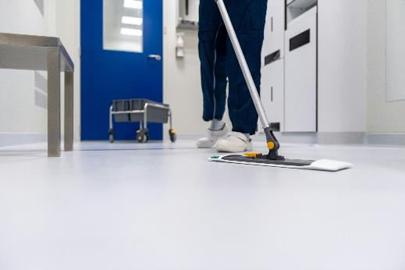
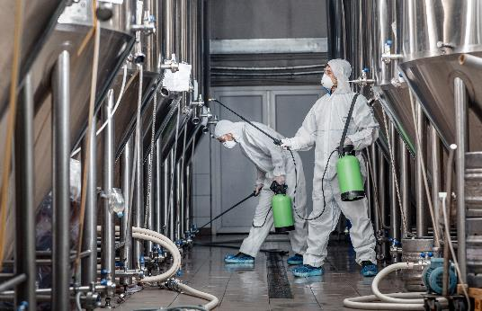
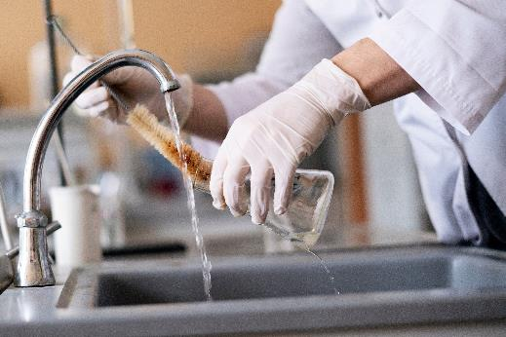
Why is cleaning important?
Introduction
Look at the three images.
Why is it important to regularly clean surfaces and equipment?
List as many reasons as you can.
Lesson 4: Maintaining clean work areas, machinery and resources
Notes:
Image © Unsplash/Toon Lambrechts
Image © Shutterstock/Prostock-studio
Image © Shutterstock/Mike_shots

Slide 4
Why is it important to regularly clean surfaces and equipment and prepare work areas for use?
Introduction
Cleaning surfaces – to avoid the spread of infection and health and safety issues involving spillages of toxic substances.
Cleaning laboratory glassware – to avoid issues with contamination/cross-contamination, which will prevent invalid results and the possible production of dangerous by-products.
Cleaning equipment – to avoid the spread of infection, to avoid any cross-contamination, to increase the function/lifespan of the equipment, to avoid damage to the equipment.
Preparation of work area – to increase efficiency and avoid increased costs and timescales if preparation is not complete.
Lesson 4: Maintaining clean work areas, machinery and resources

Slide 5

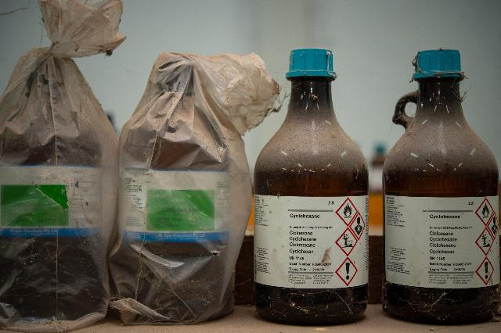
The importance of correct storage
Activity 1
It is important to store chemicals, materials and equipment carefully. For each of the following scenarios, decide:
What is the problem with the item being stored in this way?
What are the potential consequences of this?
Scenario 1
Scenario 2
Lesson 4: Maintaining clean work areas, machinery and resources
Notes:
Image © Shutterstock/Rabbitmindphoto
Image © Shutterstock/Robert Kneschke

Slide 6
The importance of correct storage
Activity 1
Incorrect storage can cause:
a health and safety risk to employees, for example:
from a spill/toxic gas release
spread of infection
or injury caused by lifting/reaching too high
cross-contamination
breakdown of limited stability products
loss of samples or degradation of reagents not stored at the correct temperature (such as in a fridge, freezer or at room temperature)
difficulties in locating stock which has been stored for extended periods of time – products may then exceed their expiry date (resulting in a financial loss as products have to be disposed of).
Lesson 4: Maintaining clean work areas, machinery and resources

Slide 7
Contamination and cross-contamination
Activity 2
Contamination – this refers to the unintentional introduction of a foreign body, material or microorganism into a product.
Cross-contamination – this refers to the contamination caused when the materials used in two or more processes, taking place at the same time, are accidentally introduced from one to another.
Lesson 4: Maintaining clean work areas, machinery and resources

Slide 8
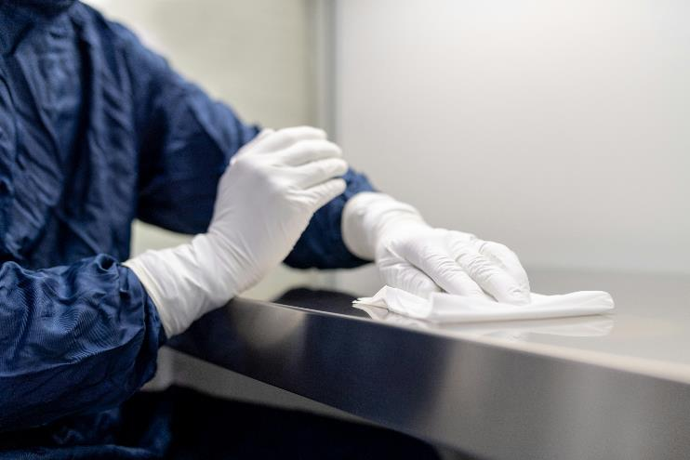
Contamination and cross-contamination
Activity 2
Examples:
If a batch of paint contains dust or dirt which fell into the batch during mixing, it would be said to be contaminated by the presence of those substances.
If a lab bench is not cleaned appropriately, it may become contaminated by hazardous materials.
Lesson 4: Maintaining clean work areas, machinery and resources
Notes:
Image © Shutterstock/Muenchbach

Slide 9

Contamination and cross-contamination
Activity 2
Examples:
When preparing raw meat, if hands and preparation equipment are not cleaned between handling different products, cross-contamination of microorganisms from the raw meat may occur.
During the serial dilution of a reagent, if the samples of different concentration are accidentally mixed, cross-contamination has occurred.
Lesson 4: Maintaining clean work areas, machinery and resources
Notes:
Image © Shutterstock/kathrinerajalingam

Slide 10
Contamination and cross-contamination
Activity 2
Follow the worksheet to complete an activity that demonstrates how cross-contamination can occur.
Resources needed
L4 Activity 2 Worksheet
Practical equipment
Lesson 4: Maintaining clean work areas, machinery and resources

Slide 11
Contamination and cross-contamination
Activity 2
Potential impacts of contamination include:
invalid results – in a medical laboratory this could lead to incorrect diagnosis and treatment for disease
risks to health and safety – staff could be exposed to harmful chemicals or organisms
inefficient working practices – delays occur to clean up and identify the source of contamination/repeat experiments
damage/reduced function of equipment – for example, chemical spills could cause corrosion of elements of a machine.
Lesson 4: Maintaining clean work areas, machinery and resources

Slide 12
The importance of regular maintenance, cleaning and servicing of equipment
Activity 3
Carry out research into a specific industry example where regular cleaning and maintenance of work areas and equipment is important.
When researching your chosen topic, you should think about the following:
What are the health and safety risks to workers of unhygienic work areas/equipment or faulty equipment?
How could invalid results be produced?
Are working practices inefficient?
Is there any specific equipment which is likely to be damaged?
Resources needed
L4 Activity 3 Worksheet
Lesson 4: Maintaining clean work areas, machinery and resources

Slide 13
The importance of regular maintenance, cleaning and servicing of equipment
Activity 3
There are a number of potential impacts of not maintaining, cleaning and servicing equipment. These include:
risks to health and safety, such as spread of infection or increased risk of injury from faulty equipment
invalid results, for example, through contamination or cross-contamination of samples or faulty equipment
reduced function of equipment, leading to a decreased lifespan of equipment and increased costs, for example, by equipment needing to be repaired or replaced, and therefore out of service
regular scheduled maintenance can be put in place for equipment.
Lesson 4: Maintaining clean work areas, machinery and resources

Slide 14
Study question
Plenary
Ahmed is on a hospital placement in the microbiology department. He needs to store a blood sample. The designated fridge labelled ‘Blood Products Only’ is full, so he decides to place the sample at the bottom of another nearby fridge where only a few drugs are stored at the top.
Explain two reasons why this is not suitable.
(4 marks)
Lesson 4: Maintaining clean work areas, machinery and resources

Slide 15
Mark scheme
Plenary
AO2
Award one mark for each part of the explanation up to a maximum of two marks per explanation. For example:
It is important to adhere to proper storage guidelines to ensure that samples are kept safe (1). Even though the blood product is physically separated from the drugs there is the possibility of cross-contamination across the items (1).
The fridge with the drugs may be set at a different temperature to the blood storage fridge (1). This may mean that the blood sample will be wasted/unusable if is not the correct temperature (1).
The blood product may not be found if it is in the wrong fridge (1), which may lead to delayed care for the patient (1).
In storing the blood sample with the drugs, Ahmed will be in breach of the SOP (1). This may result in a liability issue for the department (1).
Accept any other suitable response.
Lesson 4: Maintaining clean work areas, machinery and resources

Slide 16
In this lesson, we have:
Plenary
Described the difference between contamination and cross-contamination.
Explained the importance of regular cleaning of work areas and equipment.
Analysed some potential consequences of incorrectly storing, cleaning and maintaining products, materials and equipment, and work areas.
Skills:
CS3.2: Meet their responsibilities when working in a wider team by ensuring that the project is compliant with relevant requirements/regulations/SOPs/time-scales
CS6.1 Provide results and recommendations (written and verbal) to customers/clients
General competencies:
English:
GEC1 Convey technical information to different audiences
GEC2 Present information and ideas
GEC3 Create texts for different purposes and audiences
Digital:
GDC1 Use digital technology and media effectively
Lesson 4: Maintaining clean work areas, machinery and resources

Slide 17
Consolidation
Consolidation
Produce a checklist to be placed inside a fridge to ensure its contents are stored correctly, minimising the risk of cross-contamination. The fridge stores food products which are checked for the safety of being eaten up until their ‘use-by’ date.
To help with this task you can use the following website: www.foodstandards.gov.scot/consumers/food-safety/at-home/washing-and-preparing-food-1
Lesson 4: Maintaining clean work areas, machinery and resources
Notes:
www.foodstandards.gov.scot/consumers/food-safety/at-home/washing-and-preparing-food-1

