Slide 1
Science
Route: Health and Science
Topic: Good scientific and clinical practice
Lesson 1: What is a standard operating procedure (SOP)?
Notes:
Image © Shutterstock/Gorodenkoff

Slide 2
In this lesson, we will:
Introduction
Describe what a standard operating procedure (SOP) is and why their use is essential.
State the key principles of good practice in scientific and clinical settings.
Discuss potential consequences of not following good practice in scientific and clinical settings.
Skills:
CS3.2 Meet their responsibilities when working in a wider team by ensuring that the project is compliant with relevant SOPs specific to the lab in which they are working
General competencies:
English:
GEC4 Summarise information/ideas
GEC6 Take part in/lead discussions
Lesson 1: What is a standard operating procedure (SOP)?

Slide 3
Introduction
Introduction
Work in pairs.
Verbally tell your partner how to use a pipette to fill a beaker to exactly 30cm³. They must follow your instructions exactly.
Then swap roles.
Use the measuring cylinder to accurately measure the volume of water in your beakers. Did you both manage to use the pipette to measure out exactly 30cm³?
Resources needed
10cm³ pipette
50cm³ beaker
50cm³ measuring cylinder
Water
Lesson 1: What is a standard operating procedure (SOP)?

Slide 4

Introduction
Introduction
Look at the picture on the right.
What is happening here?
Read the SOP.
In groups, discuss your initial ideas about what a SOP is.
What is the purpose of this SOP?
Why do you think they are used in industry?
Resources needed:
www.lboro.ac.uk
Lesson 1: What is a standard operating procedure (SOP)?
Notes:
Websites linked in this slide: https://learn.lboro.ac.uk/pluginfile.php/1128655/mod_folder/content/0/SOP057%20Use%20and%20Maintenance%20of%20Pipettes%20.pdf? (with permission)
Image © Shutterstock/Gorodenkoff

Slide 5
Introduction
Introduction
A SOP is a set of sequential steps or instructions designed to standardise the approach to a process or action.
It is important everyone follows SOPs to:
maintain health and safety
enable consistency of approach
meet any legal or organisational requirements
uphold professional standards
demonstrate compliance for audit purposes.
Lesson 1: What is a standard operating procedure (SOP)?

Slide 6
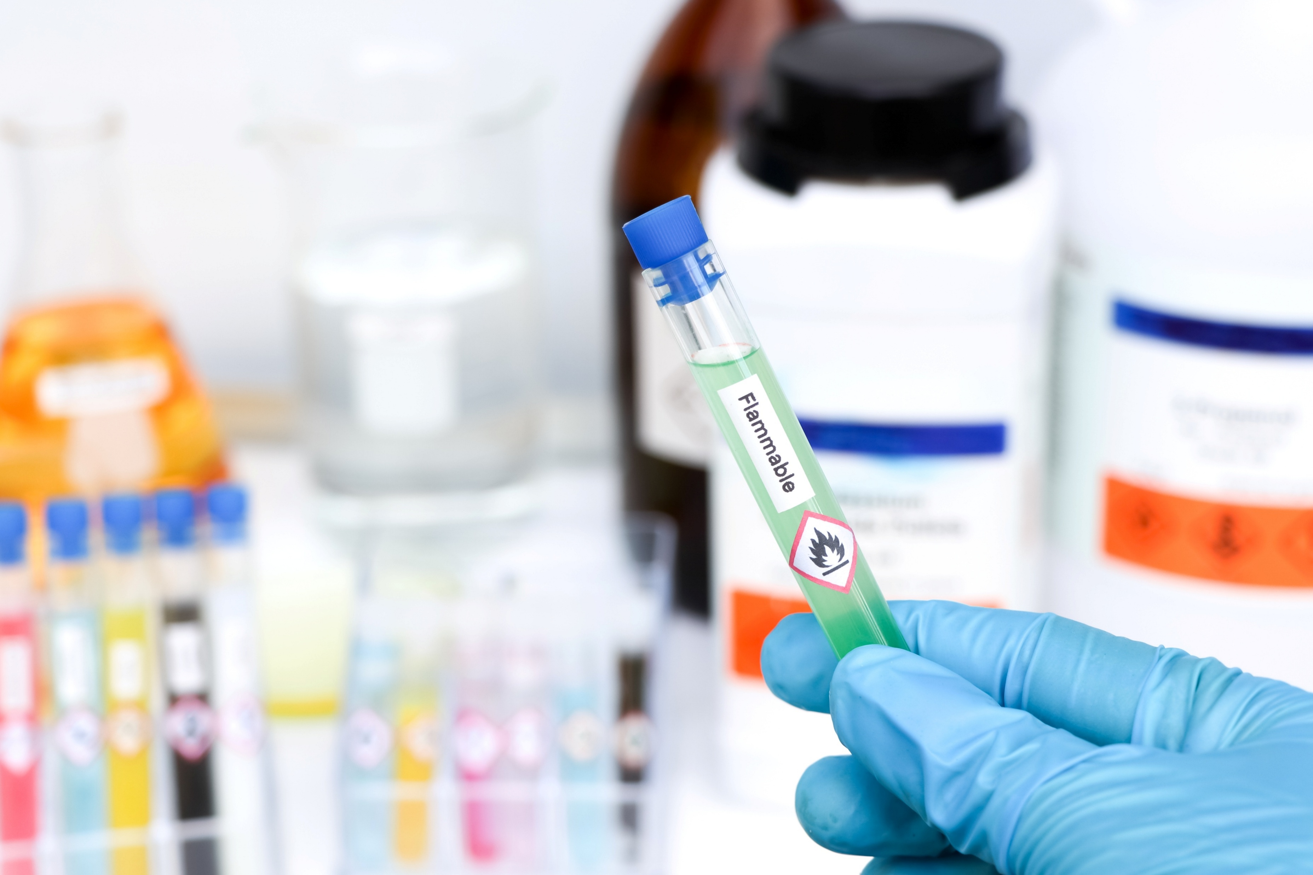
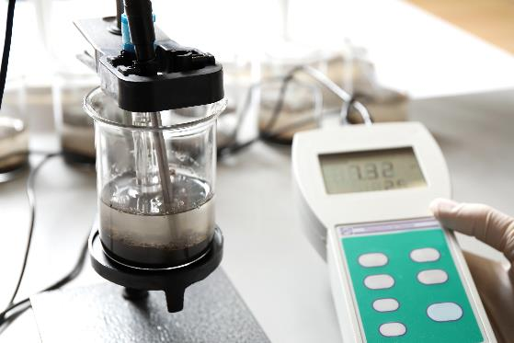
Purposes of SOPs
Activity 1
Look at the images below.
Identify what each image shows and why it needs a SOP.
Look at image 2. Why might you need to measure the pH of soil?
Click on the image to read the SOP.
1
2
Lesson 1: What is a standard operating procedure (SOP)?
Notes:
Picture 1 = www.learn.lboro.ac.uk/pluginfile.php/1128655/mod_folder/content/0/SOP039 Storage%2C Handling and Disposal of waste Chemicals .pdf (SOP on handling and disposal of waste chemicals) (with permission)
Image © Shutterstock/chemical industry
Picture 2 = www.cifor-icraf.org/resources-documents/Method-for-analyzing-soil-pH-in-water.pdf (SOP for a soil pH test) (with permission)
Image © Shutterstock/New Africa

Slide 7
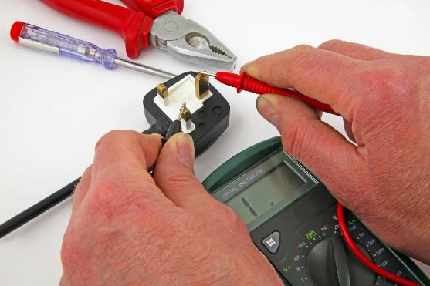
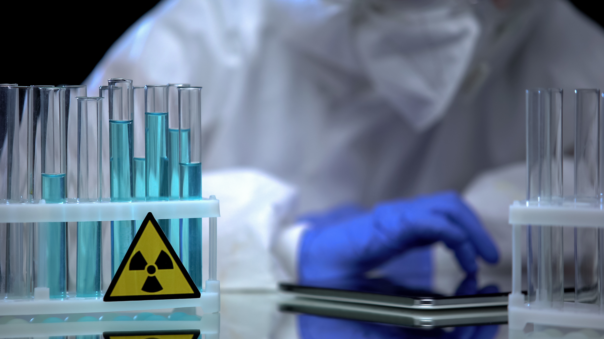
Purposes of SOPs
Activity 1
Look at the images below.
Identify what each image shows and why it needs a SOP.
Click on the image to read the SOP.
3
4
Lesson 1: What is a standard operating procedure (SOP)?
Notes:
Picture 3 = https://www.nhsfife.org/about-us/policies-and-procedures/general-policies/electrical-safety/ (SOP on electrical safety and PAT testing)
Image © Shutterstock/Richard z
Picture 4 = https://www.plymouthhospitals.nhs.uk/download/trwirssop4316-control-of-radioactive-substancespdf.pdf?ver=29381&amp%3Bdoc=docm93jijm4n18891 (SOP on handling of radioactive sampling)
Image © Shutterstock/Motortion Films

Slide 8
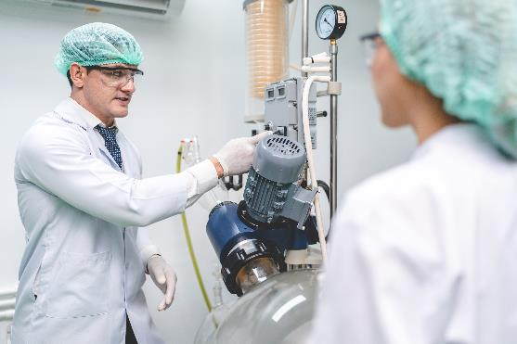
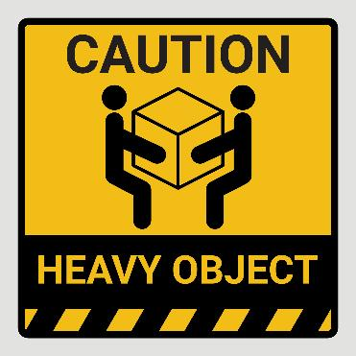
Purposes of SOPs
Activity 1
Look at the images below.
What profession is the person in image 5 training to become? What are professional standards?
What is the training called in image 6?
Click on the image to read the SOP.
5
6
Lesson 1: What is a standard operating procedure (SOP)?
Notes:
Picture 5 = https://istonline.org.uk/about/code-of-practice/
(Code of professional conduct) (with permission)
Image © Shutterstock/Chokniti-Studio
Picture 6 = https://www.plymouthhospitals.nhs.uk/download/trwmahsop6052-02-inanimate-load-handlingpdf.pdf?ver=29463&doc=docm93jijm4n18958.pdf (SOP on moving and handling)
Image © Shutterstock/Fox Reel

Slide 9
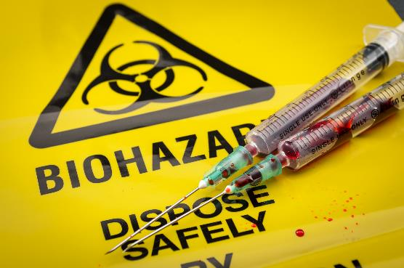
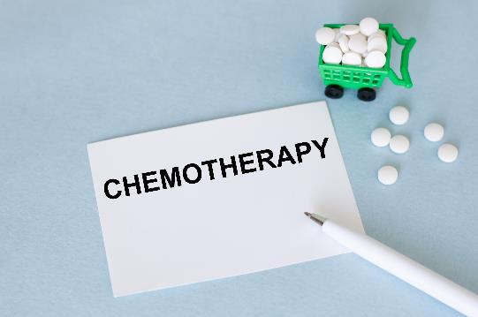
Purposes of SOPs
Activity 1
Look at the images below.
Describe what a biohazard is and why it needs a SOP for disposal.
Explain why chemotherapy drugs need a SOP for what to do if a spillage occurs.
Click on the image to read the SOP.
7
8
Lesson 1: What is a standard operating procedure (SOP)?
Notes:
Picture 7 = https://royalpapworth.nhs.uk/application/files/7817/4920/2461/SOP130_TB_Waste_Management_and_Tissue_Disposal_v1.pdf (SOP on tissue sample disposal)
Image © Shutterstock/Victor Moussa
Picture 8 = www.england.nhs.uk/mids-east/wp-content/uploads/sites/7/2018/04/spillage-of-cytotoxic-and-anti-cancer-drugs.pdf (SOP on spillage of anti-cancer drugs)
Image © Shutterstock/Volha Barysevich

Slide 10
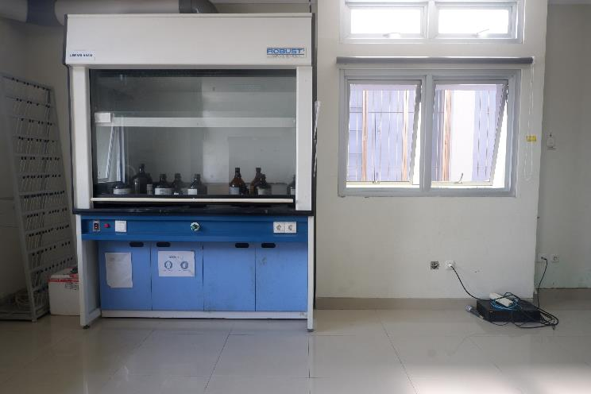
Purposes of SOPs
Activity 1
Look at image 9.
You are working with chemicals that give off chlorine gas in a fume cupboard. What do you need to check?
Find an example of a SOP for a fume cupboard online, from your industry placement or from your provider. Compare the SOP with what you have learned about SOPs so far.
9
Lesson 1: What is a standard operating procedure (SOP)?
Notes:
Picture 9 = https://www.staffnet.manchester.ac.uk/media/eps/chemistry-intranet/physics/SOP_Fume-Cupboard_V1.docx (SOP on use and maintenance of a fume cupboard)
Image © Shutterstock/Sije18

Slide 11
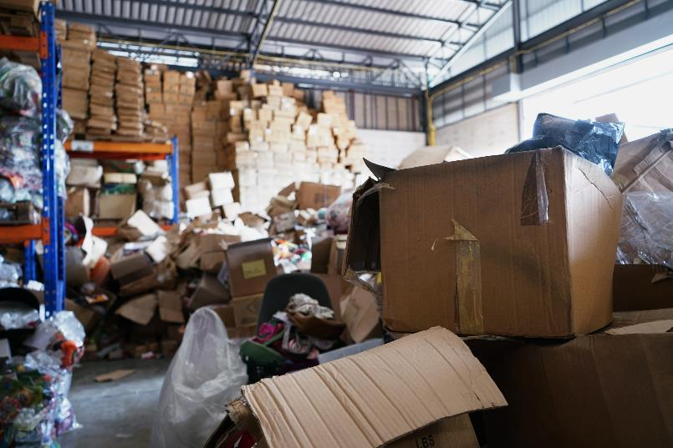

Principles of good practice
Activity 2
What principle is being shown?
Store materials appropriately
Lesson 1: What is a standard operating procedure (SOP)?
Notes:
Image © Shutterstock/TaraPatta
Image © Shutterstock/vichie81

Slide 12
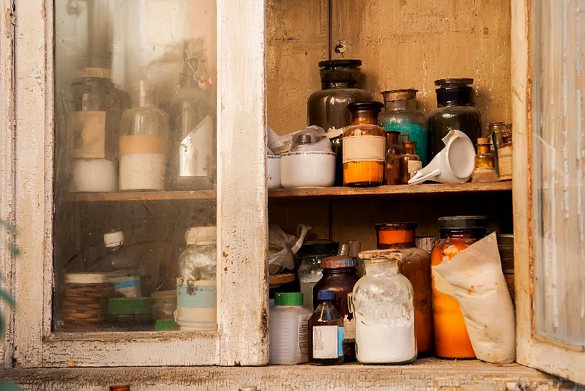
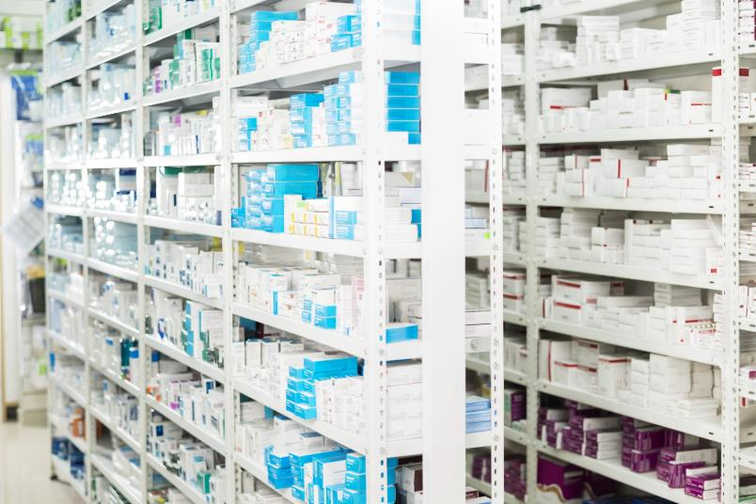
Principles of good practice
Activity 2
What principle is being shown?
Store drugs/chemicals appropriately
Lesson 1: What is a standard operating procedure (SOP)?
Notes:
Image © Shutterstock/Alisa24
Image © Shutterstock/Tyler Olson

Slide 13
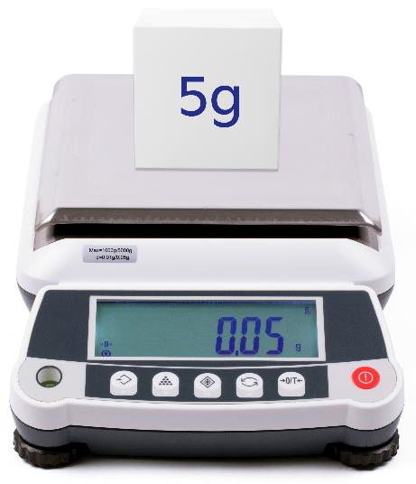
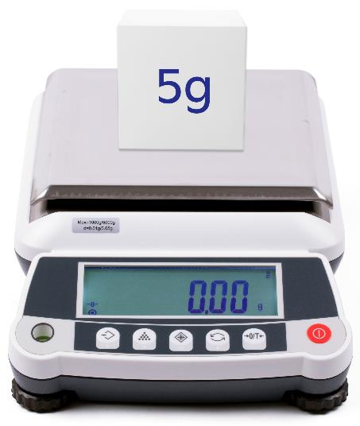
Principles of good practice
Activity 2
What principle is being shown?
Calibrate and maintain equipment
Lesson 1: What is a standard operating procedure (SOP)?
Notes:
Image © Shutterstock

Slide 14
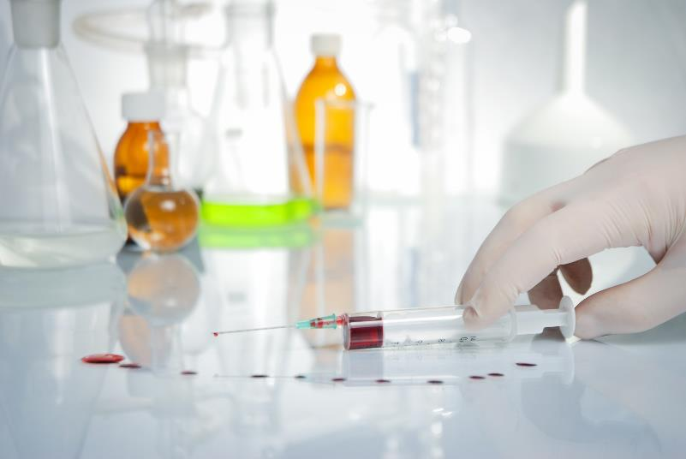
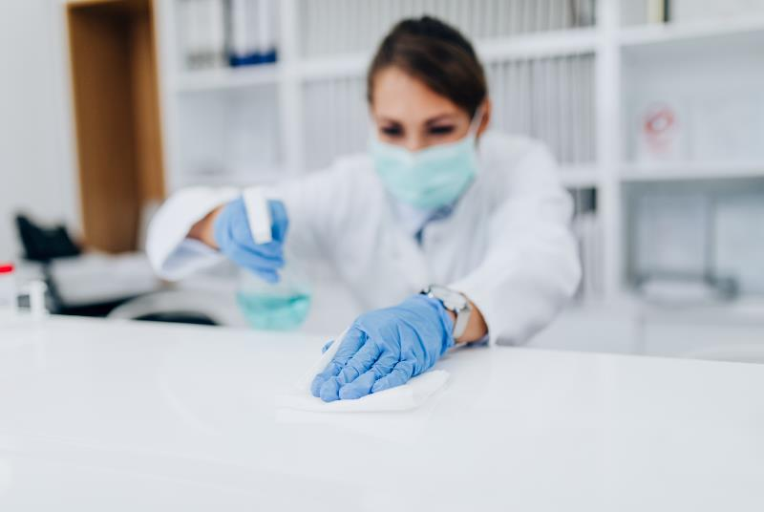
Principles of good practice
Activity 2
What principle is being shown?
Maintain work areas
Lesson 1: What is a standard operating procedure (SOP)?
Notes:
Image © Shutterstock/Anastasiia Lieonova
Image © Shutterstock/hedgehog94

Slide 15
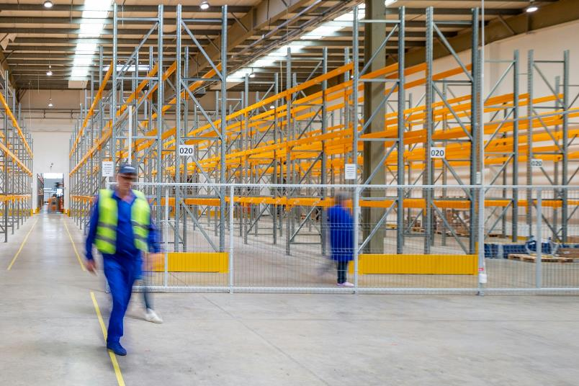

Principles of good practice
Activity 2
What principle is being shown?
Effectively manage stock levels
Lesson 1: What is a standard operating procedure (SOP)?
Notes:
Image © Unsplash/Adrian Sulyok
Image © Shutterstock/Shutter.B

Slide 16
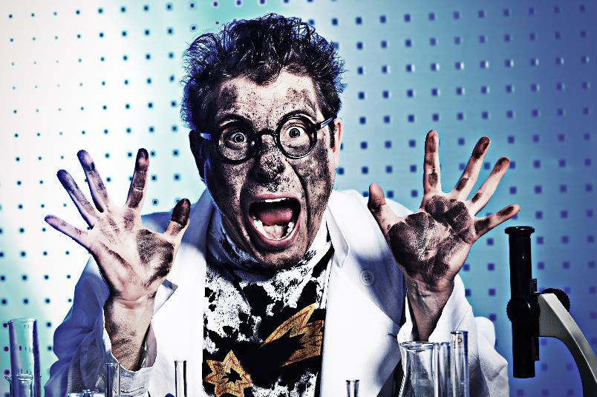

Principles of good practice
Activity 2
What principle is being shown?
Use standard operating procedures (SOPs)
Lesson 1: What is a standard operating procedure (SOP)?
Notes:
Image © Shutterstock/Kiselev Andrey Valerevich
Image © Shutterstock/tilialucida

Slide 17

Five key principles of good practice
Activity 2
Store materials and chemicals appropriately.
Calibrate and maintain equipment.
Maintain work areas.
Effectively manage stock levels.
Use standard operating procedures (SOPs).
Lesson 1: What is a standard operating procedure (SOP)?

Slide 18
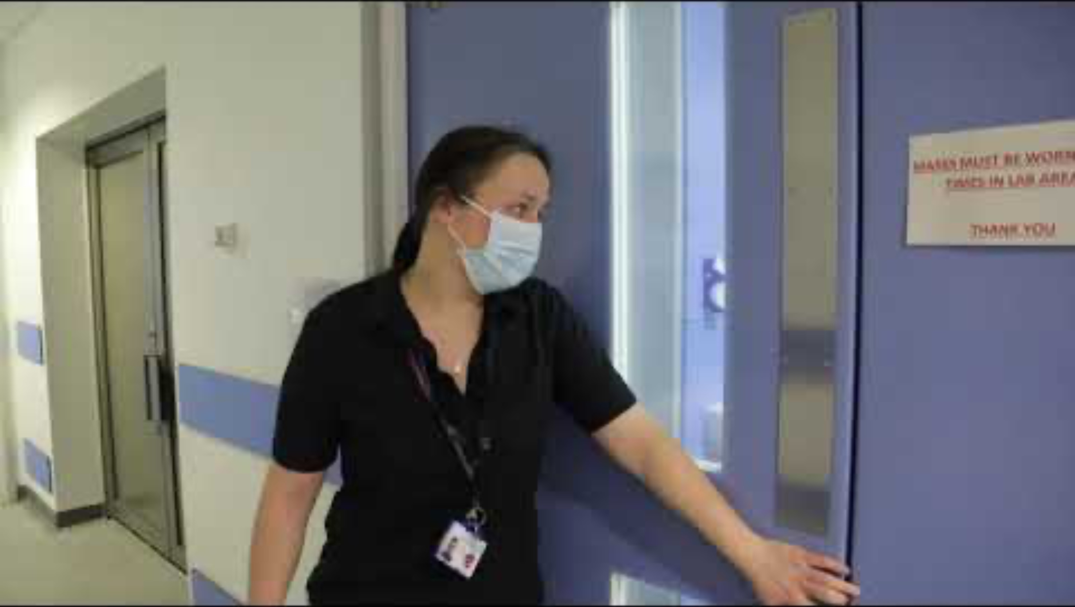
Principles of good practice
Activity 2
Watch these case studies and identify the principles of good practice shown in each one.
Click on the link to see case study 2: Healthcare lab technician real-life story
https://www.technicians.org.uk/stories/toluwani-alade/
Case study 1: Insight into a microbiology lab
Lesson 1: What is a standard operating procedure (SOP)?
Notes:
Case study 1 (Insight into a microbiology lab): www.youtube.com/watch?v=LnOcAgEsySw&t=102s (with permission) Clinical Illustration, Royal Wolverhampton NHS Trust
Case study 2 (Healthcare Laboratory Technician): https://www.technicians.org.uk/stories/toluwani-alade/

Slide 19
What could go wrong?
Activity 3
The following slides show a number of different scenarios where good practice has not been followed.
For each scenario consider:
What is wrong?
What impact could this have?
Why might this have happened?
What should be done to mitigate the risk of this happening again?
Lesson 1: What is a standard operating procedure (SOP)?

Slide 20
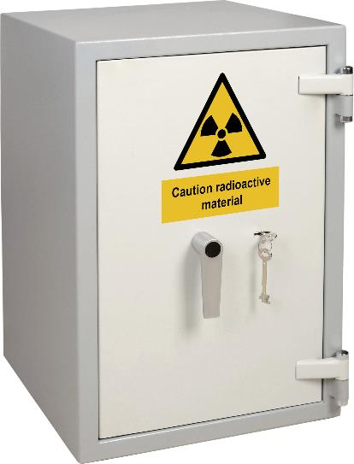
Scenario 1
Activity 3
You have lost the keys to the radioactive sources store.
What could go wrong?
How could the situation be rectified or prevented from happening?
Other questions to consider:
What should you do?
What are the worst consequences of not reporting it straight away?
Lesson 1: What is a standard operating procedure (SOP)?
Notes:
Image © Shutterstock/stock pictures

Slide 21
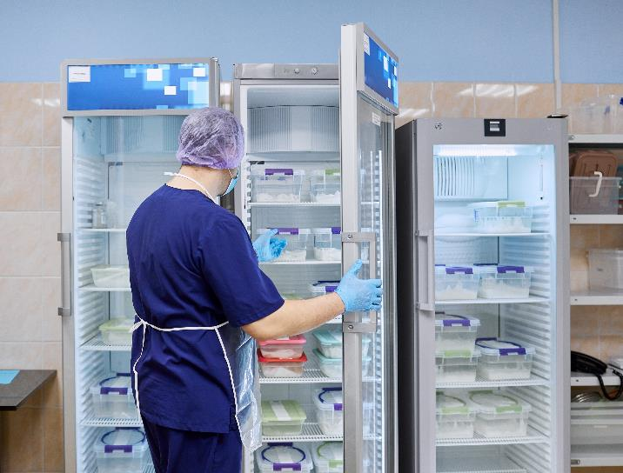
Scenario 2
Activity 3
The staff fridge is full, so you put your packed lunch into the medicine refrigerator for a short time.
What could go wrong?
How could the situation be rectified or prevented from happening?
Other questions to consider:
Is this acceptable?
What might the consequences be?
Lesson 1: What is a standard operating procedure (SOP)?
Notes:
Image © Shutterstock/Sergei Anishchenko

Slide 22
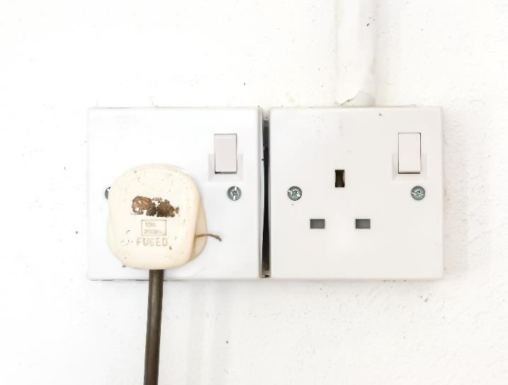
Scenario 3
Activity 3
You notice that the biological sample refrigerator has been turned off. It still feels cold inside, so it probably hasn’t been switched off for long.
What could go wrong?
How could the situation be rectified or prevented from happening?
Other questions to consider:
Should you just turn it on again?
What are the possible consequences if you do not report it immediately?
Lesson 1: What is a standard operating procedure (SOP)?
Notes:
Image © Shutterstock/Ekahardiwito

Slide 23
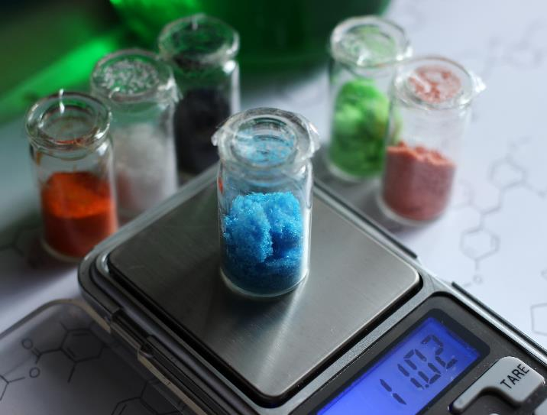
Scenario 4
Activity 3
You have made several batches of chemicals when you notice that the balance you are using has a zero error.
What could go wrong?
How could the situation be rectified or prevented from happening?
Other questions to consider:
What should you do?
Lesson 1: What is a standard operating procedure (SOP)?
Notes:
Image © Shutterstock/Ihor Matsiievskyi

Slide 24
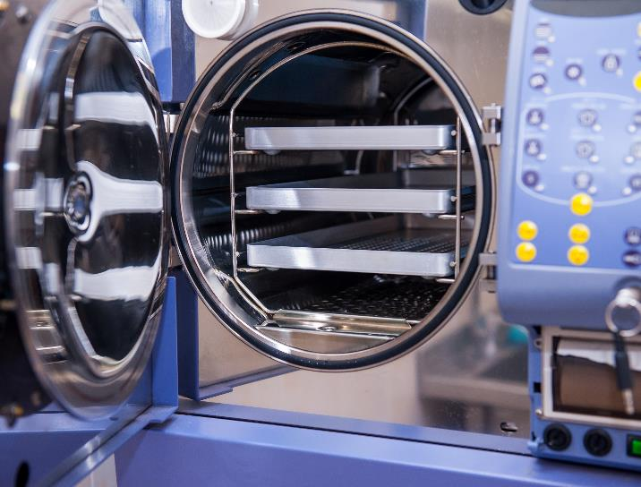
Scenario 5
Activity 3
A senior colleague has told you how to use the autoclave to sterilise a microbiology plate. They tell you that you do not need to use the SOP as they have done it loads of times.
What could go wrong?
How could the situation be rectified or prevented from happening?
Other questions to consider:
What should you do?
Lesson 1: What is a standard operating procedure (SOP)?
Notes:
Image © Shutterstock/Okrasiuk

Slide 25
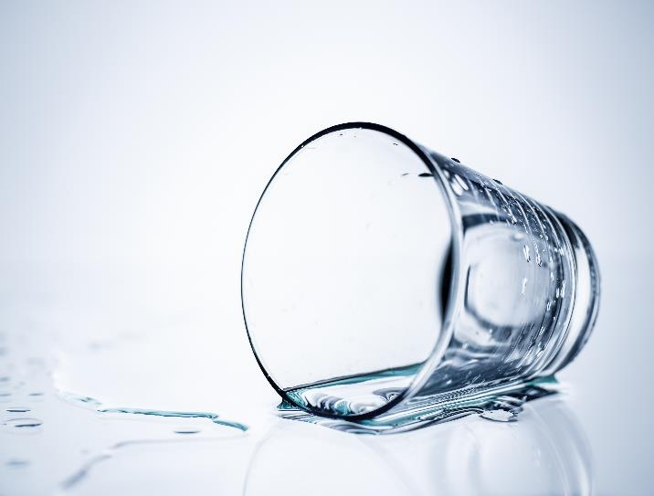
Scenario 6
Activity 3
There is a drinking glass on its side on the laboratory workbench and a spilled liquid that looks like water around it. There is a SOP on how to deal with chemical spills.
What could go wrong?
How could the situation be rectified or prevented from happening?
Other questions to consider:
Should you assume it is water?
What should you do?
Lesson 1: What is a standard operating procedure (SOP)?
Notes:
Image © Shutterstock/Makitalo

Slide 26
Consequences of not following SOPs: Chemical Handling
Activity 3
Failure to follow SOPs for chemical handling resulted in a laboratory accident at the University of California, Los Angeles (UCLA) in 2008. A research assistant was working with a highly reactive compound called tert-Butyllithium without using proper safety precautions. The compound reacted violently with air, causing an explosion and subsequent fire that resulted in the death of the assistant, and injuries to other researchers.
Lesson 1: What is a standard operating procedure (SOP)?
Notes:
Source: https://en.wikipedia.org/wiki/Sheri_Sangji_case

Slide 27
Consequences of not following SOPs: Hazardous Biological materials
Activity 3
In 2014, a laboratory accident occurred at the Centers for Disease Control and Prevention (CDC) in the United States. A mishandling of potentially live anthrax samples due to failure to follow proper SOPs resulted in the potential exposure of over 80 CDC employees to the bacterium. Although no one was seriously ill, the incident emphasized the critical importance of adhering to SOPs when working with hazardous biological materials.
Lesson 1: What is a standard operating procedure (SOP)?
Notes:
Source: https://archive.cdc.gov/#/details?url=https://www.cdc.gov/media/releases/2014/p0711-lab-safety.html

Slide 28
Multiple-choice question
Plenary
Which of the following describes the primary purpose of using standard operating procedures (SOPs) for manual handling?
To enhance communication within the organisation
To ensure compliance with regulatory requirements
To improve productivity and efficiency
To minimise the risk of injuries and accidents
(1 mark)
Lesson 1: What is a standard operating procedure (SOP)?

Slide 29
Multiple-choice question
Plenary
Which of the following describes the primary purpose of using standard operating procedures (SOPs) for manual handling?
To enhance communication within the organisation
To ensure compliance with regulatory requirements
To improve productivity and efficiency
To minimise the risk of injuries and accidents
(1 mark)
Answers
AO1
D To minimise the risk of injuries and accidents
Lesson 1: What is a standard operating procedure (SOP)?

Slide 30
In this lesson, we have:
Plenary
Described what a standard operating procedure (SOP) is and why their use is essential.
Stated the key principles of good practice in scientific and clinical settings.
Discussed potential consequences of not following good practice in scientific and clinical settings.
Skills:
CS3.2 Meet their responsibilities when working in a wider team by ensuring that the project is compliant with relevant SOPs specific to the lab in which they are working.
General competencies:
English:
GEC4 Summarise information/ideas
GEC6 Take part in/lead discussions
Lesson 1: What is a standard operating procedure (SOP)?

Slide 31
Consolidation
Consolidation
Critique elements of an industry SOP. Which parts are useful? What could be improved?
Alternatively, write a SOP for using a piece of standard laboratory equipment which you are confident in using, such as a light microscope or a practical procedure. Use the template on the worksheet.
Resource needed
Industry SOP
Consolidation Worksheet
Lesson 1: What is a standard operating procedure (SOP)?

