Slide 1
Agriculture
Route: Agriculture, Environmental
and Animal Care
Topic: Business and finance
Resource 6: Principles of project management
Notes:
Image: © Shutterstock/VisualBricks

Slide 2
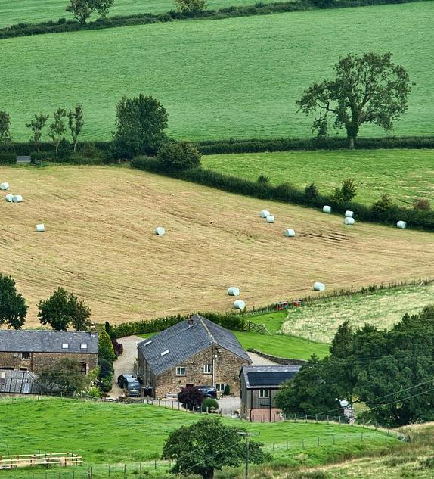
The land-based sector faces challenges
Introduction
Environmental pressures – climate change, biodiversity loss, soil health decline
Public misunderstanding – misconceptions about farming and land use
Policy and regulation changes – reforms, environmental targets
Economic pressures – rising costs, market volatility
Skills shortages – workforce recruitment and retention
Resource 6: Principles of project management
Notes:
Image: © Pixabay/MemoryCatcher

Slide 3
Campaigns exist to support them
Introduction
A campaign is a planned series of activities designed to achieve a specific goal within a set time frame.
They can be designed to:
  raise awareness
  influence behaviour
  promote sustainable practices
  secure funding or investment
  influence policy
  build public trust.
Resource 6: Principles of project management

Slide 4

Campaigns use coordinated actions
Introduction
Social media and marketing
Events and demonstrations
Education programmes
Petitions or lobbying
Partnerships and community engagement
What challenges are there to organising a campaign?
Resource 6: Principles of project management
Notes:
Image: © Pixabay/WebTechExperts

Slide 5
Campaigns are run by different organisations
Introduction
Industry organisations, e.g. National Farmers' Union
Environmental charities, e.g. The Woodland Trust
Government departments, e.g. Department for Environment, Food & Rural Affairs (DEFRA)
Conservation organisations, e.g. RSPB
Private companies
Resource 6: Principles of project management

Slide 6
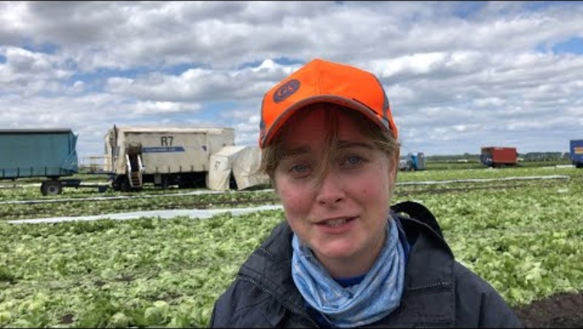
Pick for Britain
Introduction
During the COVID-19 pandemic, travel restrictions reduced the number of seasonal overseas workers available to work on UK farms.
Pick for Britain was a national recruitment campaign to encourage people in the UK to work on farms harvesting fruit and vegetables.
It was run by the government department DEFRA.
The campaign used videos like this to encourage people to sign up.
Do you think this is a good idea for the campaign? Why?
What other ideas would you use?
Resource 6: Principles of project management
Notes:
Can you Pick for Britain? DEFRA video link (with permission): https://www.youtube.com/watch?v=0RX_9qISj-c

Slide 7
Campaigns must be well planned
Introduction
Successful campaigns do not happen by accident. They require:
  clear purpose
  defined target audiences
  realistic budgets and timelines
  coordinated teamwork.
Poorly-planned campaigns can fail to achieve meaningful change as well as waste money and damage reputation.
This is where project management becomes essential.
Resource 6: Principles of project management

Slide 8

Project management
Introduction
Project management is the structured process of planning, organising and controlling resources to achieve a specific goal within a set timeframe.
In campaigns, it ensures that ideas are turned into effective, measurable action.
Resource 6: Principles of project management
Notes:
Iimage: © Pixabay/StockSnap

Slide 9





Stages of project management
Introduction
1. Research
2. Planning
3. Preparation
4. Implementation
5. Evaluation
Resource 6: Principles of project management

Slide 10
Stages of project management
Introduction
1. Research
State the purpose and scope of the project
Identify stakeholders and produce a communication plan
Set objectives and success measures
Allocate roles and responsibilities
Create a timescale
Allocate budget
Identify risks
2. Planning
3. Preparation
Develop materials and content
Secure partners and approvals
Train staff/volunteers
4. Implementation
Launch the campaign
Deliver activities and monitor progress
5. Evaluation
Measure outcomes against objectives
Analyse impact and feedback
Resource 6: Principles of project management

