Slide 1
Digital software development
Route: Digital
Topic: Computational thinking skills
Resource 1: Core computational thinking skills
Notes:
Image © Shutterstock/wee dezign

Slide 2
In this resource, we will:
Introduction
give the components of computational thinking
identify essential information by using abstraction
explain how to break problems down using decomposition
identify pattern recognition
design algorithms.
Skills:
Be able to reflectively evaluate
Communicate information clearly to a technical and non-technical audience
Apply a logical approach to solving problems
General competencies:
English:
E2 Present information and ideas
E4 Summarise information/ideas
E6 Take part in/leading discussions
Digital:
D1 Use digital technology and media effectively
D3 Communicate and collaborate
Resource 1: Core computational thinking skills

Slide 3

Decomposition
Introduction
Decomposition is the process of breaking a problem down into smaller, more manageable tasks.
Think about the last time you made yourself a to-do list. What was the big problem, and how did you break it down?
Resource 1: Core computational thinking skills
Notes:
Image © Shutterstock/Cherdchai101

Slide 4

Practice: Decomposition
Introduction
You are planning a trip to a theme park.
List all of the tasks you need to do to prepare.
Think about:
When are you going?
Who are you going with?
How will you get there?
Resource 1: Core computational thinking skills
Notes:
Image © Shutterstock/aapsky

Slide 5
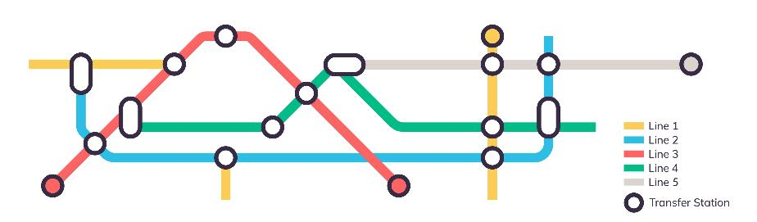
Abstraction
Introduction
Abstraction is the process of identifying essential information while ignoring irrelevant details.
Transport network maps showing bus routes, metro routes and train routes are an example of abstraction. Explain to your partner why this is.
Resource 1: Core computational thinking skills
Notes:
Image © Shutterstock/PaleStudio

Slide 6
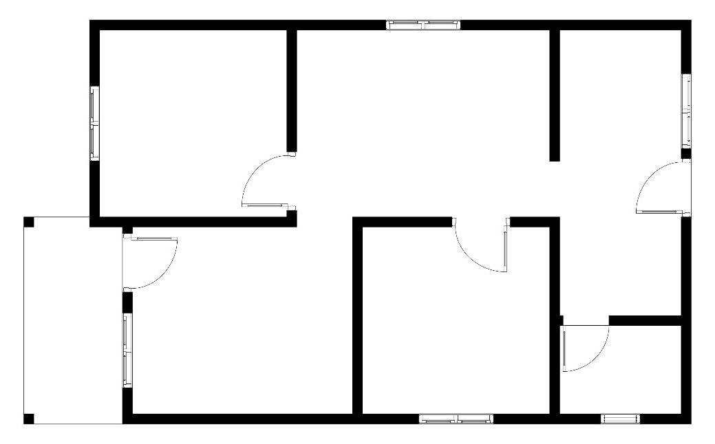
Practice: Abstraction
Introduction
You need to design a simple floor plan of your classroom,
Your floor plan should include essential features such as doors, windows and desks, but ignore unnecessary detail.
Resource 1: Core computational thinking skills
Notes:
Image © Shutterstock/FR.HUNIAN

Slide 7

Pattern recognition
Introduction
Pattern recognition involves identifying similarities and trends in problems.
Look at the pattern in the image. Describe it to the person sitting next to you.
Resource 1: Core computational thinking skills
Notes:
Image © Shutterstock/Kirti Bhole

Slide 8
Multiple choice questions
Introduction
What shape and colour will appear next?
Resource 1: Core computational thinking skills

Slide 9

Algorithm design
Introduction
Algorithm design involves writing step-by-step instructions for completing a task.
Think about a time when you have needed to follow step-by-step instructions to help you complete a task. What made them successful?
Resource 1: Core computational thinking skills
Notes:
Image © Shutterstock/Vladeep

Slide 10

Practice: Algorithm design
Introduction
You are making a cake for your friend’s birthday.
Write an algorithm for this task. You can use the internet to help you.
Think about:
What cake are you making?
What order do you need to add the ingredients?
How will you know when it is done?
Resource 1: Core computational thinking skills
Notes:
Image © Shutterstock/AI Max

Slide 11
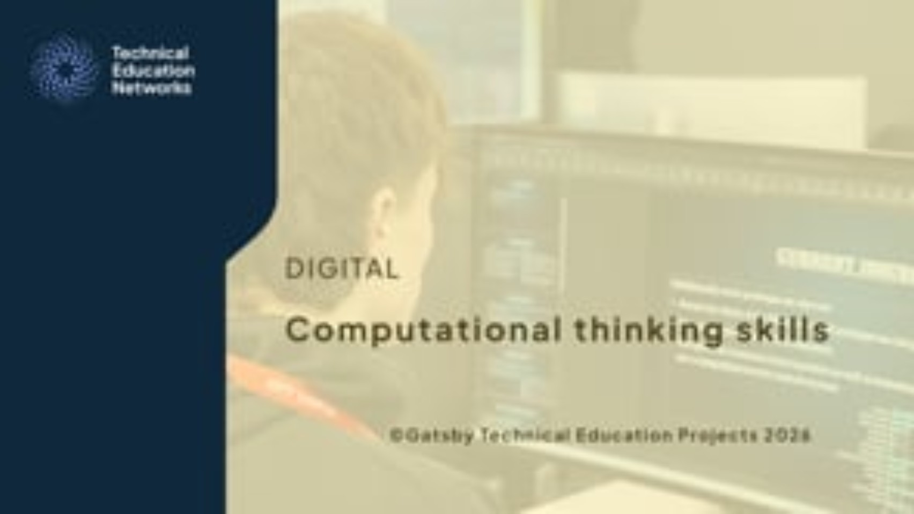
Computational thinking – summary
Introduction
Resource 1: Core computational thinking skills
Notes:
Computational thinking skills Animation - https://vimeo.com/1189307861

Slide 12
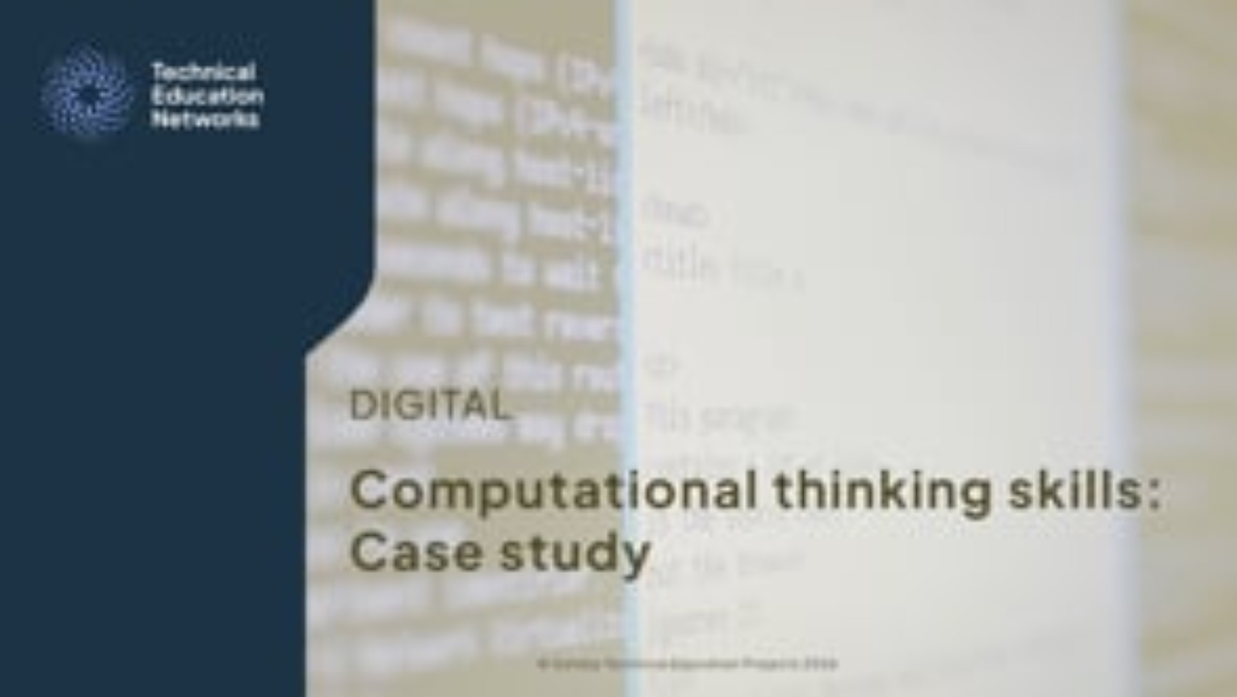
Activity 1: The Four Skills of Computational Thinking
Activity 1
Resources needed:
R1 Activity 1 Worksheet
Watch the video
Answer the questions on the worksheet.
Resource 1: Core computational thinking skills
Notes:
Computational thinking skills Case study video - https://vimeo.com/1189304588

Slide 13
Activity 2: Computational thinking scenarios
Activity 2
Apply the computational thinking skills to each of the scenarios on the worksheet.
Resources needed:
R1 Activity 2 Worksheet
Resource 1: Core computational thinking skills

Slide 14

CT skills in industry
Activity 2
Decomposition is the basis of agile project management, where large tasks are broken down into manageable tasks for team sprints.
Abstraction links directly to the work of a systems architect who must design the overall system structure.
Pattern recognition is essential for data analysts and software developers for identifying trends and ensuring code reusability.
Algorithm design is crucial for all developers, as creating unambiguous instructions is necessary for reliable software and unit testing.
Resource 1: Core computational thinking skills
Notes:
Image © Shutterstock/VRVIRUS

Slide 15
Matching task
Plenary
Match the computational thinking skill to its description:
Algorithm design | A. Finding similarities, trends or repeated features
2. Decomposition | B. Focusing on the most important parts and hiding the rest
3. Pattern recognition | C. Breaking a large problem into smaller, easier parts
4. Abstraction | D. Creating a list of ordered, step-by-step instructions
Resource 1: Core computational thinking skills

Slide 16
Matching task
Plenary
Match the computational thinking skill to its description:
Answers
1 D
2 C
3 A
4 B
Algorithm design | A. Finding similarities, trends or repeated features
2. Decomposition | B. Focusing on the most important parts and hiding the rest
3. Pattern recognition | C. Breaking a large problem into smaller, easier parts
4. Abstraction | D. Creating a list of ordered, step-by-step instructions
Resource 1: Core computational thinking skills

Slide 17
In this resource, we have:
Plenary
given the components of computational thinking
identified essential information by using abstraction
explained how to break problems down using decomposition
identified pattern recognition
designed algorithms.
Skills:
Be able to reflectively evaluate
Communicate information clearly to a technical and non-technical audience
Apply a logical approach to solving problems
General competencies:
English:
E2 Present information and ideas
E4 Summarise information/ideas
E6 Take part in/leading discussions
Digital:
D1 Use digital technology and media effectively
D3 Communicate and collaborate
Resource 1: Core computational thinking skills

Slide 18
Applying computational thinking
You are planning a surprise 17th birthday party for your friend Alex this Saturday. You have a budget of £500. There will be eight guests and the party will be held in a local school hall. Alex loves the colour blue and anything related to space travel. Alex hates loud music and chocolate cake. The school has three long tables and 20 blue chairs but the lights are broken. You have one other friend to help you with the setup but they can only arrive one hour before the party starts.
Use the four CT skills (abstraction, decomposition, pattern recognition and algorithm design) to plan the steps you need to take to make Alex’s party a success!
Resource 1: Core computational thinking skills

