Slide 1
Building Services Engineering
Route: Construction
Topic: Employer-set Project (Research, planning and evaluation)
Resource 1: Research skills in the ESP
Notes:
Image © Shutterstock/PeopleImages

Slide 2
In this resource, we will:
Introduction
identify the key components of effective research as outlined in the ESP band descriptors;
explain common pitfalls in student research, including poor organisation and imbalanced focus on core knowledge areas;
plan and structure a research approach that aligns with the ESP brief and assessment criteria;
apply core knowledge consistently across areas such as costs, performance, environmental and financial benefits, and relevant legislation;
demonstrate digital skills in sourcing, collating and presenting research findings in line with industry expectations.
Skills:
CSA, CSB, CSC, CSD
General competencies:
English:
EC1, EC2, EC4, EC5, EC6
Maths:
MC5, MC7
Digital:
DC1, DC2, DC3, DC4, DC5
Resource 1: Research skills in the ESP

Slide 3
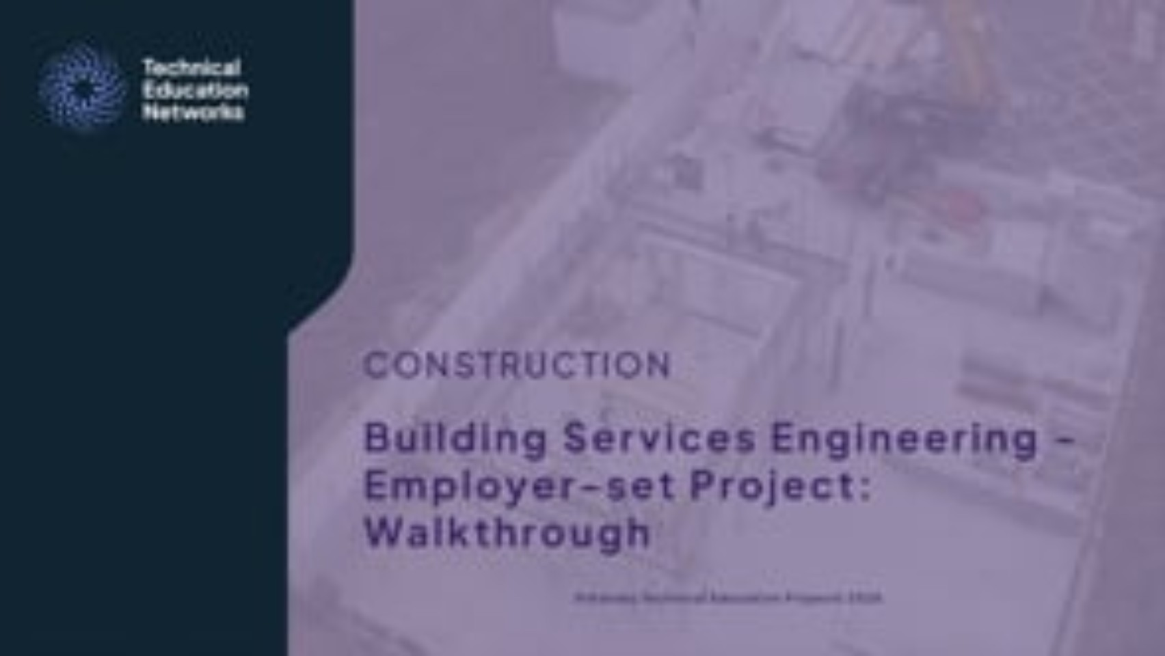
An introduction to the Employer-set Project
Introduction: video
Watch the video and write down any questions that it raises for you.
Resource 1: Research skills in the ESP
Notes:
Employer-set Project: Walkthrough video: https://vimeo.com/1200701427/acedd0e016

Slide 4
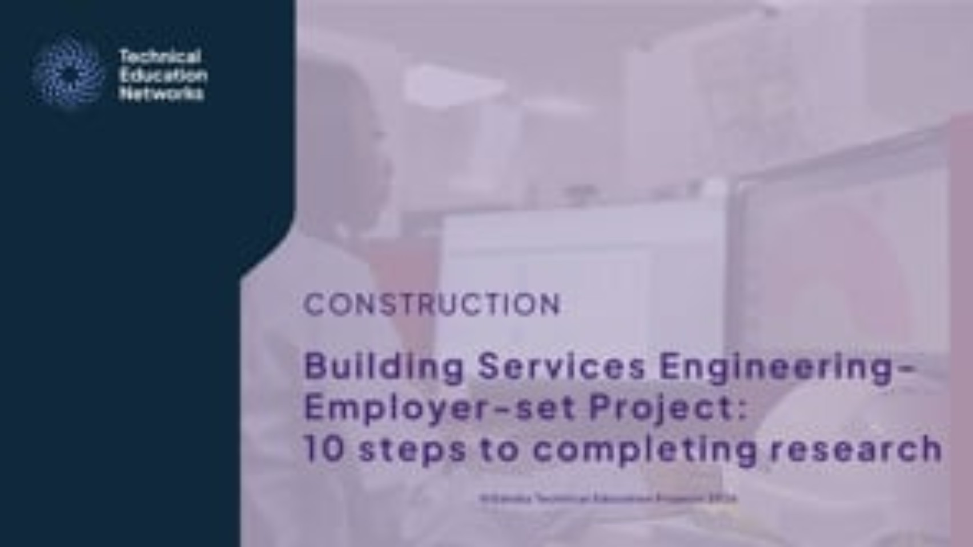
Research for the Employer-set Project
Animation: Activity 1, Activity 4, Activity 5
Watch the animation and complete the related activities.
Resource 1: Research skills in the ESP
Notes:
Employer-set Project: 10 steps to completing research video: https://vimeo.com/1198368149/4b0d253f43

Slide 5
Research for the Employer-set Project
Activity 1
Reflect on the role of research in the Employer-set Project
Why is research the starting point of the Employer-set Project?
What makes a source reliable or unreliable?
How should you record research so it can be used later?
How can you show that your research directly addresses the client’s requirements?
How does comparing options show deeper understanding than just listing information?
Resource 1: Research skills in the ESP

Slide 6
Why recording research matters
Activity 1
Recording research matters because:
it ensures brief requirements are fully considered;
it provides clear evidence of a methodical approach;
it demonstrates professional practice in line with industry standards;
it supports the application of core knowledge across renewable, modular and conservation technologies;
it supports the completion of the tasks included in the employer-set projects.
Resource 1: Research skills in the ESP

Slide 7
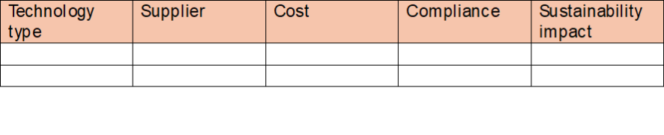
Good practice in recording research
Activity 4
Methodical approach
Record findings in tables or spreadsheets for clarity.
Use structured headings: technology type, supplier, cost, compliance, sustainability impact.
Resource 1: Research skills in the ESP

Slide 8

Good practice in recording research
Activity 4
Comprehensive sources
Include manufacturer websites, government guidance, industry standards (e.g., CIBSE, BSRIA, WRAS).
Provide full reference details (author, date, URL, accessed date).
Resource 1: Research skills in the ESP

Slide 9

Good practice in recording research
Activity 4
Alignment with brief
Link each finding directly to project requirements.
Resource 1: Research skills in the ESP
Notes:
Image © Shutterstock/FOTO Eak

Slide 10

Good practice in recording research
Activity 4
Evidence of core knowledge
Apply technical understanding: sizing, efficiency, compliance with Approved Documents.
Resource 1: Research skills in the ESP
Notes:
Image © Shutterstock/PV productions

Slide 11
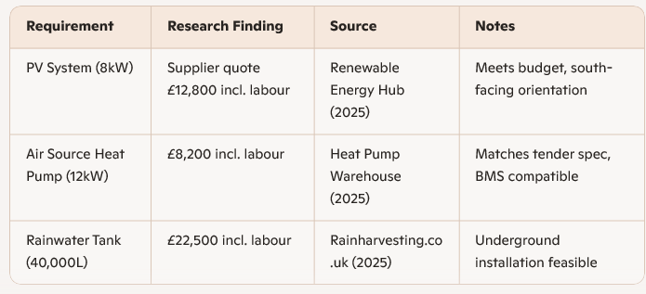
Good practice in recording research
Activity 4
Gather accurate, relevant information that directly addresses the Employer-set Project brief.
Demonstrate a methodical and thorough approach to information gathering.
Show clear application of core knowledge (e.g., building regulations, sustainability, installation requirements).
Use industry references (e.g., CIBSE, BSRIA, WRAS, manufacturer websites).
Avoid non‑authoritative sources (e.g., adverts, blogs without technical credibility).
Record full citation details: author, organisation, date, URL, date accessed.
Include a range of sources to demonstrate breadth and reliability.
PPT_AW_003
Example good practice table
Resource 1: Research skills in the ESP

Slide 12
Task 1.1 Band 3 descriptor
Activity 4
Brief requirements fully considered throughout research and information collation – clear evidence of a methodical and thorough approach to research and information gathering. Systematic and comprehensive research conducted, including a detailed list of sources in line with industry standards.
Core knowledge applied in all areas of the brief requirements.
Resource 1: Research skills in the ESP

Slide 13

Bad practice in recording research
Activity 4
Unstructured notes
Copy–pasting text without headings or context
Mixing supplier adverts with technical data
Resource 1: Research skills in the ESP
Notes:
Image © Shutterstock/worradirek

Slide 14
Bad practice in recording research
Activity 4
Incomplete sources
‘Found online’ or ‘from a website’ without proper citation
No dates or manufacturer details
Resource 1: Research skills in the ESP
Notes:
Image © Shutterstock/worradirek

Slide 15

Bad practice in recording research
Activity 4
Ignoring brief requirements
Researching generic systems without checking system requirements
Not using system costings as part of the research
Resource 1: Research skills in the ESP
Notes:
Image © Shutterstock/anatoliy_gleb

Slide 16
Bad practice in recording research
Activity 4
Notes on bad practice:
Disorganised or incomplete, making it unclear what has been researched
Recorded vague statements
Failure to show how research supports the Employer-set project requirements
Systems not sourced from the supplier
Missing costings linked to the project brief
Solar panels – £10k approx (no source, no system size)
Heat pump info from Google (no supplier, no spec)
Rainwater tank – big one needed (no capacity, no compliance check)
Example bad practice notes
Resource 1: Research skills in the ESP

Slide 17
Task 1.1 Band 1 descriptor
Activity 4
Some evidence of a planned approach to research, results lack order and organisation.
Some elements of Core knowledge referenced but focus may be imbalanced and more focused on one area than another.
Resource 1: Research skills in the ESP

Slide 18
Tips for students
Plenary
Always cross-check against project specification.
Use industry-standard referencing.
Present findings in tables, charts or annotated diagrams.
Keep a research log (date, source, summary, relevance).
Resource 1: Research skills in the ESP
Notes:
Image © Shutterstock/worradirek

Slide 19
In this resource, we have:
Plenary
identified the key components of effective research as outlined in the ESP band descriptors;
explained common pitfalls in student research, including poor organisation and imbalanced focus on core knowledge areas;
planned and structured a research approach that aligns with the ESP brief and assessment criteria;
applied core knowledge consistently across areas such as costs, performance, environmental and financial benefits, and relevant legislation;
demonstrated digital skills in sourcing, collating and presenting research findings in line with industry expectations.
Skills:
CSA, CSB, CSC, CSD
General competencies:
English:
EC1, EC2, EC4, EC5, EC6
Maths:
MC5, MC7
Digital:
DC1, DC2, DC3, DC4, DC5
Resource 1: Research skills in the ESP

