Slide 1
Engineering and Manufacturing: Core
Route: Engineering and Manufacturing
Topic: Manipulating equations and calculus
Resource 4: Calculus – Differentiation
Notes:
Image © Shutterstock/Gorodenkoff

Slide 2
In this resource, we will:
Introduction
Skills
CSE (Communicate and present outcomes and evidence)
General competencies
English:
EC1 Convey technical information to different audiences
Maths:
MC2 Estimating, calculating and error spotting
calculate the derivatives of polynomial functions using the power rule;
calculate rates of change using differentiation;
calculate maximum or minimum values in optimisation problems by setting the derivative to zero and using algebraic skills.
Resource 4: Calculus – Differentiation

Slide 3
Calculus – Differentiation
Introduction
  Calculus is fundamental throughout engineering and manufacturing.
  It is a branch of maths that consists of two key parts:
  differential calculus;
  integral calculus.
Differential calculus helps to understand the rate of change of one quantity in relation to another.
Resource 4: Calculus – Differentiation

Slide 4

Differentiation in industry
Introduction
Differentiation is essential in industry, including when:
calculating velocity and acceleration of moving objects;
finding operating speeds that minimise costs;
optimising designs for manufacturing;
identifying when normal operating parameters of systems are being exceeded, and by how much.
Resource 4: Calculus – Differentiation
Notes:
Image © Shutterstock/Gorodenkoff

Slide 5


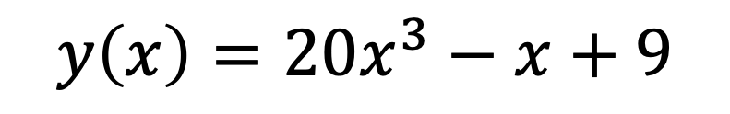
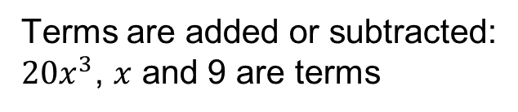


Polynomials
Recap and Worked examples
A polynomial is a mathematical expression made of terms with variables raised to a whole-number power or index.
Polynomials are common in engineering modelling.
Terms are added or subtracted:
$20x^{3}$, $x$ and 9 are terms
3 is a power or index
$x$ is a variable
$$y\left(x\right)={20x}^{3}−x+9$$
$y$ is a function of $x$
$9$ is a constant
$20$ is a coefficient
$x$ has coefficient 1, even though it is not written
Resource 4: Calculus – Differentiation

Slide 6
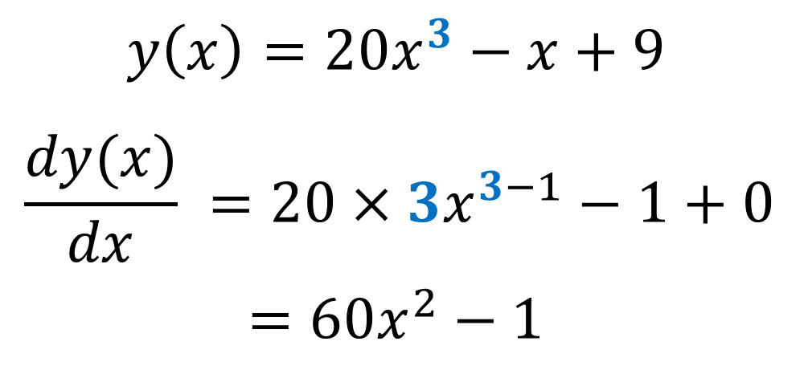
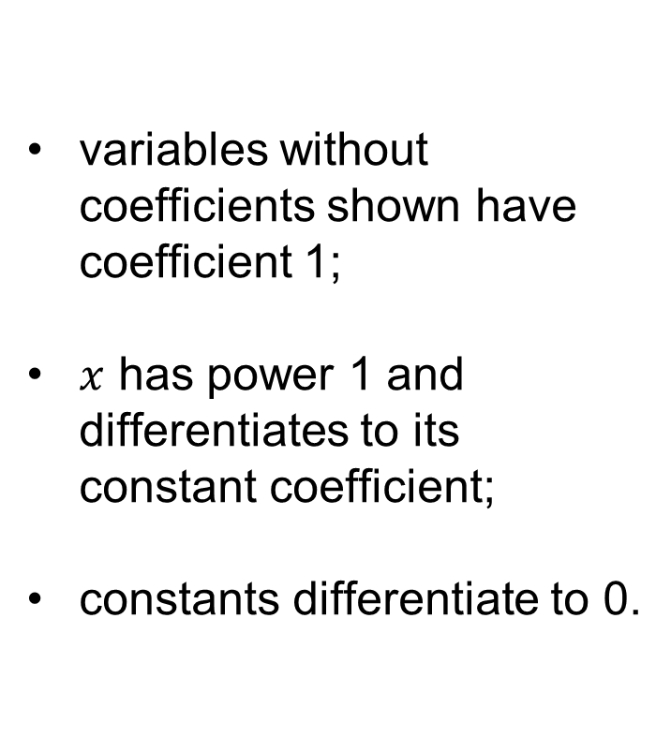
Differentiation of polynomials
Recap and Worked examples
The power rule: for each term
multiply the coefficient by the power
reduce the power by 1
variables without coefficients shown have coefficient 1;
$x$ has power 1 and differentiates to its constant coefficient;
constants differentiate to 0.
Keep in mind
$$y\left(x\right)={20x}^{3}−x+9$$
$$\frac{dy(x)}{dx} =20×3x^{3−1}−1+0$$
$$=60x^{2}−1$$
Resource 4: Calculus – Differentiation

Slide 7





Differentiation practice
Recap and Worked examples
Find $\frac{d}{dx}$:
$$y=x$$
$$v=x^{2}−1$$
$$z(x)={−x}^{3}$$
$$f\left(x\right)={2x}^{3}−x^{2}$$
Resource 4: Calculus – Differentiation

Slide 8
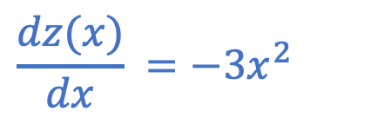
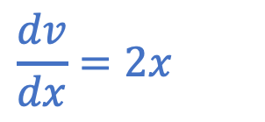
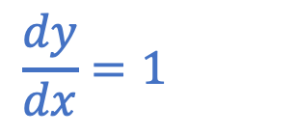
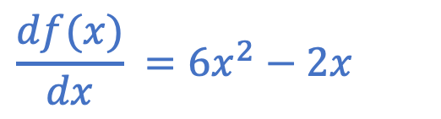
Differentiation practice: Answers
Recap and Worked examples
Find $\frac{d}{dx}$:
Find the rate of change at $x= 2$ by substituting:
$$\frac{dy}{dx}=1$$
$$y=x$$
$$\frac{dv}{dx}=2x$$
$$v=x^{2}−1$$
$$\frac{dz(x)}{dx} ={−3x}^{2}$$
$$z(x)={−x}^{3}$$
$$\frac{df(x)}{dx} ={6x}^{2}−2x$$
$$f\left(x\right)={2x}^{3}−x^{2}$$
Resource 4: Calculus – Differentiation

Slide 9
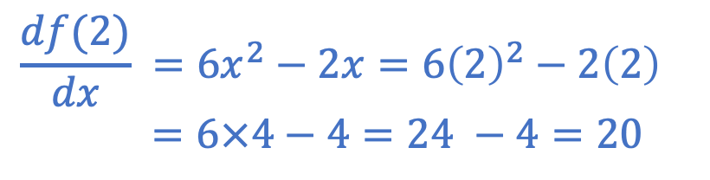
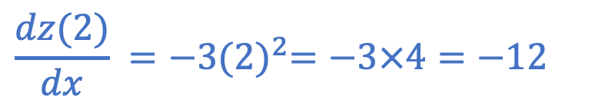
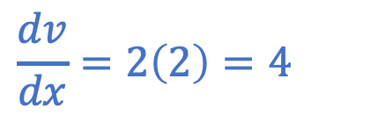
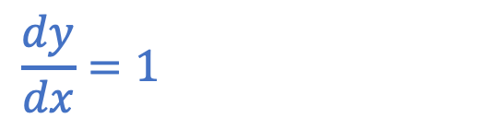
Differentiation practice: Answers
Recap and Worked examples
Find $\frac{d}{dx}$:
Find the rate of change at $x= 2$ by substituting:
$$\frac{dy}{dx}=1$$
$$\frac{dy}{dx}=1$$
$$y=x$$
$$\frac{dv}{dx}=2x$$
$$\frac{dv}{dx}=2\left(2\right)=4$$
$$v=x^{2}−1$$
$$\frac{dz(x)}{dx} ={−3x}^{2}$$
$$\frac{dz(2)}{dx} ={−3(2)}^{2}=−3×4=−12$$
$$z(x)={−x}^{3}$$
$$\frac{df(x)}{dx} ={6x}^{2}−2x$$
$$\frac{df(2)}{dx} ={6x}^{2}−2x={6\left(2\right)}^{2}−2\left(2\right)$$
$=6×4−4=24 −4=20$
$$f\left(x\right)={2x}^{3}−x^{2}$$
Resource 4: Calculus – Differentiation

Slide 10
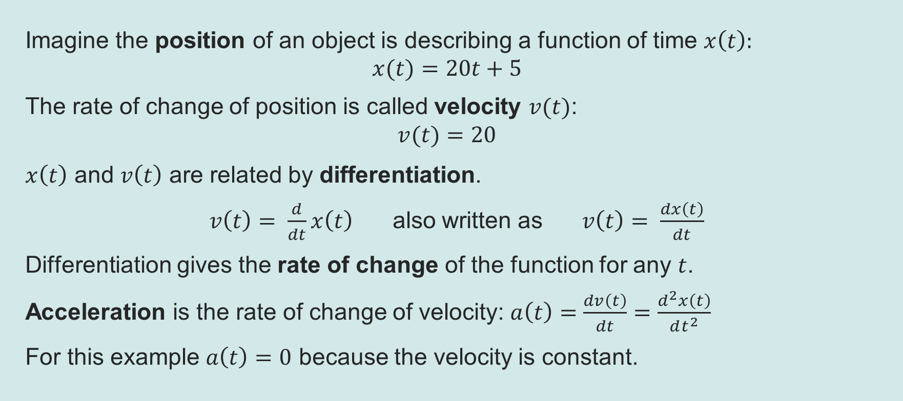
Rates of change
Recap and Worked examples
Imagine the position of an object is describing a function of time $x\left(t\right):$
$$x(t)=20t+5$$
The rate of change of position is called velocity $v(t)$:
$$v(t)=20$$
$x\left(t\right)$ and $v\left(t\right)$ are related by differentiation.
$v\left(t\right)= \frac{d}{dt}x\left(t\right)$ also written as $v\left(t\right)= \frac{dx\left(t\right)}{dt}$
Differentiation gives the rate of change of the function for any $t$.
Acceleration is the rate of change of velocity: $a\left(t\right)=\frac{dv\left(t\right)}{dt}=$ $\frac{d^{2}x\left(t\right)}{dt^{2}}$
For this example $a\left(t\right)=0$ because the velocity is constant.
Resource 4: Calculus – Differentiation

Slide 11
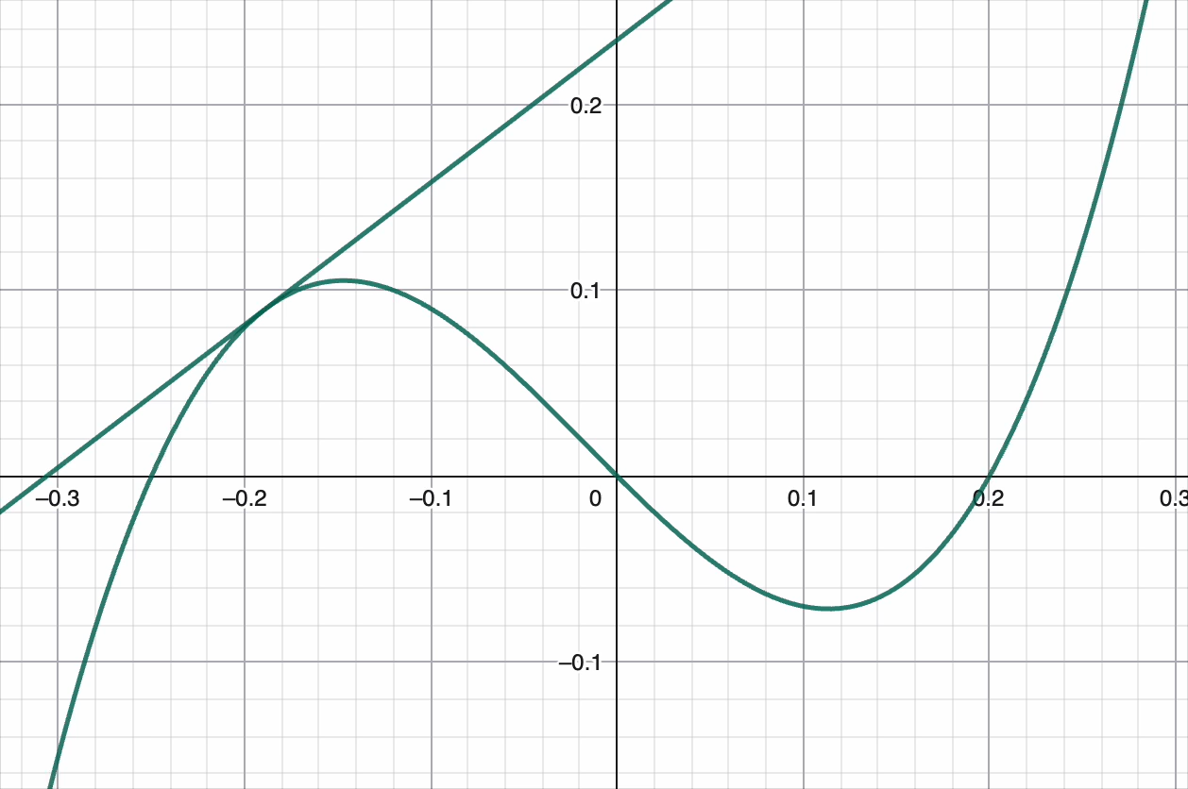
Optimisation
Recap and Worked examples
Differentiation is useful for finding the minimum or maximum of a function.
At a minimum or maximum, the gradient (or rate of change) is zero.
That is, a minimum or maximum occurs where the derivative equals zero.
Imagine at the top of a hill or bottom of a valley, even if just for a small spot, the gradient goes neither up nor down.
The second derivative tells us whether it is a maximum or minimum.
Click to play the animation above
Resource 4: Calculus – Differentiation
Notes:
Made with GeoGebra®

Slide 12

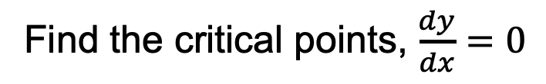
Maximum or minimum
Recap and Worked examples
To find the maximum and minimum of $y=x^{3}−6x^{2}+9x:$
Find the critical points, $\frac{dy}{dx}=0$
Find $\frac{d^{2}y}{dx^{2}}$ at the critical points
Resource 4: Calculus – Differentiation

Slide 13

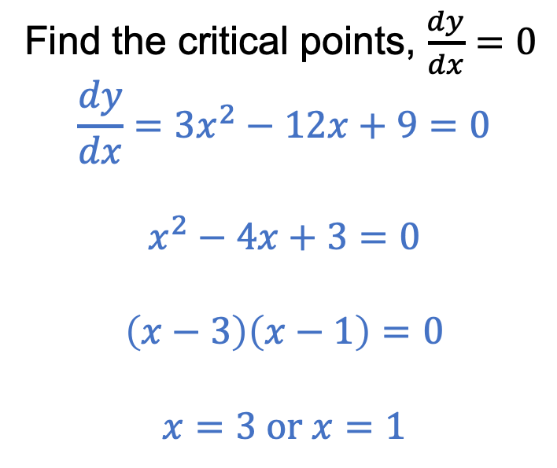
Maximum or minimum: Answers
Recap and Worked examples
To find the maximum and minimum of $y=x^{3}−6x^{2}+9x:$
Find the critical points, $\frac{dy}{dx}=0$
$$\frac{dy}{dx}=3x^{2}−12x+9=0$$
$$x^{2}−4x+3=0$$
$$\left(x−3\right)\left(x−1\right)=0$$
$$x=3 or x=1$$
Find $\frac{d^{2}y}{dx^{2}}$ at the critical points
Resource 4: Calculus – Differentiation

Slide 14

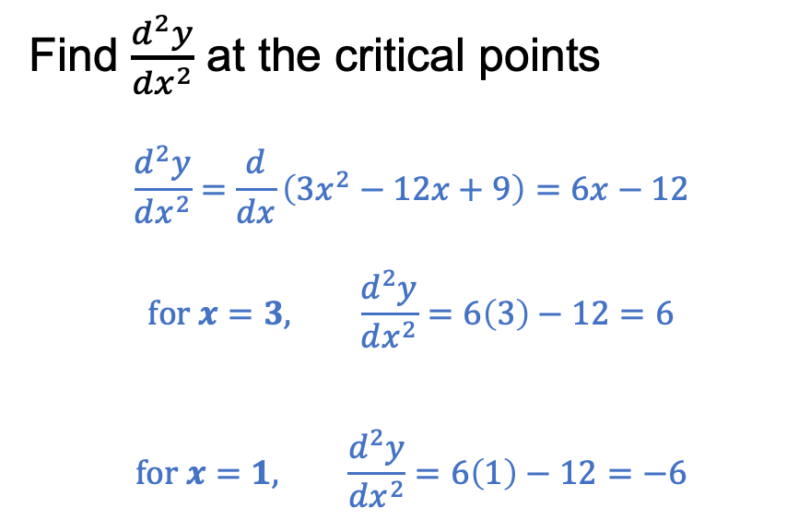


Maximum or minimum: Answers
Recap and Worked examples
To find the maximum and minimum of $y=x^{3}−6x^{2}+9x:$
Find the critical points, $\frac{dy}{dx}=0$
$$\frac{dy}{dx}=3x^{2}−12x+9=0$$
$$x^{2}−4x+3=0$$
$$\left(x−3\right)\left(x−1\right)=0$$
$$x=3 or x=1$$
Find $\frac{d^{2}y}{dx^{2}}$ at the critical points
$$\frac{d^{2}y}{dx^{2}}=\frac{d}{dx}\left({3x}^{2}−12x+9\right)=6x−12$$
$$for x=3, \frac{d^{2}y}{dx^{2}}=6\left(3\right)−12=6$$
$$for x=1, \frac{d^{2}y}{dx^{2}}=6\left(1\right)−12=−6$$
positive means $x=3$is a minimum
negative means $x=1$ is a maximum
Resource 4: Calculus – Differentiation

Slide 15
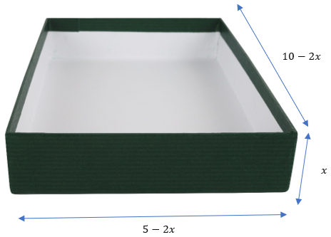
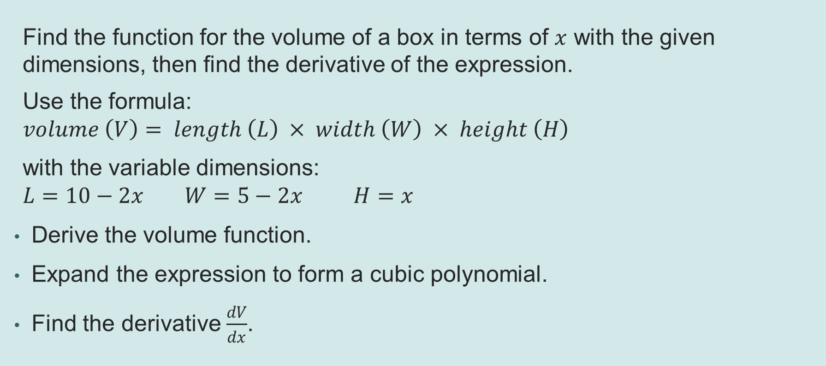
Worked example 1: Box size optimisation
Recap and Worked examples
Find the function for the volume of a box in terms of $x$ with the given dimensions, then find the derivative of the expression.
Use the formula:
$$volume \left(V\right)= length \left(L\right) × width \left(W\right) × height \left(H\right)$$
with the variable dimensions:
$$L=10−2x W=5−2x H=x$$
Derive the volume function.
Expand the expression to form a cubic polynomial.
Find the derivative $\frac{dV}{dx}$.
Resource 4: Calculus – Differentiation
Notes:
Image © Shutterstock/Richard Peterson

Slide 16
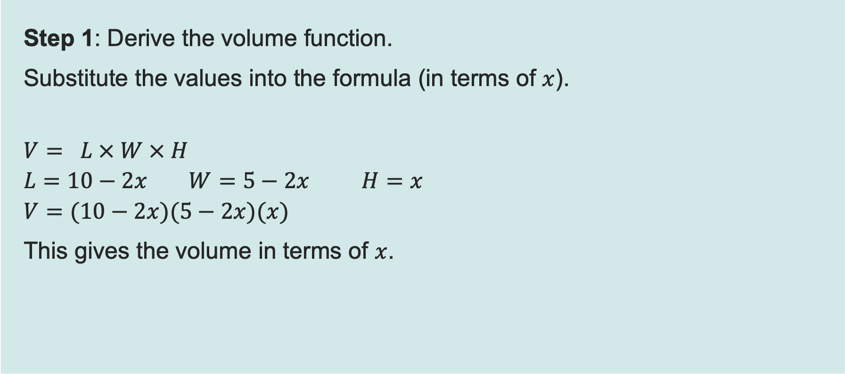
Worked example 1: Box size optimisation
Recap and Worked examples
Step 1: Derive the volume function.
Substitute the values into the formula (in terms of $x$).
$$V= L × W × H$$
$$L=10−2x W=5−2x H=x$$
$$V=(10−2x)(5−2x)(x)$$
This gives the volume in terms of $x$.
Two or more sets of brackets written next to each other mean they are multiplied together.
Resource 4: Calculus – Differentiation
Notes:
Image © Shutterstock/Richard Peterson

Slide 17
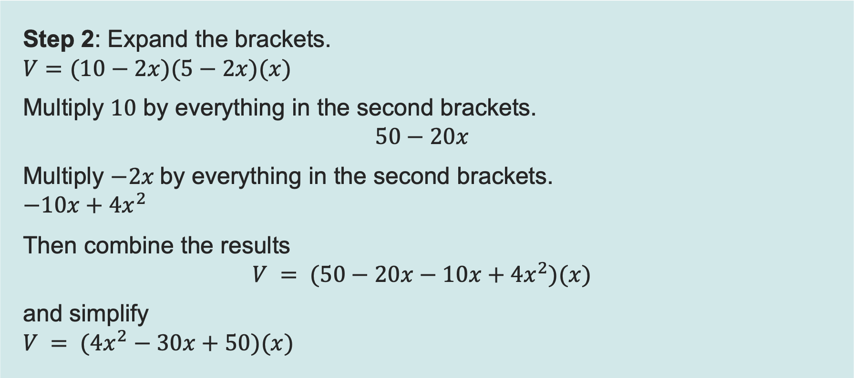
Worked example 1: Box size optimisation
Recap and Worked examples
Step 2: Expand the brackets.
$$V=(10−2x)(5−2x)(x)$$
Multiply $10$ by everything in the second brackets.
$$50−20x$$
Multiply $−2x$by everything in the second brackets.
$$−10x+4x^{2}$$
Then combine the results
$$V = (50−20x−10x+{4x}^{2})(x)$$
and simplify
$$V = ({4x}^{2}−30x+50)(x)$$
Resource 4: Calculus – Differentiation

Slide 18
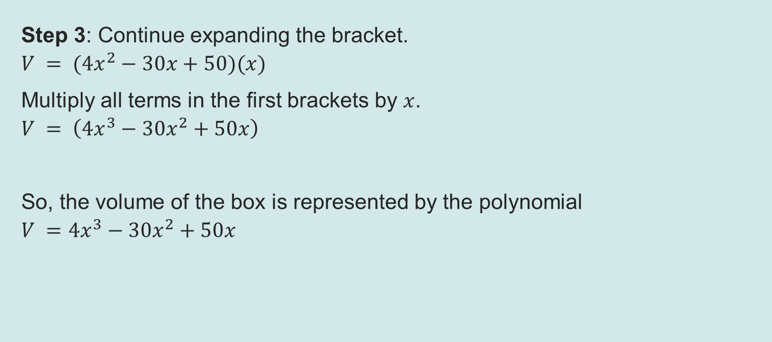
Worked example 1: Box size optimisation
Recap and Worked examples
Step 3: Continue expanding the bracket.
$$V = ({4x}^{2}−30x+50)(x)$$
Multiply all terms in the first brackets by $x$.
$$V = \left({4x}^{3}−{30x}^{2}+50x\right)$$
So, the volume of the box is represented by the polynomial
$$V ={4x}^{3}−{30x}^{2}+50x$$
Resource 4: Calculus – Differentiation

Slide 19
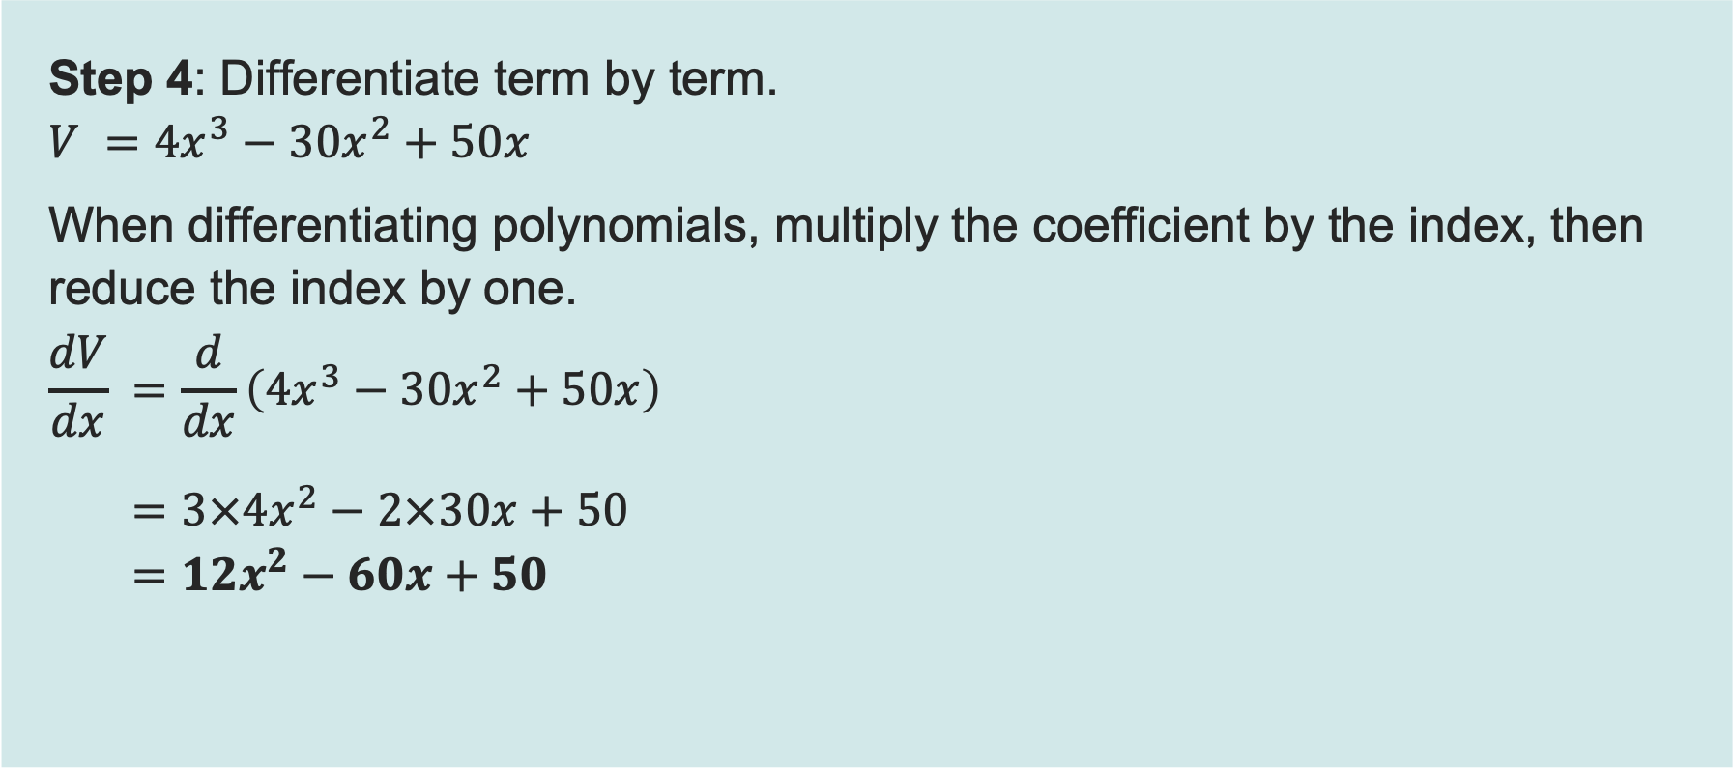
Worked example 1: Box size optimisation
Recap and Worked examples
Step 4: Differentiate term by term.
$$V ={4x}^{3}−{30x}^{2}+50x$$
When differentiating polynomials, multiply the coefficient by the index, then reduce the index by one.
$$\frac{dV}{dx} =\frac{d}{dx}\left({4x}^{3}−{30x}^{2}+50x\right)$$
  $$=3×4x^{2}−2×30x+50$$
  $$=12x^{2}−60x+50$$
$x$can be written as $x1$. When differentiated, the index reduces to 0, so the result is $x0$.
Anything to the power of 0 is 1, so the derivative of $x$ is $x^{0}=1$.
Resource 4: Calculus – Differentiation

Slide 20
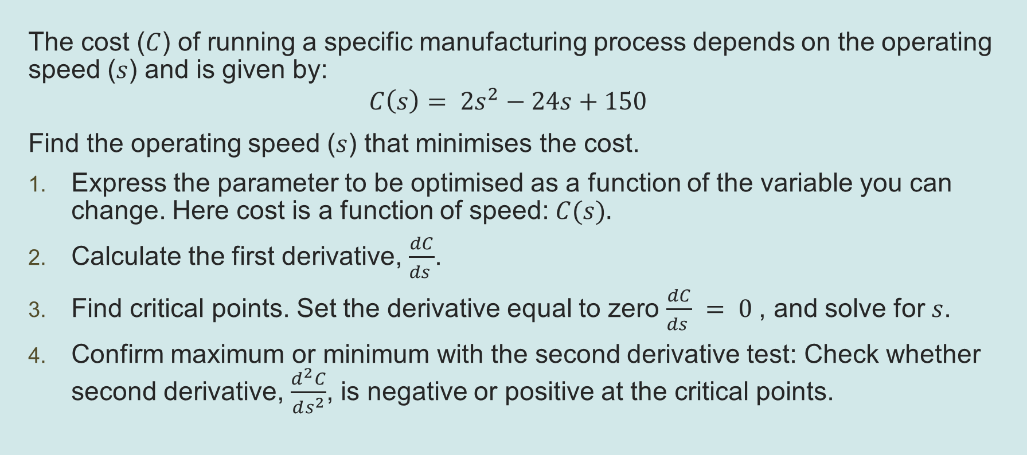
Worked example 2: Finding the optimal point
Recap and Worked examples
The cost ($C$) of running a specific manufacturing process depends on the operating speed ($s$) and is given by:
$$C\left(s\right)= 2s^{2}−24s+150$$
Find the operating speed ($s$) that minimises the cost.
Express the parameter to be optimised as a function of the variable you can change. Here cost is a function of speed: $C(s).$
Calculate the first derivative, $\frac{dC}{ds }$.
Find critical points. Set the derivative equal to zero $\frac{dC}{ds } = 0$, and solve for $s$.
Confirm maximum or minimum with the second derivative test: Check whether second derivative, $\frac{d^{2}C}{ds^{2}}$, is negative or positive at the critical points.
Resource 4: Calculus – Differentiation

Slide 21
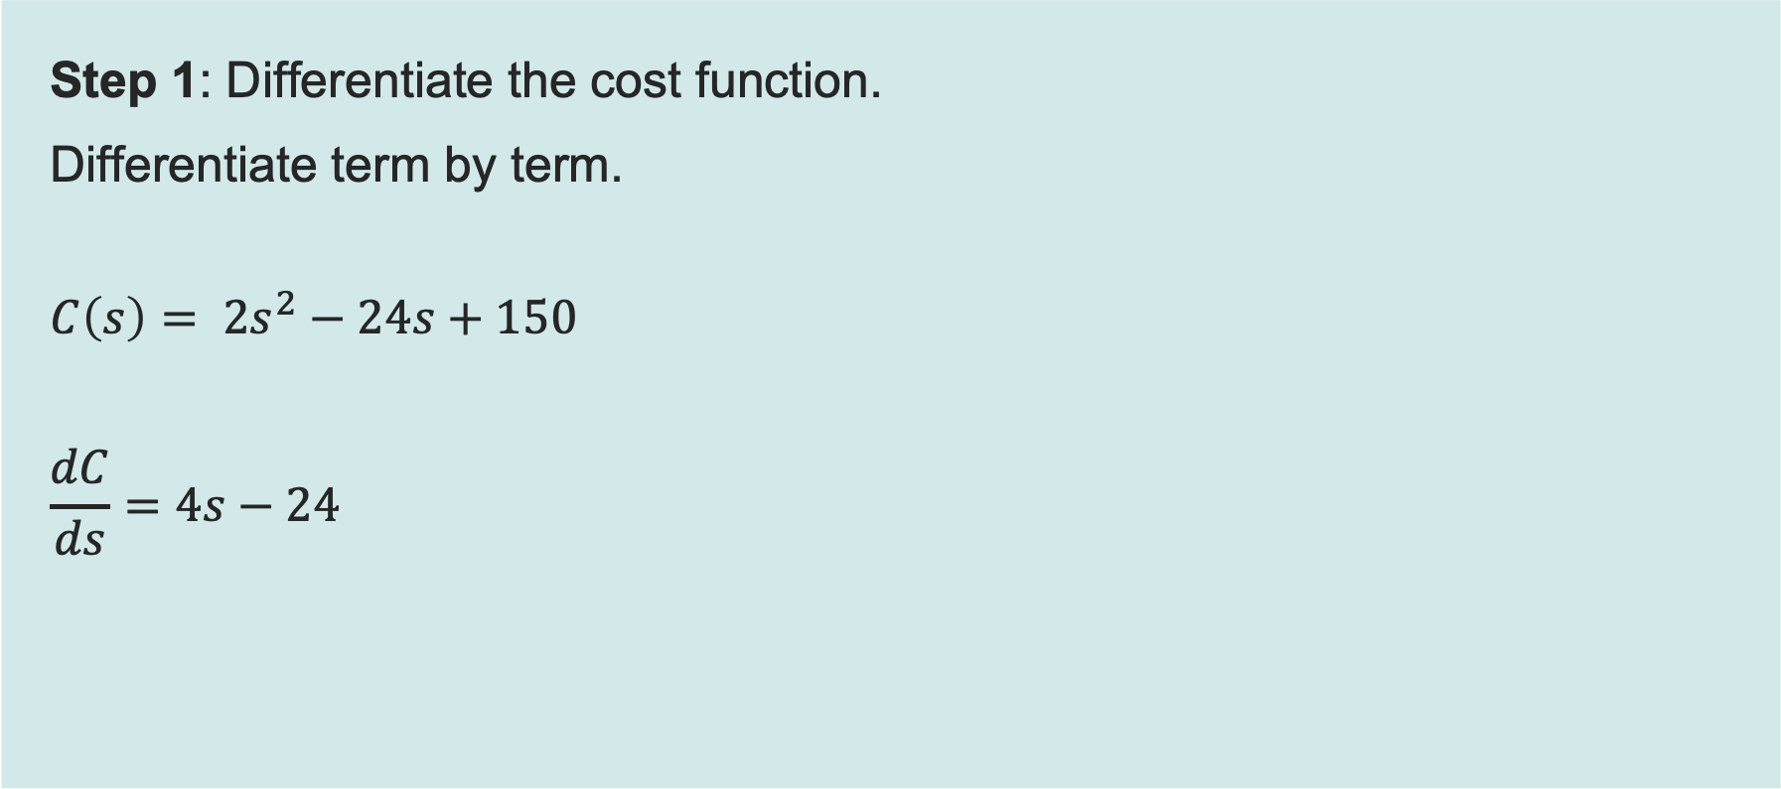
Worked example 2: Finding the optimal point
Recap and Worked examples
Step 1: Differentiate the cost function.
Differentiate term by term.
$$C\left(s\right)= 2s^{2}−24s+150$$
$$\frac{dC}{ds}=4s−24$$
When you differentiate a number (a constant), the result is always 0.
Resource 4: Calculus – Differentiation

Slide 22
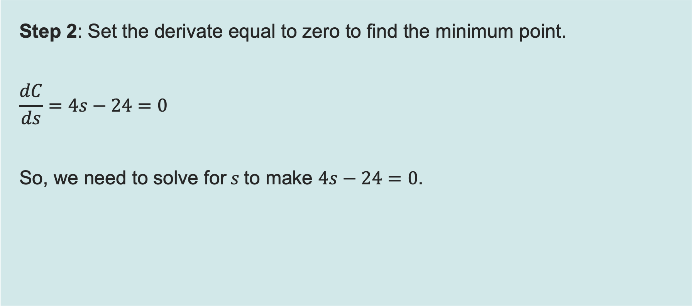
Worked example 2: Finding the optimal point
Recap and Worked examples
Step 2: Set the derivate equal to zero to find the minimum point.
$$\frac{dC}{ds}=4s−24=0$$
So, we need to solve for$s$to make $4s−24=0$.
To find critical points: Set the derivative equal to zero and solve.
If the second derivative is negative, the critical point will be a maximum.
If the second derivative is positive, the critical point will be a minimum.
Resource 4: Calculus – Differentiation

Slide 23
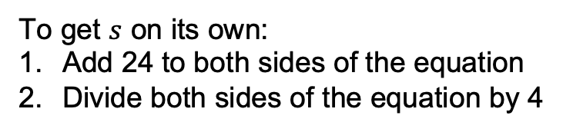
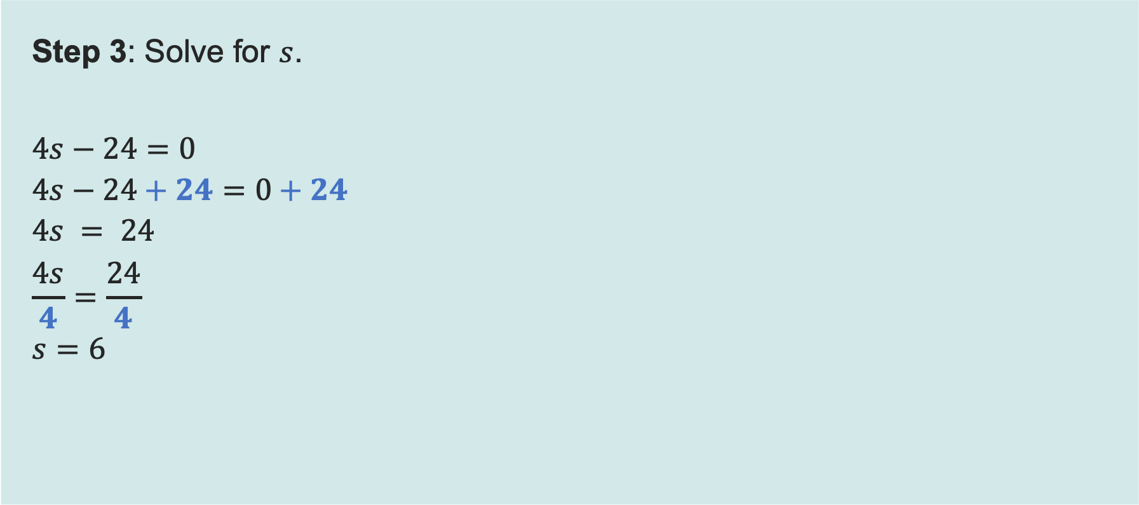
Worked example 2: Finding the optimal point
Recap and Worked examples
Step 3: Solve for $s$.
$$4s−24=0$$
$$4s−24+24=0+24$$
$$4s = 24$$
$$\frac{4s}{4}=\frac{24}{4}$$
$$s=6$$
To get $s$ on its own:
Add 24 to both sides of the equation
Divide both sides of the equation by 4
Resource 4: Calculus – Differentiation

Slide 24
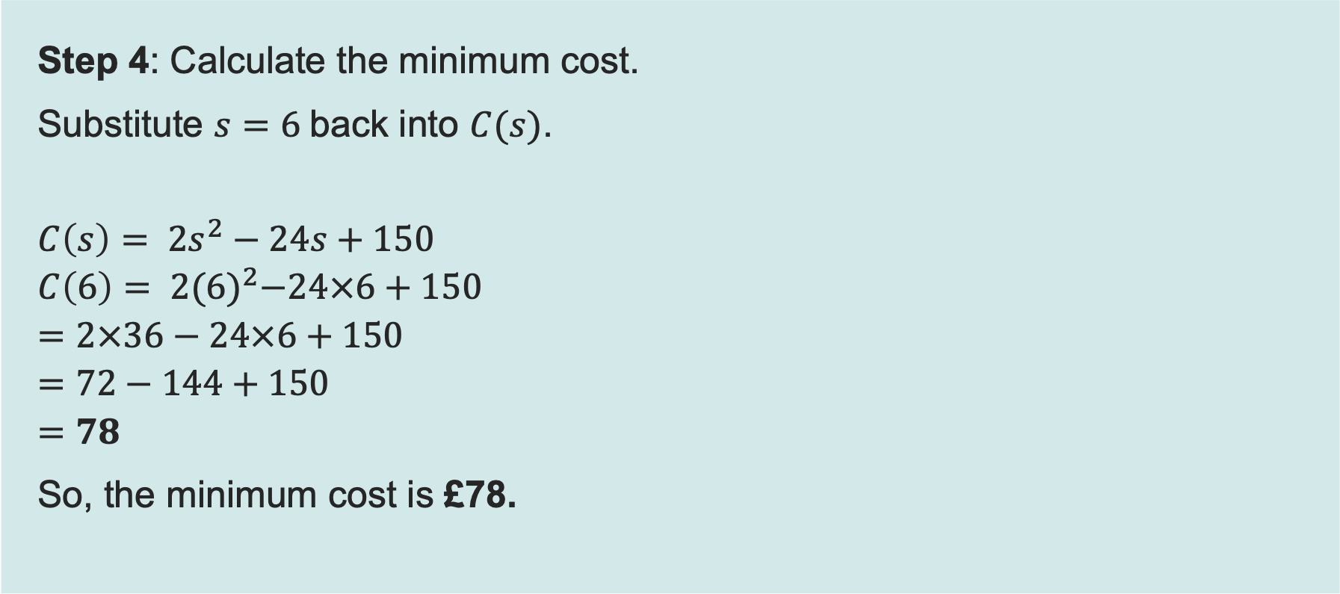
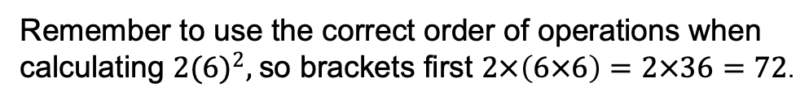
Worked example 2: Finding the optimal point
Recap and Worked examples
Step 4: Calculate the minimum cost.
Substitute $s=6$back into $C(s)$.
$$C\left(s\right)= 2s^{2}−24s+150$$
$$C\left(6\right)= 2{(6)}^{2}−24×6+150$$
$$=2×36−24×6+150$$
$$=72−144+150$$
$$=78$$
So, the minimum cost is £78.
Remember to use the correct order of operations when calculating $2{(6)}^{2},$so brackets first $2×\left(6×6\right)=2×36=72$.
Resource 4: Calculus – Differentiation

Slide 25
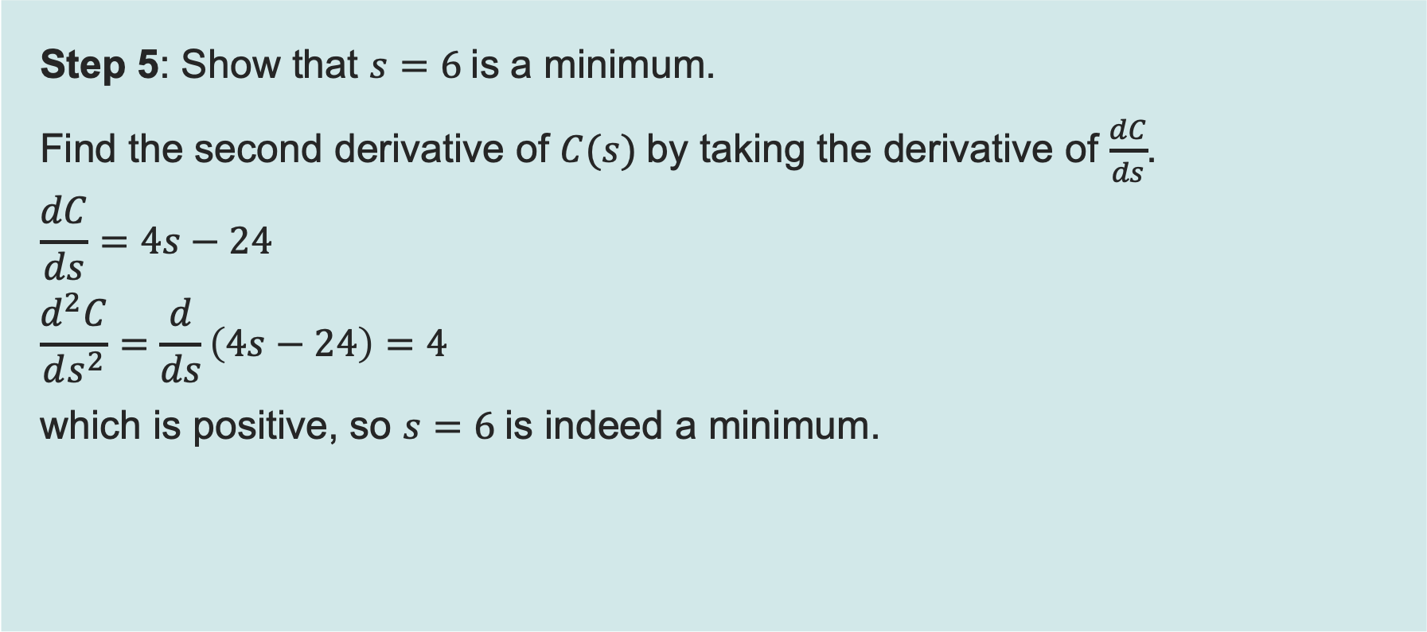
Worked example 2: Finding the optimal point
Recap and Worked examples
Step 5: Show that $s=6$is a minimum.
Find the second derivative of $C(s)$by taking the derivative of $\frac{dC}{ds}$.
$$\frac{dC}{ds}=4s−24$$
$$\frac{d^{2}C}{ds^{2}}=\frac{d}{ds}\left(4s−24\right)=4$$
which is positive, so $s=6$is indeed a minimum.
To find critical points: Set the derivative equal to zero and solve.
If the second derivative is negative, the critical point will be a maximum.
If the second derivative is positive, the critical point will be a minimum.
Resource 4: Calculus – Differentiation

Slide 26

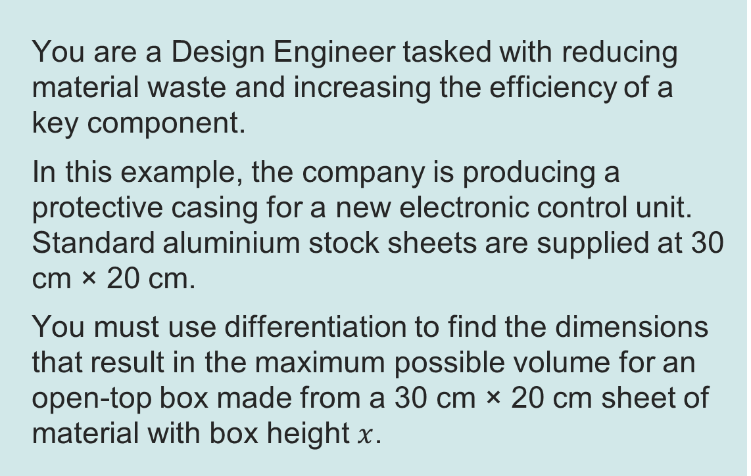

Activity 1 – Box optimisation
Activity 1
20 cm
You are a Design Engineer tasked with reducing material waste and increasing the efficiency of a key component.
In this example, the company is producing a protective casing for a new electronic control unit. Standard aluminium stock sheets are supplied at 30 cm × 20 cm.
You must use differentiation to find the dimensions that result in the maximum possible volume for an open-top box made from a 30 cm × 20 cm sheet of material with box height $x$.
30 cm
$$x$$
$$x$$
Resource 4: Calculus – Differentiation

