Slide 1
Engineering and Manufacturing: Core
Route: Engineering and Manufacturing
Topic: Manipulating equations and calculus
Resource 5: Calculus - Integration
Notes:
Image © Shutterstock/Gorodenkoff

Slide 2
In this resource, we will:
Introduction
Skills
CSE (Communicate and present outcomes and evidence)
General competencies
English:
EC1 Convey technical information to different audiences
Maths:
MC2 Estimating, calculating and error spotting
calculate indefinite integral using the power rule in reverse for polynomial functions, including the constant of integration;
calculate the area under a curve (or cumulative quantities) given interval using definite integration;
calculate the constant of integration using initial conditions in engineering contexts.
Resource 5: Calculus – Integration

Slide 3
Calculus – Integration
Introduction
  Calculus is fundamental throughout engineering and manufacturing.
  It is a branch of maths that consists of two key parts:
  differential calculus
  integral calculus.
Integral calculus helps us determine how things accumulate.
Resource 5: Calculus – Integration

Slide 4
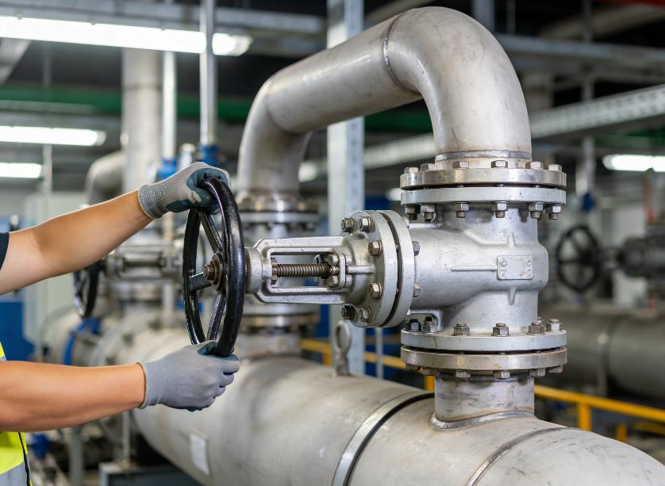
Integration in industry
Introduction
Integration is essential in industry, including when calculating:
total energy consumption
over time;
total volume of water from
a variable flow;
total distance travelled from
a changing velocity;
electronic circuit component values where input values can change.
Resource 5: Calculus – Integration
Notes:
Image © Shutterstock/Snide12

Slide 5


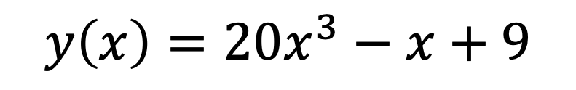
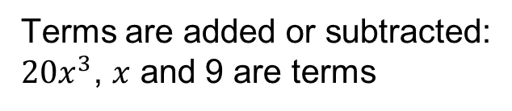


Polynomials
Recap and Worked examples
A polynomial is a mathematical expression made of terms with variables raised to a whole-number power or index.
Polynomials are common in engineering modelling.
Terms are added or subtracted:
$20x^{3}$, $x$ and 9 are terms
3 is a power or index
$x$ is a variable
$$y\left(x\right)={20x}^{3}−x+9$$
$y$ is a function of $x$
$9$ is a constant
$20$ is a coefficient
$x$ has coefficient 1, even though it is not written
Resource 5: Calculus – Integration

Slide 6
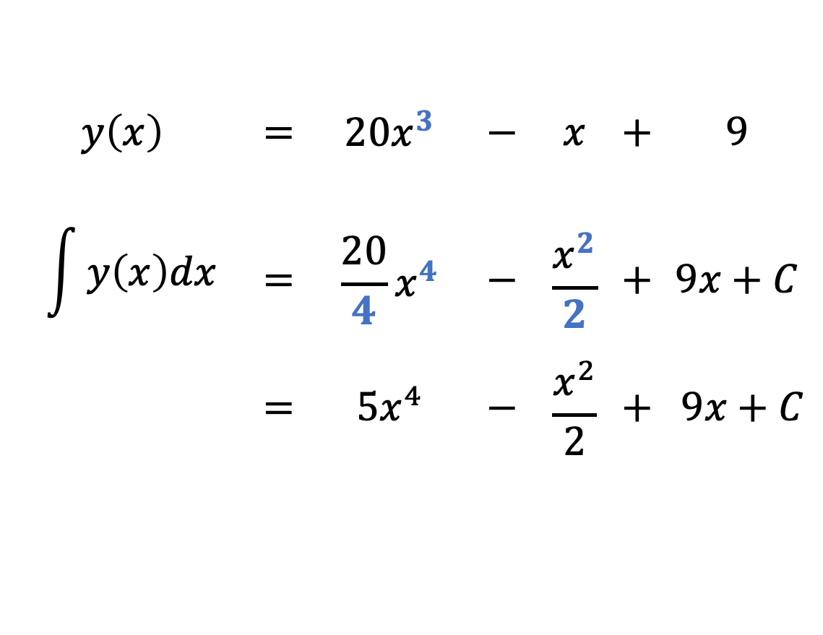
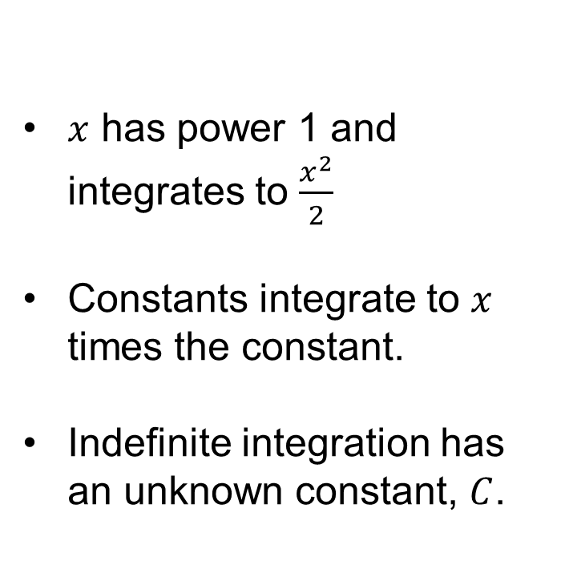
Indefinite integration of polynomials
Recap and Worked examples
The power rule: for each term
increase the power by 1
divide the coefficient by the new power
$x$ has power 1 and integrates to $\frac{x^{2}}{2}$
Constants integrate to $x$ times the constant.
Indefinite integration has an unknown constant, $C$.
Keep in mind
$$y\left(x\right)$$ | $$=$$ | $${20x}^{3}$$ | $$−$$ | $$x$$ | $$+$$ | $$9$$
$$\int{y\left(x\right)dx}$$ | $$=$$ | $$\frac{20}{4}x^{4}$$ | $$−$$ | $$\frac{x^{2}}{2}$$ | $$+$$ | $$9x+C$$
 | $$=$$ | $$5x^{4}$$ | $$−$$ | $$\frac{x^{2}}{2}$$ | $$+$$ | $9x+C$
Resource 5: Calculus – Integration

Slide 7
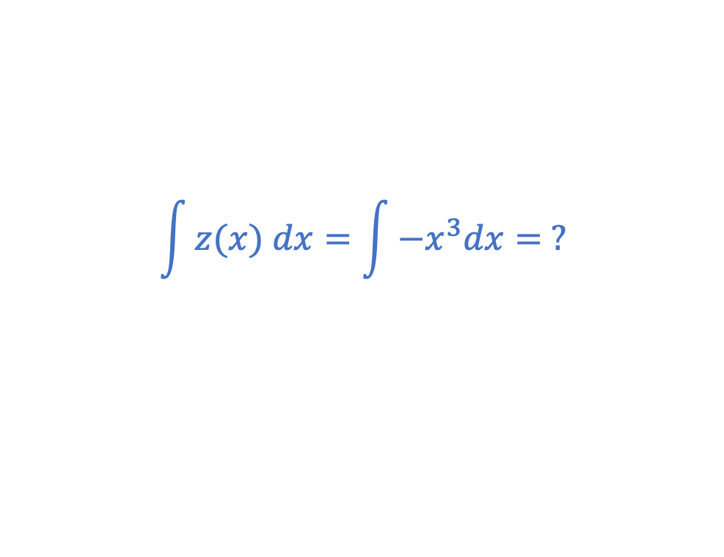

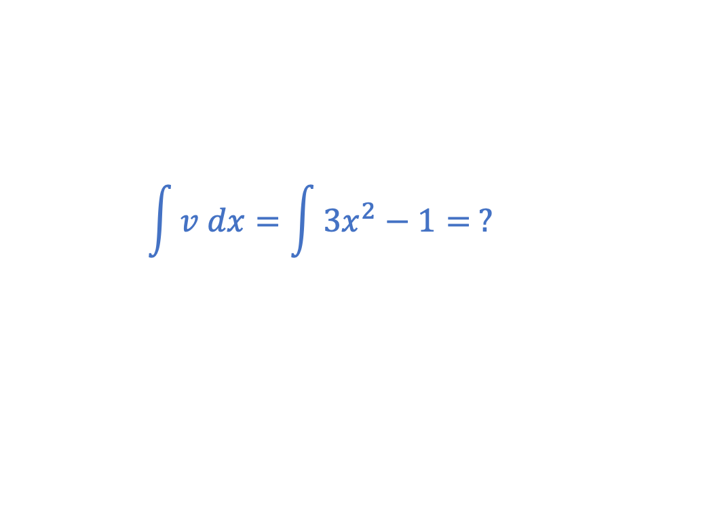


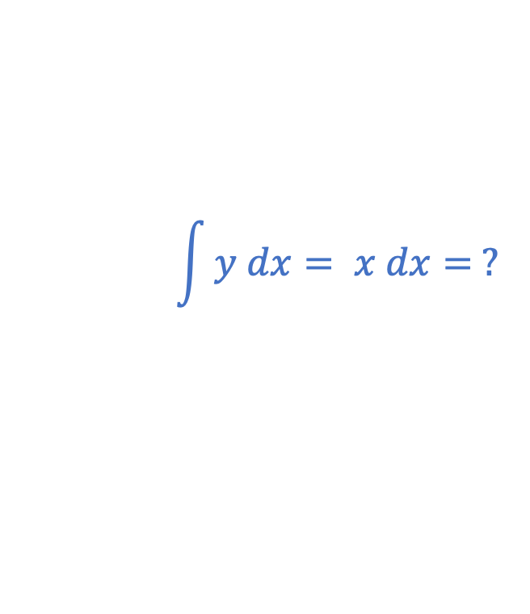

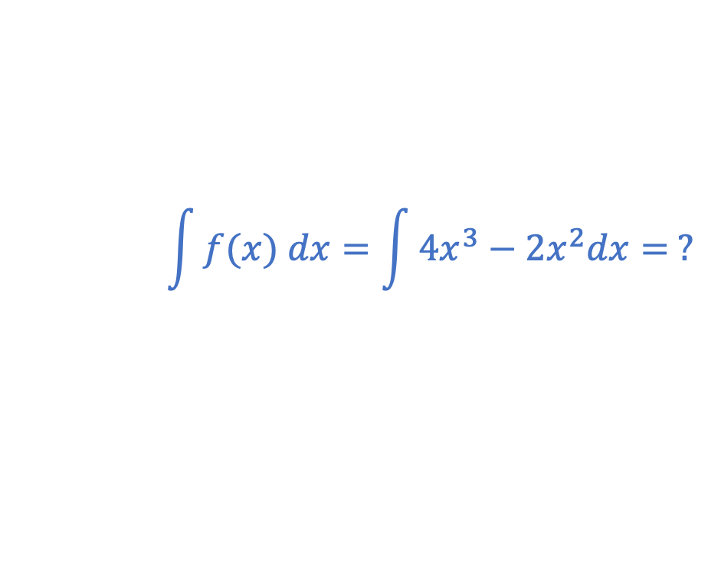
Indefinite integration practice
Recap and Worked examples
Integrate each function with respect to $x$:
$$\int{y dx= x dx= ?}$$
$$y=x$$
$$\int{v dx=\int{3x^{2}−1= ? }}$$
$$v={3x}^{2}−1$$
$$\int{z(x) dx=\int{−x^{3}dx= ?}}$$
$$z(x)={−x}^{3}$$
$$\int{f(x) dx=\int{{4x}^{3}−{2x}^{2}dx= ?}}$$
$$f\left(x\right)={4x}^{3}−{2x}^{2}$$
Resource 5: Calculus – Integration

Slide 8
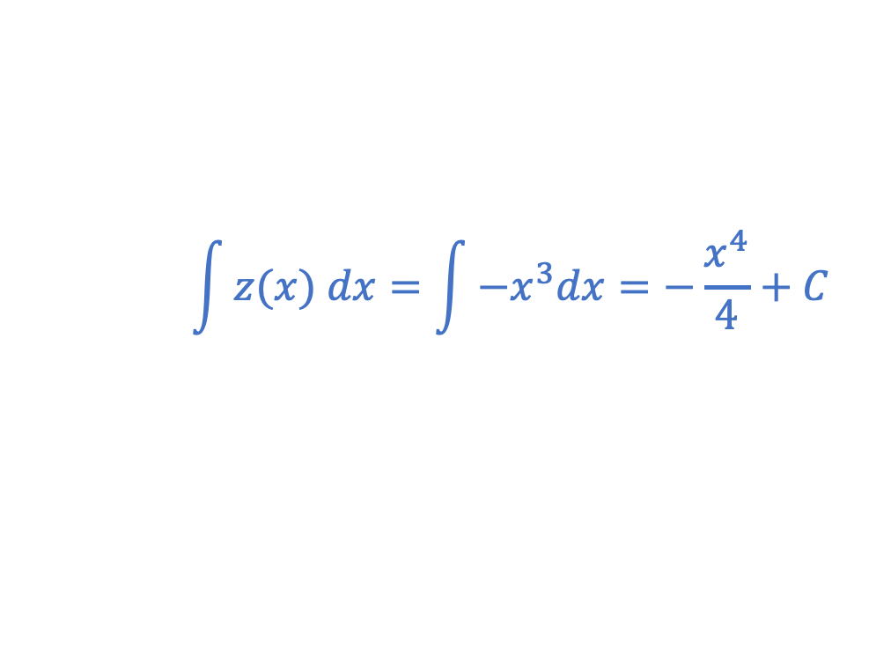
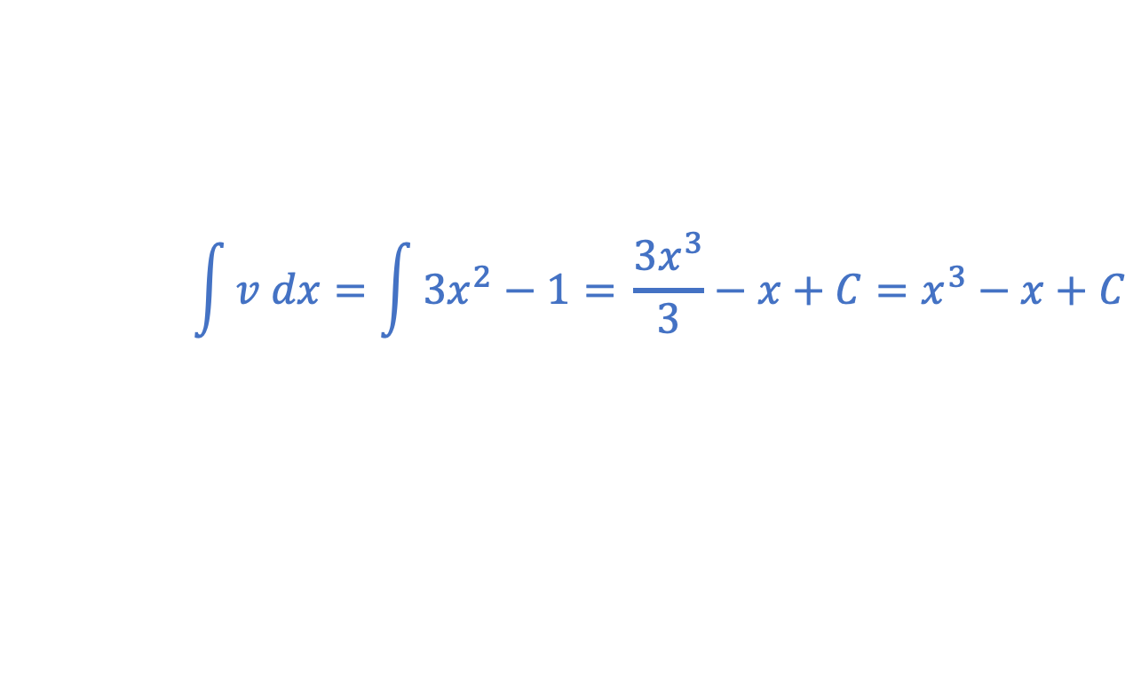
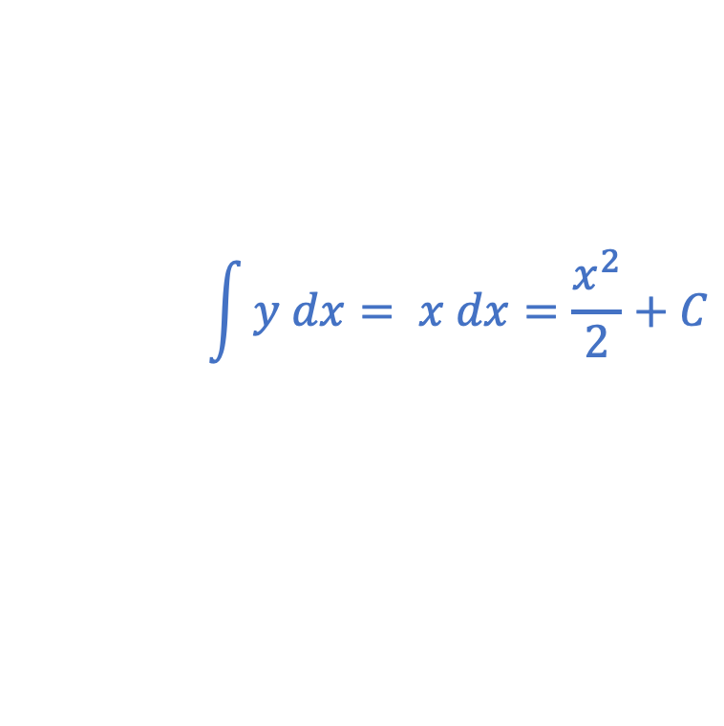
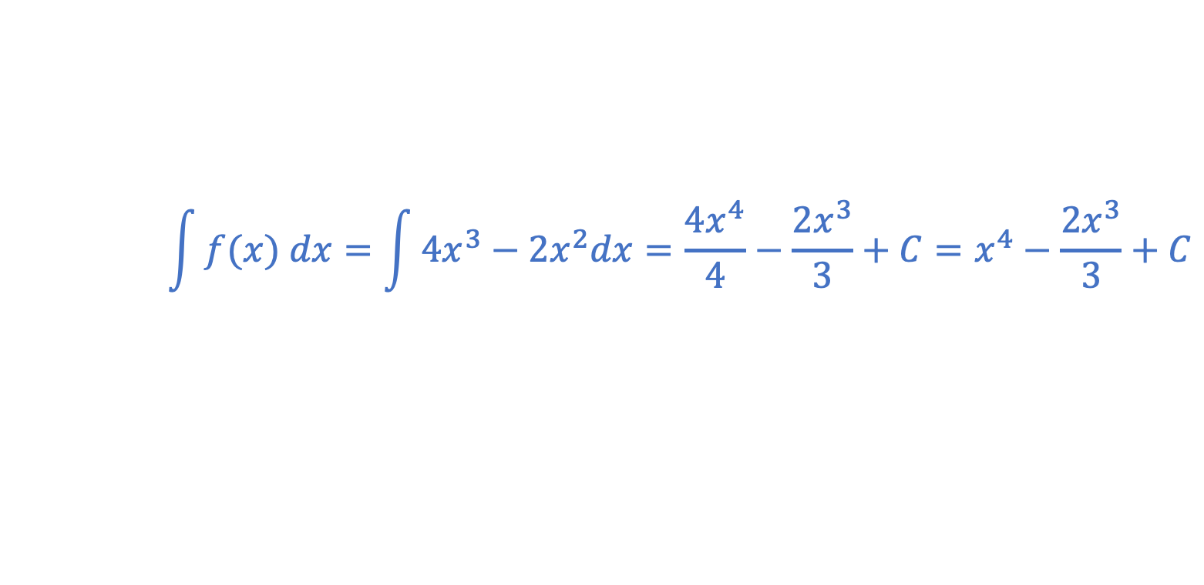
Indefinite integration practice: Answers
Recap and Worked examples
Integrate each function with respect to $x$:
$$\int{y dx= x dx=\frac{x^{2}}{2}+C}$$
$$y=x$$
$$\int{v dx=\int{3x^{2}−1= }\frac{{3x}^{3}}{3}−x+C=x^{3}−x+C}$$
$$v={3x}^{2}−1$$
$$\int{z(x) dx=\int{−x^{3}dx=−\frac{x^{4}}{4}+C}}$$
$$z(x)={−x}^{3}$$
$$\int{f(x) dx=\int{{4x}^{3}−{2x}^{2}dx=\frac{{4x}^{4}}{4}−\frac{{2x}^{3}}{3}+C=x^{4}−\frac{2x^{3}}{3}+C}}$$
$$f\left(x\right)={4x}^{3}−{2x}^{2}$$
Resource 5: Calculus – Integration

Slide 9

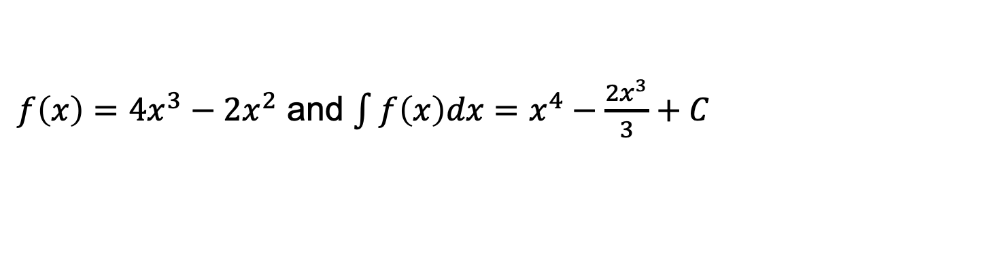
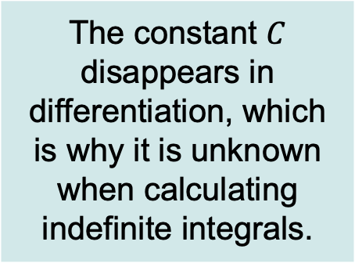
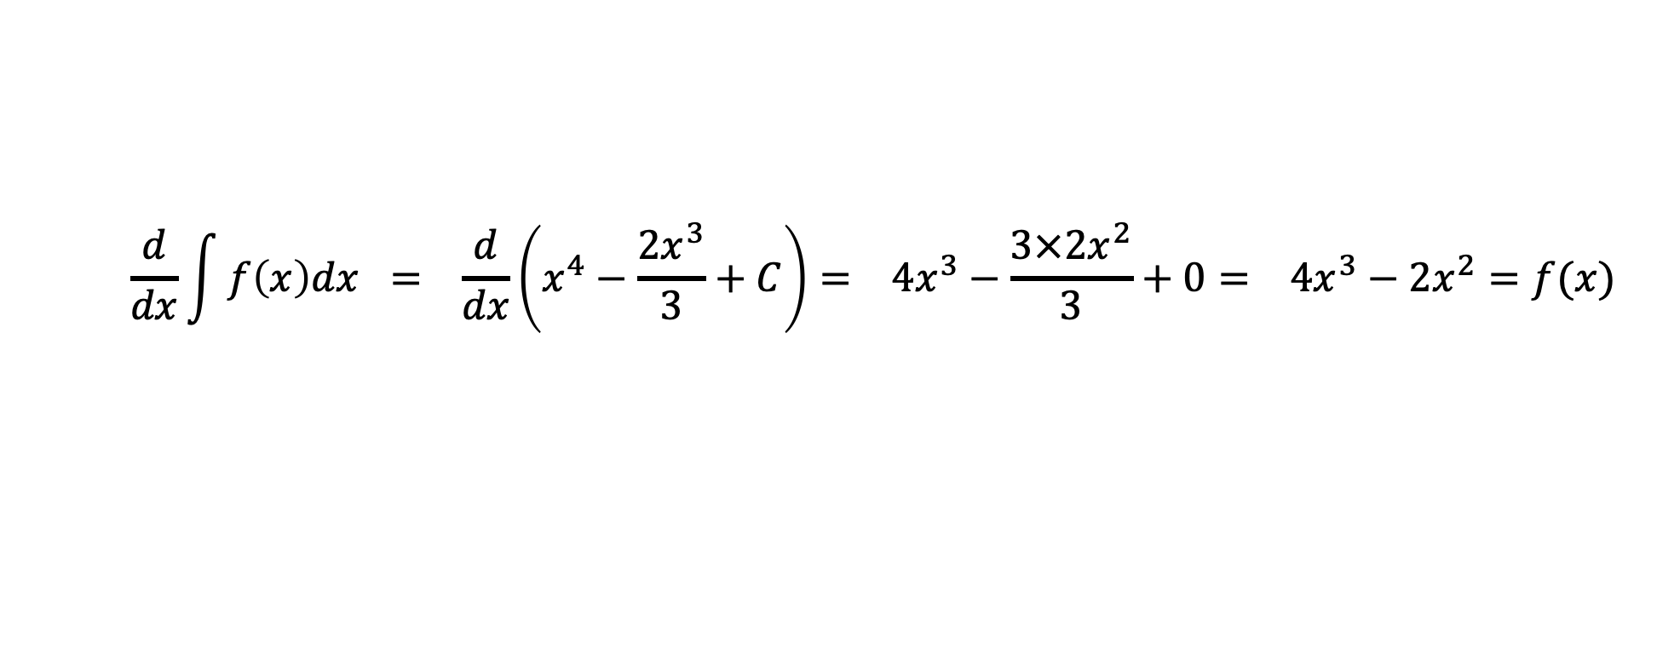
Integration and differentiation
Recap and Worked examples
Integration is the inverse operation of differentiation.
The constant $C$ disappears in differentiation, which is why it is unknown when calculating indefinite integrals.
From the previous practice question:
$f\left(x\right)={4x}^{3}−{2x}^{2}$ and $\int{f\left(x\right)dx=x^{4}−\frac{2x^{3}}{3}+C}$
Take the derivative of $\int{f\left(x\right)dx}$ to show it is $f(x)$.
$$\frac{d}{dx}\int{f\left(x\right)dx = \frac{d}{dx}\left(x^{4}−\frac{2x^{3}}{3}+C\right)= 4x^{3}−\frac{3×2x^{2}}{3}}+0= 4x^{3}−2x^{2}=f(x)$$
Resource 5: Calculus – Integration

Slide 10
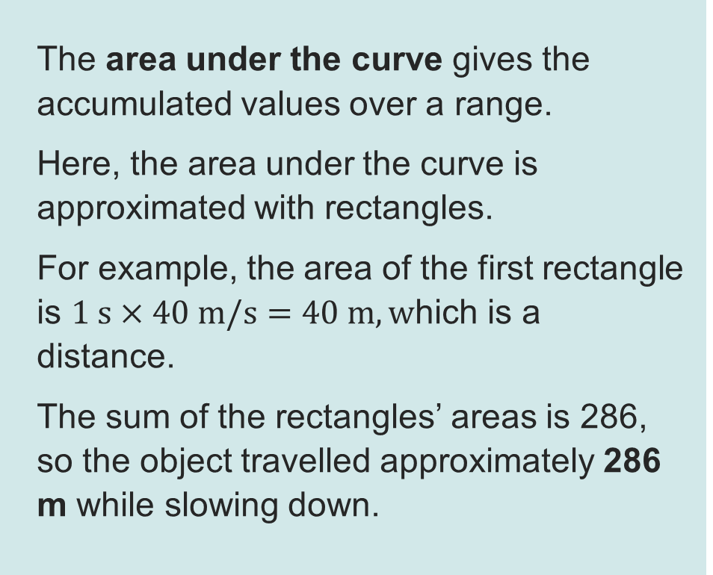
Area under the curve
Recap and Worked examples
The area under the curve gives the accumulated values over a range.
Here, the area under the curve is approximated with rectangles.
For example, the area of the first rectangle is $1 s×40 m/s=40 m, w$hich is a distance.
The sum of the rectangles’ areas is 286,
so the object travelled approximately 286 m while slowing down.
The plot shows the velocity of an object slowing down.
Resource 5: Calculus – Integration

Slide 11
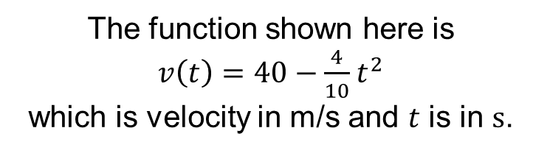
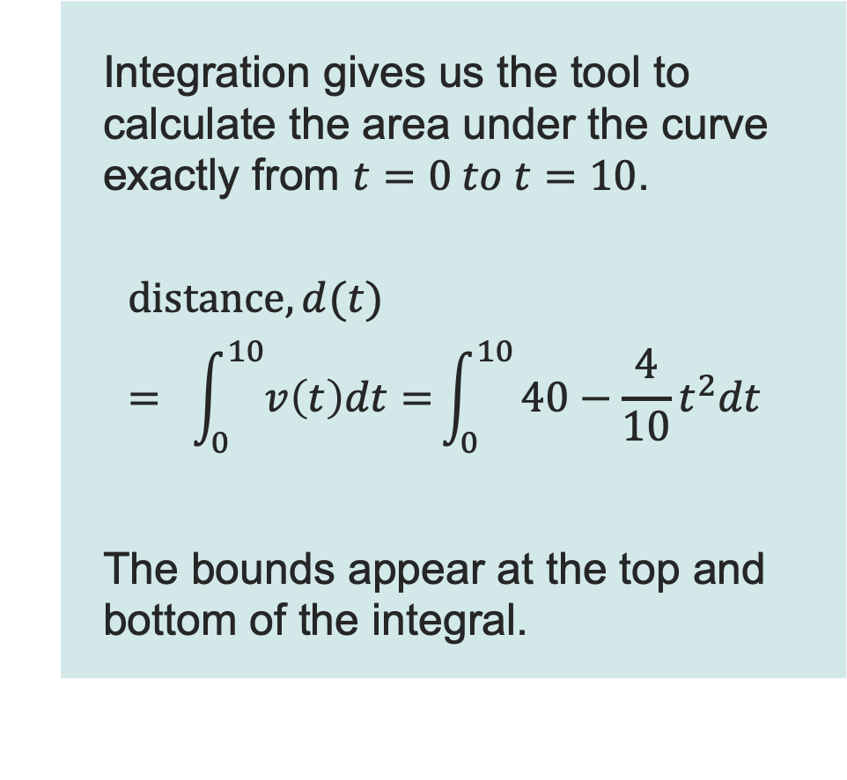
Definite integrals
Recap and Worked examples
The function shown here is
$v\left(t\right)=40−\frac{4}{10}t^{2}$
which is velocity in m/s and $t$ is in $s$.
Integration gives us the tool to calculate the area under the curve exactly from $t=0 to t=10$.
$$distance, d(t) = \int_{0}^{10}{v\left(t\right)dt=}\int_{0}^{10}{40−\frac{4}{10}t^{2}dt}$$
The bounds appear at the top and bottom of the integral.
Resource 5: Calculus – Integration

Slide 12
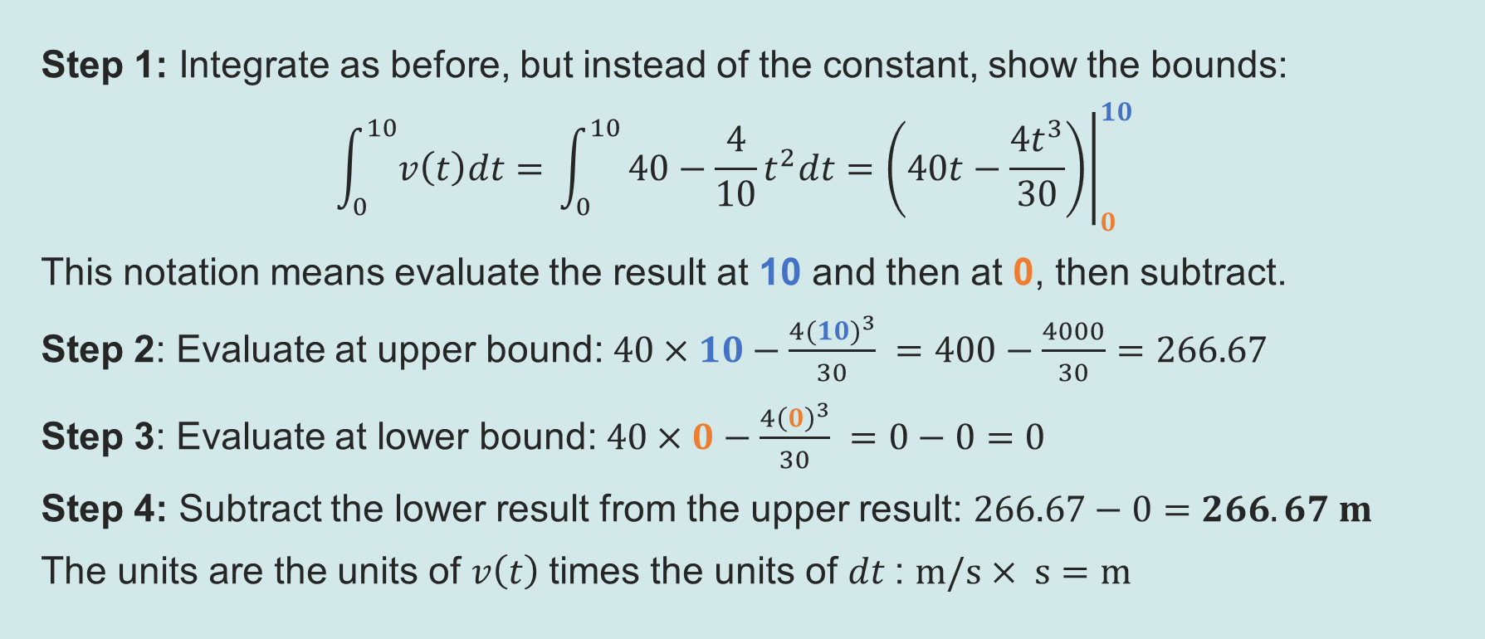
Evaluating definite integrals
Recap and Worked examples
Step 1: Integrate as before, but instead of the constant, show the bounds:
$$\int_{0}^{10}{v\left(t\right)dt=} \int_{0}^{10}{40−\frac{4}{10}t^{2}dt}={\left.\left(40t−\frac{{4t}^{3}}{30}\right)\right|}_{0}^{10}$$
This notation means evaluate the result at 10 and then at 0, then subtract.
Step 2: Evaluate at upper bound: $40×10−\frac{{4(10)}^{3}}{30} =400−\frac{4000}{30}=266.67$
Step 3: Evaluate at lower bound: $40×0−\frac{4{\left(0\right)}^{3}}{30} =0−0=0$
Step 4: Subtract the lower result from the upper result: $266.67−0=266.67 m$
The units are the units of $v\left(t\right)$times the units of $dt$: $m/s× s=m$
Resource 5: Calculus – Integration

Slide 13

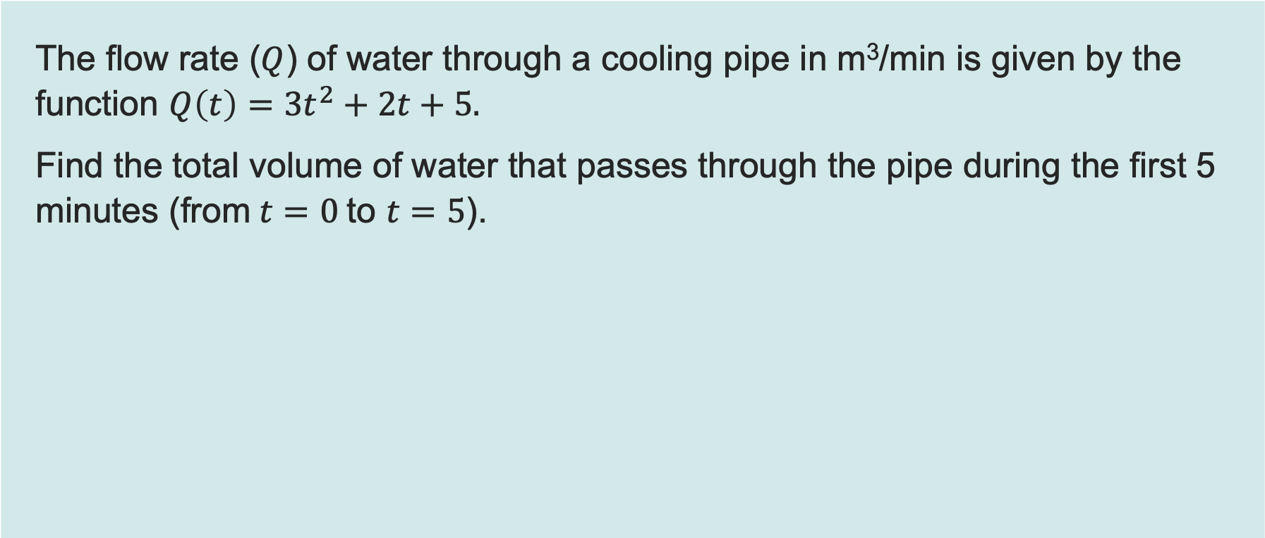
Worked example 1: Definite integral
Recap and Worked examples
The flow rate ($Q$) of water through a cooling pipe in m³/min is given by the function $Q\left(t\right)=3t^{2}+2t+5.$
Find the total volume of water that passes through the pipe during the first 5 minutes (from$t=0$to $t=5$).
Definite integral: Used to find the total quantity (area under the curve) between two points.
Resource 5: Calculus – Integration

Slide 14
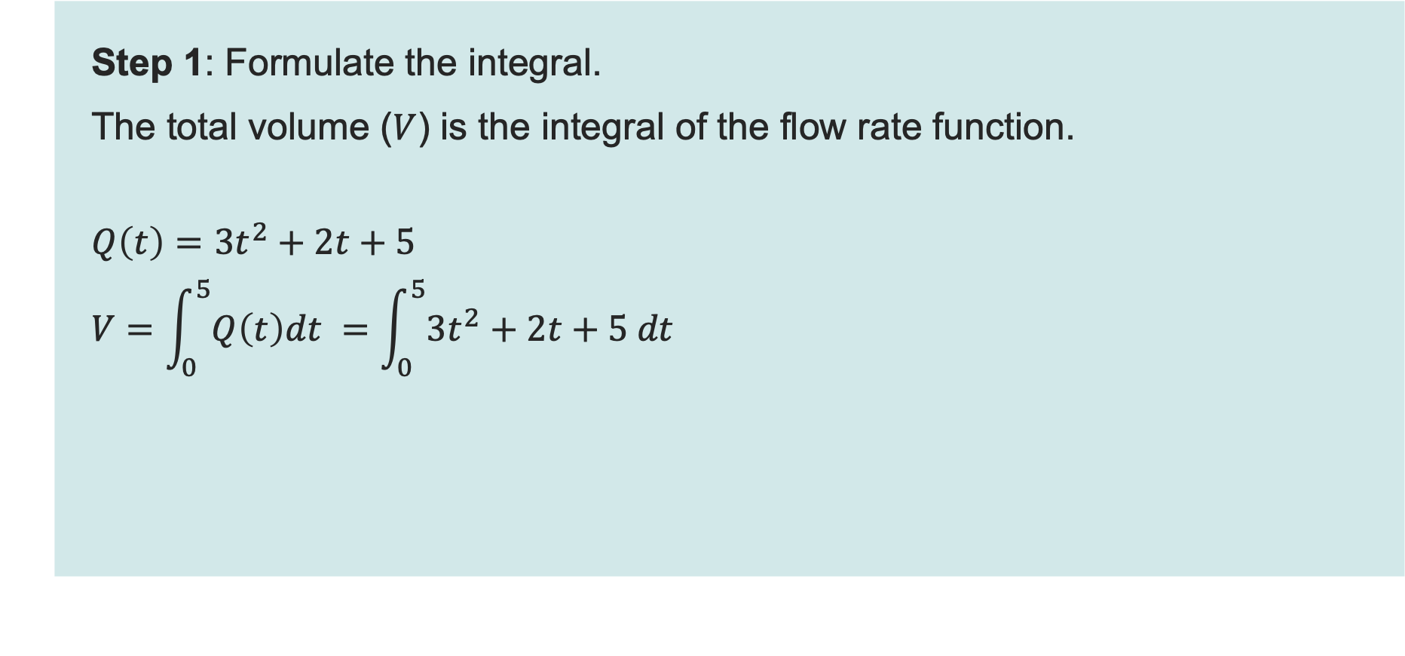

Worked example 1: Definite integral
Recap and Worked examples
Step 1: Formulate the integral.
The total volume ($V$) is the integral of the flow rate function.
$$Q\left(t\right)=3t^{2}+2t+5$$
$$V=\int_{0}^{5}{Q\left(t\right)dt }=\int_{0}^{5}{3t^{2}+2t+5 dt }$$
For definite integration, add the limits to the integral.
In this example from $t=0$to $t=5$.
Resource 5: Calculus – Integration

Slide 15
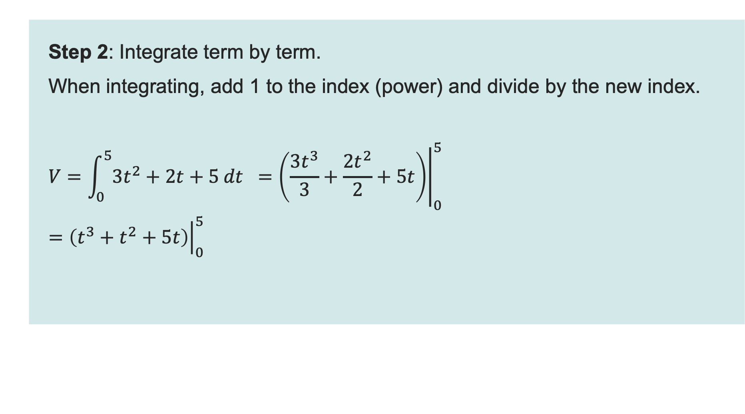
Worked example 1: Definite integral
Recap and Worked examples
Step 2: Integrate term by term.
When integrating, add 1 to the index (power) and divide by the new index.
$$V=\int_{0}^{5}{3t^{2}+2t+5 dt } ={\left.\left(\frac{3t^{3}}{3}+\frac{2t^{2}}{2}+5t\right)\right|}_{0}^{5}$$
$$={\left.\left(t^{3}+t^{2}+5t\right)\right|}_{0}^{5}$$
Resource 5: Calculus – Integration

Slide 16
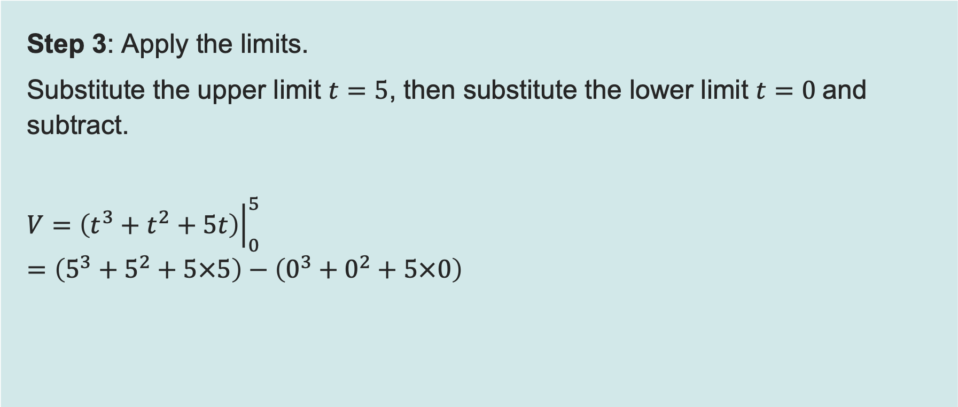
Worked example 1: Definite integral
Recap and Worked examples
Step 3: Apply the limits.
Substitute the upper limit $t=5$, then substitute the lower limit $t=0$and subtract.
$$V={\left.\left(t^{3}+t^{2}+5t\right)\right|}_{0}^{5}$$
$$=\left(5^{3}+5^{2}+5×5\right)−\left(0^{3}+0^{2}+5×0\right)$$
Resource 5: Calculus – Integration

Slide 17
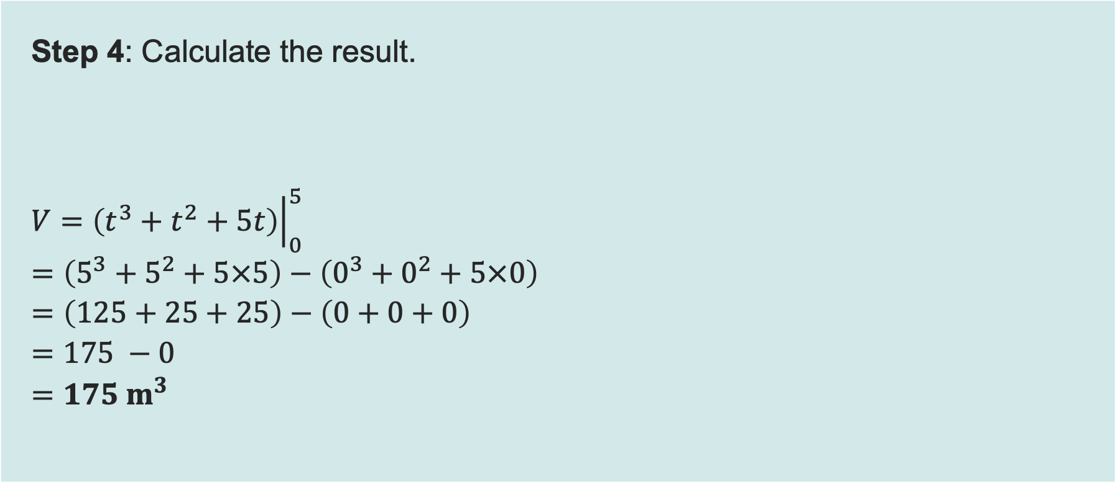
Worked example 1: Definite integral
Recap and Worked examples
Step 4: Calculate the result.
$$V={\left.\left(t^{3}+t^{2}+5t\right)\right|}_{0}^{5}$$
$$=\left(5^{3}+5^{2}+5×5\right)−\left(0^{3}+0^{2}+5×0\right)$$
$$=\left(125+25+25\right)−\left(0+0+0\right)$$
$$=175 −0$$
$$=175 m^{3}$$
Resource 5: Calculus – Integration

Slide 18

Worked example 2: Indefinite integral
Recap and Worked examples
The velocity ($v$) of a component starting from a test rig is given by the function $v\left(t\right)=4t^{3}−6t+2 m/s.$
If the component starts from a position $s = 3 m$(when $t=0$), find the equation for its displacement $s(t)$.
Indefinite integral: Used to find the general formula.
Resource 5: Calculus – Integration

Slide 19
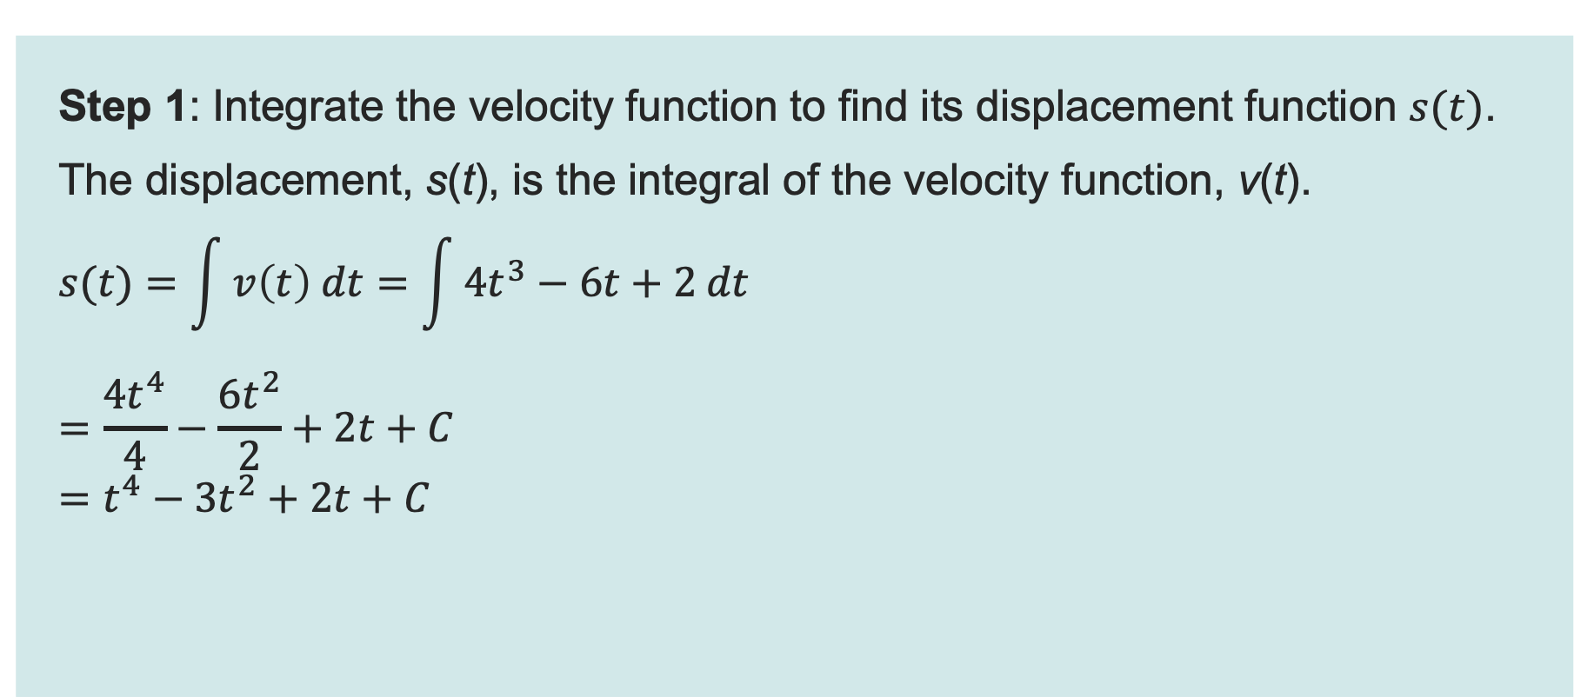
Worked example 2: Indefinite integral
Recap and Worked examples
Step 1: Integrate the velocity function to find its displacement function $s(t)$.
The displacement, s(t), is the integral of the velocity function, v(t).
$$s(t)=\int{v\left(t\right) dt}=\int{4t^{3}−6t+2 dt}$$
$$=\frac{4t^{4}}{4}−\frac{6t^{2}}{2}+2t+C$$
$$=t^{4}−3t^{2}+2t+C$$
In indefinite integration, add the constant C because integration tells us about the shape of the movement, but C represents the specific starting position which cannot be known from the velocity alone.
This means that…
efficiency = output power ÷ input power
Resource 5: Calculus – Integration

Slide 20
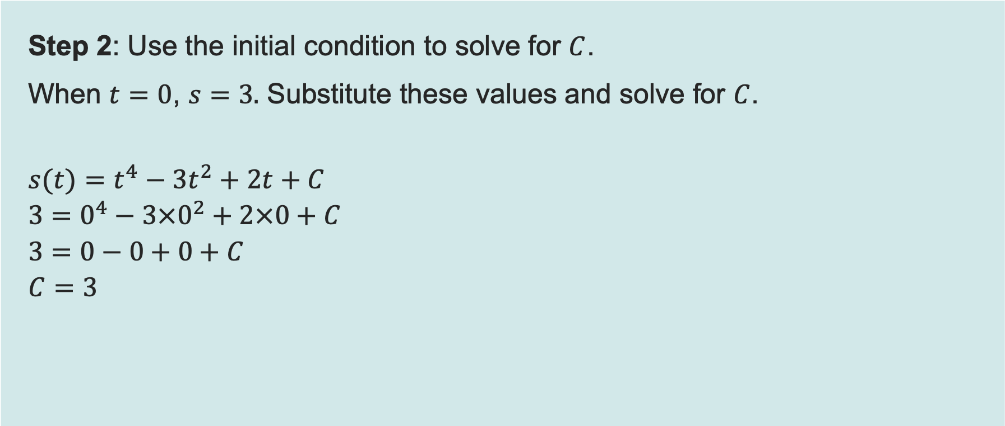
Worked example 2: Indefinite integral
Recap and Worked examples
Step 2: Use the initial condition to solve for $C$.
When $t=0$, $s=3.$ Substitute these values and solve for $C$.
$$s(t)=t^{4}−3t^{2}+2t+C$$
$$3=0^{4}−3×0^{2}+2×0+C$$
$$3=0−0+0+C$$
$$C=3$$
Resource 5: Calculus – Integration

Slide 21

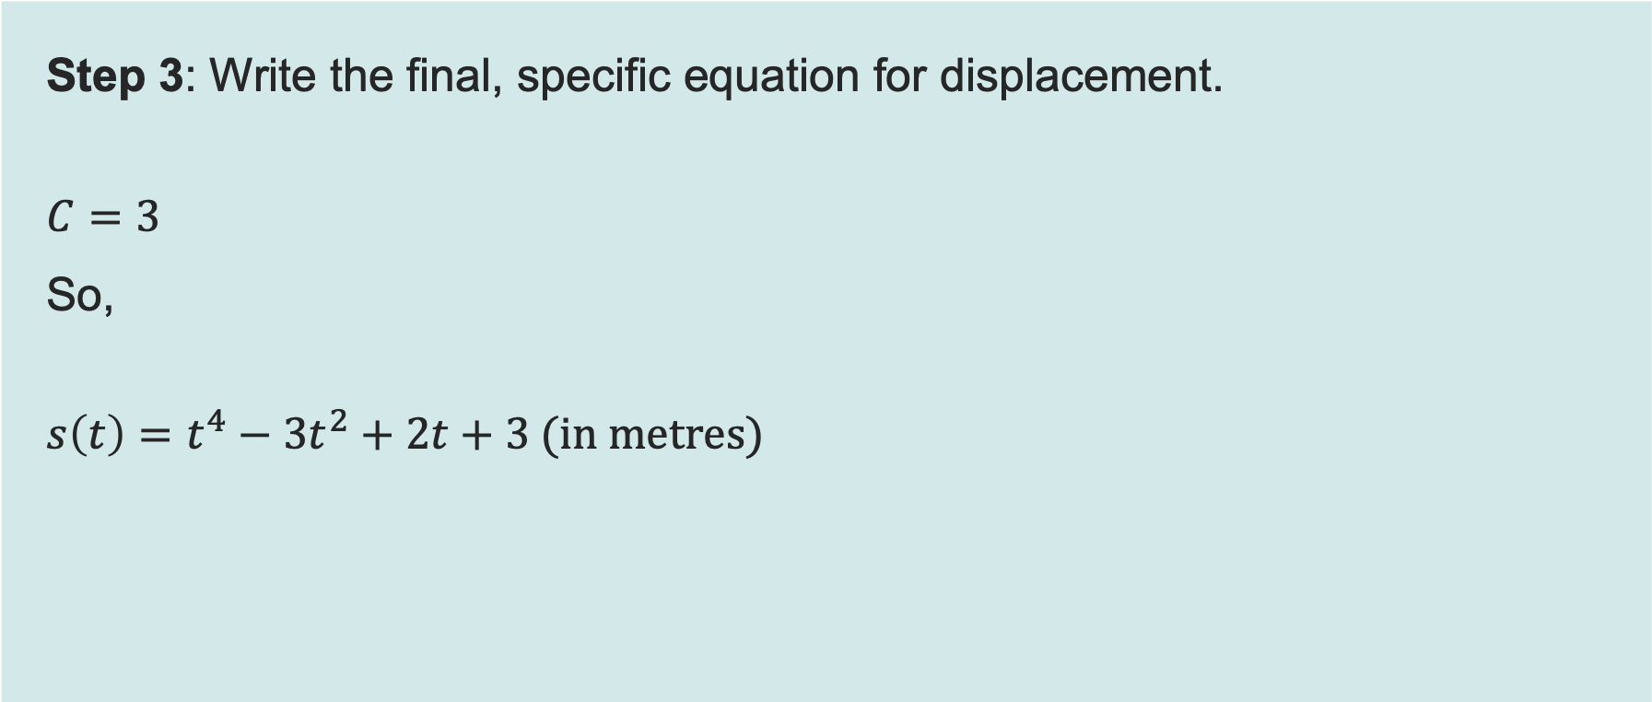
Worked example 2: Indefinite integral
Recap and Worked examples
Step 3: Write the final, specific equation for displacement.
$$C=3$$
So,
$$s\left(t\right)=t^{4}−3t^{2}+2t+3 (in metres)$$
Resource 5: Calculus – Integration

Slide 22

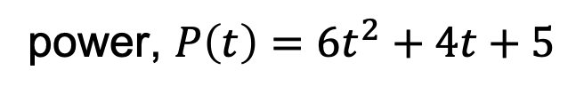
Activity 1 – Energy consumption
Activity 1
You are a Maintenance Engineer responsible for tracking the performance and energy usage of manufacturing machinery. You cannot simply read the total energy meter because the machine's power output fluctuates over time.
You must use the mathematical technique of integration to calculate the exact total energy consumed by the machine over a specific period, given the function that describes its instantaneous power output.
power, $P\left(t\right)=6t^{2}+4t+5$
Resource 5: Calculus – Integration
Notes:
Image © Shutterstock/Chokniti-Studio

