Slide 1
Engineering and Manufacturing: Core
Route: Engineering and Manufacturing
Topic: Project management
Lesson 2: Constraints, risks and collaboration
Notes:
Image © Shutterstock/Gorodenkoff

Slide 2
In this lesson we will:
Introduction
Skills:
CSA. Planning and scoping project parameters (e.g. timescales, resources, costs)
CSB. Interpreting and using technical information and media
CSC. Complying with the requirements and needs of a client’s brief
General competencies:
English:
EC4. Summarise information/ideas
EC5. Synthesise information
EC6. Take part in/lead discussions
Maths:
MC2. Estimating, calculating and error spotting
MC9. Costing a project
define a project constraint and explain the potential impact of changes to one constraint on others;
estimate the cost of a project and ensure it remains within budget;
interpret a basic risk register;
identify benefits of effective team collaboration in a project environment.
Lesson 2: Constraints, risks and collaboration

Slide 3
Recap quiz
Introduction
Which of the following is an example of an operational requirement in a project brief?
Machine must integrate with the existing conveyor system
Machine must not expose any moving internal parts
Machine must stay within budget
Lesson 2: Constraints, risks and collaboration

Slide 4
Recap quiz
Introduction
Which of the following is an example of an operational requirement in a project brief?
Machine must integrate with the existing conveyor system
Machine must not expose any moving internal parts
Machine must stay within budget
Machine must integrate with the existing conveyor system
B is a safety requirement and C is a constraint.
Lesson 2: Constraints, risks and collaboration

Slide 5
Recap quiz
Introduction
Which type of digital tool is used to plan out a whole project?
Risk register
Gantt chart
Cost spreadsheet
Lesson 2: Constraints, risks and collaboration

Slide 6
Recap quiz
Introduction
Which type of digital tool is used to plan out a whole project?
Risk register
Gantt chart
Cost spreadsheet
B. Gantt chart
A risk register is used to reduce the likelihood of anyone being harmed. A cost spreadsheet is used to keep track of the total amount of the budget spent.
Lesson 2: Constraints, risks and collaboration

Slide 7
Recap quiz
Introduction
During which stage of a project life cycle are outcomes reflected on and improvements considered?
Evaluation
Planning
Implementation
Lesson 2: Constraints, risks and collaboration

Slide 8
Recap quiz
Introduction
During which stage of a project life cycle are outcomes reflected on and improvements considered?
Evaluation
Planning
Implementation
Evaluation
Planning is carried out at the start of a project and involves scheduling and resource planning. Implementation is the stage where a product is built and tested.
Lesson 2: Constraints, risks and collaboration

Slide 9
Project constraints
Activity 1
In your groups:
list typical project constraints;
group the constraints into categories such as:
  resources;
  quality.
Lesson 2: Constraints, risks and collaboration

Slide 10
Project constraints
Activity 1
Constraints are the limits you must work within. Typical constraints include:
budget (keeping the project under a certain amount of money);
time (deadlines, milestones);
quality (performance, tolerances);
safety (pressure limits, safe operation, legislation);
resources (materials, equipment, staff availability);
communication (meetings, reporting structures);
changing requirements (client updates, new information).
Lesson 2: Constraints, risks and collaboration

Slide 11
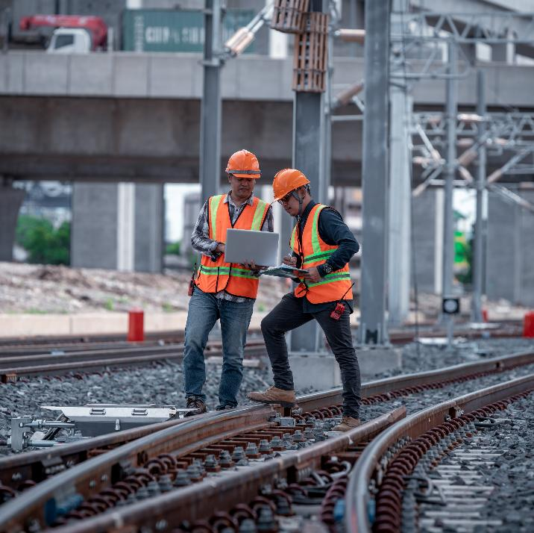
Identifying constraints
Activity 1
Think about an engineering project you have worked on (or are aware of) within an engineering workplace. For example,
HS2 (the high-speed railway from Birmingham to London).
List four specific constraints.
Lesson 2: Constraints, risks and collaboration
Notes:
Image © Shutterstock/APChanel

Slide 12
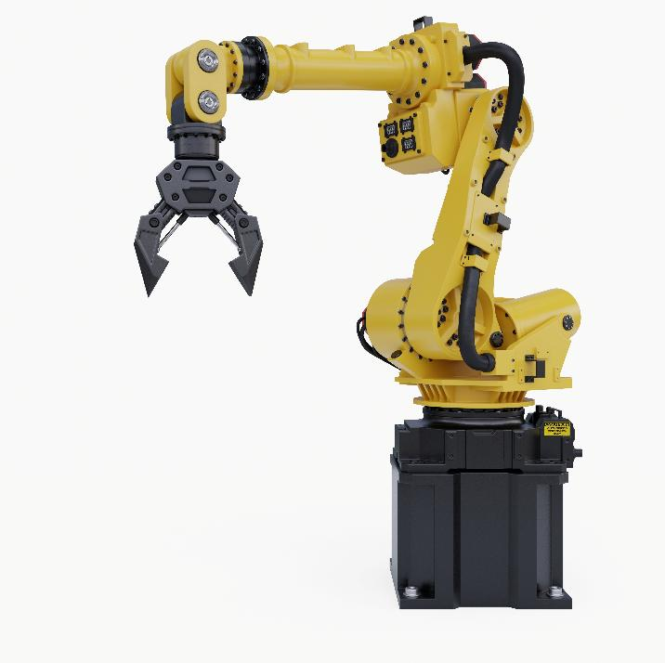
Workbook
Activity 1
Complete Lesson 2 Activity 1: Cost estimation
Lesson 2: Constraints, risks and collaboration
Notes:
Image © Shutterstock/vanitjan

Slide 13

Risk management
Activity 2
Risk management means identifying what might go wrong, how likely it is, how serious it is and what can be done to reduce the risk.
Common engineering risks include:
being over-budget;
faulty components;
delays in materials;
safety hazards;
miscommunication;
unclear requirements;
time overruns;
reputation.
Lesson 2: Constraints, risks and collaboration
Notes:
Image © Shutterstock/Washburn HM

Slide 14
Risk register
Activity 2
Complete the risk register.
A score of 1 is the highest and 5 is the lowest.
Risk | Likelihood (1–5) | Impact (1–5) | Mitigation action
Delay in materials arriving
Change of specification from the customer
Hard-to-procure items incur an increased cost which takes the project over budget
Lesson 2: Constraints, risks and collaboration

Slide 15
Risk register – answers
Activity 2
Risk | Likelihood (1–5) | Impact (1–5) | Mitigation action
Delay in materials arriving | 3 | 4 | Order early; identify alternative suppliers; include buffer time in plan.
Change of specification from the customer | 1 | 5 | Ensure clear communication between project management and customer.
Hard to procure items incur an increased cost which takes the project over budget | 2 | 4 | Market research and part / item availability to be conducted early in the planning phase to minimise risk.
Lesson 2: Constraints, risks and collaboration

Slide 16
Collaborative working
Activity 3
Engineering teams use collaborative working to share tasks, solve problems and complete projects efficiently.
Matrix working: individuals may report to more than one leader (e.g. Project Manager and Technical Lead)
Collaborative technologies: Teams*, Slack**, shared documents, cloud-based CAD, shared Gantt charts
Communication structures: daily check-ins, reporting delays, updating plans
Lesson 2: Constraints, risks and collaboration
Notes:
**Teams is a trademark of the Microsoft Corporation.
**Slack is a trademark and service mark of Slack Technologies, Inc., registered in the U.S. and in other countries.

Slide 17
Communication plan
Activity 3
Imagine that you are going to be part of a team designing a new factory machine, which needs to be integrated into a production line in six months.
Write a short plan for how your team should communicate during the project. Think about:
How often will you update each other?
What tools will you use?
Who will report any delays to the Project Manager?
Lesson 2: Constraints, risks and collaboration

Slide 18
The conveyor belt crisis simulation
Plenary
A manufacturing plant that produces small plastic components has reported that its automated conveyor system is shutting down intermittently during operation. The shutdowns are causing production delays, missed deadlines and rising costs.
Initial checks suggest that the issue may involve inconsistent component handling, possible sensor misalignment or wear in pneumatic actuators used along the conveyor line. The system must operate continuously during an 8-hour shift, and downtime beyond 48 hours will result in financial penalties from the client.
Your engineering team has been given 48 hours to stabilise the system and present a short plan for repair and control before a full redesign is considered.
Lesson 2: Constraints, risks and collaboration

Slide 19
The conveyor belt crisis simulation
Plenary
TASK – You have five minutes to complete the three-part Emergency Plan.
Identify the constraints – choose two and be specific.
Scan for risks – identify one major risk and how you will mitigate it.
Plan your team communication. Answer one of these:
How will your team share updates?
Who is responsible for reporting delays?
What collaborative tool will you use?
Lesson 2: Constraints, risks and collaboration

Slide 20
In this lesson, we have:
Plenary
Skills:
CSA. Planning and scoping project parameters (e.g. timescales, resources, costs)
CSB. Interpreting and using technical information and media
CSC. Complying with the requirements and needs of a client’s brief
General competencies:
English:
EC4. Summarise information/ideas
EC5. Synthesise information
EC6. Take part in/lead discussions
Maths:
MC2. Estimating, calculating and error spotting
MC9. Costing a project
defined a project constraint and explained the potential impact of changes to one constraint on others;
estimated the cost of a project and ensured it remains within budget;
interpreted a basic risk register;
identified benefits of effective team collaboration in a project environment.
Lesson 2: Constraints, risks and collaboration

