Slide 1
Engineering and Manufacturing: Core
Route: Engineering and Manufacturing
Topic: Manipulating equations and calculus
Resource 2: Formulae and rearrangement
Notes:
Image © Shutterstock/Gorodenkoff

Slide 2
In this resource, we will:
Introduction
Skills
CSC (Develop response/s using key skills and processes)
General competencies
English:
EC5 Synthesise information
Maths:
MC4 Using rules and formulae
MC7 Interpreting and representing with mathematical diagrams
Digital:
DC4 Process and analyse numerical data
calculate values by substituting into engineering formulae
calculate any given variable by rearranging formulae
calculate torque, pressure (Pascal's Law) and electrical quantities (Ohm's Law formulae).
Resource 2: Formulae and rearrangement

Slide 3
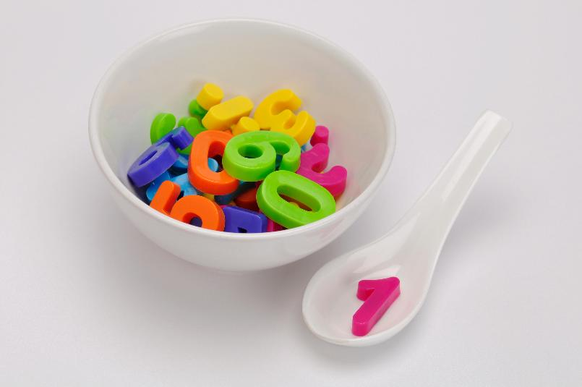
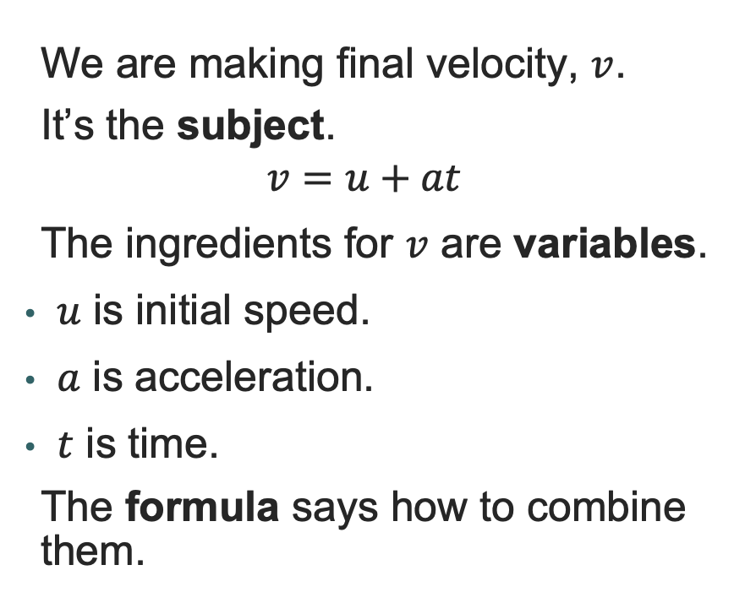
Formulae as recipes
Introduction
We are making final velocity, $v$.
It’s the subject.
$$v=u+at$$
The ingredients for $v$ are variables.
$u$ is initial speed.
$a$ is acceleration.
$t$ is time.
The formula says how to combine them.
Resource 2: Formulae and rearrangement
Notes:
Image © Shutterstock/JOAT

Slide 4

Orange Racing by JMH video – formulae in industry
Introduction
Resource 2: Formulae and rearrangement
Notes:
Formulae and rearrangement in industry video: https://vimeo.com/1199780576/490c675b4c

Slide 5
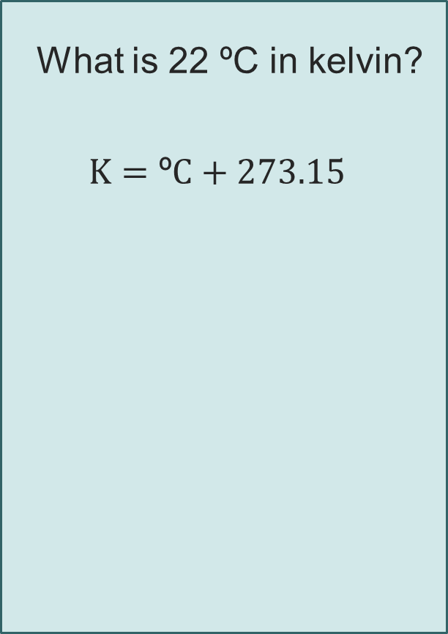
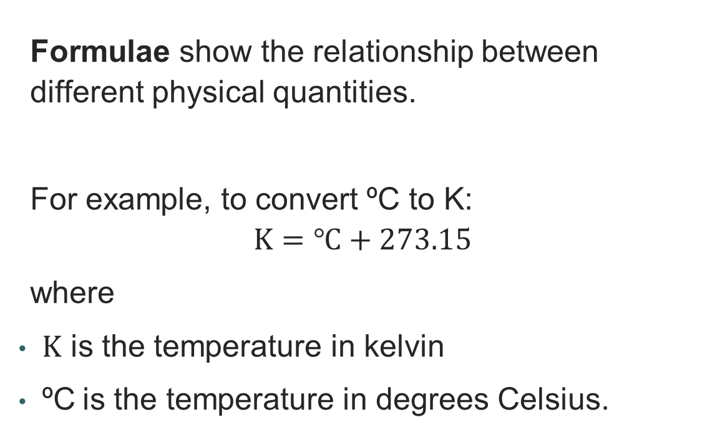
Substitution in formulae
Recap and Worked examples
What is 22 ºC in kelvin?
$$K=\text{º}C+273.15$$
Formulae show the relationship between different physical quantities.
For example, to convert ºC to K:
$$K=℃+273.15$$
where
$K$ is the temperature in kelvin
ºC is the temperature in degrees Celsius.
Resource 2: Formulae and rearrangement

Slide 6
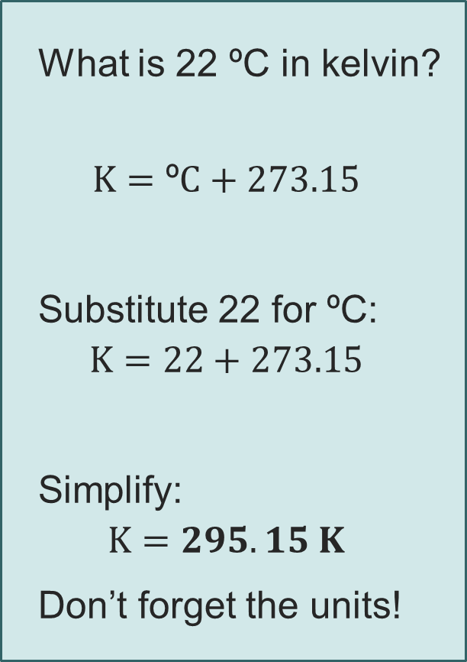
Substitution in formulae
Recap and Worked examples
What is 22 ºC in kelvin?
$$K=\text{º}C+273.15$$
Substitute 22 for ºC:
$$K=22+273.15$$
Simplify:
$$K=295.15 K$$
Don’t forget the units!
Formulae show the relationship between different physical quantities.
For example, to convert ºC to K:
$$K=℃+273.15$$
where
$K$ is the temperature in kelvin
ºC is the temperature in degrees Celsius.
Resource 2: Formulae and rearrangement

Slide 7
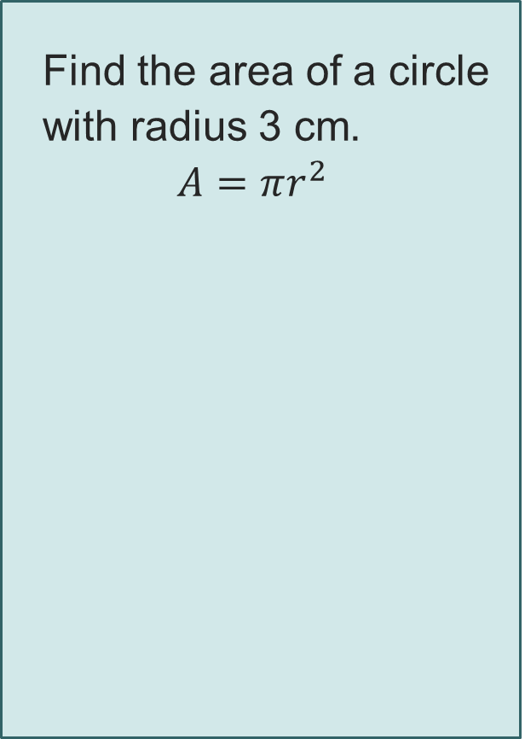
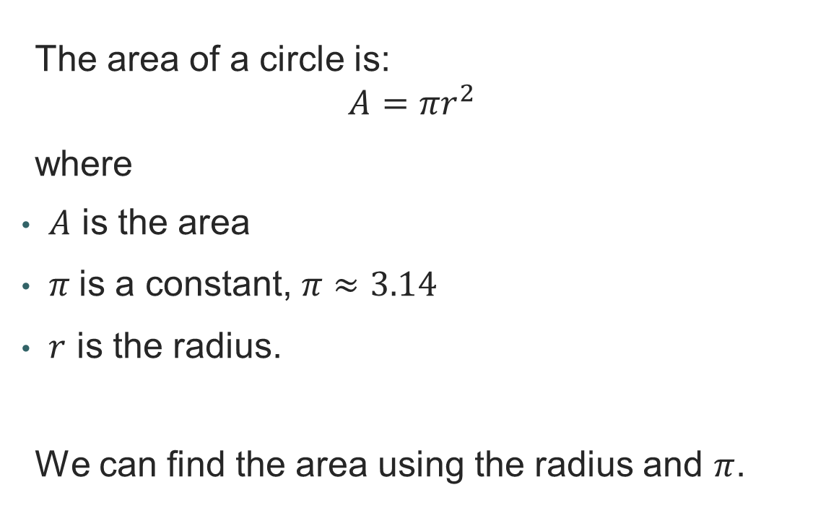
Substitution in area of a circle
Recap and Worked examples
Find the area of a circle with radius 3 cm.
$$A=πr^{2}$$
The area of a circle is:
$$A=πr^{2}$$
where
$A$ is the area
$π$is a constant, $π≈3.14$
$r$ is the radius.
We can find the area using the radius and $π$.
Resource 2: Formulae and rearrangement

Slide 8
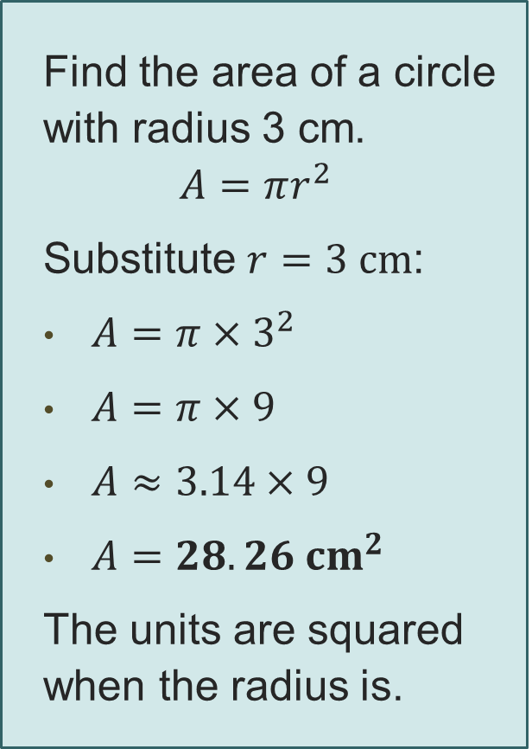
Substitution in area of a circle
Recap and Worked examples
Find the area of a circle with radius 3 cm.
$$A=πr^{2}$$
Substitute $r=3 cm$:
$A=π{ ×3}^{2}$
$A=π×9$
$A≈3.14×9$
$A=28.26 {cm}^{2}$
The units are squared when the radius is.
The area of a circle is:
$$A=πr^{2}$$
where
$A$ is the area
$π$is a constant, $π≈3.14$
$r$ is the radius.
We can find the area using the radius and $π$.
Resource 2: Formulae and rearrangement

Slide 9



Worked example 1: Using formulae
Recap and Worked examples
The pitch control arm has a pivot radius of 1.2 m.
The scale model exerts a weight (force) of 2000 N at this distance.
Calculate the required torque in Nm.
Use the formula:
$$T= F×r$$
where
$$r=radius$$
$$F=force$$
$$T=torque$$
Resource 2: Formulae and rearrangement

Slide 10
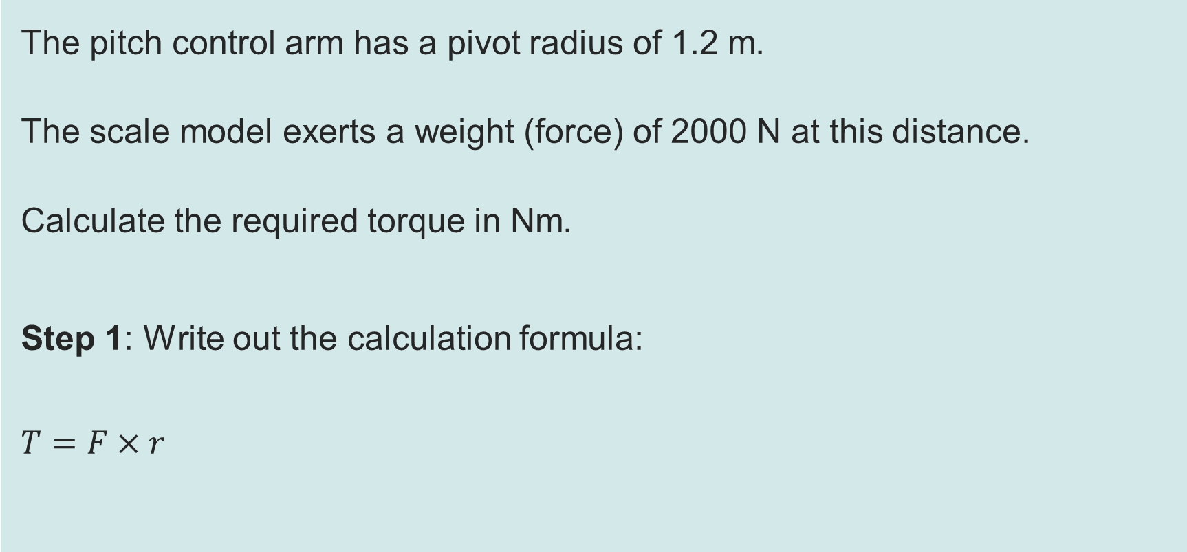

Worked example 1: Using formulae
Recap and Worked examples
The pitch control arm has a pivot radius of 1.2 m.
The scale model exerts a weight (force) of 2000 N at this distance.
Calculate the required torque in Nm.
Step 1: Write out the calculation formula:
$$T=F×r$$
This means that
$$torque=force×radius$$
Resource 2: Formulae and rearrangement

Slide 11
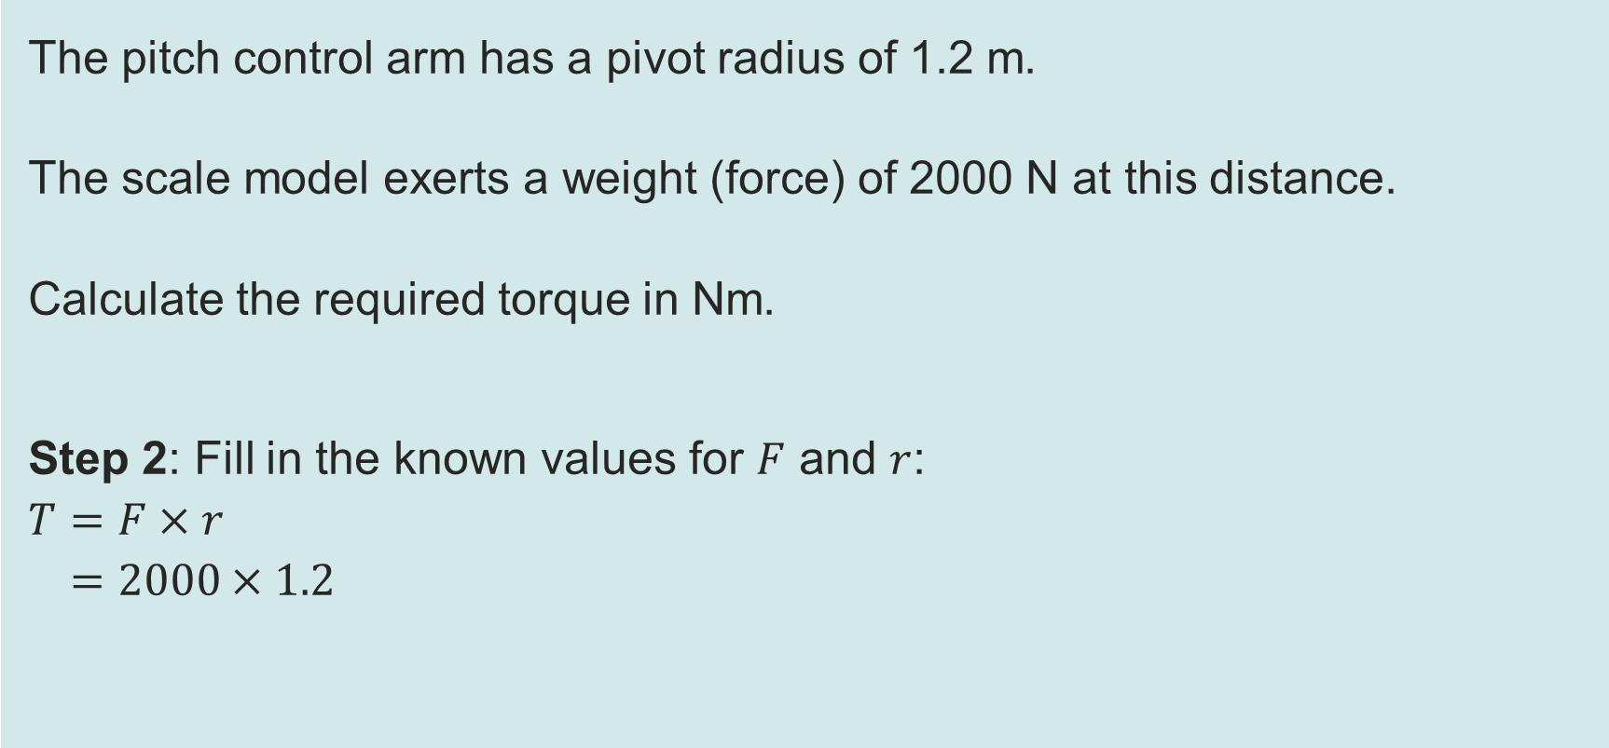
Worked example 1: Using formulae
Recap and Worked examples
The pitch control arm has a pivot radius of 1.2 m.
The scale model exerts a weight (force) of 2000 N at this distance.
Calculate the required torque in Nm.
Step 2: Fill in the known values for $F$ and $r$:
$$T=F×r$$
$$T=2000×1.2$$
Remember to add units with your values.
Resource 2: Formulae and rearrangement

Slide 12
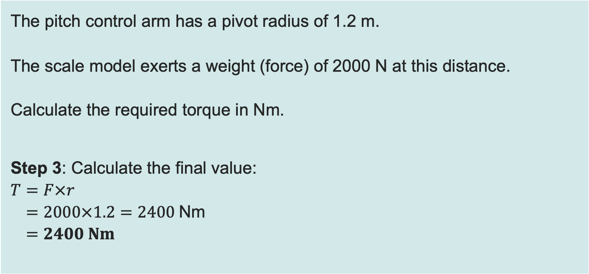
Worked example 1: Using formulae
Recap and Worked examples
The pitch control arm has a pivot radius of 1.2 m.
The scale model exerts a weight (force) of 2000 N at this distance.
Calculate the required torque in Nm.
Step 3: Calculate the final value:
$$T=F×r$$
$$T=2000×1.2=2400 \text{Nm}$$
$$T=2400 Nm$$
Many quantities have a composite unit, a unit made up of the units of quantities from which it has been calculated, like in this example.
Resource 2: Formulae and rearrangement

Slide 13
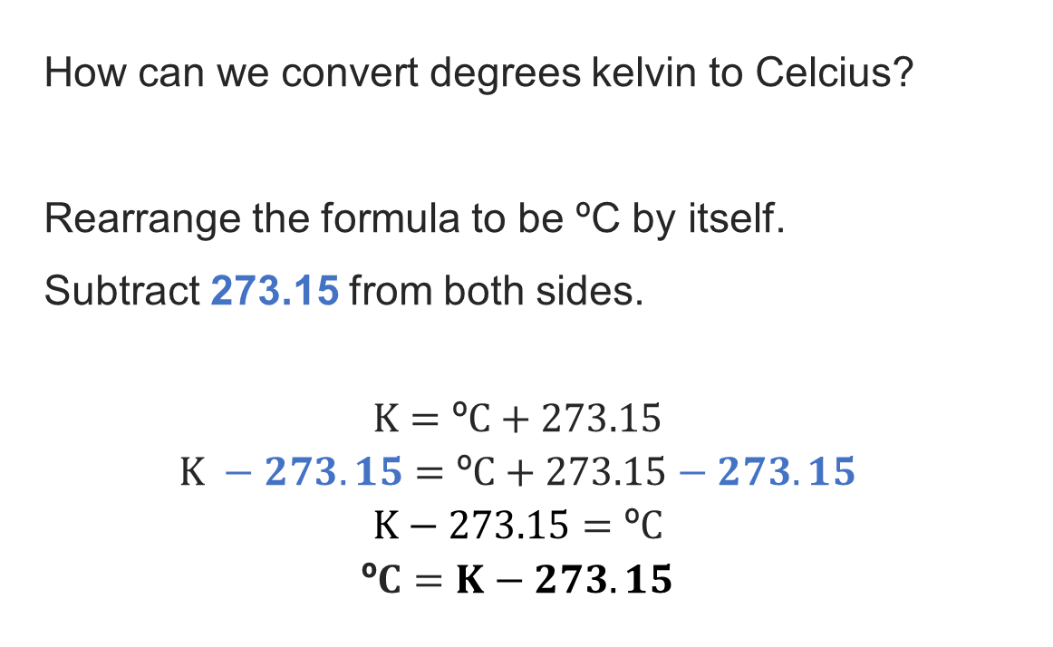
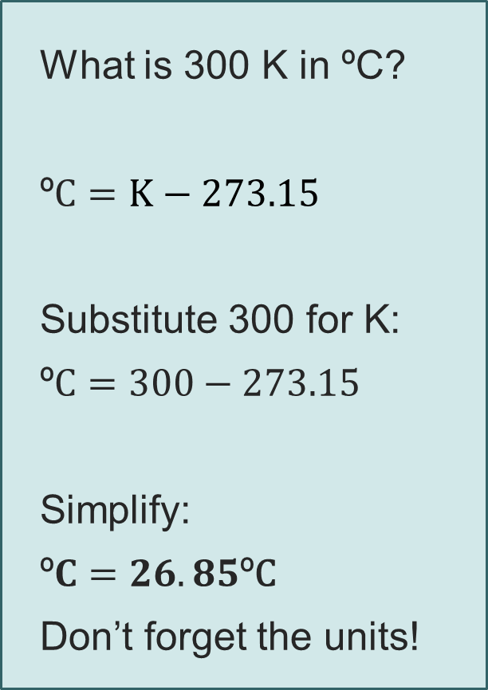
Rearranging formulae
Recap and Worked examples
What is 300 K in ºC?
º$C=K−273.15$
Substitute 300 for K:
º$C=300−273.15$
Simplify:
º$C=26.85\text{º}\text{C}$
Don’t forget the units!
How can we convert degrees kelvin to Celcius?
Rearrange the formula to be ºC by itself.
Subtract 273.15 from both sides.
$$K=\text{º}C+273.15$$
$$K −273.15=\text{º}C+273.15−273.15$$
$$K−273.15=\text{º}C$$
$$\text{º}C=K−273.15$$
Resource 2: Formulae and rearrangement

Slide 14
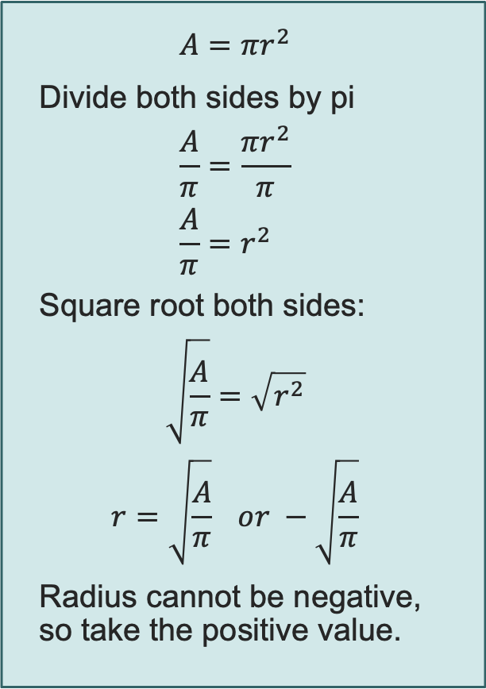
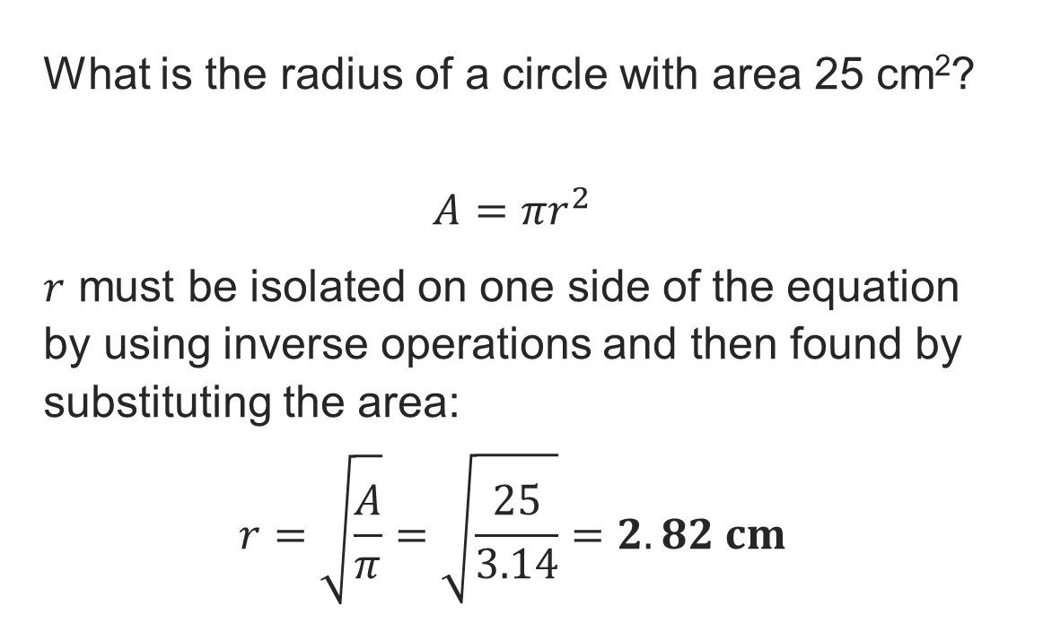
Rearranging area of a circle
Recap and Worked examples
$$A=πr^{2}$$
Divide both sides by pi
$$\frac{A}{π}=\frac{πr^{2}}{π} \\ \frac{A}{π}=r^{2}$$
Square root both sides:
$$\sqrt{\frac{A}{π}}=\sqrt{r^{2}}$$
$$r=\sqrt{\frac{A}{π}} or −\sqrt{\frac{A}{π}}$$
Radius cannot be negative, so take the positive value.
What is the radius of a circle with area 25 cm²?
$$A=πr^{2}$$
$r$ must be isolated on one side of the equation by using inverse operations and then found by substituting the area:
$$r=\sqrt{\frac{A}{π}}=\sqrt{\frac{25}{3.14}}=2.82 cm$$
Resource 2: Formulae and rearrangement

Slide 15
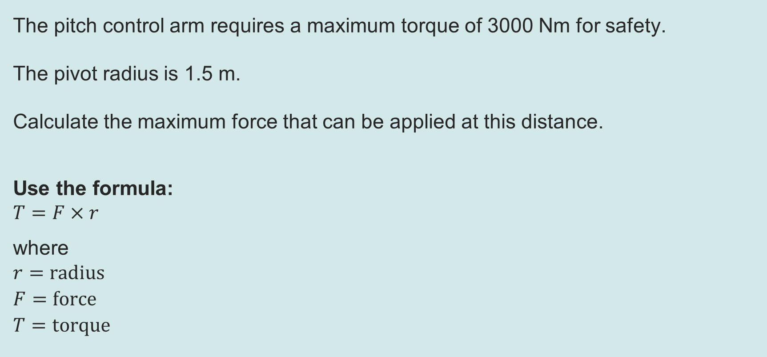
Worked example 2: Rearranging formulae
Recap and Worked examples
The pitch control arm requires a maximum torque of 3000 Nm for safety.
The pivot radius is 1.5 m.
Calculate the maximum force that can be applied at this distance.
Use the formula:
$$T=F×r$$
where
$$r=radius$$
$$F=force$$
$$T=torque$$
Resource 2: Formulae and rearrangement

Slide 16

Worked example 2: Rearranging formulae
Recap and Worked examples
The pitch control arm requires a maximum torque of 3000 Nm for safety.
The pivot radius is 1.5 m.
Calculate the maximum force that can be applied at this distance.
Step 1: Write out the calculation formula:
$$T=F×r$$
This means that
$$torque=force×radius$$
Resource 2: Formulae and rearrangement

Slide 17

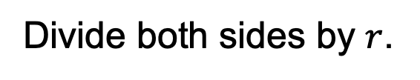

Worked example 2: Rearranging formulae
Recap and Worked examples
The pitch control arm requires a maximum torque of 3000 Nm for safety.
The pivot radius is 1.5 m.
Calculate the maximum force that can be applied at this distance.
Step 2: Rearrange the formula to make the unknown (force) the subject:
$$T=F×r$$
$$\frac{T}{r}=\frac{F×r}{r}$$
$$F=\frac{T}{r}$$
Always rearrange a formula before adding any values.
Divide both sides by $r$.
The $r$’s on the righthand side cancel.
Resource 2: Formulae and rearrangement

Slide 18
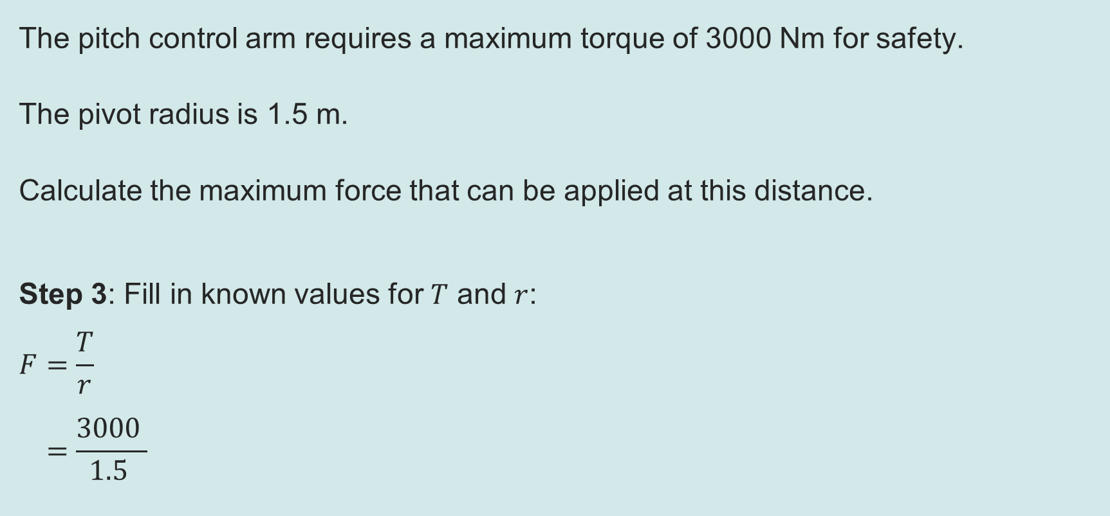
Worked example 2: Rearranging formulae
Recap and Worked examples
The pitch control arm requires a maximum torque of 3000 Nm for safety.
The pivot radius is 1.5 m.
Calculate the maximum force that can be applied at this distance.
Step 3: Fill in known values for $T$ and $r$:
$$F=\frac{T}{r}$$
$$F=\frac{3000 }{1.5 }$$
Resource 2: Formulae and rearrangement

Slide 19
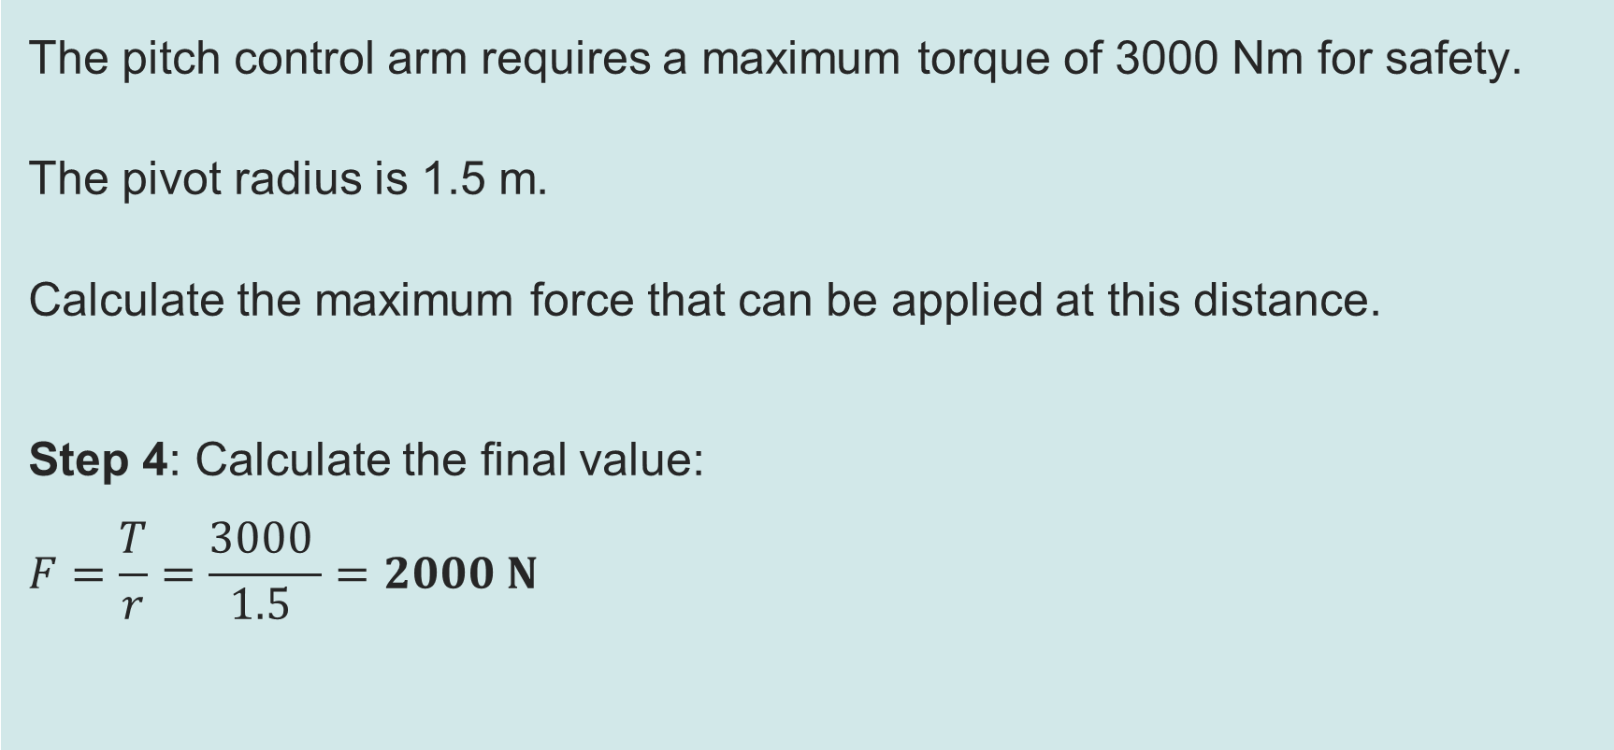
Worked example 2: Rearranging formulae
Recap and Worked examples
The pitch control arm requires a maximum torque of 3000 Nm for safety.
The pivot radius is 1.5 m.
Calculate the maximum force that can be applied at this distance.
Step 4: Calculate the final value:
$$F=\frac{T}{r}=\frac{3000 }{1.5 }=2000 N$$
Resource 2: Formulae and rearrangement

