Slide 1
Engineering and Manufacturing: Core
Route: Engineering and Manufacturing
Topic: Project management
Lesson 1: Interpreting project briefs
Notes:
Image © Shutterstock/Gorodenkoff

Slide 2
In this lesson, we will:
Introduction
explain the key purpose and scope of a given project brief;
state and sequence the main stages of the project life cycle for a given project proposal;
differentiate between requirements, constraints and measurable success criteria.
Skills:
CSA. Interpreting and confirming project requirements
CSC. Complying with the requirements and needs of a client’s brief
General competencies:
English:
EC5. Synthesise information
EC6. Take part in/lead discussions
Lesson 1: Interpreting project briefs

Slide 3

What is project management?
Introduction
DISCUSS…
1. What is project management?
2. Why is project management needed?
3. How is project management carried out?
4. Who is responsible for project management?
Lesson 1: Interpreting project briefs

Slide 4
What is project management?
Introduction
1. What is project management?
Project management is the process of planning, organising and controlling tasks so that an engineering project is completed safely, on time, within budget and to the required quality.
2. Why is project management needed?
In engineering, project management involves managing deadlines, safety risks, budgets, multiple people and roles, and technical constraints.
Without project management, even good technical ideas can fail.
Lesson 1: Interpreting project briefs

Slide 5
What is project management?
Introduction
3. How is project management carried out?
Project management includes interpreting the project brief, planning tasks and timelines, managing risks, monitoring progress, communicating with the team and client, reviewing outcomes and improvements.
4. Who is responsible for project management?
In larger organisations, a dedicated Project Manager oversees the process.
In smaller companies or SMEs (Small and Medium-sized Enterprises), one person may carry out several roles, including project management.
Lesson 1: Interpreting project briefs

Slide 6
What is a project brief?
Introduction
A project brief:
explains what must be achieved and why it is needed;
includes key requirements (also known as the project specification):
technical requirements: performance needs, dimensions, pressures, materials;
operational requirements: how long it must run, environment, cycle rate;
commercial requirements: budget, cost efficiency, reliability;
safety requirements: risk of damage, over-pressure, safe handling;
identifies constraints – fixed limits you cannot change;
highlights assumptions – things you must check before
designing;
outlines client expectations.
Lesson 1: Interpreting project briefs

Slide 7
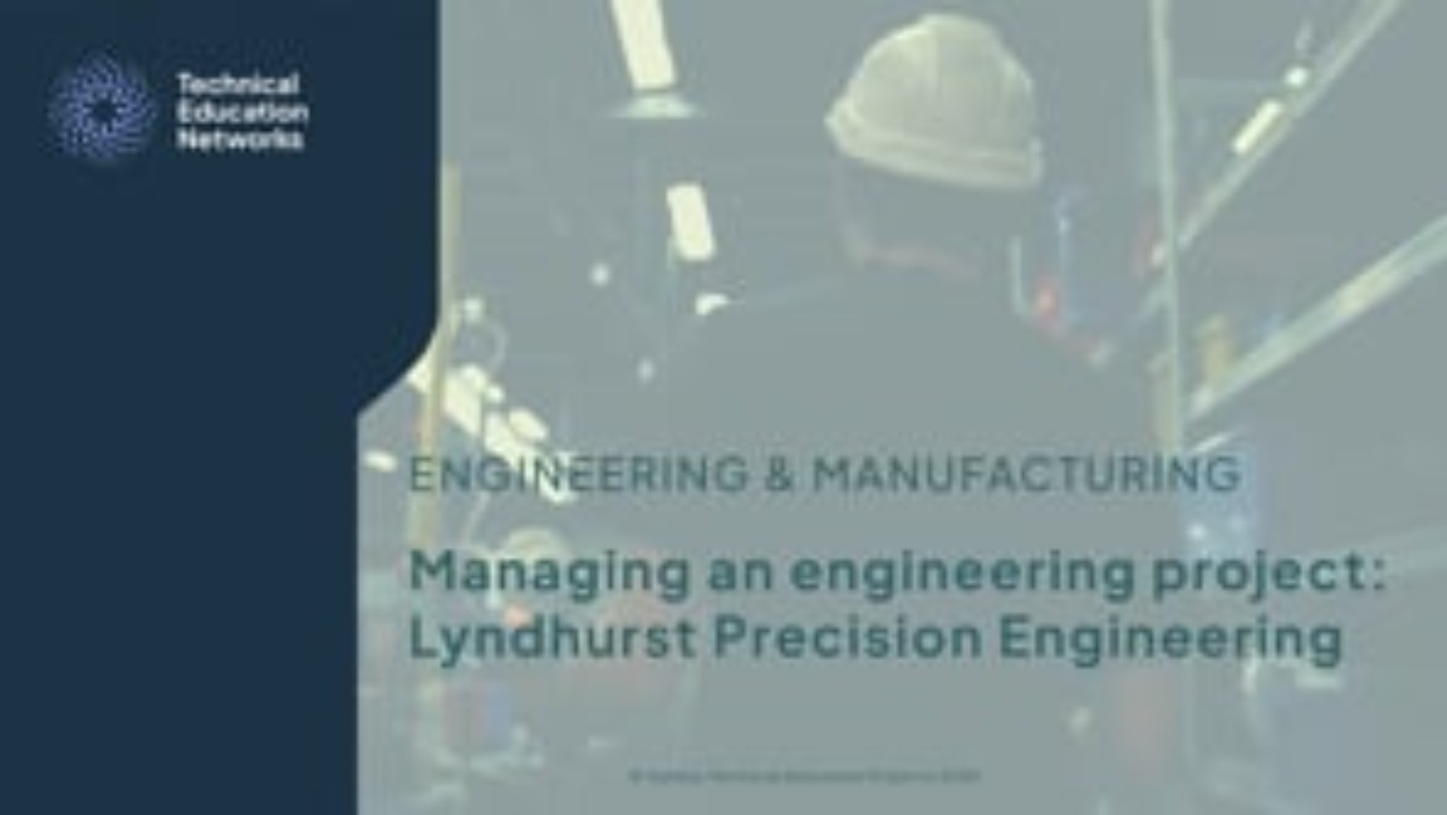
Managing an engineering project
Introduction
Lesson 1: Interpreting project briefs
Notes:
Managing an engineering project video: https://vimeo.com/1204108902/d9300f8818

Slide 8

Why brief interpretation matters
Introduction
Why do you think it's important to consider your brief carefully when starting an engineering project?
What do you think could go wrong if a requirement in the brief is missed?
Why do you need to be able to give clear justification for your project decisions?
Lesson 1: Interpreting project briefs
Notes:
Image © Shutterstock/Rawpixel.com

Slide 9
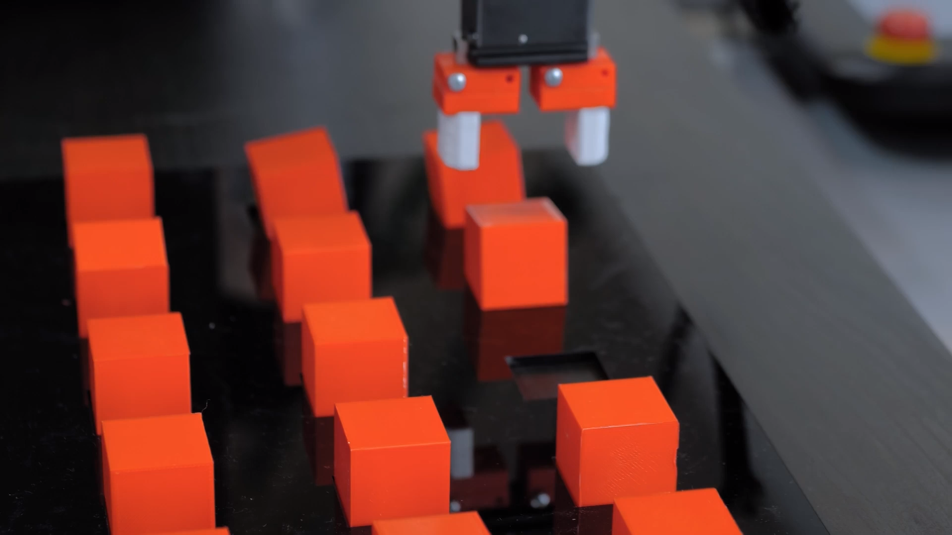
Pneumatic gripper
Activity 1
Pneumatic gripper arms are used in various industrial applications for grasping, lifting, holding, rotating and placing objects into set locations.
Lesson 1: Interpreting project briefs
Notes:
Video © Shutterstock/Zyabich family

Slide 10
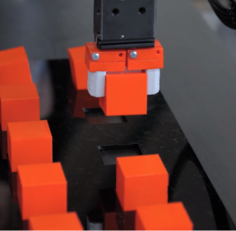
Spot the requirements
Activity 1
Basic brief:
Design a gripper arm to pick up small pieces of plastic. It must operate at 6 bar, fit within a 300 × 300 × 400 mm working envelope and cost no more than £150.
Identify the:
three requirements;
one constraint.
Lesson 1: Interpreting project briefs
Notes:
Image © Shutterstock/Zyabich family

Slide 11
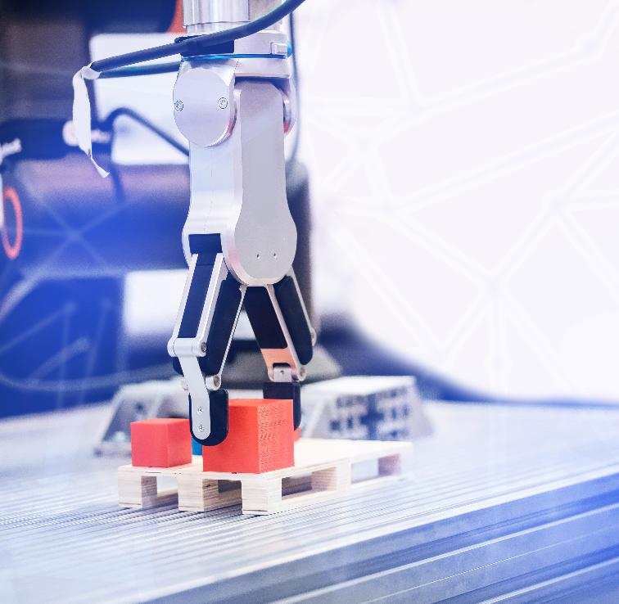
Spot the requirements
Activity 1
Requirement 1: The gripper must operate at 6 bar pressure.
Requirement 2: The gripper must fit within a 300 × 300 × 400 mm working envelope.
Requirement 3: The gripper must handle components without damage (implied by context).
Constraint: The total cost must be £150 or less.
Lesson 1: Interpreting project briefs
Notes:
Image © Shutterstock/Parilov

Slide 12
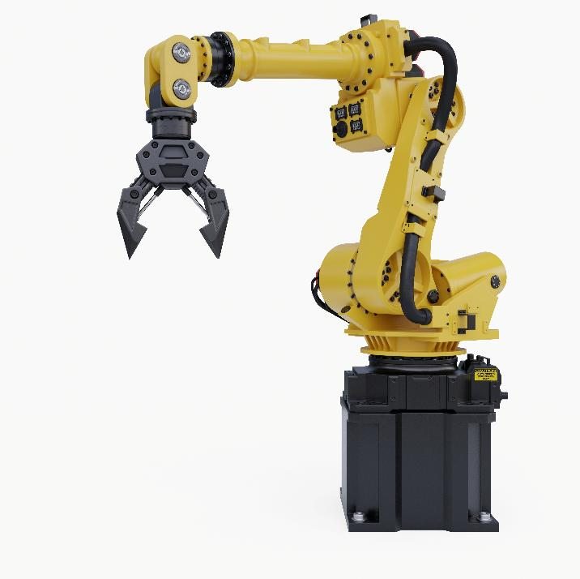
Workbook document
Activity 1
Read the following sections to identify the core problem:
1: Introduction and Industry Context
2: Task
Complete Lesson 1 Activity 1: Brief Interpretation Table
Lesson 1: Interpreting project briefs
Notes:
Image © Shutterstock/vanitjan

Slide 13

Project goals and success criteria
Activity 2
Goal = overall aim of the project
Success criteria = how success is measured
Lesson 1: Interpreting project briefs
Notes:
Image © Shutterstock/Space Oak

Slide 14
Writing success criteria
Activity 2
Look at the goal below and write two success criteria.
Goal: Design a pneumatic gripper that handles small plastic parts safely.
(Hint – Look at your workbook for specific details you could include.)
Lesson 1: Interpreting project briefs

Slide 15
Writing success criteria
Activity 2
Examples of success criteria
No damage to parts during testing
Gripper fits within a 300 × 300 × 400 mm working envelope
Operates at a consistent pressure / operates consistently at
6 bar ±0.5 bar
Completed within the budget limit
Project completed on time
Lesson 1: Interpreting project briefs
Notes:
Image © Shutterstock/vanitjan

Slide 16
Writing SMART goals
Activity 2
Specific
Measurable
Achievable
Relevant
Time-bound
Lesson 1: Interpreting project briefs

Slide 17
Workbook document
Activity 2
Complete Lesson 1 Activity 2: SMART project goals
Lesson 1: Interpreting project briefs
Notes:
Image © Shutterstock/vanitjan

Slide 18
The project life cycle
Activity 3
Every engineering project follows a life cycle:
Initiation – Understanding the brief, identifying requirements
Planning – Scheduling, budgeting, resource planning
Implementation – Building, testing, producing the solution
Monitoring – Tracking progress, controlling risks
Reporting – Presenting progress to the team/client
Evaluation – Reflecting on outcomes and improvements
Lesson 1: Interpreting project briefs

Slide 19
Activity 3 – Match the stage
Activity 3
Match each scenario to the correct life cycle stage:
A. You update the Gantt chart because tasks are taking longer than planned.
B. You check whether the design met the brief after testing.
C. You list the materials and components you need.
D. You read the client brief and highlight requirements.
E. You start to manufacture the design solution.
F. You provide an update on progress to the client
Initiation
Planning
Implementation
Monitoring
Reporting
Evaluation
Lesson 1: Interpreting project briefs
Notes:
<photo credit to be included in slide notes>

Slide 20
Activity 3 – Match the stage: ANSWERS
Activity 3
SCENARIO | LIFE CYCLE STAGE
A. You update the Gantt chart because tasks are taking longer than planned. | Monitoring – Tracks progress and adjust plans.
B. You check whether the design met the brief after testing. | Evaluation – Happens AFTER testing.
C. You list the materials and components you need. | Planning – Includes resources and scheduling.
D. You read the client brief and highlight requirements. | Initiation – This is always the first step.
E. You start to manufacture the design solution. | Implementation – Manufacturing is building the design solution.
F. You provide an update on progress to the client. | Reporting – Client updates can be in the form of a report amongst others.
Lesson 1: Interpreting project briefs
Notes:
<photo credit to be included in slide notes>

Slide 21
The Broken Robot Mystery
Plenary
A small assembly robot has stopped working. Your team has been called in as emergency project managers. The client hands you a very short brief:
‘Fix the robot so it can safely grip small components again.’
Paired task:
Write four things you MUST ask the client before beginning the project. Choose one from each category:
a requirement you need to clarify;
a constraint you must confirm;
a success criterion you need to measure;
a project life cycle stage you must complete first – and why.
Lesson 1: Interpreting project briefs

Slide 22
In this lesson, we have:
Plenary
Skills:
CSA. Interpreting and confirming project requirements
CSC. Complying with the requirements and needs of a client’s brief
General competencies:
English:
EC5. Synthesise information
EC6. Take part in/lead discussions
explained the key purpose and scope of a given project brief;
stated and sequenced the main stages of the project life cycle for a given project proposal;
differentiated between requirements, constraints and measurable success criteria.
Lesson 1: Interpreting project briefs

