Slide 1
Engineering and Manufacturing: Core
Route: Engineering and Manufacturing
Topic: Manipulating equations and calculus
Resource 3: Mechanical calculations
Notes:
Image © Shutterstock/Gorodenkoff

Slide 2
In this resource, we will:
Introduction
Skills
CSC (Develop response/s using key skills and processes)
CSE (Communicate and present outcomes and evidence)
General competencies
English:
EC2 Present information and ideas
Maths:
MC3 Working with proportion
MC10 Optimising work processes
MC8 Communicating using mathematics
Digital:
DC4 Process and analyse numerical data
calculate speed ratio, torque, power and belt speed for a mechanical system;
explain the relationship between input power, output power and efficiency;
analyse an industry-relevant belt system scenario.
Resource 3: Mechanical calculations

Slide 3

Conveyor belt systems
Introduction
Conveyor belts are fundamental to the smooth running of many industries including factories, airports and mines.
Their purpose is to transport materials quickly and efficiently from one place to another.
Resource 3: Mechanical calculations
Notes:
Image © Shutterstock/Gorodenkoff

Slide 4
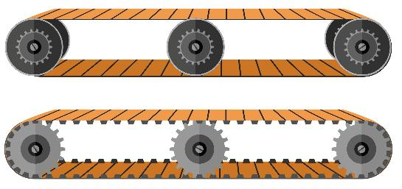
Conveyor belt systems
Introduction
Consist of a looped belt stretching over two (or more) wheels.
One wheel (the drive pulley) is powered by a motor. When it turns, it pulls the belt along.
The belt becomes a moving floor. Items placed on the top travel along the belt.
Idler rollers (non-powered) underneath support the belt and load.
Once items reach the end, they drop off. The belt loops back underneath, ready for the next batch. It’s a continuous cycle.
Resource 3: Mechanical calculations
Notes:
Image © Shutterstock/AIexVector

Slide 5
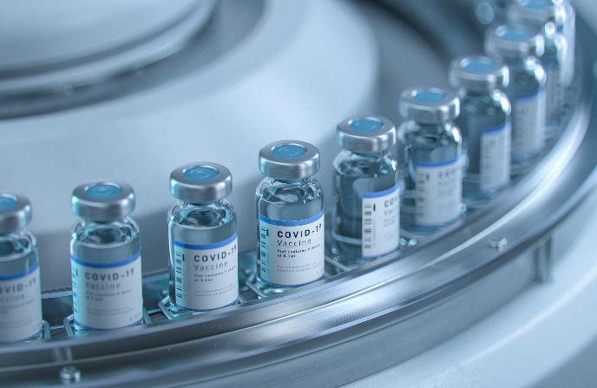
Conveyor belt systems
Introduction
Conveyor belts:
make it easy to move heavy, bulky or awkward items quickly and efficiently;
save time;
reduce the need for labour;
are versatile – they can go straight, up an incline, or around a curve; this allows them to move materials across floors, up ramps and around corners.
Resource 3: Mechanical calculations
Notes:
Image © Shutterstock/Gorodenkoff

Slide 6
Activity 1
Recap and Worked examples
You are a Commissioning Engineer at a manufacturing plant where a new conveyor system has just been installed.
The contractor who installed the system provided a data sheet of theoretical performance values, but they used mixed units.
Your task is to review and confirm the key operational parameters – speed, torque and power – to ensure the system runs safely and efficiently before final handover.
Resource 3: Mechanical calculations

Slide 7

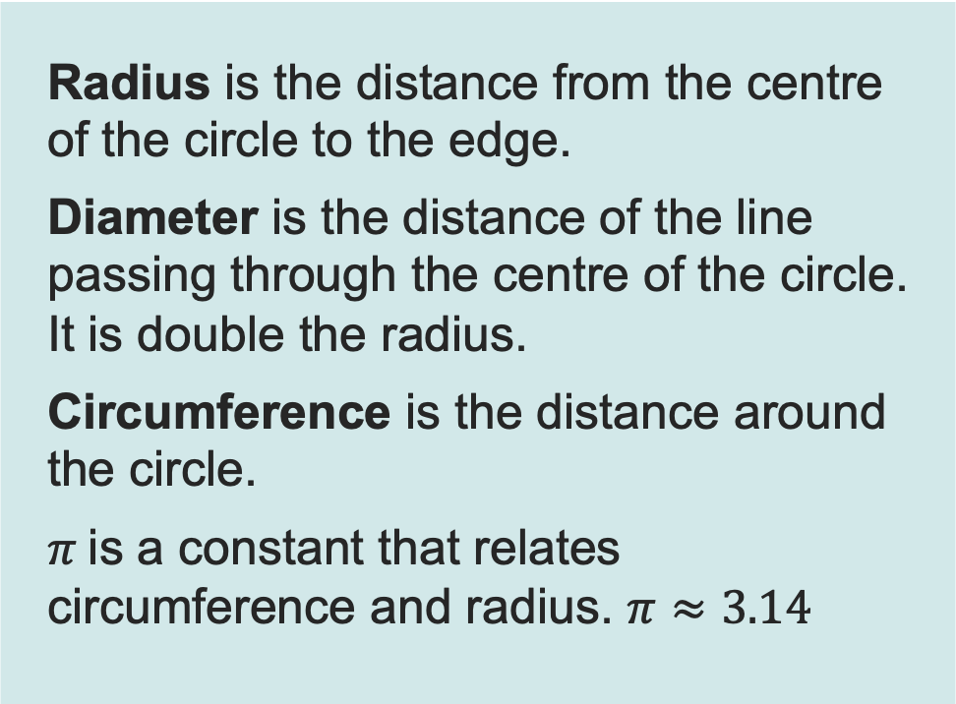


Circles
Recap and Worked examples
Radius is the distance from the centre of the circle to the edge.
Diameter is the distance of the line passing through the centre of the circle. It is double the radius.
Circumference is the distance around the circle.
$π$is a constant that relates circumference and radius. $π≈3.14$
$$radius, r$$
$$diameter, D=2r$$
$$C, circumference=πD=2πr$$
Resource 3: Mechanical calculations

Slide 8
Revolutions and rotational speed
Recap and Worked examples
The roller of a conveyor belt can be modelled as a circle rotating about its centre.
When a circle makes one complete rotation, this is called a revolution.
The rate at which the circle rotates is called its angular speed (or rotational speed). This can be measured in revolutions per minute (rpm).
belt
$$radius, r$$
$$diameter, D=2r$$
$$C, circumference=πD=2πr$$
Resource 3: Mechanical calculations

Slide 9
Revolutions to distance example 1
Recap and Worked examples
A roller of a conveyor belt has radius 5 cm, and it is rotating at 20 rpm.
How far does the belt travel in one minute?
belt
$$radius, r$$
$$diameter, D=2r$$
$$C, circumference=πD=2πr$$
Resource 3: Mechanical calculations

Slide 10
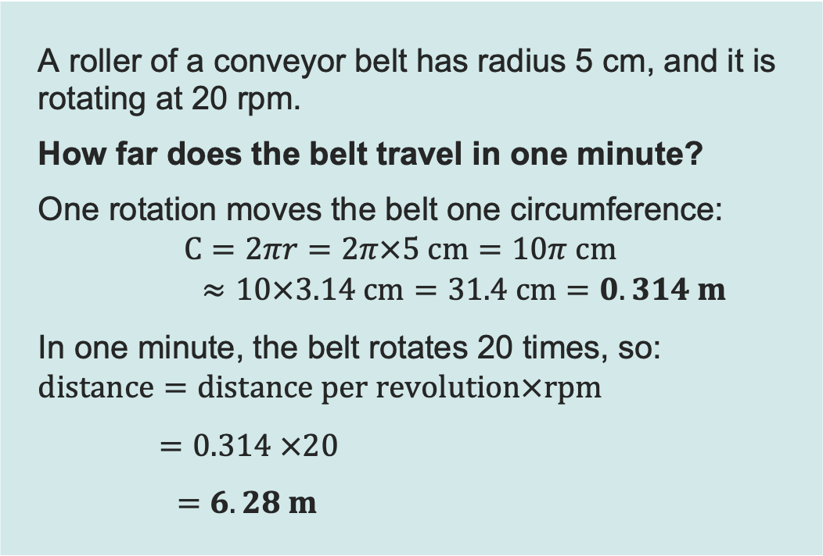
Revolutions to distance example 1: Answer
Recap and Worked examples
A roller of a conveyor belt has radius 5 cm, and it is rotating at 20 rpm.
How far does the belt travel in one minute?
One rotation moves the belt one circumference:
$$C=2πr=2π×5 cm=10π cm$$
$$≈10×3.14 cm=31.4 cm=0.314 m$$
In one minute, the belt rotates 20 times, so:
$$distance=distance per revolution×rpm$$
$=0.314 ×20$
$=6.28 m$
belt
$$radius, r$$
$$diameter, D=2r$$
$$C, circumference=πD=2πr$$
Resource 3: Mechanical calculations

Slide 11
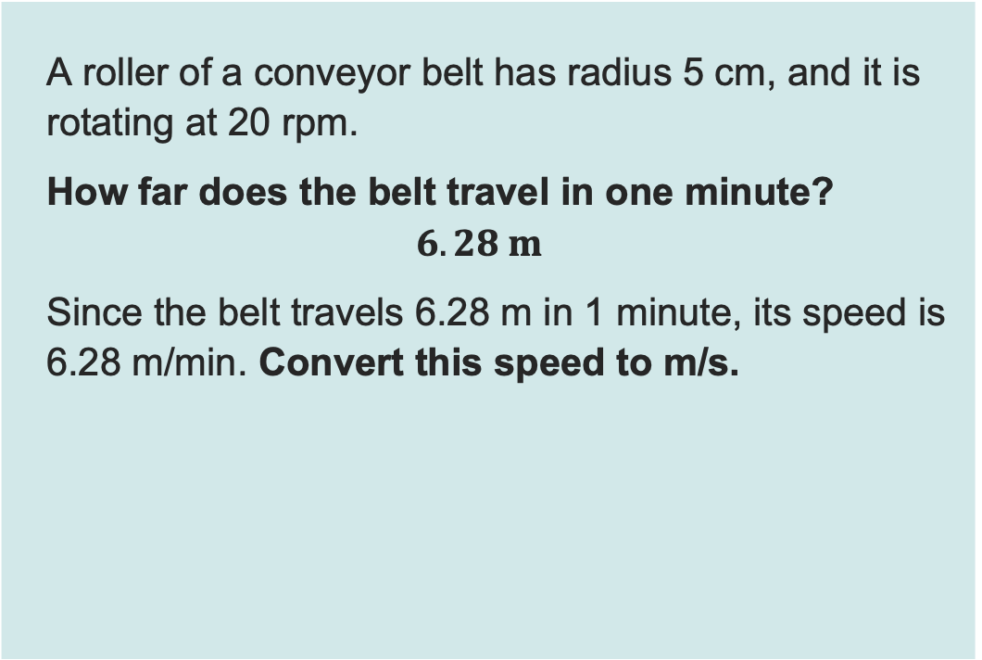
Revolutions to distance example 2
Recap and Worked examples
A roller of a conveyor belt has radius 5 cm, and it is rotating at 20 rpm.
How far does the belt travel in one minute?
$$6.28 m$$
Since the belt travels 6.28 m in 1 minute, its speed is 6.28 m/min. Convert this speed to m/s.
belt
$$radius, r$$
$$diameter, D=2r$$
$$C, circumference=πD=2πr$$
Resource 3: Mechanical calculations

Slide 12
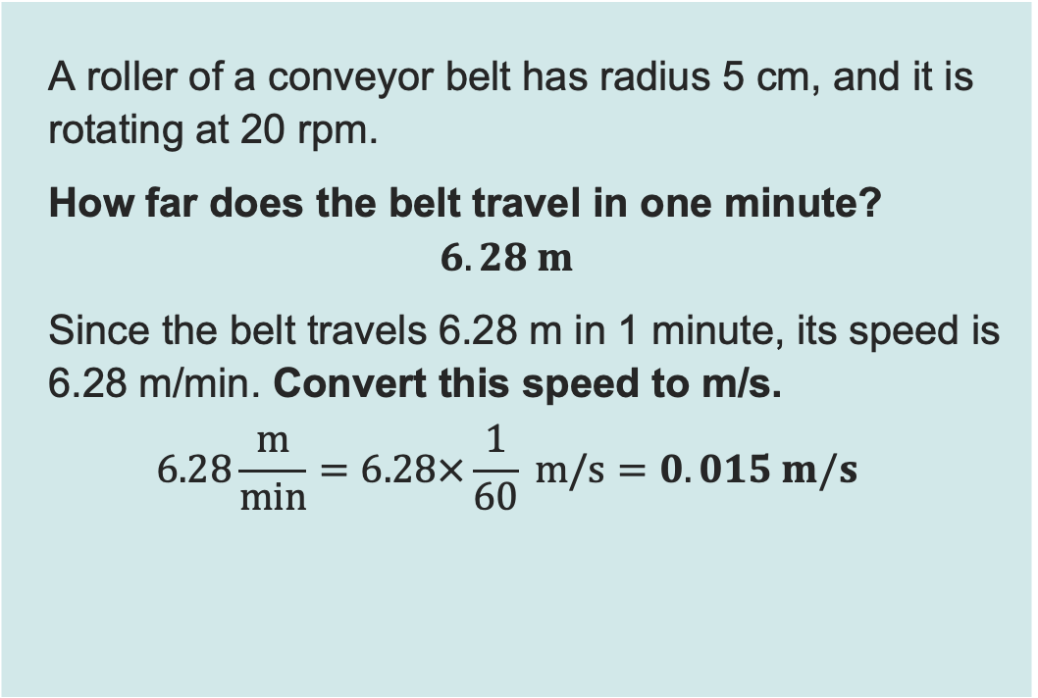
Revolutions to distance example 2: Answer
Recap and Worked examples
A roller of a conveyor belt has radius 5 cm, and it is rotating at 20 rpm.
How far does the belt travel in one minute?
$$6.28 m$$
Since the belt travels 6.28 m in 1 minute, its speed is 6.28 m/min. Convert this speed to m/s.
$$6.28\frac{m}{min}=6.28×\frac{1}{60} m/s=0.015 m/s$$
belt
$$radius, r$$
$$diameter, D=2r$$
$$C, circumference=πD=2πr$$
Resource 3: Mechanical calculations

Slide 13
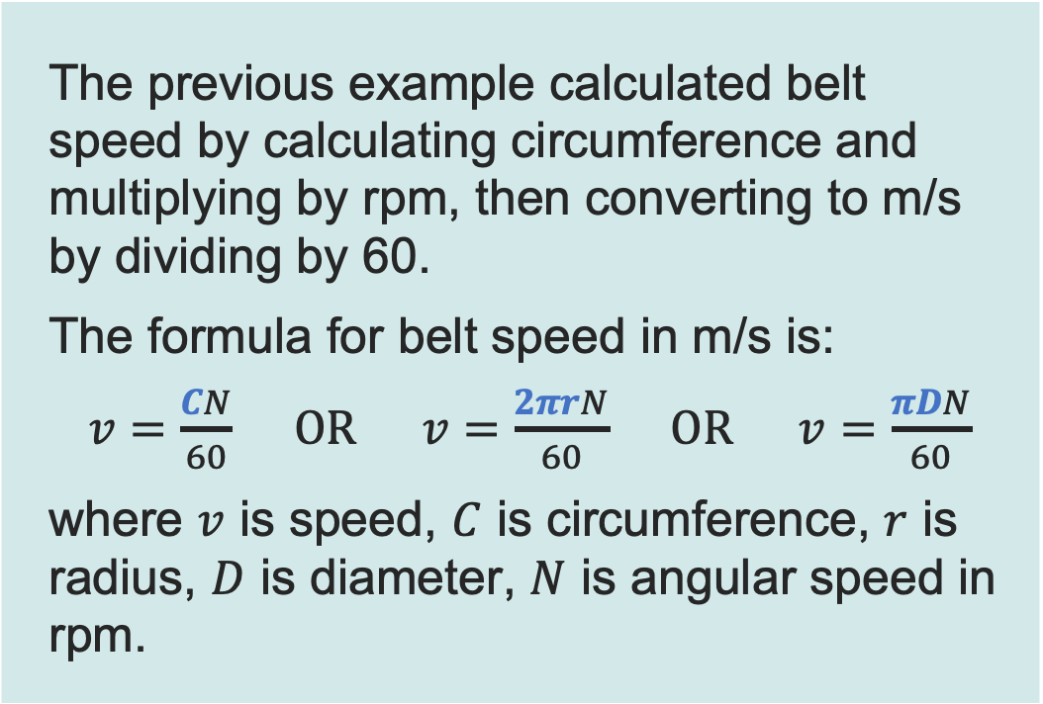
Belt speed formula
Recap and Worked examples
The previous example calculated belt speed by calculating circumference and multiplying by rpm, then converting to m/s by dividing by 60.
The formula for belt speed in m/s is:
$v=\frac{CN}{60} OR v=\frac{2πrN}{60} OR v=\frac{πDN}{60}$
where $v$ is speed, $C$ is circumference, $r$ is radius, $D$ is diameter, $N$ is angular speed in rpm.
belt
$$radius, r$$
$$diameter, D=2r$$
$$C, circumference=πD=2πr$$
Resource 3: Mechanical calculations

Slide 14
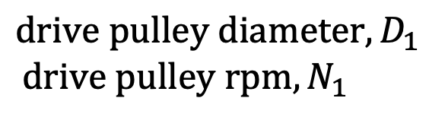
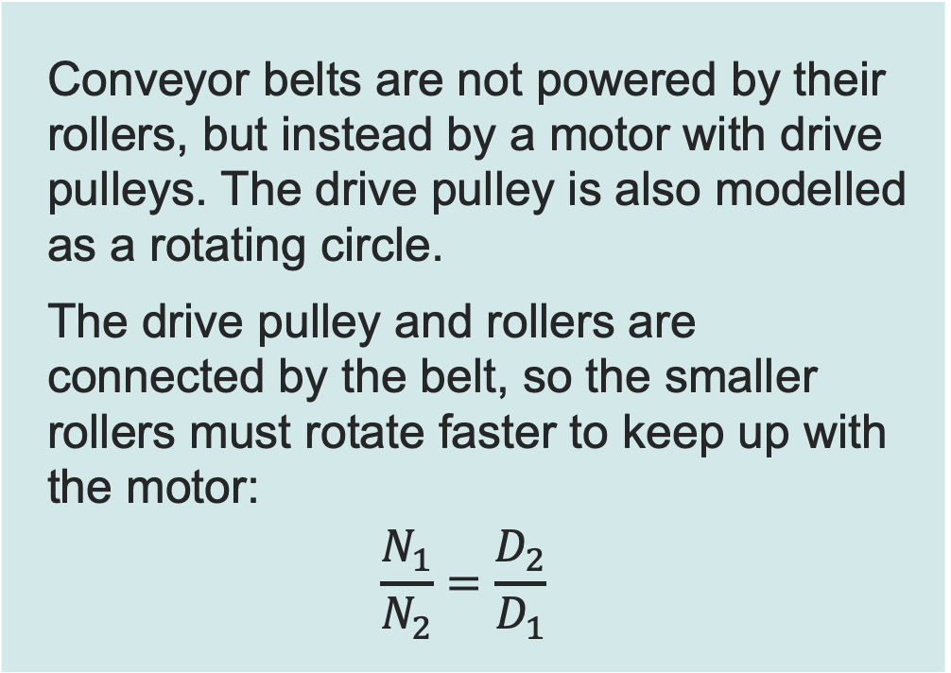
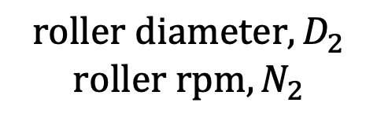
Speed ratio
Recap and Worked examples
Conveyor belts are not powered by their rollers, but instead by a motor with drive pulleys. The drive pulley is also modelled as a rotating circle.
The drive pulley and rollers are connected by the belt, so the smaller rollers must rotate faster to keep up with the motor:
$$\frac{N_{1}}{N_{2}}=\frac{D_{2}}{D_{1}}$$
$$drive pulley diameter,D_{1}$$
$$drive pulley rpm,N_{1}$$
$$roller diameter,D_{2}$$
$$roller rpm,N_{2}$$
Resource 3: Mechanical calculations

Slide 15
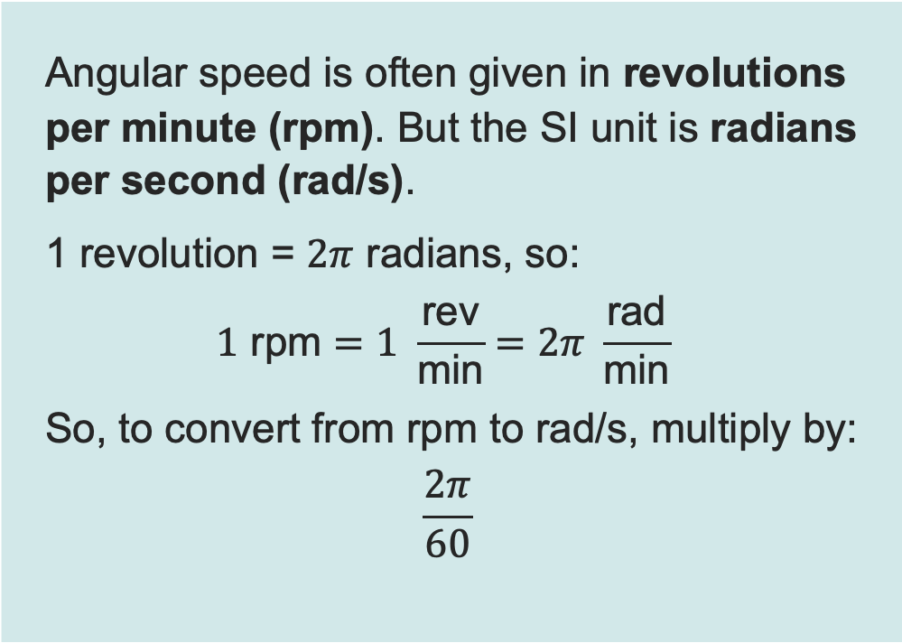
SI units for angular speed
Recap and Worked examples
Angular speed is often given in revolutions per minute (rpm). But the SI unit is radians per second (rad/s).
1 revolution = $2π$ radians, so:
$$1 \text{rpm}=1 \frac{\text{rev}}{\text{min}}=2π \frac{\text{rad}}{\text{min}}$$
So, to convert from rpm to rad/s, multiply by:
$$\frac{2π}{60}$$
$$radius, r$$
$$diameter, D=2r$$
$$C, circumference=πD=2πr$$
Resource 3: Mechanical calculations

Slide 16
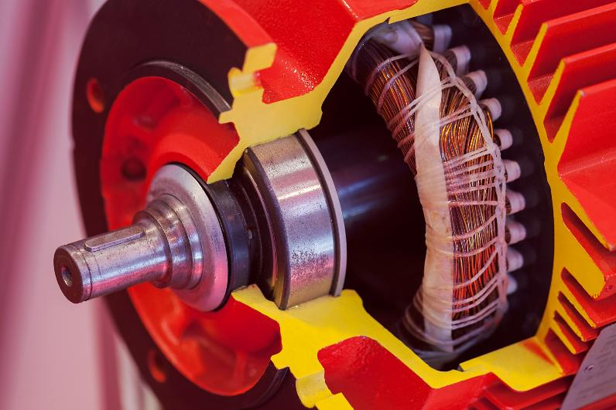
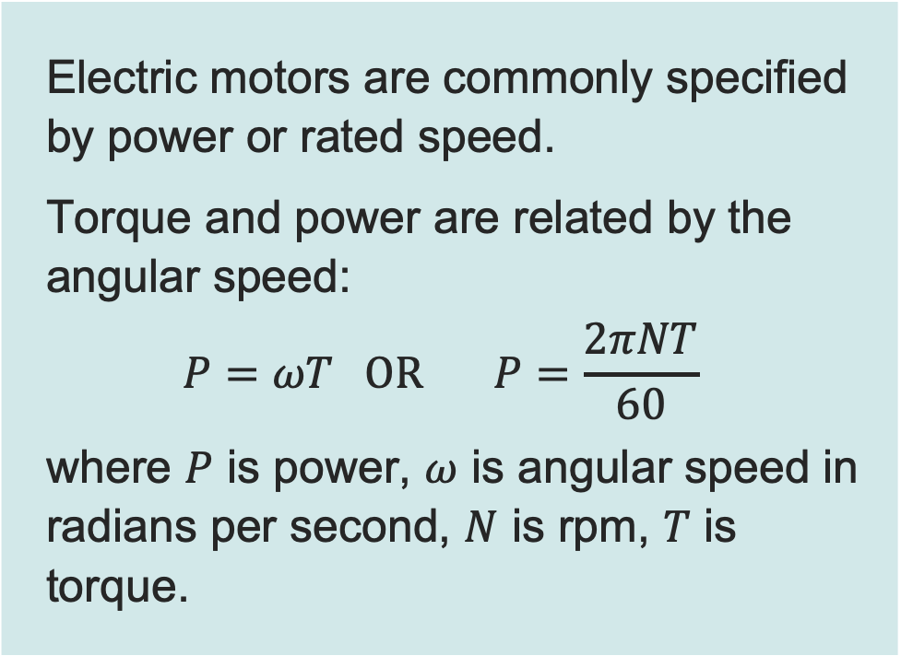
Motors, torque and power
Recap and Worked examples
Electric motors are commonly specified by power or rated speed.
Torque and power are related by the angular speed:
$$P=ωT OR P=\frac{2πNT}{60}$$
where $P$ is power, $ω$ is angular speed in radians per second, $N$ is rpm, $T$ is torque.
Resource 3: Mechanical calculations
Notes:
Image © Shutterstock/Vladimir Nenezic

Slide 17

Motors example
Recap and Worked examples
A motor is driving a conveyor belt. Calculate the revolutions per minute required to provide 2000 W of power.
$$motor torque=200 Nm$$
Resource 3: Mechanical calculations

Slide 18
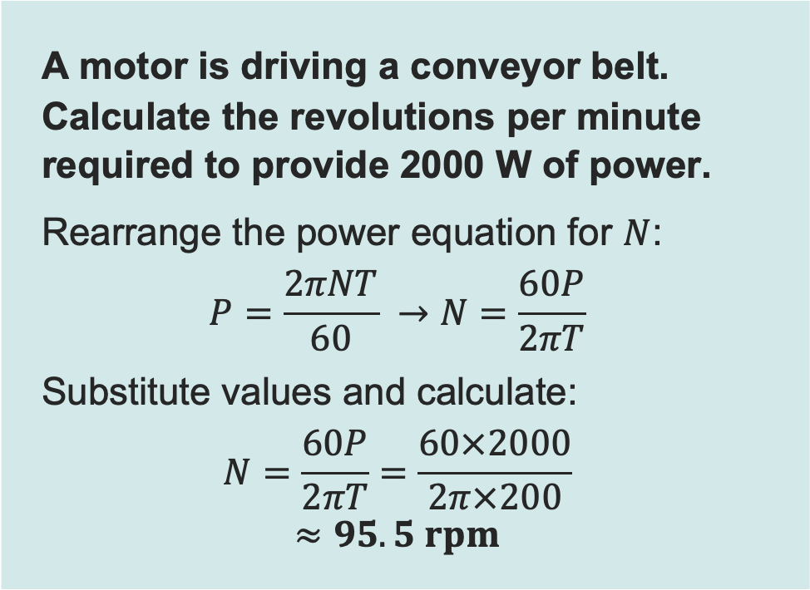
Motors example: Answer
Recap and Worked examples
A motor is driving a conveyor belt. Calculate the revolutions per minute required to provide 2000 W of power.
Rearrange the power equation for $N$:
$$P=\frac{2πNT}{60} →N=\frac{60P}{2πT}$$
Substitute values and calculate:
$$N=\frac{60P}{2πT}=\frac{60×2000}{2π×200}$$
$$≈95.5 rpm$$
$$motor torque=200 Nm$$
Resource 3: Mechanical calculations

Slide 19

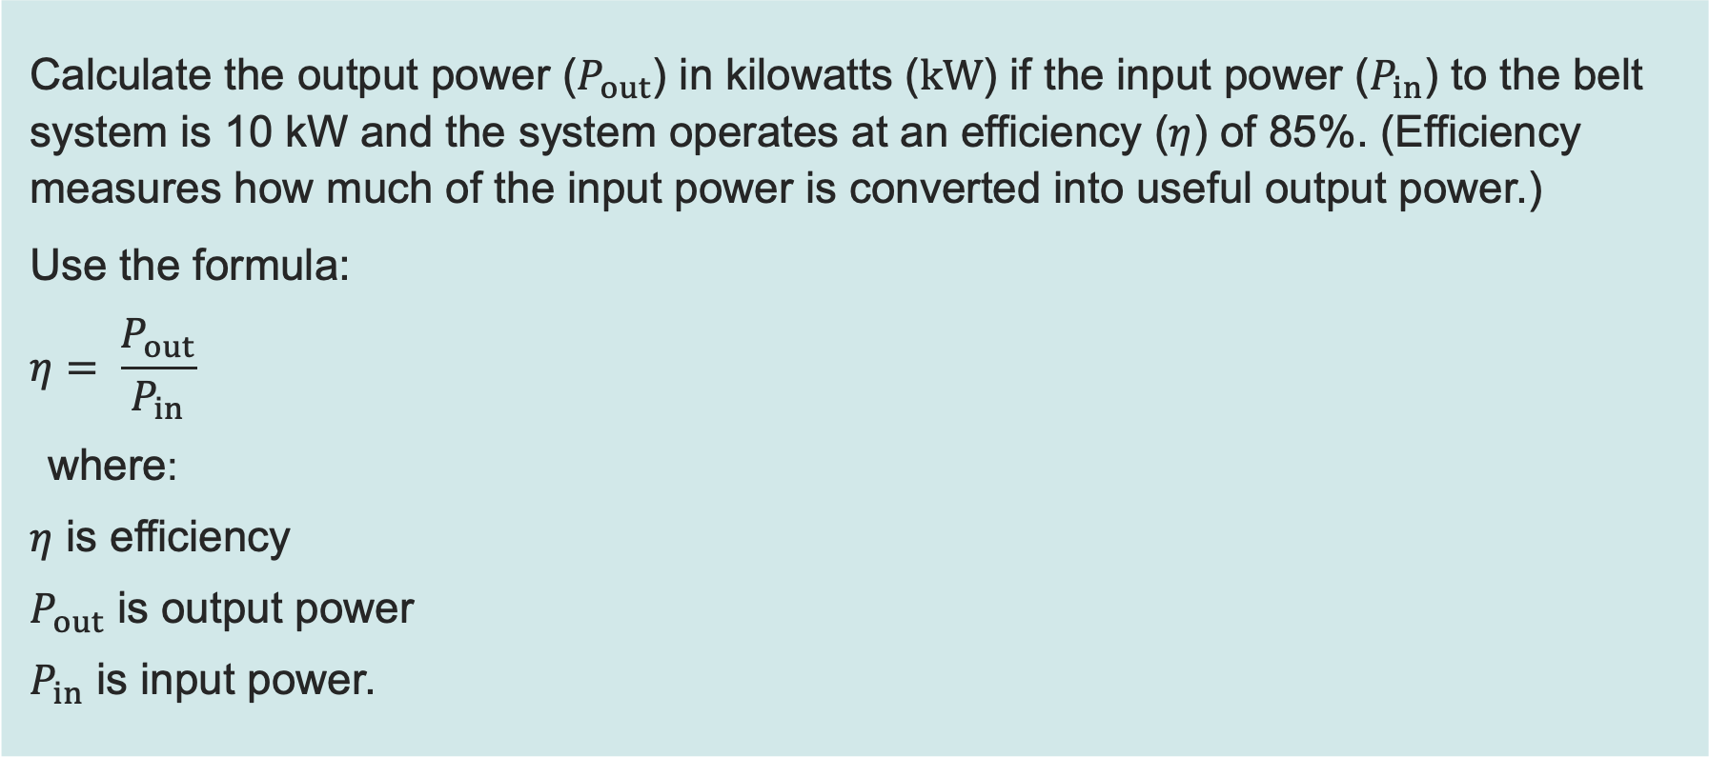
Worked example: Calculating output power
Recap and Worked examples
Calculate the output power ($P_{out}$) in kilowatts ($kW$) if the input power ($P_{in}$) to the belt system is 10 kW and the system operates at an efficiency ($η$) of 85%. (Efficiency measures how much of the input power is converted into useful output power.)
Use the formula:
$$η= \frac{P_{out}}{P_{in}}$$
where:
$η$ is efficiency
$P_{out}$ is output power
$P_{in}$ is input power.
Resource 3: Mechanical calculations

Slide 20
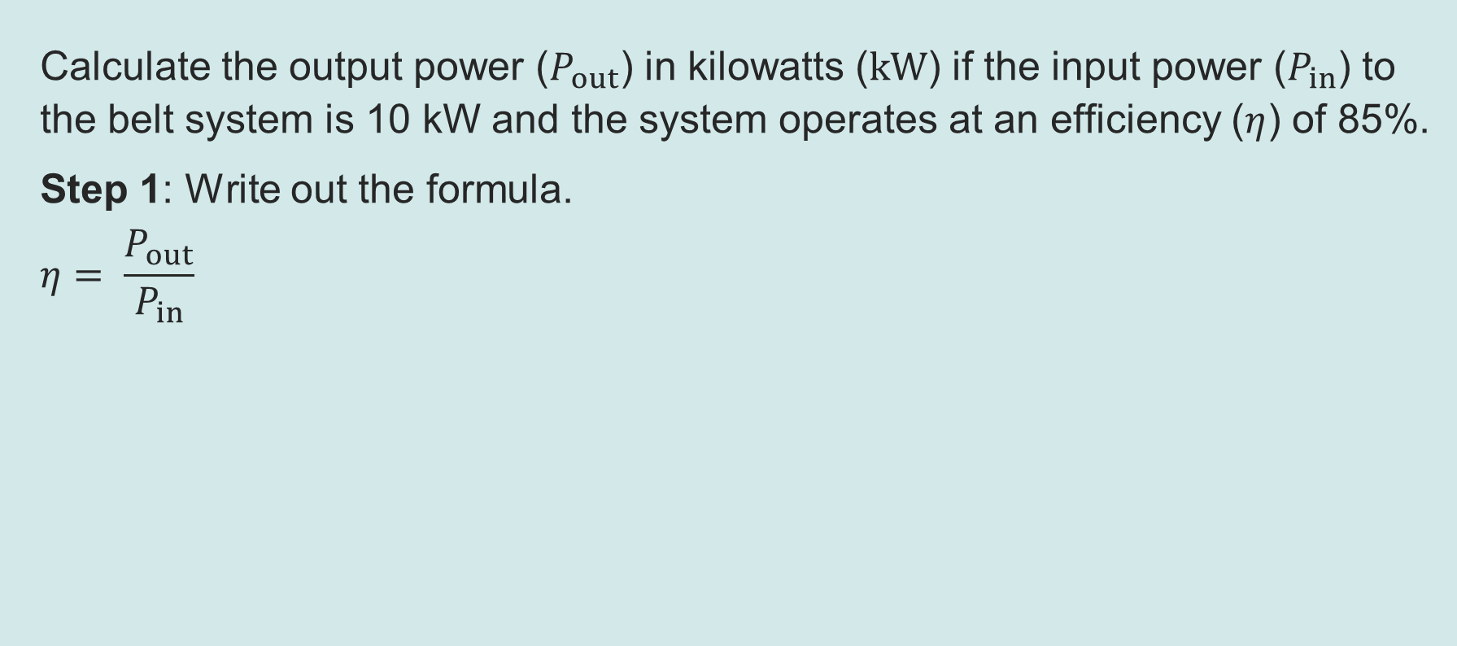
Worked example: Calculating output power
Recap and Worked examples
Calculate the output power ($P_{out}$) in kilowatts ($kW$) if the input power ($P_{in}$) to the belt system is 10 kW and the system operates at an efficiency ($η$) of 85%.
Step 1: Write out the formula.
$$η= \frac{P_{out}}{P_{in}}$$
This means that…
efficiency = output power ÷ input power
This means that …
efficiency = output power ÷ input power
Resource 3: Mechanical calculations

Slide 21


Worked example: Calculating output power
Recap and Worked examples
Calculate the output power ($P_{out}$) in kilowatts ($kW$) if the input power ($P_{in}$) to the belt system is 10 kW and the system operates at an efficiency ($η$) of 85%.
Step 2: Rearrange the formula to make output power the subject.
$$η= \frac{P_{out}}{P_{in}}$$
$$η×P_{in}= \frac{P_{out}}{P_{in}}×P_{in}$$
$$η×P_{in}=P_{out}$$
$P_{out}=$ $η×P_{in}$
Multiply both sides by $P_{in}$
Cancel
Reverse equation
This means that…
efficiency = output power ÷ input power
Always rearrange a formula before substituting any values.
Resource 3: Mechanical calculations

Slide 22
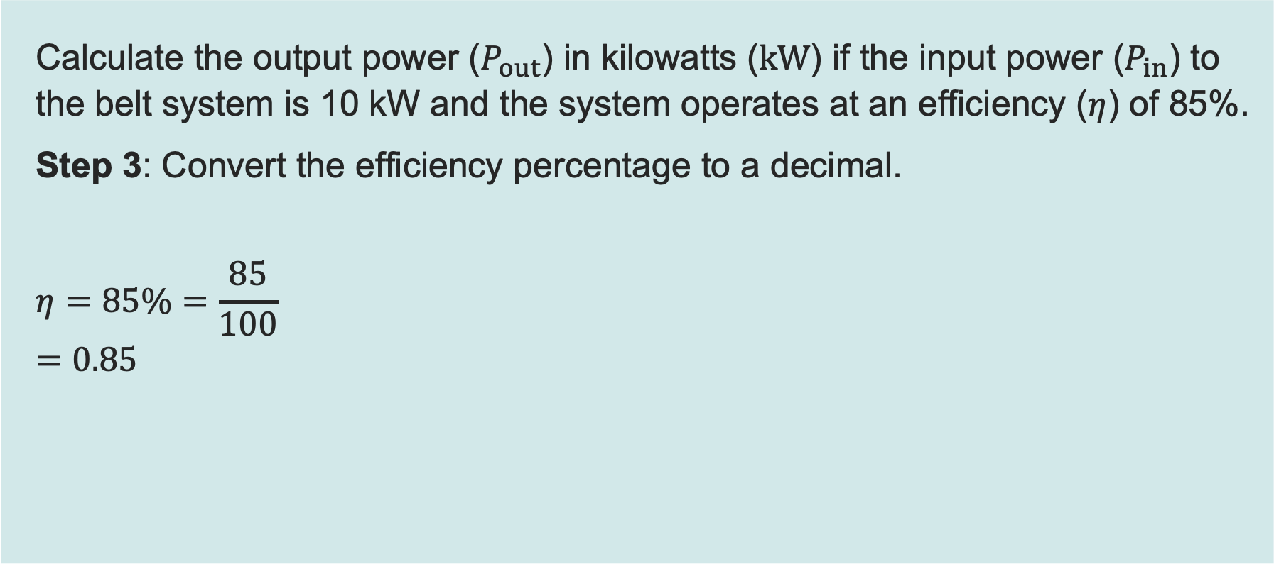
Worked example: Calculating output power
Recap and Worked examples
Calculate the output power ($P_{out}$) in kilowatts ($kW$) if the input power ($P_{in}$) to the belt system is 10 kW and the system operates at an efficiency ($η$) of 85%.
Step 3: Convert the efficiency percentage to a decimal.
$$η=85\%=\frac{85}{100}$$
$$=0.85$$
This means that…
efficiency = output power ÷ input power
To convert a percentage to a decimal divide by 100.
Resource 3: Mechanical calculations

Slide 23
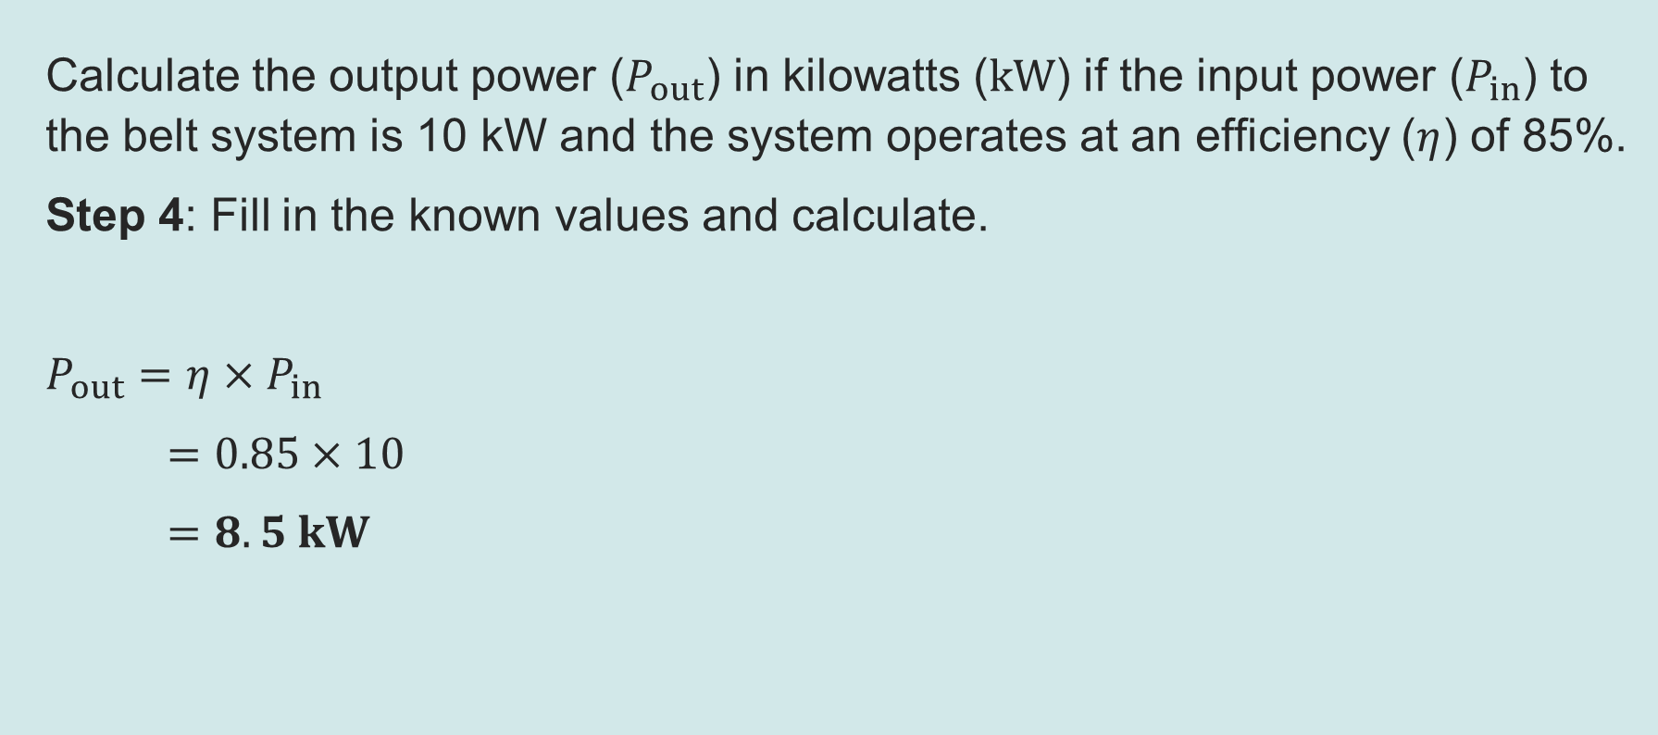
Worked example: Calculating output power
Recap and Worked examples
Calculate the output power ($P_{out}$) in kilowatts ($kW$) if the input power ($P_{in}$) to the belt system is 10 kW and the system operates at an efficiency ($η$) of 85%.
Step 4: Fill in the known values and calculate.
$P_{out}=$ $η×P_{in}$
$=$ $0.85×10$
$=8.5 kW$
This means that…
efficiency = output power ÷ input power
Remember to include units on the final answer.
Resource 3: Mechanical calculations

